Slide 1
Wessex Institute Sustainable Development and Planning Conference, 27-29 June 2017
Raising the Standard: Developing a Benchmark for Green Infrastructure
G. Jerome1,2, D. Sinnett*1, R. Mortlock2, T. Calvert1, S. Burgess1, N. Smith1
1University of the West of England, UK, 2Gloucestershire Wildlife Trust, UK

Slide 2
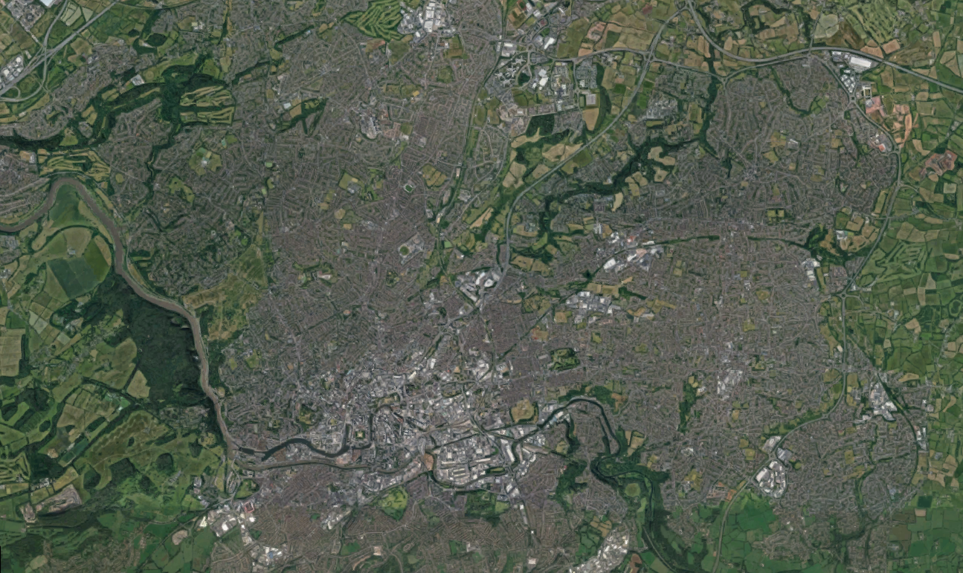
Green city systems

Slide 3
Green city systems

Slide 4
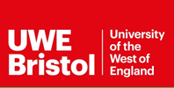
Green infrastructure: Definitions
“Green infrastructure is a strategic network of multi-functional green space, both new and existing, both rural and urban, which supports natural and ecological processes and is integral to the health and quality of life in sustainable communities. It delivers a broad range of functions and provides vital socio-economic and cultural benefits which underpin individual and community health and wellbeing”
CLG, 2010
Notes:
We have taken the definition of GI used in the draft PPS Planning for a natural and healthy environment. This definition focuses on the idea of a network of green spaces that are multifunctional and provide a range of functions and ecosystem services. The definition goes on to list a number of the functions provided by GI including providing wildlife corridors; reducing noise and air pollution; and helping communities to adapt to a changing climate through water and carbon management. In urban areas, functions include providing routes (e.g. footpaths and cycleways) which link areas of open space within settlements; providing sustainable drainage, flood storage and urban cooling; and providing a wide range of opportunities for engagement and active citizenship, relaxation and quiet contemplation, sport, recreation and children’s play.

Slide 5
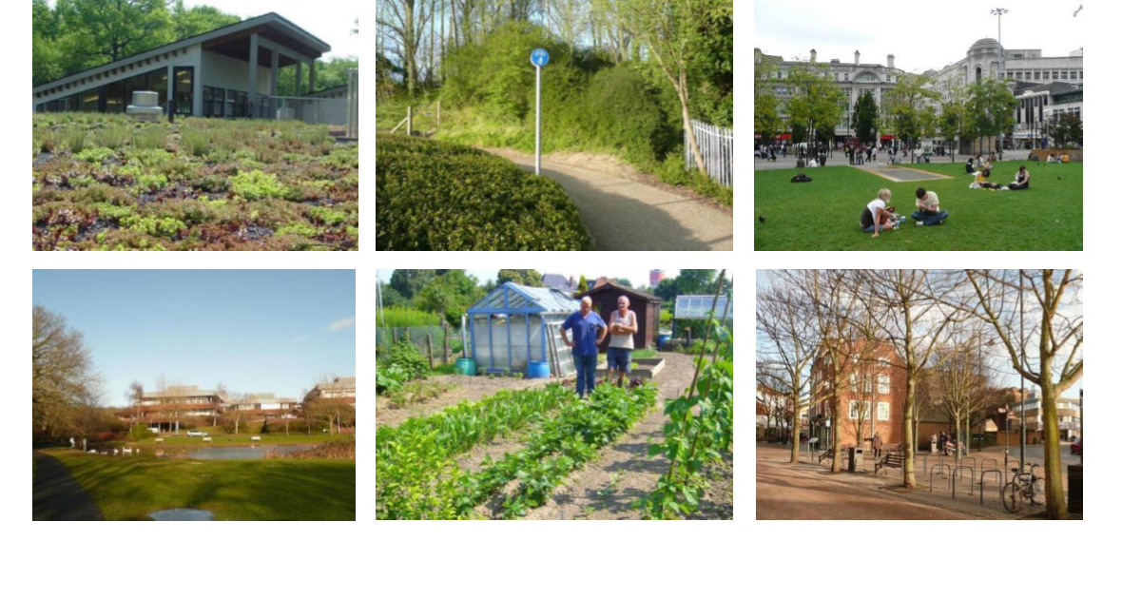
Promoting the form, role and benefits of GI and ecosystem services at a range of spatial scales

Slide 6
Ecosystem service | Final ecosystem service | Description of the main goods and services from the urban environment
Provisioning | Crop, plants, livestock, fish | Food e.g. vegetables, fruit, meat, milk, honey; Fibre e.g. compost; Ornaments e.g. flowers; Genetic resources
 | Water supply | Drinking water; Industrial use of water; Energy
Provisioning/ cultural | Wild species | Wild food e.g. berries; Recreation and tourism
Cultural | Environmental settings | Physical and mental health; Spiritual and religious; Heritage (includes cultural heritage, aesthetic and inspirational, security and freedom, neighbourhood development, social and environmental citizenship); Recreation and tourism; Education
Regulating | Climate | Avoidance of climate stress; Carbon sequestration
 | Hazard | Erosion protection; Flood protection; Avoidance of climate stress
 | Purification | Clean air; Clean water; Clean soil
 | Noise | Noise reduction
Source: UK National Ecosystem Assessment (2011a)

Slide 7
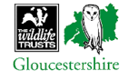
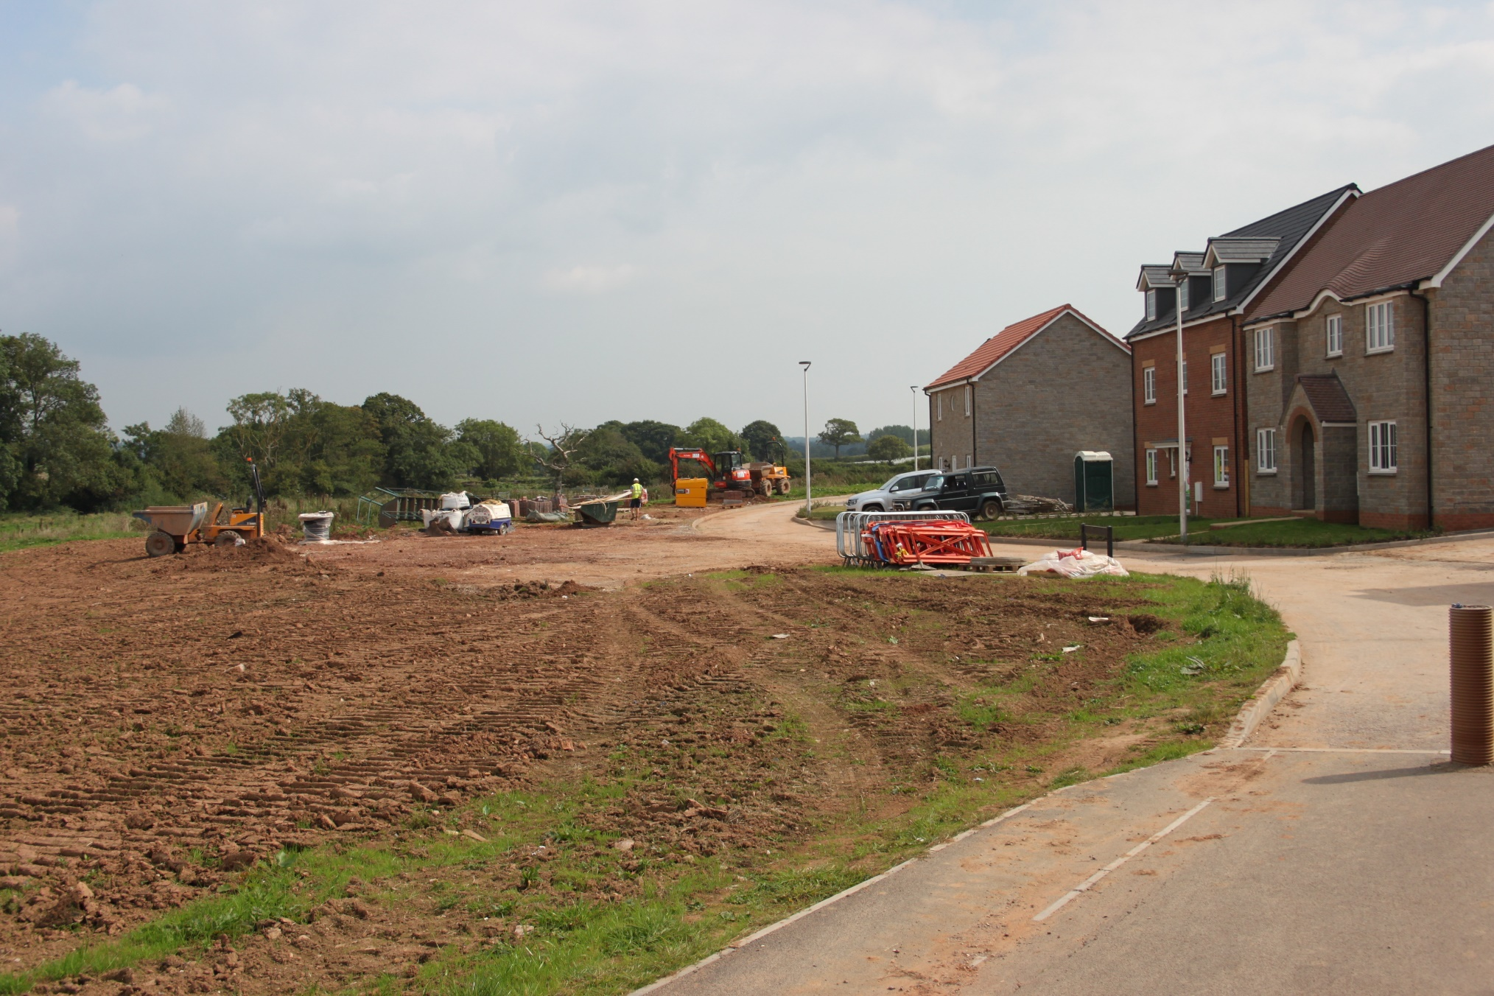
Securing implementation is key

Slide 8
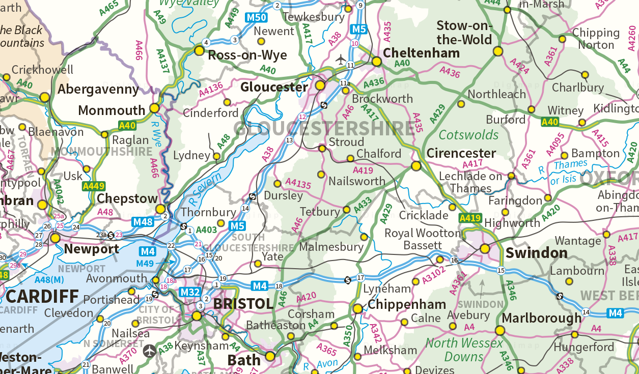
Study geography
Contains OS data © Crown copyright and database right 2017. FOR EDUCATIONAL USE ONL

Slide 9
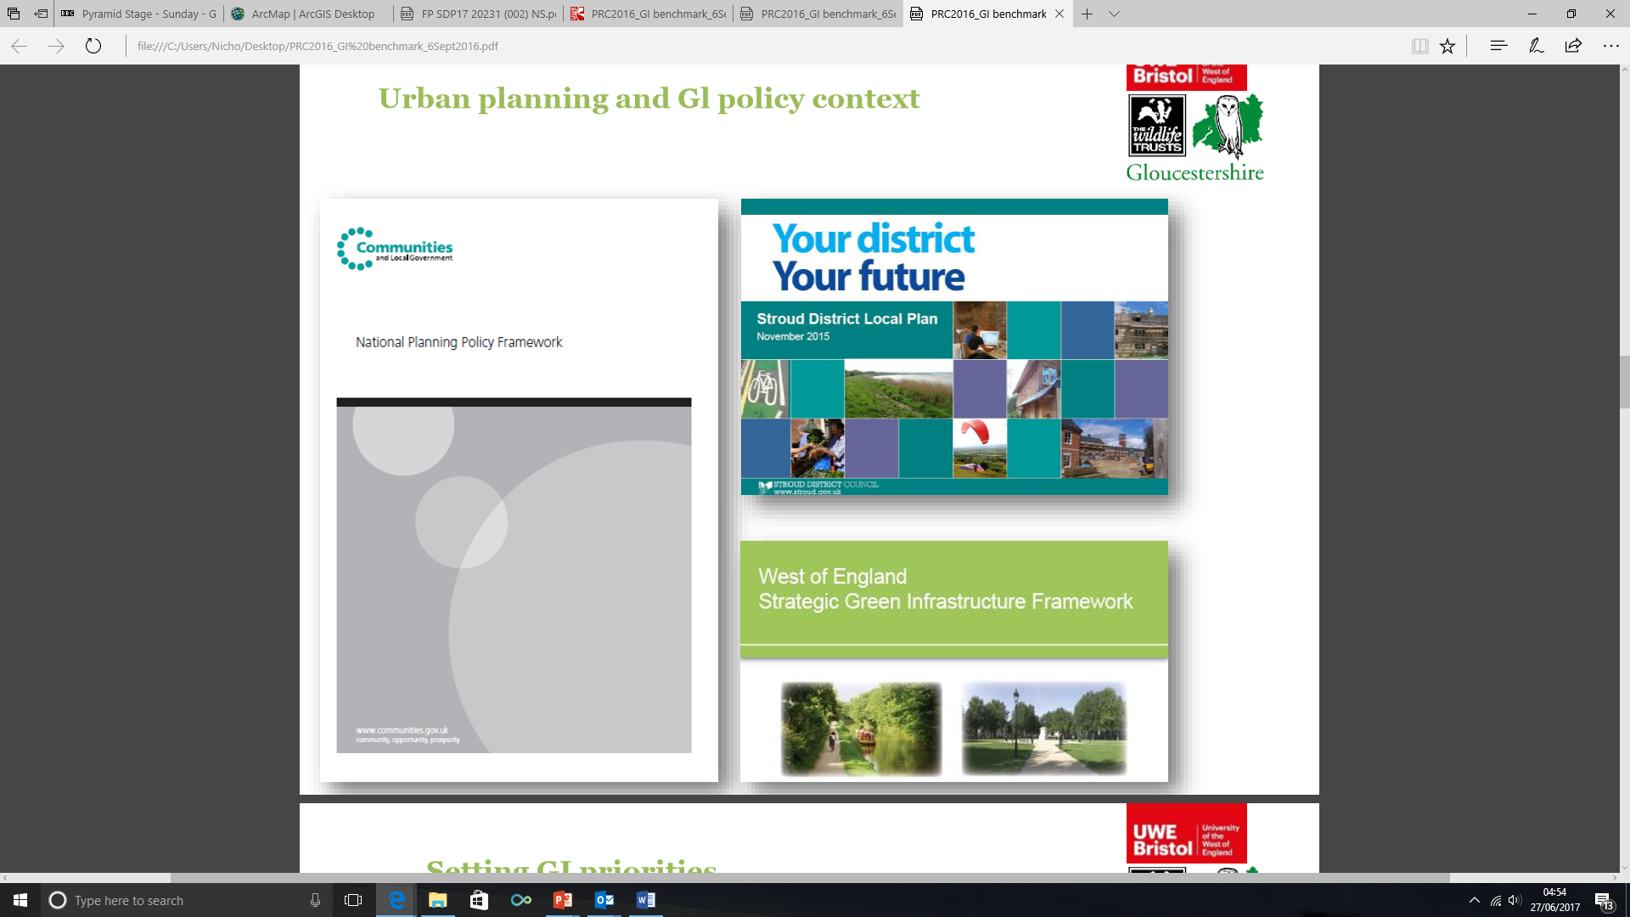
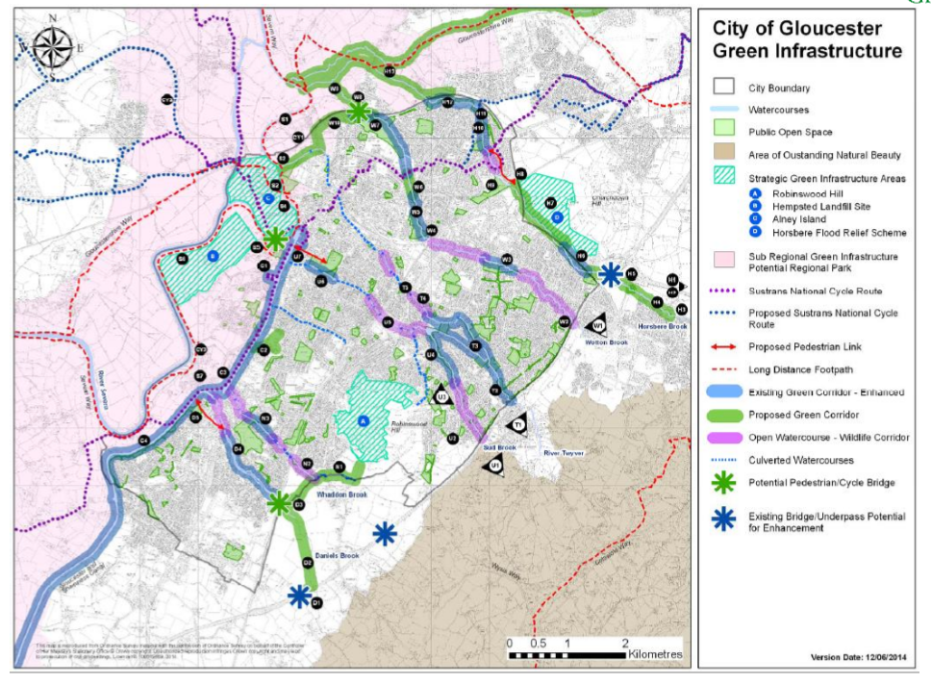

Slide 10
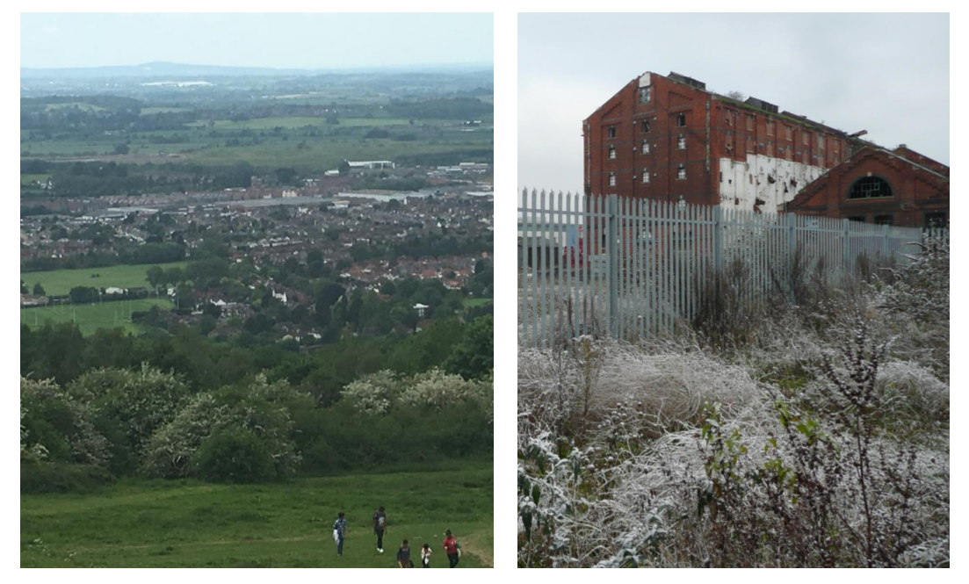
Contrasting development opportunities

Slide 11
Key challenges (local / national)
Strong policy but lack of clarity on the best response
Varied policies between local authorities
Lack of certainty, skills and knowledge in sector
Proposed GI often not responding to the needs of the site/area
Proposed and delivered GI often not a multifunctional network
GI seen as less important than other objectives
GI often good in outline planning applications but diminishes through the development process and delivery disappointing
Uncertainty and concern over maintenance and management arrangements
Notes:
Looking first at the challenges we have identified locally and in England through the feasibility study these are summarised as shown:
As we said locally there is relatively strong policy and this is mirrored in may other areas, but there is often a lack of clarity on the best response in terms of exactly what the GI should include and how to deal with competing demands (for example, access and nature conservation).
There is substantial variation between local authorities which leads to uncertainty for developers who are having to provide different solutions for different areas. It also means local authorities with weaker policy are struggling to set requirements for GI hence the use of Building with Nature for policy development.
There is a lack of certainty, skills and knowledge in sector, professionals pointed to the overwhelming amount of guidance available which was difficult to navigate especially for those without the necessary expertise to balance competing demands.
Proposed GI as part of new planning applications often not responding to the needs of the site/area instead including features that are ‘expected’ without matching them with need.
GI often features across multiple documents (e.g. water, nature conservation, open space) meaning it is not a coherent network often representing a missed opportunity to deliver multifunctionality.
GI seen as less important than other objectives especially in areas with a high demand for housing or that are trying to encourage development.
GI often good in outline planning applications but is watered down as the application progresses with the final delivery often being a bit disappointing.
Uncertainty and concern over maintenance and management arrangements especially with many local authorities refusing to take on new GI assets but requiring them to be delivered to secure planning permission.

Slide 12
Introduction to the project
KTP started in August 2015
  UWE and Gloucestershire Wildlife Trust
  Extensive local customer requirements testing
Identified the need for a ‘local’ benchmark:
  Quality of green infrastructure planning, design, implementation and management is hugely varied
  Lack of detailed planning guidance on green infrastructure
Potential users: planners, developers, ecological consultants, landscape architects, maintenance contractors, homeowners/homebuyers
Aim: to improve the quality and delivery of green infrastructure
Notes:
To give you a brief overview of how we got here. The project has been initially funded through a Knowledge Transfer Partnership between UWE and GWT. Initially this was to embed GI expertise in the Trust one aspect of which was the development of a suite of good practice guidance. However, early customer requirements testing with a range of local authority and built environment professionals in private practice highlighted the need for a benchmark and so this became the format through which this good practice is articulated. There are other strands of work within the KTP but the focus of today is this benchmark. The main issues that were identified in Gloucestershire and the West of England were that although the GI policy is relatively strong there is real uncertainty in how this should be represented through planning and subsequent delivery. A lack of detained planning guidance was seen as a key reason for this. This results in a huge variation in the quality of GI, a lot of which is quite disappointing, which hampers the ability to deliver the benefits. The area has an extremely high demand for new housing but often new development is met with opposition with the quality of development including the GI one of the issues. We heard from a multitude of professionals including planners, landscape architects, ecologists, public health professionals, and developers and their consultants who shared these concerns. It was also felt that a benchmark would be useful to prospective buyers looking to ensure they were investing in a high quality environment. The aim of the benchmark is to improve the quality and delivery of green infrastructure in a broad range of developments.

Slide 13
Feasibility study
Early 2016
Testing the market for a benchmark in England with NERC
Three questions:
  What types of GI and corresponding ecosystem services should the benchmark include?
  What is the demand for a GI benchmark in the built environment sector?
  What is the most appropriate model to ensure the long-term success of the benchmark?
Desk study to review existing benchmarks in the sector
Testing findings with stakeholders and end-users
Final report: http://eprints.uwe.ac.uk/29514/
Conference presentation: http://eprints.uwe.ac.uk/30057/
Notes:
In addition to the KTP we were also awarded a NERC Innovation Fund in 2016 to test the market for a benchmark in England. This sought to answer the three questions shown here through a review of existing benchmarks in the sector and to test these findings and those of the local customer requirements testing with a range of stakeholders. Briefly, we reviewed the commonly used assessment systems for the built environment, including BREEAM Communities and Building for Life as well as some devoted to aspects of GI such as the Green Flag Award to look at how they assessed GI, whether this was adequate and their broader operation as a means of assessing what the sector would tolerate. The findings from this and the stakeholders suggested that the existing systems do not assess GI sufficiently, for example, they concentrate on individual components as opposed to the multifunctional network, or they do not include a post-construction assessment. Stakeholders broadly felt that there was need for a benchmark but that we needed to ensure that it was attractive to developers for example in its functionality, simplicity and expectations.

Slide 14
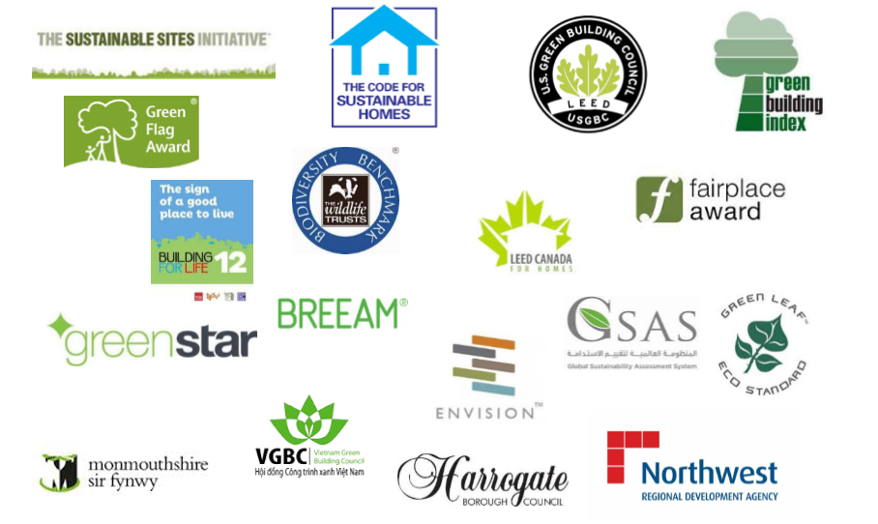
Review of existing standards

Slide 15
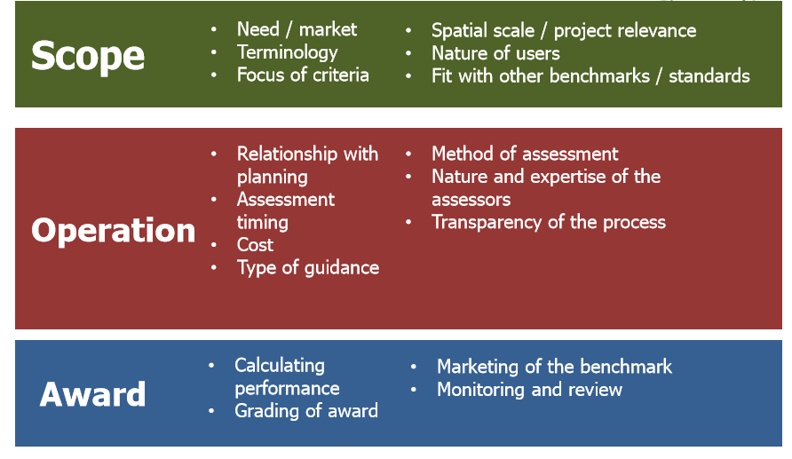
Project scoping

Slide 16
The Building with Nature approach
Provides clarity for developers and planners
  Consolidates existing standards and guidance
Applies to GI policy, new development and retrofit
Two stage process:
  Candidate: draft policy or planning stages
  Full award: final policy or post-construction
Mandatory standards that address:
  GI as a multifunctional network
  Fit with local character
  Fit with local policy and need
  Contribution to climate change and environmental quality
  Long-term management and maintenance arrangements
Notes:
Building with Nature aims to address these challenges mainly by providing clarity for developers and planners. It consolidates existing standards and guidance and provides pointers to these where appropriate (e.g. TDAG).
It has been developed to apply to policy development, for example GI plans, strategies, frameworks etc. so that a local authority or combined authority can have their policy awarded Building with Nature and individual schemes can contribute to this. And it applies to new development and retrofitting GI, for example where social housing estates are being regenerated.
One of the major limitations of existing assessment systems is their basis on pre-construction stages of development so Building with Nature provides a Candidate status so that the scheme can works towards the benchmark during planning, and therefore use this in marketing properties etc., but cannot gain the full award until after construction.
It has a series of mandatory standards that a critical to the success of GI and aim to address some of the key limitations of GI at the moment.

Slide 17
Operation of Building with Nature
Notes:
Moving on to how Building with Nature operates, this schematic shows an overview of the different types of project the benchmark could be used for, who might use it and how this fits in with new policy, development or retrofitting processes. Here you can see that for policy development a local or combined authority might chose to go for the candidate award at the draft policy stage, for example if it were going out for public consultation with the full award being granted at final publication. With new development or retrofitting the applicant can apply for candidate status during pre-construction stages, for example, at design, outline or detailed planning permission stages and then the full award post-construction. For new development and retrofitting applicants have the option to apply for achieved or excellent, which we will come on to later, whereas policy can only be awarded achieved status due to the nature of the standards (IS THAT RIGHT?). Of course applicants can skip the candidate status completely and just go straight for the full award but there are good reasons for doing so, for example for phased developments, where the candidate status may assist with any public consultation or marketing, or where the applicants wants the assurance that they are on track.

Slide 18
The award process
Identify goal to certify with Building with Nature
Trained assessor:
  Embedded in project team (e.g. local authority, built environment consultant)
  Works towards award, compiles evidence
Certification body:
  Independent body reviews evidence
  Awards Building with Nature Candidate, Achieved or Excellent
Phased development:
  Candidate status at planning
  Achieve or Excellent as each phase delivered
Five yearly review for completed schemes
Standards Board review performance of Building with Nature
Notes:
Moving on to the award process, the applicant would have identified a goal, preferably early on in their process, to certify their policy or scheme with Building with Nature. We would then anticipate that they appoint a trained assessor to work with the project team to work towards the benchmark and compile the necessary evidence. We envisage this being someone who is already part of a project team, for example, a landscape architect but who would liaise with other specialists on the team (e.g. ecologists, water engineers) to ensure that they understand the requirements of the benchmark at either achieved or excellent. A certification body will then independently review the evidence submitted, and where necessary, undertake a site visit, before signing off the award as candidate, achieved or excellent. We have not yet approached an organisation to take on this role and are currently exploring whether this should be an existing organisation, for example, who already run built environment assessment method, or a new one.
One of the questions we have been repeatedly asked is how the benchmark deals with phase development. So for example, if a surveyor submits an planning application for a large scheme and then either delivers the development in phased over many years or hands the delivery over to multiple developers to deliver. In this case the plans could be awarded Candidate status and then each phase awarded the full award following completion.
One area that was highlighted in the feasibility study was the need for a post-occupancy review, for example, every five years to ensure that the standard of GI is being maintained. We are currently looking in to how this could/would work in practice, for example, whether this could be paid for through CIL contributions, or service charging.
As we have said the aim is to improve the quality of GI and we have tried to set the standards at a level that is representative of existing high quality developments. We would hope that as the quality improves the standards can evolve over time, as has been the case with other areas of green building. Therefore a standards committee will be appointed to conduct an annual review of the benchmark and adapt any standards or the technical guidance in light of this or as new research and guidance becomes available.

Slide 19
Scope of the benchmark
Five mandatory standards
Three themes:
  Wildlife: Six standards
  Water management: Six standards
  Health and well-being: Six standards
Within each theme the six standards are split into three ‘achieved’ standards and three ‘excellent’ standards
 | Achieved |  | Excellent
Mandatory 1 to 5 | + | Wildlife 1, 2, 3 Water 1, 2, 3 Well-being 1, 2, 3 | + at least 6 of | Wildlife 4, 5, 6 Water 4, 5, 6 Wellbeing 4, 5, 6
Notes:
Hopefully you’ve all had chance to grab some lunch. Moving on to the final session: the scope and format of the benchmark. Building with Nature consists of 23 standards. Five mandatory standards covering the areas we have already discussed: GI as a multifunctional network; fit with local character, local policy and need, contribution to climate change and environmental quality, and long-term management and maintenance arrangements.
The remaining eighteen standards are split into three themes identified as representing significant services provided by GI in Gloucestershire and the West of England where there was sufficient evidence to develop robust standards: wildlife, water management, and health and well-being.
As we have already alluded to there are two levels of award: achieve and excellent. So, for achieved, applicants would have to satisfy the requirements of the five mandatory and the first three ‘achieve’ standards in the three themes: giving a total of 14 standards. For, excellent applicants would also meet the requirements of 6 out of the remaining 9 standards: giving a total of 20 standards.
This affords applicants the flexibility to specialise in two of themes by gaining all three of the excellent standards in those themes or spreading across all three themes but only meeting the requirements of two excellent standards in each.

Slide 20
Scope of standards
Wildlife:
  Ecological enhancement, connectivity to wider countryside, biodiversity promoted throughout construction process
  Connectivity within built environment, enhancement of ecological networks, viability of key species
Water management:
  Minimising run-off and maximising re-use now and in the future, design, delivery and management of SuDS, water quality on site
  Innovation in water management, water quality downstream, added value to overall design
Health and well-being:
  Accessibility for all, designed to facilitate use, designed to be accessible all year
  Responds to health inequalities, innovation in overcoming barriers to access and use, integral to local distinctiveness
Notes:
As we have said we are not here to review the standards in detail today however this slides gives a summary of the scope of the standards across the three themes, the first bullet representing the achieved standards and the second the excellent standards.

Slide 21
Level and format of the standards
Level of standards:
  Achieve: current high quality developments and policies
  Excellent: current exemplary developments
Some of the ‘excellent’ standards could not be achieved by policy alone so this option is not available to policy
Evidence already supplied in planning documents
Expected to evolve over time
Used existing standards and good practice where possible
Technical guidance:
  Process for award and certification
  Each standard has more detailed criteria and the evidence required to demonstrate achievement
  Further information and guidance
Notes:
As we have said earlier we have been careful in trying to match the level of the standards with existing practice to ensure the benchmark is achievable and attractive to developers. A system that is seen as too demanding will not appeal to the sector and we are trying to improve the quality of the usual developments instead of providing a very niche system. So, the achieve standards have been set at a level that we believe current high quality developments would meet and the excellent standards have been set at a level that exemplary developments would meet.
This approach seems to be working based on our desktop evaluation of the two developments with the higher quality one on course for an ‘excellent’ award subject to quality being maintained post-construction and the lower quality one not meeting the even the mandatory standards.
This work also reassured us that the evidence requirements are not too onerous with an evaluation being possible from existing planning applications. Although to keep the costs of the certification down we would expect this information to be presented in a standard format (e.g. including a GI parameter plan).
As we have said we expect these standards to evolve over time and have used existing standards (such as Natural England’s ANGSt) and guidance where possible. This means that Building with Nature shouldn’t contradict other systems such as Building for Life or BREEAM Communities.
The technical guidance provides detail on the process for certification and further detail on each standard including what its aim, detailed criteria and the evidence required to demonstrate achievement. It also contains links to further information and guidance.

Slide 22
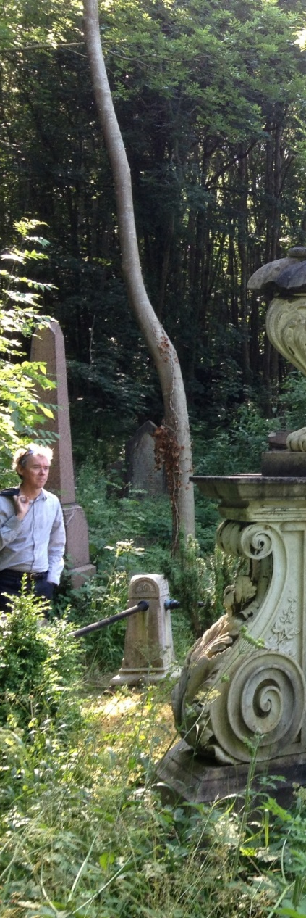
Ongoing work
Development of a User Guide and Technical Standards
Internal operational review
External review
Front running testing
Contacts:
  Gemma.Jerome@gloucestershirewildlifetrust.co.uk
  Danielle.Sinnett@uwe.ac.uk
  Nicholas12.Smith@uwe.ac.uk
Notes:
Thank you for some really useful discussions which will inform our work. Before we hand back to Max we thought it would be useful to give you an overview of how we will use the information you have provided and the next steps of the work. We will write the workshop up into a briefing paper that will be circulated in July. The workshop and briefing paper will inform the selection of demonstration sites (for example, if any particular types of development have been highlighted as being an issue in Scotland) and how we measure the performance of the benchmark in these sites.
Following the demonstration work we anticipate a further workshop with those involved in these sites to evaluate the performance of the benchmark, refine the standards and technical guidance.
Finally we are planning to bid for further funding to test the benchmark in other areas of England and Scotland, and have been discussing this with Max, and Berkshire, Buckinghamshire and Oxfordshire Wildlife Trust and Wildlife Trust for Bedfordshire, Cambridgeshire and Northamptonshire.
Please feel free to contact us if you have any further comments or require more information.

