Slide 1
Dialogic feed-forward assessment:
re-energising the undergraduate essay
Jennifer Hill
Associate Professor | UWE, Bristol
Harry West
Graduate Tutor | UWE, Bristol
Innovative Assessment of Geography Students in Higher Education
RGS-IBG Annual International Conference, September 2017

Slide 2
Feedback Context
Feedback should help students to:
- understand current performance
- understand how to close the ‘performance gap’ in future assignments
- have the confidence and belief they have control over their success
- maintain motivation throughout their degree
(Hattie & Timperley, 2007)
But … there is a recognised gap between staff perceptions of feedback and the student experience (Price et al., 2011)
Low satisfaction scores for assessment/feedback in national student surveys

Slide 3
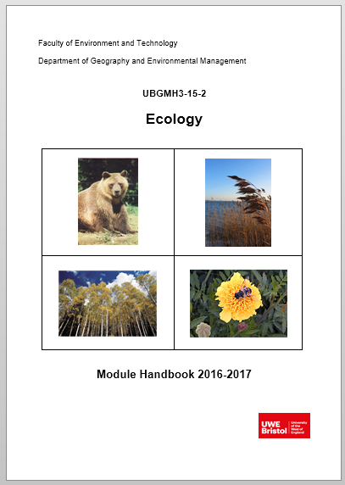
Feedback Intervention
We implemented an assessment approach on a second year physical geography module to optimally support students’ use of feedback
Traditional essay used innovatively to move students beyond ‘regurgitation’ of information
Based on premise that feedback should occupy a central position within a dialogic approach to learning & teaching (Alexander, 2004; Sutton, 2009) and be future-oriented (Sadler, 2010; Beaumont et al., 2011)

Slide 4
Definitions
Dialogic feedback is the creation of meaning and understanding via spoken discourse between lecturer and student, or student to student
(Nicol, 2010)
Feed-forward refers specifically to feedback given by tutors that:
impacts upon an upcoming assignment
is given post-assignment with more specific direction on how this can be applied to future assignments
(Carless, 2007)
Notes:
Dialogic feedback is the creation of meaning and understanding via spoken discourse between lecturer and student, or student to student (Wegerif 2006).
Feed-forward focuses on providing students with prior exposure to and practice with assessment in order to develop a clear sense of expectations and standards, which they can apply to future work (Carless, 2007; Baker & Zuvela, 2013).

Slide 5
Research Aims
Explore student perceptions of the dialogic feed-forward approach and whether it asserted a positive influence on their learning experience
Identify if and how the task-specific behaviour of students was altered by the assessment approach
Identify the extent to which students believed their self-efficacy and self-regulation skills were improved
Examine whether the assessment approach enhanced student performance and whether it could potentially raise NSS scores related to feedback

Slide 6
Module Assessment Structure
Supporting Lectures
Students choose essay from selection
Students write draft essay
Students submit draft and attend ‘feed-forward’ meeting
Students reflect on meeting and essay – grading their work
Students complete and submit final essay
25% module assessment
75% module assessment
Assessment discourse
Feedback
discourse
Notes:
We offered preparatory guidance, in-task guidance and performance feed-forward.
Interviews were audio-recorded and exemplar paragraphs were used during them. Students engage with learning ‘head on’
Arrow on right leads on to ipsative feedback – ‘based on a comparison with the learner’s previous performance and linked to long-term progress’ (Hughes 2011, p. 353). Supports development of long-term generic skills over short-term achievement of assessment criteria.
Also undertook essay marking seminar: students work with marking criteria and match LOs to standards

Slide 7
Data Collection
Qualitative case study approach
Individual semi-structured interviews … two consecutive level 2 cohorts at end of module (2015-16 and 2016-17) … analysed thematically via grounded theory
Group semi-structured interviews with level 3 students elucidating post-assignment behaviour
Essay performance data pre- and post-assessment intervention (inferential stats)
Answers to NSS feedback questions

Slide 8
Enhanced Learning Experience
Conversation compels students to engage critically with their work:
‘when I have had drafts handed back to me and it’s just written over, either I don’t understand what they are trying to say, or it’s not clear enough. I can ask you questions if we’re talking to each other about it, it’s easier to see things … It’s definitely better to talk about it’ R7
‘I’ve had it before where you get electronic feedback and you might not be sure what some of the comments mean … being able to discuss it is important. You get that progress and can discuss how you can change it as opposed to just saying this is wrong’ R9
Notes:
Students can decode feedback: gain greater understanding of the written feedback through verbal clarification and use of exemplars
Cathartic spaces – ‘coming clean’ with progress
Cognitive and affective enhancement of student learning experience

Slide 9
Enhanced Learning Experience
Motivational due to pertinent application:
‘the bit in between my draft and writing the final piece was the best bit because I knew what I was doing and could tweak it and I enjoyed that process of making it better. It gave me more confidence in my writing skills’ R7
‘my first draft was quite vague and I didn’t really know what direction I was going with it. Then, after speaking and having the feedback, I spent more time on it because I knew where I needed to go with it’ R8
Notes:
Students can ‘make good’ – immediate relevance of feedback for good practice
To that point students had developed a personal interpretation of the meaning and requirements of their question. The feedback allowed them to judge how far they were meeting the performance standards of the assessment criteria as interpreted by the tutor.

Slide 10
Task-Specific Behaviour & Self-Regulation
‘it helped me to realise how to critique my own essays because I was able to sit down with you and go through the essay and know exactly why you were commenting on something … It allows me now to see in other essays the same things I’m doing’ R10
‘I never understood how good submitting a draft and getting feedback is and now that I’ve done it I’m definitely going to take advantage of it this year’ R24
Notes:
Nicol’s self-regulation
Baxter-Magolda’s self-authorship

Slide 11
Self-Efficacy
Students display increased self-efficacy: stronger beliefs in their capabilities to accomplish tasks in future
Believe learning is carried over to other level 2 assignments
Self-avow to altered level 3 behaviour:
‘I felt my critical analysis was improved through the feedback session and this has been helpful writing other essays and exam answers … I was able to achieve higher 2:1s and 1sts at level 3 because my understanding of critical analysis had improved’
Notes:
Further quote for altered level 3 behaviour
‘Since this module I have made sure that whenever possible I meet with academics and gather their opinions on my work. This is something which prior to the Ecology module would scare me as I was embarrassed by the mistakes within my work. Overall, I now see the importance of getting feedback on any piece of work which I produce’ …… ‘In third year I also completed all of my deadlines earlier than the submission day and started them as soon as possible due to the Ecology module helping me realise the importance of drafts and reflection of my work before it is submitted’

Slide 12
Enhanced Student Performance
Significantly higher marks 2015-17 v 2011-13 (p = < 0.0001)
Band (%) | 2011-2012 (%) | 2012-2013 (%) | 2015-2016 (%) | 2016-2017 (%)
0-39 (inc. NS) | 16 | 5 | 0 | 5.5*
40-49 | 9 | 14 | 3* | 5.5*
50-59 | 34 | 38 | 28 | 17
60-69 | 41 | 38 | 58 | 58
70-100 | 0 | 5 | 11 | 14
Number (n) | 32 | 37 | 36 | 36
Average Ecology mark 4.5% higher than average mark for other second year optional modules (p = 0.01)
* Did not have a meeting
Dialogic assessment
Notes:
Mean mark increase 2011-2013 to 2015-2017 of 7%: 56% to 63%
Increase seen most in moving students from 2:2 to 2:1. Reduction in students failing module. Increase in first class marks.
Mean final year mark for students taking Ecology (n=31): 61.7%
Mean final year mark for students not taking Ecology (n=12): 57.2%
Difference of 4.5% again but not significant at p=0.05

Slide 13
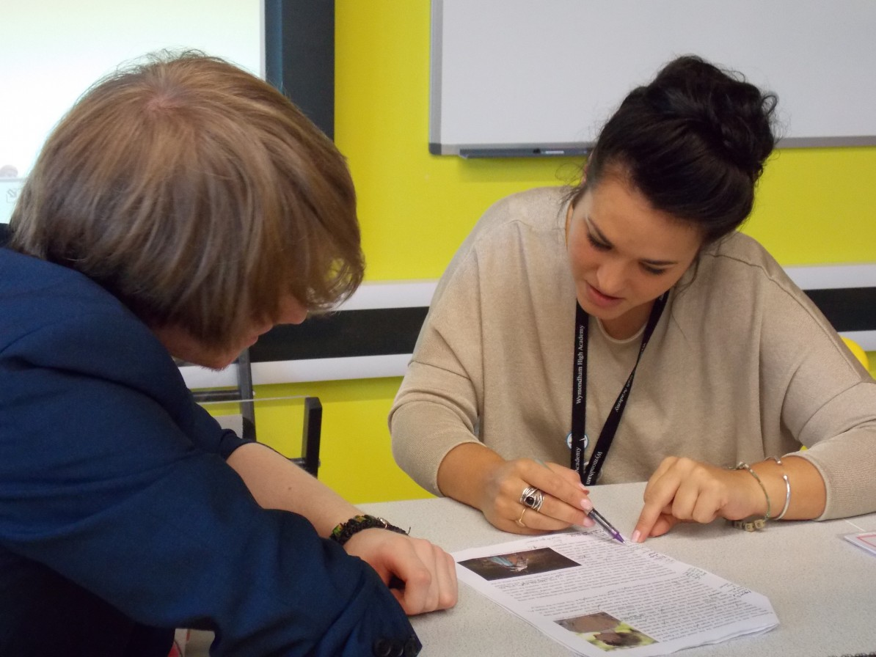
Enhanced NSS & TEF Metrics
All students rated the module as giving them high quality feedback: detailed, conversational, personalised, timely (relevant application), multi-faceted
All students said the feedback helped them clarify things they did not understand: proactive engagement with learning – they had to prepare for the meeting, think about their work, ask and answer questions
Notes:
‘I felt like you cared’ R1
‘I definitely felt like you cared about what I was getting’ R7
Note 2017 NSS results for BSc Geog: Feedback on my work has been timely: 97% I have received helpful comments on my work: 97%
The educational alliance, is an important influence on their perceptions of the quality of feedback

Slide 14
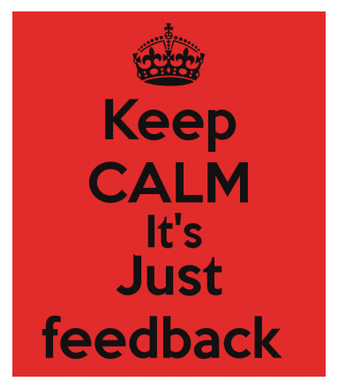
Conclusions
Dialogic feed-forward assessment enhanced the student learning experience by:
Increasing motivation to engage with current assignment
Increasing confidence in their ability to complete the assignment
Solidifying good practice in-task & supporting higher assignment grades
Increasing satisfaction with the feedback process (potentially boosting NSS metrics)
Encouraging feedback proactive recipience (Winstone et al., 2017)
Positively changing behaviour working towards future assignments (fostering self-efficacy & self-regulation)
Notes:
Feedback from students can help tutors to adapt and adjust their teaching strategies in order to accommodate the learning needs of particular students.

Slide 15
References
Alexander, R. (2004) Towards Dialogic Teaching: rethinking classroom talk (Third edition). University of Cambridge: Dialogos.
Beaumont, C., O’Doherty, M. & Shannon, L. (2011) Reconceptualising assessment feedback: a key to improving student learning? Studies in Higher Education, 36, 671-687.
Carless, D. (2007) Learning-oriented assessment: conceptual bases and practical implications. Innovations in Education and Teaching International, 44, 57-66.
Hattie, J. & Timperley, H. (2007) The power of feedback. Review of Educational Research, 77, 81-112.
Nicol, D. (2010) From monologue to dialogue: improving written feedback processes in mass higher education. Assessment and Evaluation in Higher Education, 35, 501-517.
Price, M., Handley, K. & Millar, J. (2011) Feedback: focussing attention on engagement. Studies in Higher Education, 36, 879-896.
Sadler, D.R. (2010) Beyond Feedback: Developing student capability in complex appraisal. Assessment and Evaluation in Higher Education, 35, 535-550.
Sutton, P. (2009) Towards dialogic feedback. Critical and Reflective Practice in Education, 1, 1-10.
Winstone, N.E., Nash, R.A., Rowntree, J. & Parker, M. (2017) ‘It’d be useful, but I wouldn’t use it’: barriers to university students’ feedback seeking and recipience. Studies in Higher Education (in print).

Slide 16
Thank You For Listening
Questions?
jennifer.hill@uwe.ac.uk harry.west@uwe.ac.uk | https://www.linkedin.com/pub/dr-jennifer-hill/a2/7a6/22 https://uk.linkedin.com/in/harrywest94

