Slide 1
Learning Through Successful Feedback:
Digital Opportunities for Effective Feedback in Architectural Education
Jonathan Bassindale
Architect and Senior Lecturer
Programme Leader BA(Hons) Architecture and Planning

Slide 2
CONTEXT
“Studies have shown that effective assessment and feedback can lead to significant learning gains”
(Black and William, 1998, P.3)
Assessment and Feedback is monitored by the National Student Survey and directly addressed by five of the 23 questions that make up the survey. The 2016 survey shows that nationally these questions score low by comparison with all five questions in the six lowest scoring categories
This trend continues nationally across all participating Architecture schools with all five of questions in the seven lowest scoring categories.
(Guardian, 2016).
NSS Assessment and Feedback questions contribute to TEF Metrics.

Slide 3
THE ARCHITECTURE COHORT
Total number of students on the shared first year modules around 225.
Marks are generally generated by the means of a ‘student review’ or, in common terminology, a ‘crit’.
In order to fit the assessment into one day, with a review for each student, up to sixteen review groups were formed and each group was marked by a different tutor who marked up to fifteen students with around 20 minutes each.
The review was recorded, and the feedback transmitted, by a printed standardised A4 sheet.

Slide 4
THE PROBLEMS - MODERATION
Full and proper moderation of the work is difficult.
Analysis showed differences in tutor average marks and also the range of marks used.
Students enquire to the Module Leader about their grades and use the comparison to a peers work in order to question their own grades.
The review is not recorded or the work handed in therefore no practical way of finding reasons for these differences and therefore they could not be easily addressed through moderation.

Slide 5
THE PROBLEMS - QUALITY
Quality of feedback varied greatly between the tutors.
Some of the tutors spend a lot of time making sure that the written feedback is neat, legible, understandable and a full account of the review discussion
Other feedback sheets had problems such as poor handwriting making it difficult to read or only very short written feedback compared with that given by others
A comparison between the two appendices shows very obvious differences.

Slide 6
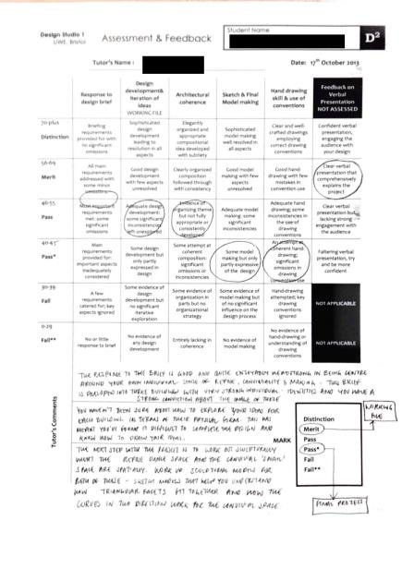
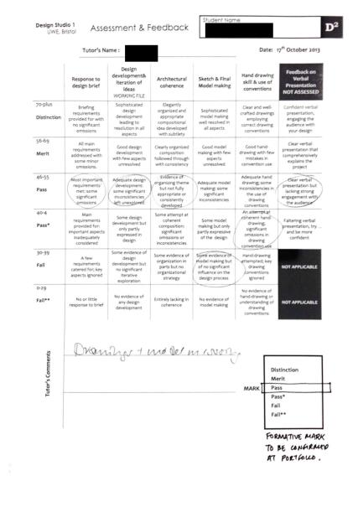

Slide 7
THE PROBLEMS – RUBRIC CONSISTANCY
Sometimes difficult to understand how the final mark was reached from the rubric criteria selected
Students would question how their marks were arrived at if there was inconsistency in the rubric

Slide 8
THE DIGITAL MARKING TOOL
Started from the premise that taking a tablet computer into a review rather than a sheet of paper could provide significant improvements to the current system.
Aim to improve efficiency, format, and accessibility of formative feedback.
Aim to enable students to effectively use and engage with feedback, as well as raising student’s awareness of the extent and quality of feedback they receive.
Filemaker Pro used to create the ‘application’.
Data is secure through password protection and data is wiped from iPads after use.

Slide 9
Let’s take a look….

Slide 10
THE DIGITAL MARKING TOOL
Ability to take photographs.
Record voice.
Calculate potential marks from rubric.
Email feedback directly to the student from the database.
Speeds up delivery of feedback.
Professionalises and improves consistency by causing behavioral change to the marker.

Slide 11
THE PROJECT SO FAR
Awarded a grant to develop the tool through UWE Learning for All: Learning and Teaching Projects
Tested in a number of marking scenarios including with and without the presence of students
Mark sheets and voice recordings emailed directly to students
Subsequent feedback discussion with students was positive about the accessibility of the digital delivery of this feedback, which, they noted, encouraged them to study it in more detail and take more account of the general feedback included with their individual feedback reports.

Slide 12
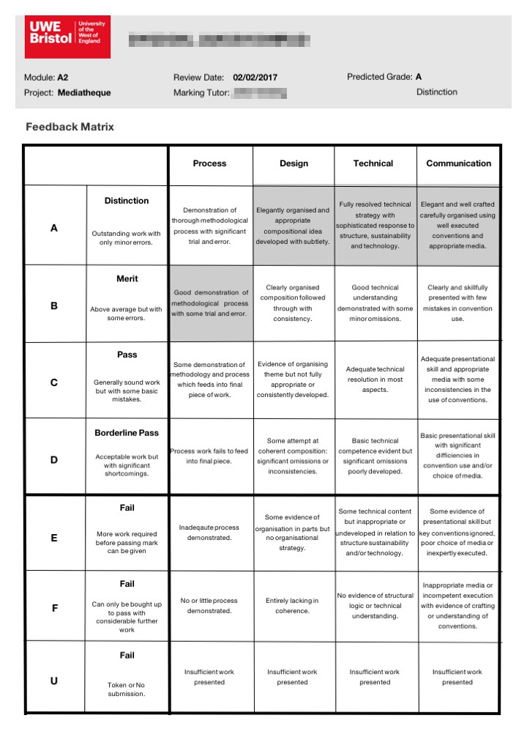
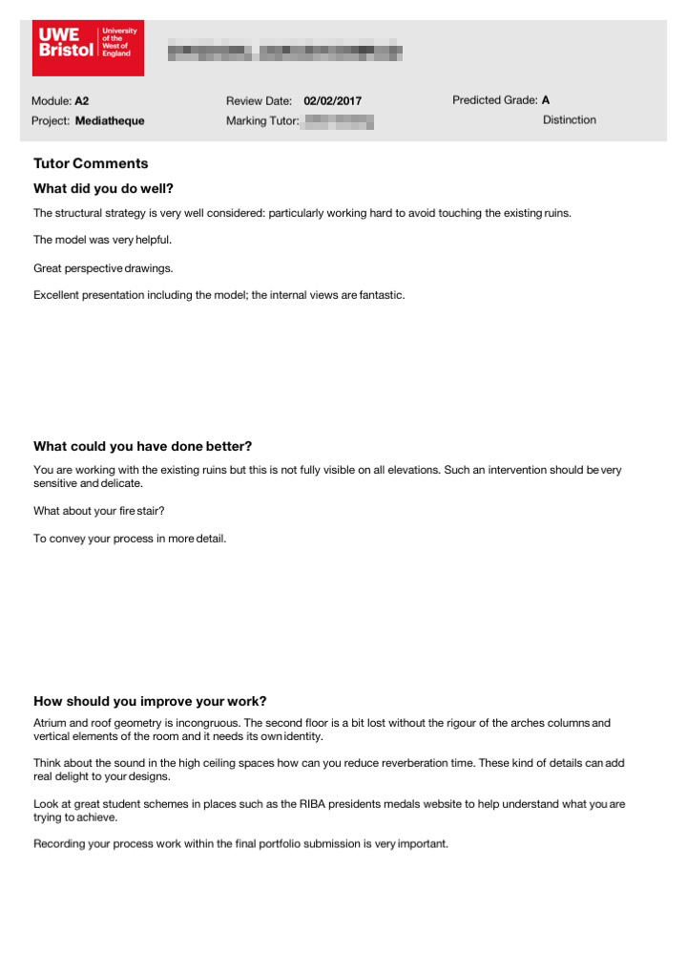
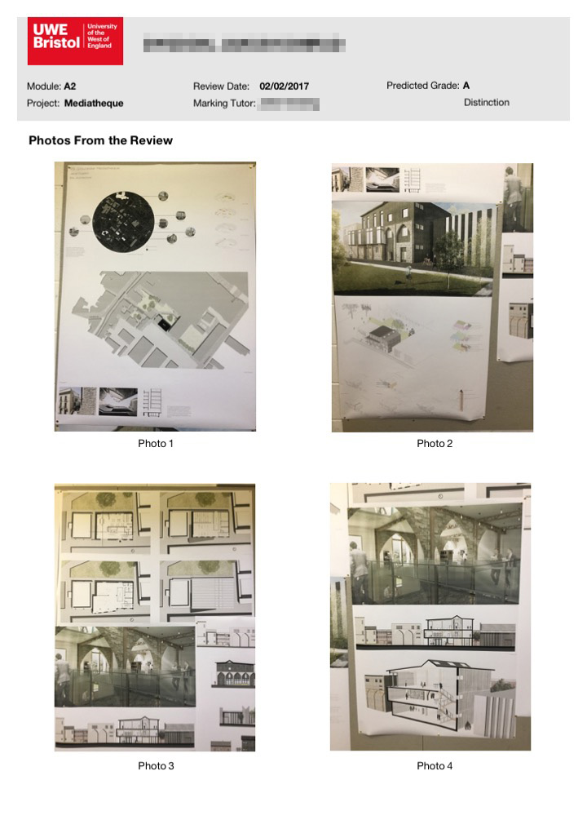
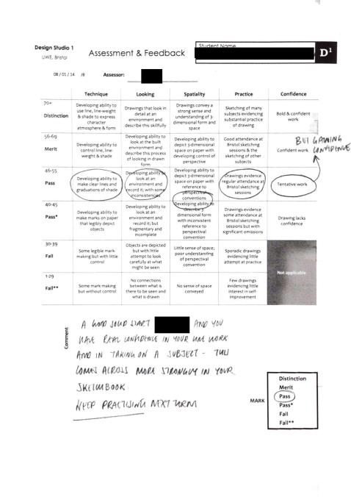

Slide 13
REFLECTIONS: ARE THERE ANY DOWNSIDES?
The assessors had different levels of success in adjusting to this digital approach, but a general impression was that the quality of feedback offered improved in terms of detail and individual relevance.
Feedback was disseminated by email to students, which initially caused confusion because 1st years often do not check their UWE email accounts.
Hardware and software set-up cost.
Time spent adjusting the database for different marking scenarios.

Slide 14
REFLECTIONS: STUDENT VOICE
Comments from Student Focus Group
“The feedback is more comprehensive and includes photographs, voice recordings and legible notes.”
“The ability to link a comment to a specific picture of the presentation has proved to be particularly helpful, as it is normally easy to forget which aspects of the work comments relate to.”
“Quicker feedback; compared to the usual one to two weeks, feedback is received within a couple of days.”
“It is more useful to have a digital copy rather than a physical copy, which is easier to lose.”
“There seems to be more agreeable feedback from different tutors; maybe this is due to the more organised and legible format of the feedback form.”

Slide 15
REFLECTIONS: CONCLUSIONS & NEXT STEPS
UWE now has the highest feedback satisfaction scores of any Architecture school for last two years at 92.7% up from 82.7% in 2015. (Guardian League Tables)
We will continue to innovate to further improve the feedback we give our students.
There are still some improvements and developments that we are trying to make and hope to instigate.
- The tool only partially connects with the UWE VLE, Blackboard.
- Interaction on the database with students… how far can this go?
- Possible research direction into digitising different types of feedback

Slide 16
THANK YOU
jonathan.bassindale@uwe.ac.uk

