Slide 1
Hannah Hickman,
Senior Research Fellow
Dr Aidan While (University of Sheffield)
Richard Dunning (University of Liverpool)
The new politics
of
soft densification
September 2017

Slide 2
Presentation Structure
The concept of soft-densification
Contemporary discussion of soft densification
The English experience – a study for PUCA (Plan Urbanisme Construction Architecture)
The pressures of housing demand
Phase 1 – a quantitative overview of English densification between 2001-11
Phase 2 – case studies of Ealing and Bristol
Conclusions
Notes:
PUCA's concern with the impact of densification on pre-existing urban form.
Conclusions about the politics of managing that …

Slide 3
The concept of soft densification
“There has been very little significant physical expansion of urban areas in England in the last 20 years or longer. Densification of development has occurred both on the urban brownfield sites (previously developed land) favoured by policy and, less frequently, on urban green field sites (previously undeveloped land within cities).” (Bibby et al., 2016)
Soft densification occurs through:
Internal subdivision of houses into flats
Extension/reconfiguration of properties to provide new units
Auxiliary dwellings on residential “garden infill”
Division of house plots (villa-suburbs to multiple high-status dwellings / low rise-apartments)
Infill development on spare or undeveloped plots
Change of use from non-residential (construction/subdivision).
Notes:
Densification has been characteristic of many of our urban areas as Peter Bibby describes …
But what is the contribution and impact of soft densification?

Slide 4
Relevant planning policy history
Long tradition of attempts to prevent urban sprawl
1944: Abercrombie plans a green belt for London
1946: New Towns Act concentrated dispersal to new towns
1955: England policy rolled out to check ‘ the unrestricted sprawl of the built up areas, and of safe-guarding the countryside against further encroachment…by the formal designation of clearly defined green belts’ (Min. of Housing & Local Govt 42/55)
1980’s: Green belt policy expanded to encourage urban regeneration
1990’s: Urban containment meets sustainable development (e.g. PPG3), Compact City dominates policy, 60% development on brownfield (2000)
Current strong national policy stance towards densification
Notes:
Why have we been densifying? No rocket science here ...

Slide 5
Contemporary debate(s) about soft densification
Densification and sustainable urban development is a strong narrative in the EU & USA
The issue of 'soft' densification and its particular impact and regulation - depends on context and morphology (Touati, 2015)
Literature on SD has a tendency to focus on suburbs – and the diversity of 'suburban densification regimes' (Charmes & Keil, 2015)
Politics around the regulation of soft densification are influenced by garden-grabbing debates, the impact and attitude of existing residents, and issues around infrastructure provision
In the English context, densification broadly is driven by a broadly pro-development policy / presumption in favour of development
But, there is a void regarding SD in the NPPF:
tacit support for SD but little prescription
but presumption in favour of SD was questioned by the Coalition government in 2010 – gardens no longer within the definition of brownfield sites – now there is discussion of post garden-grabbing politics?
therefore it is the local political context where pressures around SD emerge.
Notes:
So what has the literature got to say about SD and its impact and contribution
Firstly, very little …
NPPF - encourage the reuse of existing resources, including conversion of existing
buildings;
LPAS should not be avoid being OVERLY PRESECRIPTIVE
The NPPF also states that in order to significantly boost the supply of housing, LPAs should set
their own approach to housing density that reflects local circumstances. However LPAs are
encouraged to avoid being unnecessarily prescriptive in density terms, and to concentrate instead on
the relationship of proposed development to neighbouring buildings and the local area more
generally in terms of scale, massing, height, landscape, layout, materials, and access.
The NPPF specifically excludes residential gardens from any calculation of ‘windfall’ sites18
contributing to strategic housing land supply, and LPAs are encouraged to consider policies to resist
inappropriate development of residential gardens, for example where development would cause
harm to the local area. In addition, the definition of ‘previously developed land’, which is favoured
for development, specifically excludes land in built-up areas such as private residential gardens,
parks, recreation grounds and allotments. This definition of ‘previously developed land’ highlights
the alteration to the position prior to 2010 that residential gardens are included in the definition of
brownfield development and therefore makes garden infill developments more difficult to justify.
Further notes on the changes in the definition of previously developed land and garden infill may be
found in the conclusion.

Slide 6
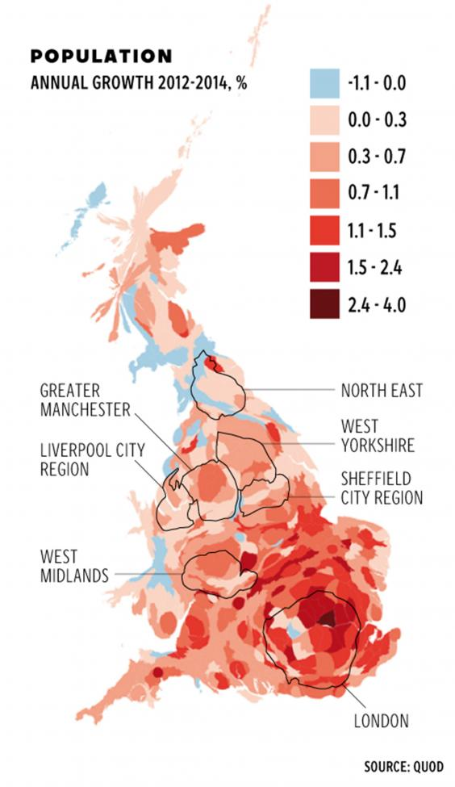
The spatial distribution
of housing demand
English housing need driven by backlog of households (stock) and newly arising households (flow)
Barker Review (2004) – 250,000 new homes p.a. – largely uncontested today
Demand is spatially uneven:
Attributed to backlog (quality vs quantity)
Attributed to population growth
Housing Crises not Housing Crisis
Pressure to increasing housing supply has reinforced the orientation of English planning policy towards urban containment and urban densification
Notes:
Why do we need to densify?
We have extremely high housing demand? Concentrated – as you can see in this graphic from quod – in major urban areas …
Barker’s
We know the expansion of the green belt is controversial so densification needs to occur.
Before I move on to the next slide – is anyone prepared to estimate what proportion of dwellings provided in urban areas of 2001-2011 period came from SD?

Slide 7
Phase 1 (Peter Bibby et al)
Quantitative overview of soft densification in England (2001 to 2011)
Using a combination of Postcode Address Files with Land Use Change Statistics, changes in densification (attributed to different types of densification) mapped to hectare grid for England
SD accounted 29% of total number of dwellings developed in urban areas, or 17% of the entire increase in the dwelling stock.
38% of units arising from SD were result of internal reorganisation of buildings, including conversion and subdivision of buildings formerly in non-residential use.
SD particularly prevalent within single family residential neighbourhoods (which accounted for 32% of the total increase in dwellings), with over 60% of additional dwellings arising from infill developments (mostly on vacant plots or on sites previously in non-residential use).
De-densification: Some areas became less densely developed because of the reinstatement of formerly sub-divided single dwellings or the combination of previously separate dwellings (suburban gentrification).
Notes:
First stage of our study was to look nationally …
Method
- Using a combination of Postcode Address Files (and prolog) with Land Use Change Statistics, changes in densification (attributed to different types of densification) mapped to hectare grid for England
Detail and methodology can all be found in the main report.

Slide 8
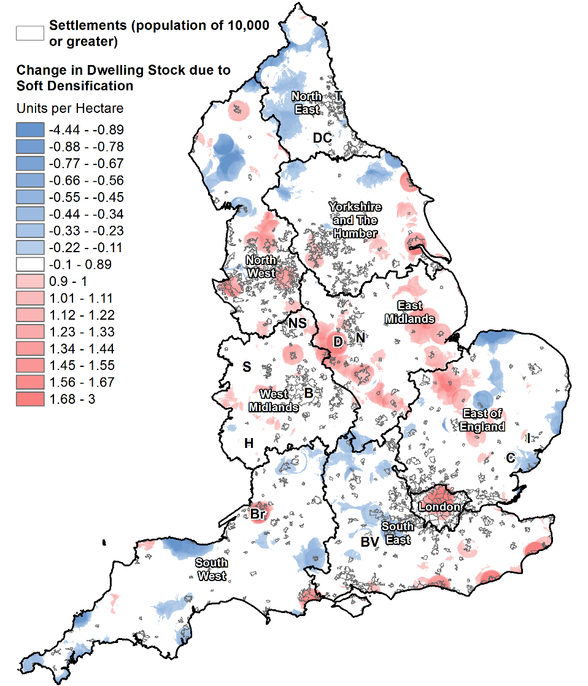

Slide 9
Phase 2 case studies
Method:
Desk based policy and literature analysis; interviews with residents, estate agents, developers and planning officers; and, site visits
Ealing:
Suburban local authority area
Experienced concurrently significant soft densification and de-conversion of existing stock in the period 2001 to 2011
Long history of densification and in-migration
Housing pressure radiating from central London
Bristol:
City unitary authority
Experienced a high level of housing growth with significant densification and relatively little de-conversion 2001 to 2011
Housing pressure radiating from London
Pro-densification planning framework

Slide 10
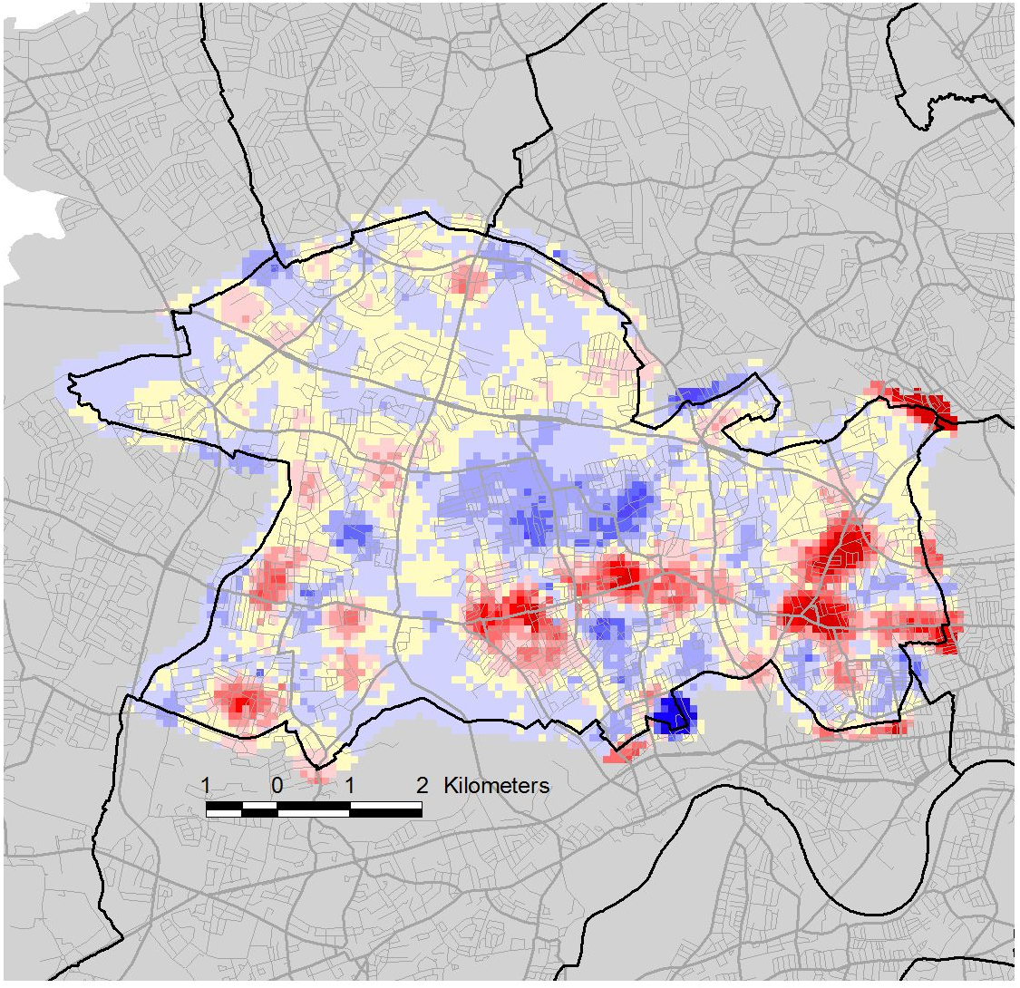
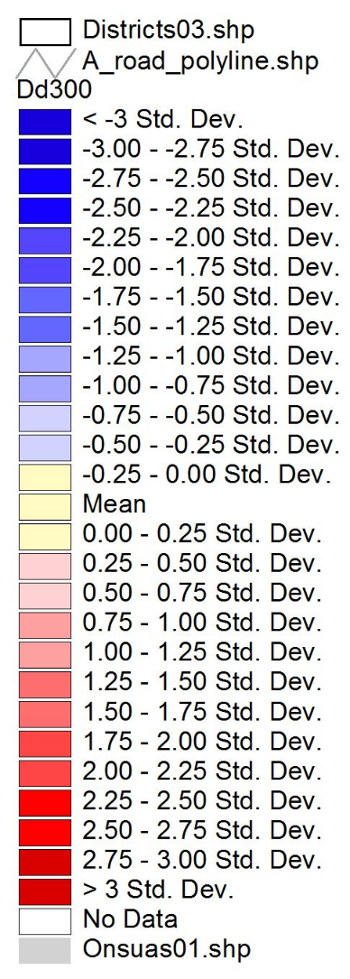
Notes:
Hard, soft and de-densification all occurring. Ealing is a heterogenous suburb.

Slide 11
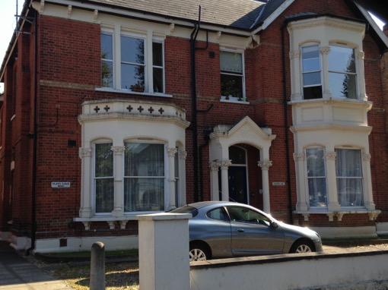
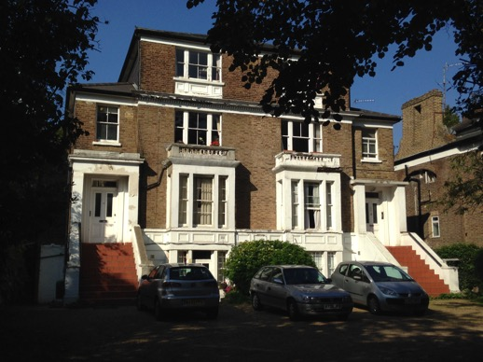
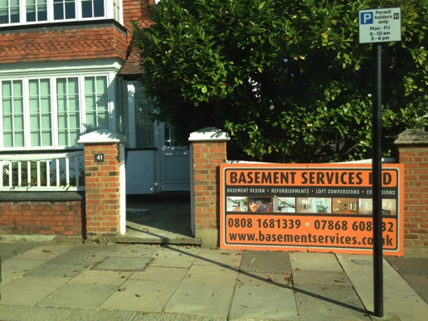
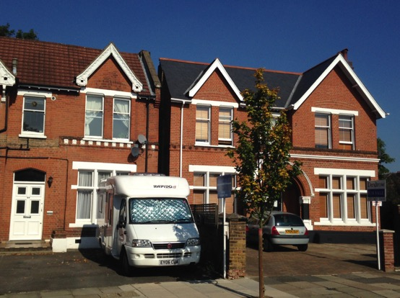
Pierrepoint Road, Ealing (Lat: 51.5144, Long: -0.2734)
Mattock Lane, Ealing (Lat: 51.511, Long: -0.3103)
Amherst Road, Ealing (Lat: 51.5169, Long: -0.3131)
Woodville Road, Ealing (Lat: 51.5183, Long: -0.2999)
Notes:
Top left: Single family dwelling converted into five flats
Top right: 2 SF dwellings sub-divided into multiple flats, extensive off-street parking.
Bottom left: SF dwelling but with densification: basement conversion to increase the residential floor plate.
Bottom right:
Sub-terranean development

Slide 12
Ealing conclusions
SD recognized as part of Ealing’s history/life - therefore not contentious
Garden grabbing not really occurring
Council policy sits within constraints of NPPF & the London Plan and the council is pro-densification
Location and type of SD influenced by neighbourhood ‘character’, housing morphology, access to transport, access to services & conservation area designations
Housing economics are abnormal in Ealing (balance between SD & DD)
Council well versed in types of SD, but with limited resource/ideas how to shape preferred forms of SD
SD has had a significant impact upon the character (incl. aesthetics) of neighbourhoods in Ealing
The outcomes of SD are less well known and the cumulative effect has had a greater than expected impact on some neighbourhoods and residents, leading to under resourced services and in some cases, to the erosion of the aesthetics or character of a neighbourhood.

Slide 13
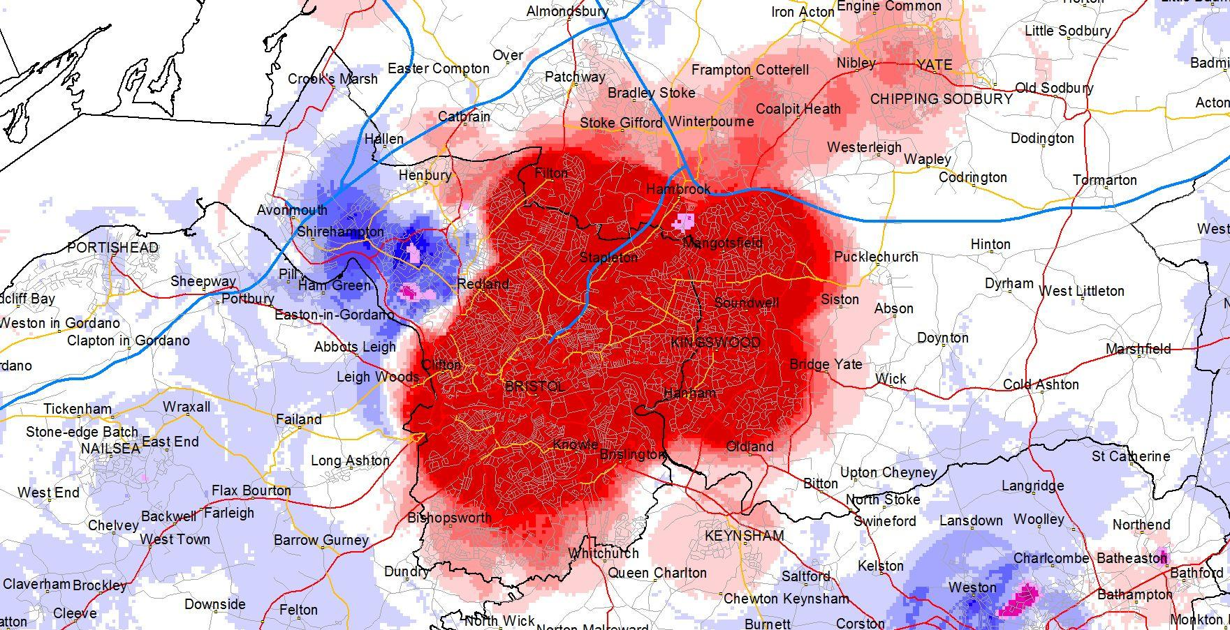
Notes:
City under siege from densification

Slide 14
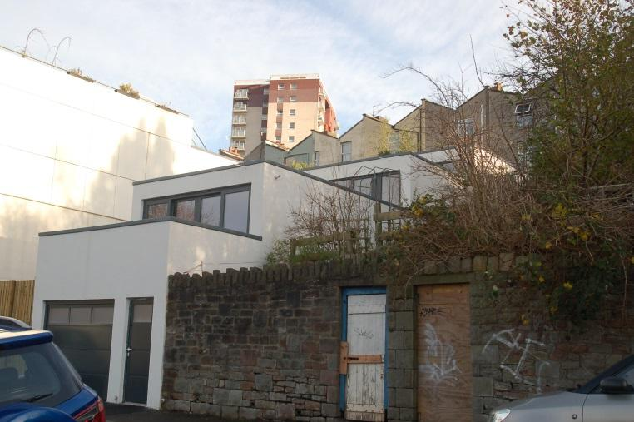
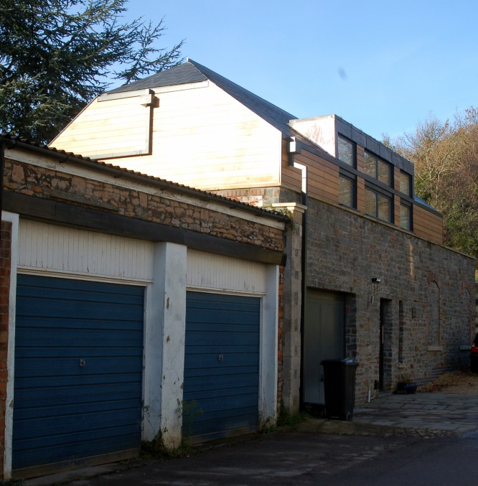
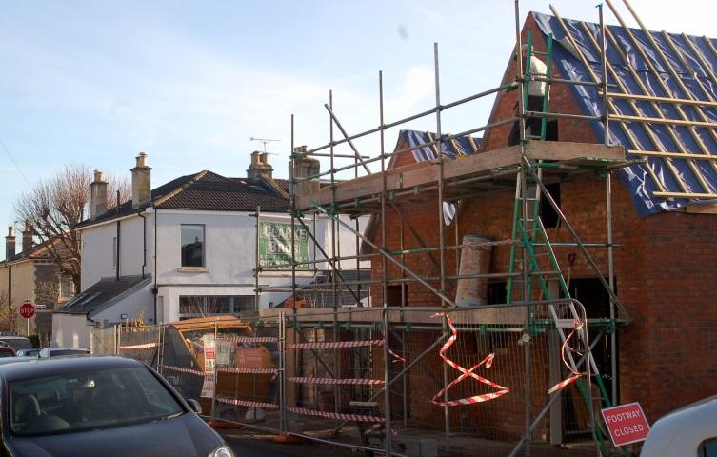
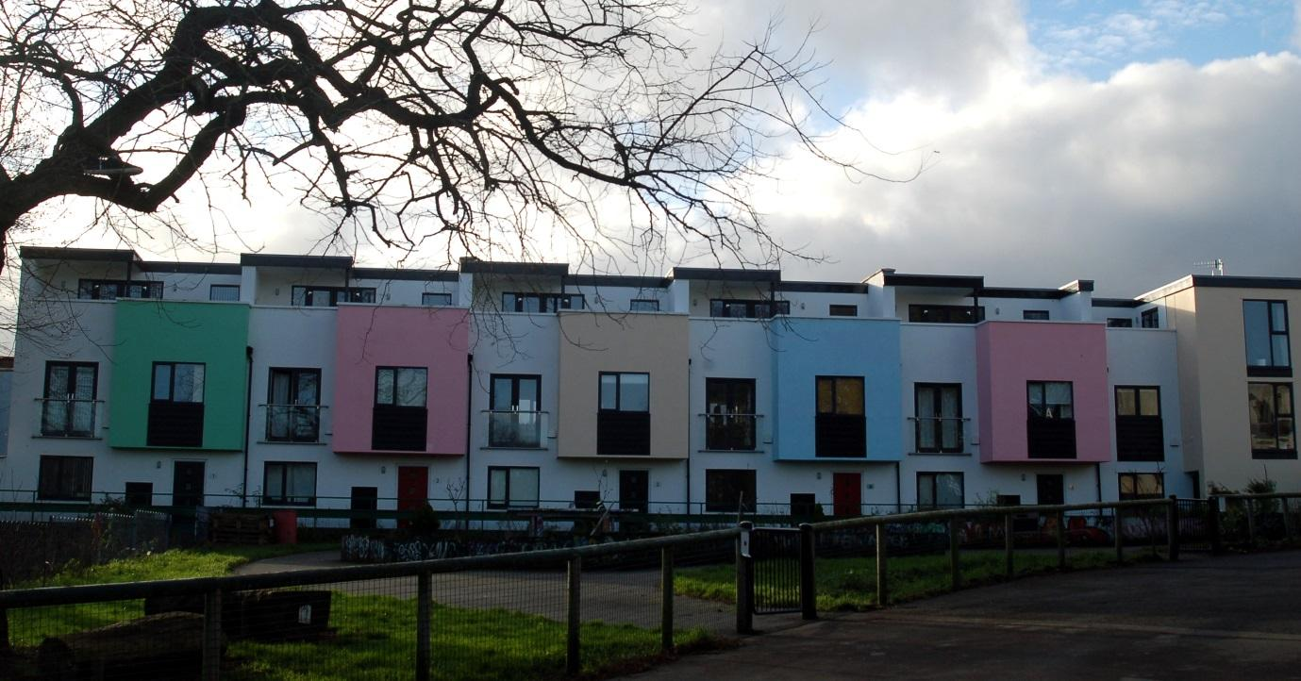
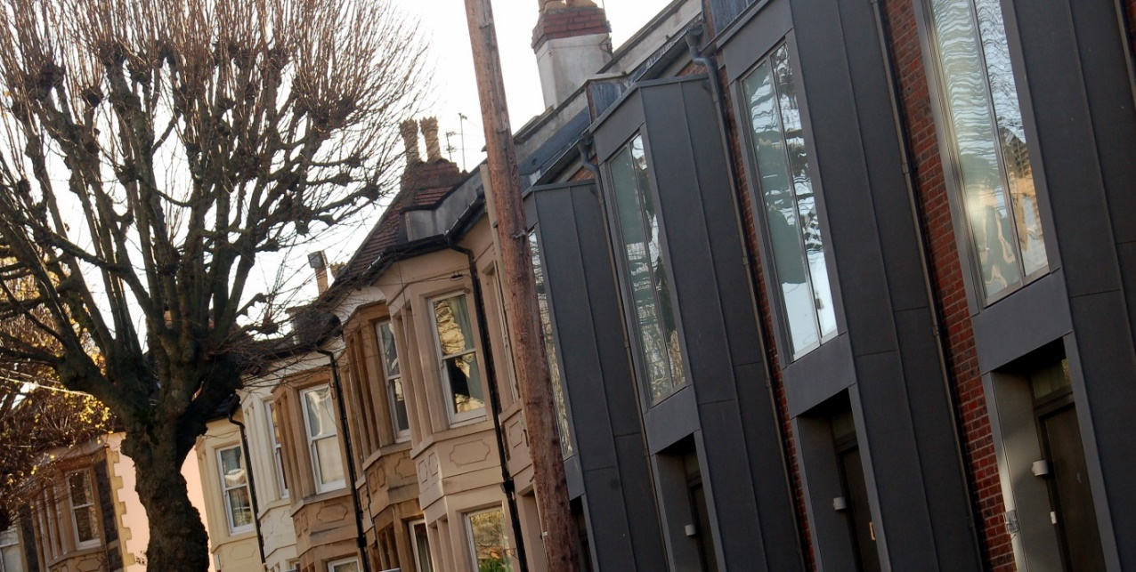

Slide 15
Bristol conclusions
BCC policy position in favour of development and densification however not specifically aimed at SD (linguistic vacuum)
Strong support for small sites and re-use of existing buildings
Residential sub-division more restrictive
Garden development policy reflects national policy, but some permissible criteria
Clear macro and micro (finances of conversion) economic drivers for SD
Politics
Opposition to garden grabbing (although many examples of development)
Small site development and sub-division driven by opposition to green belt/green field development, orthodoxy of compact city as environmentally & socially sustainable (incl. supporting public transport)
Regulation
Interviewees identified ease of regulating HD in comparison to SD, but recognised that there was an (undiscernible) tipping-point for neighbourhoods
Little to link SD with wider local authority services / infrastructure
SD more likely where it was complementary to existing urban fabric, increasing values and in close proximity to public transport/services.
Low density – high value neighbourhoods – seemingly protected
SD more contentious than in Ealing.
Notes:
“Bristol City Council will always work proactively with applicants jointly to find solutions which mean that proposals can be approved wherever possible” (BCC, 2014, 7).
during the 2014/15 period 100 dwellings - almost a quarter of small site completions - were garden developments.

Slide 16
Conclusions
The prominence of SD reflects a combination of market pressures, national planning policy in favour of development, and support for urban intensification in local planning policies
This pro-development national policy is creating difficulties in managing SD for LPAs - SD is a governance story of discretionary control, impacted by a range of competing and contradictory policy pressures
Control has previously focussed on protecting places largely as they are – this is shifting, and it is proving harder to regulate SD
Whether this is a good or bad thing depends on whose interests you are representing: has protection of homeowners shifted in favour of developers? How can a middle ground be achieved?
The fine grain of urban contexts is leading to varied experiences. Existing urban morphology is an important driver, but even places previously ‘regulated out’ are opening up. Existing literature has tended to focus on post sub-urbanisation, but this not the only narrative
There are significant concerns around the cumulative impacts of SD and a linguistic void / policy vacuum about how to manage them
Some readjustment in some LPAs emerging to focus on specific areas to manage externalities and impact – current focus on metrics not planning judgement.
Notes:
– HD far easier to regulate and is the focus - given its potential contribution towards infrastructure funding etc.
“We are kidding ourselves if we think that by maintaining the built form we are maintaining character”
(Planning officer)
Regulation – of hard densification much easier

Slide 17
Research team and acknowledgements
The interdisciplinary research team was led by Jean-Marie Halleux and John Henneberry. John Henneberry is Professor of Property Development Studies in the Department of Urban Studies and Planning at the University of Sheffield. Jean-Marie Halleux is Chair of economic geography at ECOGEO at the Université de Liège.
The research in Phase I was undertaken by Peter Bibby and Andrew Philips.
The research in Phase II was undertaken by Hannah Hickman, Richard Dunning and Aidan While.
This research was funded by Plan Urbanisme Construction Architecture, an agency of the French government. We are grateful for the resources they provided to conduct this research and for the interviewees who freely gave up their time.
The full project report can be downloaded at:
http://orbi.ulg.ac.be/handle/2268/195017

