Slide 1


Incontinence: The Engineering Challenge XI
Non-invasive Parameter for Assessing Urine Flow Rate in Frequency Domain to Differentiate DU with BOO in Male
Presentation by
Rui Li
Supervisors: Prof Quanmin Zhu
Mr Andrew Gammie
Dr Mokhtar Nibouche
This project is partially supported by a grant from Astellas Pharma

Slide 2
Incontinence: The Engineering Challenge XI
Detrusor underactivity (DU)
One third elder patients in both gender
PFS to diagnose, cannot be differentiate with BOO non-invasively
Weaker detrusor contractility, more frequent detrusor contractions and abdominal straining
‘DU/BOO patterns’
Analysis urine flow rate in frequency domain
ICS standardization: frequency difference (Gammie et al.)
  Detrusor contraction (BOO and normal): 0.1Hz
  Abdominal straining (DU): 1Hz

Slide 3
Incontinence: The Engineering Challenge XI
Peak counting analysis:
Apply filter with specified cut-off frequencies on urine flow rate curve
Count peak number in raw/filtered curve
Ratio of peak number in 1Hz/0.1Hz filtered curve
Filter specifications:
No ripple on passband
Sharp roll-off on cut-off frequency point
Constant value on group delay response
-40 dB attenuation on stopband
Minimum order designed
Kaiser window filter was chosen

Slide 4
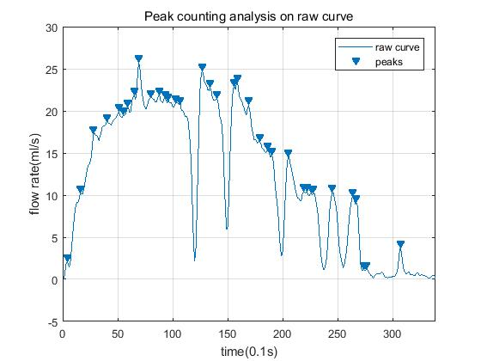
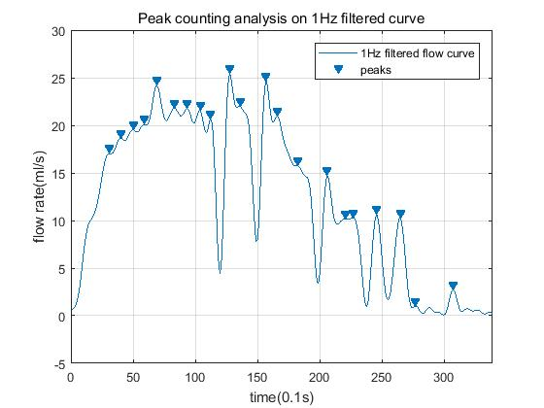
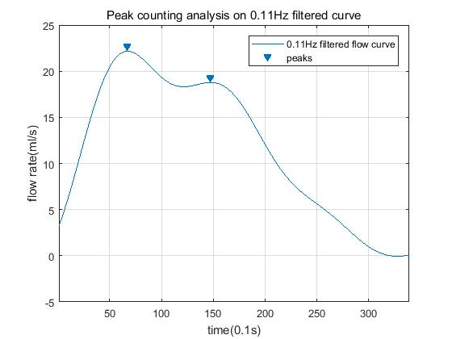
Incontinence: The Engineering Challenge XI
Analysis result for peak counting
Peak numbers much reduced in 0.1Hz filtered curve
Artefact still remain in 1Hz filtered curve
A further quantitative analytical method for frequency is required

Slide 5
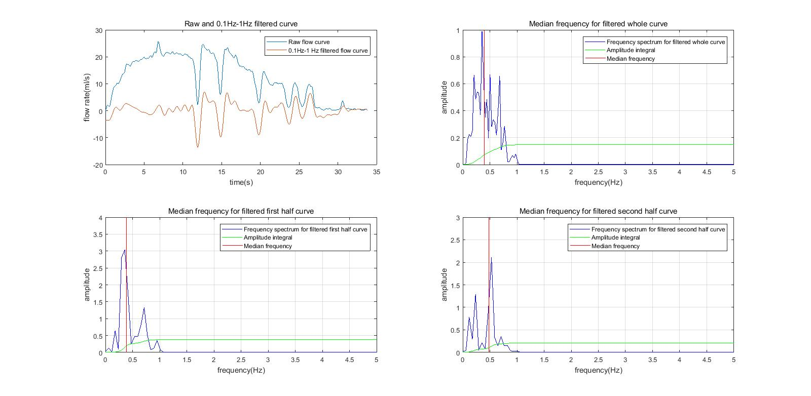
Incontinence: The Engineering Challenge XI
Median power frequency analysis
Kaiser window filter with 0.1Hz-1Hz bandpass frequency
-40 dB attenuation on both stopband
Filtered data shifted as appropriate
FFT to generate frequency spectrum
calculate median power frequency in power spectrum

Slide 6
Incontinence: The Engineering Challenge XI
Interpretation of Results
273 male urine flow rate data analysed including 104 BOO, 93 DU and 76 BOO&DU free data
Blind during analysing procedure
 | P value | AUC | Sensitivity | Specificity
Peak counting analysis | <0.0001 | 0.673 | 63.4% | 67.3%
Median power frequency | <0.001 | 0.663 | 38.7% | 90.4%
Multivariance analysis* | <0.0001 | 0.848 | 84.9% | 69.2%
CART analysis** | Diagnosing accuracy: 82.2% |  | 89.2% | 76%
*Multivariance use 25 non-invasive urodynamic parameters
**CART training procedure was performed by criteria of minimum number of 20 in parent node and 5 in child node

Slide 7
Incontinence: The Engineering Challenge XI
Further research plan:
Other analytical methods such as wavelet theory, time series
Artificial neural network for better diagnosing power
Flow shape normalization
Modelling the UFR curve
Sum of amplitude changes on upward slope in 0.1Hz-1Hz filtered curve

Slide 8
Incontinence: The Engineering Challenge XI
Reference:
Gammie, A., Clarkson, B., Constantinou, C., Damaser, M., Drinnan, M., Geleijnse, G., Griffiths, D., Rosier, P., Schäfer, W., van Mastrigt, R. and International Continence Society Urodynamic Equipment Working Group (2014) International Continence Society guidelines on urodynamic equipment performance. Neurourology and Urodynamics. 33 (4), pp.370-379.
Thanks

