Slide 1
Trans-Atlantic partnership working in developing a UK Physician Associate programme: reflections and
lessons learnt
Dr Fiona Lawrence
Janice St John-Matthews
Alex Stevens
Rex Hobbs
Ottawa- ICME Conference
Abu-Dhabi: March 2018

Slide 2
National Health Service (NHS)
UK’s largest employer
Over 1.5 million staff from all over the world
Celebrates 70th Birthday this year
More than 350 different careers
Physician Associate a new role to the NHS

Slide 3
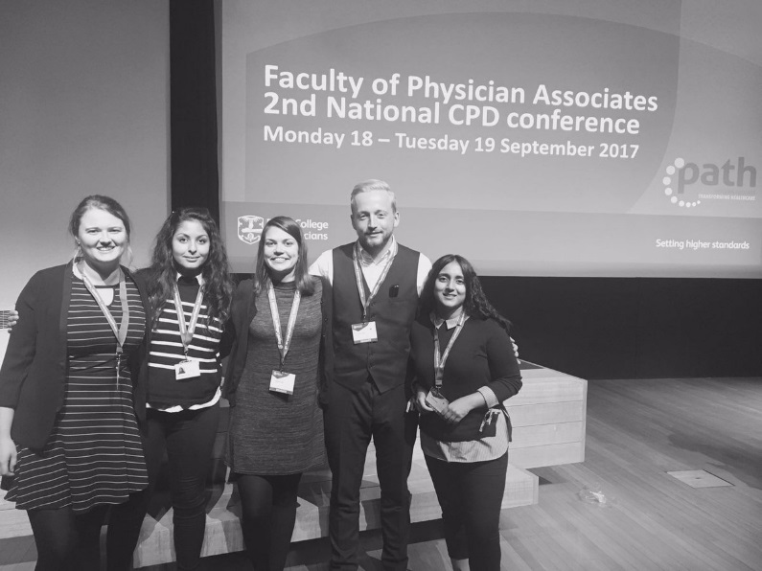
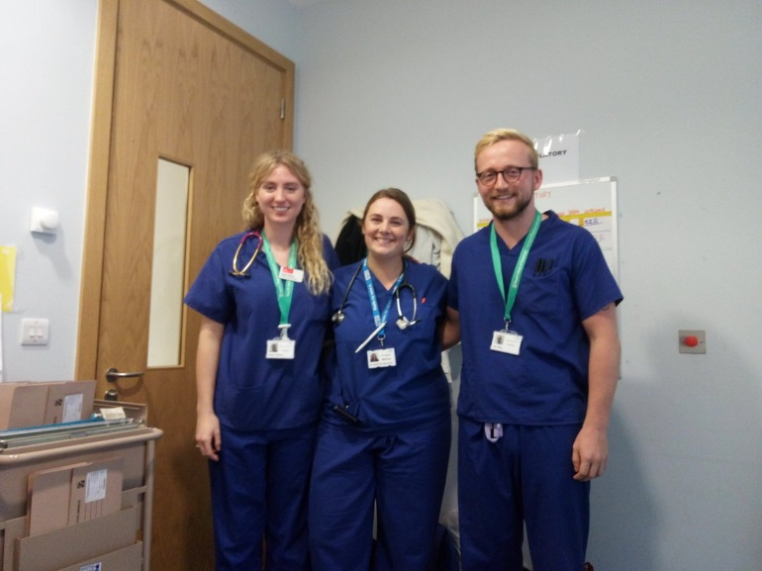
What is a Physician Associate?
Physician Associate or Physician Assistant
A healthcare professional who, while not a doctor, works to the medical model, with the attitudes, skills and knowledge base to deliver holistic care and treatment within the general medical and/or general practice team under defined levels of supervision

Slide 4
US Physician Assistant
105,000 PAs certified to practice in the US
Profession has existed for 50 years ¹
~170 accredited educational programmes
PAs in the US consistently report high job satisfaction
UK Physician Associate
Currently 450 PAs working in the UK and 1200 PA learners ²
Work in a variety of medical fields across the primary, secondary care sectors
Profession is set to grow rapidly in the coming years with the Government pledging ~1,000 PAs in primary care by 2020 ³

Slide 5
The challenge…….
how do we design a programme when there are so few PAs in the country to help inform the curriculum?

Slide 6
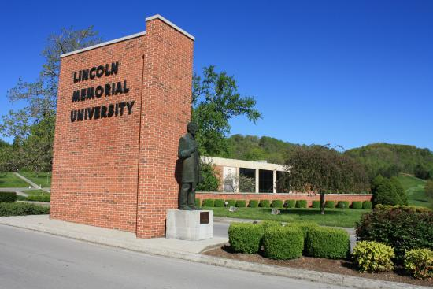
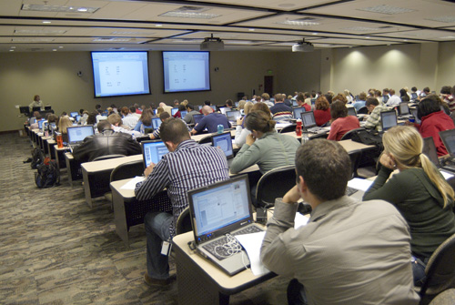
Lincoln Memorial University (LMU)
Programme details
Established 2009 ⁴
Full-time; 27 month program; Master of Medical Science degree
Completion certificate needed for Physician Assistant National Certifying Examination
Intake: 90 learners per annum
Notes:
The students in the PA Class of 2018 will pursue a full-time, 27-month program that leads to the Master of Medical Science degree in Physician Assistant Studies. The PA program hails the largest class size of all PA programs in the southeastern United States. The entering class of 2018 is 75% female and 25% male. The average age is 26 and the average GPA is 3.4. Approximately 60% of the class hails from the Appalachian region, with the majority of those coming from Tennessee, Kentucky or Virginia.

Slide 7
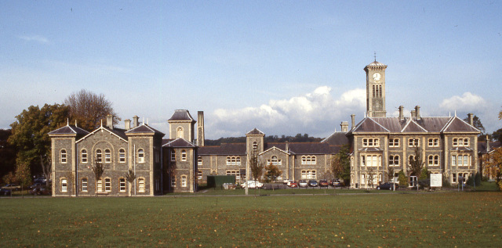
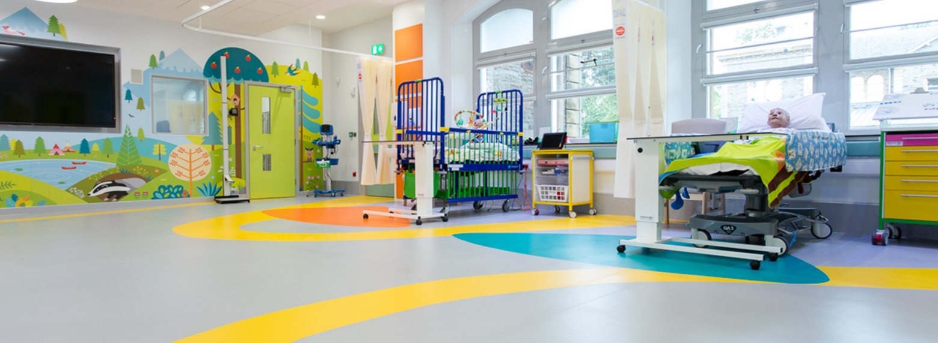
University of the West of England (UWE)
Programme details
Growth in UK PA education providers from 3 in 2014 to 28 in 2018 ¹
Full time; 24 month; Masters of Physician Associate Studies ⁵
Apply to take UK PA National Certification Exam to practice in the UK ⁶
Welcomed first cohort in September 2016 (n=15)

Slide 8
Common highlights
Programmes lead by qualified PAs
Neither has
a medical school
Dynamic institutions complimentary course profiles
Both fee paying courses
Keen to develop the profession internationally
Distant placements across a broad rural geography

Slide 9
Focused partnership working
Limited numbers of UK PA educators to draw from - UWE programme is supported at a distance by LMU PAs
LMU supported UWE to develop the curriculum, including problem based learning, teaching, learning and assessment
LMU provided support in shaping cohort and professional identity
Globally connected curriculum and outlook with longer term reciprocal visits for teaching planned

Slide 10
Timeline
May 2015
November 2015
March 2016
September 2016
Phase: Scoping
Connections made between HEIs through mutual contact. Conversations at this stage focussed on role identity, philosophy of practice and potential curriculum outline.
Phase: Designing
Visit by UWE staff to LMU and to the PAEA conference in Washington DC. Using the knowledge gained the programme was designed using innovative material from other healthcare programmes at UWE and the creation of new material to meet the core competencies, knowledge and behaviours required for a ‘fit for practice’ PA
Visit by LMU to UWE to provide support to develop a clinical placement circuit and stakeholder engagement. Lessons were shared from the LMU team on how to seek champions of the profession who would provide a supportive learning environment for the students of a new healthcare discipline
Phase: Delivering
Phase: Developing
LMU were present to welcome our new cohort. Students appreciated the breadth of knowledge LMU brought from the teaching sessions. This partnership has brought benefits to the hidden curriculum, such as the global identity of the profession, values and beliefs.

Slide 11
Reflections and lessons learnt
Partnership management, capacity and scope. Who owns the relationship between the two Universities?
Link established to help set up programme but needs to be maintained to ensure partnership is beneficial for both sides. Needs time and investment
Culture of new professions from an internal and external perspective
Professional identity – learnt a lot from the trip to the States and to the PAEA conference, but this is complex for a new workforce and needs more time

Slide 12
Summary
Based on the principles of good partnership working partnership has mutual benefits for both universities
EVOLVING
MUTUAL
RECOGNITION
UWE staff have been awarded Didactic Adjunct Faculty status. Supports teaching practice and professional development
The partnership is evolving and is now cross Faculty to include business and psychology programmes

Slide 13
References
Piemme, T.E., Sadler, A. M., Carter, R. D. & Ballweg, R. (2013) The Physician Assistant: An Illustrated History. Acacia Publishing Inc: Arizona
The Faculty of Physician Associates (2017) Physician Associate Census. Available at: http://www.fparcp.co.uk/ukphysicianassociateprogrammes/
Hunt, J (2015) A New Deal for General Practice. Available at: https://www.gov.uk/government/speeches/new-deal-for-general-practice
LMU (2018) Lincoln Memorial University Physician Assistant Programme. Available at: https://www.lmunet.edu/academics/schools/debusk-college-of-osteopathic-medicine/pa
UWE (2018) University of the West of England Physician Associate Programme
The Faculty of Physician Associates (2017) Physician Associate Exam. Available at: http://www.fparcp.co.uk/examinations

Slide 14
Thank you for listening!

