Slide 1


UKCS 2018
Multivariate analysis of variance for maximising the diagnosing accuracy in differentiating DU from BOO in males
Presentation by
Rui Li
Supervisors: Prof Quanmin Zhu
Mr Andrew Gammie
Dr Mokhtar Nibouche
This project is partially supported by a grant from Astellas Pharma

Slide 2
UKCS 2018
Detrusor Underactivity and Bladder Outlet Obstruction
Bother one third elder patients in both gender
PFS to diagnose, cannot be differentiated non-invasively
Abdominal straining (DU) and detrusor contraction (BOO) – frequency difference probably visible in urine flow rate
Several non-invasive indicators proposed, but with limited diagnosing accuracy
Multivariate Analysis of Variance (MANOVA)
Bundling multiple non-invasive parameters into a weighted linear combination variable
Maximise statistically significant difference between two groups
All free flow data has been pre-processed by the threshold value of 0.5ml/s for the start and end micturition point.

Slide 3
UKCS 2018
Non-invasive variables for MANOVA analysis
Parameters from 2 seconds averaging window filtered UFR data: Q_{max} (P<0.0001), Q_{ave} by voiding time (P<0.01), Q_{ave} by flow time (P<0.0001) and ratio of Q_{max} time to voiding time (P=0.05)
Parameters mathematically derived from 2 seconds averaging window filtered UFR data: mean flow rate in rising part and falling part (P<0.01 and P=0.01 respectively), and ratio of flow time to voiding time (P<0.05).
Parameters required complex mathematical calculation of raw flow data: median frequency values in different bandpass filtered curve (statistical difference varies from P=0.0001 to P<0.05), ratios of peak numbers in different lowpass filtered curve (P<0.0001), time constant value in falling part of 2 seconds averaging window filtered curve (P=0.01), and sum of amplitude changes in rising slope in 0.1Hz to 1Hz filtered flow curve (P<0.001).

Slide 4
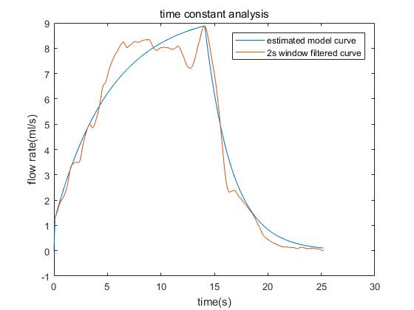
UKCS 2018
Time Constant value analysis
Two second averaging window filter
Discrete first order transform function for rising and falling part
Least Squares method for curve approximation
Calculate the time constant values on rising and falling part

Slide 5
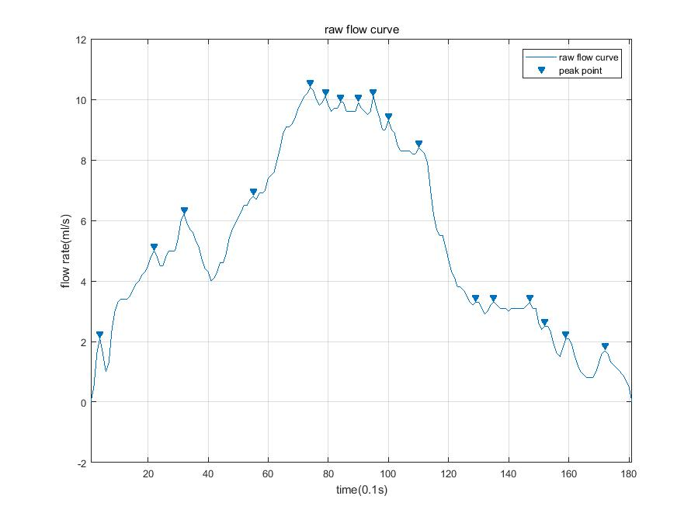
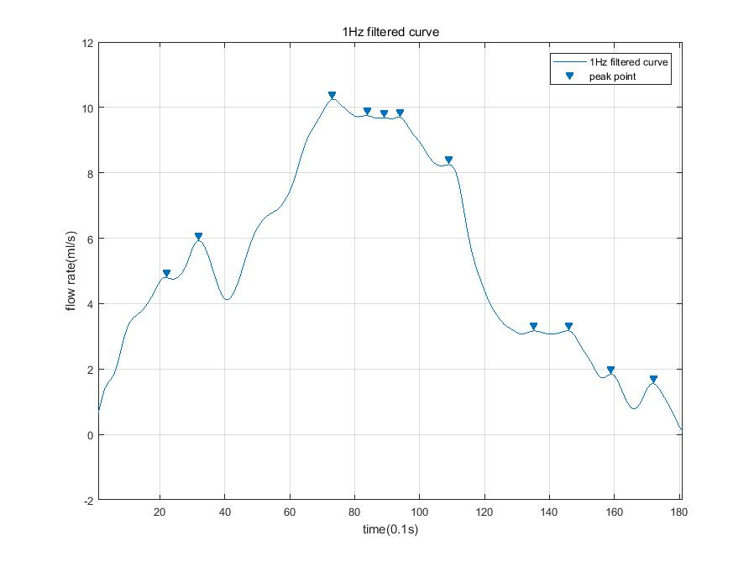
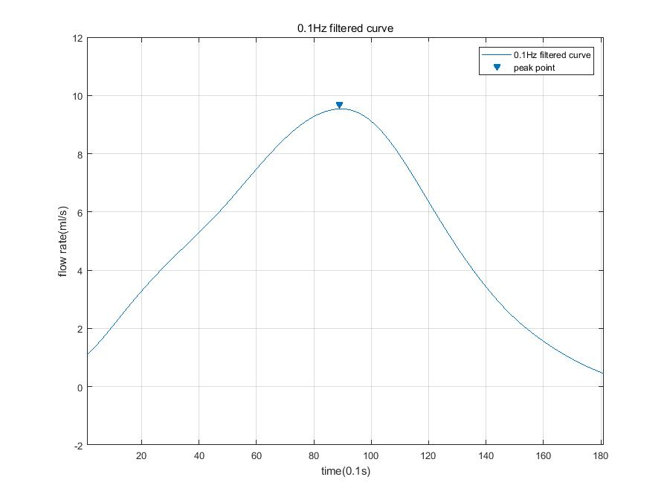
UKCS 2018
Peak counting analysis:
3rd order Butterworth filter (1Hz, 0.1Hz)
Count peak number in raw/filtered curves
Ratio of peak number in 1Hz/0.1Hz filtered curve and raw/0.1Hz filtered curve

Slide 6
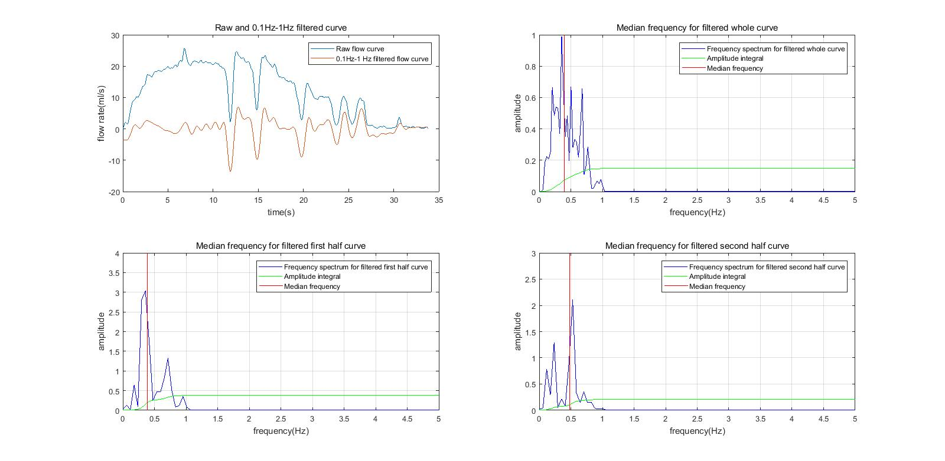
UKCS 2018
Median power frequency analysis
Kaiser window filter with 0.1Hz-1Hz bandpass frequency
-40 dB attenuation on both stopband
FFT to generate frequency spectrum
Calculate median power frequency in power spectrum

Slide 7
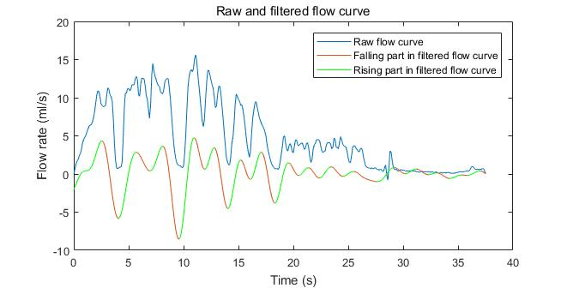
UKCS 2018
Sum of amplitude change in rising slopes in filtered curve
Kaiser window filter with 0.1Hz-1Hz bandpass frequency
-40 dB attenuation on both stopband
Calculate the sum of amplitude changes in rising slope

Slide 8
UKCS 2018
Interpretation of Results
273 male urine flow rate data analysed including 104 BOO, 93 DU and 76 BOO&DU free data for reference
Blind during analysing procedure
 | P value | AUC | Sensitivity | Specificity
Peak counting analysis | <0.0001 | 0.673 | 63.4% | 67.3%
Q_{max} | <0.0001 | 0.634 | 49.5% | 78.1%
Q_{ave} | <0.0001 | 0.672 | 72% | 55.8%
Median power frequency | <0.001 | 0.663 | 38.7% | 90.4%
MANOVA analysis* | <10⁻²³ | 0.872 | 73.1% | 84.6%
CART analysis** | Diagnosing accuracy: 82.2% |  | 89.2% | 76%
*Multivariance use 25 non-invasive urodynamic parameters
**CART training procedure was performed by criteria of minimum number of 20 in parent node and 5 in child node

Slide 9
UKCS 2018
Further research plan:
Analyse more male flow data for reliable result
Coefficients assigned to each parameter are not fixed, neural network for automatical updating on the coefficients
Validation of MANOVA/CART analysis result
Exploring other non-invasive parameters
Thank You

