Slide 1


ICI-RS Pre-meeting
Mathematical analysis of the male urine flow rate curve for differentiating between DU and BOO
Presentation by
Rui Li
Supervisors: Prof Quanmin Zhu
Mr Andrew Gammie
Dr Mokhtar Nibouche
This project is partially supported by a grant from Astellas Pharma

Slide 2
ICI-RS Pre-meeting
Detrusor Underactivity and Bladder Outlet Obstruction
Bother one third elder patients in both gender
PFS to diagnose, cannot be differentiated non-invasively
Several non-invasive indicators – limited diagnosing accuracy
Abdominal straining (DU) and detrusor contraction (BOO) – frequency difference probably visible in urine flow rate curve
Aims: non-invasively differentiate DU with BOO in male
Analyse UFR data in time domain and frequency domain
Derive novel non-invasive parameters
Statistically analyse on parameters for diagnostic use
Combine parameters to achieve best diagnosing accuracy

Slide 3
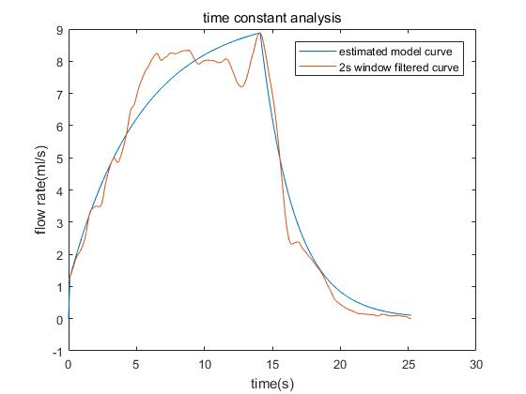
ICI-RS Pre-meeting
Time Constant value analysis
Two second averaging window filter
Discrete first order transform function for rising and falling part
Least Squares method for curve approximation
Calculate the time constant values on rising and falling part

Slide 4
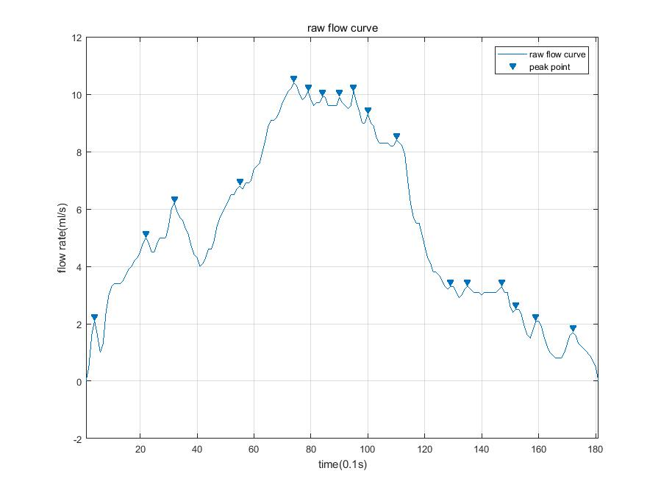
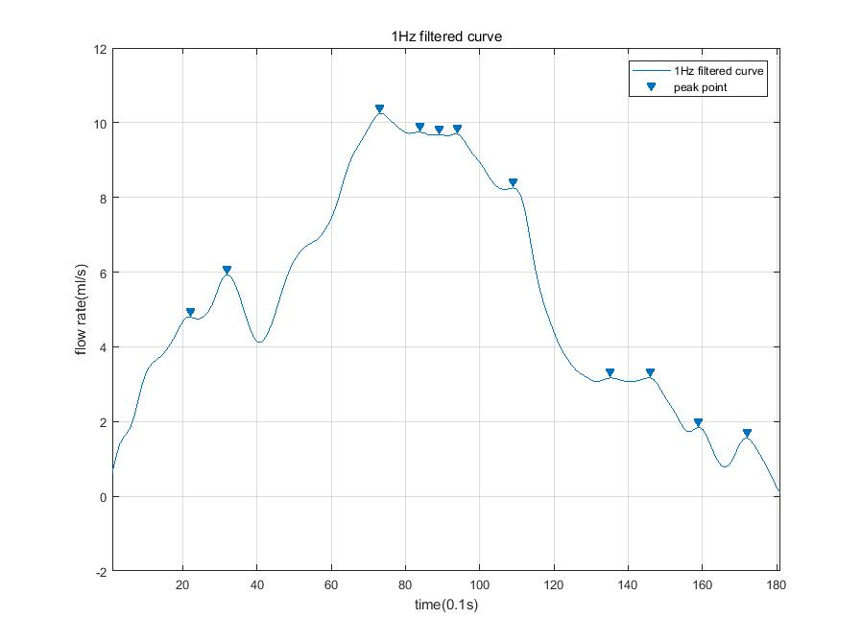
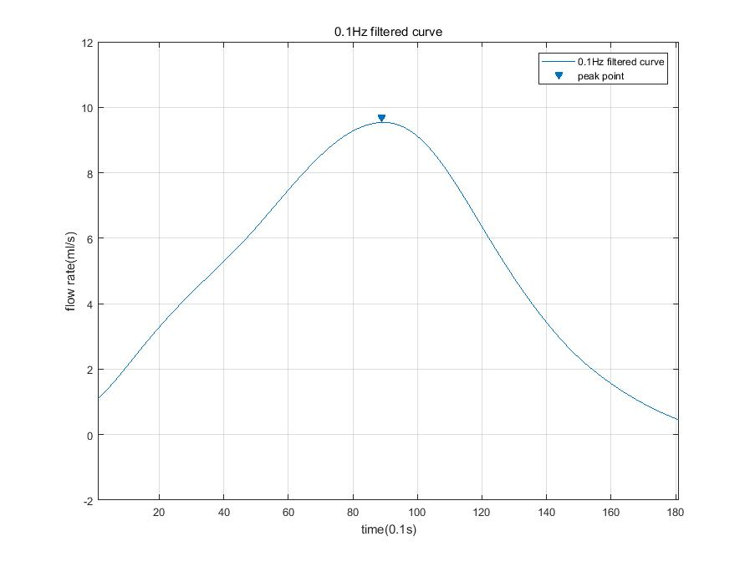
ICI-RS Pre-meeting
Peak counting analysis:
3rd order Butterworth filter (1Hz, 0.1Hz)
Count peak number in raw/filtered curves
Ratio of peak number in 1Hz/0.1Hz filtered curve and raw/0.1Hz filtered curve

Slide 5
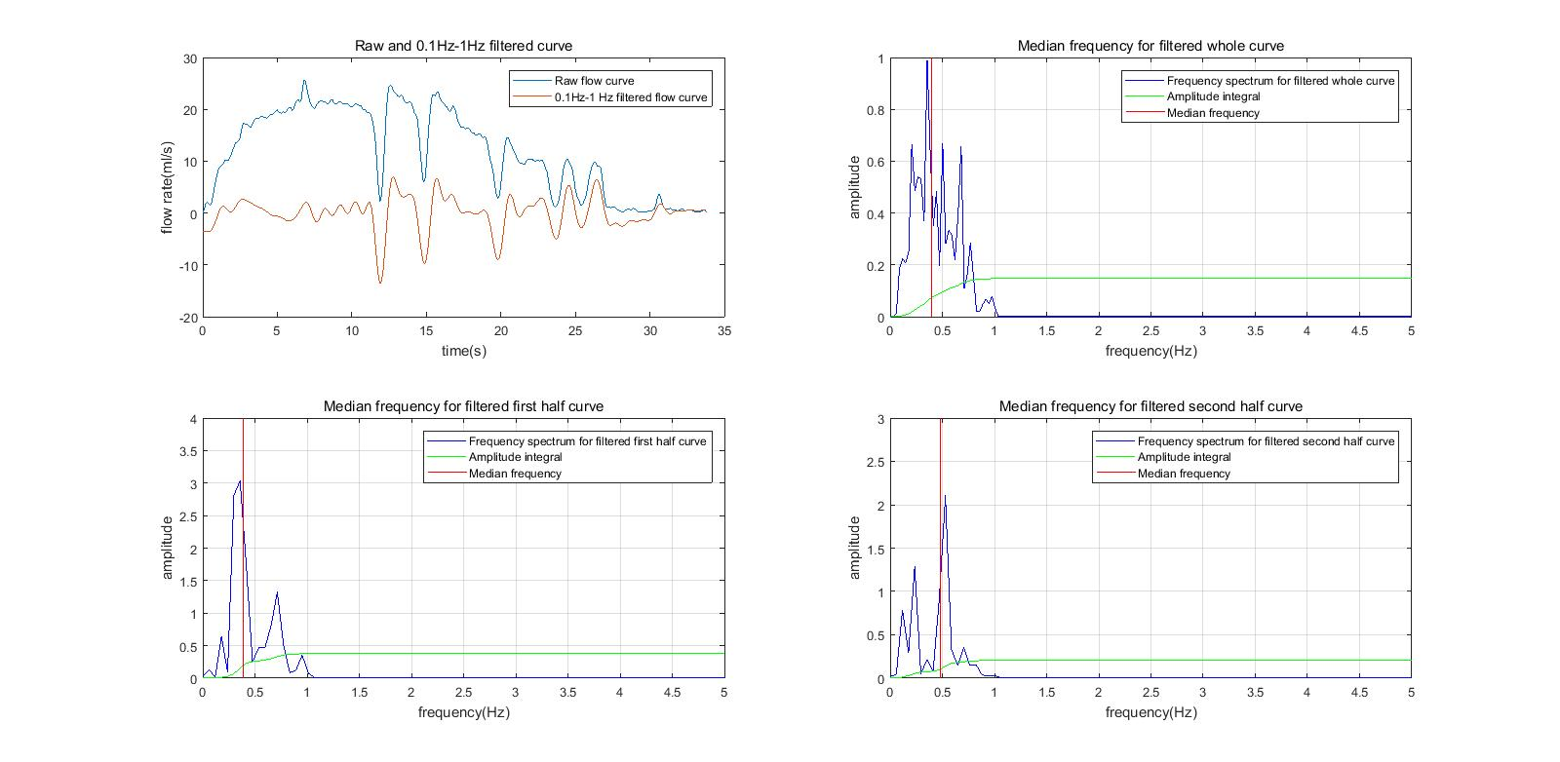
ICI-RS Pre-meeting
Median power frequency analysis
Kaiser window filter with 0.1Hz-1Hz bandpass frequency
-40 dB attenuation on both stopband
FFT to generate frequency spectrum
Calculate median power frequency in power spectrum

Slide 6
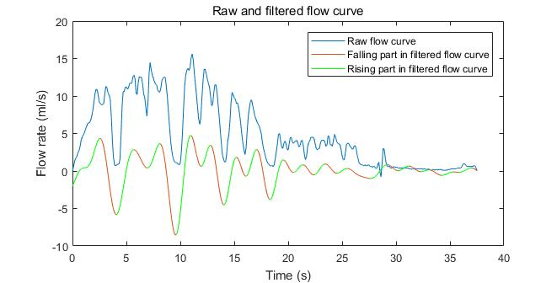
ICI-RS Pre-meeting
Sum of amplitude change in rising slopes in filtered curve
Kaiser window filter with 0.1Hz-1Hz bandpass frequency
-40 dB attenuation on both stopband
Calculate the sum of amplitude changes in rising slope

Slide 7
ICI-RS Pre-meeting
Interpretation of Results
273 male urine flow rate data analysed including 104 BOO, 93 DU and 76 BOO&DU free data for reference
Blind during analysing procedure
UFR data pre-processed by the threshold value of 0.5ml/s
Multivariance of variates analysis: bundling multiple non-invasive parameters into a weighted linear combination variable
 | P value | AUC | Sensitivity | Specificity
Peak counting analysis | <0.0001 | 0.673 | 63.4% | 67.3%
Q_{max} | <0.0001 | 0.634 | 49.5% | 78.1%
Q_{ave} | <0.0001 | 0.672 | 72.0% | 55.8%
Median power frequency | <0.001 | 0.663 | 38.7% | 90.4%
MANOVA analysis* | <10⁻²³ | 0.872 | 73.1% | 84.6%
CART analysis** | Diagnosing accuracy: 82.2% |  | 89.2% | 76%
*Multivariance use 25 non-invasive urodynamic parameters
**CART training procedure was performed by criteria of minimum number of 20 in parent node and 5 in child node

Slide 8
ICI-RS Pre-meeting
Further research plan:
Analyse more male flow data for reliable result
Coefficients assigned to each parameter are not fixed, neural network for automatically updating on the coefficients
Validation of MANOVA/CART analysis result
Exploring other non-invasive parameters
Thank You

