Slide 1
‘Corporate Liability for Economic Crime: A Critical Review’
‘Regulation of the banking sector: Challenges and emerging issues’
Bristol University
Friday 11 May 2018
Professor Nicholas Ryder
University of the West of England

Slide 2
Abstract
This presentation has two aims:
Critically considers the responses towards tackling corporate financial crime in the United States of America (US).
To analyses the United Kingdom’s (UK) efforts to tackle corporate financial crime and then compares them with the US.

Slide 3
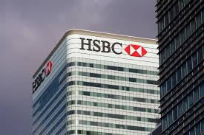
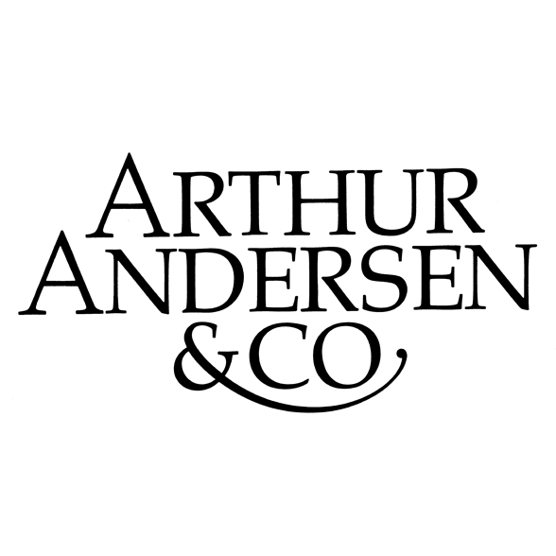
A Rogues Gallery?

Slide 4
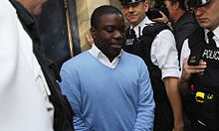
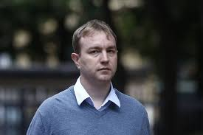
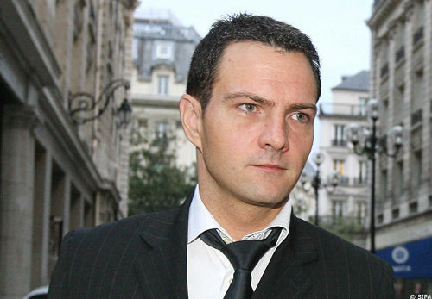
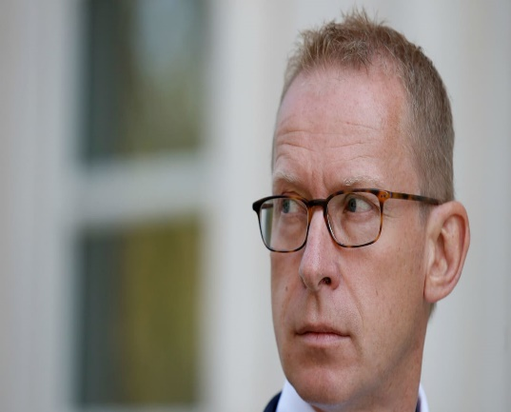
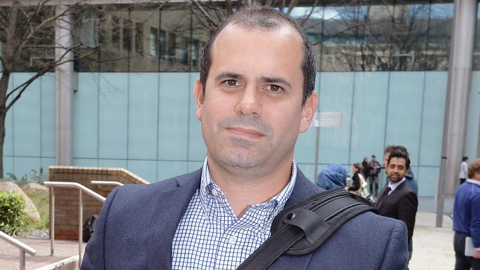
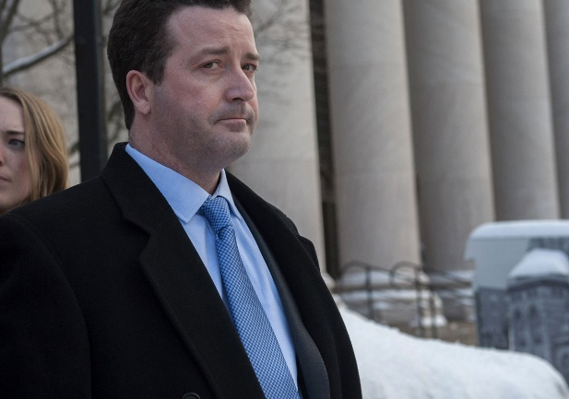
Low hanging fruit?

Slide 5
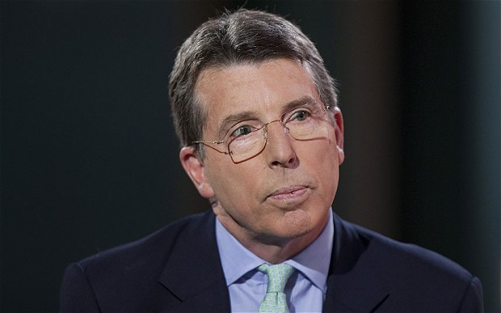
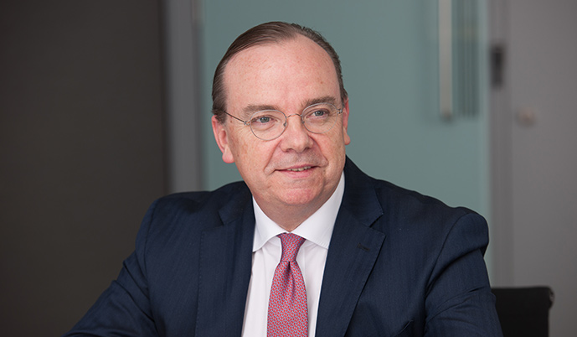
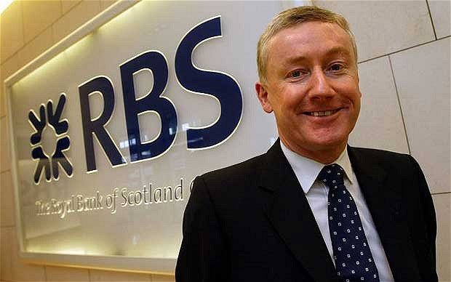
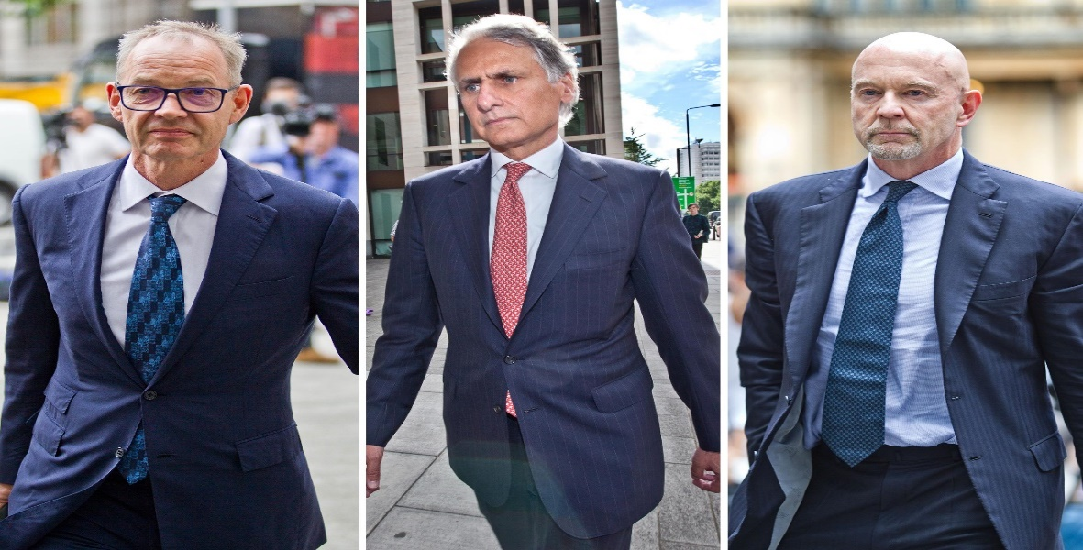
The untouchables?

Slide 6
United States of America
The US has an aggressive stance towards financial crime,
money Laundering,
fraud,
terrorist financing,
insider trading and
market manipulation.

Slide 7
United States of America
Savings and Loans Crisis:
collapse of over 2,100 financial institutions and losses exceeding $150bn,
Over 1,000 senior executives being convicted of fraud
2007/2008 Financial Crisis:
Losses exceeding £30tn
Over 1,100 fraud convictions
But what about corporations?

Slide 8
United States of America
Corporate liability can traced to:
the decision of the US Supreme Court in New York Central & Hudson River Rail Road Company 212 U.S. 481 (1909) and
the introduction of the Elkins Act (1903)
Notes:
Under the Elkins Act 1903, the acts and omissions of an officer acting within the scope of his employment was considered to be those of the corporation.

Slide 9
United States of America
Arthur Andersen LLP (AALLP):
The firm was one of the ‘big five’ accountancy firms,
AALLP conducted the auditing for Enron, which collapse in 2001 following allegations of fraud,
AALLP willingly yielded its practising licence as a Certified Public Accountants,
Convicted of obstruction of justice and
AALP filed for bankruptcy and 28,000 employees lost their jobs.

Slide 10
United States of America
Arthur Andersen LLP (AALLP):
US Supreme Court overturned conviction due to inaccurate jury directions by the US Department of Justice (DoJ):
Arthur Andersen LLP v United States 544 U.S. 696 (2005)
DoJ abandoned its traditional approach of prosecuting companies and now considers the impact on employees, investors and the economy

Slide 11
United States of America
The evolution of Deferred Prosecution Agreements (DPA):
EF Hutton
Drexel Lambert
Salomon Brothers
Prudential Securities Incorporated
HSBC

Slide 12
The United Kingdom
Courts have accepted that the common law should provide a remedy for individuals against the actions of companies:
Great Northern Rail Way Co Case (1846) 9 Q.B. 315
DPP v Kent and Sussex Contractors Ltd 1 K.B. 146,
R v ICR Haulage Co Ltd [1944] K.B. 551; (1944) Cr. App. R. 31.
Moore v Bresler Ltd [1944] 2 E.R. 515 and
Lannard’s Carrying Co Ltd v Asiatic Petroleum [1915] A.C. 705 HL

Slide 13
The Common Law Rules
Tesco Supermarkets Ltd v Nattrass [1972] A.C. 153 and the identification doctrine:
House of Lords determined that corporate criminal liability could be imposed if the prosecution could prove that the person had “the directing mind and will of the company”.

Slide 14
The Bribery Act 2000
The Bribery Act 2010 introduces a new form of corporate criminal liability:
Failure of commercial organisations to prevent bribery (s.7),
a commercial organisation can be found guilty of an offence if a person associated with the organisation bribes another, intending to obtain or retain business or a business advantage for that organisation.

Slide 15
The Bribery Act 2000
The Crime and Courts Act 2013 (Schedule 17)
Deferred Prosecution Agreements:
Standard Bank Plc (2015),
XYX Ltd (2016),
Tesco (2017) and
Rolls Royce (2017).
Favoured enforcement mechanism of the Serious Fraud Office

Slide 16
The Criminal Finances Act 2017
Corporate failure to prevent criminal facilitation of tax evasion (ss. 44-52)
The offence of corporate failure to prevent criminal facilitation of tax evasion applies to:
Companies, partnerships and LLPs.
It does not apply not to:
individuals, as they can be prosecuted under existing laws

Slide 17
The Financial Services and Markets Act 2000
Withdraw a firm’s authorisation,
Prohibit individuals from carrying on regulated activities,
Suspending firms and individuals,
Issuing fines against firms and individuals,
Applying to the courts for injunctions,
Restitution orders,
Winding-up and other insolvency orders and
bringing criminal prosecutions to tackle financial crime.

Slide 18
The Financial Services and Markets Act 2000
Senior Managers and Certification Regime:
Places the management of financial crime risk within the senior management of financial institutions,
focused on holding individual managers to account for certain failings,
Could this be used to identity who has the controlling mind in the regulated sector?

Slide 19
Corporate Liability for Economic Crime
Ministry of Justice Call for Evidence (2017)
Five options for reform:
Amend Identification doctrine,
Strict (vicarious) liability,
Strict (direct) liability,
Failure to prevent as an element of the offence and
Investigate the possibility of regulatory reform on a sector by sector basis

Slide 20
Findings: United States
DoJ favours prosecuting the employees of corporations,
DoJ has abandoned efforts to impose the corporate death penalty,
It has moved towards negotiated settlement,
DPAs have done little to quell corporate misbehaviour, and
DPAs must be used with financial penalties, civil litigation and the prosecution of errant employees.

Slide 21
Findings: United Kingdom
UK efforts to tackle financial crime concentrated on individuals,
Failure to prevent corporate offences introduced,
SMCR could be used to overcome the restrictive interpretation of the doctrine of corporate criminal,
FCA financial penalties unfavourable when compared the US,
The window of self-reform is closing and corporations must learn to self-regulate and
corporations will continue to operate in an ecosystem of deviance.

