Slide 1
The political is personal: The impact of Brexit on UK undergraduates’ perceptions of career
Dr. Marjorie McCrory, University of the West of Scotland
Theresa Thomson, University of the West of England

Slide 2
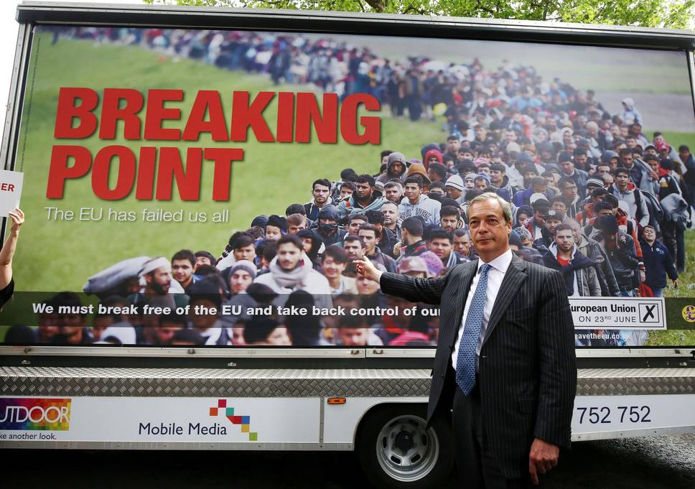
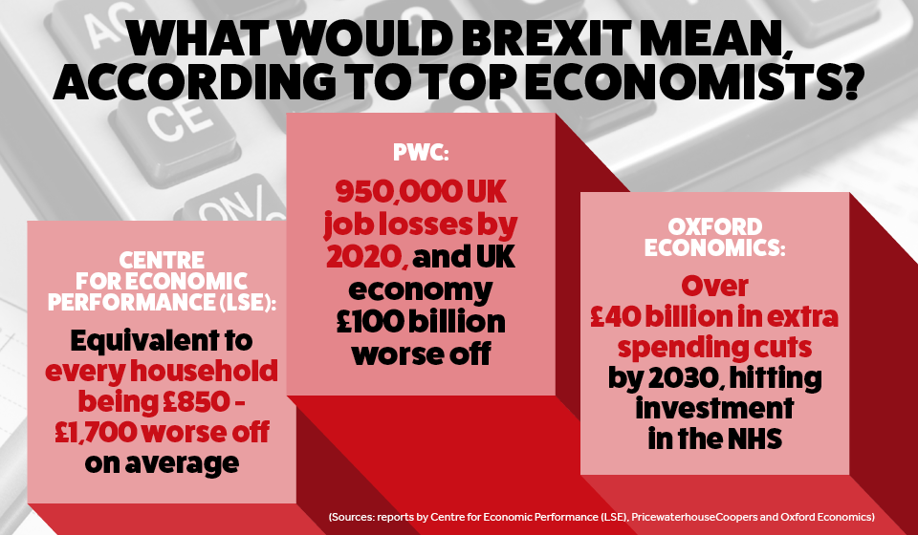
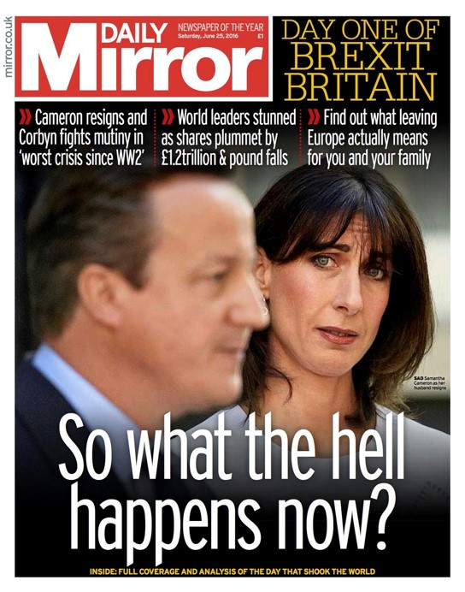
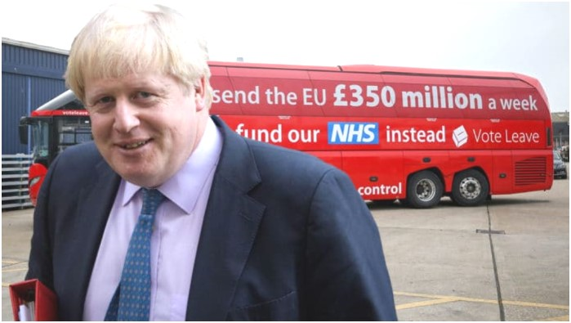
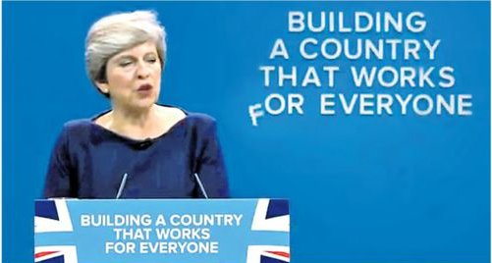

Slide 3
Research Study
What?
How?
How do final year UK domestic students view their options for future employment and further study, during a time of political uncertainty?
How has students’ decision-making been impacted by the Brexit vote?
15 final year UK students, from a cross section of courses at UWE Bristol
In-depth, semi-structured interviews
Interview transcripts – thematically analysed

Slide 4
Is everything going to go wrong now?
Socially…you’re kind of mediaeval Britain again.
Now it’s what can I do? What can I contribute?
It begs the question, is this a state I want to reside in?
I want to be this kind of teacher, because of Brexit.
It’s made me more passionate
…it’s suddenly all gone black and white and cold and scary
There will be impacts that are positive…. it’s about being adaptable and resilient to change.
I had some bridge into Europe. Now a lot of those doors are closed off.
values and emotion
feeling uncertain about the future
focussed & deeper career thinking
frustration with the UK
impact of Brexit on career thinking
feeling uncertain about the future
(anxiety)
focussed & deeper career thinking
(values)
frustration with the UK
(anger)

Slide 5
What can we learn from this?
the findings show the impact of the wider world we live in, including the impact of political events, on potential career choice
values and emotion may drive the desire to make positive life/career choices in a post-Brexit world
economic uncertainty is balanced by some optimism and acceptance of adaptability

Slide 6
Implications for practice?
Is it time to move away from the (popular) psychological approach of career guidance?
A shift in practice to place values centre stage and acknowledge the potential impact of social and political context ?
An approach which is:
Part psychological
(e.g. Who am I? What motivates me? What do I want to achieve in life?);
Part sociological
(e.g. What sort of society do I want to live in? What do I want to change? What is stopping me?)
Deeper ‘career conversations’ to help our students navigate their way in a post-Brexit world, and challenge the status quo and make a meaningful impact.

