Slide 1
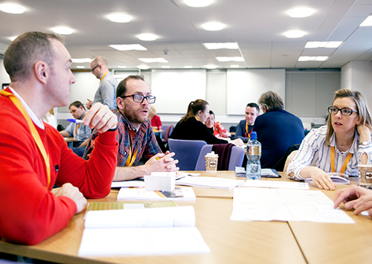
Building Learning Communities to Enhance Assessment
Jenny Hill
Associate Professor
Harry West
Graduate Tutor
7 June 2018
Image courtesy of Advance HE

Slide 2
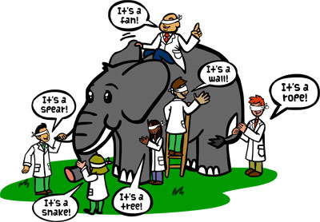
Session outline
1. Context
2. What is the purpose of assessment & feedback in HE?
3. Reconsidering assessment and feedback in HE
4. Improving your assessment literacy and that of your
students through learning communities
5. Programme focussed assessment
to enhance practice
6. Overall implications for practice

Slide 3
1. Context
assessment and feedback are arguably more influential to the learner experience than teaching (Hattie & Timperley, 2007)
But …
they receive consistently low satisfaction scores in national student surveys around the world (Nicol, 2010; Yang & Carless, 2013)
assessment standards are being challenged across the sector

Slide 4
Breakout activity 1
What is the purpose of assessment & feedback in HE?
share some examples with us
(5 minutes)

Slide 5
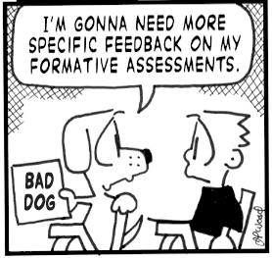
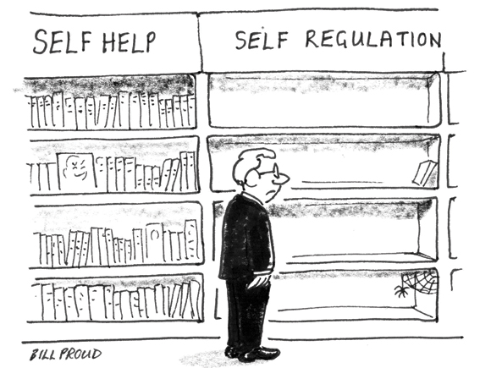
2. Assessment and feedback purpose
a) Assessment OF learning
(to demonstrate achievement)
b) Assessment FOR Learning
(to give feedback on L & T)
c) Assessment AS Learning
(to self-regulate)

Slide 6
Breakout activity 2
What key issues are you grappling with re A & F?
share some examples with us
(5 minutes)

Slide 7
3. Re-considering A & F
What key issues is the sector grappling with re A & F?
Authentic assessment
- Real world, live projects
- Co-production
Inclusive assessment
- Student-centred learner
analytics / dashboards
- PLEs
Building assessment self-regulation
- Reflective practition & responsibility
- Lifelong learning
Grade inflation
- Calibrating
standards
Building self-efficacy
- Positive mental wellbeing

Slide 8
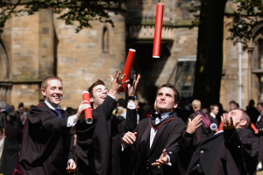
we challenge you to …
reimagine assessment and feedback …
to promote the knowledge and skills (graduate attributes) needed for academic success and twenty-first century careers
Whilst …
enhancing NSS and TEF metrics

Slide 9
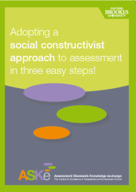
4. Improving assessment literacy
Dialogic feed forward assessment
involve students in dialogic assessment activities
students use feedback from peers or themselves as part of an ongoing process of developing self-regulation
(Nicol & Macfarlane-Dick, 2006)
any assessment that does not build students’ capacity to effectively judge their work is unsustainable
(Boud & Malloy, 2013)
see Oxford Brookes ASKe leaflet
leaflet

Slide 10
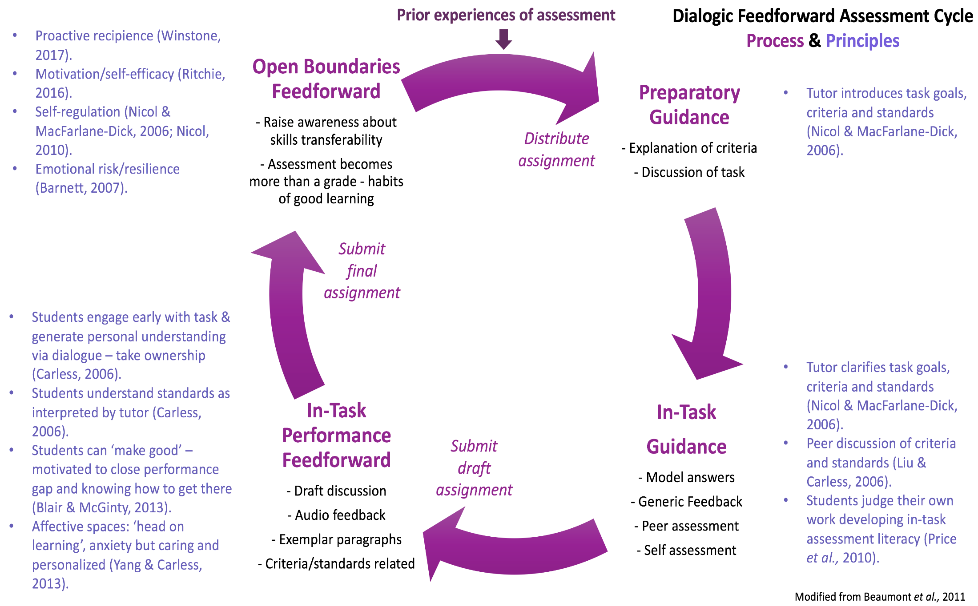
Example dialogic feedforward in a FET module at UWE
Notes:
Heutagogy (self-determined learning) (See Hase, S. & Kenyon, C. (Eds) (2013) Self-Determined Learning: Heutagogy in Action. London: Bloomsbury Academic) – double-loop learning process
Heutagogical capabilites: self-sufficiency in learning, reflexivity, applicability of what is learnt, positive learning values

Slide 11
Selected results
conversation compels students to engage critically with their work:
‘when I have had drafts handed back to me and it’s just written over, either I don’t understand what they are trying to say, or it’s not clear enough. I can ask you questions if we’re talking to each other about it, it’s easier to see things … It’s definitely better to talk about it’ R7
‘I’ve had it before where you get electronic feedback and you might not be sure what some of the comments mean … being able to discuss it is important. You get that progress and can discuss how you can change it as opposed to just saying this is wrong’ R9
Notes:
Students can decode feedback: gain greater understanding of the written feedback through verbal clarification and use of exemplars
Cathartic spaces – ‘coming clean’ with progress,
Affective space - Being judged – head-on learning but they have the emotional capacity to cope with this

Slide 12
task-specific behaviour … and self-regulation
‘it helped me to realise how to critique my own essays because I was able to sit down with you and go through the essay and know exactly why you were commenting on something … It allows me now to see in other essays the same things I’m doing’ R10
‘Now, I feel like I can evaluate at different stages throughout assessment and therefore make changes. Before, I just skimmed over work, handed it in, and got feedback at the end without really thinking about it’ R29
Notes:
Nicol’s self-regulation
Baxter-Magolda’s self-authorship

Slide 13
Self-efficacy - students display stronger beliefs in their capabilities to accomplish tasks in future
Altered their learning behaviour:
‘I’ve altered the way I approach other modules … like preparing essay plans for exams … when I was doing my plans I said ok that needs more, that needs a reference, because I had thought about it for the Ecology essay’ R28
Enhanced NSS / TEF metrics
all students rated the module as giving them high quality feedback: detailed, conversational, personalised, timely, multi-faceted
Notes:
R28 student got 68% for the desert exam

Slide 14
Enhanced performance
Significantly higher marks 2015-17 v 2011-13
(p = < 0.0001)
Band (%) | 2011-2012 (%) | 2012-2013 (%) | 2015-2016 (%) | 2016-2017 (%)
0-39 (inc. NS) | 16 | 5 | 0 | 5.5*
40-49 | 9 | 14 | 3* | 5.5*
50-59 | 34 | 38 | 28 | 17
60-69 | 41 | 38 | 58 | 58
70-100 | 0 | 5 | 11 | 14
Number (n) | 32 | 37 | 36 | 36
Average Ecology mark 4.5% higher than average mark for other second year optional modules (p = 0.01)
* Did not have a
meeting
Dialogic assessment
Current research: dialogic spaces to consciously encounter emotion
and enhance positive mental wellbeing
Notes:
Mean mark increase 2011-2013 to 2015-2017 of 7%: 56% to 63%
Increase seen most in moving students from 2:2 to 2:1. Reduction in students failing module. Increase in first class marks.
Mean final year mark for students taking Ecology (n=31): 61.7%
Mean final year mark for students not taking Ecology (n=12): 57.2%
Difference of 4.5% again but not significant at p=0.05

Slide 15
5. Programme focussed assessment
assessment of student learning specifically designed to address key programme learning outcomes
enables:
a planned and coordinated approach to the design and inclusion of assessments across a programme
an appropriate range of assessments ‘of’, ‘for’ and ‘as’ learning
evaluation of assessments in an integrated and longitudinally oriented manner
collaboration between various contributors to the programme
builds learning communities - allows assessment calibration

Slide 16
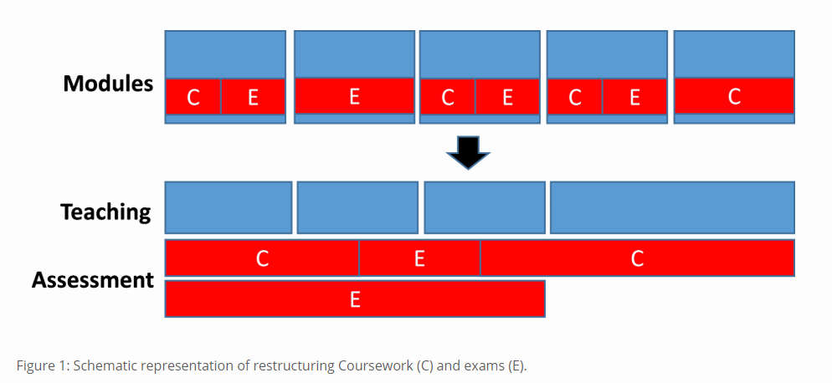
Integrated Programme Assessment at Brunel
decoupled assessment from modules
formative work supports fewer summative assessments

Slide 17
Why do we need to calibrate assessment judgement?
Gov. introduced the Teaching Excellence Framework (TEF) in 2016 to recognise and reward excellent teaching in UK
DfE introduced a grade inflation metric to the TEF in September 2017:
‘Assessors should not consider the proportion of 2:1s and firsts
to provide evidence as to the quality of teaching’
Why? Because the profile of UK degree outcomes has shown considerable upward drift over recent decades

Slide 18
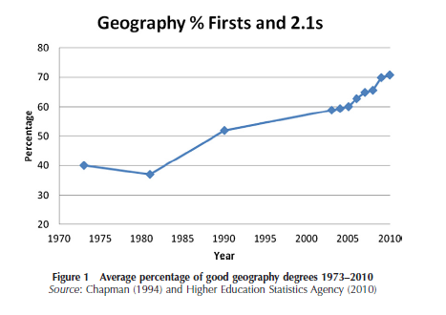
percentage ‘good’ geography degrees in UK risen from 40% in early 1970s to 71% in 2010 and 80% in 2016
(Source: Thornes, 2012 and RGS unpublished)
assessors must understand and consistently apply academic standards to ensure comparability of outcomes
Notes:
Social Moderation involves discussion of grading but is generally focused on agreeing marks
Calibration is about shared knowledge of standards, often achieved through social moderation processes in order to create ‘calibrated’ academics

Slide 19
Breakout activity 3
Approaches to reduce variation in judging academic standards
Peer scrutiny of module assessment Pre-teaching briefing to module team on assessment expectations Pre-teaching module team exercises to mark and discuss exemplar assignments Use of a detailed marking scheme Blind double-marking of work, resolving differences by discussion Moderation by comparing averages and distribution of marks given by each marker in the team External examining Markers having experience as external examiners Markers being members of a learned society or professional body Markers being familiar with national reference points
Which are the best activities to assure standards & why?
Notes:
“Consistent assessment decisions among assessors are the product of interactions over time, the internalisation of exemplars, and of inclusive networks. Written instructions, mark schemes and criteria, even when used with scrupulous care, cannot substitute for these” (HEQC, 1997)
‘calibrated’ academics … are able to make grading judgements consistent with those which similarly calibrated colleagues would make, but without constant engagement in moderation. The overall aims are to achieve comparability of standards across institutions and stability of standards over time (Sadler 2012)

Slide 20
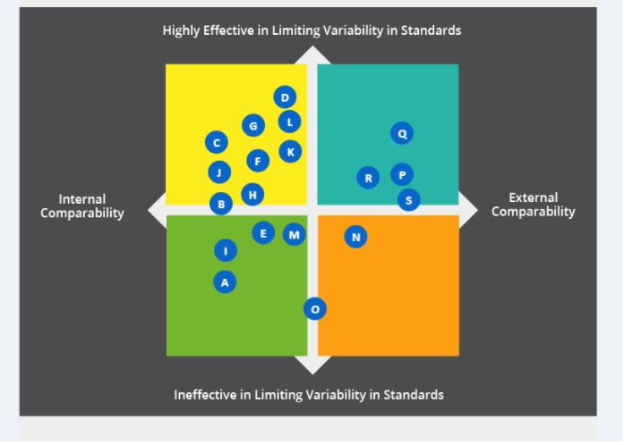
One example from an experienced HE academic …
Ineffective (?):
A = Peer scrutiny of module assessment
E = Second marking of all work
I = Use of a detailed marking scheme
M = Moderation by comparing staff marks
Effective (?):
P = External examining
Q = Markers have externally examined
R = Markers are members of a learned society
S = Markers familiar with national benchmarks

Slide 21
6. Implications for practice
To rise to the challenges of A & F in future, we could:
Work actively in programme and/or department teams, reaching out to disciplinary communities of practice
Deliver curricula with coherent assessment objectives and standardised grading schemes to facilitate developmental feed-forward
Undertake calibration activities in programme teams to help staff gain shared understanding of different levels of work
Deliver more feedback before formal grading, meeting with students or establishing peer feedback
Use assessment dialogue to support positive mental wellbeing

Slide 22
Any questions?
Jennifer.Hill@uwe.ac.uk
Jenny Hill staff profile
Harry.West@uwe.ac.uk
Harry West staff profile

Slide 23
Reference list
Beaumont, C., O’Doherty, M. & Shannon, L. (2011) Reconceptualising assessment feedback: a key to improving student learning? Studies in Higher Education, 36, 671-687.
Boud, D. & Molloy, E. (2013) Rethinking models of feedback for learning: the challenge of design, Assessment & Evaluation in Higher Education, 38, 698-712.
Hattie, J. & Timperley, H. (2007) The power of feedback. Review of Educational Research, 77, 81-112.
Nicol, D. (2010) From monologue to dialogue: improving written feedback processes in mass higher education. Assessment and Evaluation in Higher Education, 35, 501-517.
Nicol, D. & Macfarlane-Dick, D. (2006) Formative assessment and self-regulated learning: a model and seven principles of good feedback practice. Studies in Higher Education, 31, 199-218.
Thornes, J.E. (2012) External examiners and the continuing inflation of UK undergraduate geography degree results. Area, 44, 178-185.
Yang, M. & Carless, D. (2013) The feedback triangle and the enhancement of dialogic feedback processes. Teaching in Higher Education, 18, 285-297.

