Slide 1
Demystifying Practitioner Led Research AMHP Leads Conference 2018
Dr Sarah Vicary – Open University
Dr Kevin Stone – UWE, Bristol
@sao_sarah
@kevinstoneuwe
@AMHPResearch
@AMHPResearch

Slide 2
Contemporary research foci
The independent review of the Mental Health Act: Interim report May 2018, page 17
Commissioned academic literature reviews to gather evidence on themes including: interventions to reduce compulsory admissions, clinical and social predictors of detentions in Europe BUT not about the role or effectiveness of the AMHP/ASW.
In addition commissioned public bodies and two mental health trusts to conduct detailed data analysis to explore the issues of variation in detention rates, re-detention, comparisons of informal and formal admissions …..and are also considering the impact of characteristics including ethnicity, age, gender and protected characteristics)
Notes:
Should we mention our bid to NIHR (Social Care) which is to look specifically at least restrictive alternative. If the advisory group was able to lend their support to us that would be hugely helpful).

Slide 3
Contemporary research foci
CQC undertook a collaborative review with national partners and local AMHPs to identify themes that support or challenge the effective running of AMHP services informs about the effective delivery of AMHP services an also the challenges and barriers, March 2018, page 2:
AMHPs keen to share examples of innovative practice to improve focus on prevention and community provision and that the AMHP role is recognised as being the local experts in mental health legislation.
Framework for MH research – DH, 2017, page 16
Research and innovation can develop and evaluate social, prevention and other interventions.
That the research base, whilst of high quality, is relatively small and geographically concentrated.

Slide 4
Contemporary research foci continued
Social work for Better Mental Health (run by DHSC since 2016)
a project that gives a specific locality to review how mental health social work operates in their area, including AMHP. It wishes to establish a community of practice
AMHP study (King’s College London): Who wants to be an AMHP
due to report (Sarah on Advisory Group)
Not new! Richardson committee, 1999 page 48
Until we have the results of the current research we have no data on how, in practice, ASWs exercise their independence
Quirk et al. 2000 was that first qualitative research
Identified multiple roles, queried independence
Is a growing body of others (will return to this later)

Slide 5
Ethical challenges and research design
Comparative routes to ethical governance for AMHP studies.
No central centralised data set of AMHP workforce or professional identities (CQC 2018).
Time, methods, frameworks within local authorities to undertake research and Publish, building a research culture!
Research is possible with the right support.
Needs service user & carer involvement / leadership.
Inter-professional approaches to research.

Slide 6
Create a network – @AMHPResearch ‘AMHP Research Network’
There are a growing number of academics & doctoral students focusing on AMHP related research in various localities. Presenting at national and international conferences.
Stone, K (2018) Approved Mental Health Professionals and Detention: An Exploration of Professional Differences and Similarities, Practice Social Work in Action.
Vicary, S (2017) An Interpretative Phenomenological Analysis of the Impact of Professional Background on Role Fulfilment: a study of approved mental health practice PhD thesis University of Manchester
Remains a focus on need for evidence, not just anecdotal experience.
Building upon AMHP researchers’ experience and the
impact of research on practice.
Sharing of best practice and idea’s.
Joint bidding for research money, building a research culture!

Slide 7
AMHP Research Collaboration
@AMHPResearch
@kevinstoneuwe
@sao_sarah
Kevin2.stone@uwe.ac.uk
sarah.vicary@open.ac.uk

Slide 8
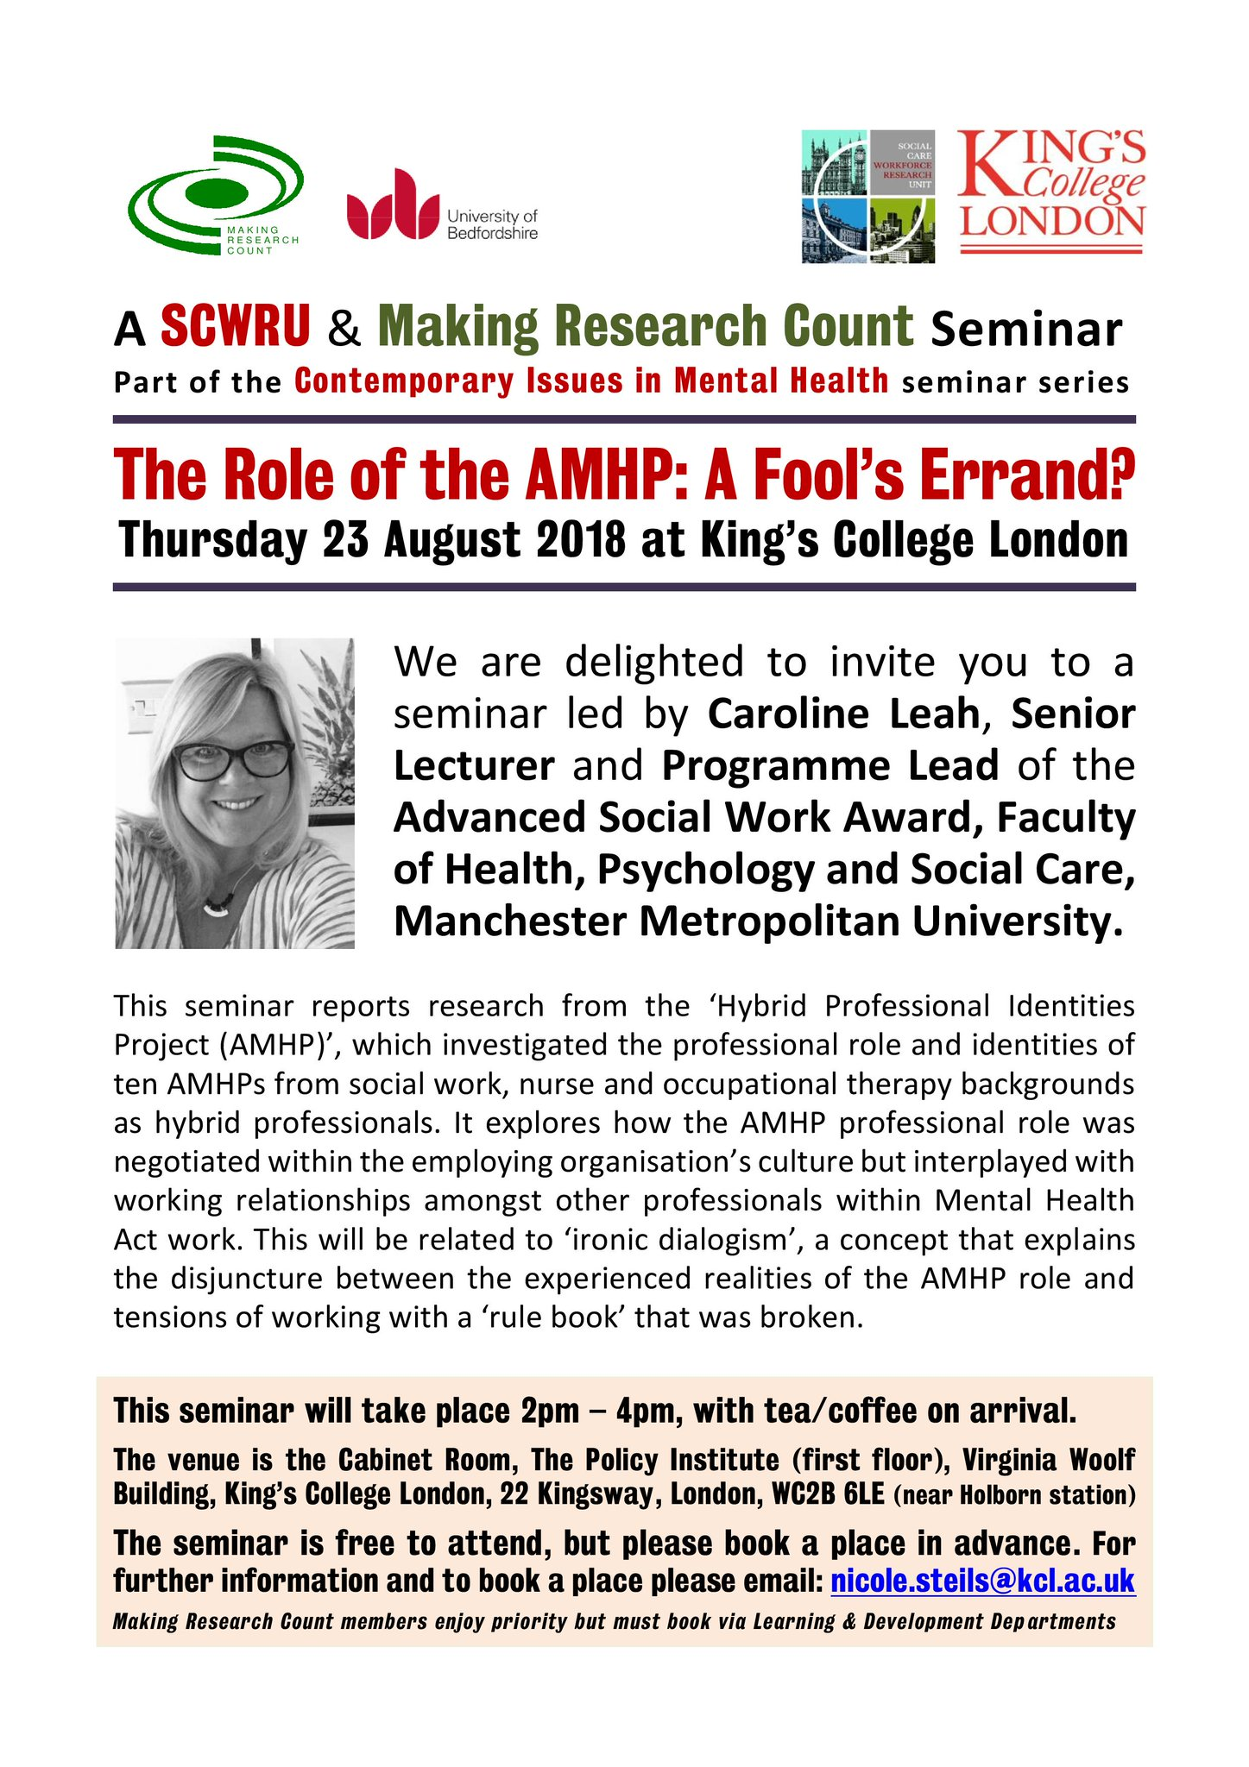
Mental Health Policy Practice & Education Group

