Slide 1
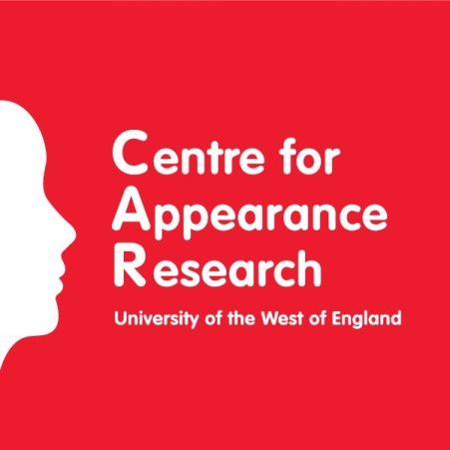
Therapeutic writing for eating disorders: A systematic review
Christine Ramsey-Wade , Dr Heidi Williamson and Dr Jane Meyrick
Department of Health and Social Sciences
HEADLINES
We can’t say yet whether therapeutic writing is an effective intervention for eating disorders
There is enough good and relevant research showing benefits to warrant exploring this intervention further
WHAT IS IT?
Therapeutic writing (TW) is expressive or creative writing for a therapeutic purpose
Examples: letter writing, journaling, writing poetry
WHY RESEARCH IT?
Therapeutic writing is already being used in clinical settings and prevention research
Writing letters to ‘anorexia my enemy / anorexia my friend’
As an alternative control group, with positive, non-significant results
Therapeutic writing has been recommended by some as part of a stepped care model of treatment
There is a weight of published clinical experience indicating benefits for this client group
METHOD
Records identified through database searching (n = 595)
PRISMA flow diagram
Records after duplicates removed (n = 574)
Abstracts screened (n = 162)
Abstracts excluded as not on therapeutic writing (n = 114)
RESULTS
No studies examining the effectiveness of therapeutic writing for eating disorders were found
3 high quality, 5 moderate quality and 1 poor quality quantitative studies of TW with subthreshold adult populations provided good to moderate evidence that writing can improve body image dissatisfaction or reduce disordered eating
Qualitative studies of TW document beneficial effects for some individuals recovering from eating disorders
Qualitative research indicates that TW can have a cathartic effect, enabling some to express and process difficult emotions in a containing way
Additional records identified through hand-searching (n = 2)
Full-text articles assessed for eligibility (n = 50)
Full-text articles excluded (n = 38):
Irretrievable sources
(n = 7)
Not on TW (n = 9)
Not research (n = 15)
Not on ED population (n = 1)
Writing intervention was not primary focus of the study (n = 6)
Quantitative studies (n = 8)
Mixed method study (n = 1)
Qualitative studies (n = 3)
Primary narrative quantitative analysis
Secondary narrative qualitative analysis
CONCLUSIONS
Expressive writing tasks may be able to improve outcomes in related areas, but this research needs replicating with larger samples
Quantitative studies of therapeutic writing with eating disorder populations are warranted
Emotional expression, group cohesion, de-centring or distraction could all be causal pathways
Correspondence: christine.ramsey-wade@uwe.ac.uk

