Slide 1
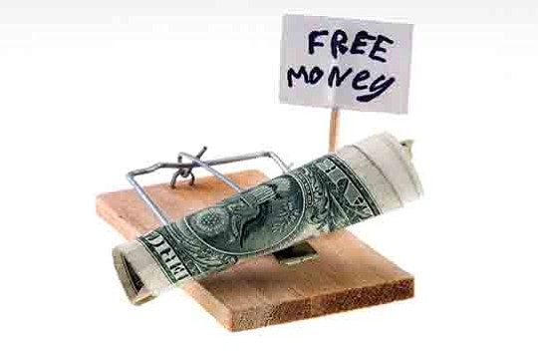
‘Predatory lending and consumer protection in the United Kingdom: time for a frank conversation’
Dr. Nicholas Ryder
Professor in Financial Crime
Bristol Law School
University of the West of England, Bristol
Tuesday 12th June 2018

Slide 2
Introduction
The objectives of this paper are to:
To provide an overview of the rapid growth of the United Kingdom’s (UK) consumer credit market,
To briefly critique the UKs regulatory approach towards the consumer credit market,
To determine if any lessons could be adopted from the United States (US)to review the relationship predatory lending and financial crime and
To provide a series of measures that could improve the levels of consumer protection in the UK.

Slide 3
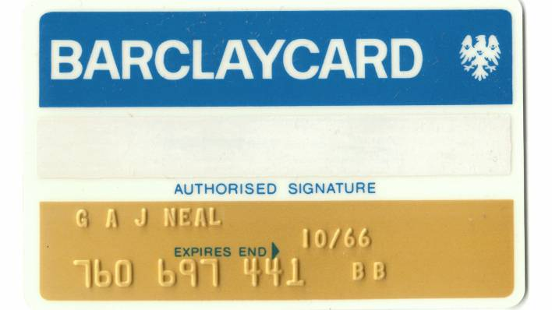
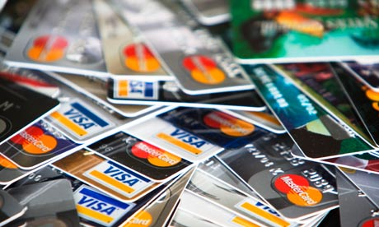
Evolution of the consumer credit market
Rapid expansion of use of credit in the 1960s and 1970s
Era of deregulation (1980s and 1990s)
Inadequate legislation
Pawnbrokers Acts 1872-1960
Moneylenders Acts 1900-1927
Hire-Purchase Act 1965
Crowther Committee on Consumer Credit (1971)
Extremely influential
Resulted in the enactment of the Consumer Credit Act 1974 and the Sale of Goods Act 1979

Slide 4
Evolution of the consumer credit market
Convenient Credit
Affordable Credit
There is a ‘dark side’ to convenient credit:
record levels of consumer debt,
increasing evidence of irresponsible lending practices,
the imposition of extortionate interest rates, and
ineffective legislative protection of consumers.
The ‘light side’ to convenient credit:
access to loans that are simple and transparent;
lenders that are sympathetic towards low income consumers’ circumstances;
simple loan application procedures;
small loans over a short period of time, and
affordable repayments

Slide 5
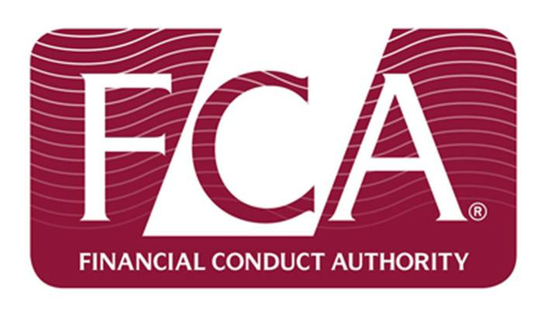
UK Regulation of Consumer Credit
The Consumer Credit Act 1974
Office of Fair Trading
The Consumer Credit Act 2006
Office of Fair Trading
Financial Services Authority
Financial Services and Markets Act 2000
Financial Conduct Authority

Slide 6
UK Regulation of Consumer Credit
Irresponsible Lending
Irresponsible Lending
increasing the credit card and overdraft limits without the customers consent,
not requesting proof of income when determining the level of credit to be offered,
providing loans and credit cards to the unemployed and people who are dependent on state benefits
the speed and simplicity of credit applications,
the prominence given to very high credit limits, the importance given to very low interest rates for cards,
incentives to use a particular brand of credit card, unwanted mail shots for credit card cheques, and
important information in small print and the indiscriminate targeting of direct mail shots.

Slide 7
UK Regulation of Consumer Credit
Irresponsible Lending
An unsatisfactory solution – self regulation
Voluntary Responsible Lending Index:
seeks to encourage best practice in credit lending
Banking Code:
“before we lend you any money or increase your overdraft, we will assess whether we feel you will be able to repay it” (2008, at para. 13.1)
Banking code redundant
From November 1 2009 retail bank deposit taking has fallen under the regulatory umbrella of the FSA
Banking Conduct of Business Sourcebook

Slide 8
EU Regulation of Consumer Credit
Consumer Credit Directive (2008/48/EC)
Article 8 Credit Worthiness:
“Member States shall ensure that, before the conclusion of the credit agreement, the creditor assesses the consumer's creditworthiness”
Implemented in the UK via several statutory instruments

Slide 9
Financial Conduct Authority
FCA regulating consumer credit market since April 1 2014,
Price cap and new rules on payday lending (July, 2017)
Restricting the way credit brokers charge fees (December, 2014)
Firms must lend responsibly and treat customers fairly (February, 2018)
New credit card rules (February, 2018)
Directing 20,000 people to free advice (September, 2016)
Overdraft Charges (May, 2018)
Enforcement activities (Financial Services and Markets Act 2000, s, 206(1))

Slide 10
Financial Conduct Authority
Financial Penalties
Financial Penalties
CFO Lending £34m (September, 2016)
Dollar Financial UK refund of £15.4m (October, 2015)
Bluefin Insurance Services Limited £4m (December, 2017)
Yorkshire Building Society £4.1m (October, 2014)
The Royal Bank of Scotland and NatWest £14.4m (September, 2014)
DB Mortgages £840,000 (February, 2011)
Deutsche Bank £840,000 and refund £1.5m (December, 2010)

Slide 11
Lessons from the United States of America
What is predatory lending?
“fraudulent, deceptive, and unfair tactics used to dupe people into mortgage loans they can’t afford” (Department of Justice, n/d)
“engaging in deception, fraud, manipulating the borrower through aggressive sales tactics, or taking unfair advantage of a borrower’s lack of understanding about loan terms” (US Department of Treasury, 2000)

Slide 12
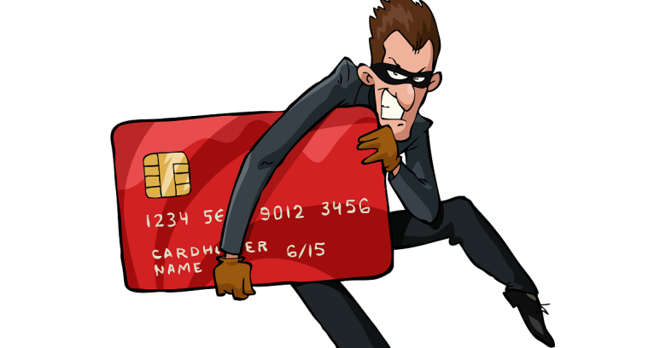
Lessons from the United States of America
Is predatory lending fraud?
American Financial Services Association v Toledo 830 N.E. 2d 1233, 1238 (Ohio Ct App. 2005), rev’d, 859 N.E. 2d 923 (Ohio 2006)
“the use of fraud or deception, manipulation of the borrower through aggressive sales tactics, or taking unfair advantage of a borrower’s lack of understanding of loan terms”.

Slide 13
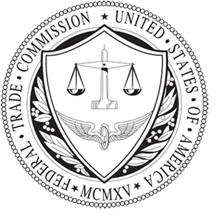
Lessons from the United States of America
Federal Trade Commission Act 1914
Equal Credit Opportunity Act 1949,
Fair Housing Act 1968
Truth in Lending Act 1968,
Real Estate Settlement Procedures Act 1974
Fair Debt Collection Practices Act 1977
Home Ownership Equity Protection Act 1994,
Mortgage Reform and Anti-Predatory Lending Act 2007 and
The Credit Card Accountability, Responsibility and Disclosure Act 2009.

Slide 14
Financial Sanctions
Financial Penalties
Financial Penalties
US Bank $200m (June, 2014)
Household International $484m (October, 2002)
Country Wide Finance $335m (December, 2011)
Bank of America £16.65bn (June, 2014)
Wells Fargo $1.2bn (August, 2016)
Wells Fargo $175m (July, 2012)
M&T Bank $64m (May, 2016)
Deutsche Bank $7.2bn (January, 2017)
Credit Suisse £5.28bn (January, 2017)

Slide 15
Conclusions/Suggestions/Recommendations
Predatory lending contributed towards the 2007/2008 financial crisis,
Predatory lending practices have risen since the emergence of the financial crisis,
The UK consumer credit market has grown at an unprecedented rate,
Complex credit products has pushed the boundaries of consumer understanding,
These practices have created the perfect economic environment that has then been exploited and misused by unprincipled lenders,
Attempts to legislate and regulate predatory lending have proved to be largely ineffective,
Self regulation is an ineffective form of regulation,
Levels of fines in the US are higher than the UK,
FCA to use broader range of its enforcement powers,
Does predatory lending breach the Fraud Act 2006 or the common law offence of conspiracy to defraud?

Slide 16
Suggested Reading
Brown, S. ‘Consumer credit relationships - protection, self-interest/reliance and dilemmas in the fight against unfairness: the unfair credit relationship test and the underlying rationale of consumer credit law’ (2016) Legal Studies, 36(2), 230-257
Brown, S. ‘EU and UK consumer credit regulation: principles, conduct, and consumer protection: divergence or convergence of approach?’ (2015) European Business Law Review, 26(4), 555-580
Lomnicka, E. ‘The future of consumer credit regulation: a chance to rationalise sanctions for breaches of financial services regulatory regimes?’ (2013) Company Lawyer, 34(1), 13-21,
Lomnicka, E. ‘Unfair credit relationships: five years on’ (2012) Journal of Business Law, 8, 713-730
Ryder, N. The Financial Crisis and White Collar Crime: The Perfect Storm? (Edward Elgar, 2014),
Ryder, N. ‘The Financial Crisis and Financial Crime in the United Kingdom: a critical analysis of the response by Financial Regulatory Agencies’, (2017) Company Lawyer, 38(1), 4-14,
Ryder, N. ‘Predatory lending and white collar crime: a critical reflection’ (2014) International Company and Commercial Law Review, 25(9), 287-293, with Broomfield, K.

