Slide 1

LETS TALK ABOUT DROUGHT!
Students as research partners in creating resources for public engagement about climate change
Michael Horswell, Harry West & Nevil Quinn

Slide 2
Longitudinal curriculum
KNOWING AND UNDERSTANDING
THINKING AND DOING
CONFIDENT AND REFLEXIVE
REMEMBER
YEAR 1
UNDERSTAND
APPLY
YEAR 2
ANALYSE
YEAR 3
EVALUATE
CREATE
YEAR 2: Learning by deciding
Technical confidence, project-related decisions, methodological considerations, explanation
Professionalization emphasis
Transferable skills: literacy, numeracy, graphicacy, self-confidence, responsiveness, academic rigour
Reflexivity
YEAR 3: Learning by independent endeavour
Project design, definition and implementation, reflective learning
Independent, creative work
Identifying development priorities
Theoretical extension
Industry standards
Professional self-awareness, reflexivity
YEAR 1: Learning by doing
Technical confidence, technical decisions, exposure to new technology, use and interpretation of data
Strong content alignment
Focussed achievable tasks
Contextualized discussion

Slide 3
Authenticity
  Offering final year students the opportunity to participate in research activities, and to provide something of value to the ‘project sponsors’ was a natural fit with the approach to GIS learning and teaching
Life beyond university
“complex of knowledge, skills and other attributes that are tied to the objectives of instruction or otherwise valued by society”
Curriculum and practice
Content and instruction
Processes and products
Conditions
Figurative context
Messick (1994) in Palm, T. (2008) Performance assessment and Authentic Assessment: A conceptual Analysis of the Literature. Practical Assessment, Research & Evaluation 13(4): 1-11

Slide 4

Final Year Assessment
Teaching staff source student projects
Projects are then showcased to students
Students identify groups and their project
Students start work on their chosen project
Updates and meetings with project ‘sponsors’
Creation of ArcGIS Online Story Maps
Presentation at a conference style event
Online hosting of Story Maps

Slide 5

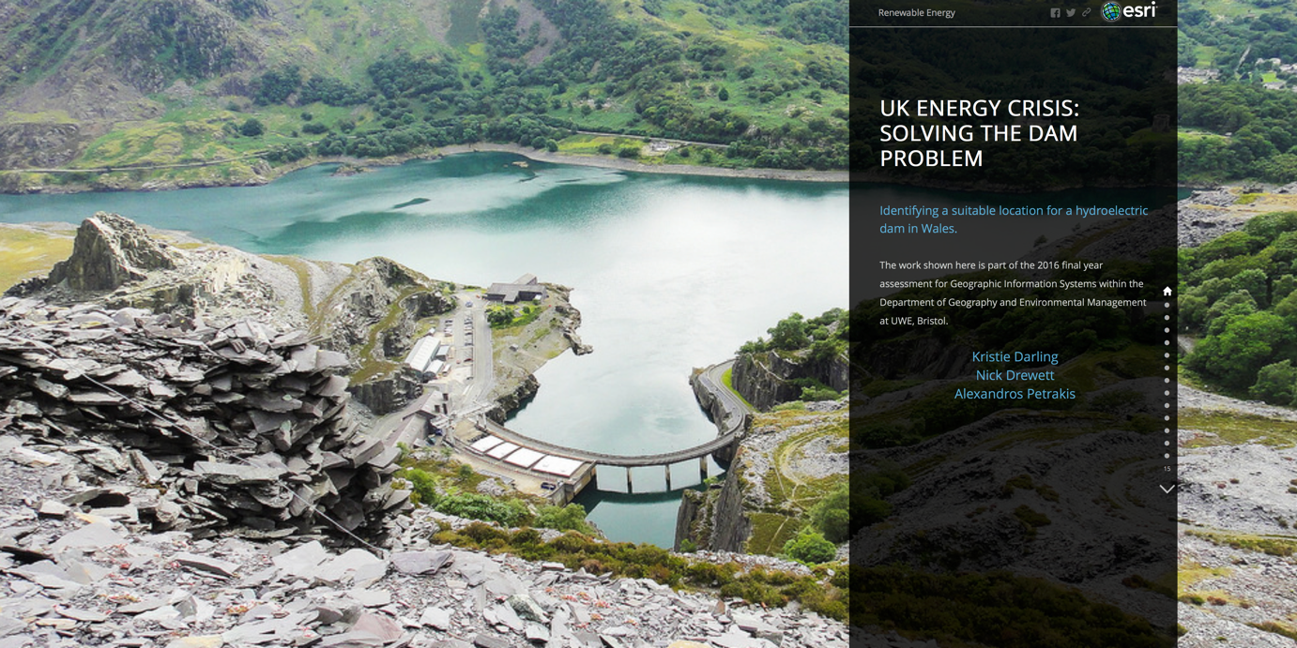
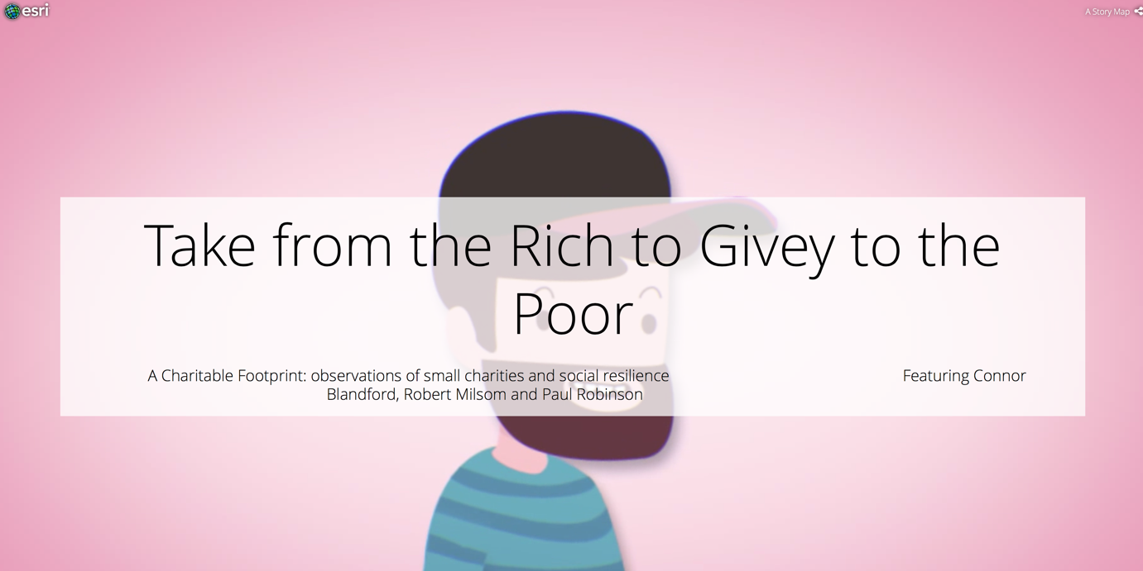


Slide 6
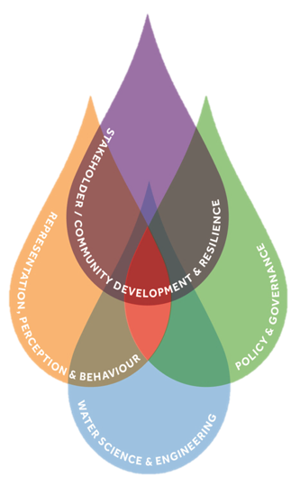


CWCR & UK Droughts & Water Scarcity Projects
Centre for Water, Communities & Resilience (UWE, Bristol)
An interdisciplinary research centre focussing on water related challenges including water security, extreme weather such as floods and droughts, as well as building socio-economic and community resilience
UK Droughts & Water Scarcity Programme (RCUK)
This is a six-year, 12 million pound research initiative funded by consortium of research councils aimed at improving understanding and response to dry weather, water scarcity and drought in the UK in the context of a changing climate.

Slide 7

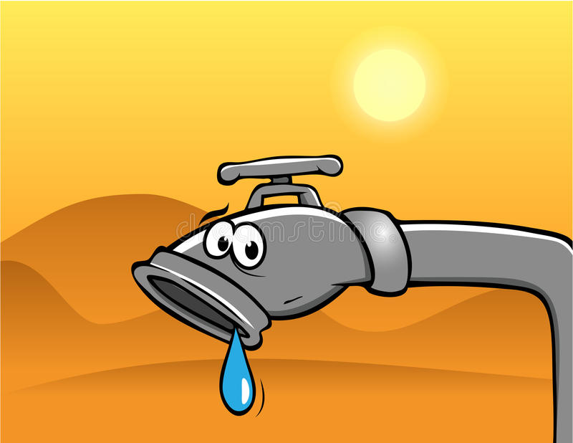

The Challenge…
WARNING!
DROUGHT

Slide 8
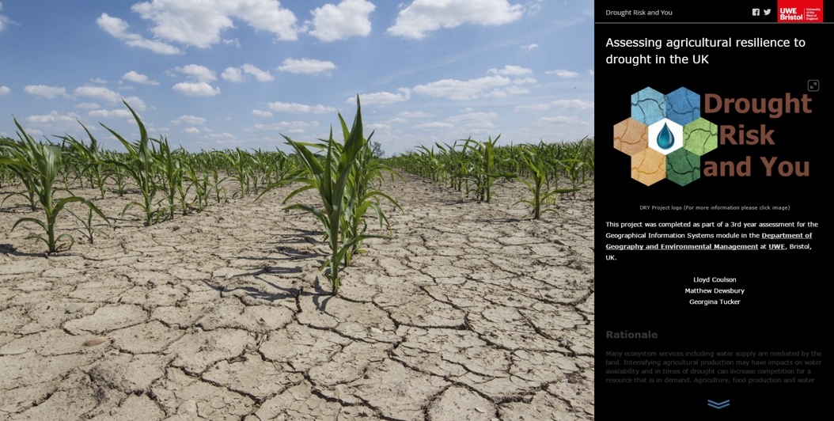
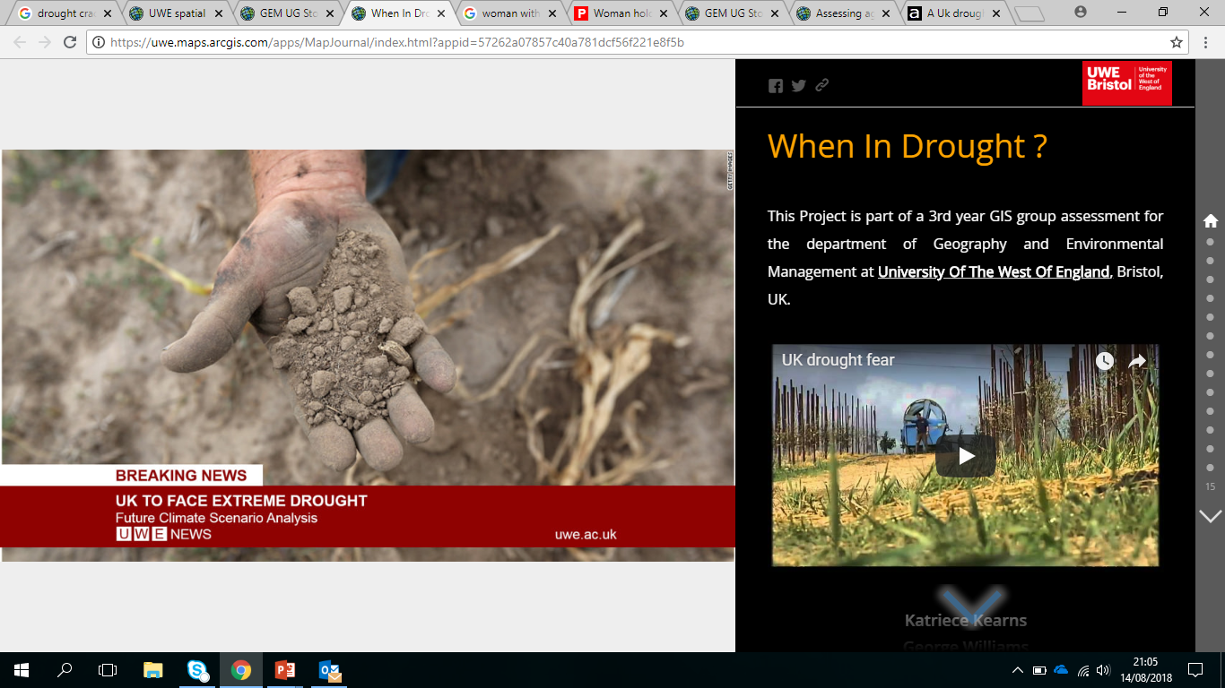
…The Solution
Value of the spatial view of data recognised – seven case study catchments across England, Scotland and Wales
Using location as an integrator for information from a range of stakeholders
Many opportunities for spatial analysis to reveal interrelationships and to present future scenarios
Maps and spatial visualization recognised as key tools in stakeholder engagement

Slide 9
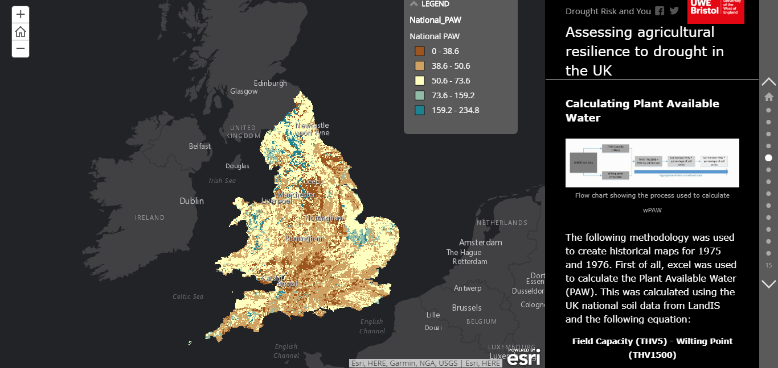

Slide 10
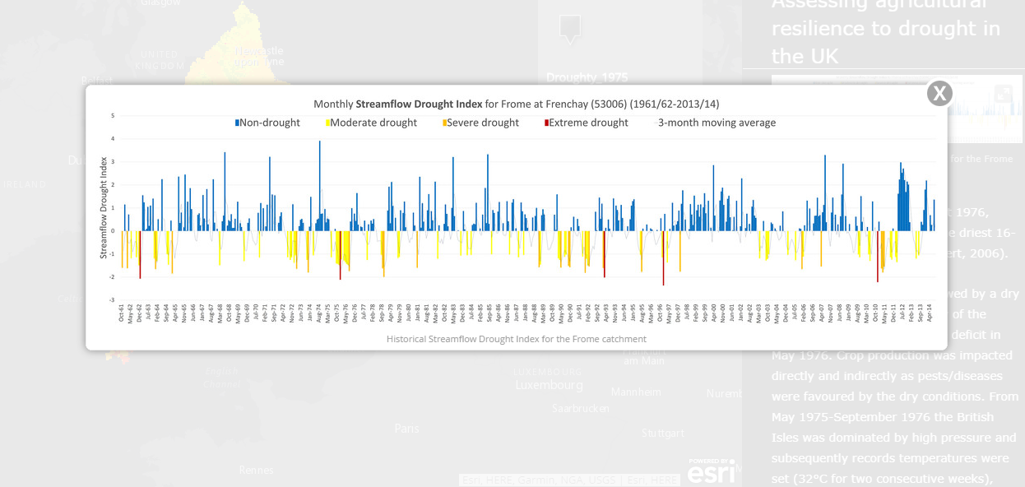

Slide 11
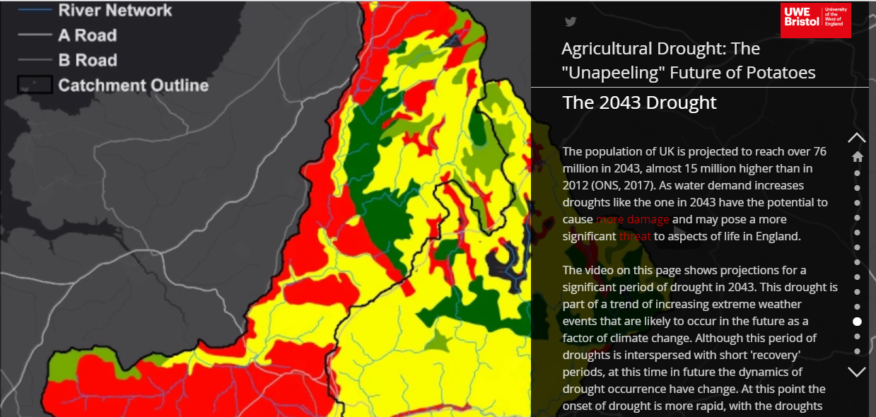

Slide 12
Benefits for Students
Authentic learning experience
Sense of purpose to assessment
Challenge of effective science communication
Projects become live resources
Graduate attribute enabling
Skills development…

Slide 13
Professional & Practice Oriented Skills
KNOWING
THINKING
COMMUNICATING
ACTING

Slide 14
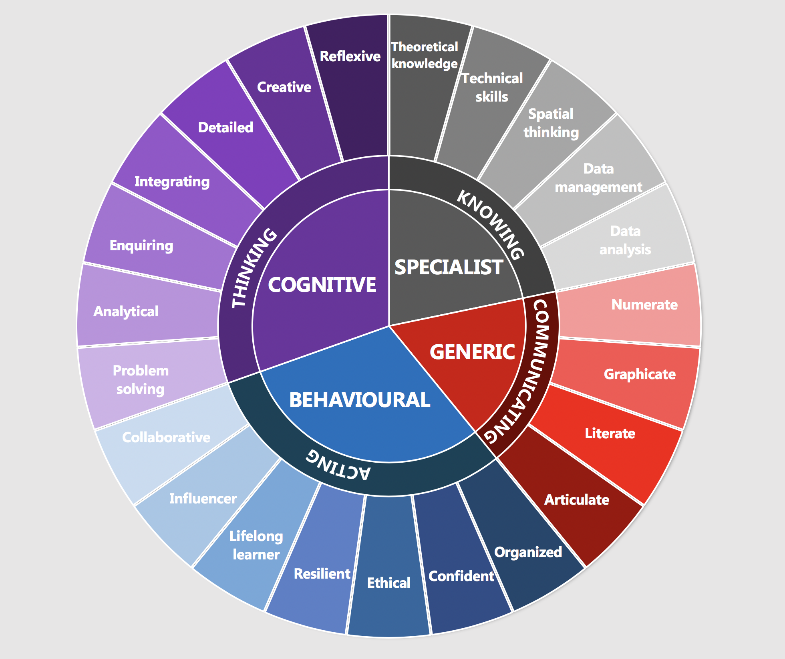
Professional & Practice Oriented Skills

Slide 15
Benefits for Project Sponsors
New assessment format for teaching staff
Valuable engagement tools
New way to present research findings
Projects become live resources
A ‘spatial’ representation/way of thinking
New skills and expertise development

Slide 16
Key Considerations
Expectations
Managing the expectations of both students and sponsors
Many projects are underway…. Students must hit the ground running
Clear communication and shared understanding are key
Why move into a spatial setting?
What can be achieved realistically? Will students understand the data fully?
What if a party is not happy/meeting expectations?
How do teaching staff effectively support both parties?
How do teaching staff weight the challenge of students addressing unfamiliar data topics in assessment criteria?
Pedagogy / Student Learning Experience

