Slide 1
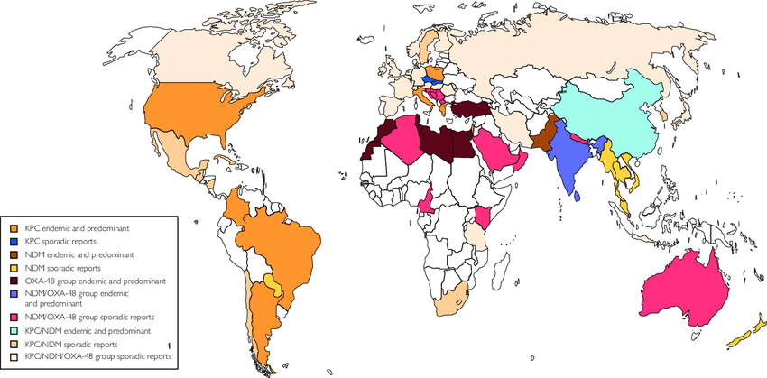
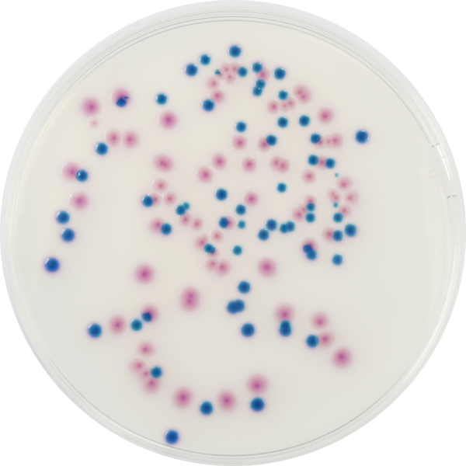
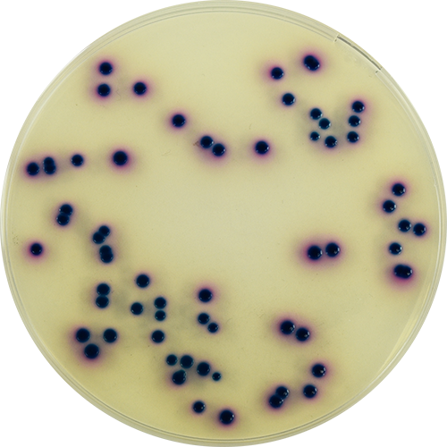
Jennifer Henderson^{1,2}, Holly Ciesielczuk¹, Shona Nelson² & Mark Wilks¹
¹Barts Health Trust, London, United Kingdom.
²University of the West of England, Bristol, United Kingdom
Community screening to determine the prevalence of carbapenemase producing organisms in East London, 2018
Introduction
Carbapenems are broad spectrum antibiotics reserved for patients who are extremely ill or suspected of having an infection caused by a multidrug resistant organism (Nordmann et al., 2011). Over the past ten years there has been a dramatic increase in resistance to carbapenems, seen worldwide, which is a growing cause for concern (figure 1).
Carbapenemases are enzymes, produced by an array of common Gram-negative organisms, which hydrolyse this class of antibiotic, conferring resistance (Papp-Wallace et al., 2011). The main protagonists are the “big five” carbapenemases, KPC, OXA-48, IMP, VIM and NDM, which have been reported across the UK. However, these reports are often a result of reactive screening, outbreaks, inpatient surveillance and from diagnostic samples. To date, there have been no studies investigating the prevalence of carbapenemase-producing organisms (CPO) in the UK community.
Results
Of the 200 community samples tested, only 1 patient tested positive for a CPO (NDM-producing Pseudomonas aeruginosa). Of note, this patient had travelled to the Caribbean. Of the 199 who screened negative, 46 also had foreign travel listed, the most common countries visited being Turkey, Morocco and Bangladesh. No travel history was detailed for 122 patients and there were no clinical details for 31 patients. Patients ranged from 1-93 years of age.
Of the 20 isolates tested for the presence of a carbapenemase by PCR, 11 were indicated to be intermediate or resistant to either ertapenem or meropenem by AST.
http://www.eolabs.com/product/pp3095-colorex-msupercarba/
Discussion
PHE guidelines state that patients from high-risk geographical locations such as Bangladesh, India, South East Asia, Italy, Turkey, Greece and Israel are at risk of CPO carriage and infection. At BHT, a significant proportion of our patient population originate from these high-risk locations and 22/46 of our study patients visited them in the last 12 months. However, only one CPO was detected in our community, giving a prevalence of just 0.5%. Furthermore, the CPO was detected in a patient who had travelled to the Caribbean, suggesting that we need to reconsider who is high-risk for CPO carriage and the relevance of national CPO rates, at least at a local level. In addition to foreign travel, previous hospitalisation is also considered a risk factor, however this cannot be determined from this study.
The AST results demonstrate that carbapenem resistance testing can not be used as the only tool for detecting carbapenemase producers.
Figure 1: Worldwide distribution of KPC, NDM and OXA-48 group carbapenemases (Vasoo et al., 2015).
Objectives
To determine the prevalence of CPOs within the community serving Barts Health Trust: Screen 200 non-duplicate samples using boil extraction followed by a modified version of a published RT-PCR assay (Zee et al., 2014).
Methods
Sources of samples
This study was performed at Barts Health NHS Trust (BHT), the largest trust in the UK, which serves 2.5 million patients across three London boroughs: Tower Hamlets, Newham and Waltham Forest. A total of 200 non-duplicate community stool samples, received sequentially by the Microbiology Laboratory at BHT, were included. Patient age, sex and foreign travel history were extracted from the laboratory information management system (LIMS), enabling the identification of potential risk factors for CPO carriage.
Screening method
Screening was performed by transferring a pea-sized portion of stool into nutrient broth and enriching overnight at 37°C. The broth was sub-cultured onto mSuperCARBA (EOlabs, UK) selective medium and incubated for a further 18 - 24 hours at 37°C.
Colonies were identified by MALDI-TOF. All identified Enterobacteriaceae, Acinetobacter and Pseudomonas species underwent antibiotic susceptibility testing (AST) by disk diffusion, according to EUCAST guidelines, against meropenem, ertapenem, fosfomycin, mecillinam, amikacin, temocillin and piperacillin-tazobactam. All isolates, regardless of the AST results, were tested for possession of carbapenemase genes using a modified version of a published RT-PCR assay (Zee et al., 2014).
Conclusion
Given the low CPO detection rate in this study, it could be expanded to include a larger sample size, which would enable the confirmation of the community prevalence rate observed here.
The stool samples used in this study were from patients presenting with a suspected gastrointestinal infection. This could lead to an imbalance of bacteria and, therefore, not be truly representative of the normal gut microbiome of that individual. To overcome this, future work could also include otherwise healthy patients for a more representative sample of the community.
Given the large number of high-risk patients served by BHT (according to PHE guidance), it is reassuring that the prevalence observed here was low.
References
Nordmann, P., Nass, T. and Poirel, L. (2011). Global spread of carbapenemase- producing Enterobacteriaceae. Emerging Infectious Diseases. 17, pp. 1791-1798.
Papp-Wallace, K., Endimiani, A., Taracila, M. and Bonomo, R. (2011). Carbapenems: Past, Present, and Future. Journal of Antimicrobial Chemotherapy. 55(11), pp. 4943-4960.
Public Health England (2016). UK standards for Microbiology Investigations: Laboratory detection and reporting of bacteria with carbapenem-hydrolysing β-lactamases (carbapenemases) Protocol B60, issue 2.1.
Public Health England (2015) English surveillance programme for antimicrobial utilisation and resistance (ESPAUR) 2010 to 2014. Available from www.gov.uk/phe (Accessed 8th July 2016).
Public Health England (2014) Acute trust toolkit for early detection, management and control of carbapenemase-producing Enterobacteriaceae. Available from www.gov.uk/phe (Accessed 1st June 2018).
Vasoo, S., Barreto, J. and Tosh, P. (2015). Emerging issues in Gram-negative bacterial resistance: An update for the practising clinician. Mayo Clinical Proceedings. 90(3),pp.395-403
Zee, A,. Roorda, L., Bosman, G., Fluit, A., Hermnas, M., Smits, P., Zanden, A., Witt, R and Ossewaarde, J. (2014). Multi-centre evaluation of real-time multiplex PCR for detection of carbapenemase genes OXA-48, VIM, IMP, NDM and KPC. BMC Infectious Diseases. 10, pp. 14- 27.

