Slide 1
Violent Impressions An investigation of slow violence in landscape through printmaking and photography
Niamh Fahy
16/12/21
Visual Culture Research Group
Research Associate & PhD candidate
Centre for Print Research
University of the West of England

Slide 2
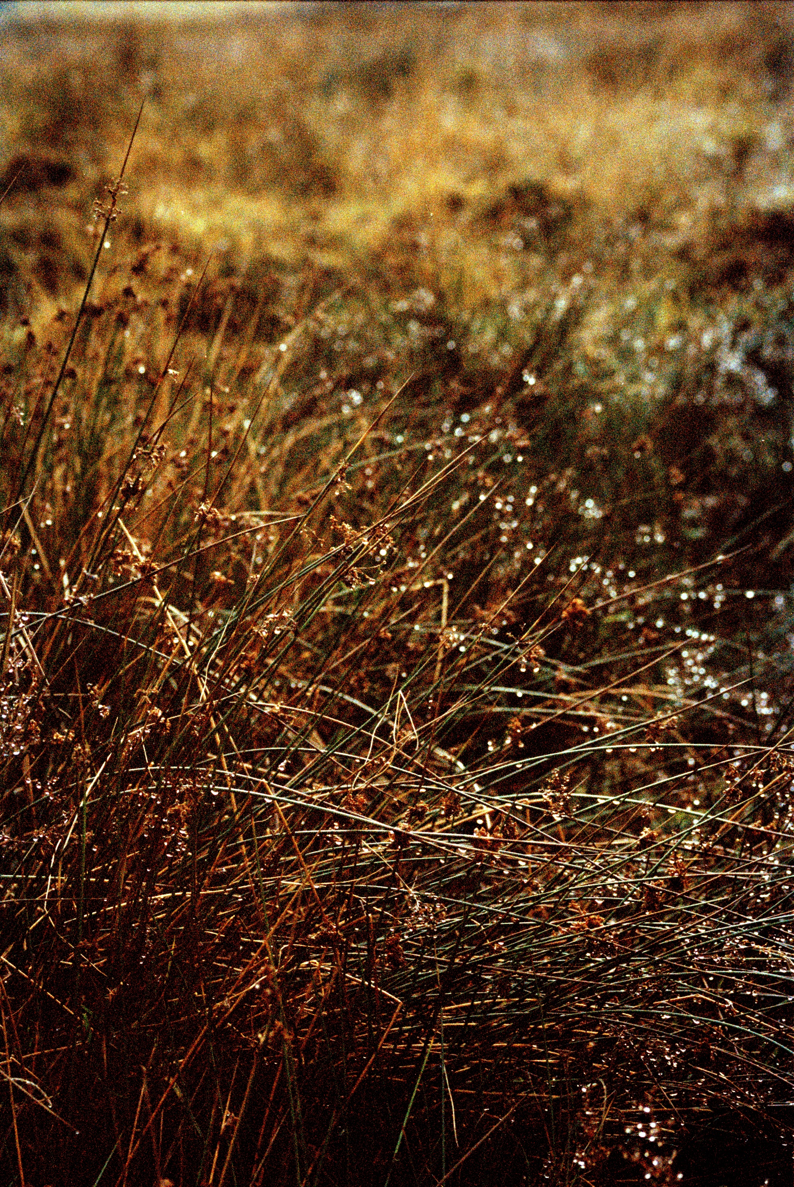
Research Question & Aims
Without the overt implication of a trace such as the evidenced in extracted landscapes, how can slow violence be recognised by the print artist ?

Slide 3
Slow Violence
The term slow violence refers to environmental destruction that takes places over a gradual period, frequently concealed, imperceptible and devoid of immediate spectacle commonly associated with notions of violence. Slow violence is often perceived as inevitable. It is too consistent to warrant the immediate scrutiny associated with disaster, presented by an image centric media.
(Nixon, 2013)

Slide 4
Violent Traces The Slieve Aughty Mountains
Niamh Fahy, Slieve Aughty Mountain, Galway, Ireland, digital photograph, 2020

Slide 5
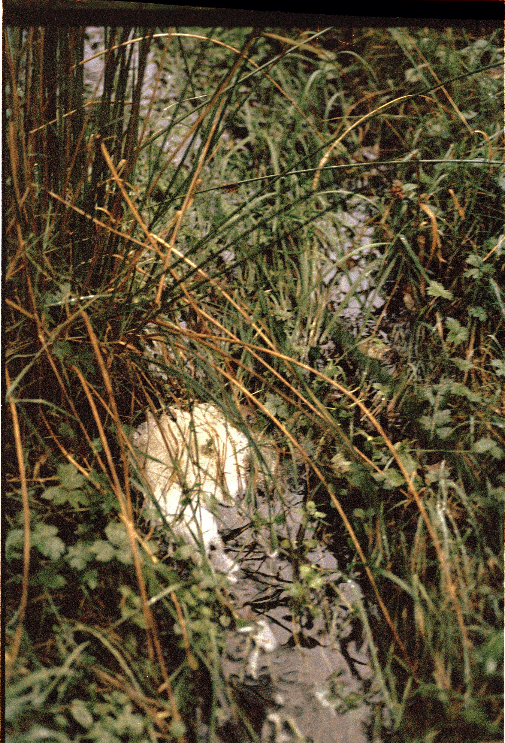
WHAT ? HOW ? WHERE ? WHO ? WHY ?
Dramatic Increase in flooding within the lowlands.
Significant changes of land use over a fifty year period.
Activity on Slieve Aughty Mountains impacts surrounding rivers and lowlands in South Galway.
3 key Stakeholders Responsible: Coillte Forestry Commission, ESB Windfarm development , Local land users engaged in land reclamation.
Changes in planting practices, flawed environmental impact assessment, non-holistic approach to commercial processes .

Slide 6
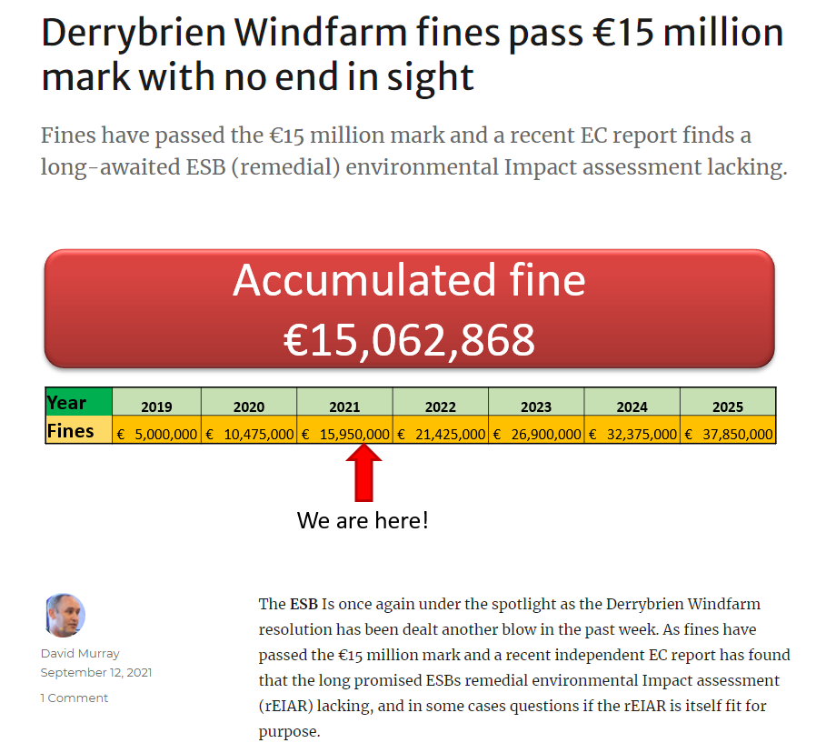
European Court issued Irish government five million euro fine for failure to carry out environmental impact assessment (EIA) necessary for the construction of Derrybrien Windfarm.
With an additional order to a pay €15,000 daily fine, as long as the Irish government remains non-compliant. This fine continues to accrue today.
David Murray, Screenshot of South Galway Floods blog, September 2021

Slide 7
Slow Violence shaping A one-world-world?
John Law refers to a “One -world -world, a world that has granted itself the right to assimilate all other worlds and by presenting itself as exclusive, cancels possibilities for what lies beyond its limits.” ( Law cited by Cadena and Blaser, 2018, p.3)
Through expanding one world we diminish another, tipping the scale of balance, we abandon an abundance of diversity that supports the majority in favour of a limited and exclusive wealth available to few. The eradication of such worlds raises questions within my own practice, what ghosts do absent worlds create and what does it do to make them visible them through artist practice.(Tsing, 2017)

Slide 8
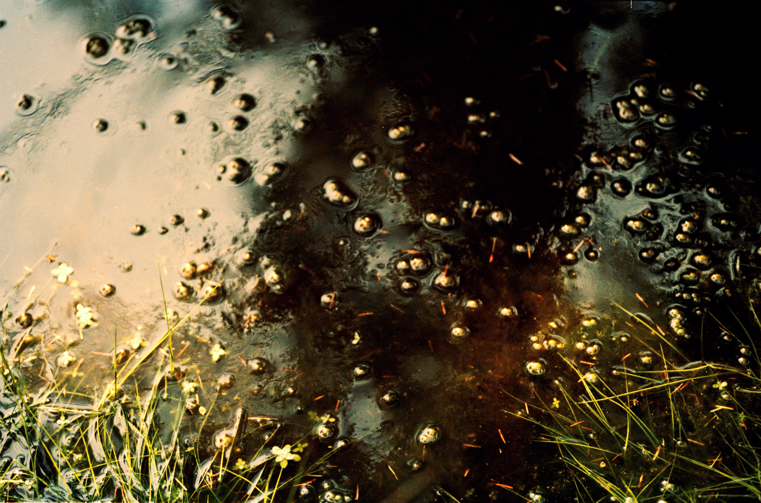
Slow Violence as Hydro-Morphological change

Slide 9
The scope & scape of the Land
“Scope comes from the classical Greek Skopos- literally ‘the target of the bowman, the mark towards which he gazes as he aims’(Carruthers 1998:79),- from which is derived the verb skopein, ‘to look ‘. ‘Scape’. Quite to the contrary, comes from Old English sceppan or skyppan, meaning ‘to shape’ ” (Olwig cited in Ingold, 2008)
“Between the haptic and the optical lies all the difference between the perspective of the farmer who shapes the land close-up and that of the painter who views the resulting scene from a distance, or – as Deleuze and Guattari
themselves observe – between ‘the ground-level plane of the Gothic journeyman’ and ‘the
metric plane of the architect, which is on paper and off site’ ” (2004: 406)

Slide 10
Deep Mapping, Slow Residencies & Fieldwork
The term ‘deep mapping’ resists disciplinary definitions or academic boundaries. It concerns the “quality of attention” (Modeen and Biggs, 2020, p.55) that is required to care for and respond to the landscapes we inhabit.
Pr0posed as “an embodied and reflexive immersion in a life that is lived and preformed spatially. A cartography of depth. A diving within” ( Roberts 2016 cited by Modeen and Biggs, 2020, p.53).
Within this research fieldwork is adapted as a practice of “anti conclusion” where periods of immersion and reflection are applied as an attentive practice which answers to the qualities of the landscape it explores.

Slide 11
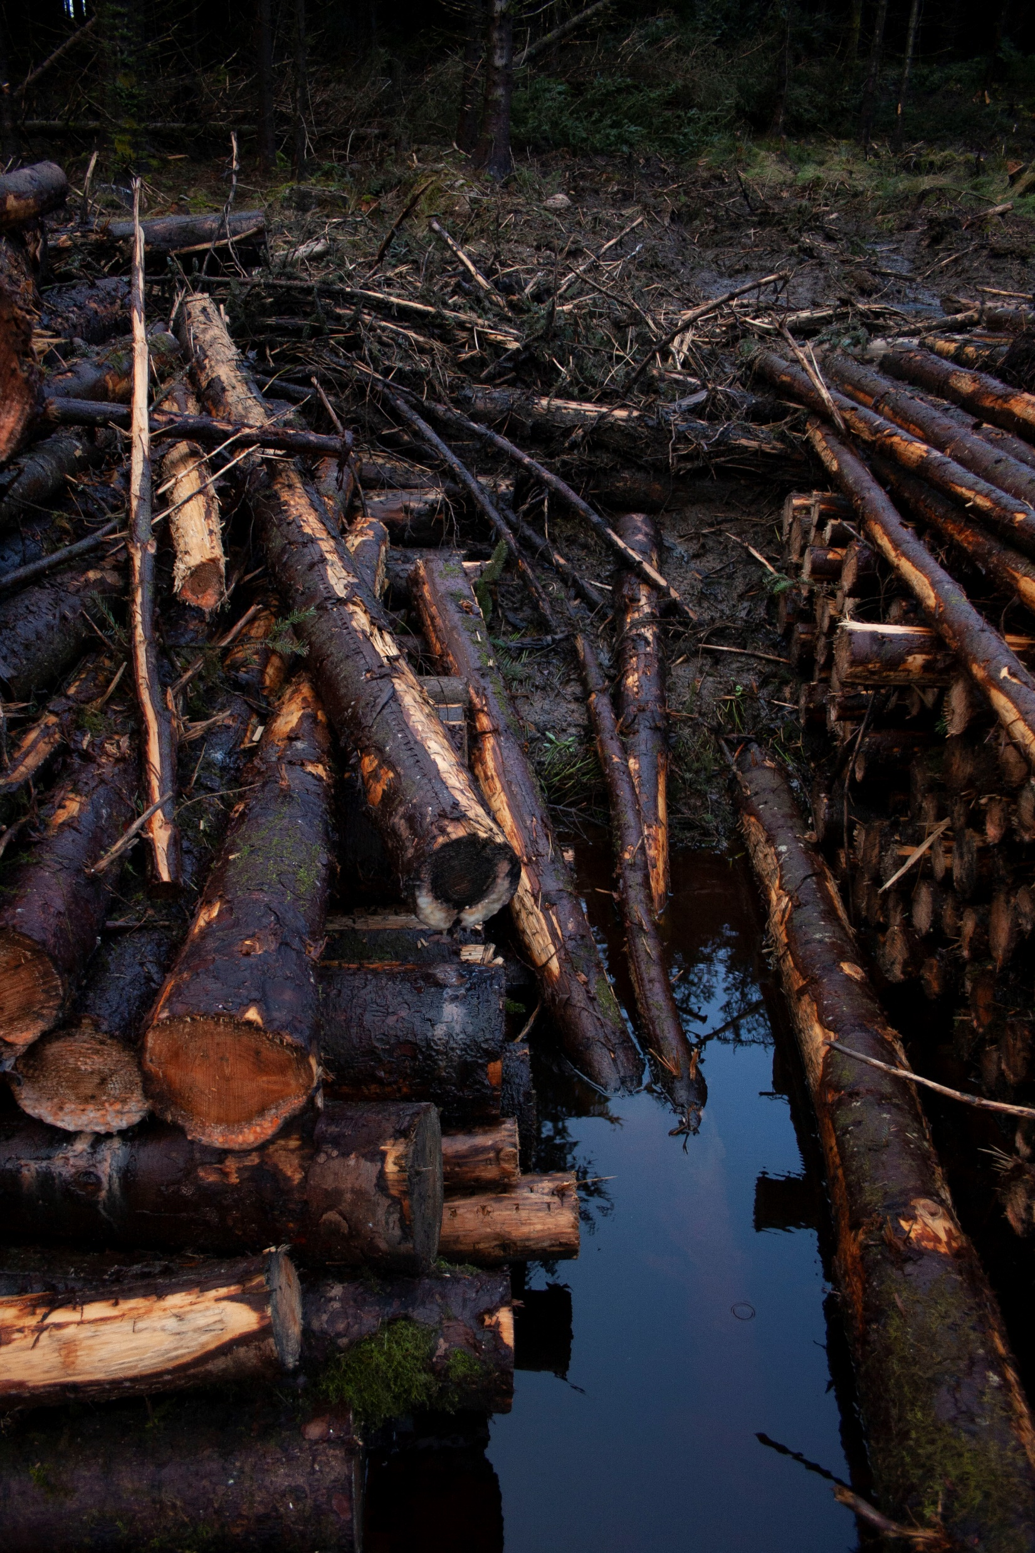
How does Slow Violence manifest in the Slieve Aughty Mountains?
Niamh Fahy, Currach, Slieve Aughty Mountains, photograph, 2021

Slide 12
Niamh Fahy, Slieve Aughty Mountains, 2021

Slide 13
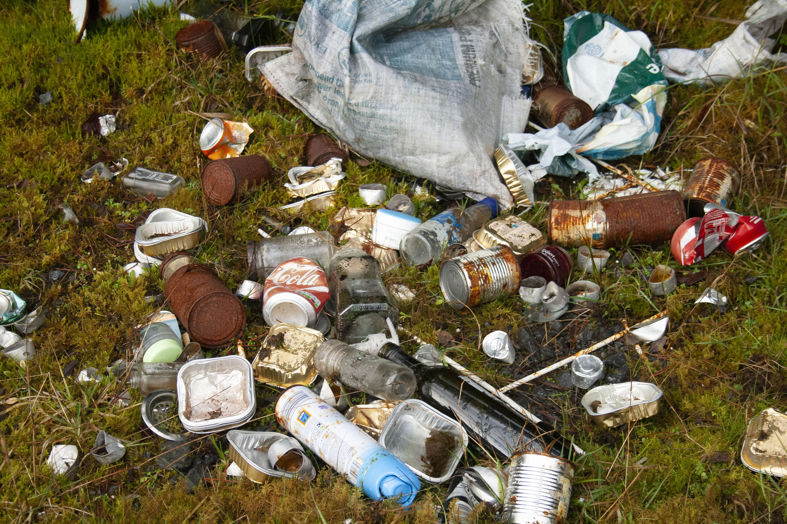
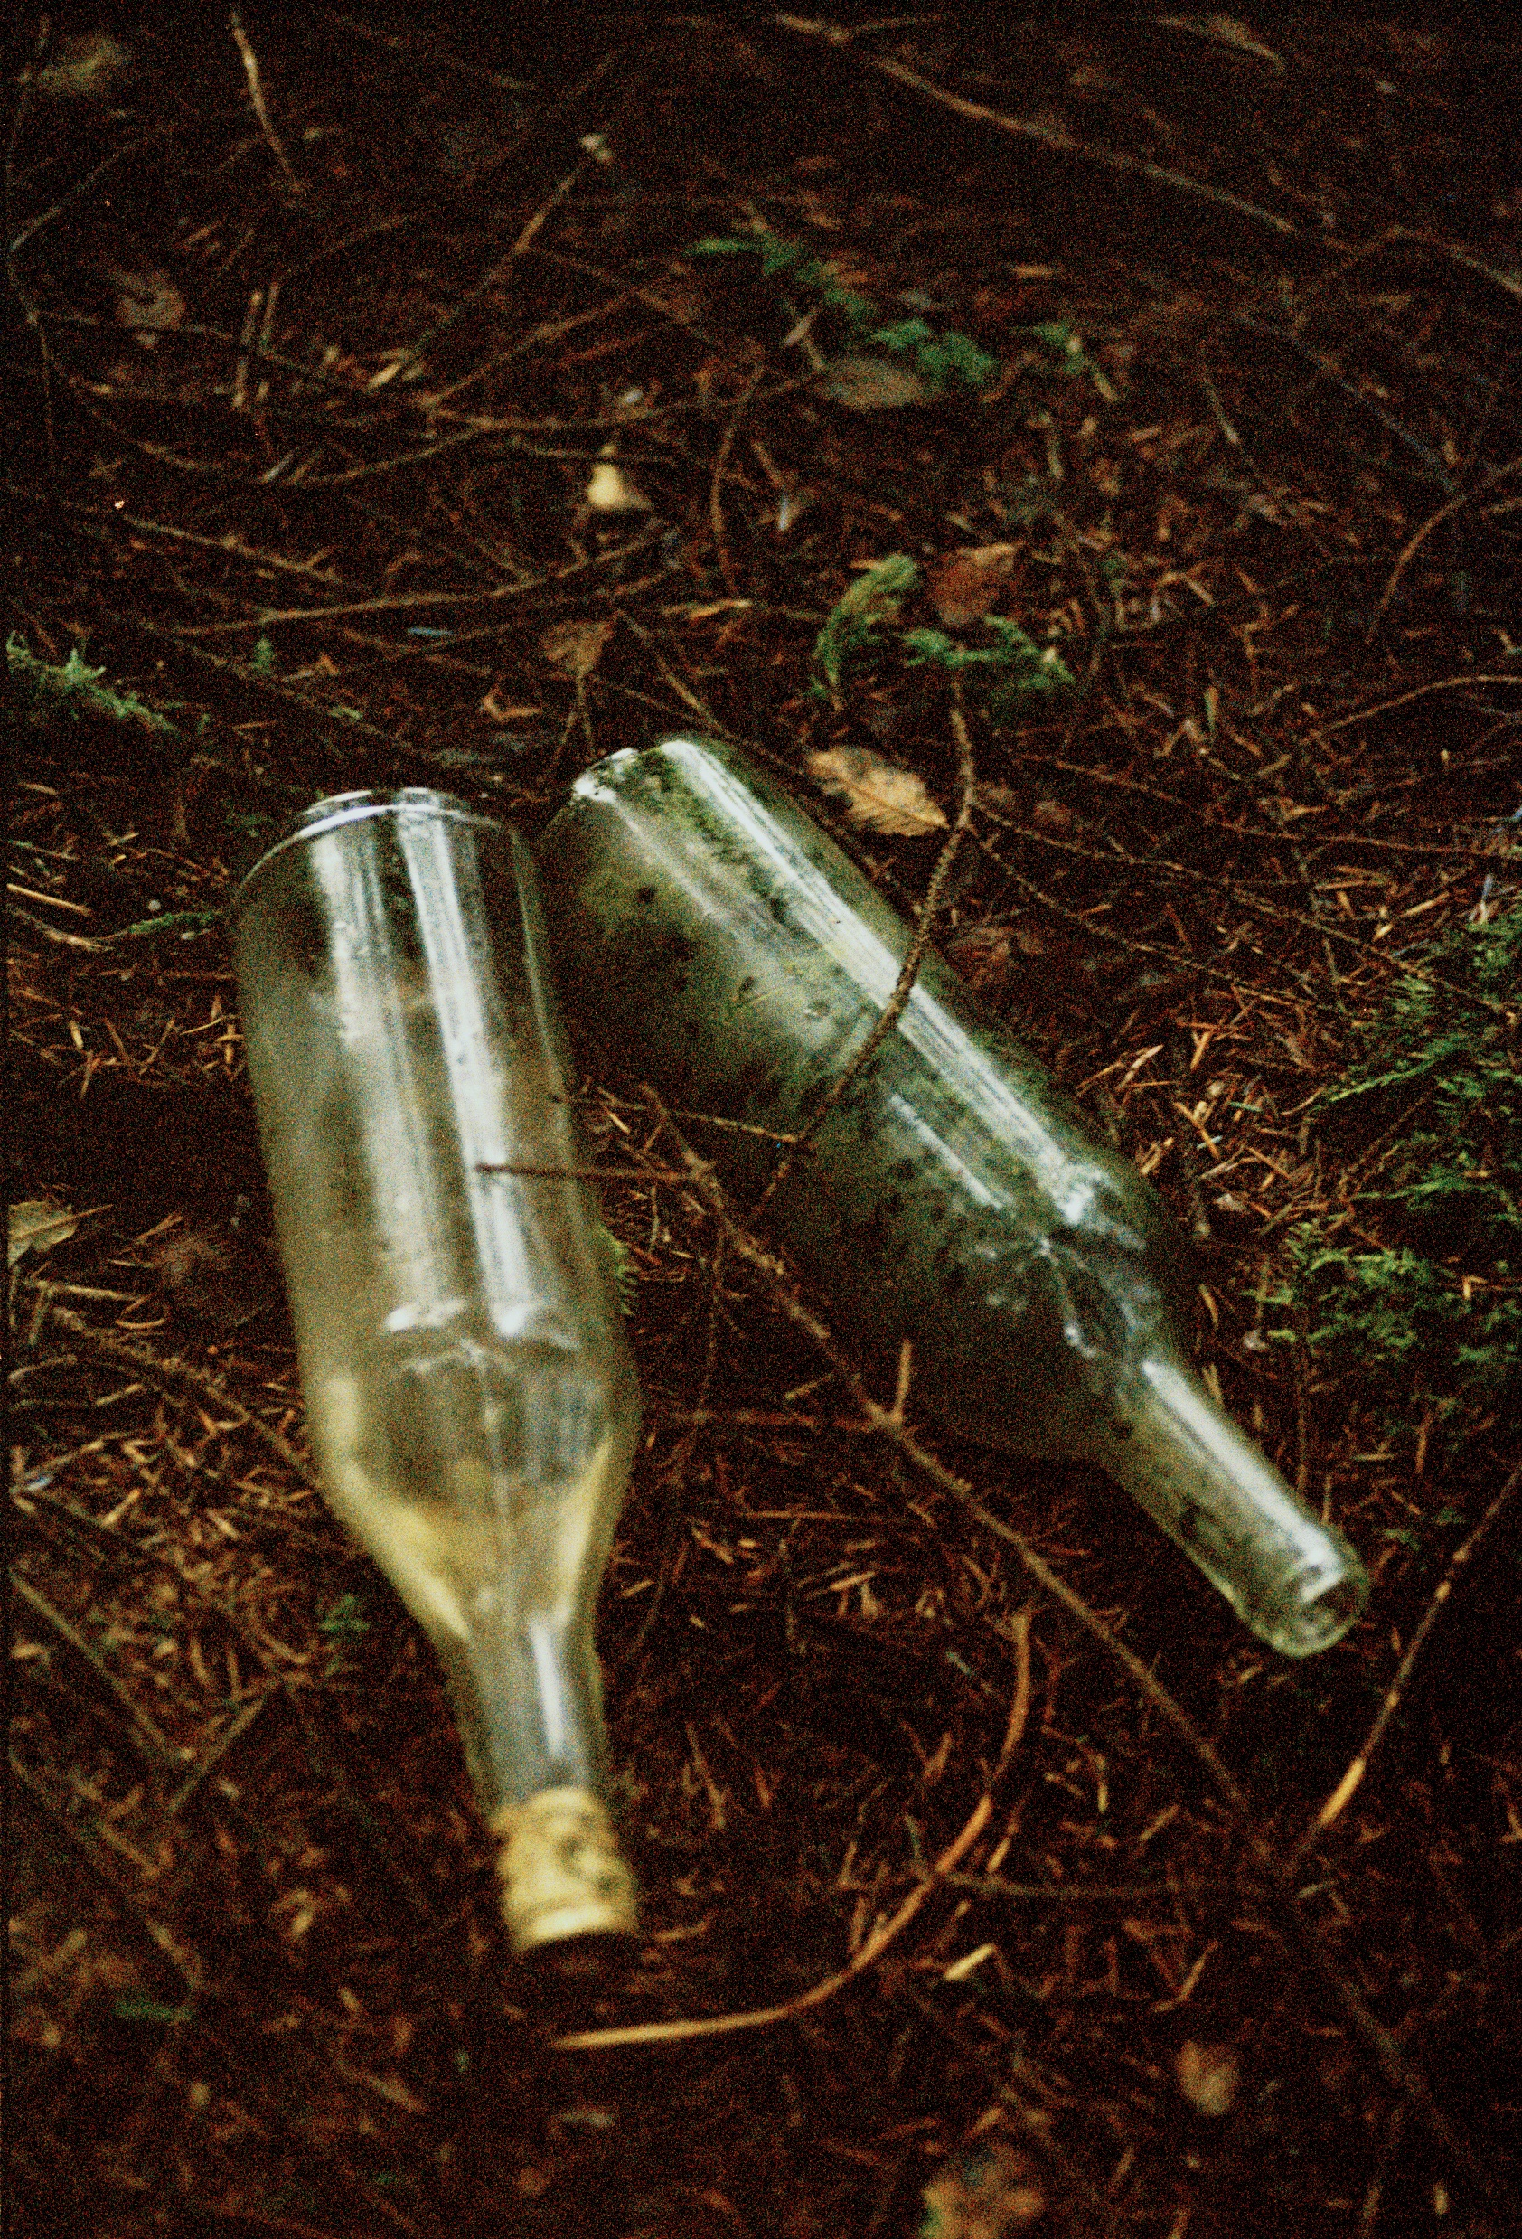
Niamh Fahy, illegal dumping, 2021

Slide 14
Intimacy through situational ethics
“Situational ethics : the ability to respond to what’s right in front of you. If we can begin to see that ethical responsiveness has everything to do with our attentiveness and our ability to let go of fixed views, we can start to see how ethics are an expression of interconnectedness or intimacy.”
Intimacy means opening to what is without necessarily acting it out or turning it in.
(Stone, 2011. pp.89- 113)

Slide 15
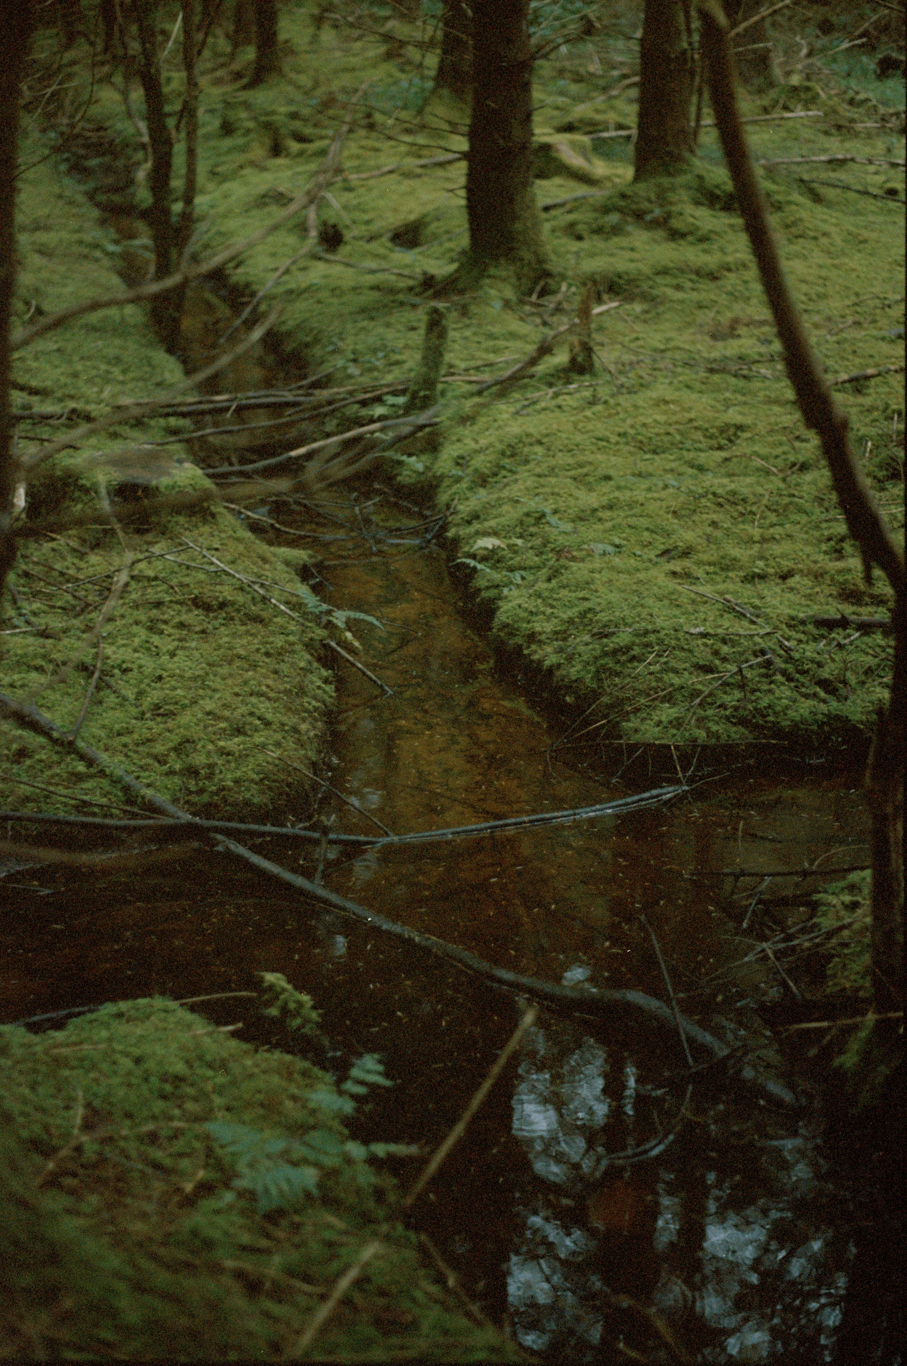

Slide 16
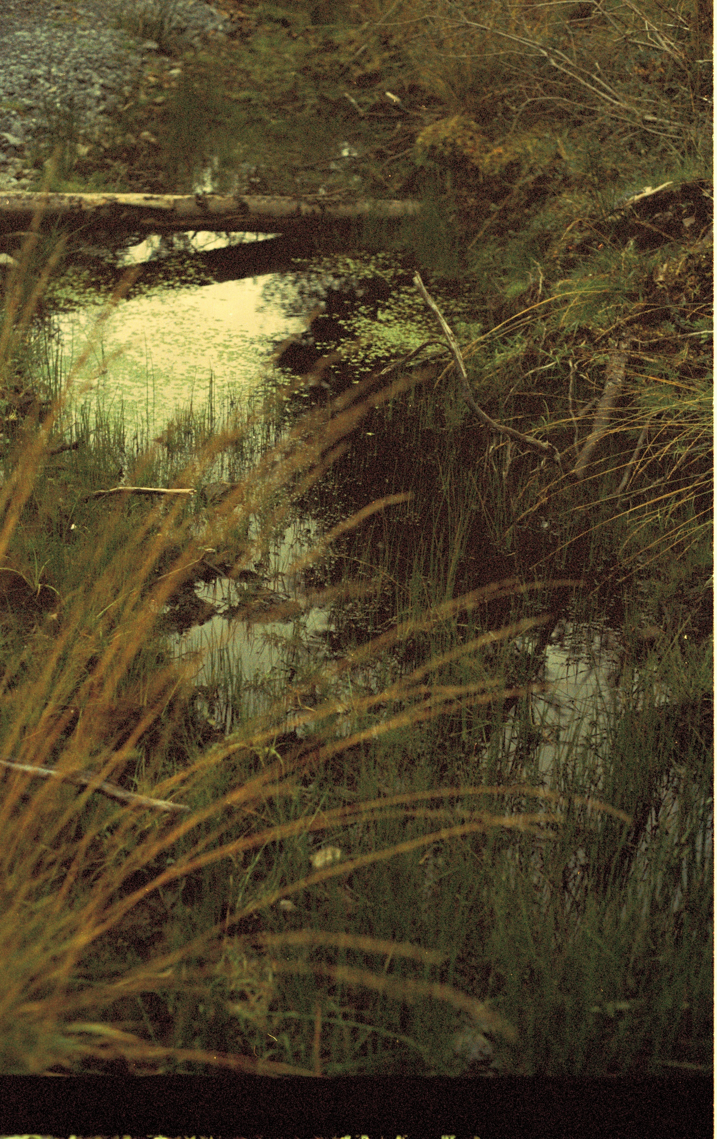

Slide 17
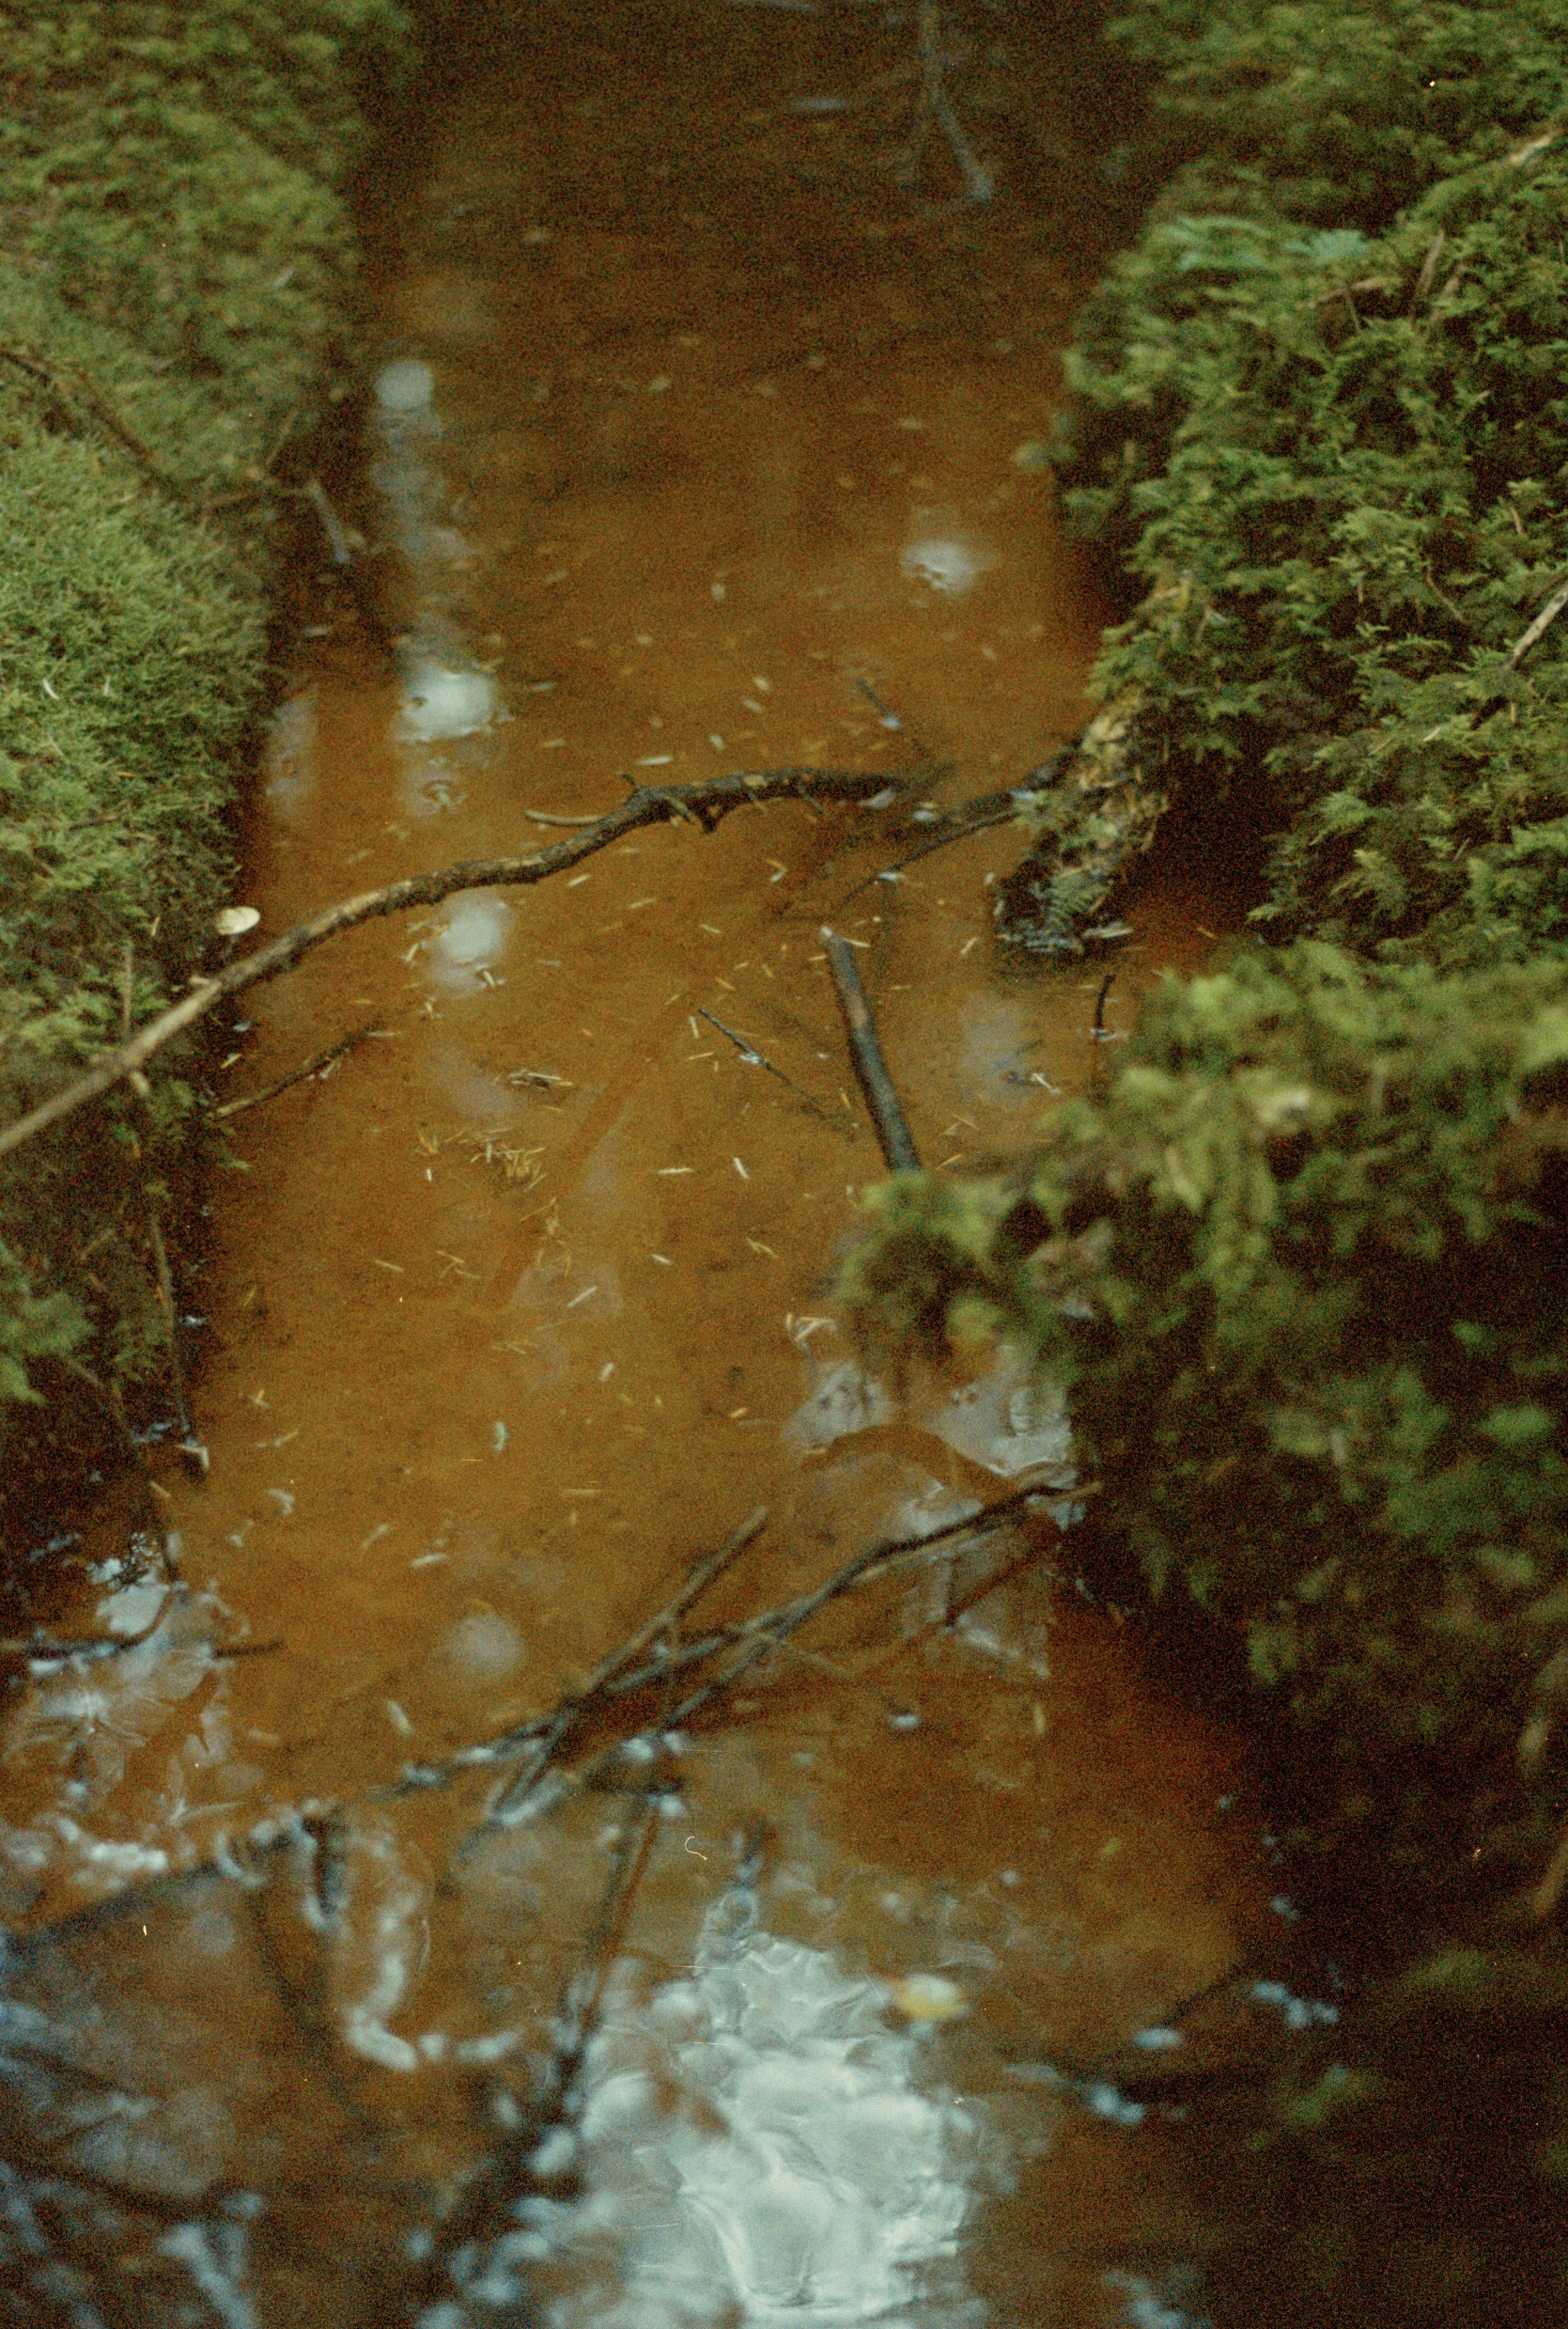
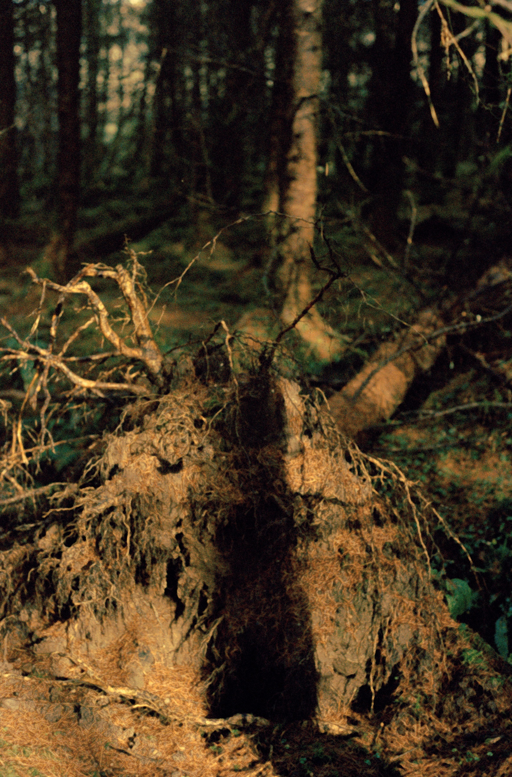

Slide 18
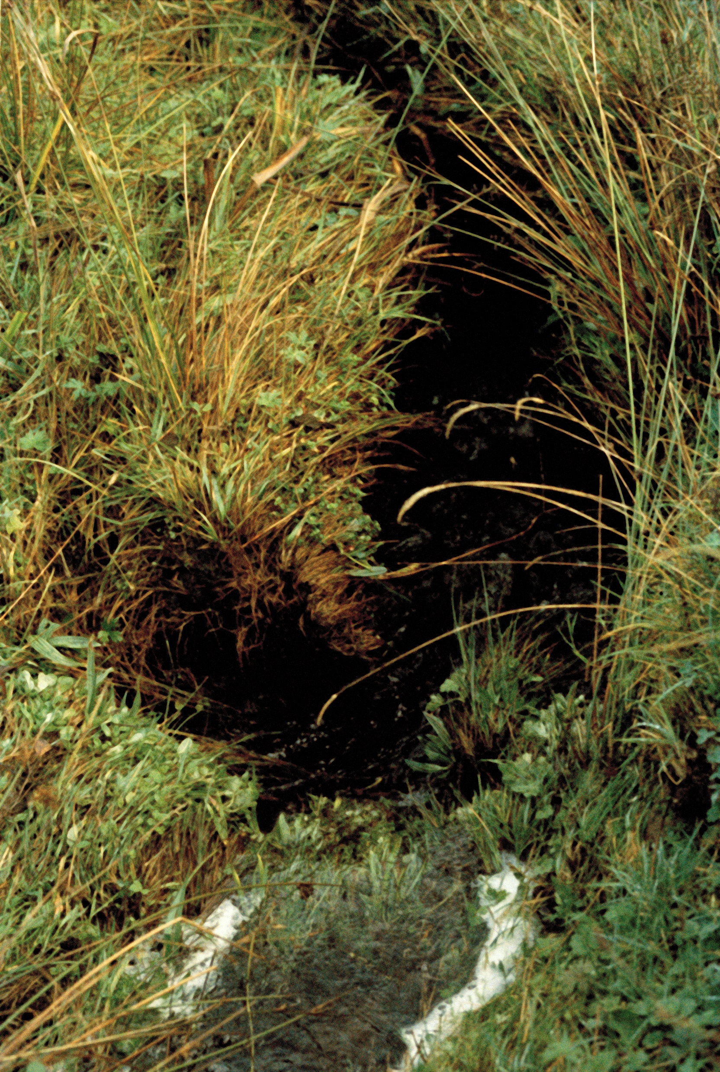
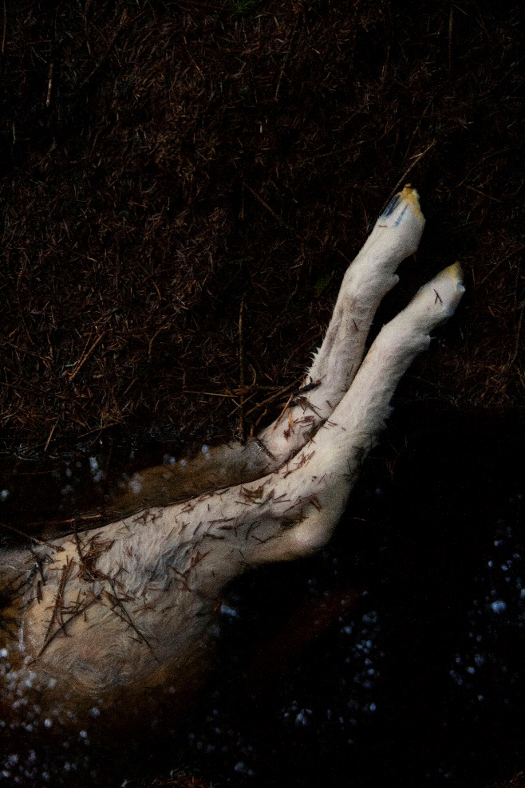
Niamh Fahy, Found Creature, Slieve Aughty Mountains, 2021

Slide 19
Creating Pluriverse through Print ?
Pluriverse is the proposal for recognising the plural perspectives, heterogenous practices and diverse life forms that compose a world of many worlds. Pluriverse imagines and magnifies the multiple, open- ended practices that co-exist within an interconnected meshwork that allows for a multitude of worlds to emerge.
(Cadena & Blaser, 2018.p.4).

Slide 20
Niamh Fahy, Polaroid tests, photo etching, 2021

Slide 21
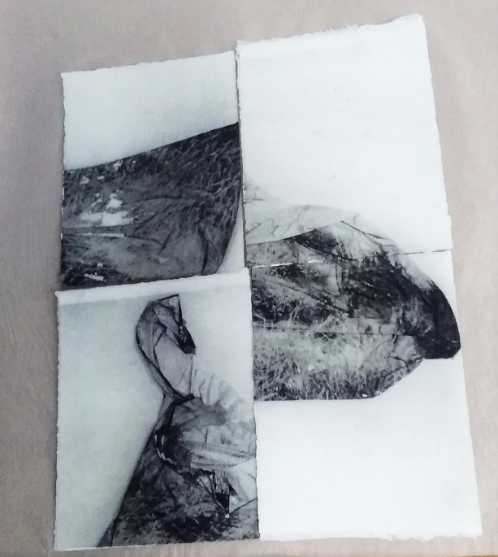
Niamh Fahy, Polaroid tests in Photo etching,2021

Slide 22
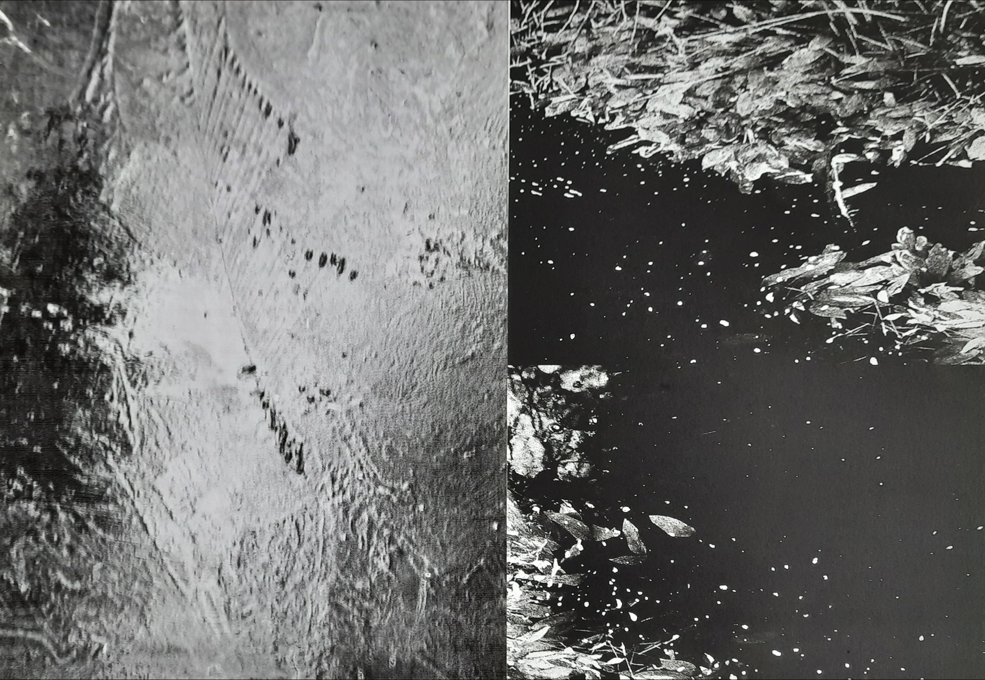
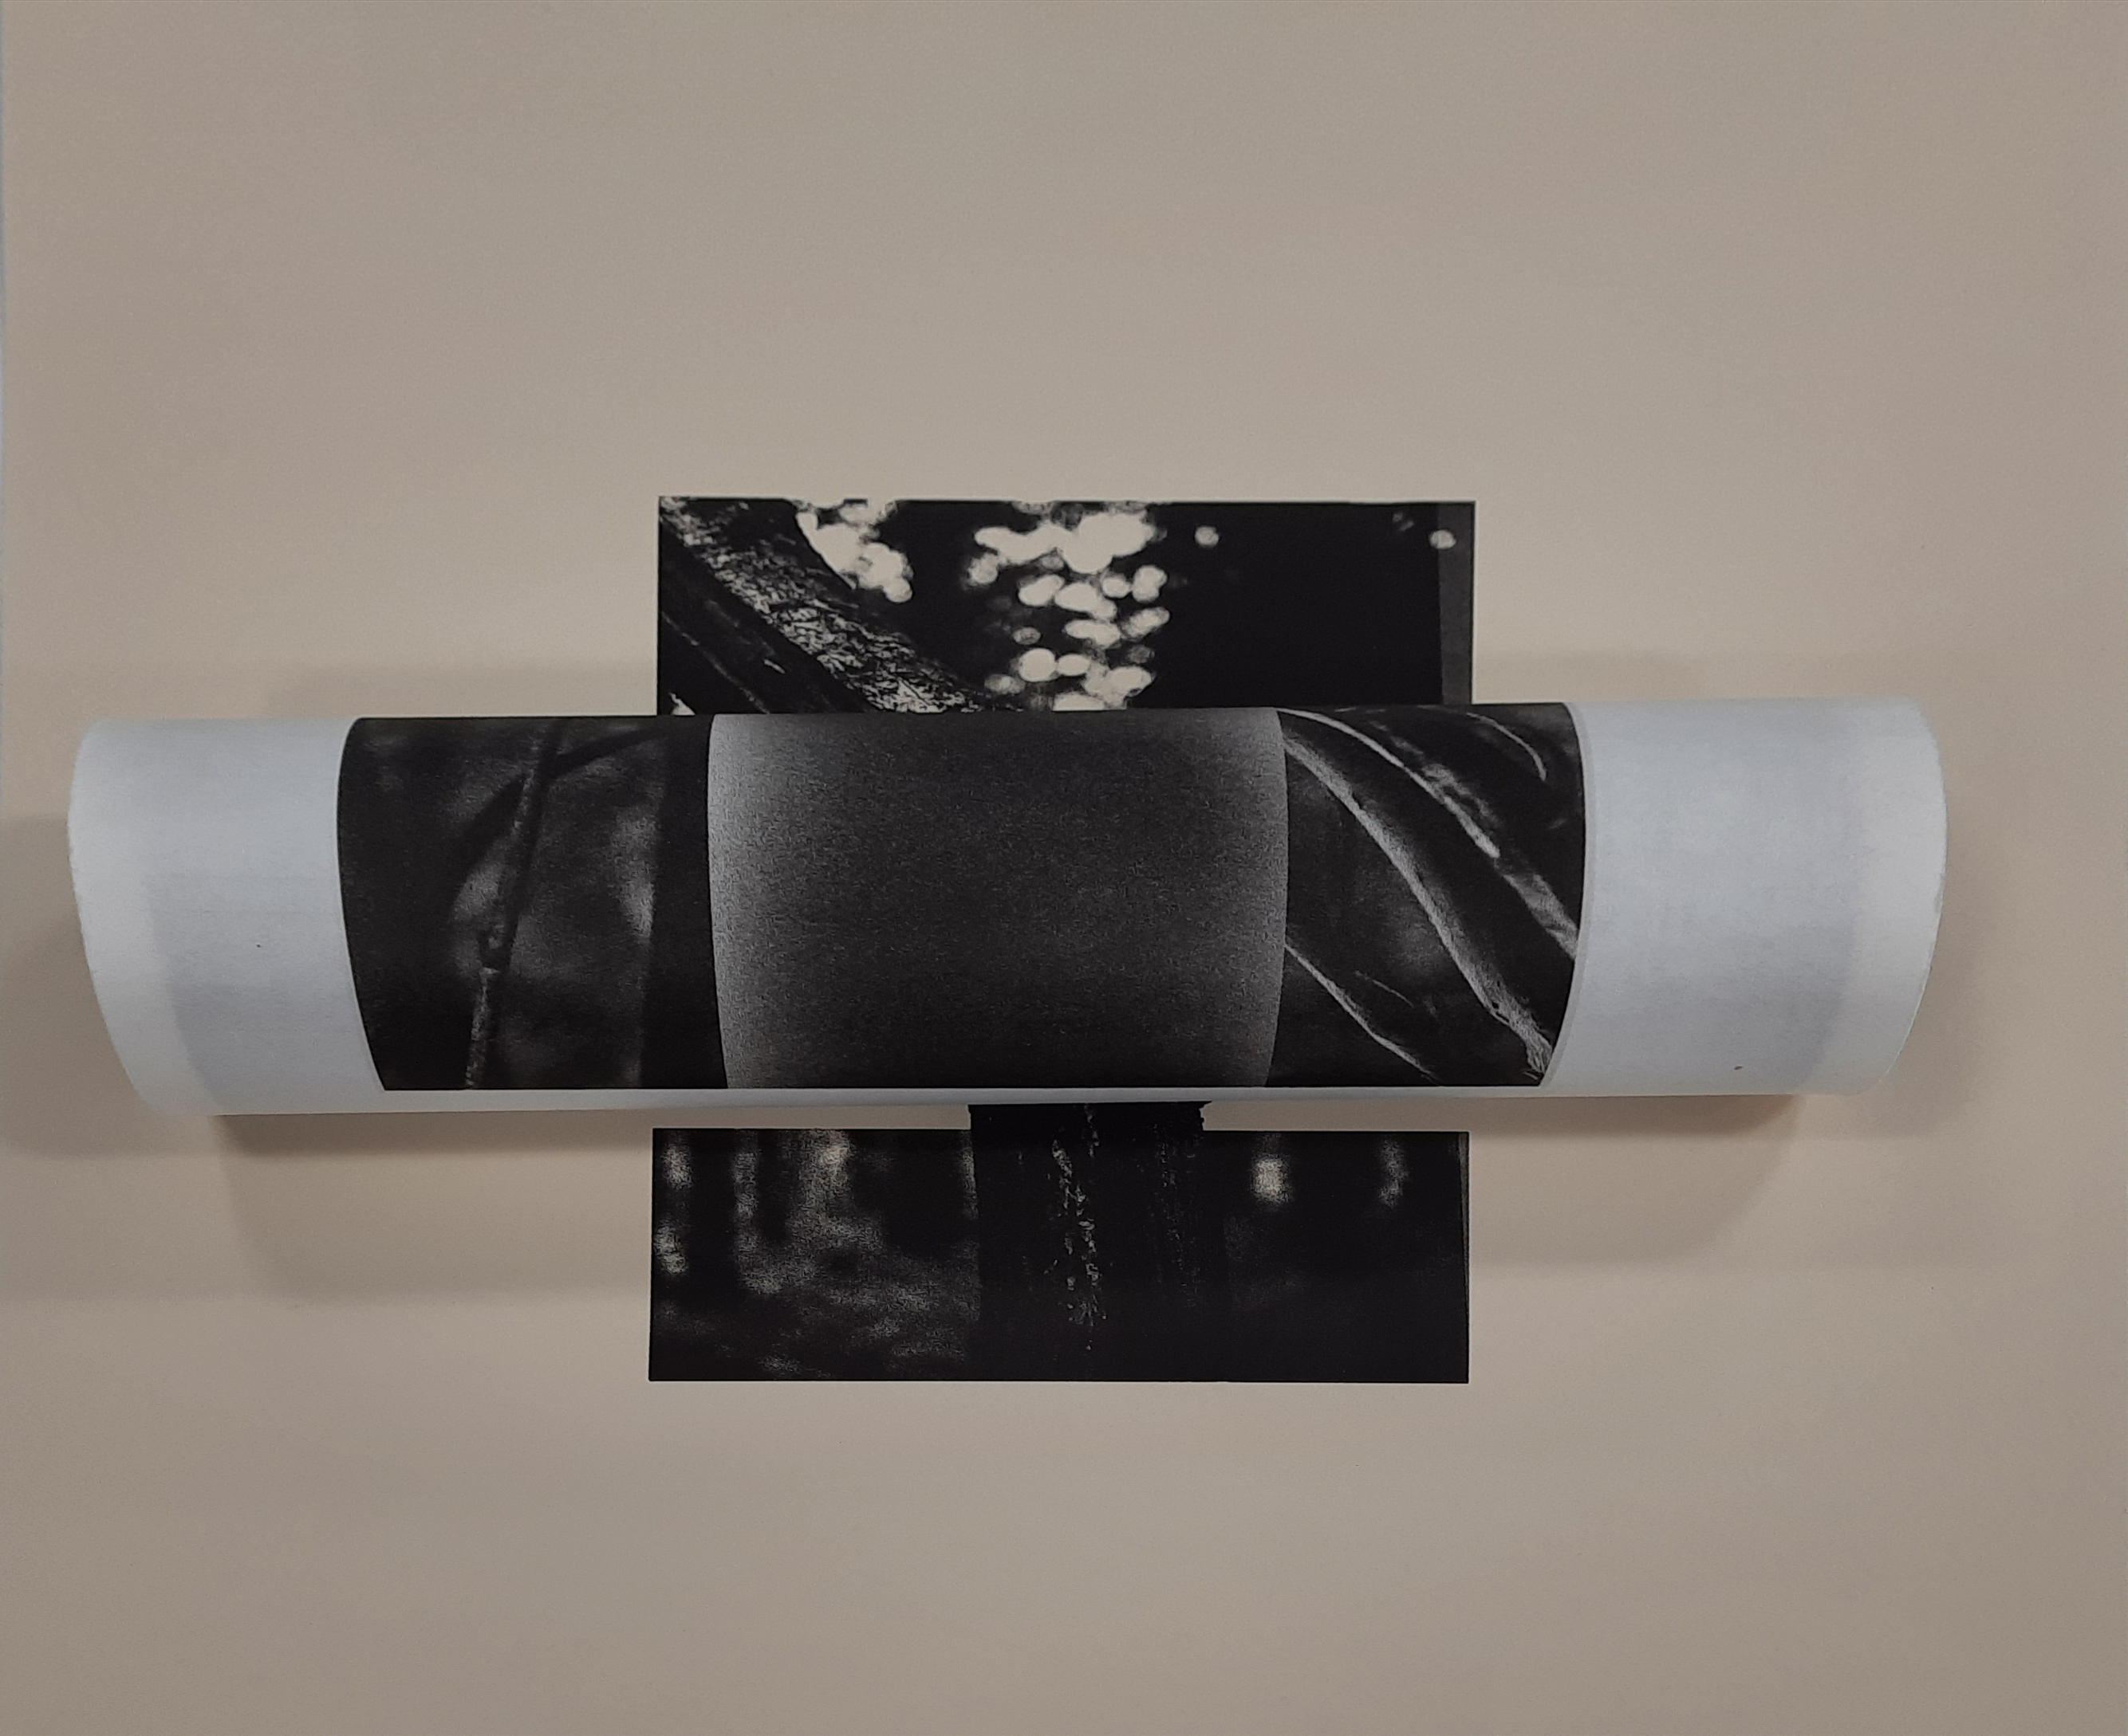
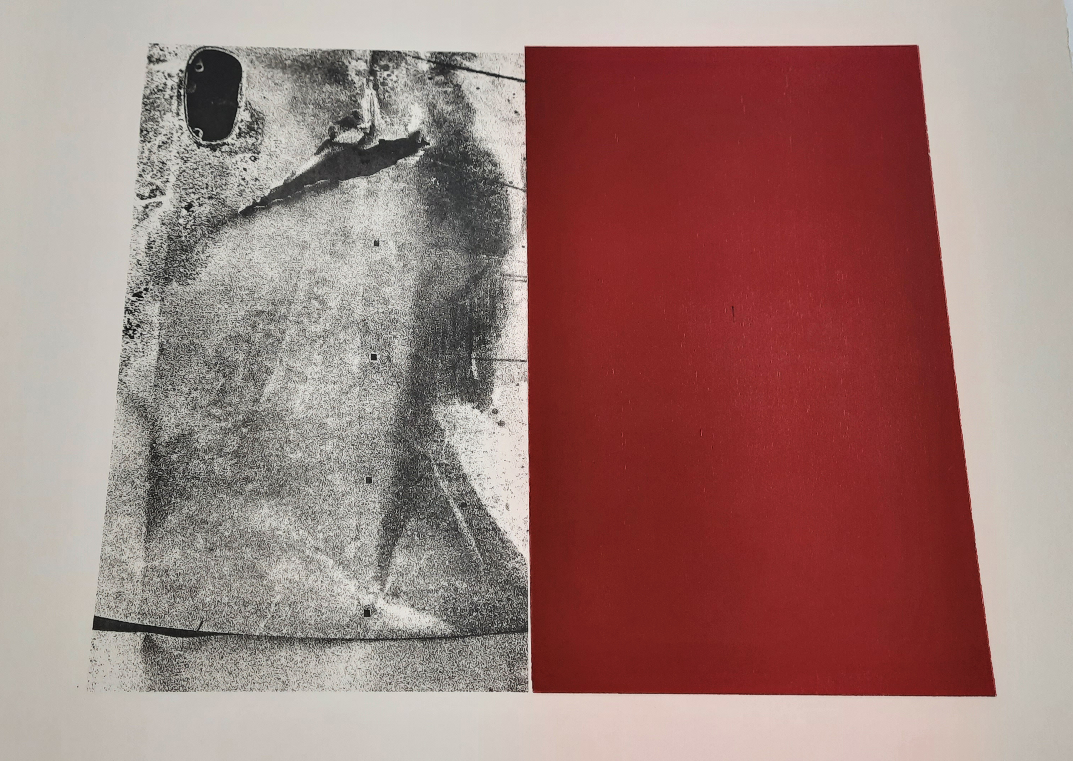

Slide 23
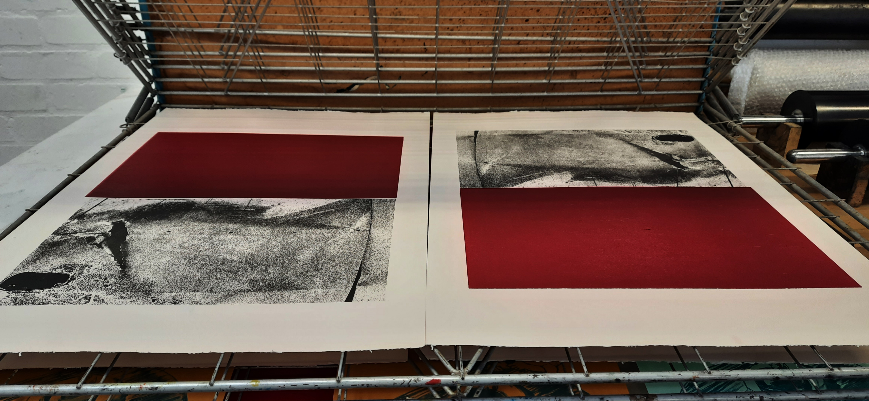
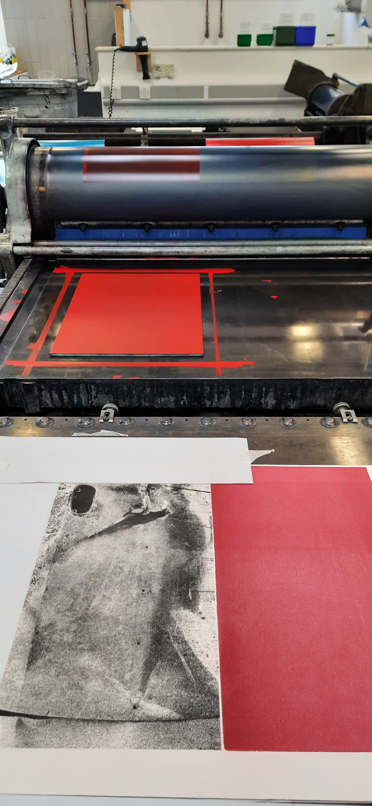
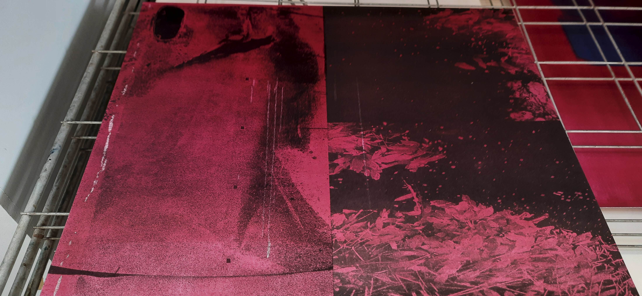

Slide 24
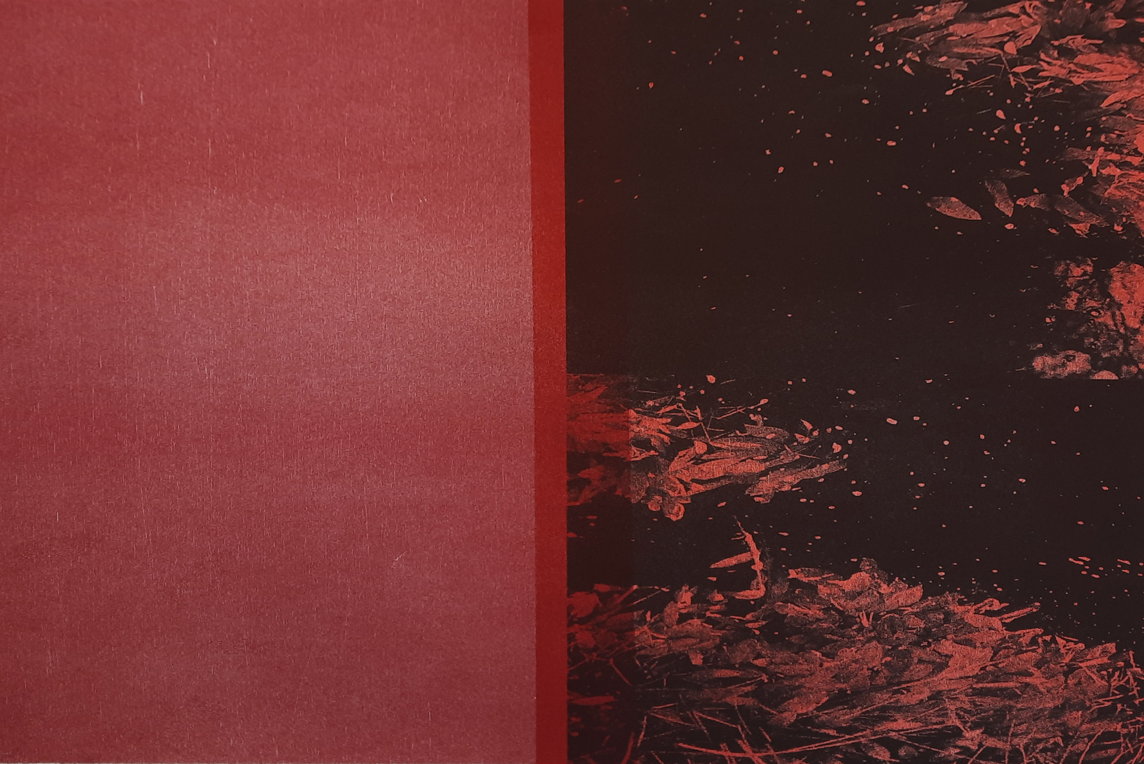
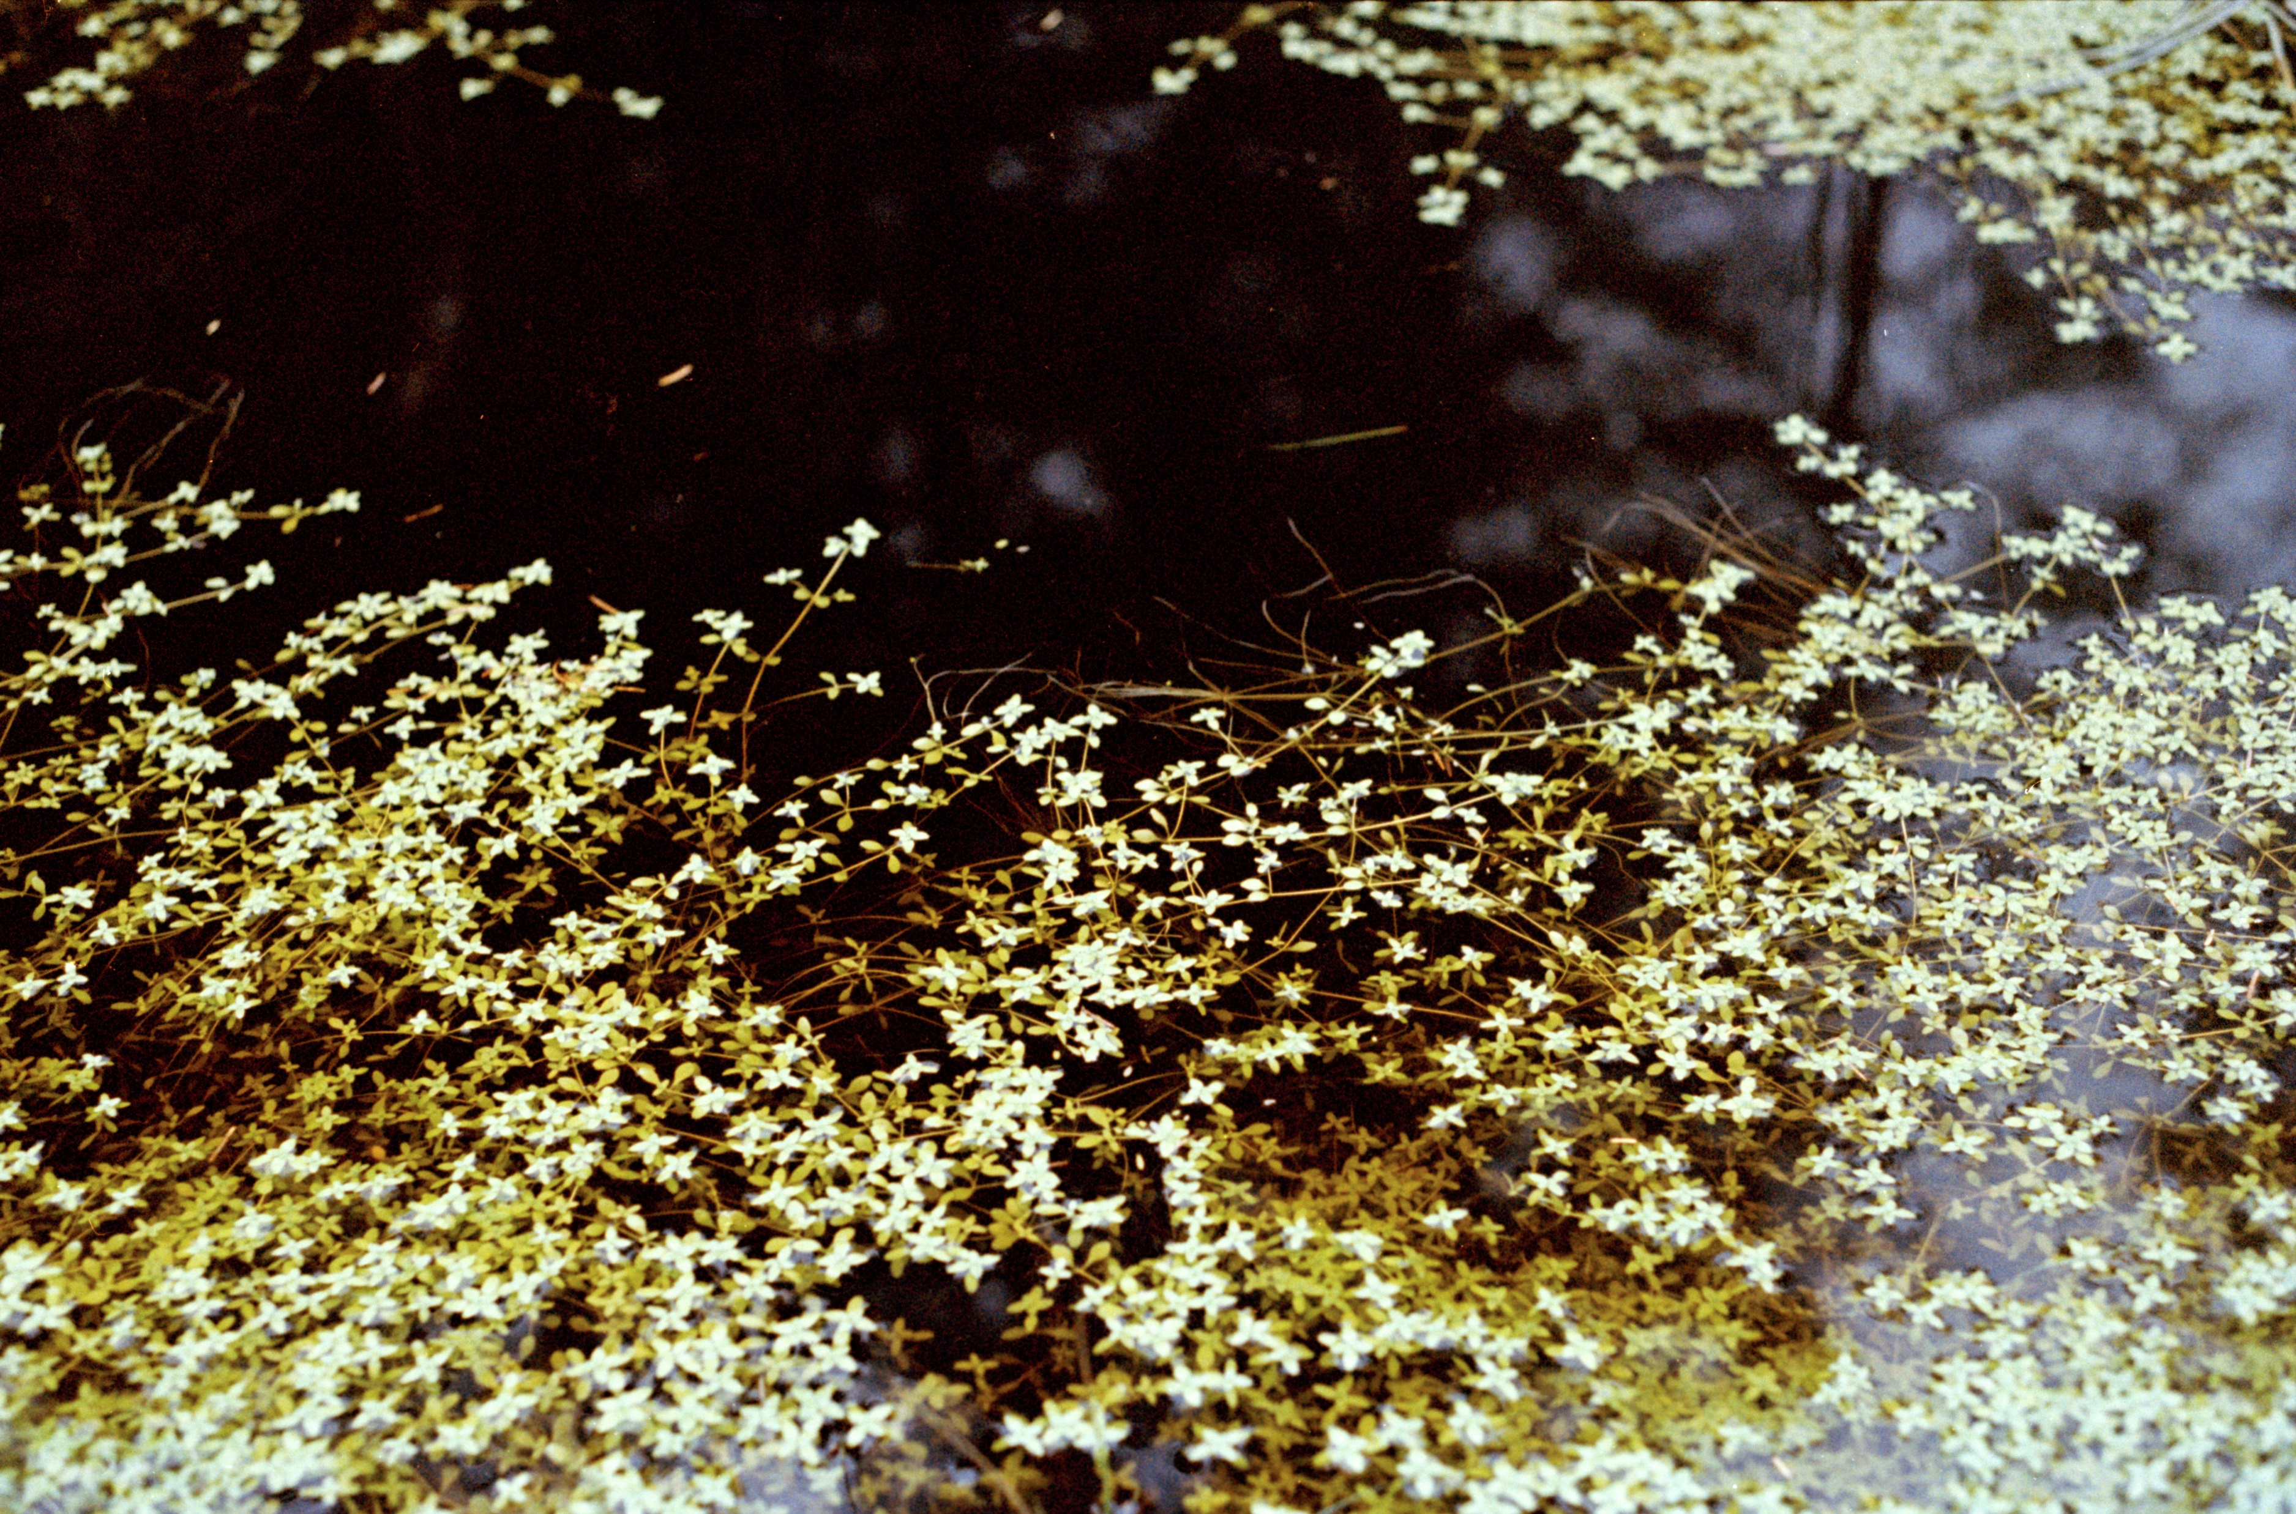
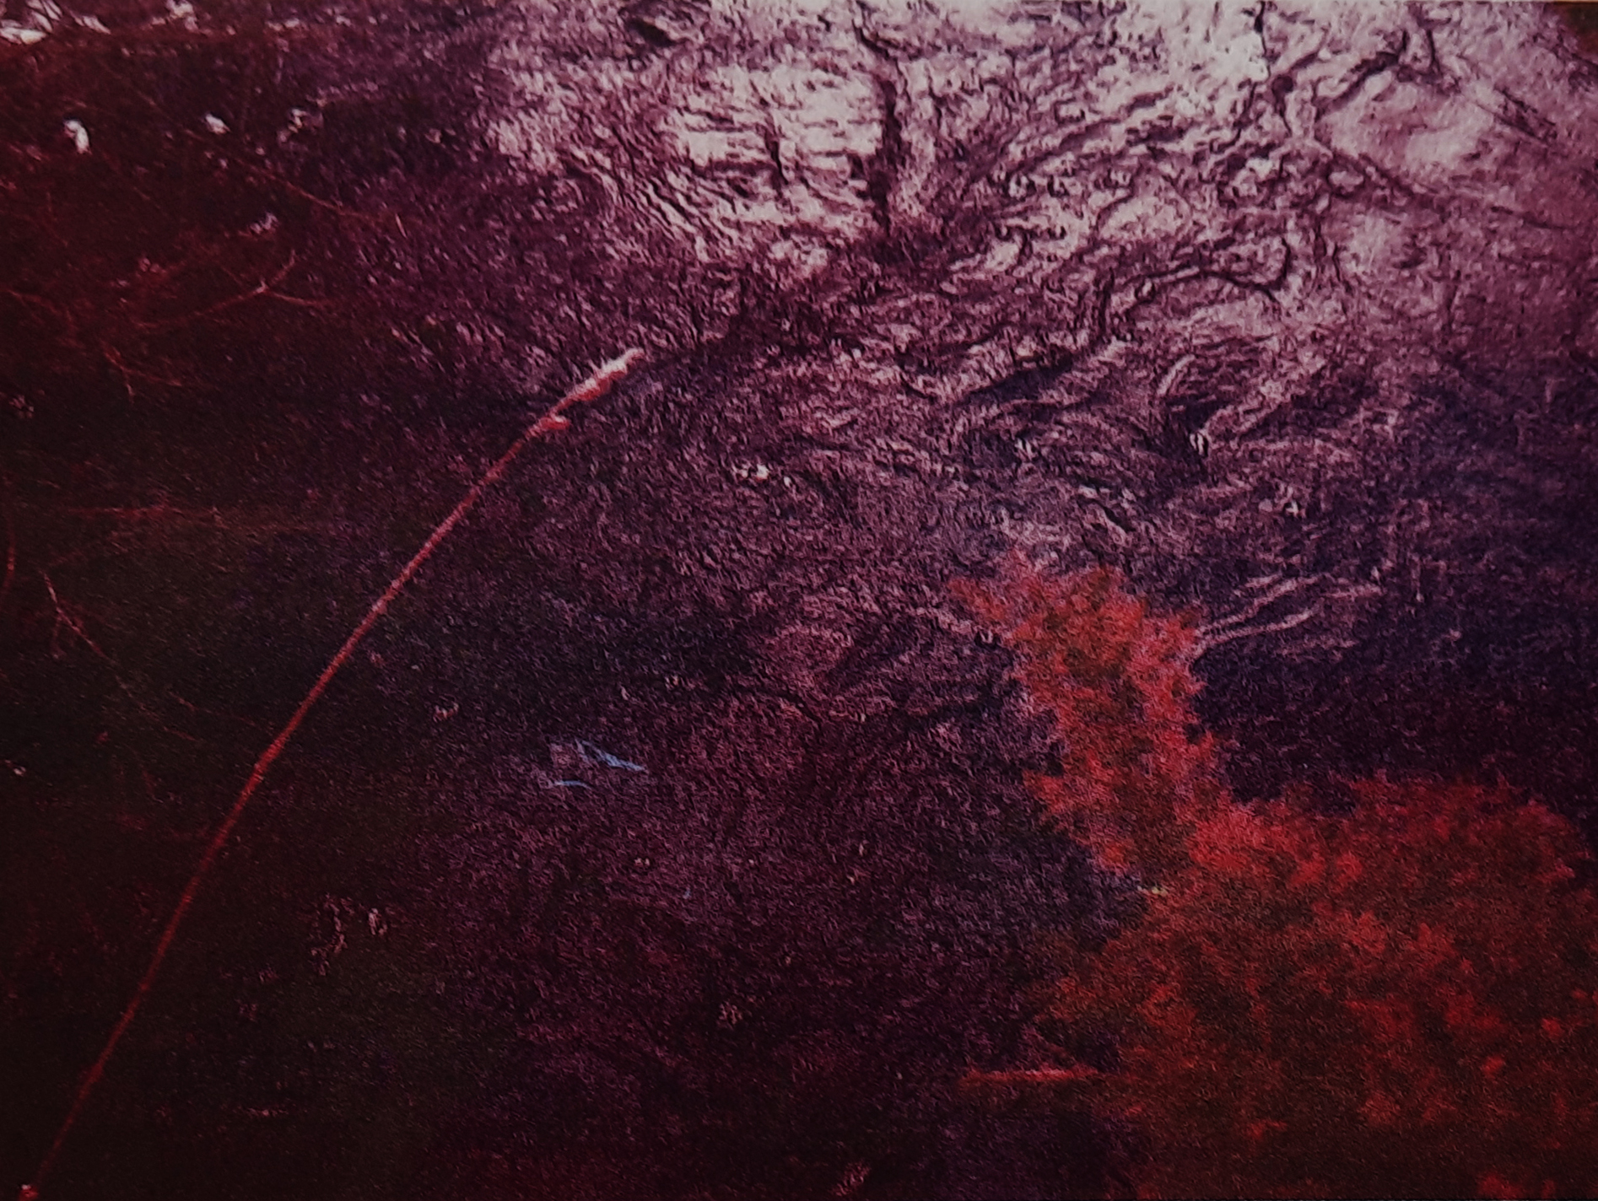
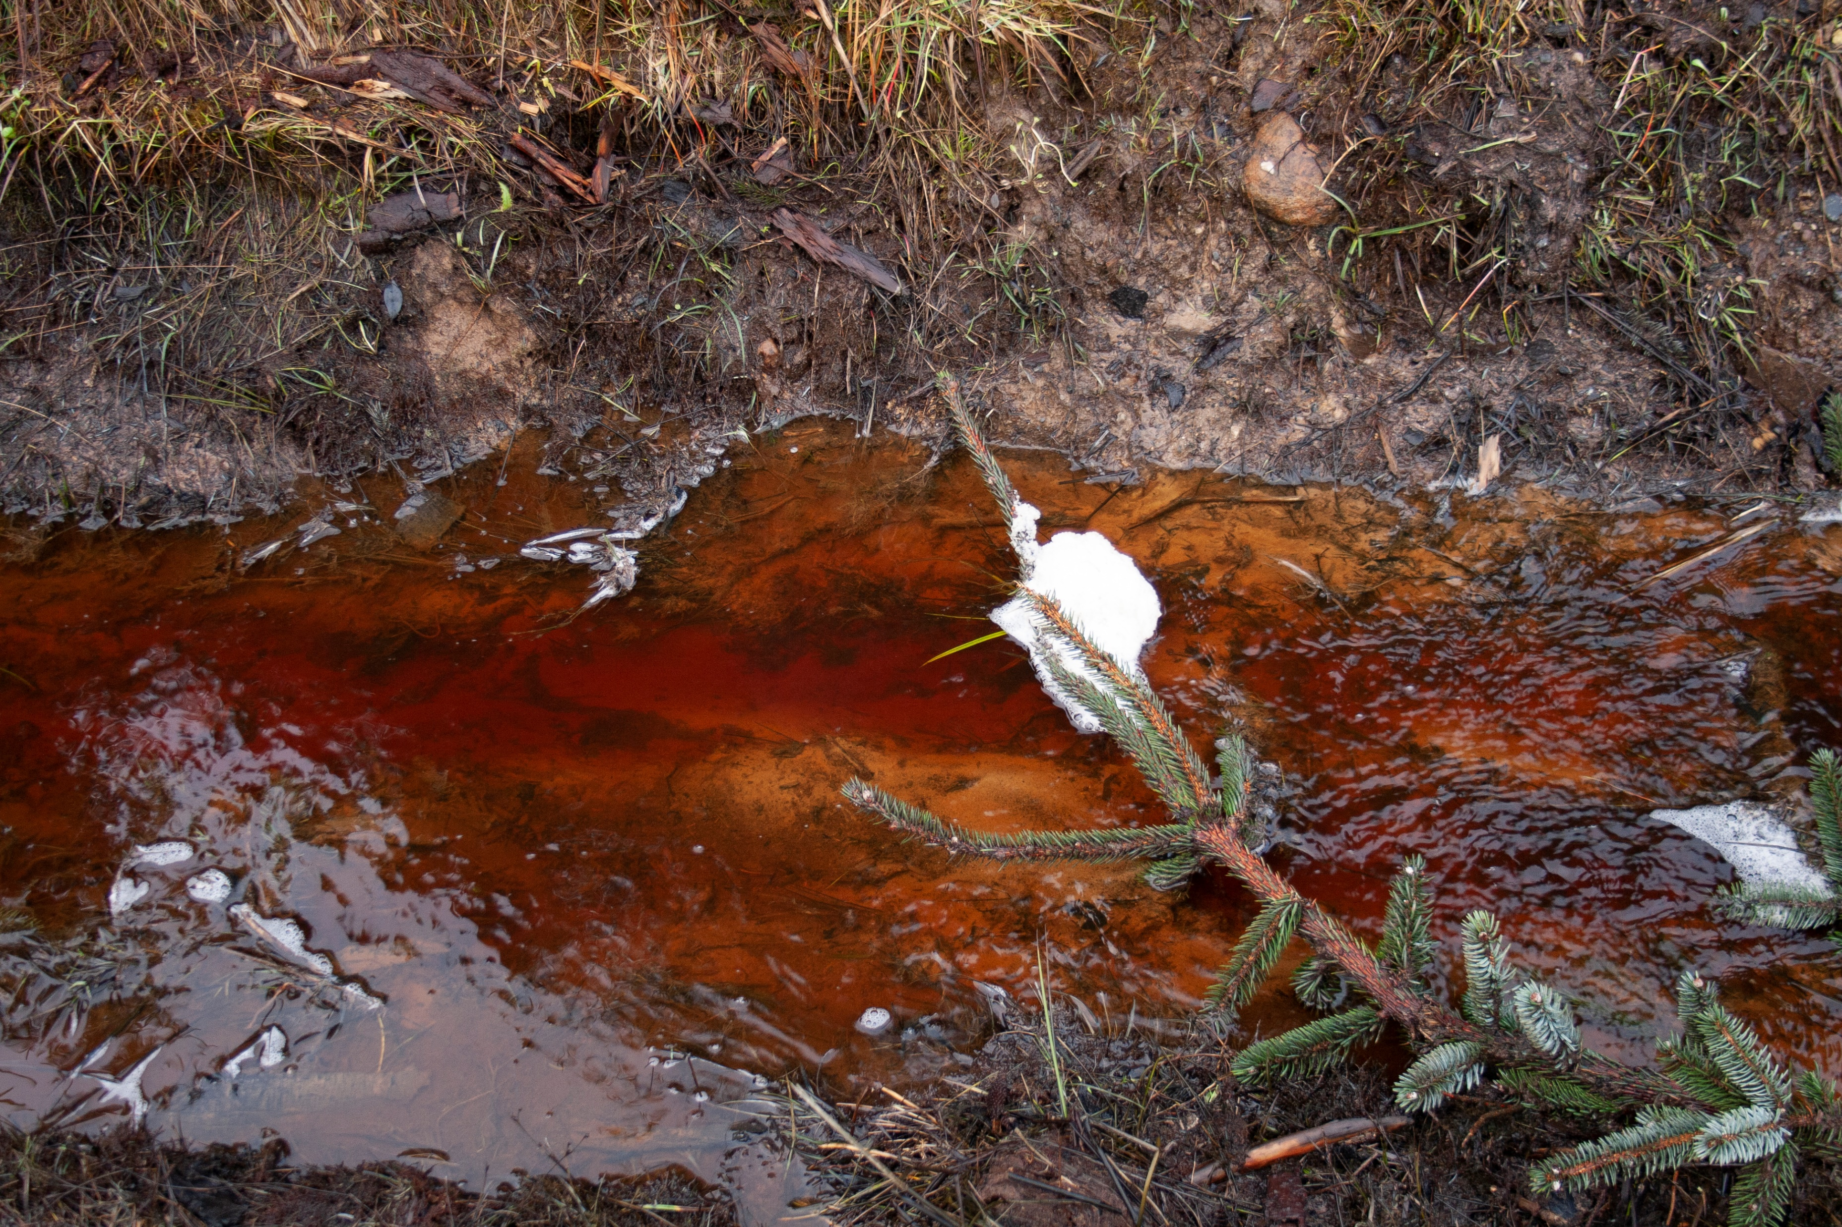

Slide 25
Boundary & Porosity
“There are ‘ spatial porosities’ and these are instances where there is an overlapping or permeation of barriers and boundaries. In fact, in these instances, it is difficult to determine boundaries at all, and instead one must experientially note qualities rather by transitions instead of boundary lines.”
(Benjamin and Lacis, 1925)

Slide 26
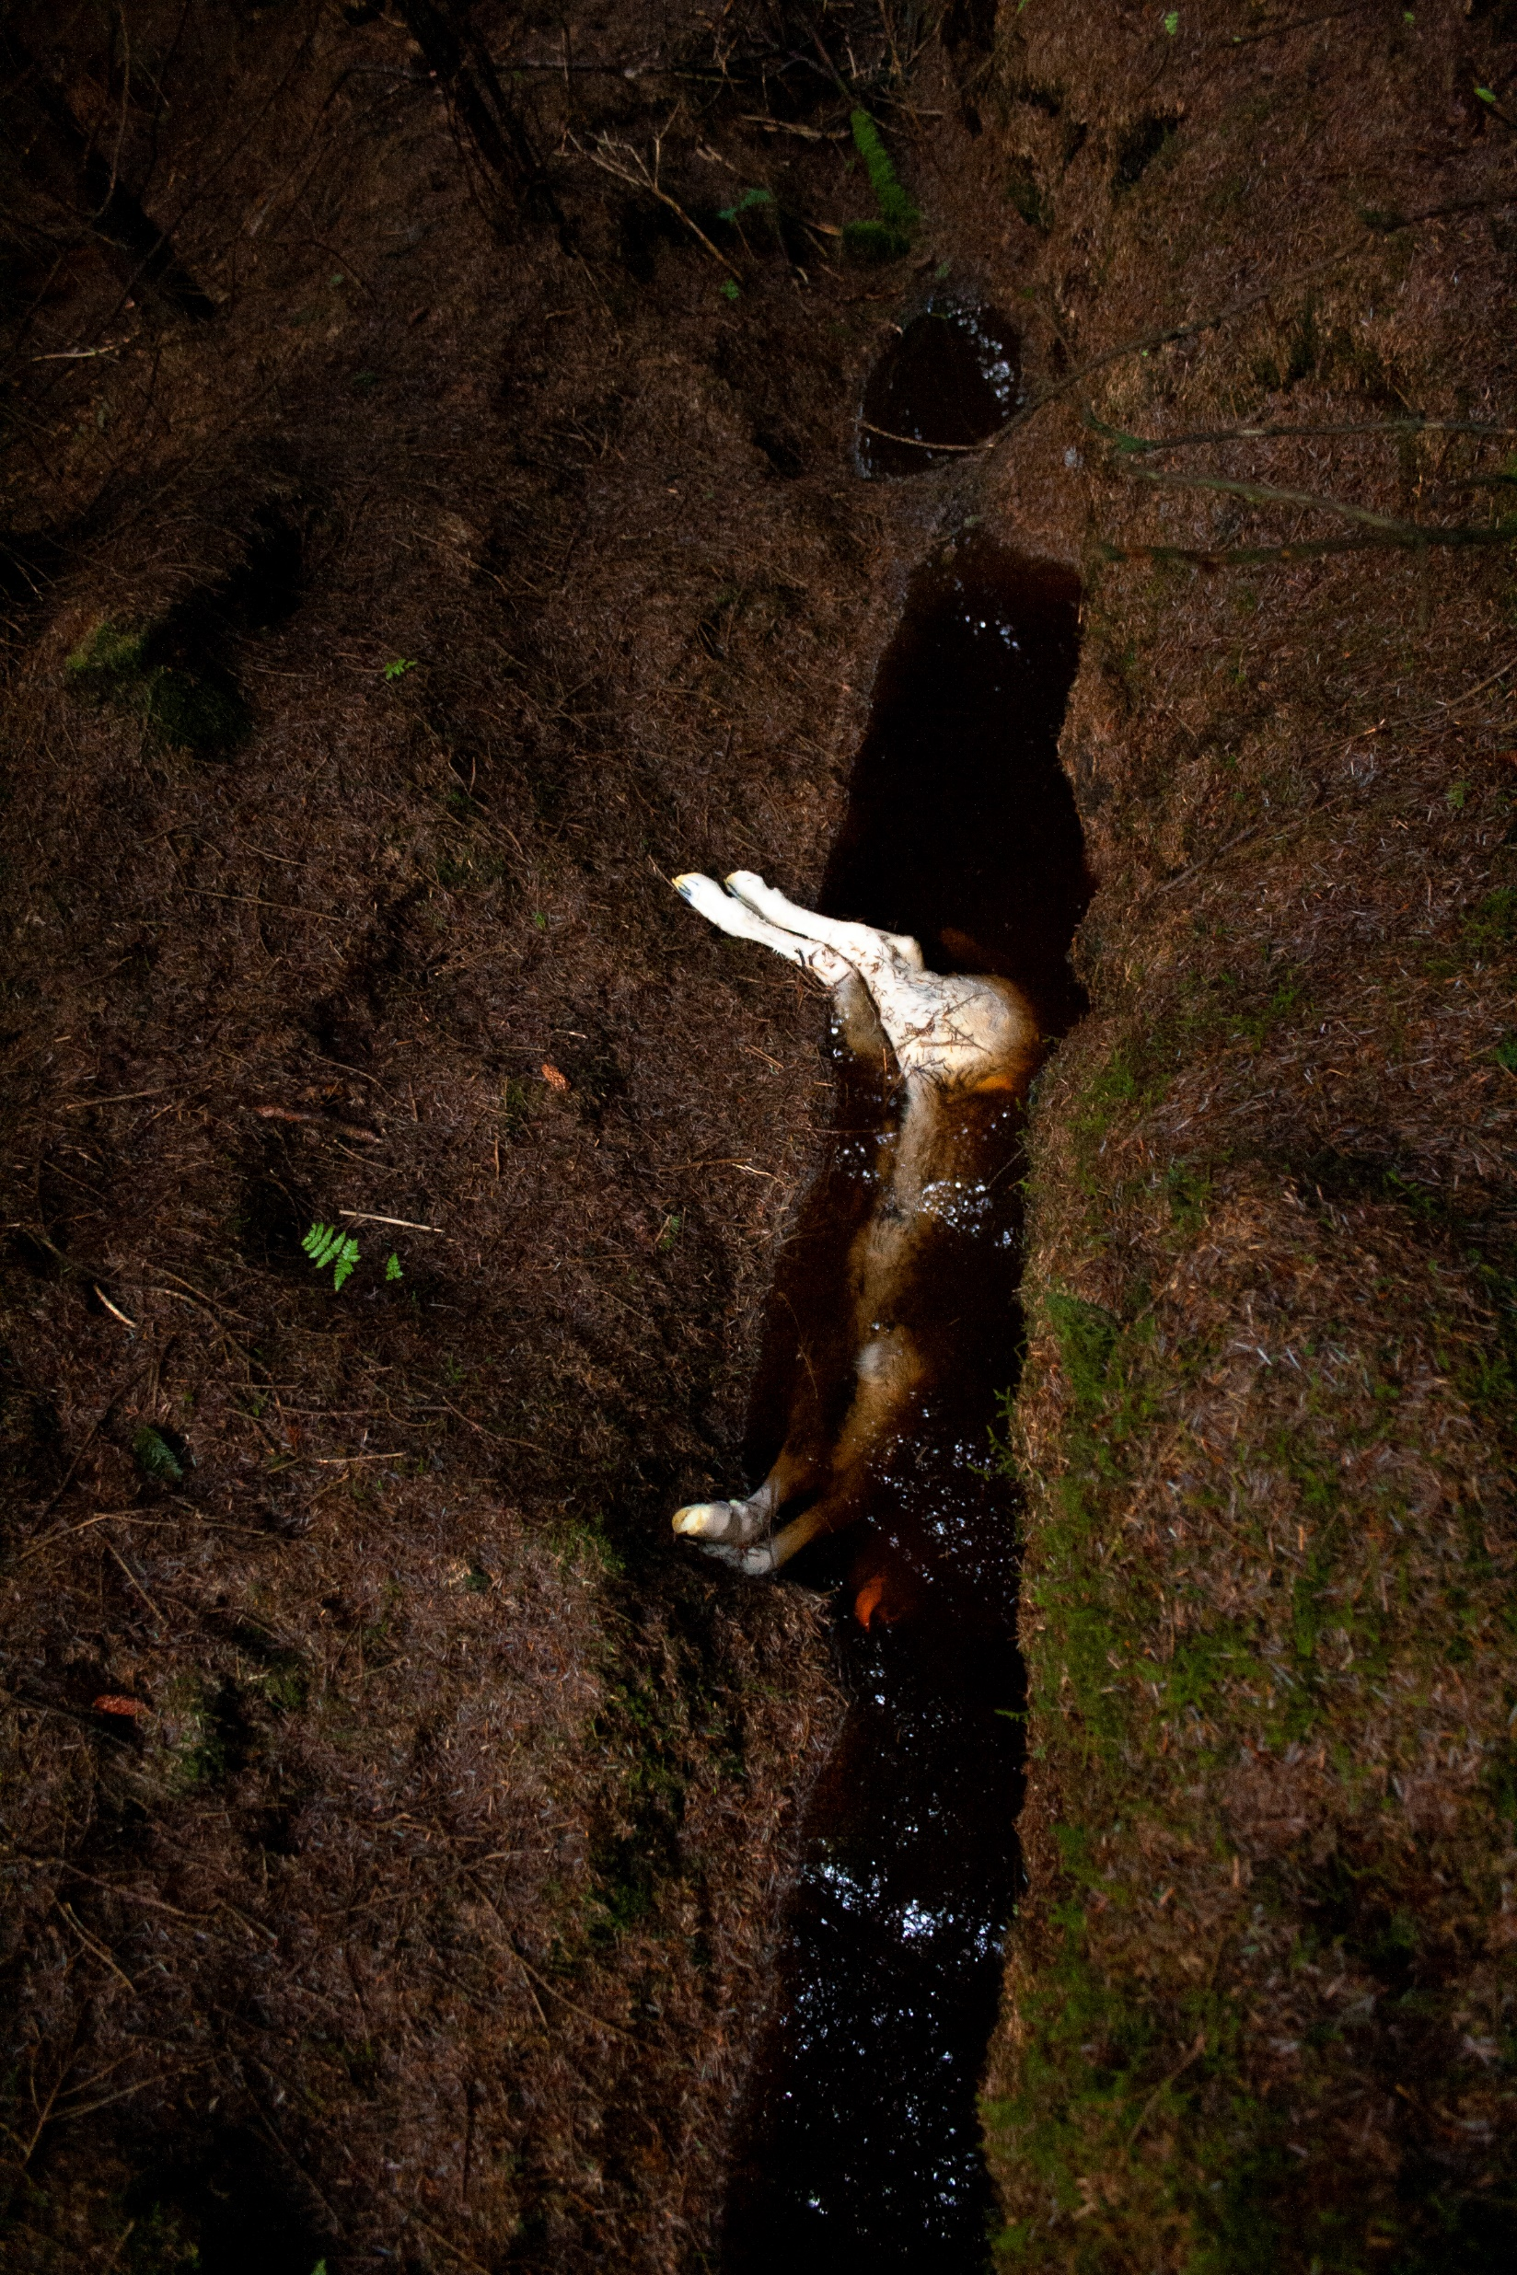
Rotting corpse, invisible bacteria, aliens carried down stream, making their way back through river and stream, to be consumed, invading ,integrating bodies, that discard such creatures. Blood and facia formed from spoiled water, an invisible line traced from one body to the next.

Slide 27
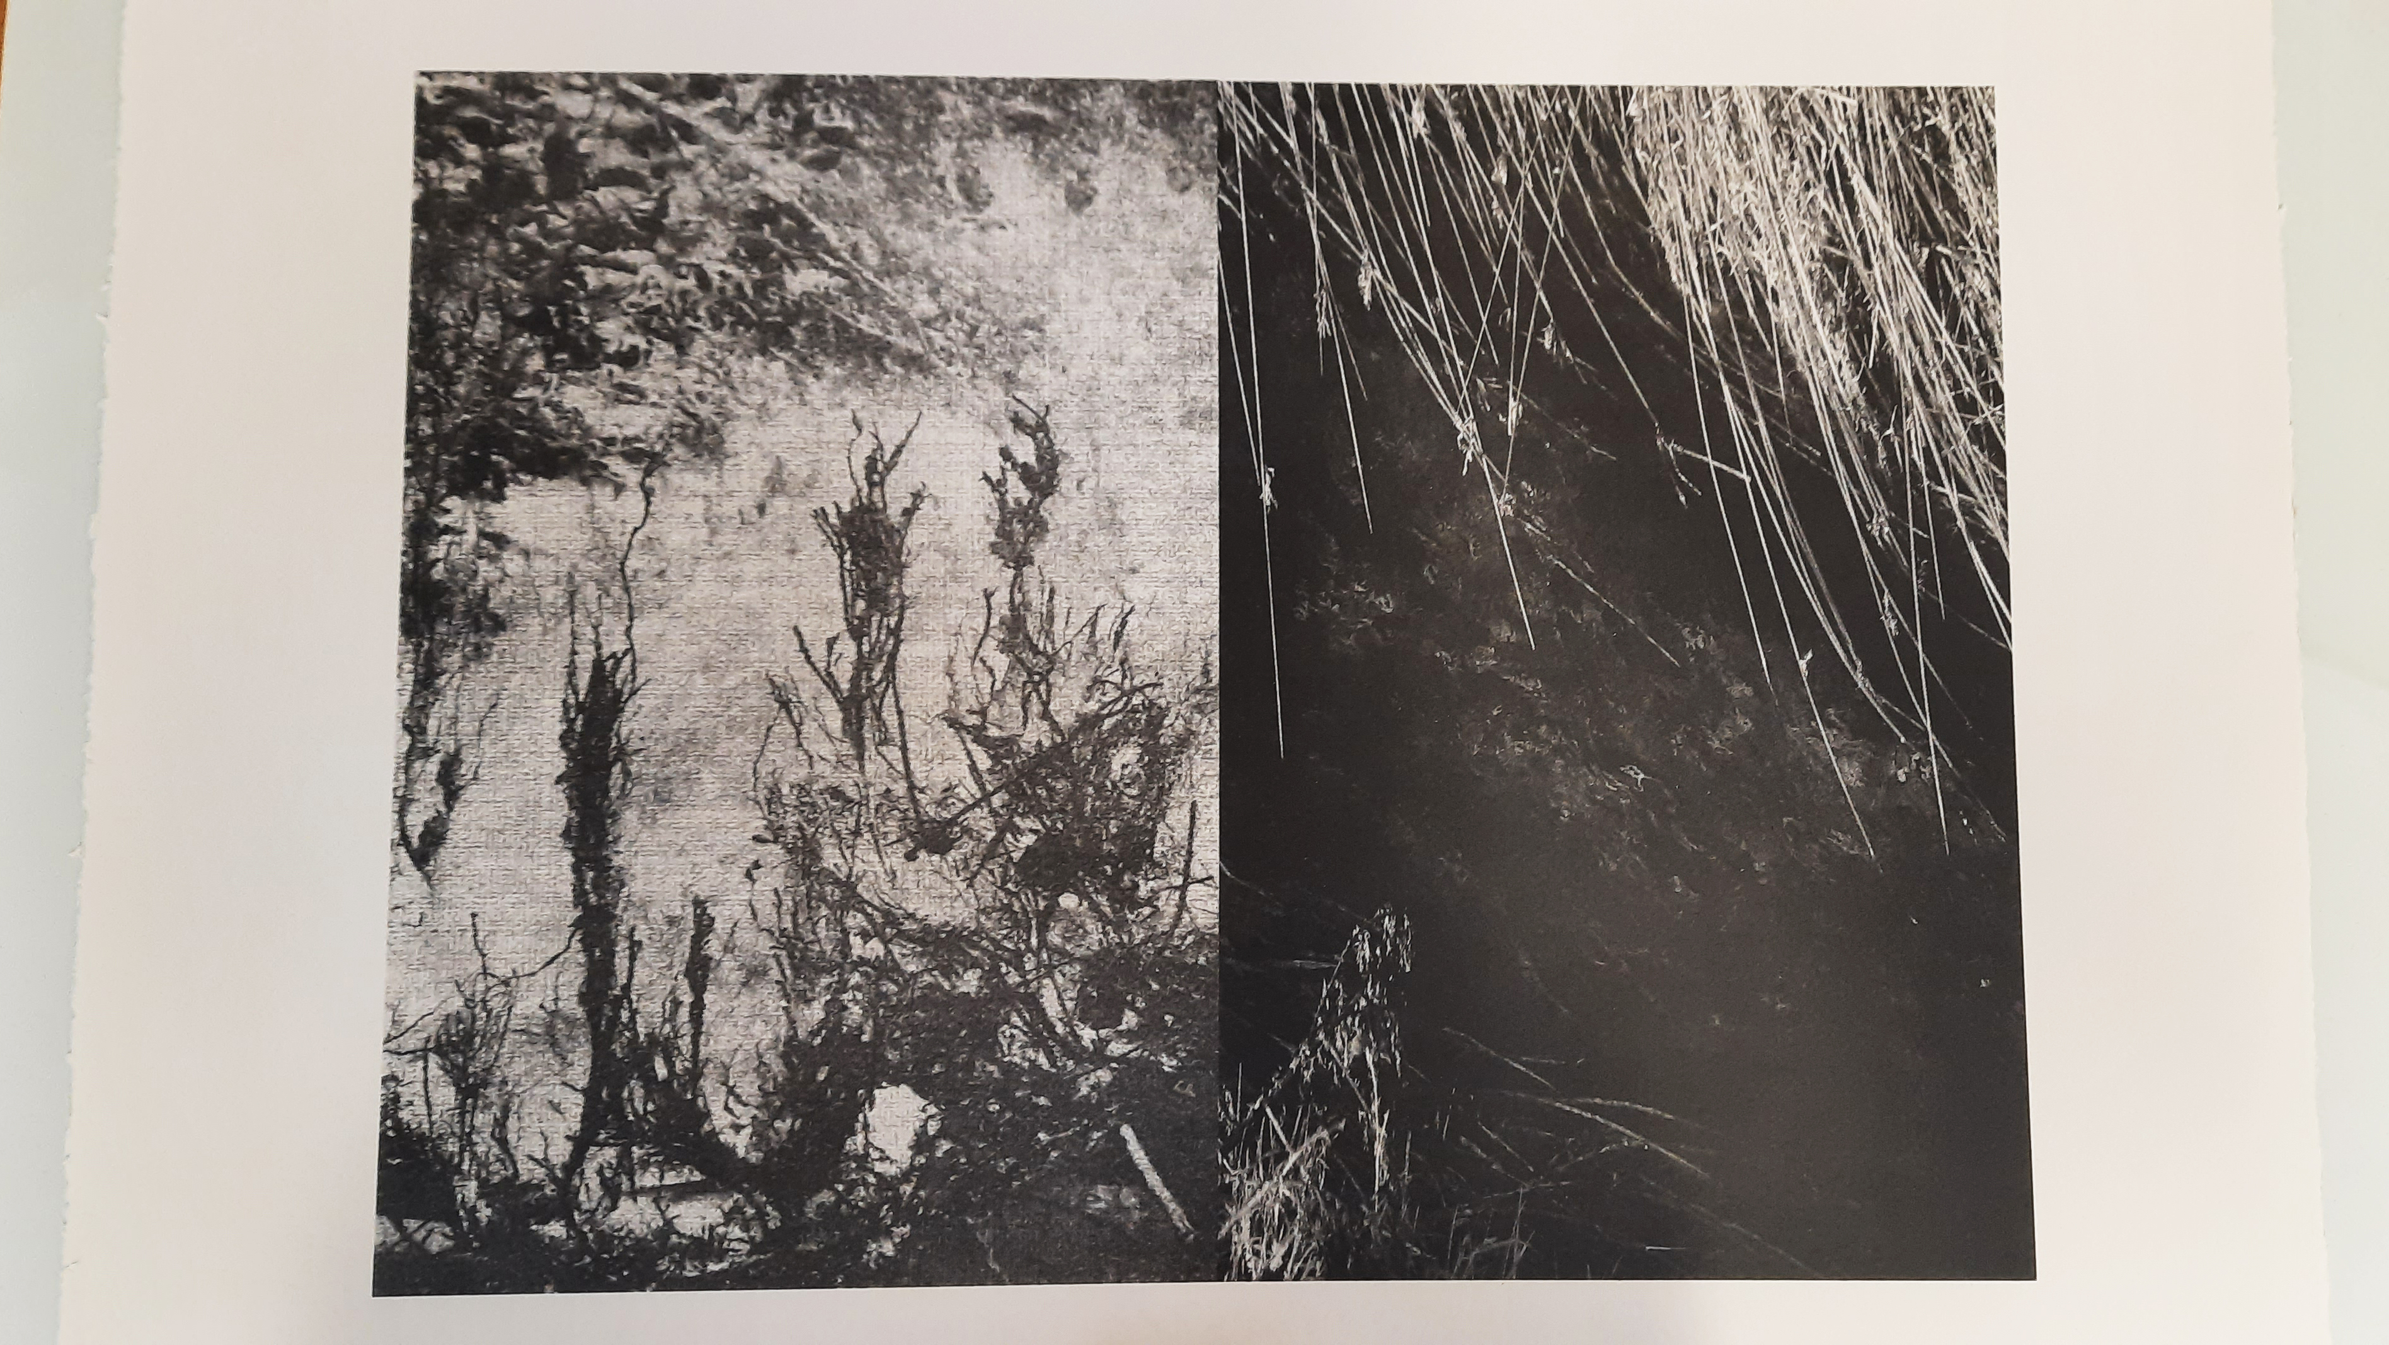
Niamh Fahy, Lithograph, 2021

Slide 28
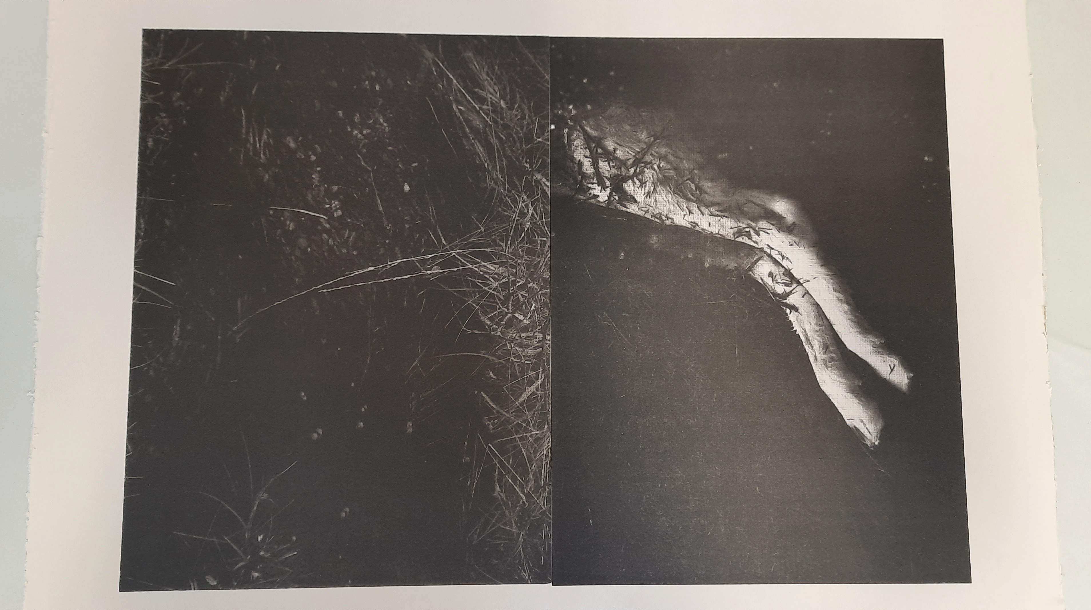
Niamh Fahy, Lithograph, 2021

Slide 29
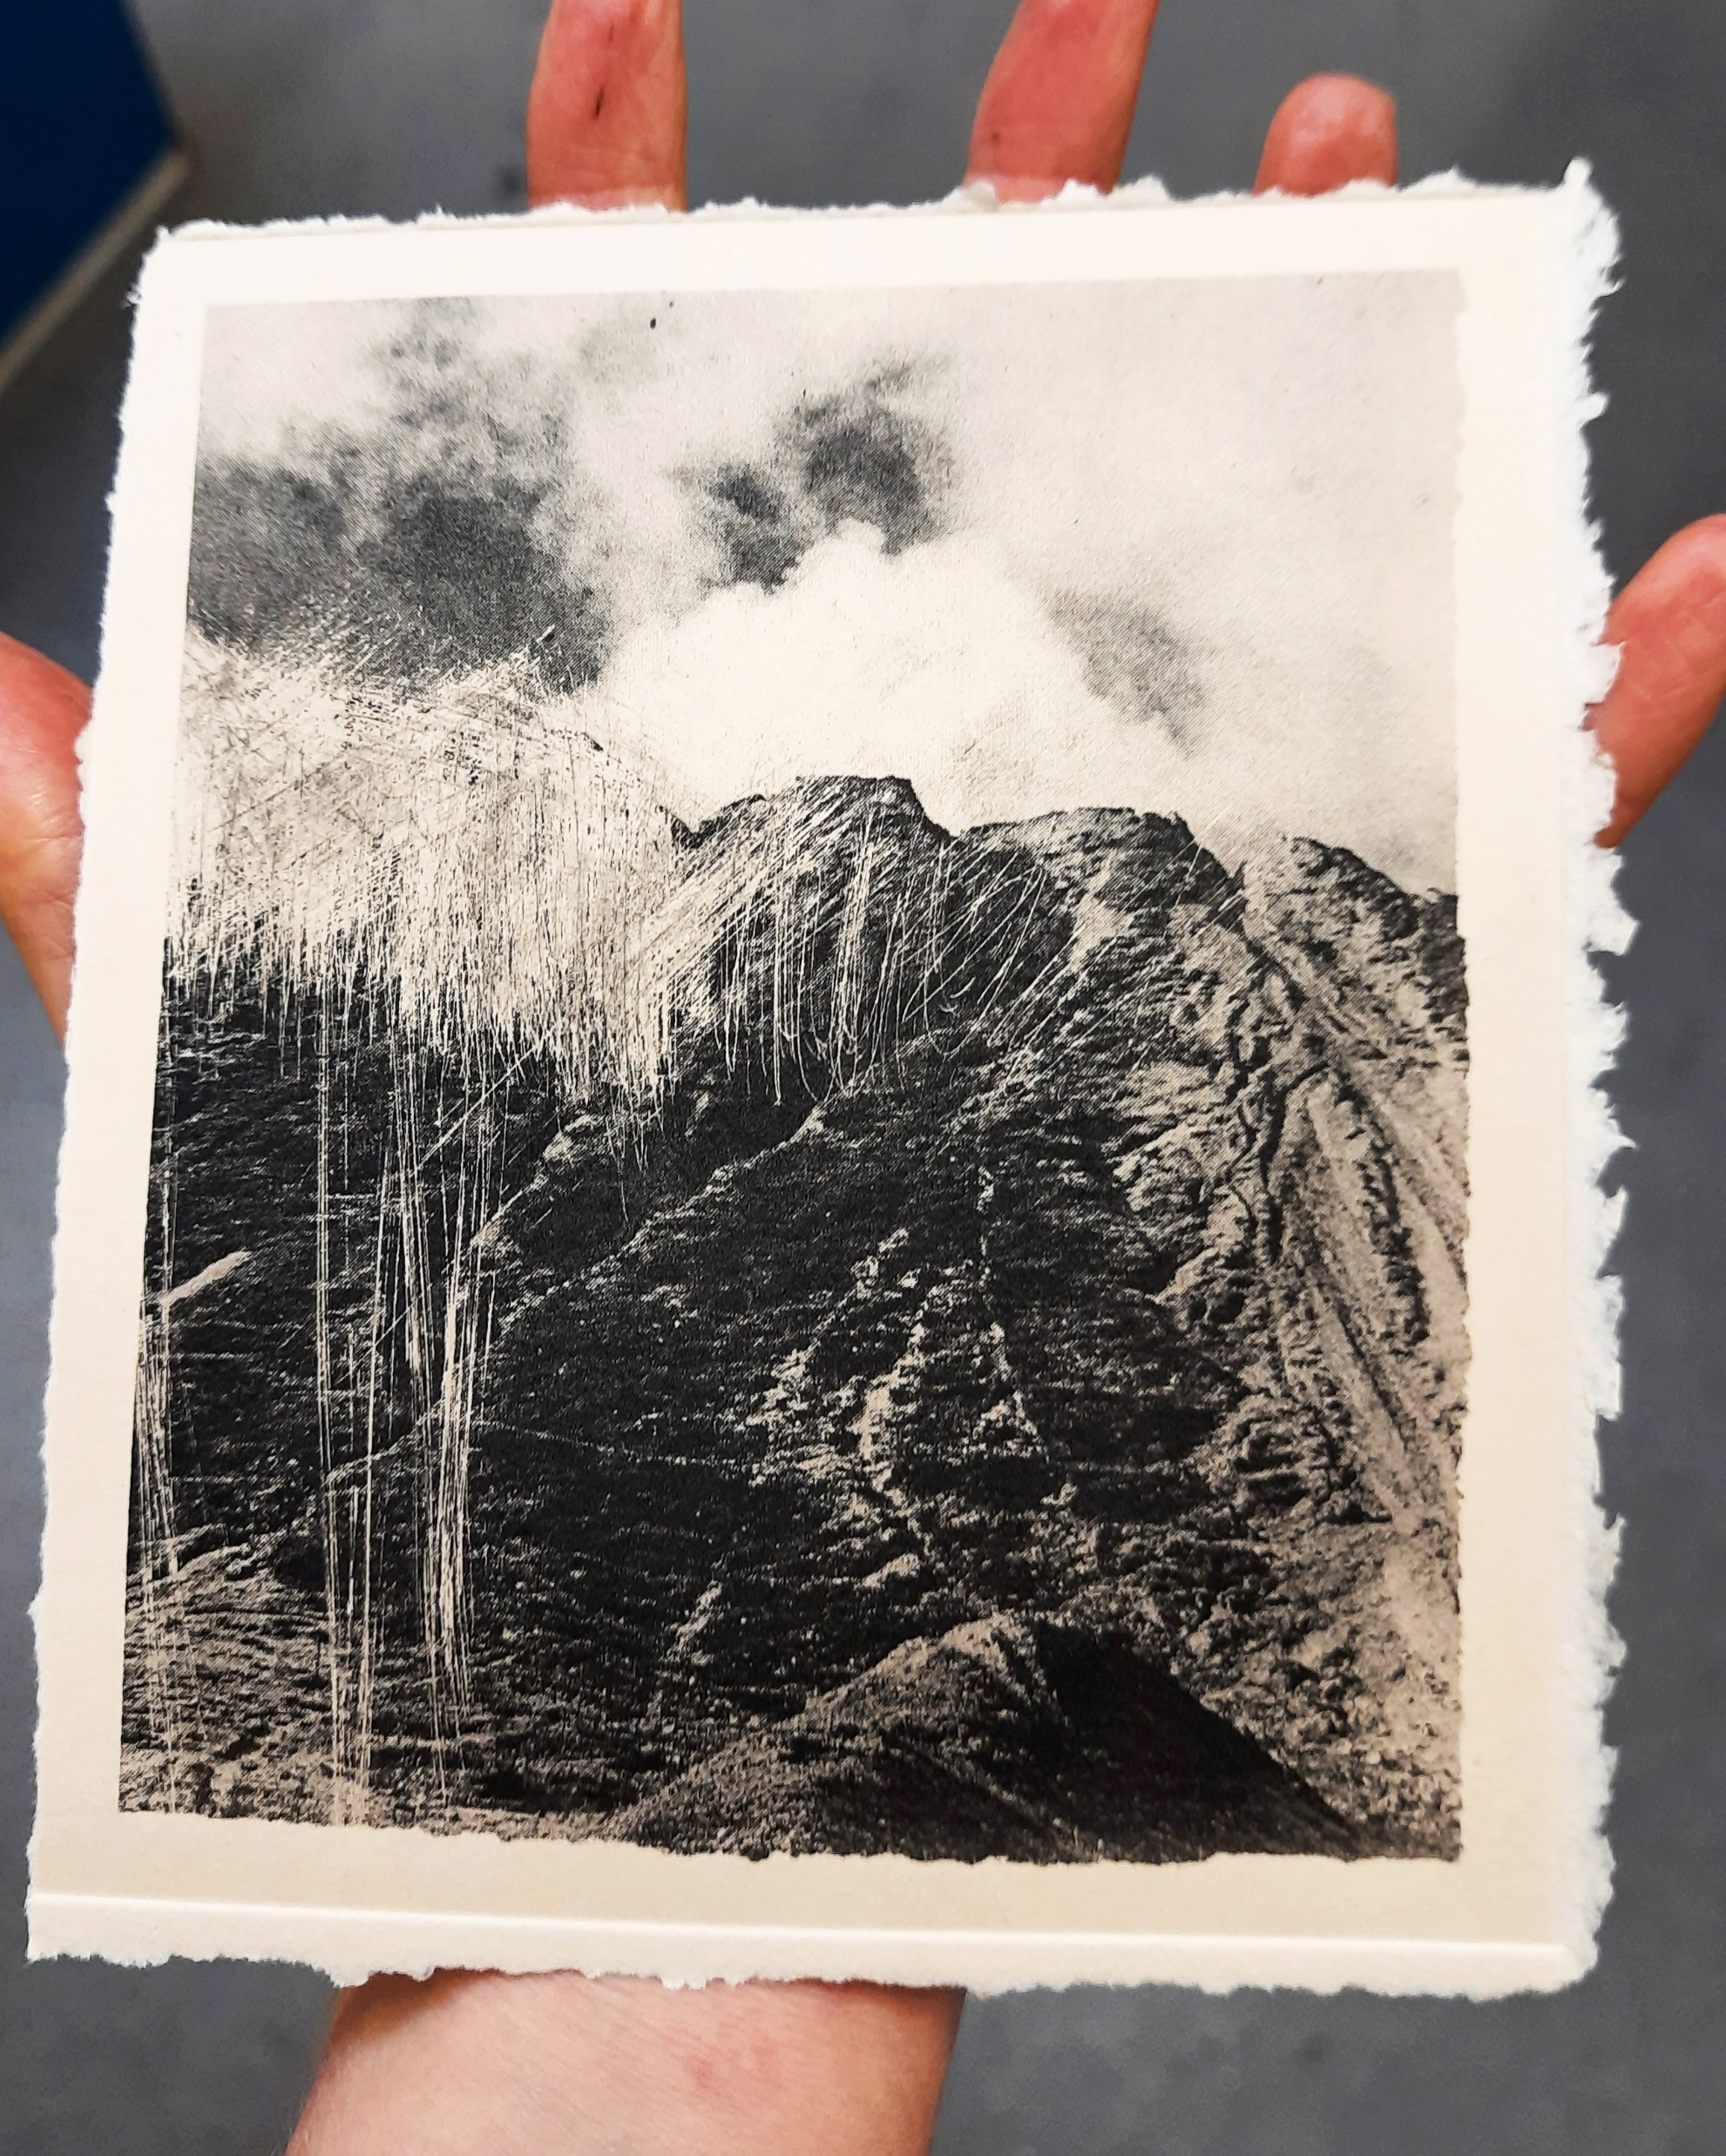
In order to carefully attend to the landscapes examined within this research it is important to reframe the notion of fieldwork as reflecting ourselves (our cells) as a component of a dynamic meshwork that exists across landscape, to recognise not only why we engage in fieldwork but “to what extent we are the fieldwork” (Modeen and Biggs, 2020, p.214). In this recognition, a responsiveness can develop that corresponds to the complex, fluid and unfolding environments that we are part of (Modeen and Biggs, 2020, p.215).
Niamh Fahy, Photo etching, 2021

Slide 30
Bibliography
Bennett, J. (2005) Empathic vision: affect, trauma, and contemporary art Cultural memory in the present. Stanford, California: Stanford University Press.
Butler, J. (2021) The Force of Nonviolence: An Ethico-Political Bind. London, UK: Verso.
Cadena, M. de la and Blaser, M. (2018) A world of many worlds. Durham: Duke University Press.
Deleuze, G. and F. Guattari 2004. A Thousand Plateaus: Capitalism and Schizophrenia, trans. B. Massumi.London: Continuum [originally published as Mille Plateaux, vol. 2 of Capitalisme et Schizophrénie, Paris: Minuit, 1980.
Haraway, D.J. (2016) Staying with the trouble: making kin in the Chthulucene Experimental futures: technological lives, scientific arts, anthropological voices. Durham: Duke University Press.
Latour, B. (2018) Down to earth: politics in the new climatic regime. English edition. Cambridge, UK; Medford, MA: Polity.
Modeen, M. and Biggs, I. (2020) Creative Engagements with Ecologies of Place: Geopoetics, Deep Mapping and Slow Residencies [online]. London& New York: Routledge. [Accessed 3 May 2021].
Murray, D. (2016) South Galway Floods. Available from : https://southgalwayfloods.wordpress.com/[ Accessed 20 September 2021]
Kupfer, P. (2019) One World for Staying and One for Going In: Nikonowicz, D. This world and others like it. Amsterdam, The Netherlands: Yoffy Press and Fw: Books. pp. 34-41.
Nixon, R. (2013) Slow violence and the environmentalism of the poor. Harvard Univ. Press paperback ed. Cambridge, Mass.: Harvard Univ. Press.
Nugent, Dr.P. (2006) aughty.org - history/heritage. Available from: http://www.aughty.org/heritage.htm [Accessed 3 May 2021].
Stone, M. (2011) Awake in the World, Teachings from Yoga and Buddhism for Living an Engaged Life. Boulder Colorado, United States: Shambala Publications Inc.
Talmor, D., Mavlian, S., Smyth, C., Smith, O. and Padley, G.(Eds.) (2020) Constructed Landscapes. Amsterdam, The Netherlands: Fw-Books.
Tsing, A., Swanson, H., Gan, E., & Bubandt, N. (Eds.). (2017). Arts of Living on a Damaged Planet: Ghosts and Monsters of the Anthropocene. Minneapolis: University of Minnesota Press.

Slide 31
Thank you for listening !
Niamh.Fahy@uwe.ac.uk
www.niamhfahy.com
https://cfpr.uwe.ac.uk
INSTAGRAM / niamhfahyart
INSTAGRAM / Cfpr_research

