Slide 1
(De)Constructing the Anthropocene (Re)Imagined landscapes Symposium June 9th -10th 2021
Niamh Fahy
Research Associate & PhD candidate
Centre for Fine Print Research
University of the West of England

Slide 2
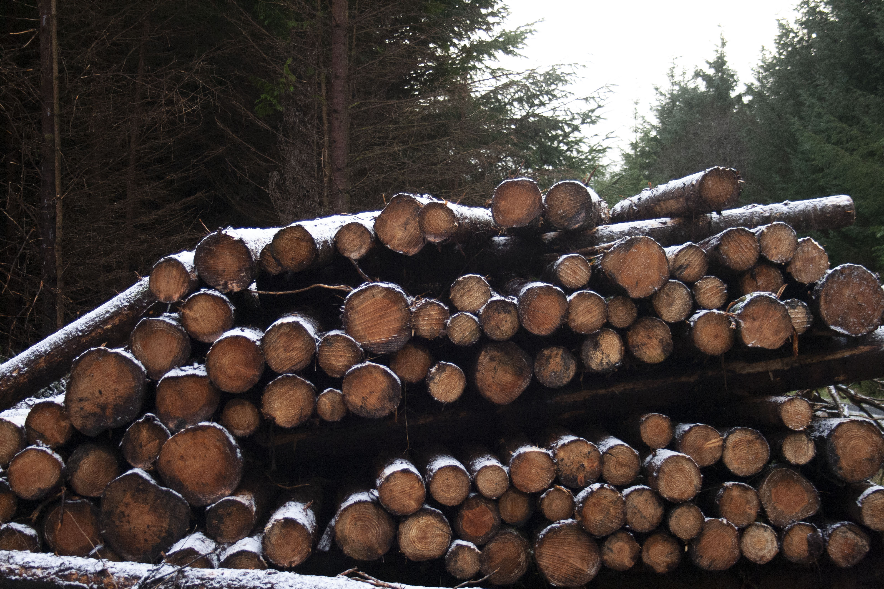
Outline
Introduction & Research Questions
Key Theories
Methodology Deep Mapping & Fieldwork
Shaping the Anthropocene
Concealed Landscapes Slieve Aughty case study
Conclusion

Slide 3
Research Question & Aims

Slide 4
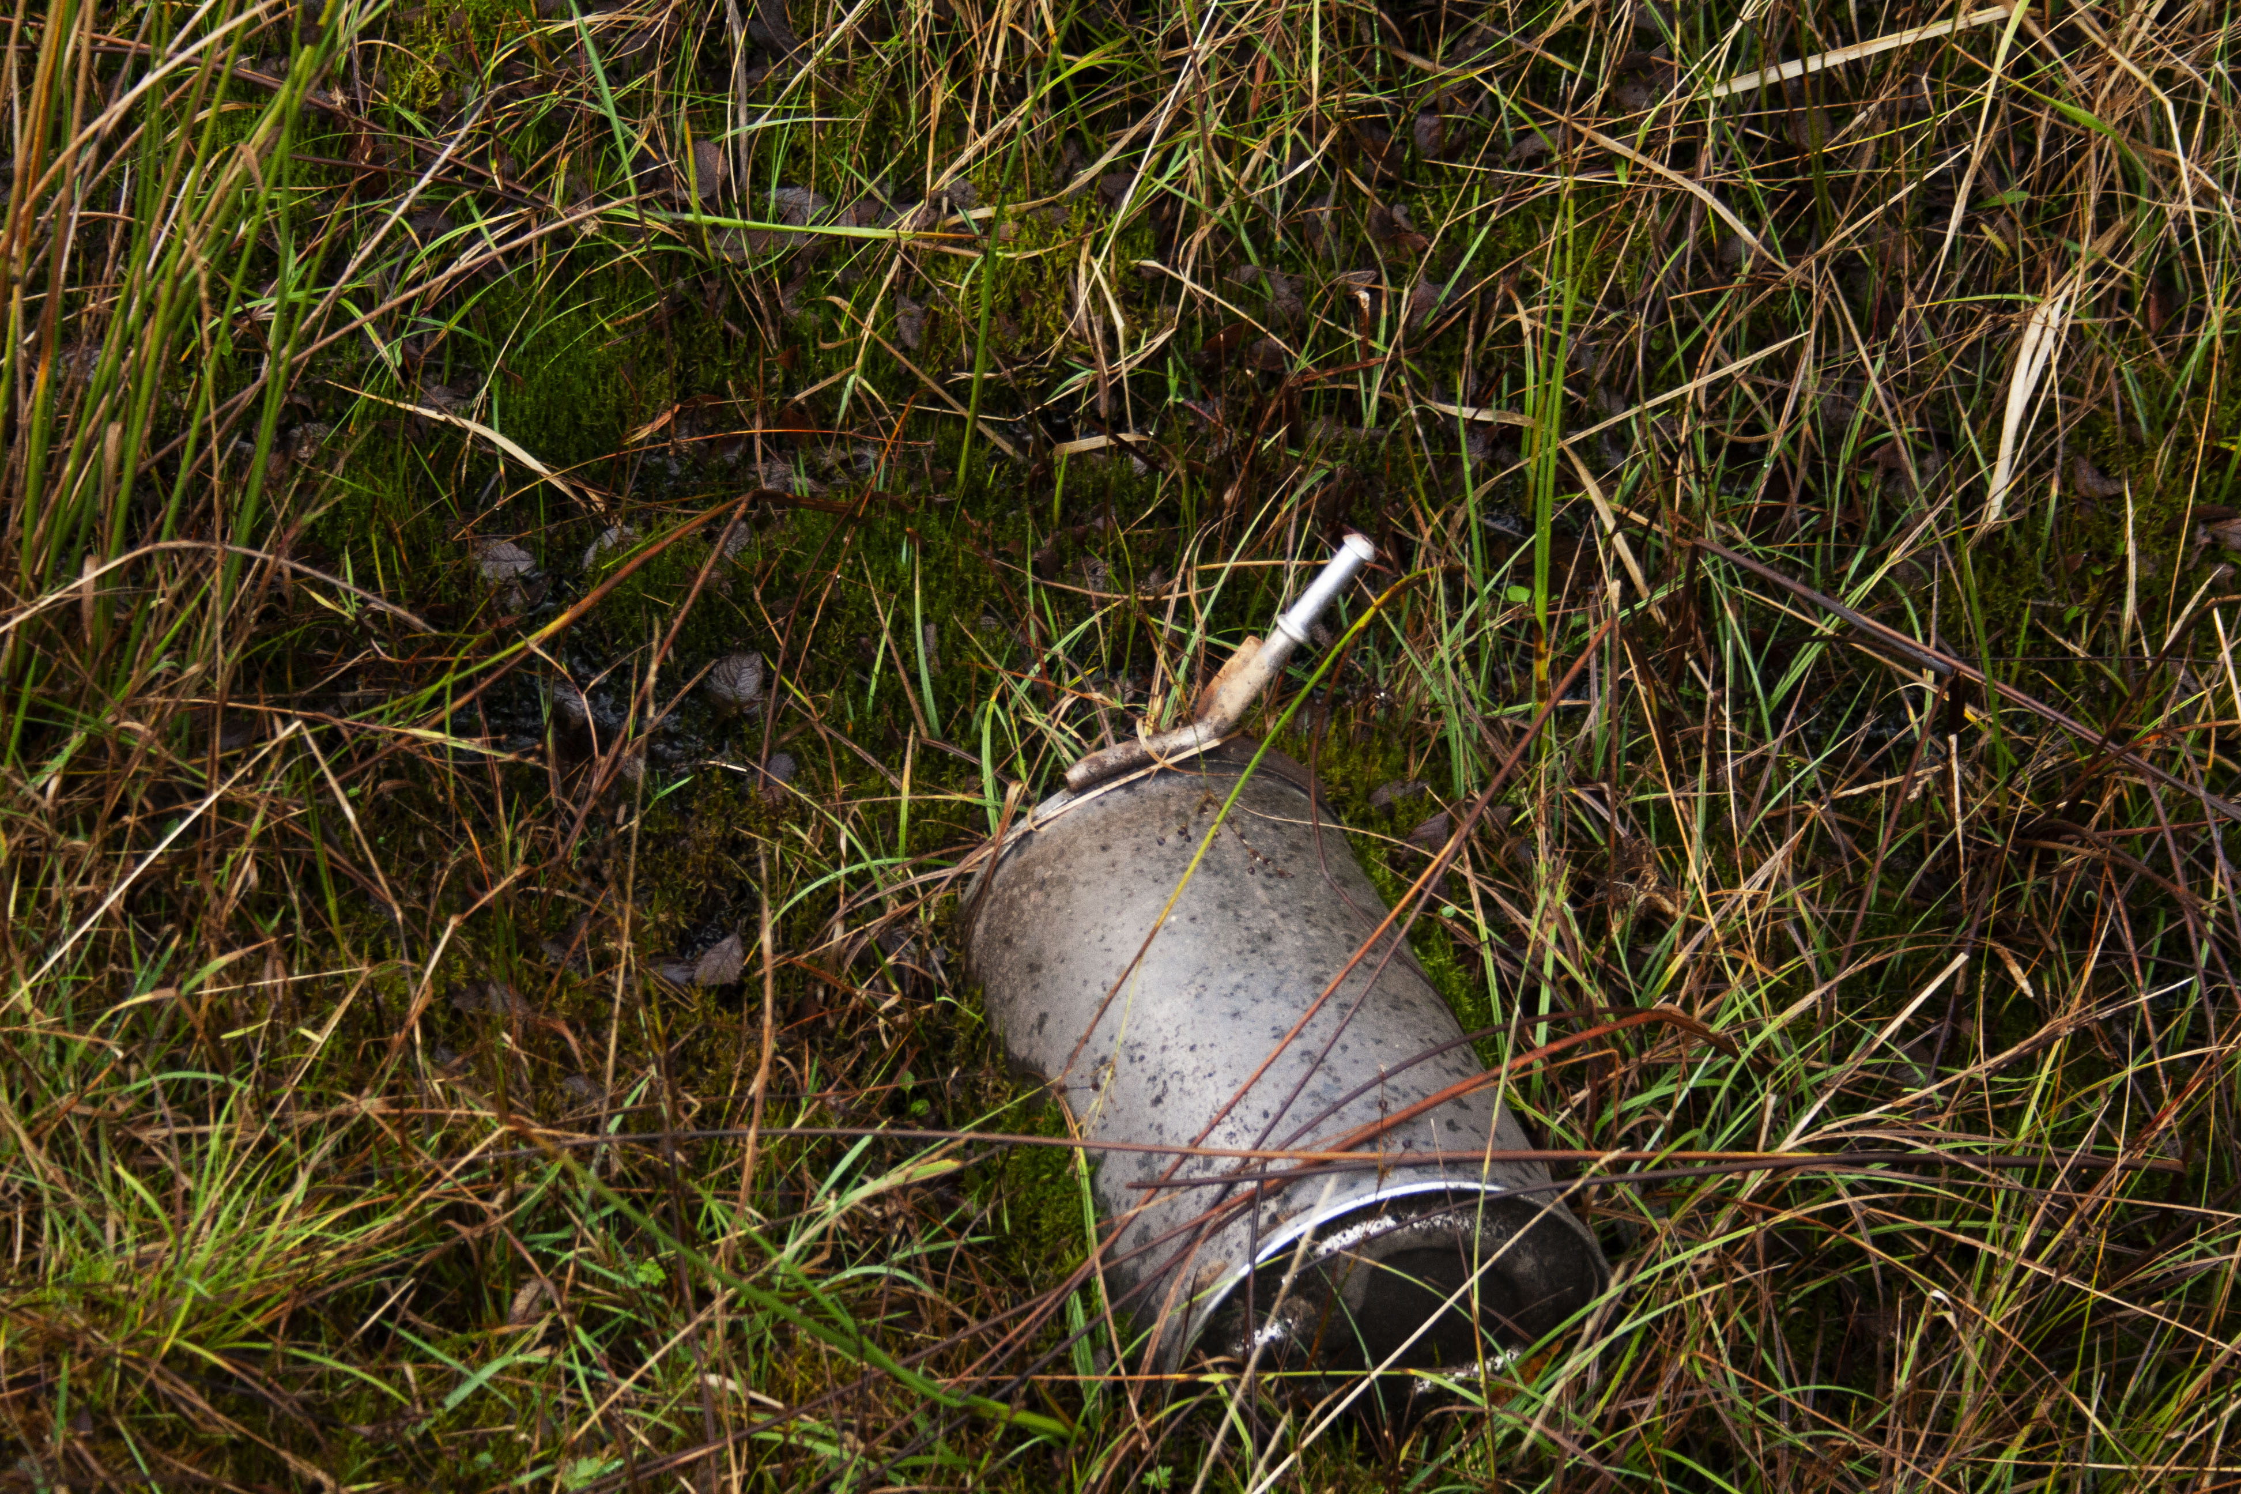
Research Question & Aims
How can the print artist contribute to understanding changes in landscape in the age of the Anthropocene?
Aims
To establish the practical methods, creative possibilities and impact of the print artist to create work that responds to changing landscapes.
To determine the capacity of the contemporary print artist to challenge and expand modes of understanding complexities within landscape change through the creation of visual narratives within print and photography that collaborates/consults with landscape experts beyond art disciplines.

Slide 5
Key Theories

Slide 6
Slow Violence
The term slow violence refers to environmental destruction that takes places over a gradual period, frequently concealed imperceptible and devoid of immediate spectacle commonly associated with notions of violence. Slow violence is often perceived as inevitable It is too consistent to warrant the immediate scrutiny associated with disaster, presented by an image centric media.
(Nixon, 2013)

Slide 7
Pluriverse
Pluriverse is the proposal for recognising the plural perspectives, heterogenous practices and diverse life forms that compose a world of many worlds. Pluriverse imagines and magnifies the multiple, open- ended practices that co-exist within an interconnected meshwork that allows for a multitude of worlds to emerge
(Cadena & Blaser,2018.p.4).

Slide 8
Methodology

Slide 9
Deep Mapping, Slow Residencies & Fieldwork
The term ‘deep mapping’ resists disciplinary definitions or academic boundaries. It concerns the “quality of attention” (Modeen and Biggs, 2020, p.55) that is required to care for and respond to the landscapes we inhabit.
Pr0posed as “an embodied and reflexive immersion in a life that is lived and preformed spatially. A cartography of depth. A diving within” ( Roberts 2016 cited by Modeen and Biggs, 2020, p.53).
Within this research fieldwork is adapted as a practice of “anti conclusion” where periods of immersion and reflection are applied as an attentive practice which answers to the qualities of the landscape it explores

Slide 10
Shaping the Anthropocene

Slide 11
Shaping the Anthropocene A one-world-world?
John Law refers to a “One -world -world, a world that has granted itself the right to assimilate all other worlds and by presenting itself as exclusive, cancels possibilities for what lies beyond its limits.” ( Law cited by Cadena and Blaser, 2018, p.3)
Through expanding one world we diminish another, tipping the scale of balance, we abandon an abundance of diversity that supports the majority in favour of a limited and exclusive wealth available to few. The eradication of such worlds raises questions within my own practice, what ghosts do absent worlds create and what does it do to make them visible them through artist practice.(Tsing, 2017)

Slide 12
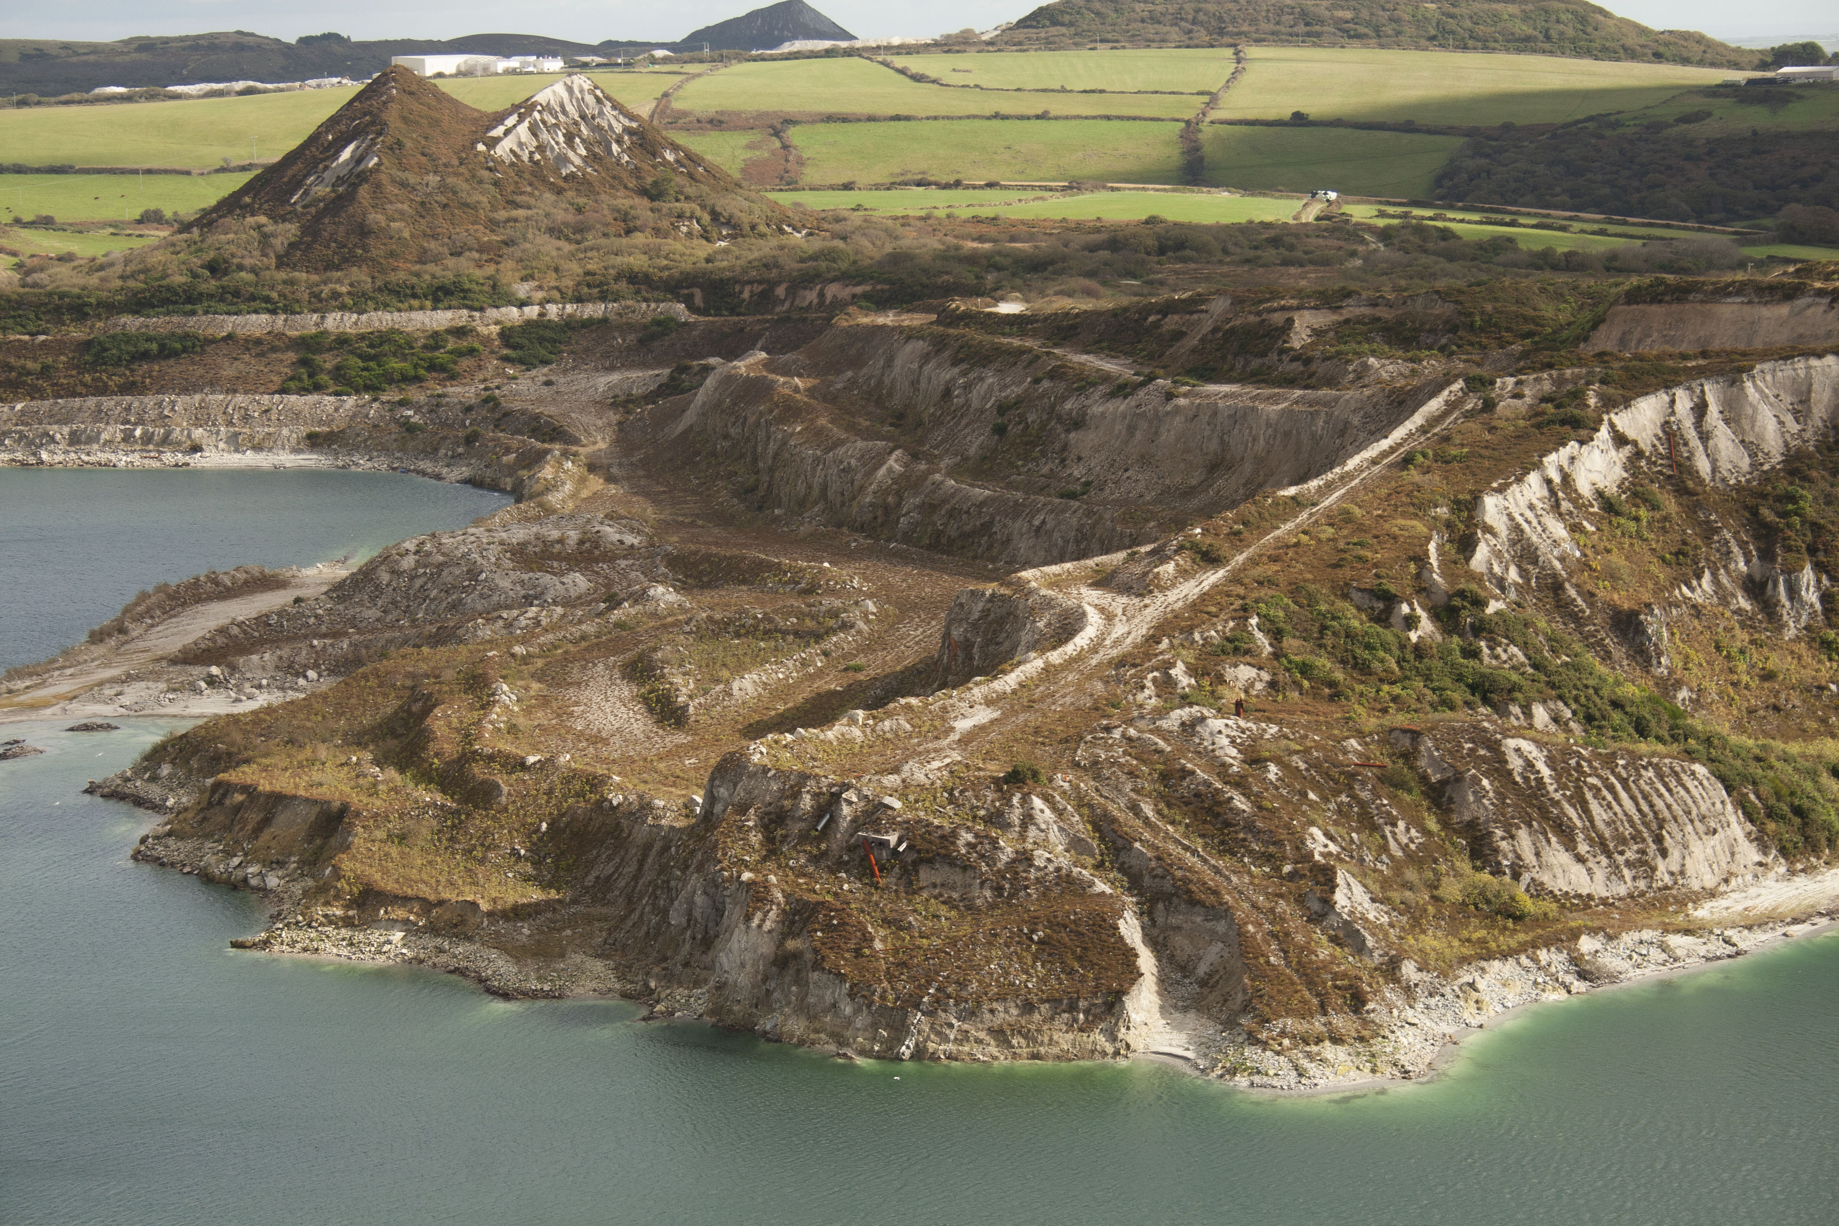
China Clay Pitts
Niamh Fahy, Blackpool Mine, digital photograph, 2020

Slide 13
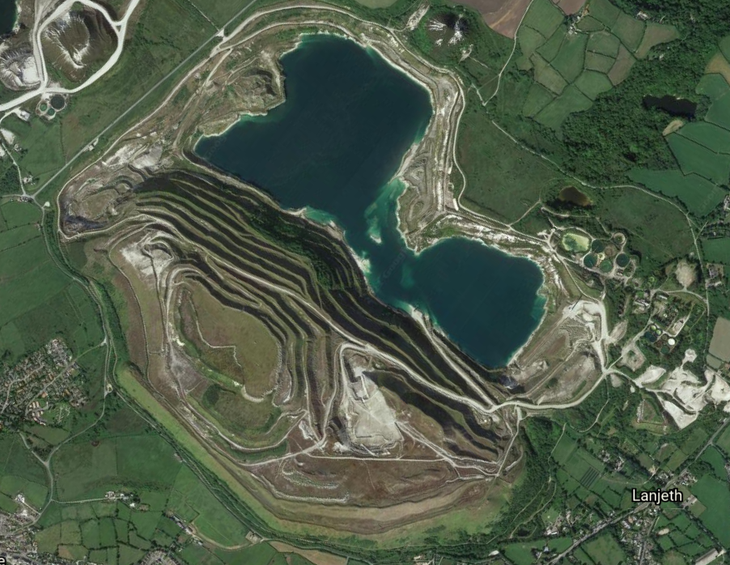
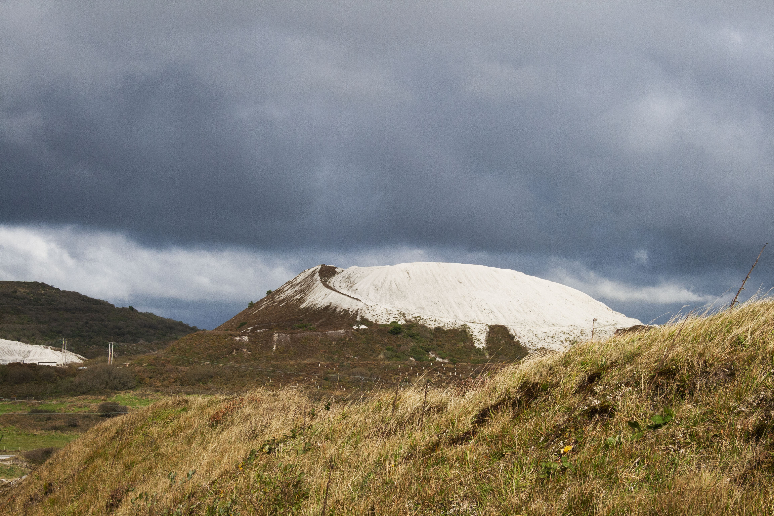
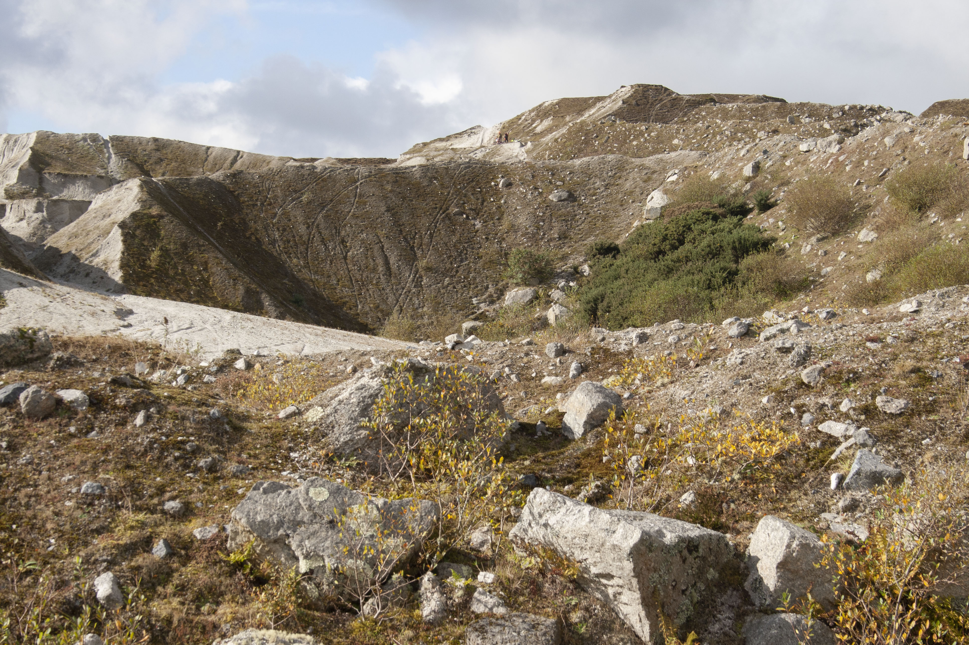
Niamh Fahy, ‘Cornish Alps’, digital photograph, 2020
Niamh Fahy, Blackpool Pit 2021, courtesy of Google Earth Satellite imagery
Niamh Fahy, Blackpool Mine, digital photograph, 2020

Slide 14
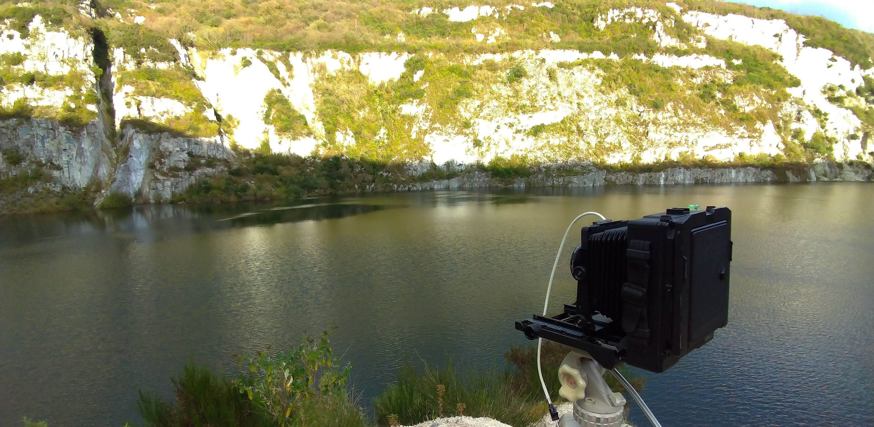
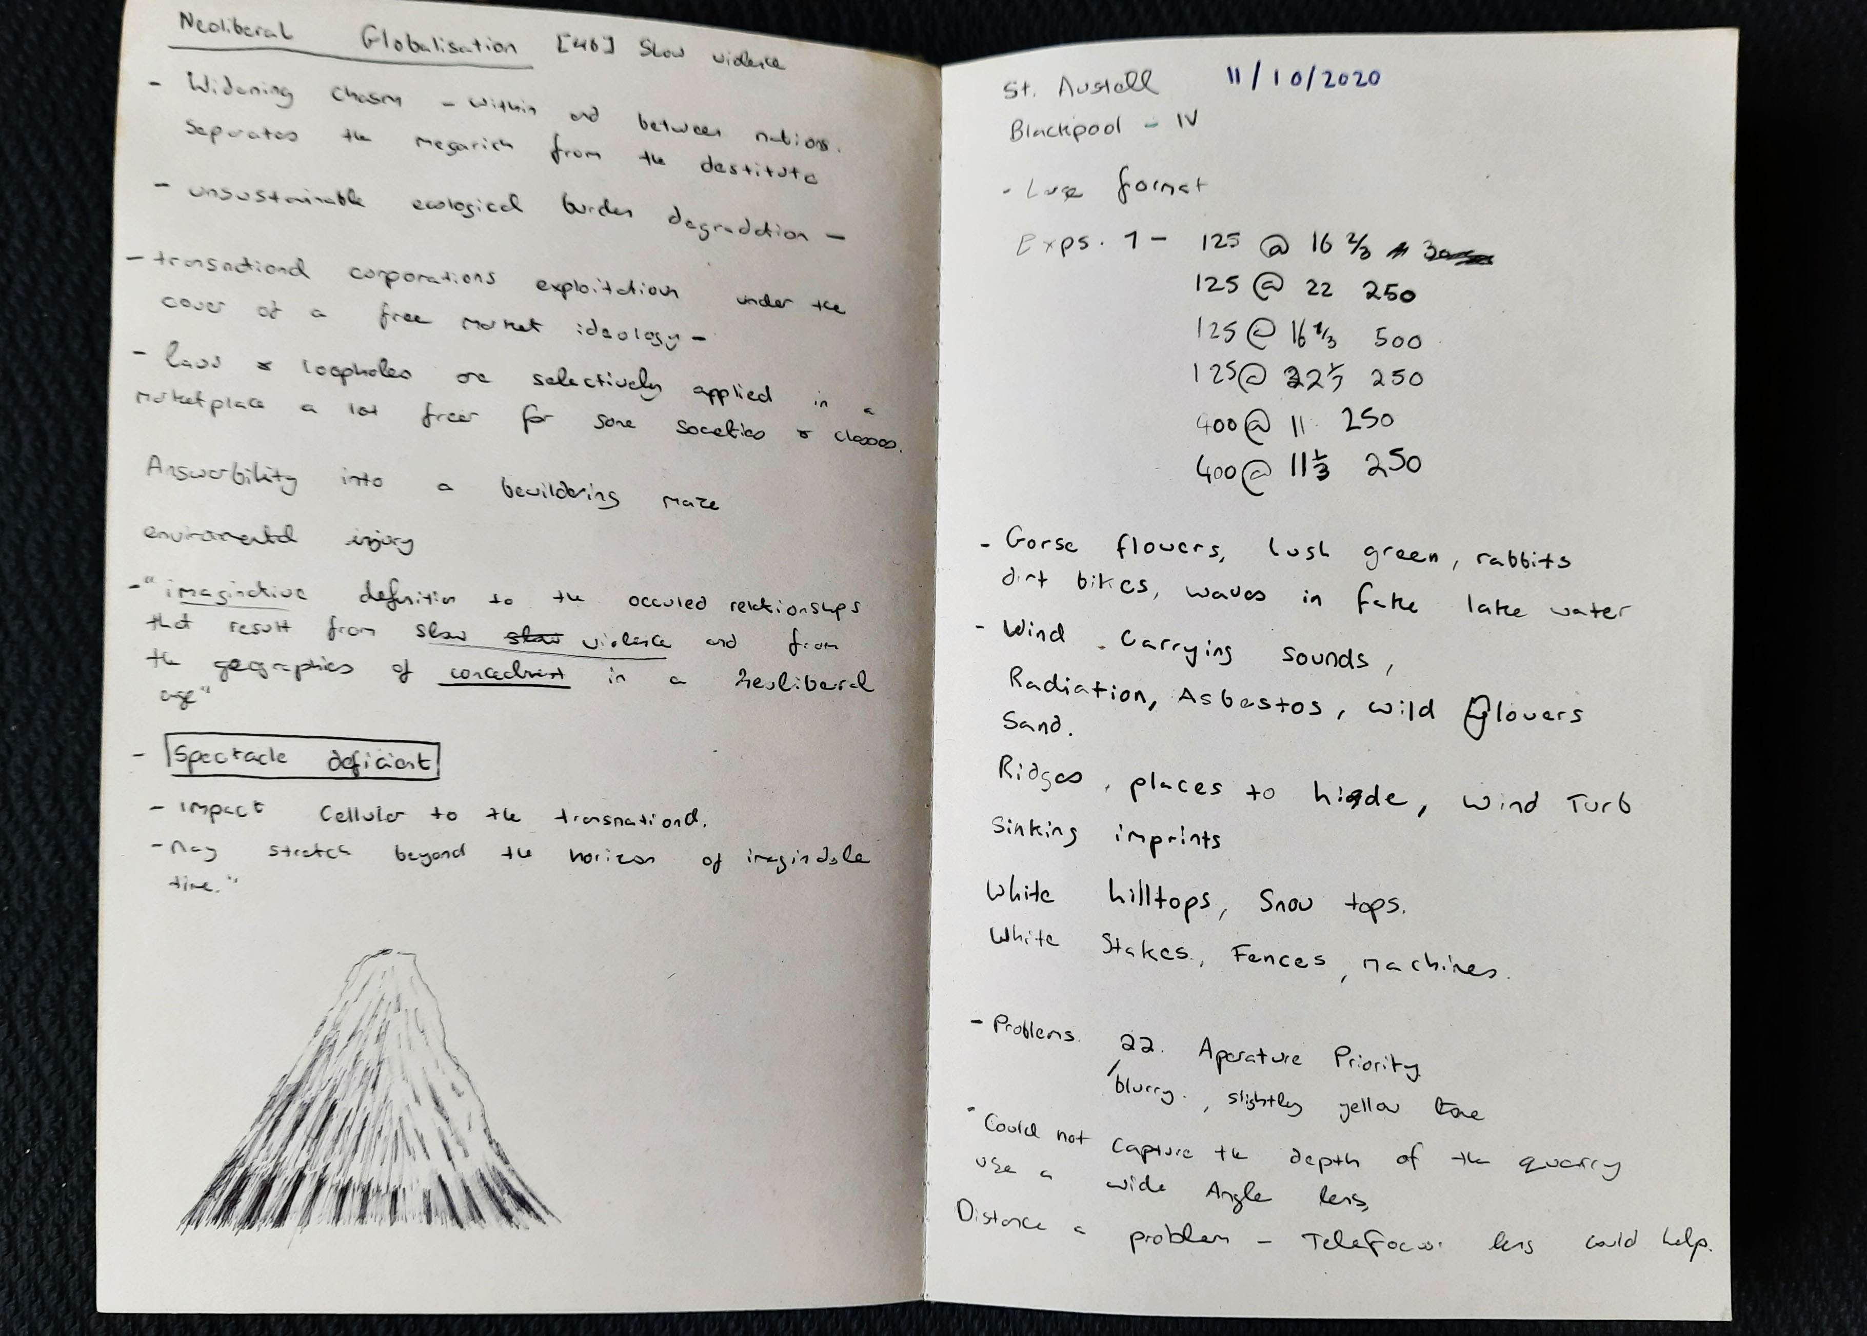
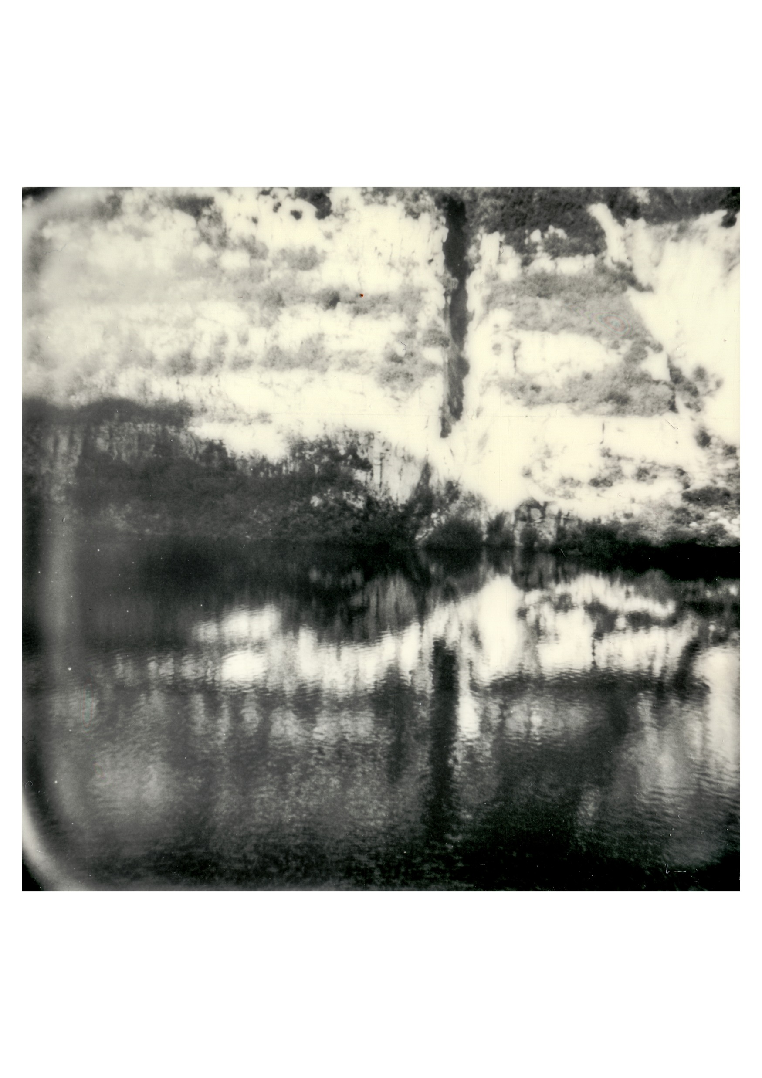
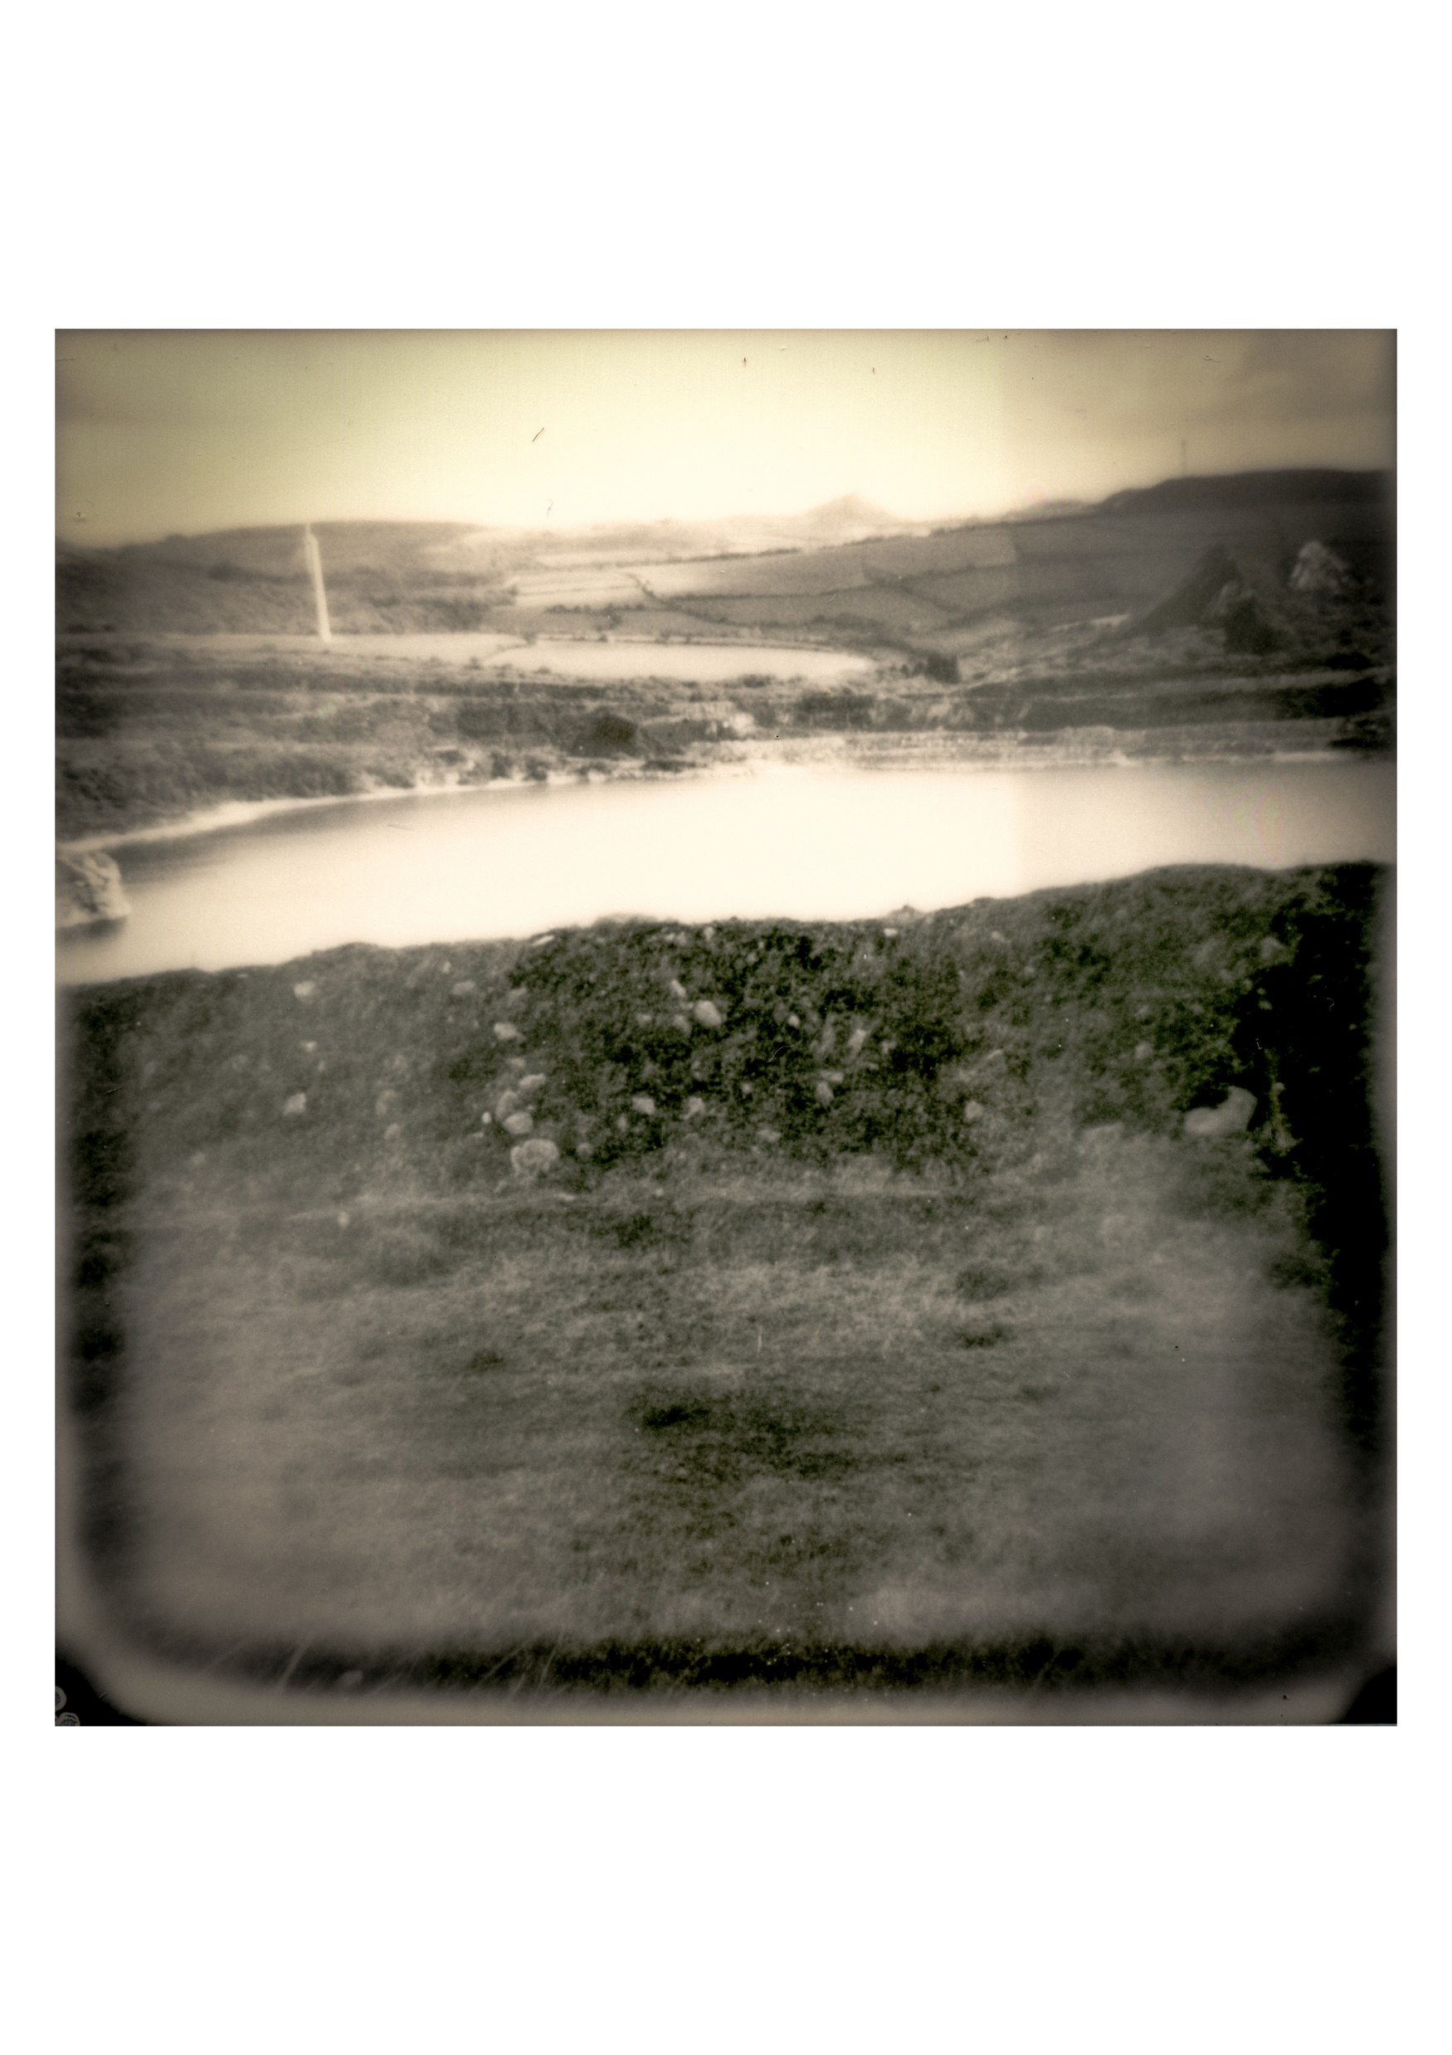
Initial Fieldwork
Niamh Fahy, China Clay pits, digital photographs, 2020

Slide 15
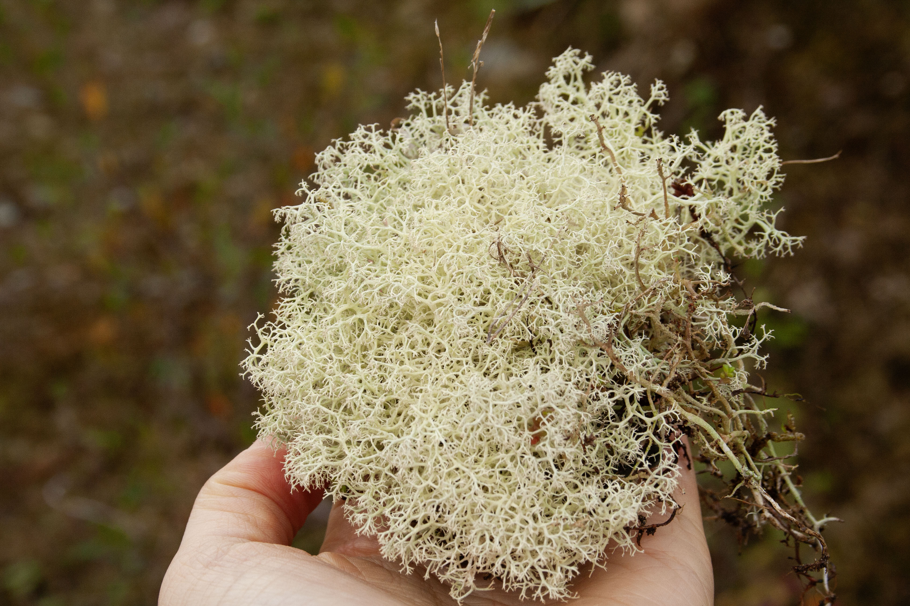
Niamh Fahy, Lichen in Blackpool pit, digital photographs, 2020
Niamh Fahy, Blackpool Mine, digital photograph, 2020

Slide 16
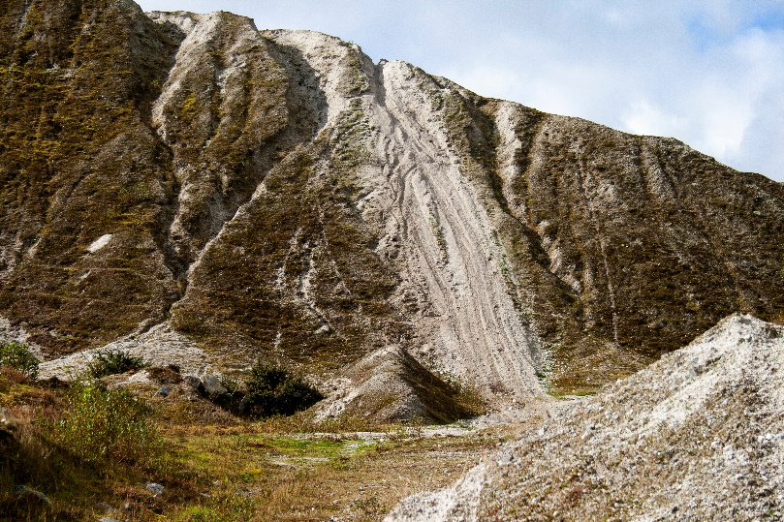
Niamh Fahy, Dirt Bikes, digital photograph, 2020
Niamh Fahy, Bike Tracks, digital photograph, 2020

Slide 17
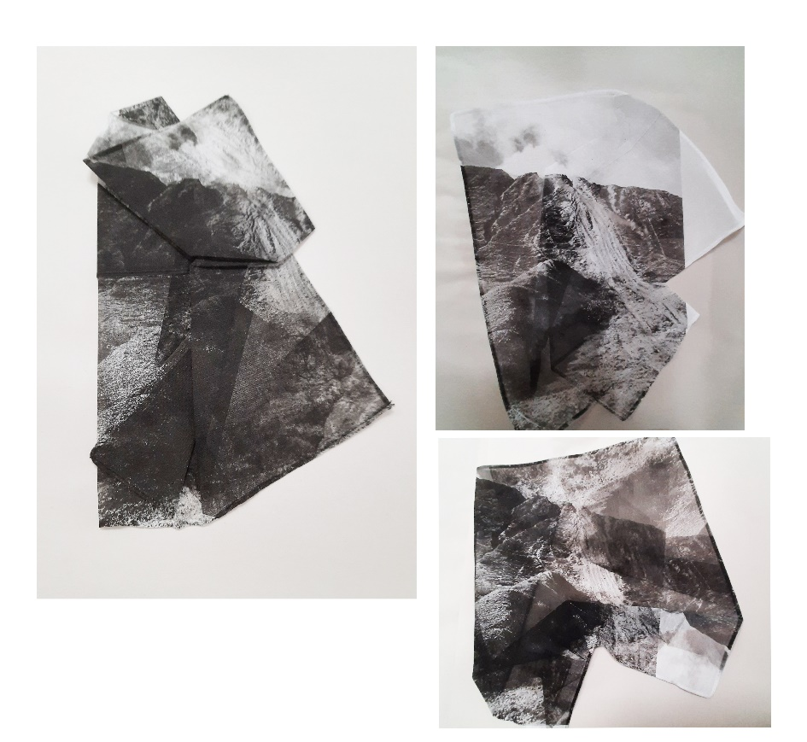
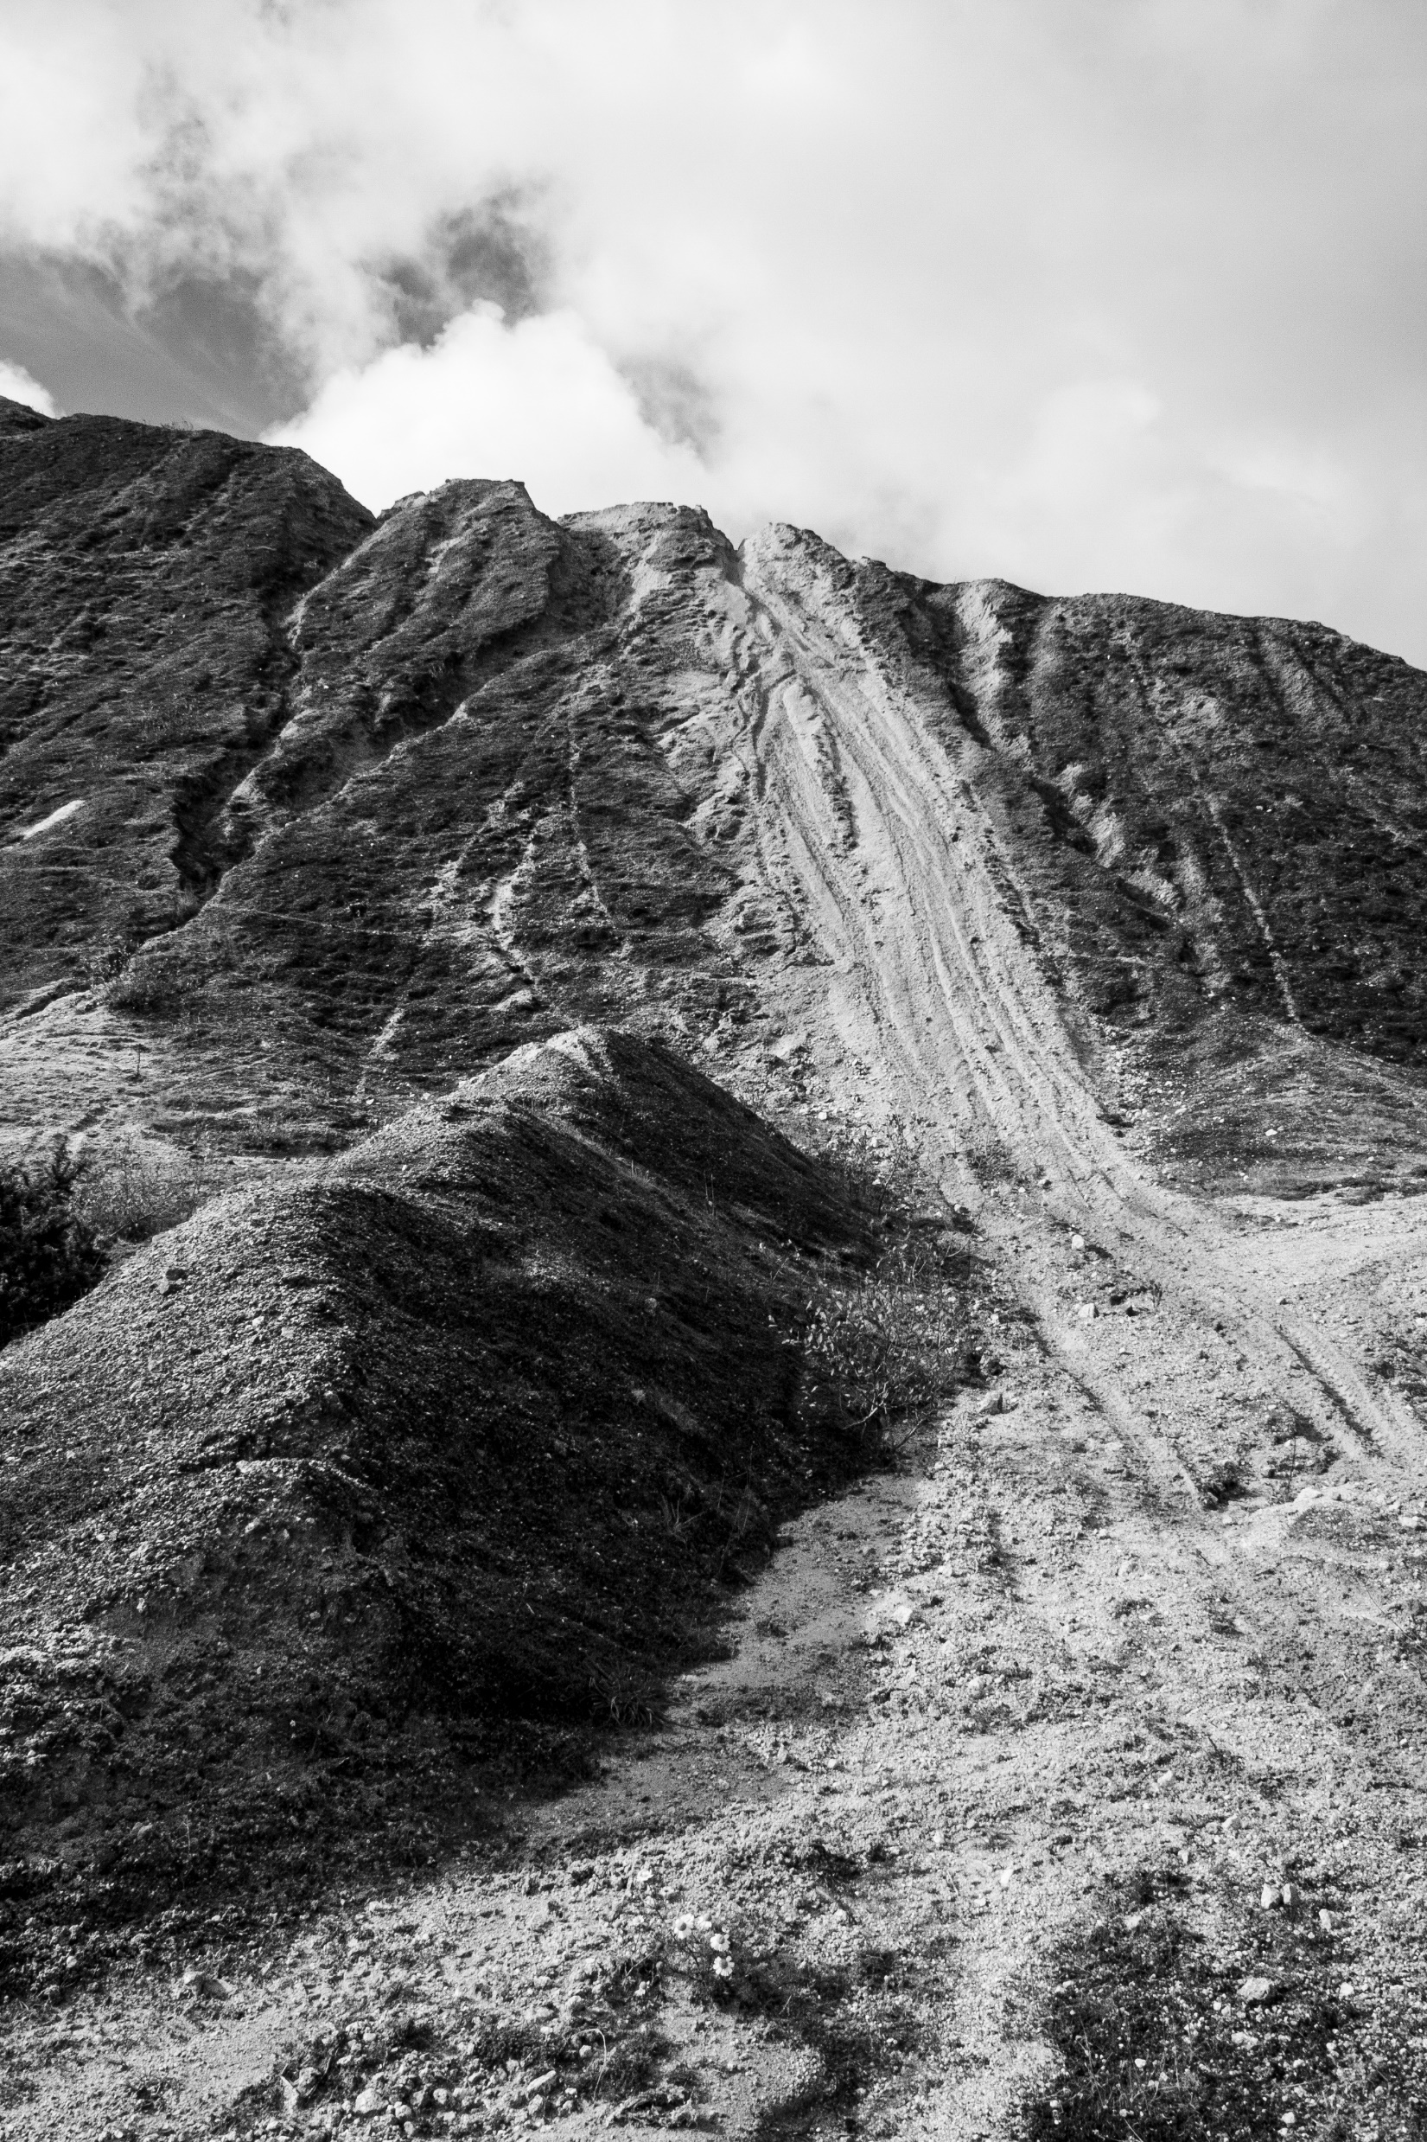
Studio work
Niamh Fahy, Shifting Impressions, lithography on cotton, 2021

Slide 18
Niamh Fahy, Polaroid tests, photo etching, 2021

Slide 19
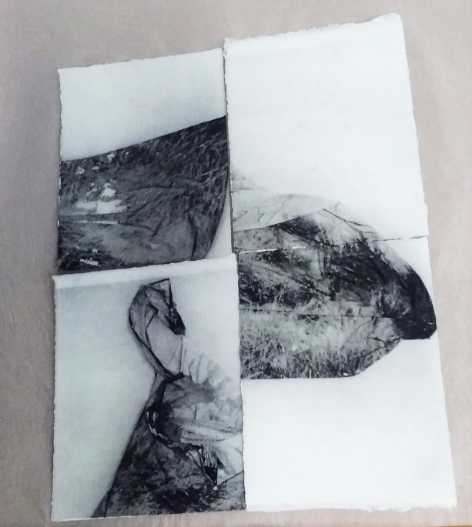
Niamh Fahy, Polaroid tests in Photo etching,2021

Slide 20
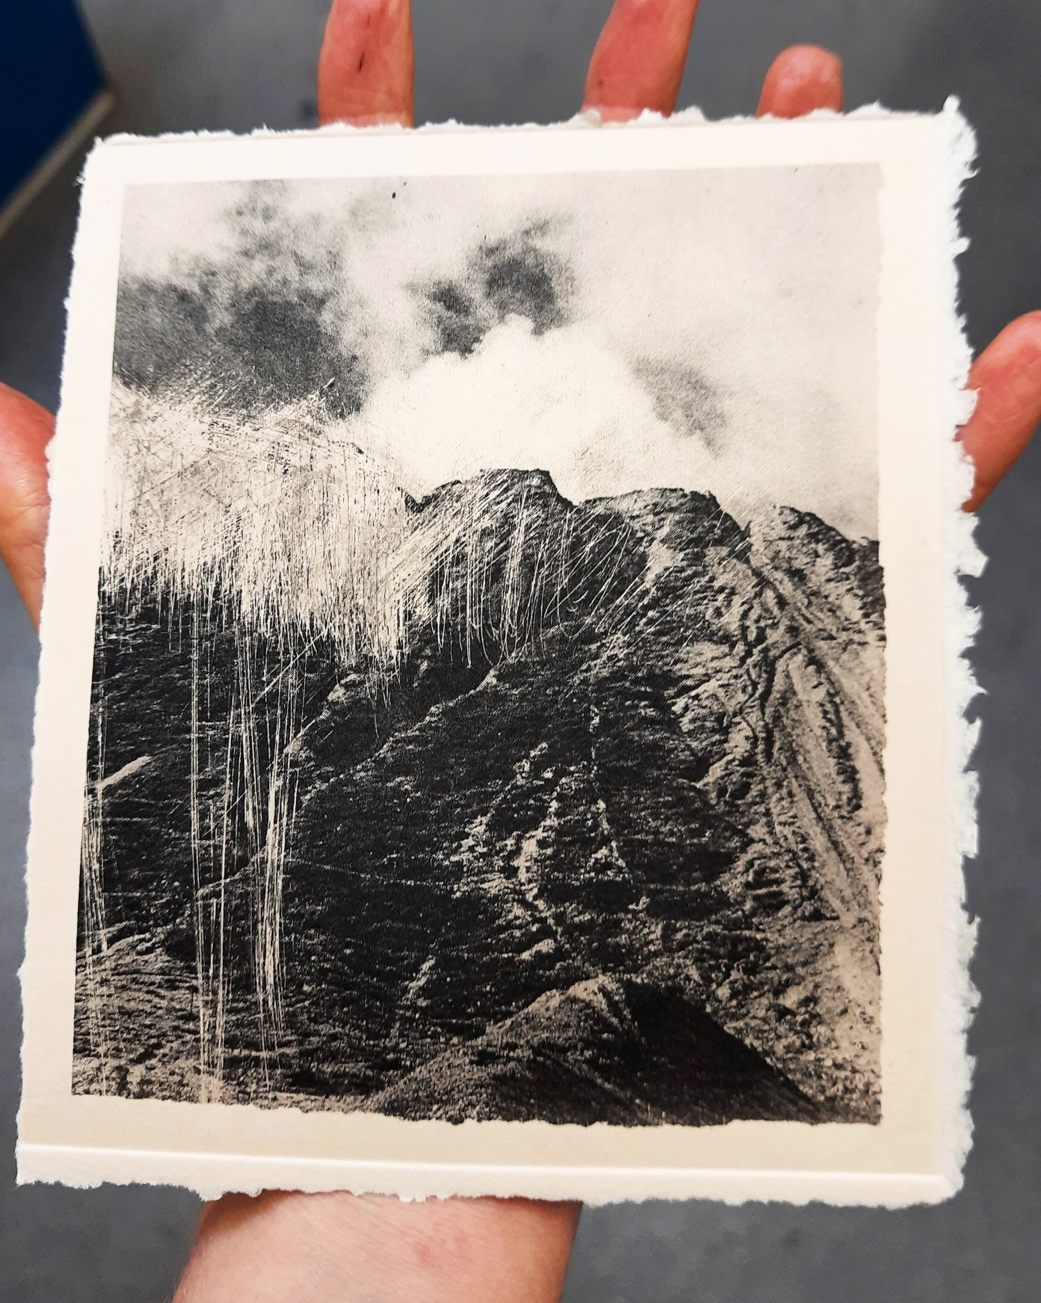
Landscapes subjected to extractivism bear the physical impact of accelerated carving on the earth’s surface, indicating a visible trace of activity. Without the overt implication of a trace, such as witnessed in the China Clay Pits, how can slow violence be recognised? What strategies can be applied to interpret landscapes affected by environmental change but absent of such spectacle.
Niamh Fahy, Photo etching, 2021

Slide 21
Concealed Landscapes Slieve Aughty Case study

Slide 22
Slieve Aughty Mountains Case study
Niamh Fahy, Slieve Aughty Mountain, Galway, Ireland, digital photograph, 2020

Slide 23
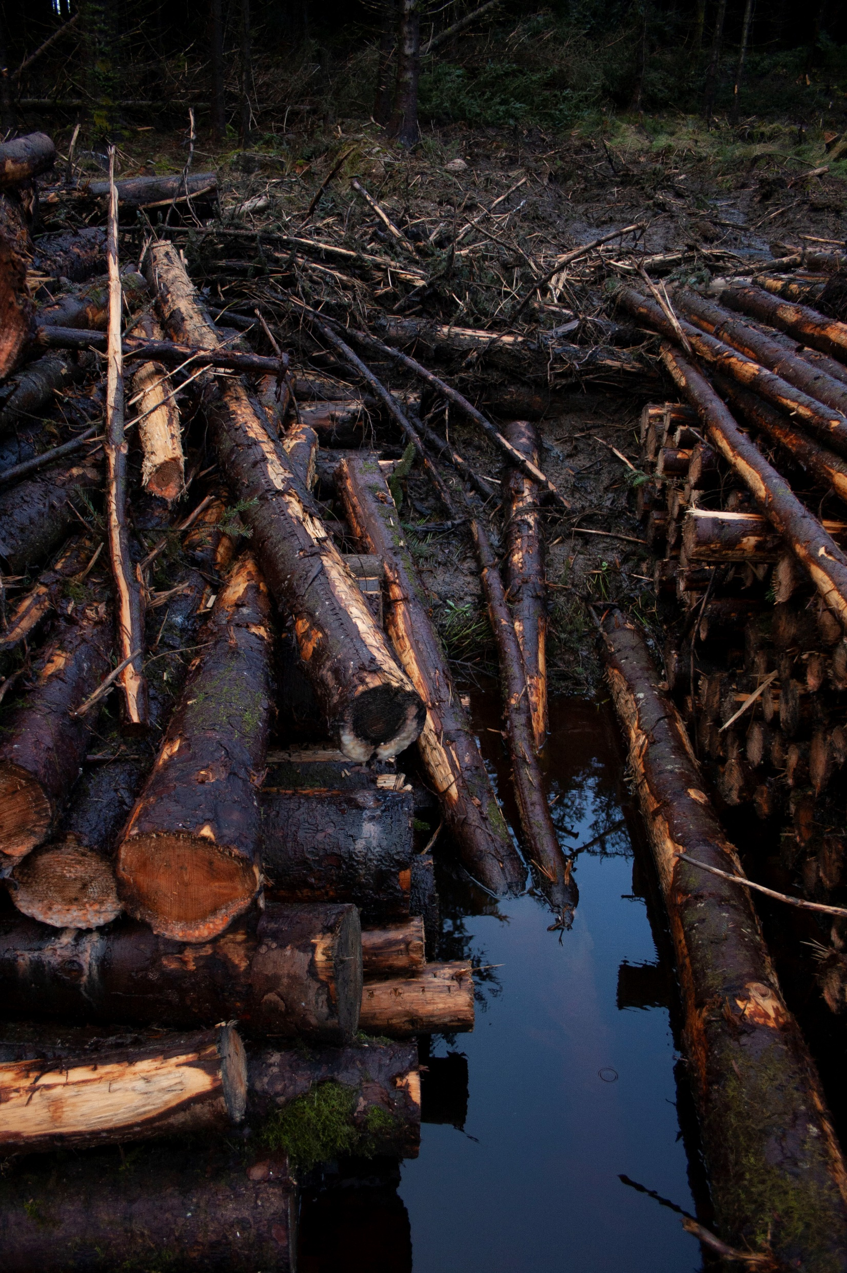
Niamh Fahy, Currach, Slieve Aughty Mountains, digital photograph, 2021

Slide 24
Niamh Fahy, Slieve Aughty Mountains, 2021

Slide 25
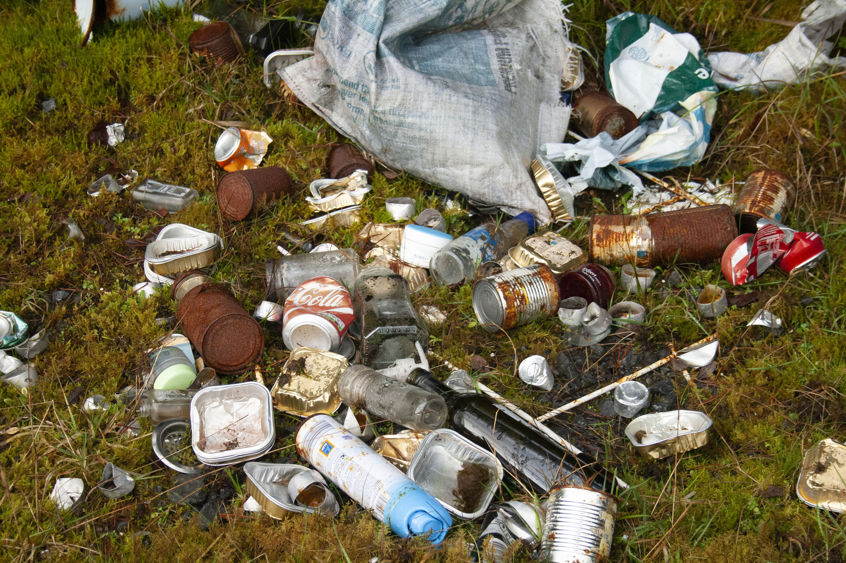
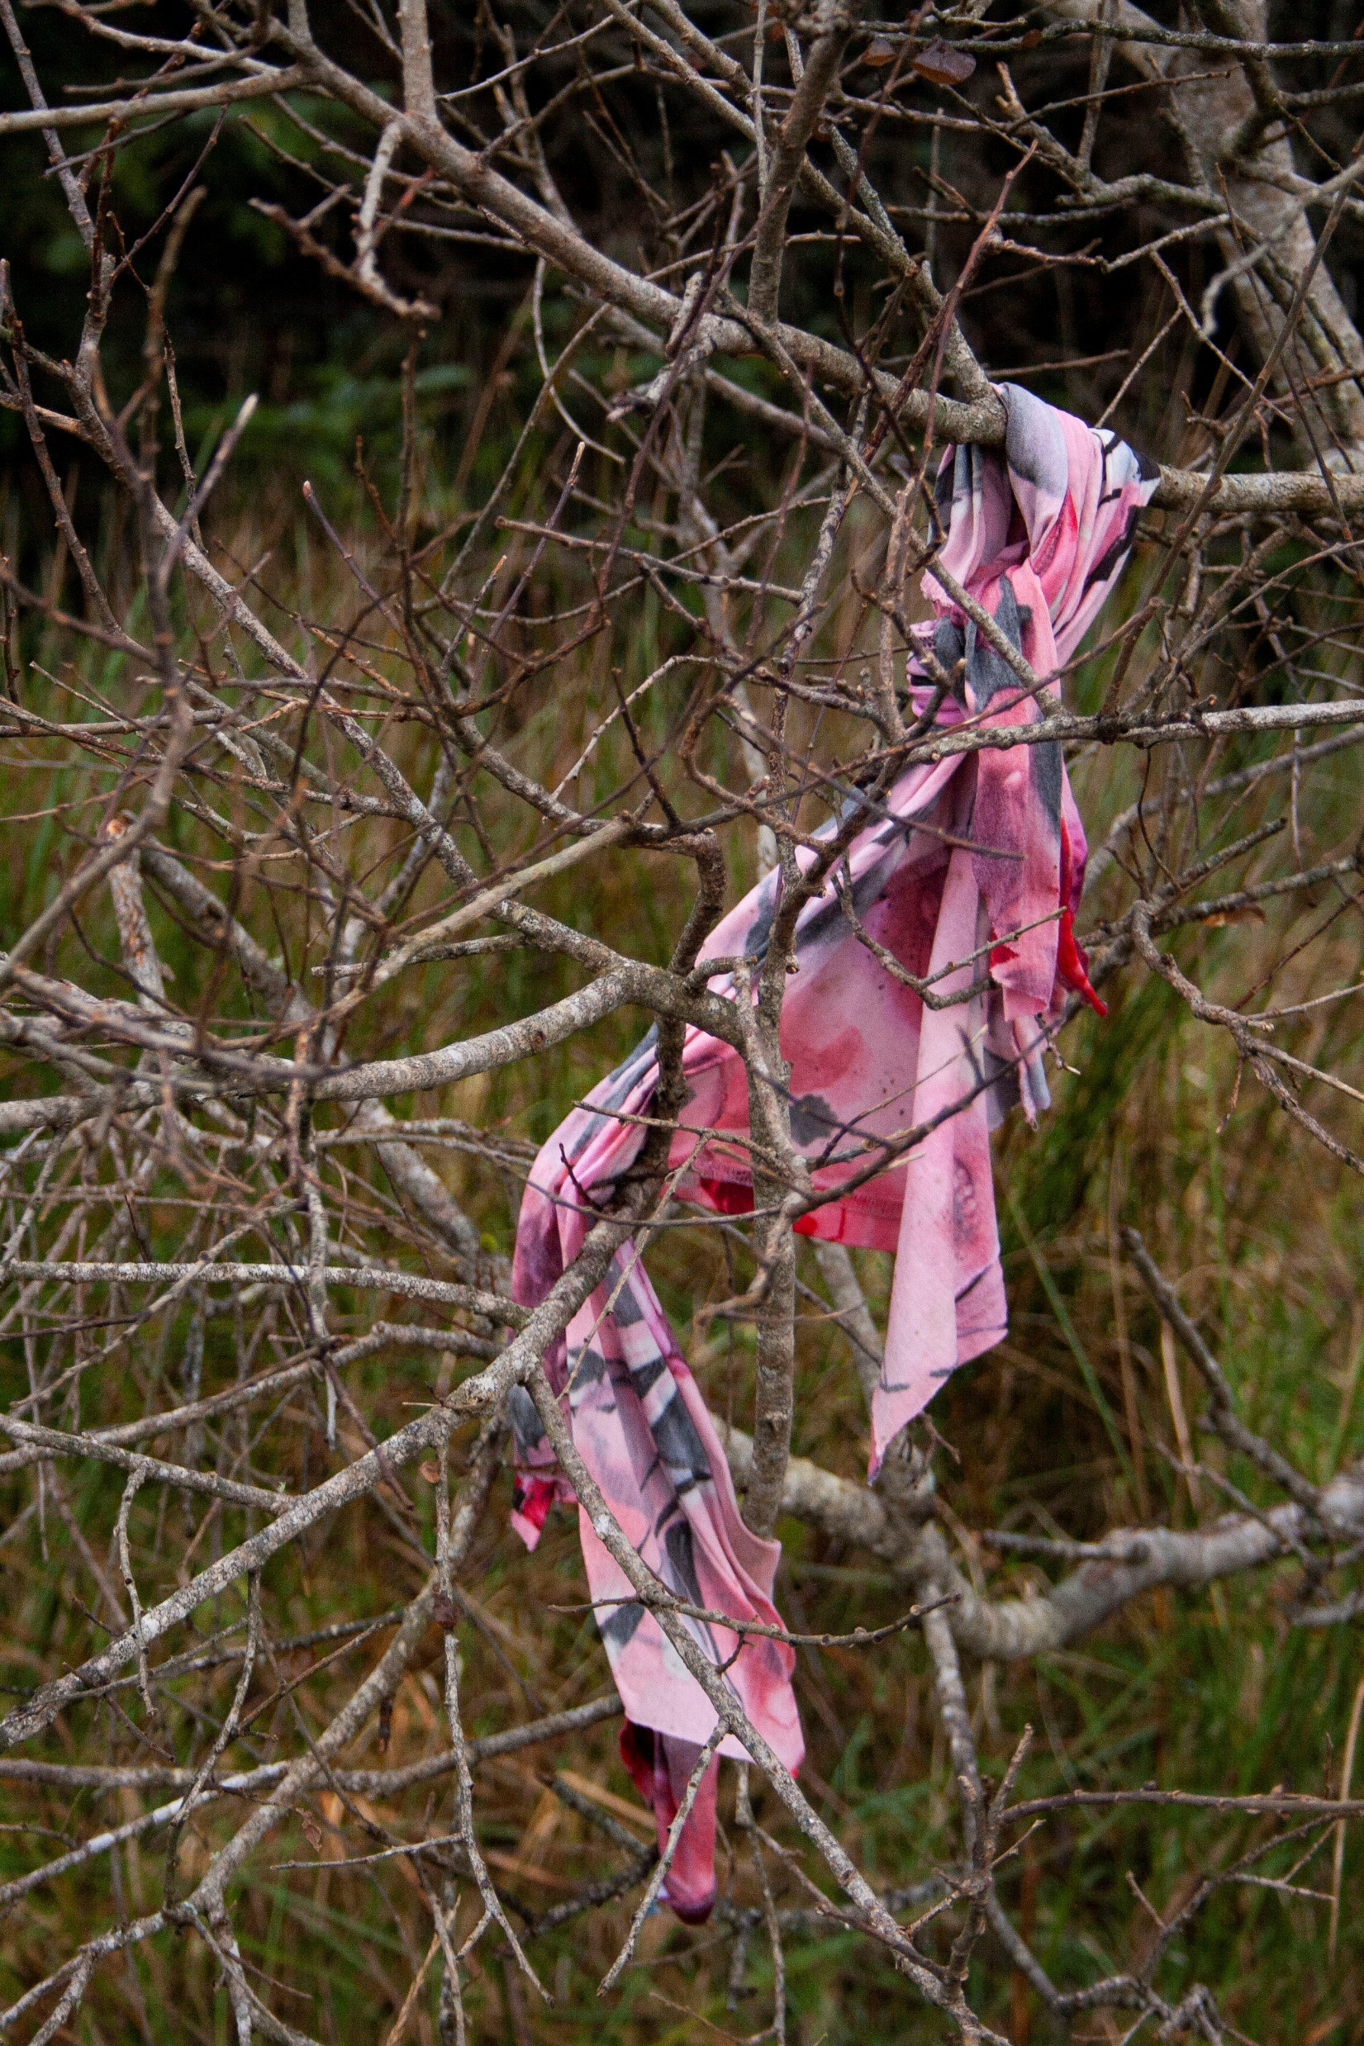
Niamh Fahy, illegal dumping, 2021

Slide 26
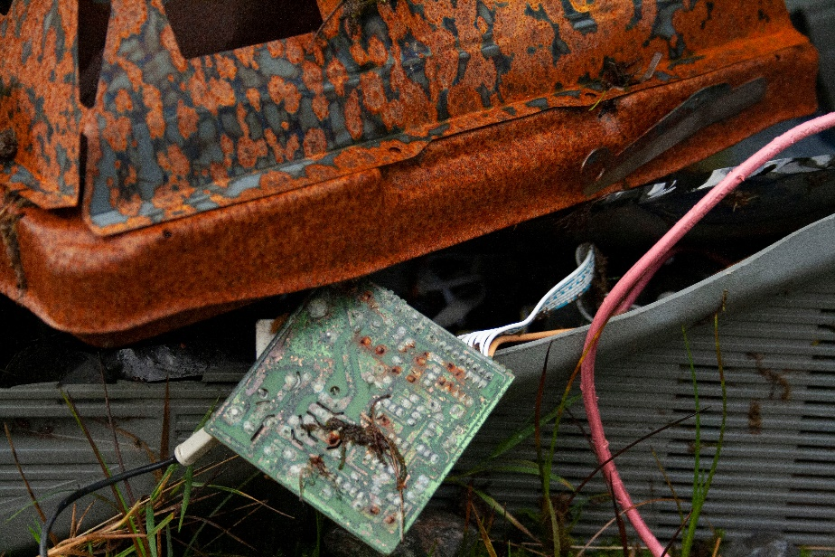
Niamh Fahy, Technological Waste, Slieve Aughty Mountains, 2021

Slide 27
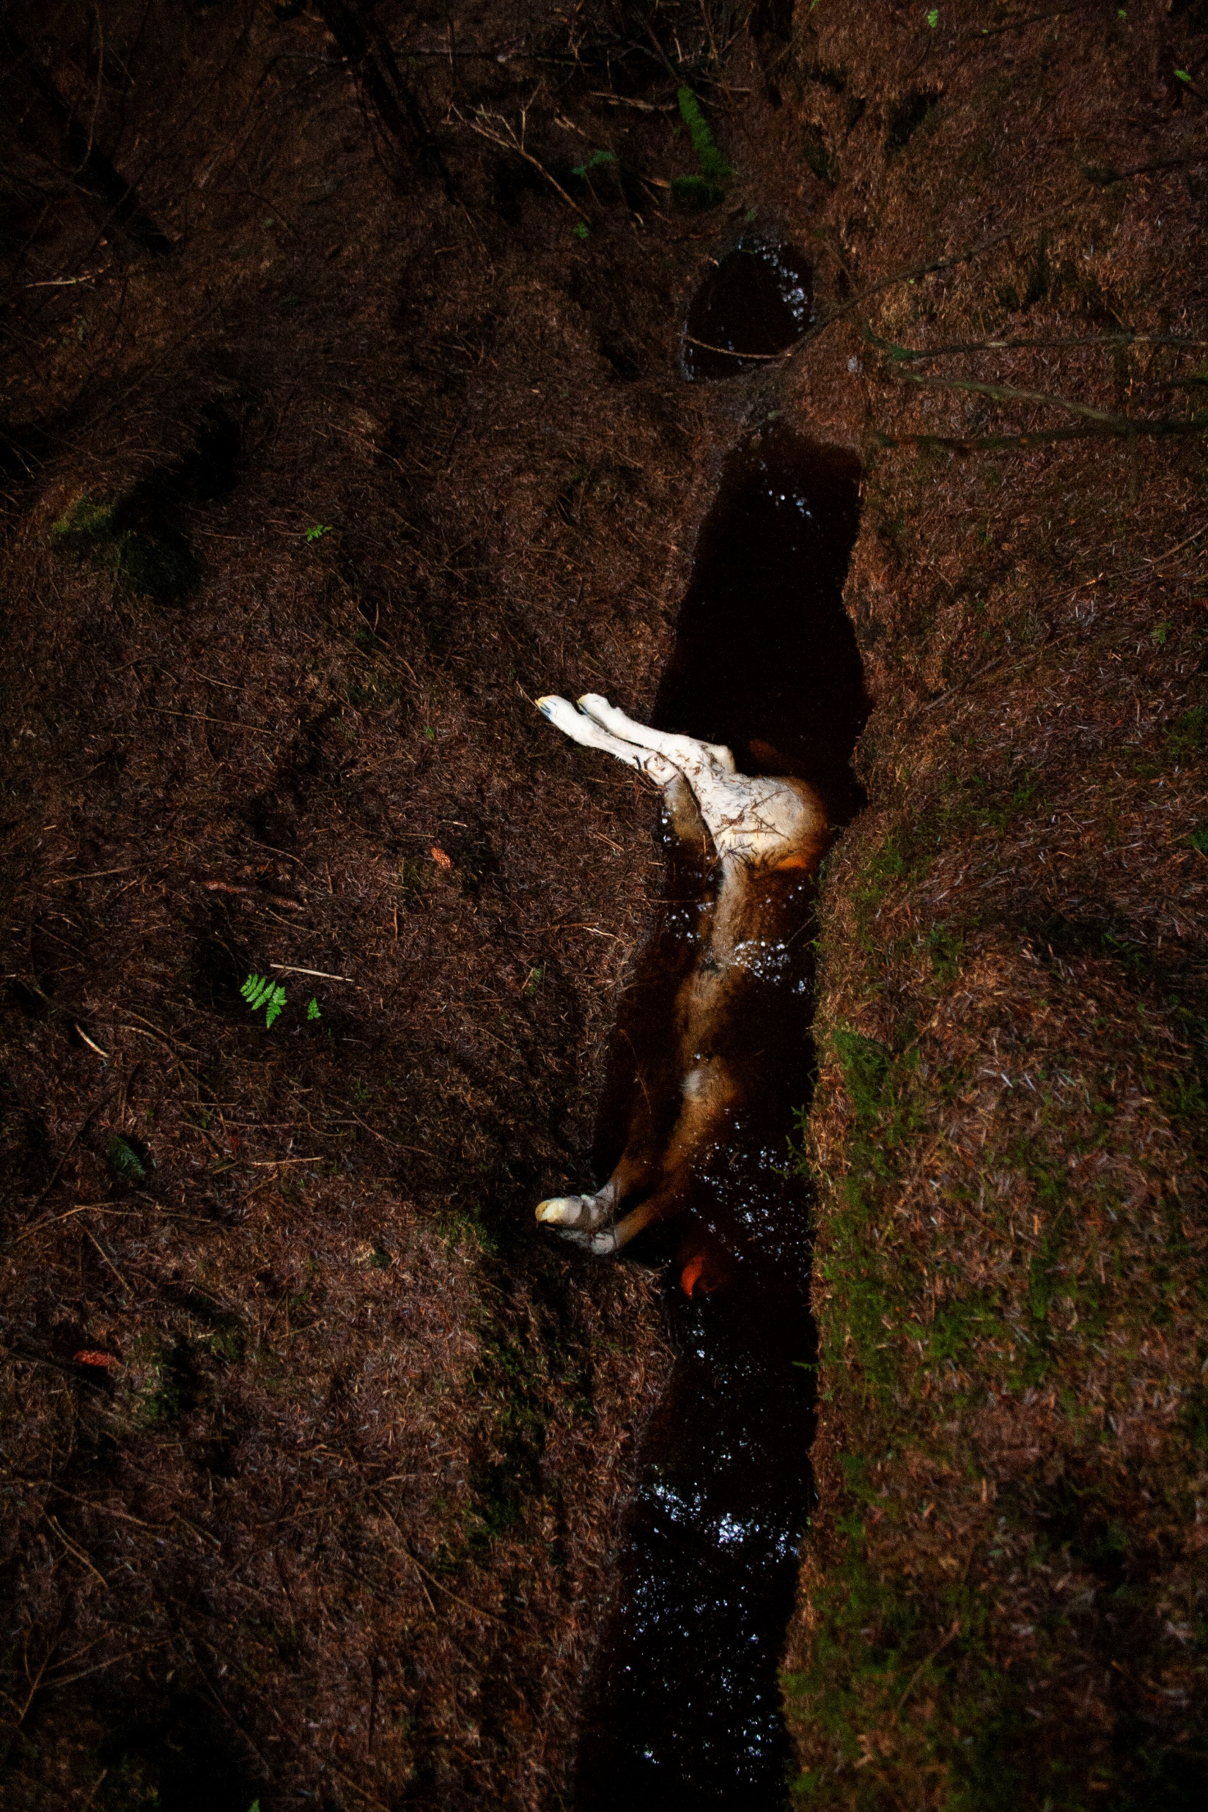
“Photographing the border of the forest, I noticed something reflected in a stream running through the undergrowth. Crawling under the low branches, I found four white legs emerging from the water. Unable to immediately identify the creature, I noted the position and features of the body as my eyes adjusted to the low light, smooth white hair, unmarked, almost pink. Perhaps the lost foetus of a cow or deer? Its head lay submerged, only a pink tongue visible, lolling in the shallow stream, the dark water runs red from the peaty earth, denying any possibility of seeing clearly.”
Niamh Fahy, Found Creature, Slieve Aughty Mountains, 2021

Slide 28
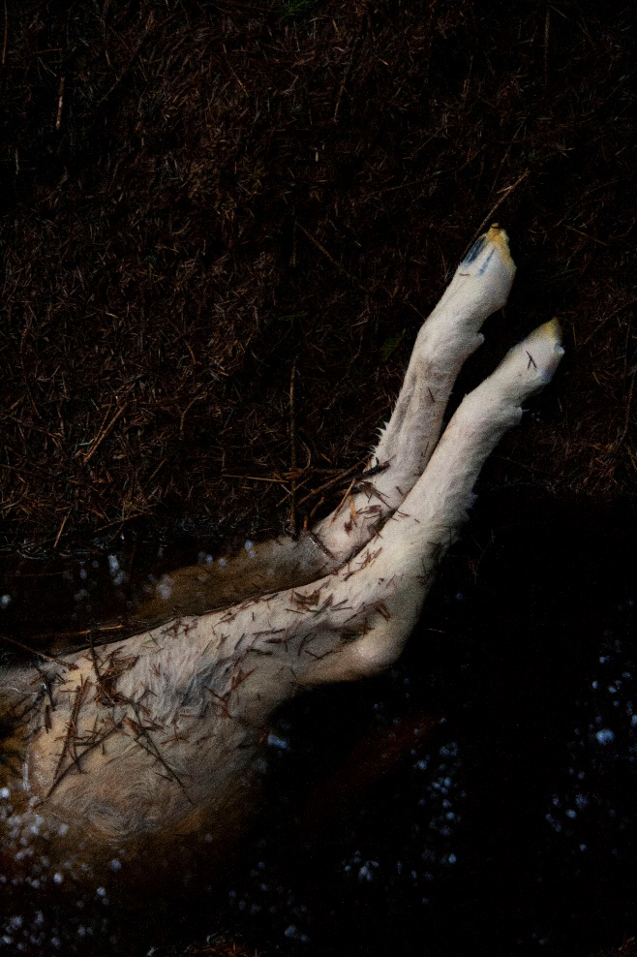
“Rotting corpse, invisible bacteria carried downstream, making their way back, through river and stream. To be consumed, invading, integrating bodies, of those who discarded such creatures. Blood and fascia formed from spoiled water, an invisible line traced from body to land and back again.”
Niamh Fahy, Found Creature, Slieve Aughty Mountains, 2021

Slide 29
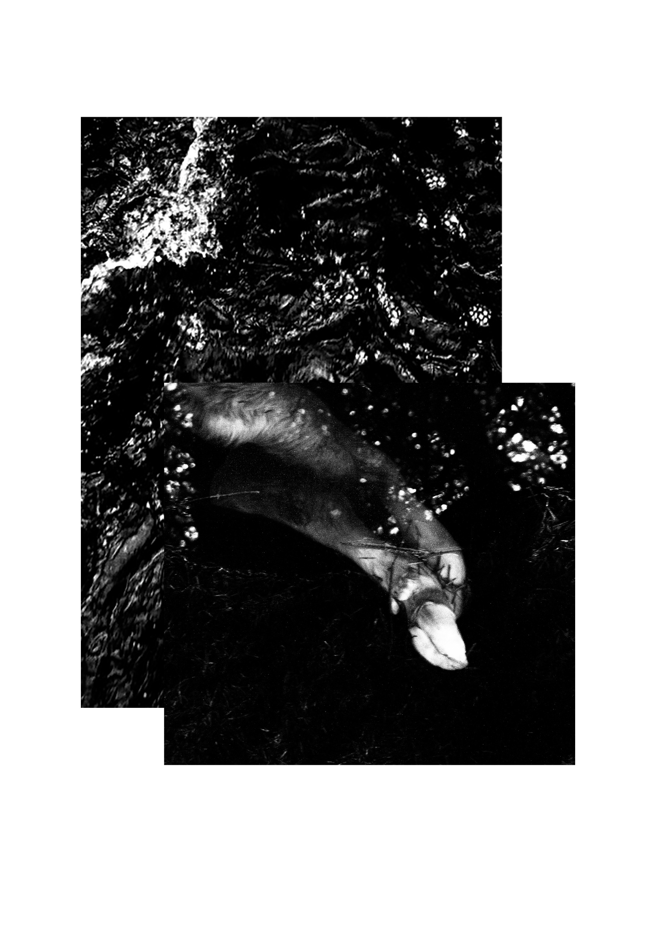
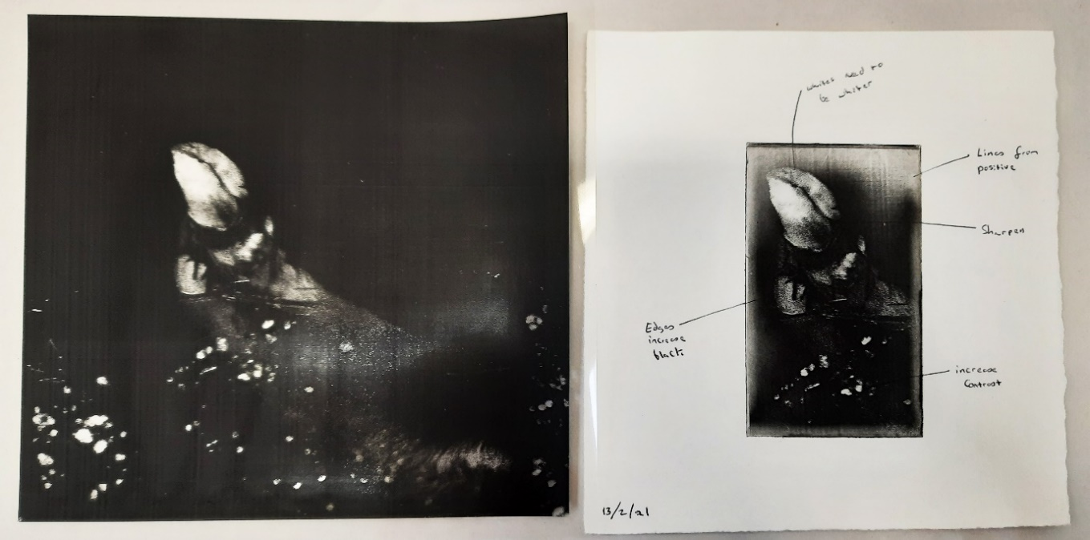
Test prints
Niamh Fahy, Photo etching test,2020
Niamh Fahy, Photo etching test, 2021

Slide 30
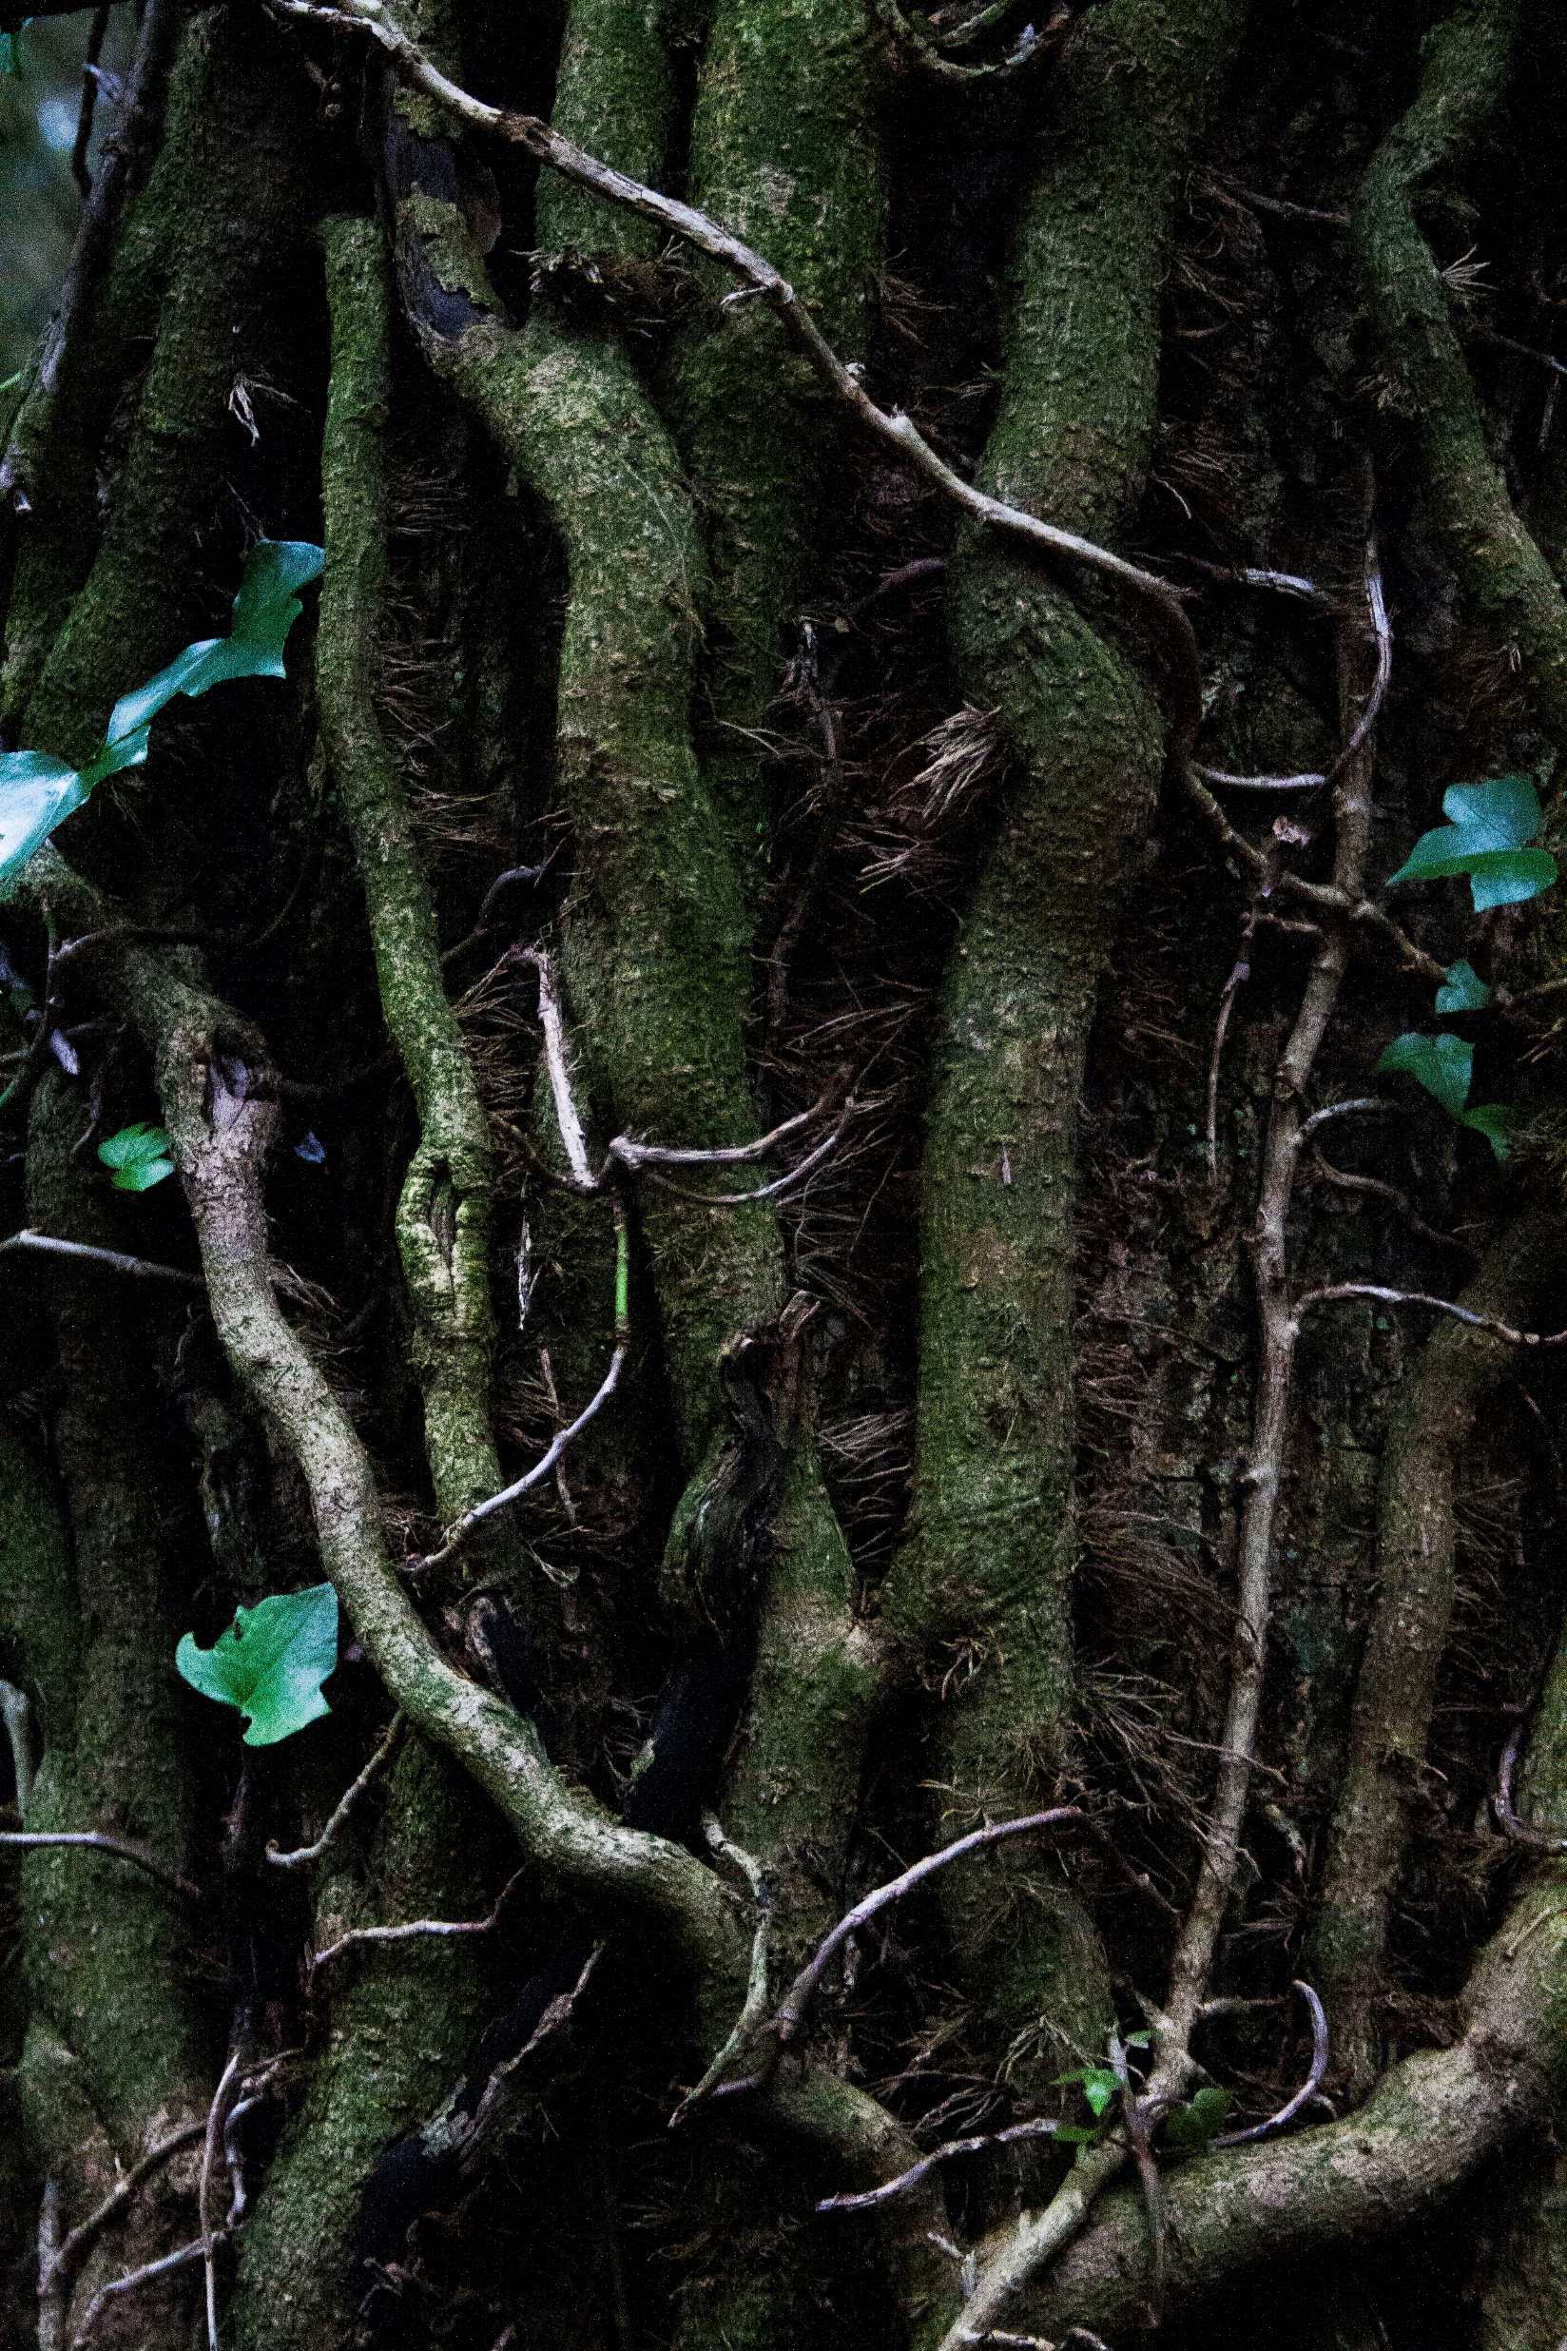
In order to carefully attend to the landscapes examined within this research it is important to reframe the notion of fieldwork as reflecting ourselves (our cells) as a component of a dynamic meshwork that exists across landscape, to recognise not only why we engage in fieldwork but “to what extent we are the fieldwork” (Modeen and Biggs, 2020, p.214). In this recognition, a responsiveness can develop that corresponds to the complex, fluid and unfolding environments we are part of (Modeen and Biggs, 2020, p.215).
Niamh Fahy, Slieve Aughty Mountains, 2021

Slide 31
Conclusion

Slide 32
Conclusion
While slow violence has a relationship to historical narratives, it cannot be confined to a past event, the traces it leaves are more accurately an “indication of a lived present, of a mode of inhabiting both place and memory” (Bennett, 2005, p.70)

Slide 33
Bibliography
Ahrens, V. (2017) BODIES OF WATER Photographic Encounters of Resistance, Ruin and Memory on the River Paraná Victoria Margaret Ahrens PHD Practice/Theory Birkbeck College. London: Birkbeck College, University of London.
Bennett, J. (2005) Empathic vision: affect, trauma, and contemporary art Cultural memory in the present. Stanford, California: Stanford University Press.
Butler, J. (2021) The Force of Nonviolence: An Ethico-Political Bind. London, UK: Verso.
Cadena, M. de la and Blaser, M. (2018) A world of many worlds. Durham: Duke University Press.
Haraway, D.J. (2016) Staying with the trouble: making kin in the Chthulucene Experimental futures: technological lives, scientific arts, anthropological voices. Durham: Duke University Press.
Latour, B. (2018) Down to earth: politics in the new climatic regime. English edition. Cambridge, UK; Medford, MA: Polity.
Modeen, M. and Biggs, I. (2020) Creative Engagements with Ecologies of Place: Geopoetics, Deep Mapping and Slow Residencies [online]. London& New York: Routledge. [Accessed 3 May 2021].
Kupfer, P. (2019) One World for Staying and One for Going In: Nikonowicz, D. This world and others like it. Amsterdam, The Netherlands: Yoffy Press and Fw: Books. pp. 34-41.
Nikonowicz D. (2019) This World and Others Like It | Fw: Books [online]. Available from: https://fw-books.nl/product/drew-nikonowicz-this-world-and-others-like-it/ [Accessed 10 May 2021b].
Nixon, R. (2013) Slow violence and the environmentalism of the poor. Harvard Univ. Press paperback ed. Cambridge, Mass.: Harvard Univ. Press.
Nugent, Dr.P. (2006) aughty.org - history/heritage. Available from: http://www.aughty.org/heritage.htm [Accessed 3 May 2021].
Talmor, D., Mavlian, S., Smyth, C., Smith, O. and Padley, G.(Eds.) (2020) Constructed Landscapes. Amsterdam, The Neatherlands: Fw-Books.
Talmor, D. (2020) Constructed Landscapes Volume II. Available from: http://www.dafnatalmor.co.uk/ [Accessed 3 May 2021a].
Tsing, A., Swanson, H., Gan, E., & Bubandt, N. (Eds.). (2017). Arts of Living on a Damaged Planet: Ghosts and Monsters of the Anthropocene. Minneapolis: University of Minnesota Press.

Slide 34
Thank you for listening !
Niamh.fahy@uwe.ac.uk
www.niamhfahy.com
@niamhfahyart

