Slide 1
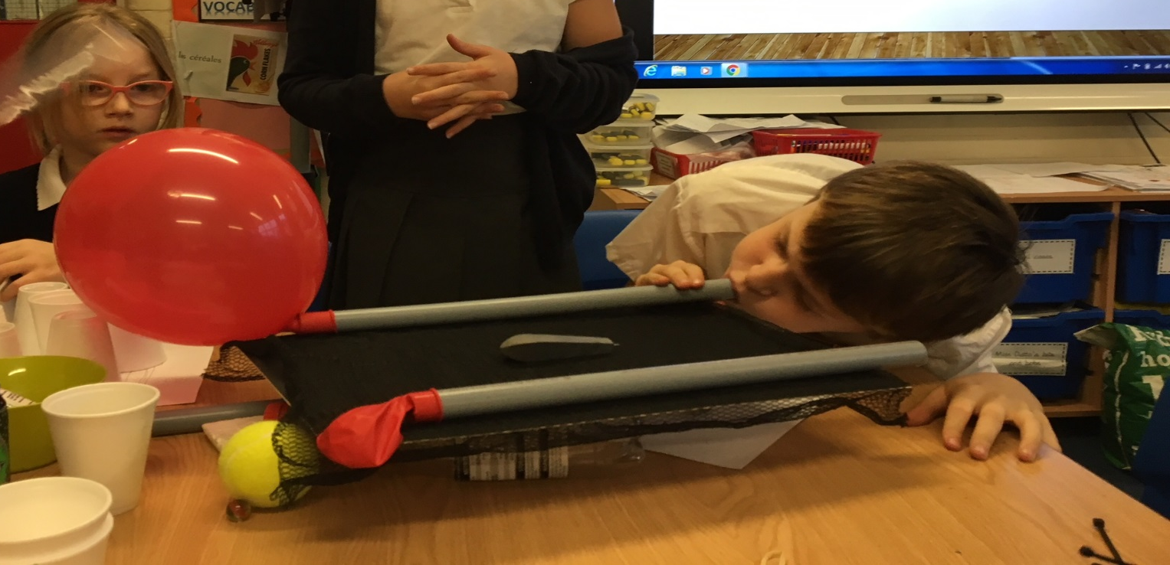
Dr Fay
Lewis
Juliet
Edmonds
Laura
Fogg-
Rogers
Children and Parents as Engineers
li

Slide 2
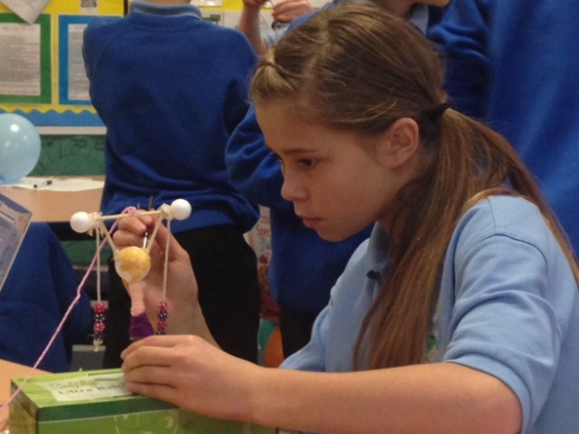
What do we actually teach?
Although students spend years in school learning about the scientific inquiry process, they never learn the engineering design process, which is responsible for most of the things that support their day-to-day lives.

Slide 3
What’s the problem
STEM subjects not taught widely enough in Primary schools.
Serious skills mismatch looming in Science and Engineering based industries.
Not enough female Physicists in the UK.
Technology entries declining at G.C.S.E.
In sufficient general interest/uptake in STEM subjects in many schools.

Slide 4
What’s the problem
We need a 20-30% increase in STEM graduates by 2016 to meet projected need.
STEM employment grew 3 times faster than non STEM employment between 2010-2012.
For every STEM graduate who works in a STEM field, three do not.
There is an urgent need to import STEM talent in the short term to meet need.
9 out of 10 businesses employ people with STEM skills but 2/3rds report difficulties recruiting such employees
Notes:
Emphasise science through engineering

Slide 5

Engineering has a image problem!
9%
Is not enough!
Notes:
Outreach can enhance learning and engagement within these subjects but provision is often ad hoc. This study united Science Communication and Education researchers to design a multidisciplinary toolkit to this address these issues. Improving public engagement skills is a key aim for engineering professional bodies (EPC, 2014) Chartership, citizenship and engineering outreach

Slide 6
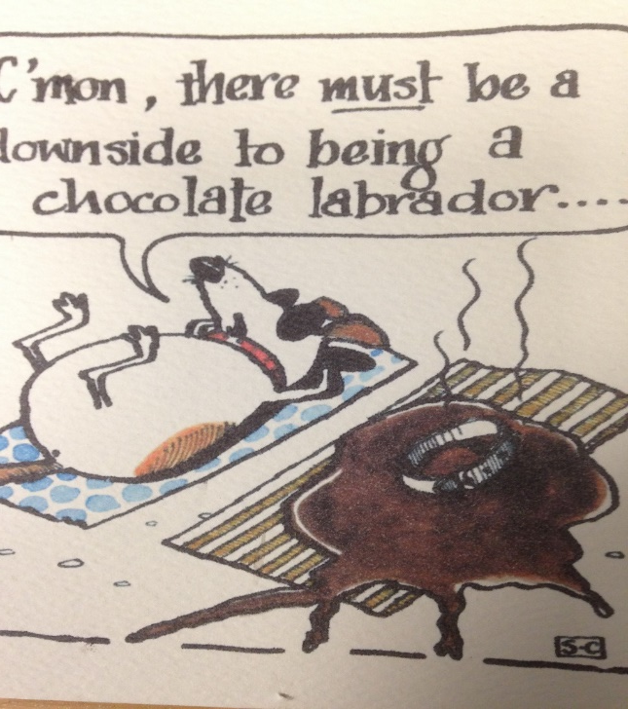
Engineering task
You are on a sunny beach having fun. You notice Snickers, your dog, is looking uncomfortable
Design a shelter for a chocolate Labrador that will protect the dog from the sun

Slide 7
Imagine

Slide 8
Ask

Slide 9
Plan

Slide 10
create

Slide 11
Improve

Slide 12
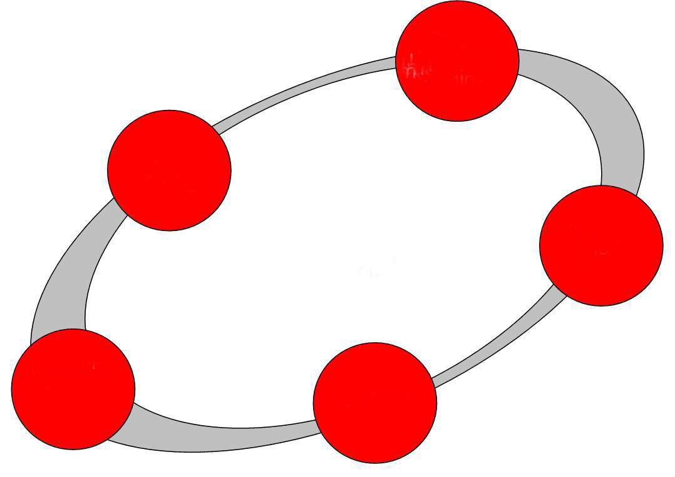
Science through Engineering
Criteria
Constraints
Sci. info
Ask
Brainstorming
No evaluation
Imagine
THE GOAL
To solve a problem by
developing or improving a
technology
PLAN
Get
specific
with one
idea
IMPROVE
CREATE
And test
Notes:
Where does the science teaching come into it?
Different model- what tends to happen is that children are taught science and DT separately. Occasionally they are taught some science and then asked to apply it to a model or practical situation but this can restrict their thinking
This model is different in that it enables the teacher to step in and teach the science as and when it is needed or at the point where an understanding would improve their work
Proven that that this real life contextualisation not only improves understanding but also attitude towards science and engagement- already one school in Bristol that teaches all their science in this way. Particularly useful for girls.

Slide 13
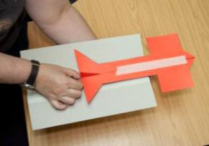
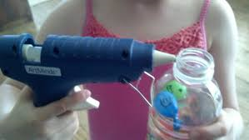
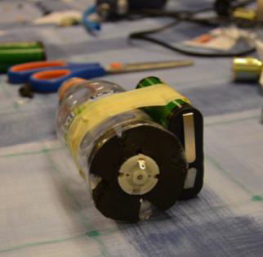
Engineering Challenges
High flyers
High and Dry
Super Sucker
Notes:
Lots of other examples
‘Real life’ contexts and stories are used to establish a problem to be solved- links to gender
Three key challenges (designing and building a floating platform for carrying items when swimming, creating a vacuum cleaner to remove classroom debris, and building a glider to carry messages between friends) were chosen on the basis of their suitability for the curriculum requirements of the schools hosting the project.

Slide 14
Project Overview
Undergraduate
Engineering Students
Knowledge and Skills Exchange
Undergraduate
Pre-service Teachers
Shared delivery of Enquiry based Engineering Challenges with UK Primary School Children (8-11)
Notes:
Project Overview
developed a new undergraduate degree module for engineers, called Engineering and Society.
The module provides a broad comprehension of the importance of professional development, lifelong learning and the competencies and social responsibilities required for ‘engineering citizenship’ in order to be a professional engineer. https://blogs.uwe.ac.uk/science-communication/engineering-in-society-new-module-for-engineering-citizenship/
Knowledge exchange framework- complementary skills of the students could be shared and exchanged during collaborative work.
Innovative engineering education outreach in primary schools. Each pair of students spent 1.5 days in a local primary school taking classes of up to 30 children per pair working with and supporting the children through engineering challenges. The school work was observed by the project team and supervised by school staff.
Over 900 primary school pupils benefited from hands on sessions delivered by the students, The children, aged between eight and 11, visited UWE Bristol for a researching conference, where they learnt about the skills, challenges and excitement of engineering.
One of the possible purposes of the research is to create a tool kit which can be rolled out to other HE institutions- vital that this is evaluated in order to produce best model possible- will discuss this in more detail later

Slide 15
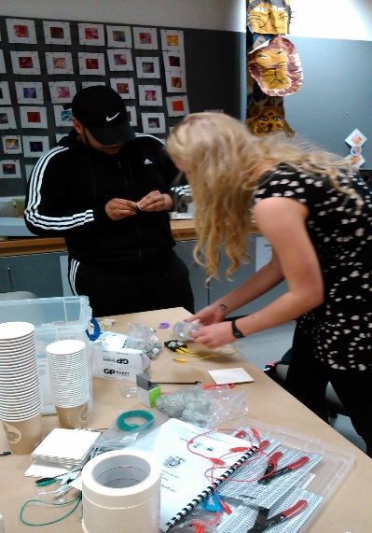
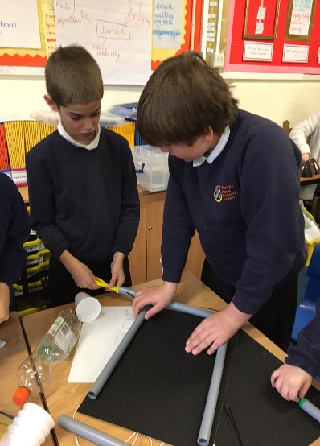
Participants
STEM subject knowledge confidence and teaching self-efficacy in ITE undergraduate students?
attitudes towards and confidence in public engagement in undergraduate engineering students?
attitudes STEM subjects and perceptions of engineering amongst children?
Notes:
Evaluate the impact of participation in the project had on the attitudes of the participants towards teaching and learning STEM subjects, and public engagement.
Pupils interest in science wanes as they reach the end of primary school (Murphy et al, 2004)
Providing positive experiences to keep the doors open for STEM based career choices.

Slide 16
Parent and children and engineers
Primary school is when ideas about whether ‘science is for me’ are formed (Royal Society, 2006)
Primary schools have closer relationship with parents than secondary schools.
Aim is to increase the mother’s/parents’ value of science/ engineering and for the child to be a witness to this. To stimulate talk between child and parent about science/engineering (DeWitt et al.,2015:2017)
Children still willing to be seen with their parents!

Slide 17
Sequence of research
Introductory activities with parents on Ideas about engineers and engineering cycle including ‘stable table’
Working alongside children and engineers on an Engineer unit .One a year.
Informal science activity trip to local science centre- children and parents.
Informal science/ engineering challenges for children and parents
Engineering /science assembly with parents and children

Slide 18

Perceived Self-Efficacy
A belief in your own ability to perform specific actions, and it reflects a perception of capability rather than measuring actual performance (Gonzalez, Goeppinger, and Lorig 1990; Bandura et al. 1997)
Teacher PSE in science influences pupils’ attitudes, achievement, and motivations (McKinnon and Lamberts 2013)
Notes:
teachers and engineers

Slide 19
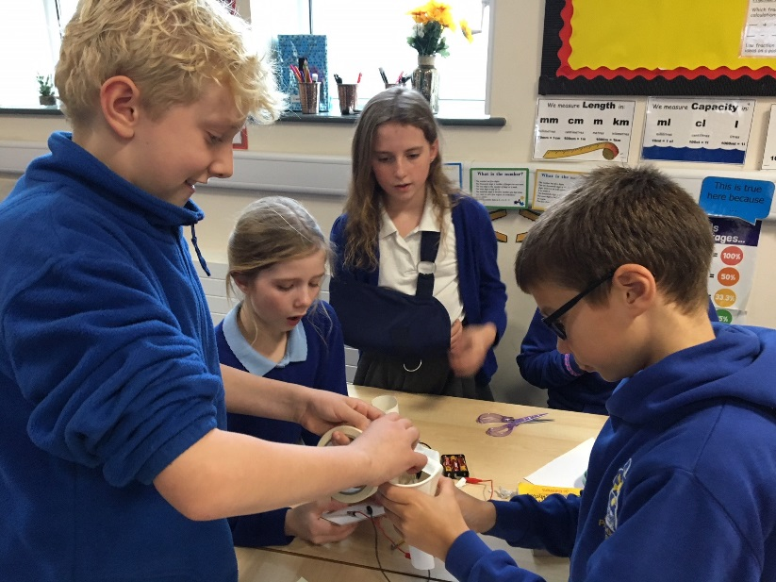
Methodology
A pre and post longitudinal mixed methods design was employed using:-
Likert type scale and open ended questions
questionnaires
Reflective diaries
Observations of teaching activities
Notes:
Interpretive research drawing on mixed methods.

Slide 20
Teachers- Subject Knowledge
‘I feel much more confident about my subject knowledge in terms of science and engineering. I will be able to answer questions from the children more confidently’
Notes:
A statistically significant increase in the confidence that the pre-service teachers had in their subject knowledge.
Quantitative data indicated that the mean level of confidence in the pre-service teachers’ Science Subject Knowledge before the project was 5.5 out of 10 (SD = 1.8). Following the project, the mean Science Subject Knowledge value was 7.5 (SD = 1.1). There was therefore a highly significant increase Z = -2.82, p= .005 in Science Subject Knowledge

Slide 21
Teachers- Self-Efficacy
‘I feel excited and much more confident. I think inquiry based learning makes it much more accessible and contextual to children's learning.’
Notes:
Statistically significant increase in ITE students confidence in their ability to teach science
Quantitative data indicated that the mean PSE for the pre-service teachers to teach science before the project was 6.3 out of 10 (SD = 0.9). Following the project, the mean PSE value was 8.2 (SD = 1.0). There was therefore a highly significant increase Z = -2.81, p= .005 in PSE for pre-service teachers to teach science following the project.)
Significant as it has been shown that teachers who have positive attitudes and are enthusiastic about a subject, engage in research based instructional strategies, seek out growth opportunities, stay current and create connections with the subject matter that are meaningful to their students (Singh and Stoloff 2008).
However, at present teacher education programmes appear to have little impact upon the way in which new and pre-service teachers view themselves as teachers. (Ballantyne, et al, 2012).

Slide 22
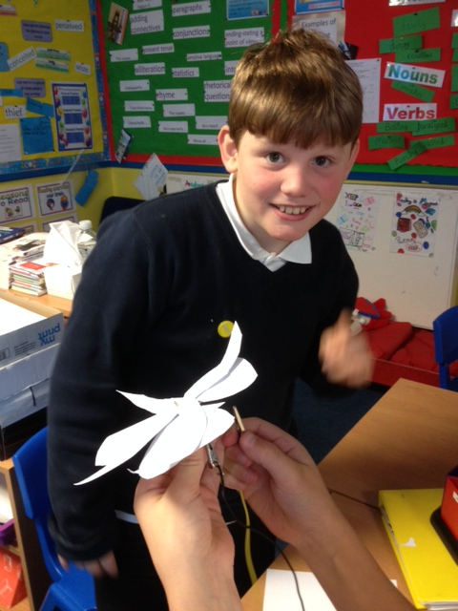
Children- Enjoyment and Attitude
Before:
Engineers fix cars
They build bridges
They always get very oily
They use spanners
An engineer fixed my Mum’s boiler
After:
Engineers solve problems
They design and make things we need
They make things better
They keep improving

Slide 23
Children- Enjoyment and Attitude
Notes:
Significant impact on childrens enjoyment of science and technology

Slide 24


Outputs
Notes:
1) The project also established a network for science communicators and science educators working with primary schools in the Bristol region, called Curiosity Connections Bristol. The network aims to enhance an inspirational primary science curriculum for all children.
Curiosity Connections Bristol aims to support people who inspire primary Science, Technology, Engineering and Mathematics (STEM) learning in the Bristol region. The network aims to bring together primary school teachers, science communicators, education providers, and people working in STEM industries. We will highlight stories, activities, and events which give ideas to primary science teachers, as well as connecting science communicators to schools. https://curiositybristol.net/
2) 10 outreach visits to schools and supporting school outreach projects (conducted alongside the Women Like Me project, and the Engineering Our Future blog). https://blogs.uwe.ac.uk/engineering/
journal paper: http://eprints.uwe.ac.uk/37215/ Fogg Rogers, L. and Fowles-Sweet, W. (2018) Engineering and society: Embedding active service learning in undergraduate curricula. In: Andrews, J., Clark, R., Nortcliffe, A. and Penlington, R., eds. (2018) 5TH Annual Symposium of the United Kingdom & Ireland Engineering Education Research Network. Aston University, pp. 125-129. ISBN 978185449443 6
Journal paper under review: Fogg-Rogers, L and Moss, T. (Under review). Engineers’ perceived self-efficacy for education outreach. International Journal of Education Psychology.
Dissemination reports :
http://eprints.uwe.ac.uk/37990/
http://eprints.uwe.ac.uk/37925/
Teacher focussed article: Edmonds, J., Lewis, F. and Fogg Rogers, L. (2018) Practical steps to building science capital in the primary classroom. Primary Science, 154. pp. 29-31. ISSN 0269-2465 Available from: http://eprints.uwe.ac.uk/37990
Teacher focused article to be published in the new year. ‘Engineering Science in the Classroom’
The project won the Teacher Educator Advancement Network Award for Innovation https://blogs.uwe.ac.uk/engineering/laura-fogg-rogers-scoops-award-for-science-teaching-project/, and was Highly Commended for the STEM Inspiration Awards. https://blogs.uwe.ac.uk/engineering/children-as-engineers-highly-commended-at-stem-inspiration-awards/

Slide 25
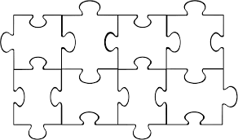
Ongoing objectives/ the toolkit
Engineers’ training
Shared training
Childrens’ conference
School partnership
Teachers’ training
Engineering in school
Resource
solutions
Parent partnership
Notes:
Dissemination of Toolikit to other HEIs
Engineers- training on public engagement, working with children in school and use of effective questioning techniques.
Pre-service teachers- training on the EDP and the roles of an engineer
Engineers + Preservice teachers Sharing of expertise through working with the materials and planning for classroom experiences
Engineering challenges in school- delivered by the paired peers
The engineering students were given training about how to support children in their learning and how to use effective questioning techniques whilst the pre-service teachers were given an introduction to engineering and the Engineering Design Process (EDP).
The pairs then came together within a knowledge exchange framework to explore a variety of engineering challenges and to plan how they could jointly deliver these and support the children in school (Fig. 1). This work utilised the EU ENGINEER design challenges which are freely available on the project website (ENGINEER 2015). These highly successful science education programmes use EDP challenges for primary school children (aged 8-12), to raise awareness, knowledge, and attainment in STEM subjects and to engage children in hands-on, real-world engineering experiences. to develop a toolkit for other HE institutions

Slide 26
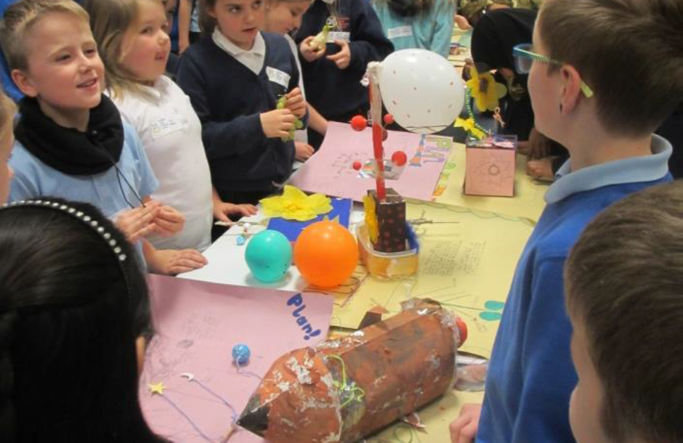
Please contact Fay.lewis@uwe.ac.uk for further information.

Slide 27
Bandura, A. (1997). Self-efficacy. [Article]. Harvard Mental Health Letter, 13(9), 4.
Bleicher, R. E. & Lindgren, J. (2005). Success in Science Learning and Preservice Science Teaching Self-Efficacy. Journal of Science Teacher Education 16: 205–225
DfE (2013). Reform of the National Curriculum in England. HMSO
DeWitt, J & Archer, L (2017) Participation in informal science learning experiences: the rich get richer?, International Journal of Science Education, Part B, 7:4, 356-373
DeWitt, J & Archer, L (2015) Who Aspires to a Science Career? A comparison of survey responses from primary and secondary school students, International Journal of Science Education, 37:13, 2170-2192
Engineering Professors’ Council (2014). 20th Anniversary Awards. Available at: http://epc.ac.uk/20th-anniversary-awards-2014/ [Accessed July 13, 2015].
Gonzalez, V. M., Goeppinger, J., & Lorig, K. (1990). Four psychosocial theories and their application to patient education and clinical practice. [Review]. Arthritis Care & Research, 3(3), 132-143.
McKinnon, Merryn, and Rod Lamberts. 2013. “Influencing Science Teaching Self-Efficacy Beliefs of Primary School Teachers: A Longitudinal Case Study.” International Journal of Science Education, Part B: 1–23.
Murphy, C., Beggs, J., Russell, H., & Melton, L., (2005). Primary Horizons: Starting out in Science. London: Wellcome Trust.
Ofsted (2011) Maintaining Curiosity. HMSO
Royal Society. (2006). Science communication excellence in science: Survey of factors affecting science communication by scientists and engineers. London.
Singh, D. & Stoloff, D.(2008). Assessment of Teacher Dispositions: College Student Journal (44), pp 1169-1180 Van Driel, J.H., Beijaard, D. and Verloop, N (2001) Professional Development and Reform in Science Education: The Role of Teachers' Practical Knowledge. Journal of Research in Science Teaching VOL. 38, NO. 2, PP. 137-158
Wellcome Trust (2011) Primary Science Survey Report [online]. London: Wellcome Trust. Available from: http://www.wellcome.ac.uk/stellent/groups/corporatesite/@msh_peda/documents/web_document/wtvm053596.pdf [Accessed 30 October 14

