Slide 1
Author engagement with altmetrics: A small case study of author awareness and use of Altmetric and Plum Analytics
Notes:
Image taken by Charley Vaughton

Slide 2
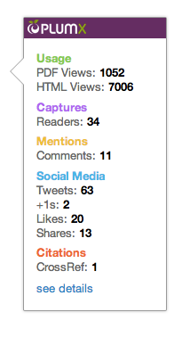
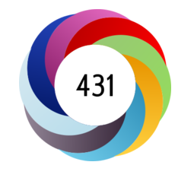
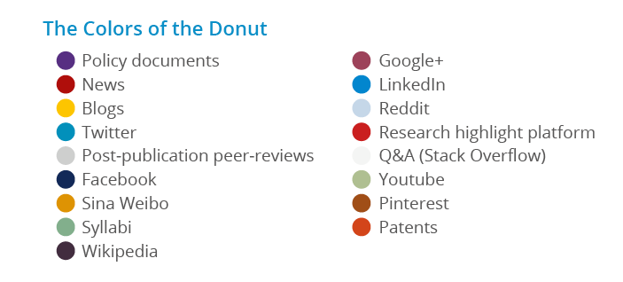

Altmetrics
Article-level metrics
Measure attention from ‘alternative’ sources
Used in conjunction with ‘traditional’ sources
Two aggregators studied
Altmetric donut
Plum print
Notes:
Altmetrics are article-level metrics (rather than journal-level metrics – such as the Journal Impact Factor, or researcher-level metrics – such as the H-index) that measure the attention that an article has received from sources such as social media, news stories, blogs, and policy documents. These are alternative sources to the traditional academic measures used to judge the impact that an article has made (e.g. citations.) Altmetrics is short for ‘alternative metrics’ and are intended to be used in conjunction with, rather than in place of, traditional metrics. In theory altmetrics can be used for lots of different forms of publications – datasets, book chapters, conference papers etc. – but in reality are often limited to articles due to the identifier required (the DOI is the easiest identifier to track and most journal articles have one.)
I looked at two altmetric aggregators in my study, Altmetric, and Plum Analytics. I chose these two because they were easily available for UWE researchers to find and use.
Altmetric displays the attention that an article has received as a colourful donut, with each colour representing a different platform. The more of a colour there is on the donut, the more attention the article has received from that platform. The donut surrounds the Altmetric Attention Score, which is calculated by taking into account the volume of attention, the platform of attention, and the author of the attention (e.g. a news story is worth more than a blog post, which is worth more than a tweet. A tweet from an academic who regularly shares links and discusses their subject is worth more than a tweet from the publisher who pushes the link out multiple times just to promote the paper.) Altmetric publishes an annual list of the top 100 articles that it has tracked, sorted by Altmetric Attention Score. The 2018 list (and link to past lists) is available online: https://www.altmetric.com/top100/2018/. We have installed a free Altmetric plugin on the Research Repository which displays the donut and attention score of articles e.g. http://eprints.uwe.ac.uk/38474/
Plum Analytics displays the attention that an article has received as a print. Rather than dividing attention by platform it divides attention by type – usage, captures, mentions, social media, and citations (Altmetric does not measure citations at all.) The bigger a circle on the print is, the more attention of that type the article has received. Plum prints are used by Elsevier on Scopus, which UWE subscribed to early in my research for my dissertation. Authors can view the prints for their articles on Scopus e.g. https://bit.ly/2FpnxaJ
Images: Altmetric donut with Altmetric Attention Score (left) and Plum print (right) from altmetric.com (https://www.altmetric.com/about-our-data/the-donut-and-score/accessed 09/04/2018) and plumanalytics.com (https://plumanalytics.com/plum-print-coming-result-list-near/ accessed 09/04/2018)

Slide 3
Research questions
Are UWE researchers aware of altmetrics?
Do UWE researchers currently engage with altmetrics?
Have authors with significant Altmetric Attention Scores purposefully promoted that article?
Do UWE researchers engage with social media?
Do UWE researchers value altmetrics as a sign of impact?
Notes:
I focused specifically on these two aggregators and on one institution – UWE. The research questions I wanted to answer were:
Are researchers at UWE aware of web-based metrics like altmetrics and, if not, are they interested in finding out more?
Do UWE researchers already engage with altmetrics (e.g. using them to track attention, using them to find articles to read, putting them on funding bids or CVs)?
Have authors with high/significant Altmetric Attention Scores purposefully engaged with social media (or other forms of dissemination) in order to promote the article? For example, if the article had a high number of tweets, did they promote it on Twitter? Or is it a fluke?
Do researchers at UWE regularly engage with social media in a professional capacity? This question is included because social media and altmetrics are so closely linked.
Do UWE researchers value altmetrics, particularly Altmetric donuts and attention scores and Plum prints, as signs of impact? Do they value one more than the other?

Slide 4
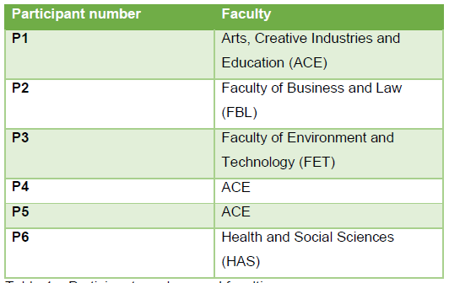
Methodology
Identified articles with significant scores on the Research Repository
Semi-structured interviews with the authors
Notes:
I wanted to interview authors with ‘significant’ Altmetric Attention Scores and donuts (aka the highest scores I could find, typically a score of over 40, and the more colourful donut the better!) I searched the Research Repository and contacted authors who had high scores, asking them to take part in a short interview about altmetrics and their research. In order to get participants for all faculties I sent out invitations to some ACE authors who had lower scores, as I had found a lack of representatives from that faculty.
I ended up with six participants, 3 from ACE, 1 from FBL, 1 from FET and 1 from HAS.

Slide 5
Findings – awareness and engagement
“Oh that’s interesting [laugh] I mean from a purely narcissistic point of view I’m quite interested to see what people are saying about it.”
“…I like seeing the members of the public engaging with my research, not that that’s my ultimate goal but it’s certainly something that I value.”
“…if you write something that you manage to get published that is particularly bad, or misinterprets or misrepresents a theory or an idea, you’re more likely to get referenced [laughs] than if you get it spot on…”
“…I have experienced this first hand, where a journal will actually reject a paper purely because it, the paper did not cite any papers published from that particular journal.”
“…my concern would be that it, that it’s just another level of surveillance that’s available to managers…I can imagine ways in which it could be abused, you know ‘you’ve not been tweeting enough, there’s not enough news interest in your work, compare that to so-and-so who’s got three hundred and twenty tweets off his last article, well you’re done on fifteen and that’s your best’…”
“…employers, the university, may value you know, engagement with members of the public over scientific value, validity…”
Notes:
Are researchers at UWE Bristol aware of web-based metrics?
Participants had some knowledge of metrics, though only one had much previous awareness of altmetrics through the Altmetric donut for their article. Other participants were familiar with the H-index, citations, downloads, and views. There was little recognition of Altmetric donuts or Plum prints. There was some motivation to find out more - they felt that the tide was heading in the direction of these metrics becoming more important, and that it was necessary to engage with metrics like these in order to avoid falling behind.
2. Do researchers at UWE Bristol currently engage with altmetrics? If so, what are their motivations, if not, do they intend to do so?
None of the participants made use of altmetrics for more than checking scores for personal interest (they found this interesting in a ‘narcissistic’ way and for showing that their work had not just gone out into the ether – people had read and engaged with it) but none used them on CVs, in funding bids, or for finding reading (examples of use given by academics in the literature.) There was little interest in using them for these functions, though some participants showed an intent to use them for funding bids in the future as proof of interest in their work. External pressures would be necessary for many of the participants to use altmetrics in this way (e.g. a requirement from funders to use altmetrics on funding applications.)
Advantages identified by the participants were the ability to show engagement faster than citations, using altmetrics to judge whether to invite an academic to be a reviewer for a journal, and identifying ‘key’ pieces of literature in a journal. One participant noted that could be used as a further form of engagement – contacting the people who had tweeted, blogged etc. and starting a conversation.
Disadvantages identified by participants were the potential for gaming the figures, the lack of nuance (only showing attention not whether the attention is positive), the metrics being used as a surveillance tool, and quantitative metrics and non-traditional engagement being used to judge the validity of a work rather than the work itself. Many of the concerns were also in relation to citations – there may be a general preference for traditional metrics over altmetrics, but researchers recognise that they are not flawless and have many of the same problems as altmetrics, or problems unique to citations (citations don’t show whether a citation is positive or negative, they take a long time to appear, there is potential for gaming by authors or journals.)

Slide 6
Findings – social media
“We certainly used it, once it came out, but sharing – mostly sharing the link because it was open access so sharing the link to the publication, Twitter and Facebook I think I use both, and I think we all did. But that was sort of secondary, you know, the other – the strategy was more planned.”
“…given his generation he’s probably a tweeter as well, but I don’t know that for sure. But I would imagine that he would be social network active in a way that I’m not…”
“…I think Facebook works well as social media, and I mean ‘social’ so its friends, family, acquaintances, silliness, pictures, you know, whereas Twitter is for me a work tool.”
“…in a professional capacity mostly Twitter, you know occasionally, not every day but you know, regularly. Mostly I share things that I find interesting, occasionally tweet about what I do but only professionally not, you know, if I go to have ice-cream or something I don’t tweet about it!”
Notes:
3. Have authors with high Altmetric Attention Scores purposefully engaged with social media (or other forms of dissemination) in order to promote that article?
In the case of these participants, the primary method of promotion and dissemination of their work was press release. Social media promotion was conducted as a secondary, supplementary method, and in at least half of the examples the bulk of the social media promotion was undertaken by a co-author or the publisher, rather than the author who was interviewed e.g. in one example which featured many different sources of engagement, most of these had been promoted by a co-author (the donut showed attention from blogs, Twitter, Wikipedia, and news stories. The lead author had updated the Wikipedia page and written a blog post prior to publication, so there was a direct correlation for those platforms.) This was the clearest example of a direct link between actions taken by the authors and the Altmetric Attention Score and variety of attention received. In other cases the link was much less clear. With little planning for social media promotion it is difficult to discern a clear link between cause and effect. For many, citations and indications of academic impact were the priority over social impact (despite making many observations about disadvantages with citations as a measure of impact as well as altmetrics as a measure of impact.)
4. Do researchers at UWE Bristol regularly engage with social media in a professional way?
Two of the participants actively avoided using social media in their personal lives and this extended to their professional use, which was minimal and only extended to checking LinkedIn. They made a conscious decision to not use social media. Half of the participants made use of Twitter to tweet about their work and their field, and Twitter was seen as a more professional tool to use, rather than Facebook (though two participants noted their use of Facebook groups within their faculties.) Twitter use tended to be sporadic, with participants retweeting information from their field and tweeting about their work rather than engaging in discussions. Those who did use social media in a professional capacity drew a clear line between personal and professional spheres, using separate tools (e.g. Facebook for personal use, Twitter for professional use) or minimising personal updates on platforms where they maintained a professional presence (e.g. making minimal personal updates on Twitter.) One had used LinkedIn to find contacts and develop new collaborations.

Slide 7
Findings – impact and barriers
“…impact is measured in several ways, I also, I use the term impact in the REF for instance it’s about making a difference, it’s about changing things, so if your research has impact it means other people have changed what they do because of your research…”
“…certainly in terms of the kind of narrow definitions that HEFCE put out for research then, no because this isn’t impact at all right It’s just citation and attention…A citation isn’t impact, it’s not evidence of impact.”
CV: “Would you call, would you say that there’s a difference in that you would almost have citations as scientific impact and altmetrics as social impact?
Participant: Yes, exactly, exactly, yeah yeah.”
"Its hours in the day isn’t it? All these things are distractions really, you know, unless you purposefully keep it down to a few minutes a day...I've got to remember how to log in to some website somewhere, and then find myself in it, and then remember the difference between Plum and Altmetric…”
"My life is so complex and busy that the idea of really generically using social media is an anathema at the moment for me...”
Notes:
5. Do UWE Bristol researchers value altmetrics, particularly the two examples of Altmetric donuts and Plum prints, as a sign of impact?
The participants found the altmetrics interesting from a personal interest point of view – they liked seeing that their work had received attention as it justified them writing it. Some participants placed more value in them in than others – these participants valued them for making engagement with their work more tangible, as a sign of scientific communication outreach with the general public, and as a way of seeing a demographic breakdown of the audience engaging with their work (for this reason one participant strongly favoured Altmetric over Plum as they found this demographic breakdown particularly interesting.) However in general this value was dependent on altmetrics being a measure of impact in conjunction with other indicators, such as citations (though citations were also criticised.) Reasons for not valuing altmetrics included ambivalence about measures of impact; impact being something that cannot be captured by a citation or a number; the fact that a tweet (or page view or download etc.) does not correlate with agreement or even someone reading the paper; potentials for gaming the system; and the non-transparency around how and where altmetrics are gathered from, how scores are calculated, and what they translate to.
At the moment, altmetrics are a sort of novelty – interesting to look at and of limited value, though they are showing something ‘new’. It would require a lot of investment from support staff (to get around the barriers currently facing academics, namely time constraints and technical understanding) and external bodies such as funding bodies (to provide the ‘stick’ i.e. require altmetrics or proof of dissemination of work outside academia to be included on bids in order to receive funding) before altmetrics will be used on a regular basis. Like citations, they may never be fully accepted as indicators of impact because the definition of impact is so broad, and for many academics cannot be measured by a number.

Slide 8

Further work?
Larger scale study
Look at differences between age, gender, professional status
Training opportunity
Notes:
This was a very small scale study – six participants, one institution – so it is not possible to generalise the findings. There is an opportunity for a much larger study, which could take in all the researchers at one institution or beyond. This study only looked at researchers who had uploaded an article to the Research Repository, thereby eliminating any researcher who had not used the system.
A further study could record information about the participants such as gender, years in academia, age, or professional status, and further analyse the findings under those lenses. It would be interesting to see if there is a difference in attitude between older and younger academics, or early career researchers and established professors.
One of the reasons I looked at altmetrics was to ascertain whether it would be worth developing training materials for UWE researchers about altmetrics, and what form this training could take. Despite several participants stating that they wanted, or felt like they needed, to know more about altmetrics the proposal of training sessions was rejected by more than one because of the time required. At the moment we are not developing anything at UWE, as other projects have become more time pressing.
Image from pixabay (https://pixabay.com/photos/thought-idea-innovation-imagination-2123970/)

