Slide 1
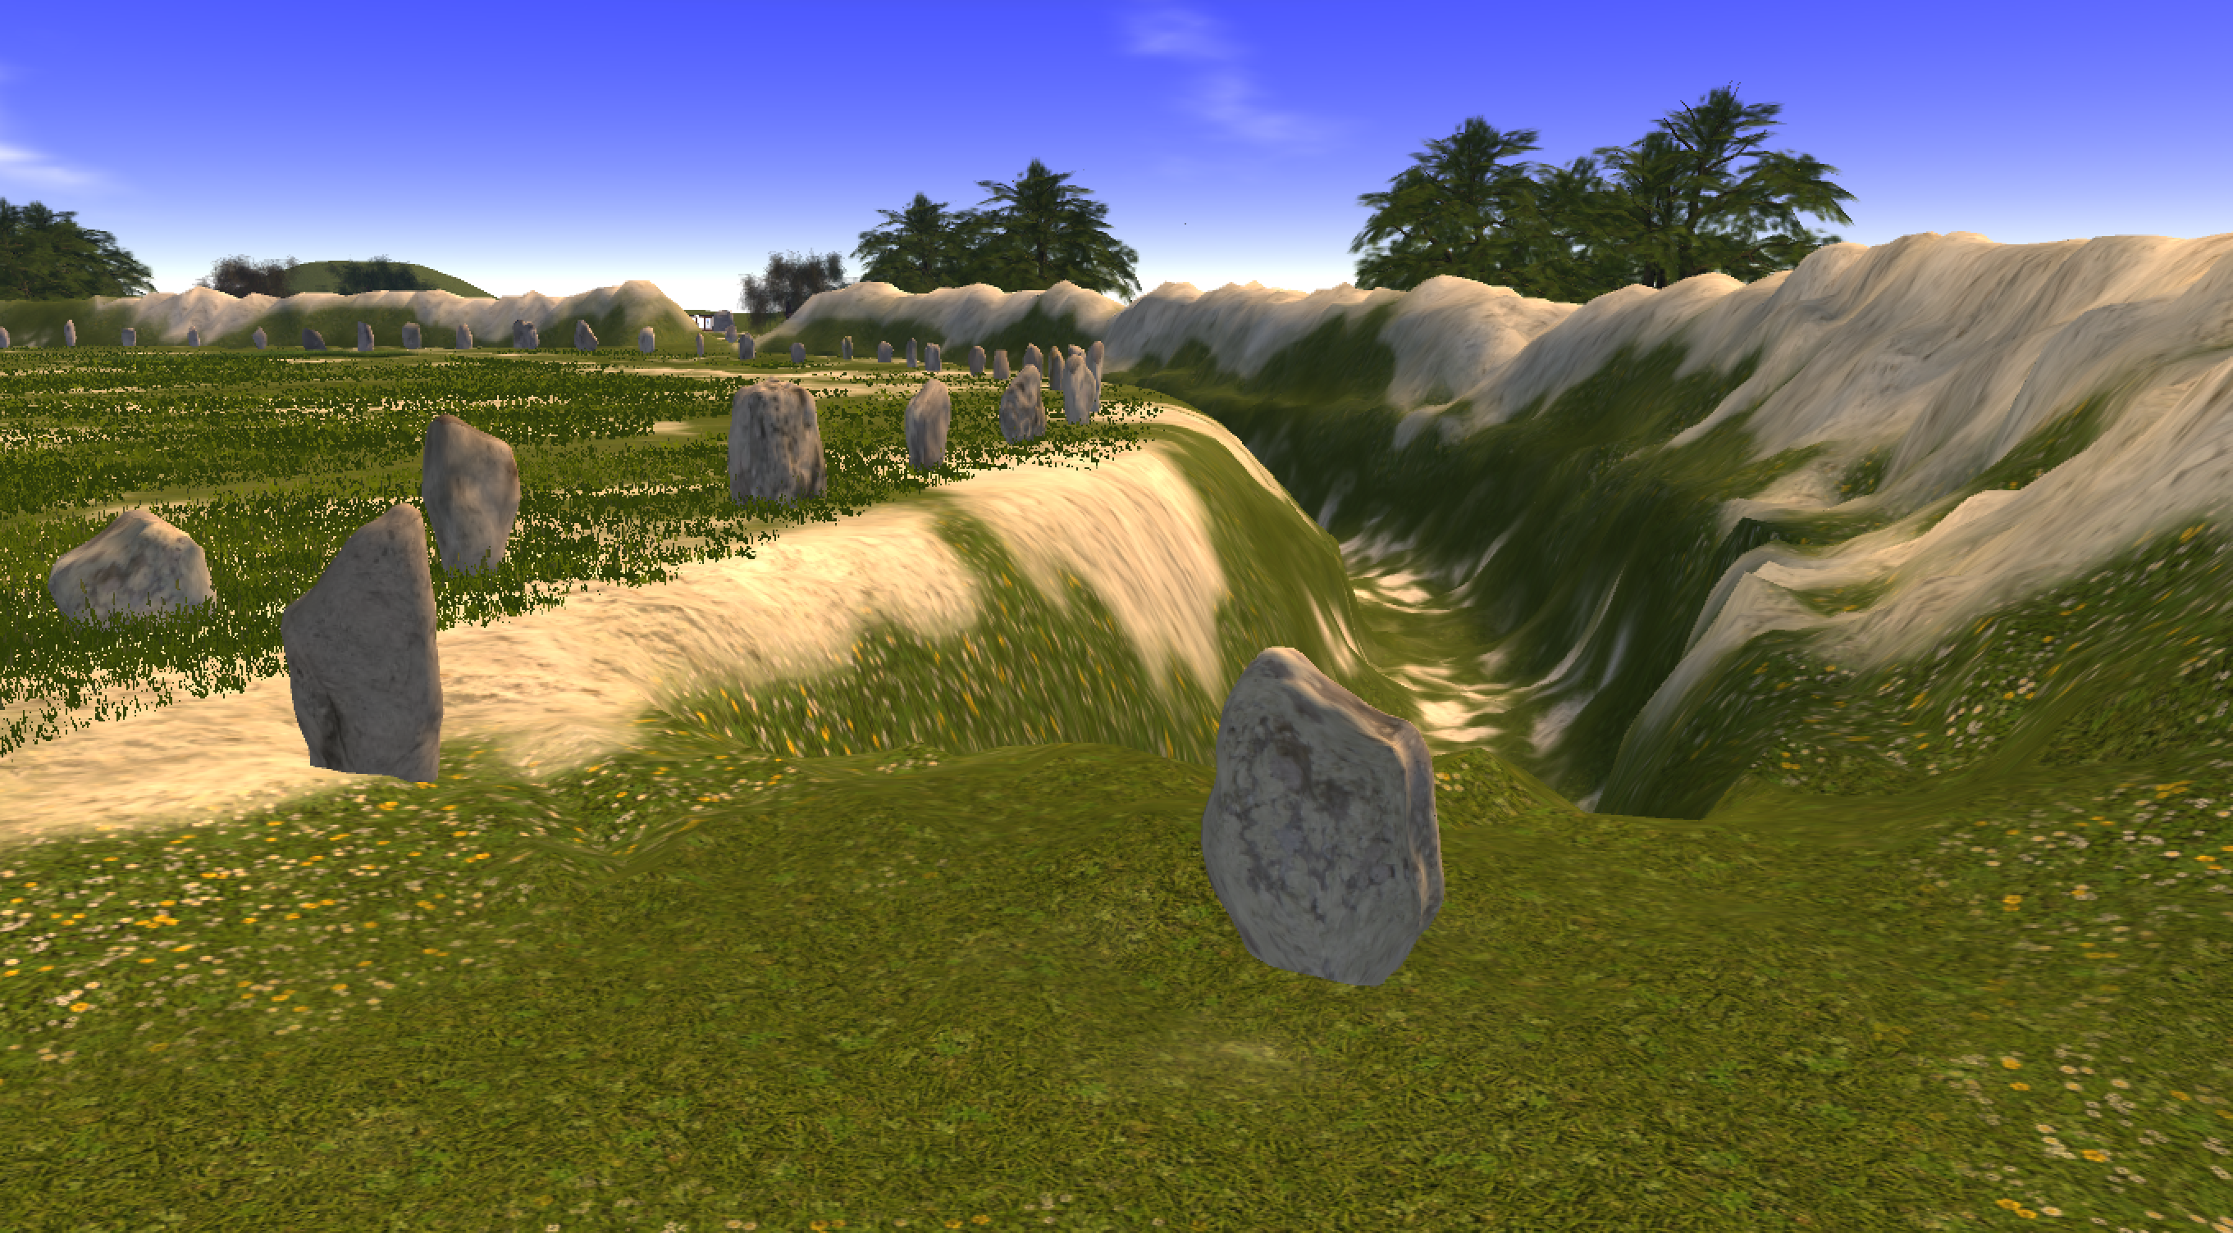
Virtual Avebury: an immersive partnership
Kate Welham, David Burden, Rosamund Cleal, Elizabeth Falconer, Ralph Hoyte, Phill Phelps, Neil Slawson, and Nicola Snashall
Notes:
This paper examines the impact of Virtual Avebury: a project funded as part of the AHRC/EPSRC Immersive Partnerships call in 2019.
The work I am presenting today is as the title suggests very much a partnership and I want to acknowledge my colleagues who cannot be here in person: Liz Falconer the PI, and our partners at the NT (a trust for the preservation of places of historic interest or natural beauty in England, Wales, and Northern Ireland, founded in 1895 and supported by endowment and private subscription, it has over 5 million members), virtual reality developers Daden and soundscape specialists Satsymph who you will hear more about later on in the talk.

Slide 2
Introduction
Notes:
Introduction
What I am going to talk to you about today is a project called Virtual Avebury. Virtual Avebury is a 3D, fully immersive simulation (not reconstruction) of Avebury henge and stone circle in Wiltshire, U.K. as it may have appeared circa 2,300 BCE. But really this project was not so much about the 3D product, but much more about partnerships in immersive technologies and user evaluation of using these types of assets in a heritage context
I am going to talk to you about:
What avebury is
How we built VA and brought the different partners together
Who used it, and what the evaluation dataset looked like
What the users and the data we collected from them tell us about our ability to engage different sectors of the public with archaeological research through immersive experiences such as this one
So what is real avebury?

Slide 3
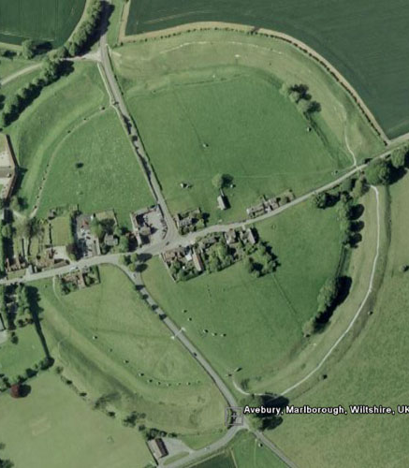
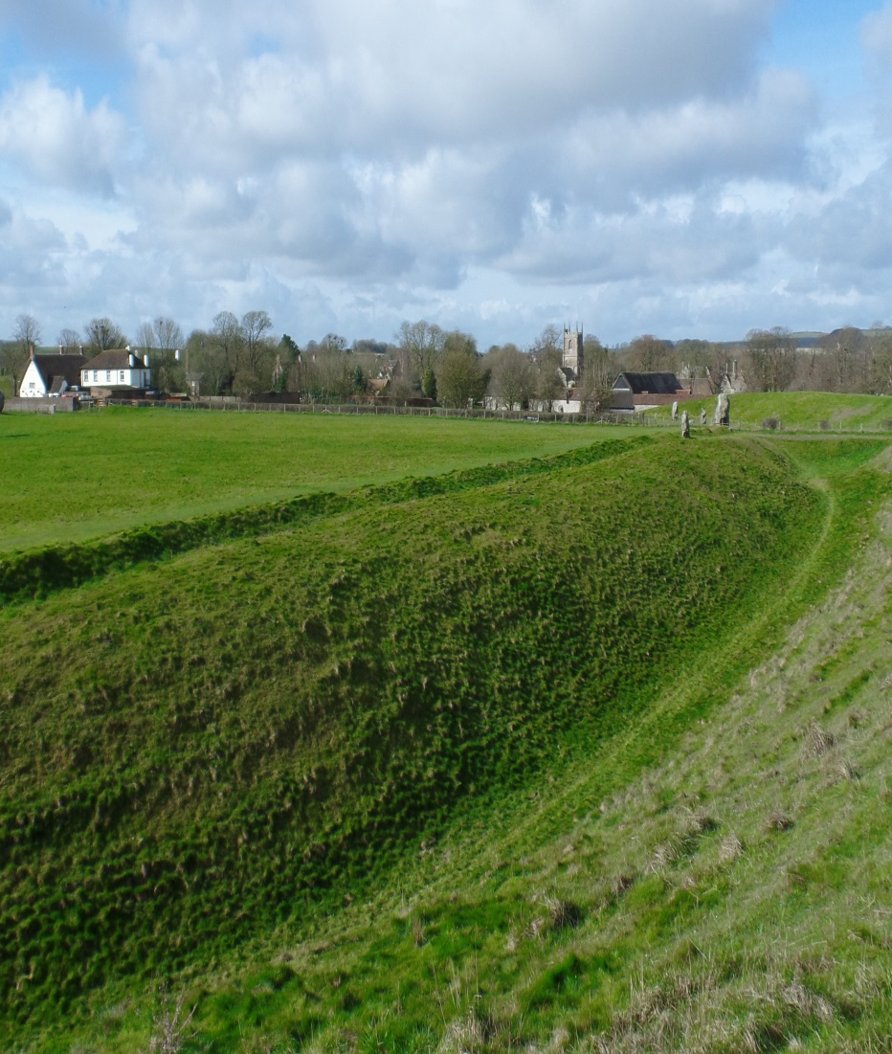
Avebury henge and stone circle
Internationally important for its outstanding prehistoric monuments. It contains
the largest prehistoric stone circle in the world.
prehistoric henge
modern roads and village
stone circles
300,000 visitors per annum
Notes:
Avebury, near Marlborough in Wiltshire –towards the south of the UK,
It is part of the UNESCO Stonehenge, Avebury and Assoc Sites WHS.
To give you a bit of context Avebury henge and stone circle is a late Neolithic monument in North Wiltshire (south of UK), estimated to have been built between 2,800 to 2,000 BCE. It is one of the largest stone circles in the world and, at 1 kilometre in circumference, it is one of the largest henge (inner ditch and outer bank) monuments in the UK. Today most of the stones have gone, the banks have slipped and eroded, the ditches have filled in and a small village lies in the middle of the henge, so that the original size and complexity of the monument is now difficult for visitors to appreciate.
Today, the monument contains part of the village of Avebury and is cut by roads (pic1) which cross each of the 4 original breaks in the henge. The pic on the right (taken from inside the monument) shows how the view across the henge is blocked by trees and modern buildings, which makes Avebury rather difficult to understand and a very relevant location for simulation that enables exploration of how it may have appeared in the ancient past.

Slide 4
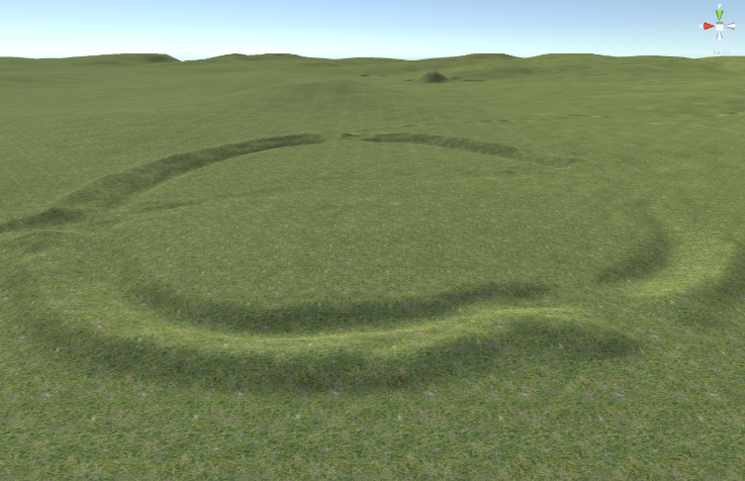
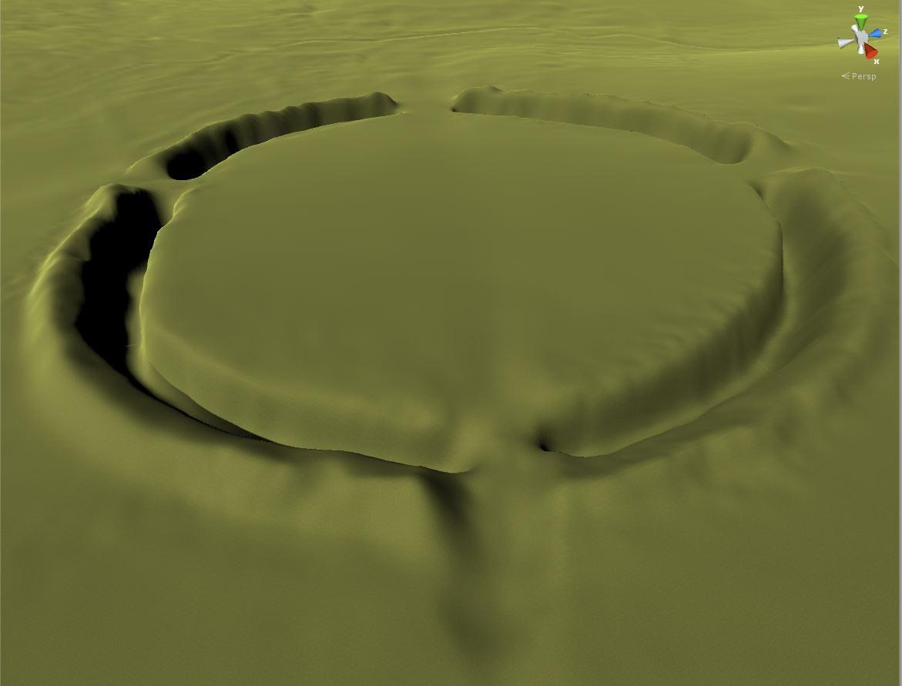
Virtual Avebury under construction
… to form the first terrain model. The ditches and banks are then terraformed to the heights and depths interpreted from archaeological data provided by BU and NT…
B
A
C
Daden create a greyscale map from Environment Agency Lidar data, and import into their Unity 3D FieldscapesTM platform…
…to simulate the henge as it may have appeared circa 2,300 BCE.
Notes:
How we built it and brought the different partners together

Slide 5
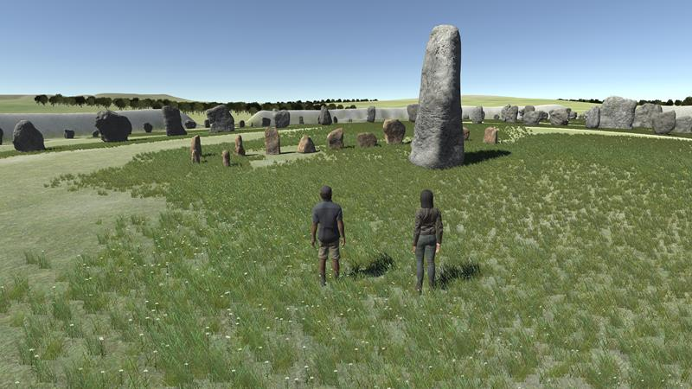
Virtual Avebury under construction
…and we all work together in the virtual environment, developing the visual and audible character of Virtual Avebury.
Satsymph start to build the soundscape structure…

Slide 6
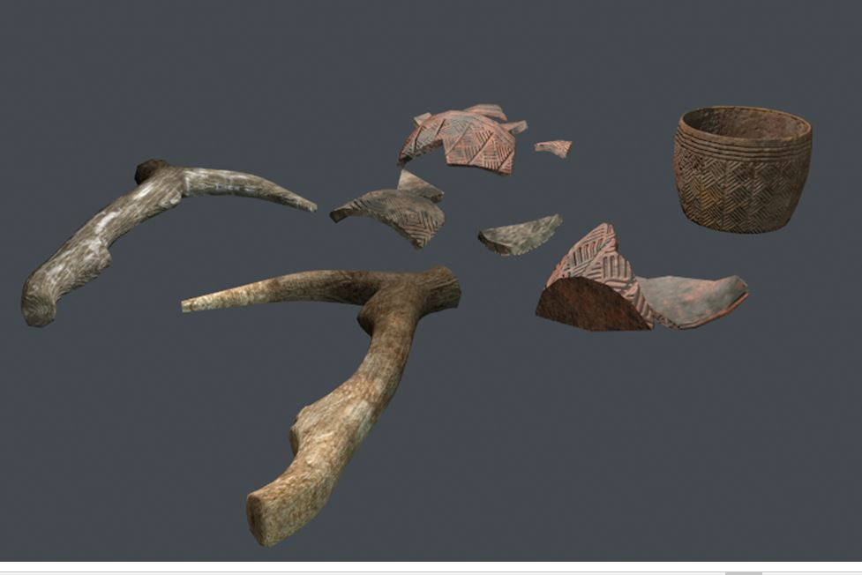
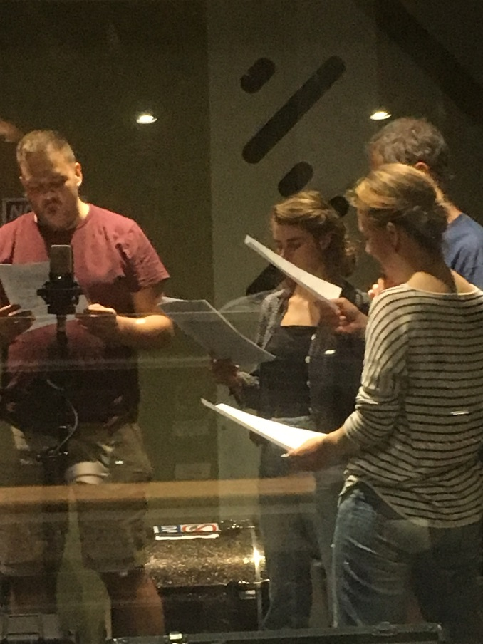
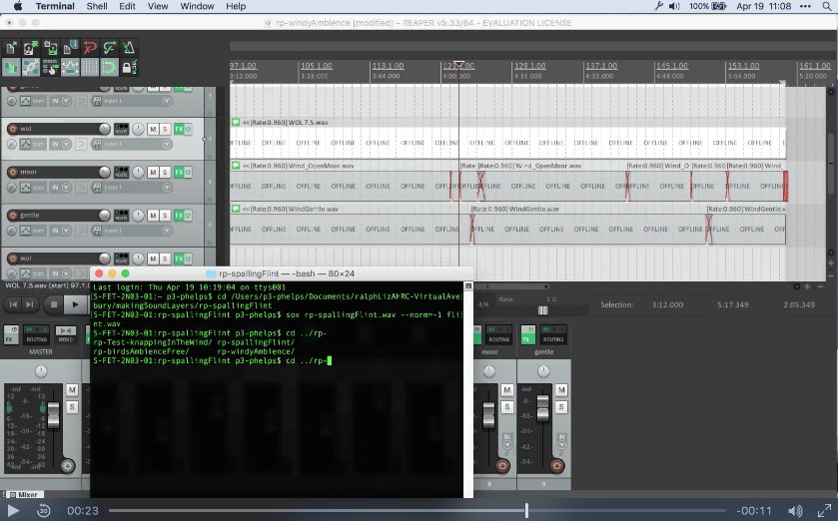
Virtual Avebury under construction
We create Neolithic artefacts such as grooved ware pottery sherds and red deer antler picks…
We record and mix sound effects such as flint knapping…
…and human voices speaking, laughing and calling.

Slide 7
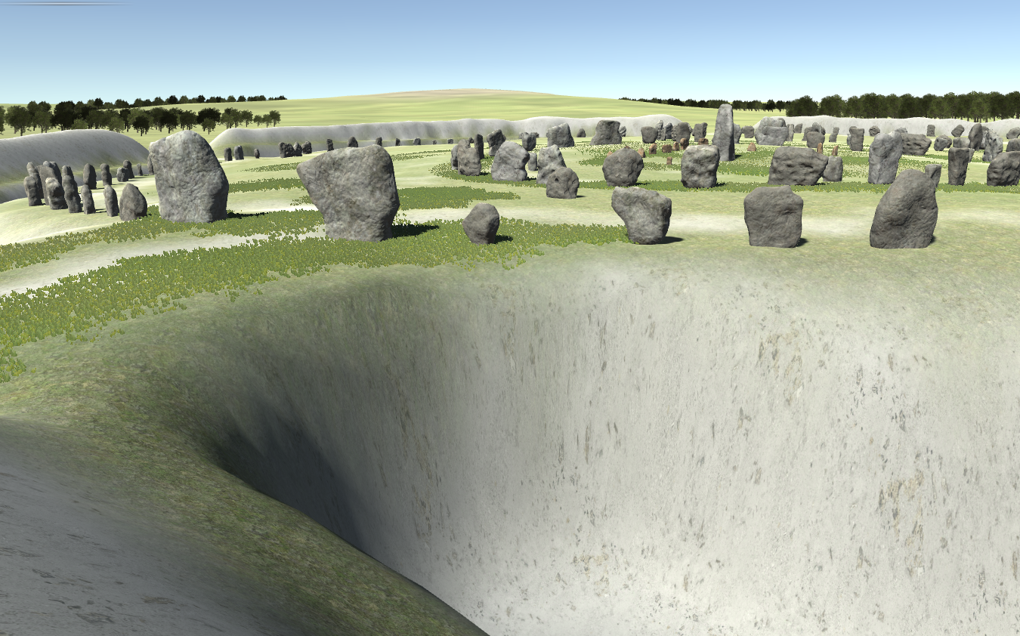
Virtual Avebury
… and all the parts are finally synthesised to create Virtual Avebury.
Notes:
So once we had built it - who used it?

Slide 8
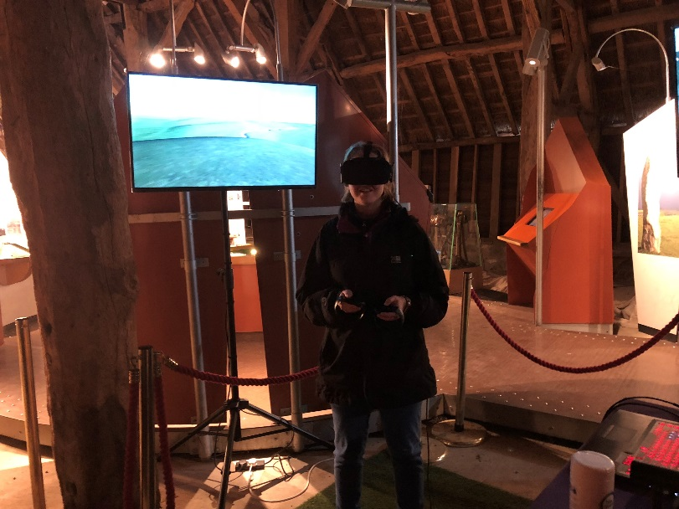
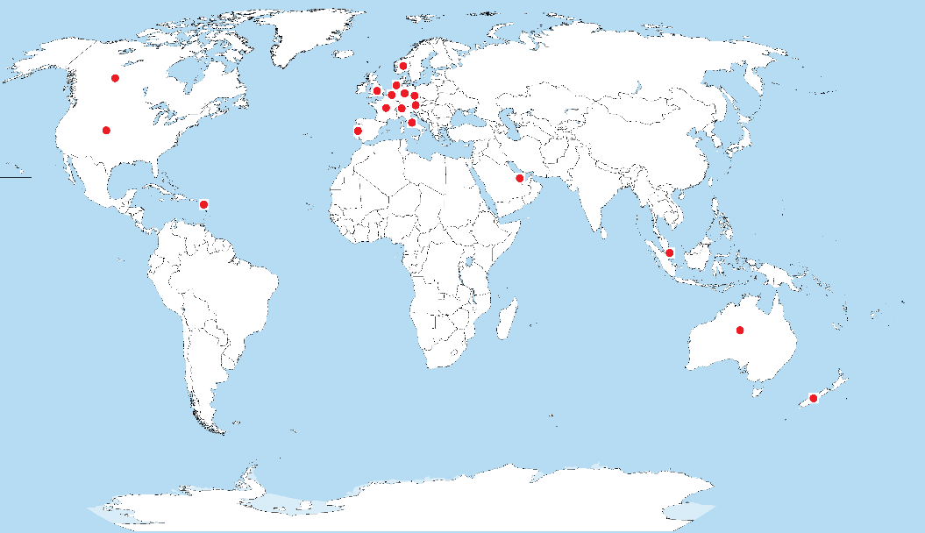
Evaluation: who participated in Virtual Avebury?
Virtual Avebury was available for public engagement on 45 days from June – September 2018, in the Barn Gallery of the Alexander Keiller Museum at Avebury.
More than 700 people tried the experience, analysable data collected from a sample of 388 of those participants – aged 16-85 years old.
Participants came from 18 different countries, 280 from the UK and the remaining 108 from the countries shown on the map.
Notes:
Virtual Avebury was available for public engagement on 45 days from June – September 2018, in the Barn Gallery of the Alexander Keiller Museum at Avebury. More than 700 people tried the experience, and we collected analysable data from a sample of 388 of those participants. They came from 18 different countries, 280 from the UK and the remaining 108 from the countries shown on the map to the left.
The age range in our sample was 16-85. Although many children experienced Virtual Avebury, our research was concerned with users over 16 years old, for ethical and practical reasons.
At the start of our questionnaire to these participants we asked people a set of demographic questions about their age, gender and nationality, and about their frequency of use of IT devices, how frequently they play computer games and how immersed they tend to become in films, books and TV. We are interested to see if there are associations between any of these variables and a set of subsequent questions relating to their experiences of, and reactions to, Virtual Avebury. So I will present a synopsis of the data to you now.

Slide 9
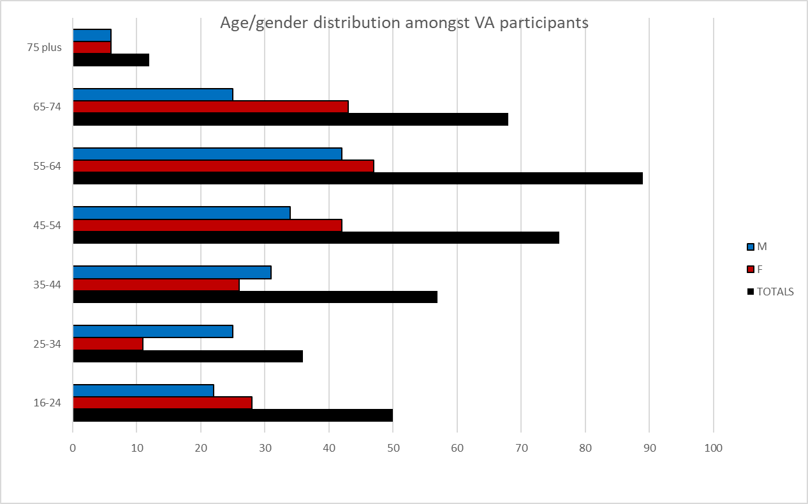
The age/gender distribution of our participants
Notes:
Lots of visitors in the 45 + demographic reflecting the NT membership. Lots of grandparents and parents with children
You can see from Figure 2 below that most of our participants were aged over 45. This is not a surprising result, considering that the first two filters for our population were 1) coming to visit Avebury, and 2) deciding to visit the Barn Gallery museum during their visit. Statistics from DCMS and heritage organisations such as National Trust and English Heritage, show that visitors to historic sites tend to be ‘middle aged and middle class’, although this is a significant generalisation.

Slide 10
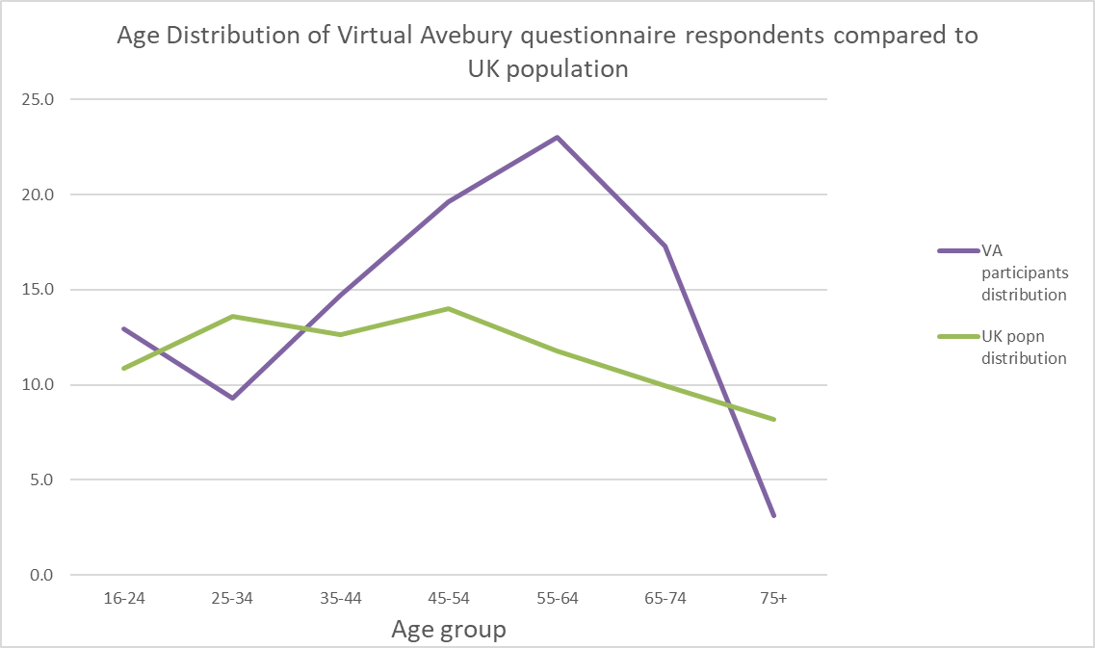
UK population compared to Virtual Avebury participants
Notes:
And you can see how this varies against the UK population – essentially a bump
So what did you data tell us about user’s experiences at VA?

Slide 11
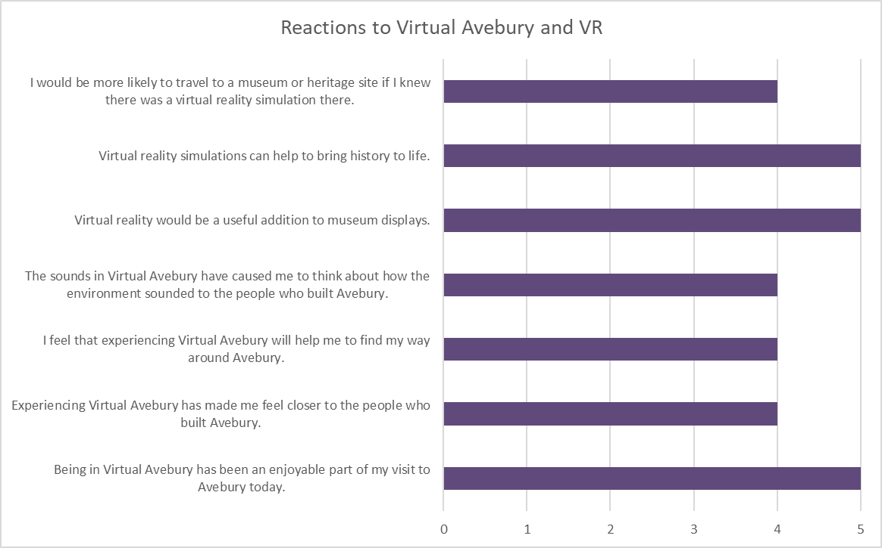
Reactions to Virtual Avebury
Notes:
5 high,, 0 low General reactions were
Had more specific questions

Slide 12
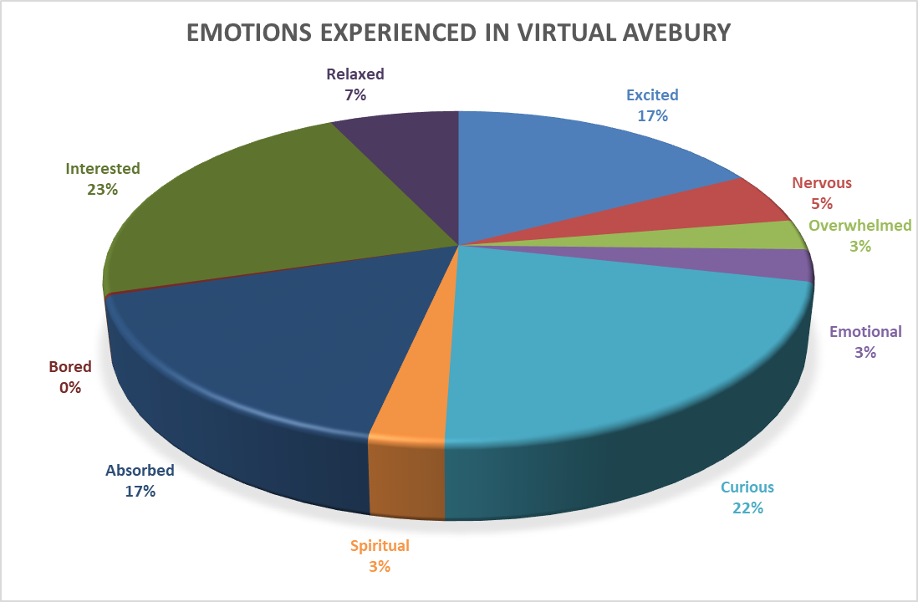
How did participants feel in Virtual Avebury?
Notes:
Most were interested, curious, absorbed and excited. A few found the experience made them nervous or overwhelmed

Slide 13
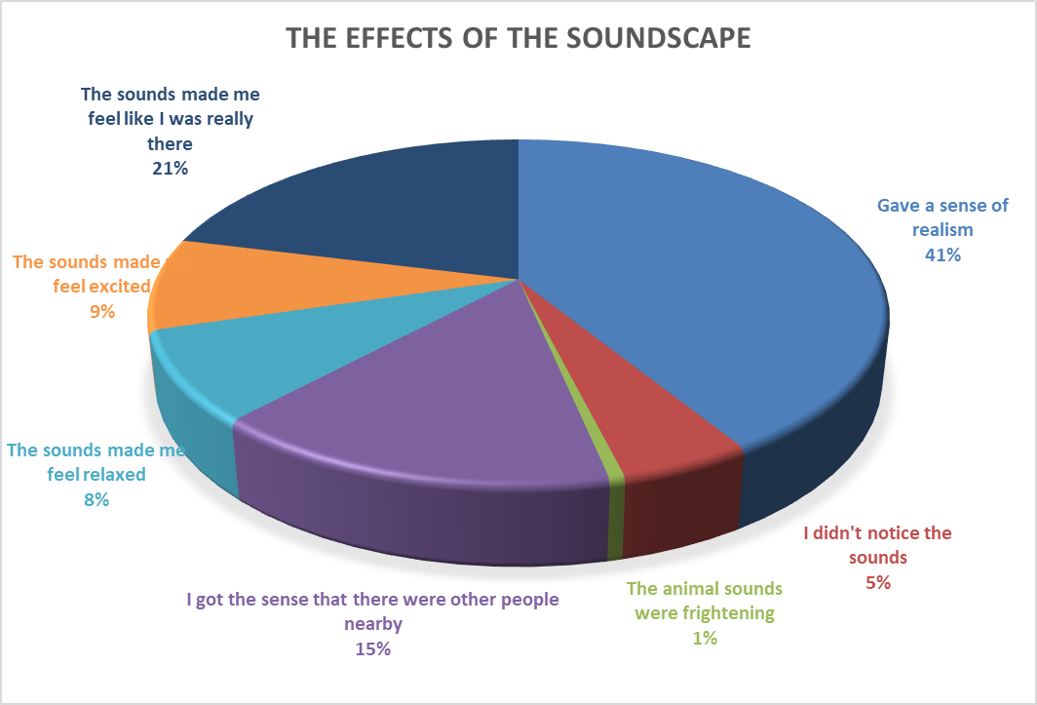
How did participants feel in Virtual Avebury?
Notes:
We also wanted to know how participants felt about the inclusion of sound in the immersive environment, and you can see that the majority really liked these
We were also interested in sense of place

Slide 14
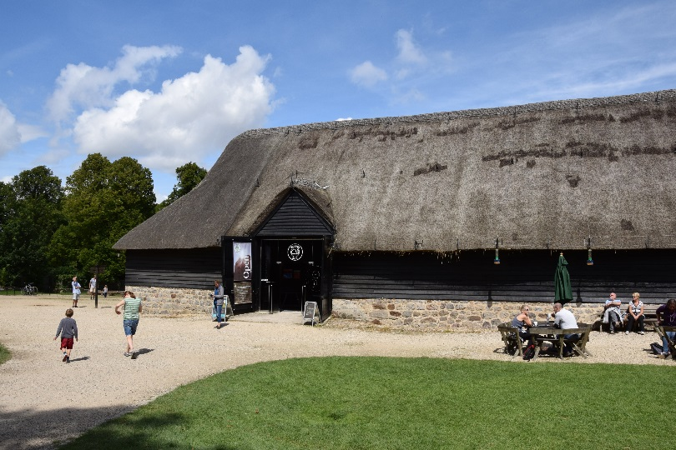
What did participants say about Virtual Avebury?
“However fascinating, the sense of the stones themselves is more powerful. This really filled in the gaps though and helped understand what was missing. The two together (physical and virtual) are a brilliant combination”
“Nervous when I went under ground or near the edge of the ditch...in a good way!”
“Awed and exhilarated would be good words to add”
Notes:
We also took free text feedback, and we could see that people really liked the experience

Slide 15
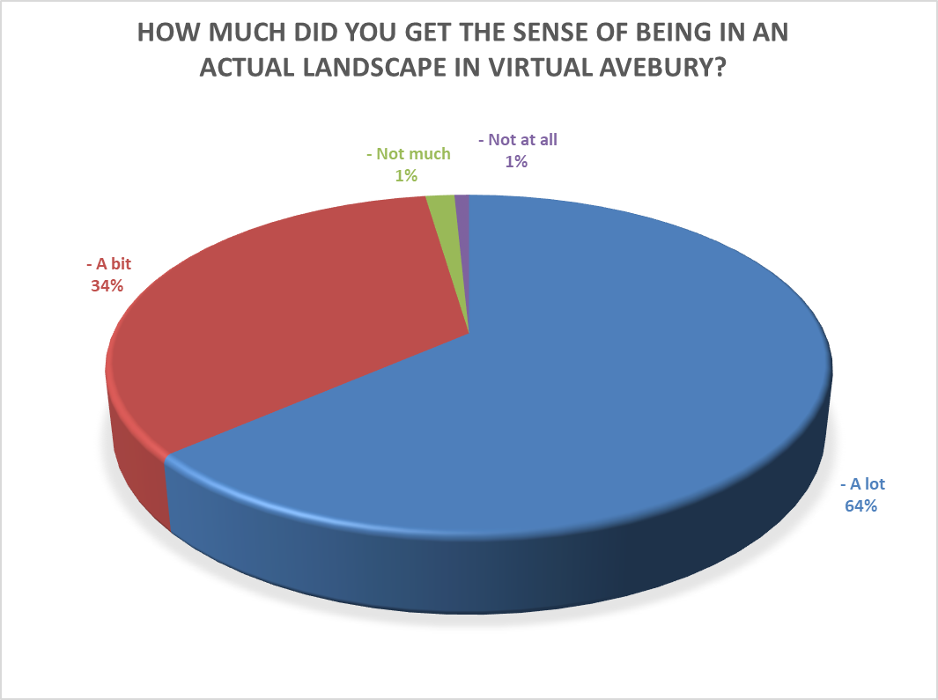
Sense of place
“I felt completely immersed in the landscape. It was really interesting to see the difference between the real stones outside and the simulation. The difference between the sizes of the banks and ditches was particularly striking!”
Notes:
One of the other areas we were keen to explore was how a immersive environment like VA could impact on an individual’s sense of place – and the majority did, and when asked about how ‘believable’ it felt

Slide 16
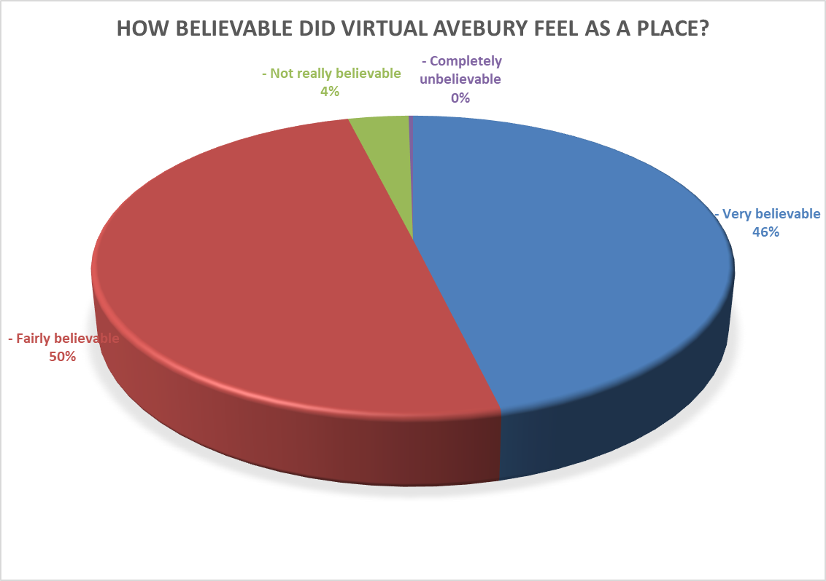
Sense of place
“It felt very different to the Avebury I know, particularly in separation from the surrounding landscape and the monuments. But that enabled a different sense of the place to be appreciated”
Notes:
The majority said it was either fairly or very believable as a place
This is maybe particularly important given the fragmented nature of the site today
We also conducted out a number of statistical tests on our data to see if demographic data such as gender, familiarity with IT use or immersive tendency of individuals was associated with responses to experiences in Virtual Avebury.
Most of the time there was no relationships between demographic data and VA experience, but
Table 1 shows that there was a very significant difference between male and female responses to the immersive tendency question, but little other significant difference.
Table 2 shows that there is little correlation between immersive tendency and Virtual Avebury experiences, and
So, positive responses to Virtual Avebury occurred across a wide range of our participants.
Table 3 shows very little correlation with familiarity with IT use.

Slide 17
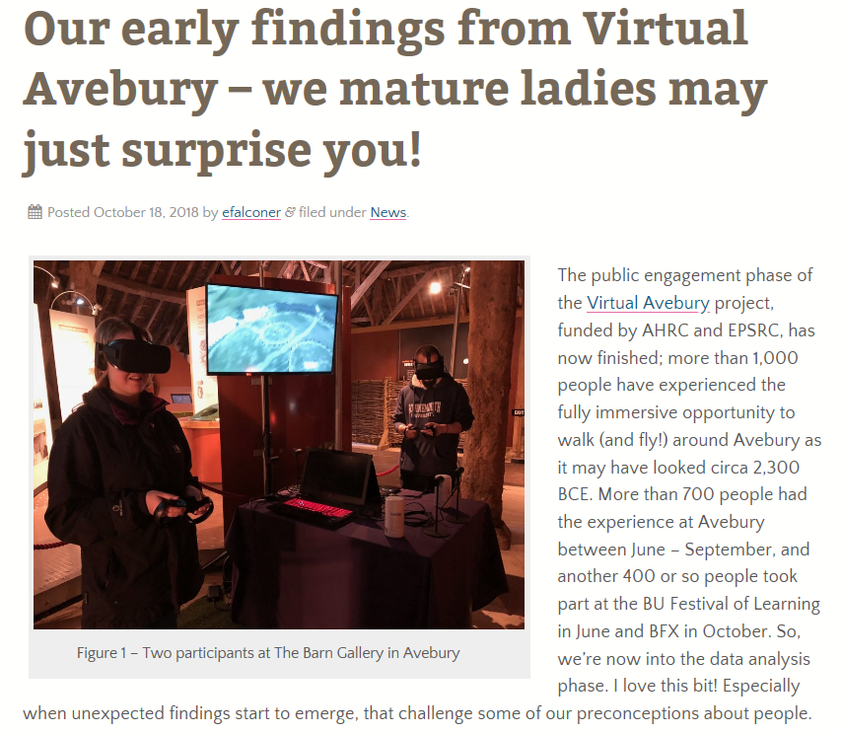
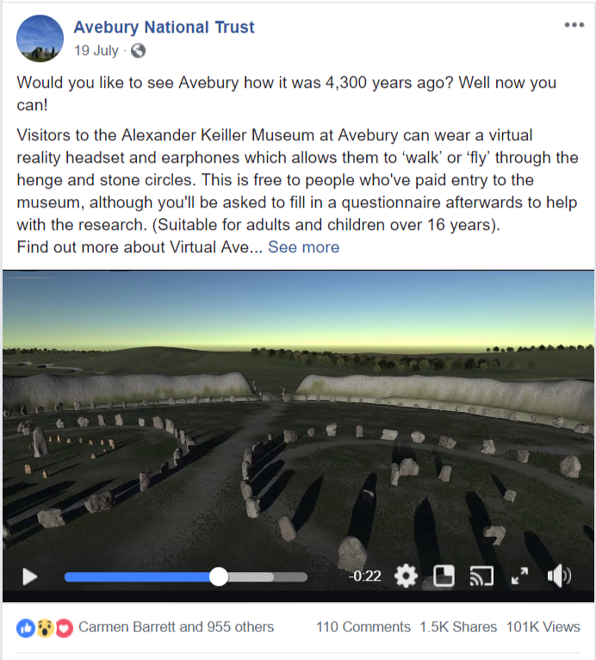
IT use, age, and gender
Notes:
So we have gathered a lot of data, and some of it is still being analysed in depth, but I’d like to explore one finding in a little more details - a phenomenon we noticed whilst conducting VA
we observed that older women, particularly when visiting with partners and grandchildren during the summer, tended to be reluctant to try Virtual Avebury, preferring to leave it to “grandad and the kids”. This observation is corroborated by the questionnaire results shown in Figure 2, which demonstrates that the gender split in the 65-74 age group was 60% male 40% female. You’ll also notice from Figure 2 that twice as many females than males participated in the 45-54 age group, but this was due to males being under-represented as visitors in this age group, rather than any observed reluctance to participate in Virtual Avebury.
We wondered what factors might be associated with older women being more reluctant to try a VR experience like Virtual Avebury, so we looked at a) the responses to questions on the frequency of use of IT devices (smartphone, tablet, laptop, desktop, games console or any form of VR equipment) and b) how frequently participants played computer games. And the findings surprised us!
When we asked question “Approximately how often do you play games using information technologies? These include console games, PC games, tablet (e.g. Candy Crush Saga) and mobile phone games”. Answers could be ‘daily’, ‘weekly’, ‘monthly’, ‘<10 times per year’ or ‘never’. These responses were number coded and then averaged for males and females in each age group.
There are probably no surprises that males in the 16-24 age group reported the highest frequency of playing computer games, but there are other trends in this graph that might not be as expected.
First of all, people of all ages played computer games. And, whilst overall the frequency of game playing did reduce with age amongst our participants, the frequency differences between males and females in the age groups were not consistent.
Also, there appears to be a pivot point at the age of 45. Below this age, males reported more frequent game-playing. Above this age, females reported more frequent game playing (it should be noted that the 75 plus age group had only 12 participants and so we are less confident about the findings in that group).
For instance, females in the 45-54 age group reported greater frequency of game-playing than 25-34 year-old males or females. And most surprising to us of all, the age group that demonstrated the greatest frequency of female game playing compared to males in the same age group was the 65-74 year-olds!
We are looking at the data relating to each type of IT device too, and it appears that there are some interesting differences in preferred devices between different age groups and males and females – an important issue for us when considering how we might make access to Virtual Avebury possible for a range of devices in the future.
So, what does all this mean? Well, we’re in the early stages of analysis so we have a lot more work to do, some of which might show us different associations in the data that shine more light on this. We wait to see! But it does suggest that we have to be careful not to explain differences we may see in responses to experiences like Virtual Avebury by referring to stereotypical expectations. And, more widely, expecting young people to be much more familiar with information technologies than older people may be a view we need to challenge.

Slide 18
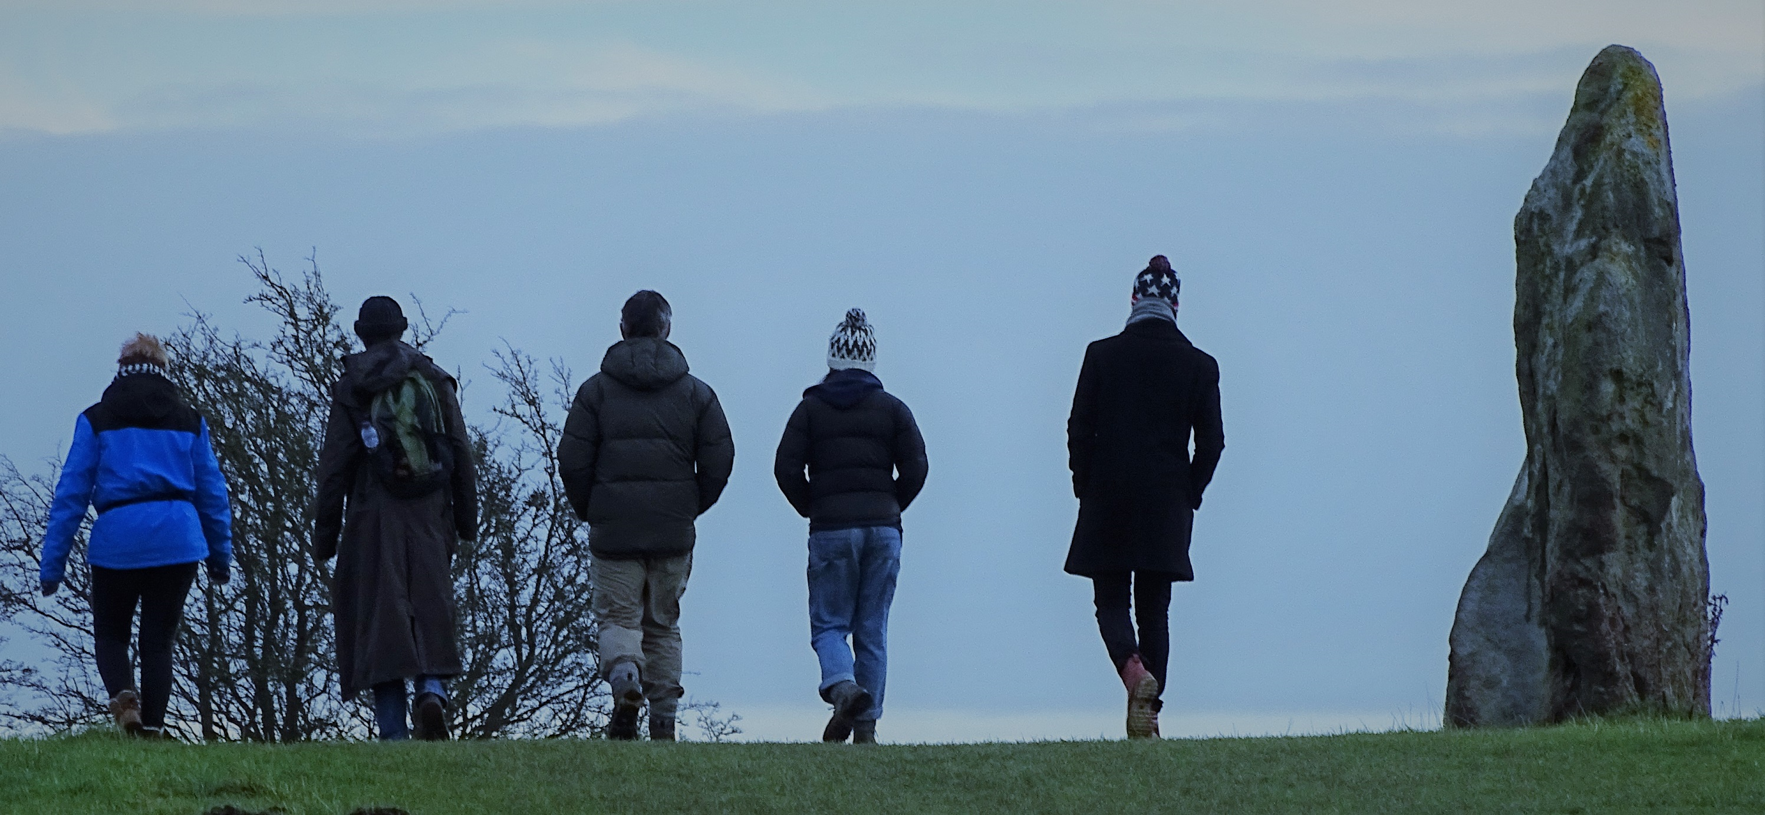
Conclusions
Photograph: Ralph Hoyte
Notes:
So in conclusion, Va has enabled us to create powerful new partnerships in immersive experiences, but importantly the evaluation we have conducted has show that:
There is NO association between age, gender, familiarity with IT or immersive tendency when those demographics are correlated with reactions to Virtual Avebury. So the appeal of virtual simulations of ancient heritage sites appears widespread, and not more attractive to younger or more “IT-savvy” populations.
SO, we will be:
Working together to make Virtual Avebury a permanent immersive experience for visitors to Avebury, and more widely available online;
Producing guidance for heritage organisations wishing to work in creative partnerships, drawn from what we have learned;
Working together on further projects to enhance visitor understanding of our rich human heritage

Slide 19
Thank you for listening Virtual Avebury: an immersive partnership kwelham@bmth.ac.uk
Kate Welham, David Burden, Rosamund Cleal, Elizabeth Falconer, Ralph Hoyte, Phill Phelps, Neil Slawson, and Nicola Snashall

