Slide 1
Clients and agencies:
Getting the most out of the relationship
Tim Hughes and Mario Vafeas
Bristol Business School

Slide 2
Applied Marketing Group
To conduct research that is academically rigorous and has impact on practice
To engage with practice
To use research and engagement to inform our teaching

Slide 3
Why research client–agency relationships?
Significant to achieving effective marketing campaigns
Greater demand for value
Co-creative: Substantive input from both sides
Impact of digital technology
Fragmentation/integration
New skills
SMEs new to using marketing agencies

Slide 4
Change and disruption
“The whole world is becoming more complex. It's changing quicker than brands and companies can deal with.”
(Anatoly Roytman, MD of EALA, Accenture Interactive. The Drum, Oct 16)
“Digital disruption and the rapid growth of data usage will fundamentally change the role of agencies, so much so that the way we know them today will not exist five years from now.”
(Ashish Bhasin, CEO of Dentsu Aegis Network, South Asia)
“Accenture Interactive has made 20 purchases since its launch in 2009 and is now a $6 billion revenue business. The thing that big clients most want is a consistently connected brand experience. Ad agencies are nowhere near being able to deliver that kind of transformative help.”
(Mike Teasdale, Opinion, Nov 2017)

Slide 5
Digital Disruption
The thing that big clients most want is a consistently connected brand experience.
The value of current agency services is decreasing mainly thanks to technology. Key services that agencies offer are becoming commoditised or automated.
Both brands and agencies believe the current set-up is not fit for purpose as a lack of communication and understanding of the consumer undermine the ability to produce great creative work
Marketing Week 12 June 2018

Slide 6
In-housing
Three quarters of major brands are reviewing their agency rosters as they admit that their current set-up is not fit for purpose. Marketing Week 12 June 2018
Marketers seek greater control, speed, efficiency and flexibility. Digital strategies demand real-time reactions, as well as faster content production and distribution.
According to research from the Association of National Advertisers, 83% of US client-side marketers with in-house agencies listed better brand knowledge and cost efficiencies as key benefits. WARC Dec2018

Slide 7
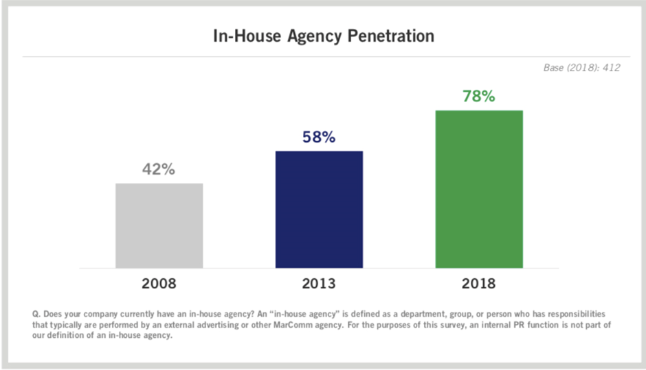
Association of National Advertisers US Report Aug 18

Slide 8
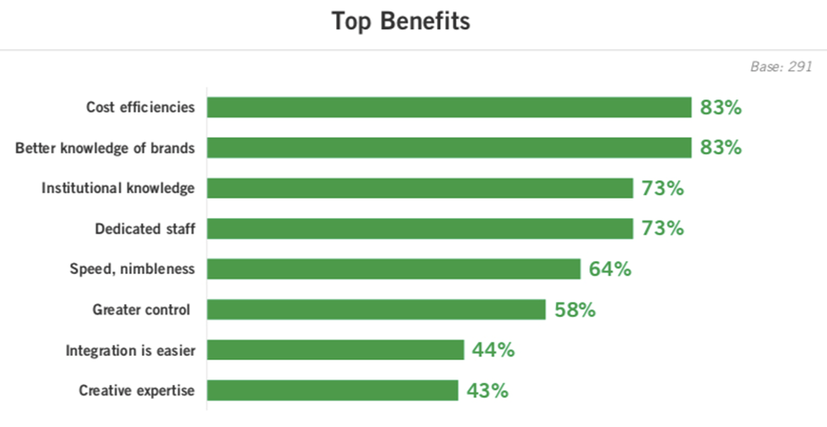
Association of National Advertisers US Report Aug 18

Slide 9
The Future
"There is everything to play for if agencies reinvent themselves in a fragmented media world. It's never been so complex but also there has never been such an opportunity to build an agency solution. If you simplify the complexity I'll buy the product."
Keith Weed (Unilever) IAB conference 7 June 2018.

Slide 10
Our research programme
2013: 25 interviews with clients, agency management, and agency creatives
2014: Qualitative data collected from workshops held with Bristol Media
2014: Survey, with 75 responses from agency personnel
2015: 10 workshops with individual agencies (140 participants)
2016: Survey, with 136 responses from agency personnel
2016: 23 interviews with clients
2017: Survey, with 209 responses from senior clients

Slide 11
Respondents
Clients: 250
Account
management: 330
Creatives: 125

Slide 12
Question
What do agencies want from their clients?

Slide 13
Themes
Information
Autonomy
Expertise
Creativity
Process management
Risk orientation
Coaching
Time

Slide 14
Information
Sufficient Specific Timely
There’s a tension between hitting deadlines and following a process. By the time you’ve got the written brief, stuff needs to be out of the door.

Slide 15
Client comment…
We’ve previously gone wrong because the brief isn’t tight enough or we’re not aligned around what we want to achieve.

Slide 16
Autonomy
Prescription Motivation
They end up restricting themselves and don’t get any value out of using us. You end up as the person moving the mouse for them.

Slide 17
Client comment…
They’re stubborn and I have to say to them “unless you shift your position, we can’t go forward.” And yet, despite this happening year after year, they continue to insist on doing things their way and it delays the process.

Slide 18
Risk
Focus groups Groupthink
Most designers hate research because you’re asking questions of consumers who have a particular frame of reference, whereas designers are trying to create something new.

Slide 19
Client comment…
Most companies I’ve worked for are pre-testing mad. The danger is you take the lowest common denominator.

Slide 20
Time
Idea generation
Time is the biggest issue. It restricts creativity more then anything else...How long does it take to create a great piece of work? It could be your first thought or your last.

Slide 21
Client comment…
We’re under a lot of pressure and typically we just throw out a brief to an agency. They want to take time to understand it, but we’re saying “just do it.”

Slide 22
Process
Briefing Stakeholders
Clients waste money by sending a design up the chain and then it comes straight back down. There’s something the junior guys didn’t know. Why didn’t they tell us that in the first place?

Slide 23
Client comment…
I’d much rather deal with a creative. I feel that communication is being lost in the middle, and that can be irritating.

Slide 24
Agency perceptions of the client brief
7=strongly agree, 1=strongly disagree
Item | Mean score
Clients are good at writing a brief | 2.88
The brief has a clear aim | 3.50
Clients understand the information required | 3.05
The brief provides all necessary information | 2.85
Clients understand the time required for the job | 3.14
N=136

Slide 25
Expertise
Knowledge Experience
We have one client where the calibre of people is exceptional. I often find myself evangelizing about them because they show up the shocking state of the rest of the industry.

Slide 26
Client comment…
You tell them what to solve, not how to solve it. Sometimes you have to go a bit further and say: “here are some ways you could do it, but I leave it to you to consider”.

Slide 27
Question
What do clients want from their agencies?

Slide 28
Themes
Content
Contact
Contact
Commitment
Context
Client commitment
Coaching
Charging
Coaching
Care
Care
Charging
Care

Slide 29
Context
Understanding the client’s world
“I work in a complicated market. They have to show they get it, but they don’t take up the opportunity to learn.”

Slide 30
Content
Insights and ideas
“We’re buying ideas not agencies.”

Slide 31
Contact
Value-added interaction
“You need everyone in the same room, working together. We need to speak to the customer with one voice.”

Slide 32
Coaching
Teaching managers to manage
“We need to equip our marketing team with the skills to be good managers of suppliers.”

Slide 33
Care
Making the client’s life easier
“I want them to push me. I want them to say ‘we should be doing this.’ That’s the whole point of having the agency.”

Slide 34
Charging
Accountability
“Agencies put a cost on everything. One even charged us for the time spent getting to know us. Their behaviour is transactional not behavioural.”

Slide 35
Client commitment to agency
Percentage agreeing or strongly agreeing
Statement | Traditional | Digital
Intend to continue relationship | 73% | 58%
Would recommend to a colleague | 67% | 57%
Difficult to find suitable alternative | 28% | 18%
Disruptive to switch agency | 52% | 39%
Emotionally attached to agency | 30% | 19%
N=208

Slide 36
Satisfaction-Loyalty Relationship
Customers who score an organization 9 or 10 out of 10 for customer satisfaction
Customers who score an organization 8.0 to 8.9 out of 10 for customer satisfaction
LOYALTY
% of customers scoring an organization 9 or 10 on intention to remain a customer
96%
63%
ADVOCACY
% of customers scoring an organization 9 or 10 on likelihood to recommend
94%
55%
(UKCSI, 2019)

Slide 37
Winning client commitment
Demonstrate industry knowledge
Demonstrate the capacity for ‘big ideas’
Challenge when appropriate
Context
Content
Process
Offer value-added account management
Demonstrate empathy
Demonstrate the benefits of cross-fertilization
Show you care
Be proactive but realistic
Be transparent
Offer training

Slide 38
Maximising value from the agency
Understand the creative process
Write a focused brief
Get stakeholder commitment to the brief
Context
Content
Process
Share the problem not the solution
Ensure alignment in interpretation of the brief
Create space for responses that take risks
Communicate your annual plan to the agency

Slide 39
In-house/agency crossover
Most likely to be provided by the client | Crossover | Most likely to be provided by an agency
Briefing | Managing customer contact | Creativity
Management of the marketing plan | Development of digital and social media content | Cross-sectoral knowledge
Management of agencies | Building and managing websites | Branding development
 | Data analysis
 | Media buying
 | Copywriting, design, and production
 | Development of marketing strategy
 | Management of Public Relations
 | Market research

Slide 40
Questions and Implications?

