Slide 1
Bristol’s 2030 Carbon Neutrality Goal
Some observations from the Urban ID Project
Presentation by
Jim Longhurst
UWE and the Bristol Green Capital Partnership
28th May 2019

Slide 2
Scope of Presentation
Introduction to Urban ID
Some Definitions and Statistics
The Green House Gas Protocol
The Urban ID Approach
Boundary and Emission Questions
A Pathway to Carbon Neutrality
Supporting Behaviour Change
How Can UWE Help?
Key Outputs

Slide 3
Bristol Urban Integrated Diagnostics Pilot Project
In this presentation, some of the findings of the Carbon Neutrality Theme of the Bristol Urban Integrated Diagnostics Pilot Project (Urban ID) will be presented.
The carbon neutrality theme was one of five case studies within Urban ID which was one of a small number of projects funded by the Urban Living Consortium to explore sustainability in city contexts.
The Urban ID project was funded by the UK research councils and Innovate UK, under EPSRC grant number EP/P002137/1.
The project ran from 2016 – 2018 with additional work continuing until early 2019.

Slide 4
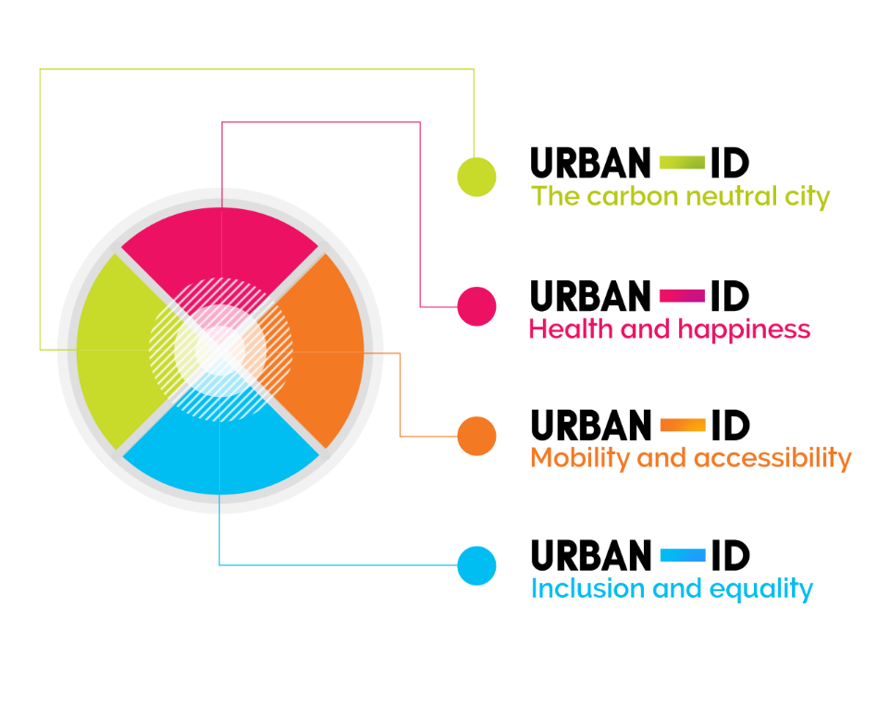
URBAN ID

Slide 5
Carbon Neutrality
The World Resources Institute (WRI) define neutrality of greenhouse gas (GHG) emissions as “net zero anthropogenic (from human activity) GHG emissions from all sectors”. This is achieved primarily by reducing GHG emissions to as close to zero as possible. Then any remaining emissions can be balanced with an equivalent amount of removal of GHGs, such as by ‘negative emissions’ technologies or sequestration, that is removal from the atmosphere for example by planting trees.
The simplified term ‘carbon neutrality’ is appropriate in an urban setting, as the majority of GHG emissions in such areas are from carbon dioxide (CO₂) from fossil fuel combustion. Other emissions can be captured through ‘CO₂ equivalent’ (CO₂e) measures.
Equivalence—the impact a GHG has on the atmosphere expressed in the equivalent amount of CO₂
http://www.wri.org/blog/2015/12/cop21-qa-what-ghg-emissions-neutrality-context-paris-agreement

Slide 6
Some numbers to start
End User Emissions 1000 tonnes, BEIS Data 2016
 | Bristol | South Gloucestershire
Industry and Commerce | 498.1 | 457.7
Domestic | 588.4 | 389.6
Transport | 548.5 | 962.1
Total | 1633.1 | 1795.4
https://www.gov.uk/government/statistics/uk-local-authority-and-regional-carbon-dioxide-emissions-national-statistics-2005-2016

Slide 7
Per Capita Emissions
 | Bristol | South Gloucestershire
Per capita emission | 3.6 tonnes | 6.5 tonnes

Slide 8
End User Basis
Emissions presented on an end user basis are distributed according to the point of energy consumption (or point of emission if not energy related).
Except for the energy industry, emissions from the production of goods are assigned to where the production takes place.
Therefore, emissions from the production of goods which are exported will be included, and emissions from the production of goods which are imported are excluded.

Slide 9
Scope 1-3 Green House Gas Protocol
The GHG Protocol defines direct and indirect emissions as follows:
Direct GHG emissions are emissions from sources that are owned or controlled by the reporting entity.
Indirect GHG emissions are emissions that are a consequence of the activities of the reporting entity, but occur at sources owned or controlled by another entity.
The GHG Protocol further categorizes these direct and indirect emissions into three broad scopes:
Scope 1: All direct GHG emissions.
Scope 2: Indirect GHG emissions from consumption of purchased electricity, heat or steam.
Scope 3: Other indirect emissions, such as the extraction and production of purchased materials and fuels, transport-related activities in vehicles not owned or controlled by the reporting entity, electricity-related activities (e.g. T&D losses) not covered in Scope 2, outsourced activities, waste disposal, etc. http://www.ghgprotocol.org/calculation-tools/faq

Slide 10
A Note on Scope 3
In many cases Scope 3 emissions are substantially greater than Scope 1 or 2.
In the case of UWE Bristol Scope 3 emissions cover
  Procurement,
  Construction,
  Water,
  Sewage,
  Waste arising,
  Student and Staff Commuting
Scope 3 emissions are some 10 – 12 times those of Scopes 1 and 2 combined.

Slide 11
Urban ID
Urban ID brought together researchers from
The University of Bristol
The University of the West of England,
Bristol City Council,
South Gloucestershire Council,
the Bristol Green Capital Partnership,
Bristol Health Partners,
Community groups
and firms to explore and co-create means of diagnosing urban sustainability problems.

Slide 12
The Urban ID Approach
Urban ID explored the barriers to major change in urban contexts. The project presents a set of diagnostic tools to help Bristol and other cities to understand the barriers to solving key challenges to sustainable development in the area.
The diagnostic tools are based on systems thinking, co-production, participatory engagement, and resilience and learning journeys and were used to examine the Bristol Urban Area through the lens of four challenge themes:
Inclusion and Equality,
Health and Happiness,
Mobility and Accessibility and
Carbon Neutral City

Slide 13
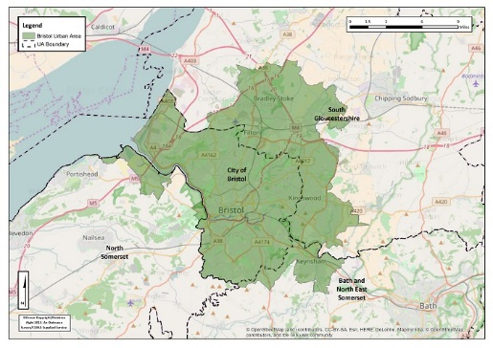
The Study Area

Slide 14
The Boundary Question
The boundary question is important.
The nominal Geographic remit of the project is the Bristol Urban Area, approximately comprising the boundary of Bristol City and a significant proportion of South Gloucestershire Unitary Authority.
The Bristol Urban Area had a population of approximately 620,000 in the 2011 Census.
Activities arising or originating in one administrative area have potential emission consequences for the other.
Boundary questions are important in understanding both emissions and control options.

Slide 15
The Emission Questions
What are the emissions associated with energy production and use in the city region?
What are the scope 1 -3 totals?
Scope 1 - combustion within the city region Scope 2 - emissions associated with purchased energy consumed in the city region
Scope 3 water, sewage, waste, construction and procurement of goods and services
What is the per capita emission of the city region’s population of approximately 620,000?
What is the embedded carbon in goods and services including food?
Is this included in the carbon neutral definition?
What are the business as usual projections?

Slide 16
The Carbon Neutrality Theme
Explored a number of key questions
What does ‘carbon neutrality’ mean for the Bristol Urban Area (and what is the Bristol Urban Area) and over what timescale should such a vision be achieved?
What are the barriers to decarbonisation across three scopes of carbon emissions (energy use; energy supply; consumption of goods and services)?
Can we co-design top-level aims and aspirations for the Bristol Urban Area in relation to carbon neutrality up to 2050?
Can carbon neutrality for the Bristol Urban Area include ‘all embodied carbon’ as well as emissions from energy use and supply?

Slide 17
A Pathway to Carbon Neutrality
Urban ID has concluded that in order to develop a pathway to carbon neutrality for the Bristol urban area there are key questions to be addressed:
What is carbon budget for the urban area associated with energy production and use in the city region across different sectors – energy supply, domestic, transport, industrial and commercial?
What are the current emissions from Scopes 1, 2 and 3 (energy use, energy supply, consumption of goods and services)?
What are the ‘business as usual’ projections for emissions to 2030 and 2050 and how do these differ from a carbon neutral pathway?
What mitigation actions are needed in different sectors to ‘zero’ the per-capita emissions value and how can carbon budgets assist with this?

Slide 18
A Pathway to Carbon Neutrality
5) What is the embedded carbon in goods and services consumed and items purchased in the urban area and is this included in the carbon neutral definition?
6) What level of carbon sequestration is it appropriate to consider to off-set any remaining emissions after mitigation actions across sectors?
7) What are the geographical and economic boundaries of the Bristol Urban Area in relation to the carbon neutrality definition?
8) What is the baseline year and what is the end point/target year for the Bristol Urban Area?

Slide 19
Achieving Carbon Neutrality: Further Questions
Behaviour change – citizen agreement to change
Technology innovation and implementation
Will existing technology be introduced at scale quickly enough?
Will new innovations become available to mitigate emissions?
How will costs change and where will costs fall?
Can a Green New Deal be demonstrated in the Bristol Urban Area?
What co-benefits might be expected - air quality, noise etc.?
What trade offs will be made?
The role of regulation to drive behaviour change and industrial, domestic and transport mitigation.

Slide 20
How will Major Land Use Decisions Incorporate Carbon Neutrality Considerations?
Housebuilding?
Transport proposals and developments?
Other major infrastructure developments?
The test of the ambition for carbon neutrality will be when a high emitting project comes forward for approval.

Slide 21

Climate Change Commission
Using known technologies the UK can deliver a net zero 2050
Transition requires a concerted effort and action by all.
Any remaining emissions after mitigation has been applied must be offset.
The offset must be verifiable by a reputable third party auditor operating to rigorous standards.
How can these actions be accelerated to achieve a carbon neutral Bristol in 2030?
https://www.theccc.org.uk/2019/05/02/phase-out-greenhouse-gas-emissions-by-2050-to-end-uk-contribution-to-global-warming/

Slide 22
Towards Carbon Neutrality
Two key requirements
Actions to accelerate the reduction in emissions
Actions to encourage behaviour change in society

Slide 23
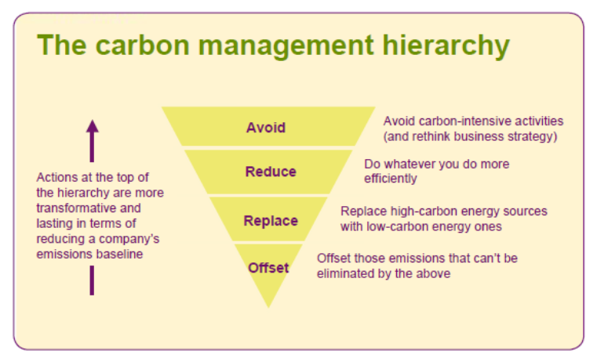
The Carbon Management Hierarchy
This highlight the need to first avoid carbon intensive activities, then reduce emissions through efficiency improvements, then replace current activity with less carbon intensity activity. Only then is offsetting or sequestering of any emissions not eliminated in the early stages considered (consistent with WRI’s GHG emission neutrality definition).
after Forum for the Future

Slide 24
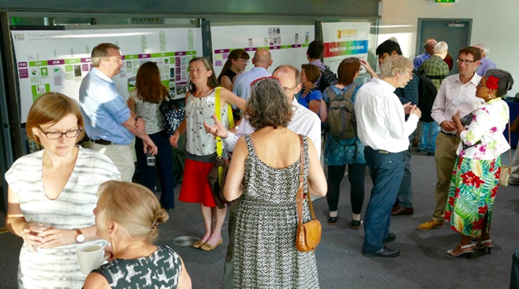
Supporting Behaviour Change
A role for BGCP and perhaps FEN
Leadership
Boundary spanning
Diverse network with reach
Legitimacy/recognition
Assets/funding
Organising power
Agency and belonging of members
Links with learning and research

Slide 25
How Can UWE Help?
Research
Consultancy
Live Brief
UG Dissertation topics
MSc Dissertation topics
Placements
Part funded internships
Knowledge Transfer Partnerships
PhDs
Networking e.g. Distinguished Executive Address Series

Slide 26
Key Outputs
Prestwood, E., Calvert, T., Clayton, W., Longhurst, J.W.S., Manchester, H., Parkhurst, G., Rosenberg, G., Taylor, C. & Townsend, I. (2017) Barriers to Better Bristol: Diagnosing our strategic sustainability challenges using systems, co-production and interdisciplinary approaches. C.A. Brebbia, J.W.S. Longhurst, E. Marco & Booth, C. (Editors) Sustainable Development and Planning IX. WIT Transactions on Ecology and the Environment 226. WIT Press, Southampton and Boston. ISBN 978-1-78466-231-8 pp 285 -296
Prestwood, E., Longhurst, J., Townsend, I., Haines, T. & Tsiarapa, E. (2018) Facilitating stakeholder dialogues on a carbon neutral city: we need to talk about carbon (and air quality) In Casares, J., Passerini, G., Barnes, J.H, Longhurst, J.W.S. & Perillo, G. (Editors, 2018) Air Pollution XXVI WIT Transactions on Ecology and the Environment, 230. WIT Press, Southampton and Boston pp501-509

Slide 27
Key Outputs
Prestwood, E., Rosenberg, G., Townsend, I. & Longhurst, J.W.S. (2018) A Partnership Approach to Carbon Neutral Bristol 2050. Cities and Climate Change Science Conference, Edmonton, Canada, March 5-7, 2018
Prestwood, E., Townsend, I. & Longhurst, J.W.S. (2019) Challenge Theme Report: Carbon Neutral City. UWE Bristol , 36pp
Publications available from UWE Research Repository http://eprints.uwe.ac.uk/

Slide 28

Professor James Longhurst
University of the West of England,
Frenchay Campus,
Bristol,
BS16 1QY
UK
Email James.Longhurst@uwe.ac.uk
Public profile http://people.uwe.ac.uk/Pages/person.aspx?accountname=CAMPUS\j-longhurst

