Slide 1
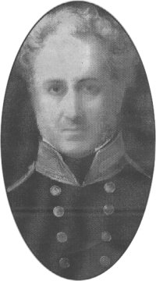
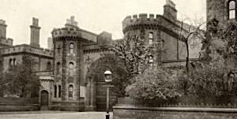
The Penal Excess of an Enlightened Reformer: Alexander Maconochie’s regimes for boys and women in Birmingham Prison, 1849-1851
J M Moore UWE CJU 24 March 2015

Slide 2
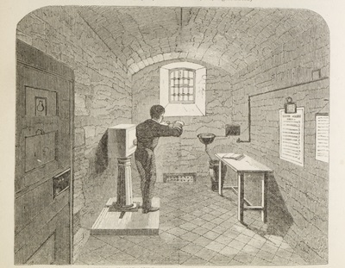
Boys under 16
48 hours Bread & Water in Solitary
Hand Crank 10,000 Revolutions a day
Food 'earned‘
Shot Drill
Classes & Limited Socialising

Slide 3
‘that the governor be authorized, in every case of insubordination by him to inflict the punishment of flogging, under the superintendence of the surgeon, and in the manner now described by the governor.’

Slide 4
a remarkably contumacious boy; I never saw a boy so obstinate, and so self willed, and he took the flogging … with excessive obstinacy. I requested … the visiting justices to authorise me to flog him by instalments. He stood the first flogging without being in the least overcome by it … I gave him, I think, only four or six cuts the second day, and the third he would not stand, he gave way, and he worked very well afterwards.

Slide 5
‘the most indolent would soon be roused to exertion – the most sensual to self-command’
‘it is only, I fear, by such treatment [regular whippings] … that his caution not to offend can be kept permanently active.’

Slide 6
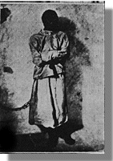
The regime for female prisoners
Handcuffs
Solitary
Bread and Water
Straightjacket

Slide 7
‘[o]n one occasion I think, and perhaps it might be two, I strapped a woman up to the railing in the centre hall of her own side.’
‘when you are quiet I will release you, but not till you are quiet’

Slide 8
The regime for female prisoners
Handcuffs
Solitary
Bread and Water
Straightjacket

Slide 9
‘... he gives just as many turns as from time to time earn him a meal on which he supports nature, besides which he this morning broke the glass in front of the index of his crank in order that he might falsify this. As he goes out on Saturday next, and may thus, if not immediately punished, escape punishment altogether, I have taken the liberty of acting on my own judgement in regard to him, and having given him six lashes at once, shall continue this at intervals till he is thoroughly subdued. This cannot injure him, a growing boy, so much as continuing longer without food, and it will much more effectively subdue him.’

Slide 10
The Penal Excess of an Enlightened Reformer: Alexander Maconochie’s regimes for boys and women in Birmingham Prison, 1849-1851
J M Moore UWE CJU 24 March 2015

Slide 11
Conclusion
‘a manly, rational, philosophical, Christian-like, prospective, provident kindness’
or
an institution where the arbitrary and illegal exercise of power increased the pain experienced by prisoners

Slide 12
The Penal Excess of an Enlightened Reformer: Alexander Maconochie’s regimes for boys and women in Birmingham Prison, 1849-1851
J M Moore UWE CJU 24 March 2015

