Slide 1
Select Committee on National Policy for the Built Environment
House of Lords: Private Briefing Seminar
The impact of the built environment on health and wellbeing
Dr Laurence Carmichael
Centre for Sustainable Planning and Environments
University of the West of England, Bristol
Laurence.carmichael@uwe.ac.uk

Slide 2
Content
Concepts
Definition of health
Wider determinants of health
The built environment as a determinant of health
Evidence base
Health problems with possible links with the built environment
  Obesity, physical activity and the built environment
  Mental health and built environment
Inequalities and built environment
  Housing and health inequalities
  Greenspace and health inequalities
Finally: a few issues to consider for policy-making health and built environment
Evidence base
Delivery mechanisms
Politics

Slide 3
The impact of the built environment on health and wellbeing
Concepts

Slide 4
What is health?
WHO definition of Health:
Health is a state of complete physical, mental and social well-being and not merely the absence of disease or infirmity
Preamble to the Constitution of the World Health Organization as adopted by the International Health Conference, New York, 19-22 June, 1946.

Slide 5
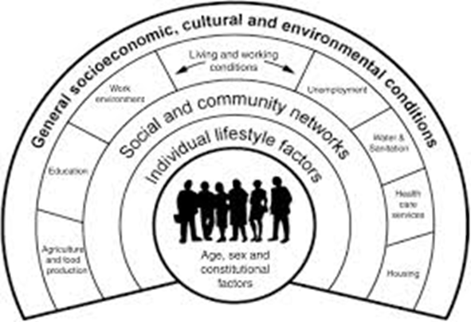
What factors influence our health?
The broader determinants of health
Social/ecological theory to health:
maps the relationship between the individual, their environment and disease.
Dahlgren and Whitehead (1991)

Slide 6
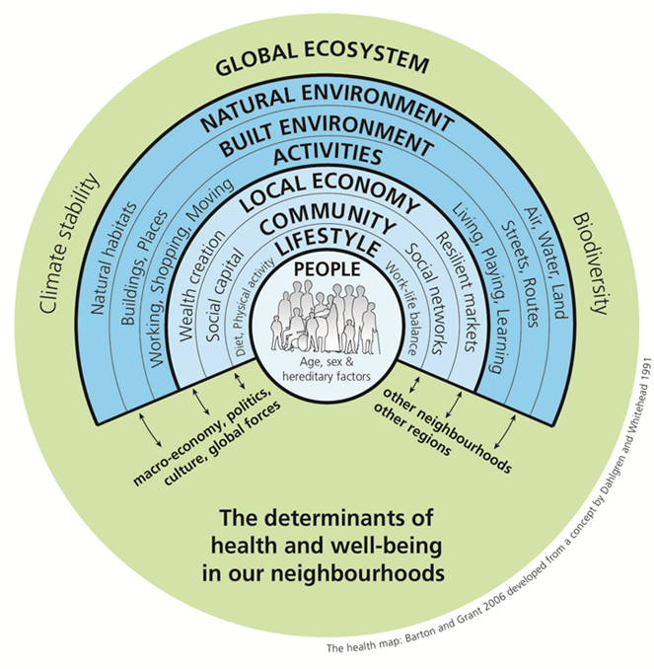
What role does the built environment play in influencing health and wellbeing?
Physical and social characteristics of communities and neighbourhoods are factors of health and can deliver health outcomes including:
Physical and mental health through:
perception of local area
social connections
physical activity
Environmental health:
air quality, water, noise
Safety, security
Health equity

Slide 7
Role of the built environment in influencing health
Pre WWII
Gains in life expectancy in 19th/20th centuries owed much to environmental public health measures:
  provision of clean water, food, and air
  healthier housing
  safer workplaces

Slide 8
Role of the built environment in influencing health
Post WWII
Post WWII: urbanisation, prosperity, increase in car affordability, road programmes, suburbanisation, out of town shopping centre, office work…

Slide 9
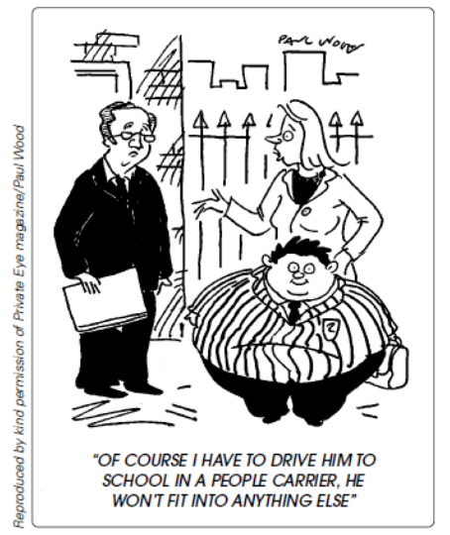
Role of the built environment in influencing health
Post WWII
In parallel: change in diet and
increase in chronic diseases
Although the causes of these
changes are complex—where
people live, how they get around,
how much they eat and are physically
active all contribute to the epidemics of obesity and chronic diseases
(Barton, 2009; Jackson, Dannenberg and Frumkin, 2013)

Slide 10
The impact of the built environment on health and wellbeing
Evidence Base

Slide 11
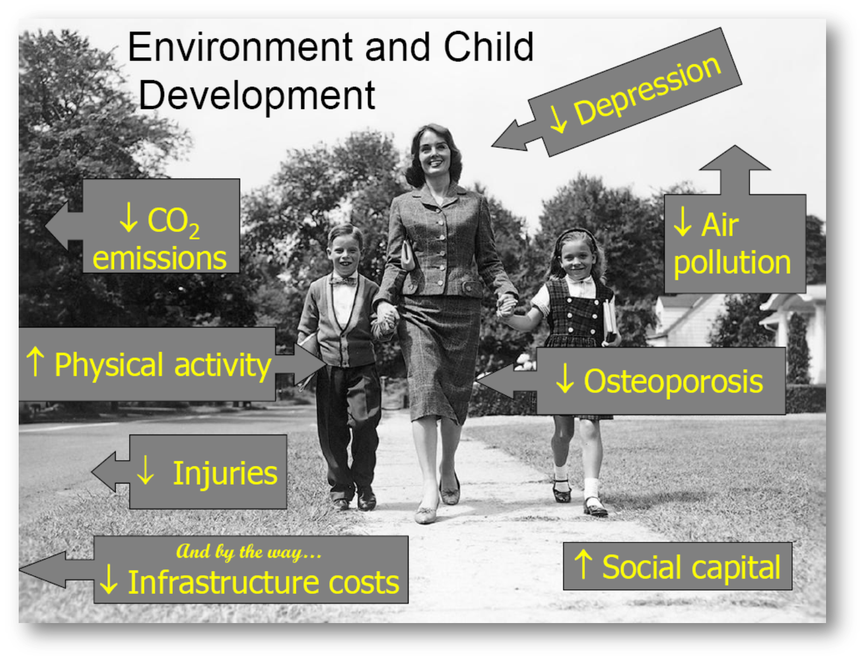

Slide 12
Public health evidence on the impact of the built environment on health: Pre WWII - focus on infectious diseases
19th century epidemiological studies:
  Eg Dr John Snow established link between cases of cholera and the use of a particular well in Soho =>well’s pump handle removed, preventing its use and the further spread of the disease among the community.
  Link between overcrowding, lack of safe water and food and inadequate sanitation led to disease and epidemics spreading
=>Response from built environment professions/authorities: advances in housing, hygiene, water and sewerage systems leading to reducing in infectious diseases

Slide 13
Public health evidence on the impact of the built environment on health
Post WWII: focus on behavioural factors, chronic diseases
Public health now concerned by individual behaviour:
coronary heart disease, diabetes, stroke and cancers are linked to a range of factors, in particular smoking, diet, physical inactivity and alcohol = factors linked to individual but also to wider determinants of health
Individual risk factors to burden of diseases and illness in UK
Smoking 12%
high body-mass 9%
physical inactivity, alcohol and poor diet (5% each)
(The Lancet, 2013)

Slide 15
Obesity and the built environment
Obesity increases risk of developing coronary heart disease, stroke, type 2 diabetes, and some types of cancers
26% of UK adults are now obese, 3x increase since 1980
Activity environment as a factor
Sources:
http://www.noo.org.uk/NOO_about_obesity/child_obesity
http://www.nhs.uk/Conditions/Obesity/Pages/Introduction.aspx

Slide 16
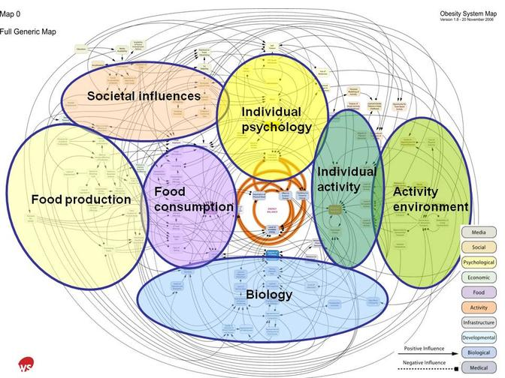
The obesity system
http://hdvchpediatricobesity.wikispaces.com/About+child+obesity

Slide 17
Built environment and physical activity
Physical activity = lifestyle factor for long-term health and to tackle obesity.
people who regularly use active transport gain health benefits
Regular physical activity helps prevent chronic diseases e.g. walking to work was associated with overall higher levels of physical activity in young and middle-aged adults
Characteristics of neighbourhood design can influence individual behaviour and take up of physical activity, for instance:
  High connectivity
  mixed neighbourhoods
  Land use mixture
  public transport, pedestrian facilities or proximity
  Parks
  Neighbourhood aesthetics used to design in walking and cycling in our daily lives
(Saelens, Sallis and Frank, 2003; Booth, Pinkston and Carlos Poston, 2005; Warburton Nicol and Bredin 2006; Lake and Townshend, 2006; Andersen, Wedderkopp, Pucher, Buehler, Bassett and Dannenberg, 2010; Kristensen, Moller, Froberg, and Cooper, 2011; Rhodes and Nasuti, 2011; de Nazelle et al., 2011; DoH, 2011; Mytton, Townsend, Rutter and Foster, 2012; Audrey, Procter and Cooper, 2014; White et al., 2013)

Slide 18
Built environment and physical activity
Supportive built environment is not enough on its own to ensure physical activity but it does facilitate it
But note: an unsupportive built environment is an effective deterrent of physical activity and exacerbates social exclusion
Source: (TRB, 2005)
Inactivity 'kills more than obesity'
http://www.bbc.co.uk/news/health-30812439

Slide 19
Characteristics of the built environment with a proven impact on mental health
Type of housing /Over-crowding
Noise /Indoor air quality
Lack of personal control and of social support
Perception of crime
Badly maintained green spaces/access to green spaces, to amenities
Deterioration of the aesthetics of neighbourhoods
Lighting, green parks and road crossing/traffic density
Provision of community centres, good public transport, recreational centre, affordable housing, grocery stores
The poor and ethnic minorities will suffer more than others => health impact of multiple environmental risk exposure must be considered when developing policies and interventions
(Evans, 2003; Phillips, Siu, Yeh and Cheng, 2005; Galea, Ahern, Rudenstine, Wallace and Zlahov, 2005; Guite, Clark and Ackrill, 2006; Guite et al., 2006; Maas, Verheij, Groenewegen, de Vries and Spreeuw enberg, 2006; Nielsen & Hansen, 2007; O’Campo et al., 2009; Kihal-Talantikite, Padilla, Lalloué, Gelormini, Zmirou-Navier and Deguen, 2013; White, Alcock, Wheeler and Depledge , 2013)

Slide 20
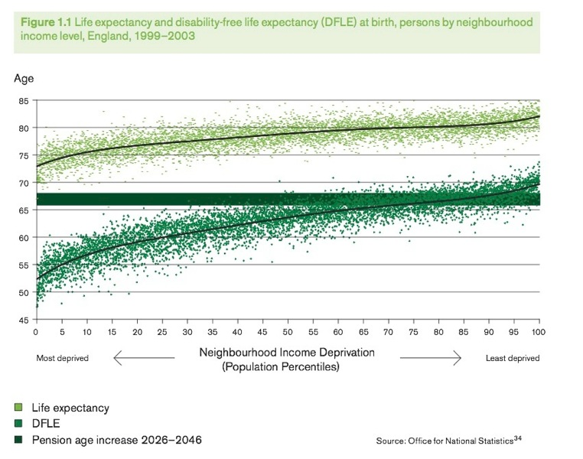
Health inequalities and the built environment
People living in areas of deprivation are more likely to be exposed to a variety of adverse conditions which affect health including:
Air pollution, flooding, noise pollution, road traffic, hazardous waste sites, places that feel unsafe, scarcity of green spaces, unsafe transport, fewer activities for healthy activities.

Slide 21
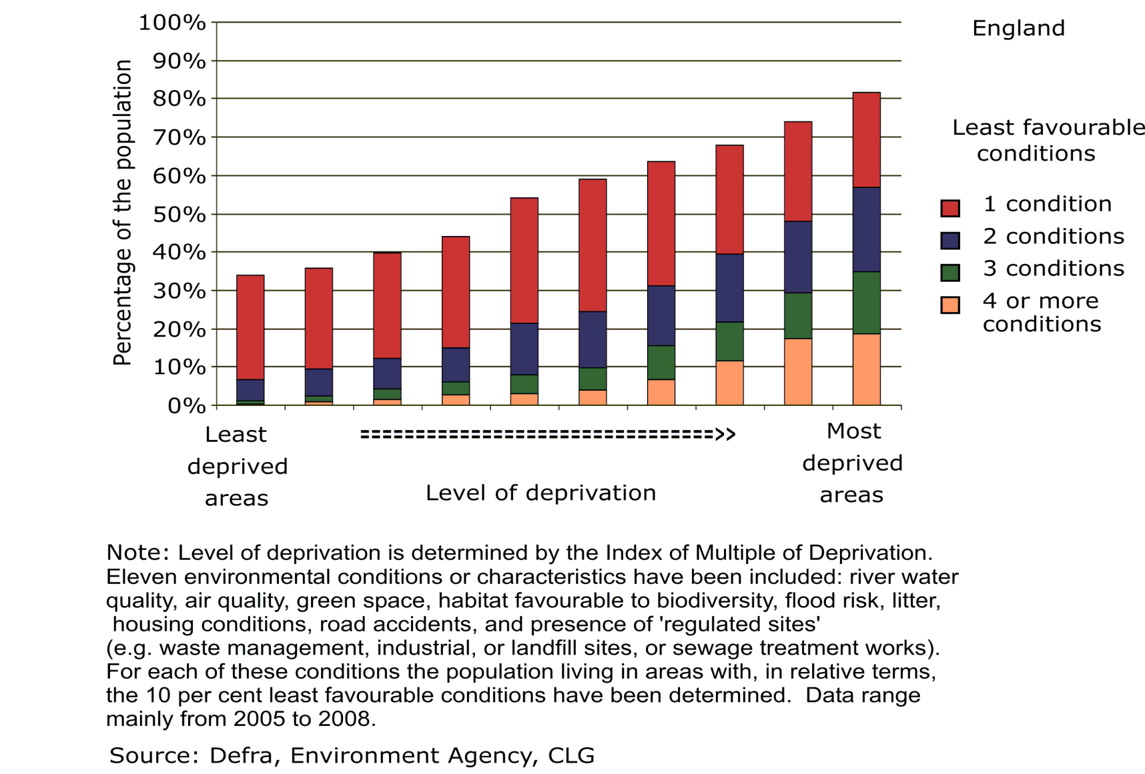
Health inequalities and the built environment

Slide 22
Impact of housing on health inequalities
Buildings where people live have an impact on their physical and mental wellbeing.
Housing factors: residential location, dwelling types and design, quality of construction and ongoing maintenance, internal features, crowding, feeling secure in one’s home, affordability.
Inequalities from housing design: fuel poverty from limited income and poor energy efficiency.
At risk populations: poorest quintiles of households, older people, children, those with long-term illnesses, those who spend their days at home.
Health effects: mortality, hospital admissions, poor mental health, respiratory problems, slow physical growth and cognitive development.
Life expectancy of a homeless woman in England is 47 (average; 77).
35% of the poorest quintile of households experience fuel poverty.
Sources: The Institute of Health Equity, 2013; Crew, 2007; Crisis, 2011; Healy, 2003; Liddell and Morris, 2010; Harker and Shelter, 2006

Slide 23
Impact of greenspace on health
Research shows the direct benefits of greenspace to physical and mental health.
Greenspace factors: levels of greenspace, contact with nature, access/proximity.
Inequalities from low level/reduced access to greenspace: 20% of most affluent neighbourhoods in England have 5 times the amount of greenspace than the most deprived 10% neighbourhoods.
Health effects: there is evidence of preventive, physical, mental and social benefits of engagement with the natural environment for people suffering from mental illness and dementia. Less greenspace in a living environment is associated with greater risk of anxiety, depression, feeling of loneliness and perceived shortage of social support.
Contact with nature is linked with improved mood, and reduced stress and anxiety
Sources: CABE, 2010a; Croucher et al., 2007; Pretty et al., 2007; Clark at al., 2013; Maas et al., 2009; CABE, 2010b.

Slide 24
Other characteristics of the built environment associated with health impact and health inequalities
Housing: overcrowding
Transport: active travel, public transport, car traffic
Accessibility of healthy food options

Slide 25
Finally: a few issues to consider for health and built environment policy-making (planning policy/planning decisions)
Evidence base (for academics and research councils)
Methodological challenges to ensure robustness of the evidence
Generalisability vs local relevance to inform local plans, planning decisions
Change the way research priorities are set, to challenge medical paradigms and the instrumental mindset of cost effectiveness
Ensure that planners inform scope of research questions, projects
Translate the evidence so it can be material consideration in planning decisions
Delivery mechanisms for spatial planning
NPPF needs to give planning for health a higher priority
develop integrated policy-making across professions at local level
Local plan: address the issue of viability (long term impact of new development on health)
Joint Strategic Needs Assessments to inform local plan and vice versa
Consider Health impact assessment in other forms of assessments
Politics
Public health seen as left of centre/health diplomacy needed
Leadership at local level
Realise the co-benefit of health agenda (transport, housing, education, sustainable development)

Slide 26
References
Aboelata, 2004. The built environment and health - 11 Profiles of Neighborhood Transformation, Prevention Institute: Oakland, CA.
TRB (2005) Does the built environment influence physical activity? : examining the evidence /
Committee on Physical Activity, Health, Transportation, and Land Use, Transportation
Research Board, Institute of Medicine of the National Academies, Washington DC.
Dahlgren G, Whitehead M. 1991. Policies and strategies to promote social equity in health. Stockholm: Institute for Future Studies.
Marmot, Sir M. (2010). Fair Society, Healthy Lives – The Marmot Review. London: Department of Health.
Jackson, R., Dannenberg, A. and Frumkin, H, (2013). Health and the Built Environment: 10 Years After, American Journal of Public Health Vol. 103, No. 9 : pp. 1542-1544.
Barton, H. (2009). Land use planning and health and well-being. Land Use Policy 26S S115–S123.
Murray, L. et al. (2013). ‘UK health performance: findings of the Global Burden of Disease Study 2010’. The Lancet,2013, Vol. 381 (9,871), 997-1020. www.thelancet.com/journals/lancet/
article/PIIS0140-6736(13)60355-4/fulltext#article_upsell
The Institute of Health Equity (2013). Review of the social determinants and the health divide in the WHO European region. Copenhagen: WHO Europe.
Crew, D. (2007). The tennants’ dilemma – warning: your home is at rick if you dare complain. Liverpool: Citizen Advice Bureau.
Crisis (2011). Homelessness: a silent killer a research briefing on mortality amongst homeless people, Crisis.

Slide 27
References
Healy, J. D. (2003). Excess winter mortality in Europe: a cross country analysis identifying key risk factors. Journal of epidemiology and community health 57(10), 784-789.
Liddell, C. and Morris, C. (2010). Fuel poverty and human health: a review of recent evidence . Energy Policy 38 (6), 2987-2997.
Harker, L. and Shelter (2006). Chance of a lifetime: the impact of bad housing on children’s lives. London: Shelter.
CABE (2010a). Community green: using local spaces to tackle inequality and improve health, London: CABE.
CABE (2010b). Urban green nation: building the evidence base. London: CABE.
Croucher, L. et al. (2007). The links between greenspace and health: a critical literature review, Stirling: Greenspace Scotland.
Pretty, J. et al. (2007). Green exercise in the UK countryside: effects on health and psychological wellbeing, and implications for policy and planning. Journal of environmental planning and management 50(2), 211-231.
Clark, P. et al. (2013). Greening dementia: a literature review of the benefits a d barriers facing individuals living with dementia in accessing the natural environment and local greenspace. Worcester: Natural England.
Maas, J. et al. (2009). Morbidity is related to a green living environment. Journal of epidem. and comm. Health 63 (12), 967-973.

Slide 28
Further references
Andersen, L. B., Wedderkopp, N., Kristensen, P. L., Moller, N. C., Froberg, K. and Cooper, A. (2011). Cycling to School and Cardiovascular Risk Factors: A Longitudinal Study. Journal of Physical Activity and Health, 8, 1025-33.
Audrey, S., Procter, S. & Cooper, A. (2014). The contribution of walking to work to adult physical activity levels: a cross sectional study. International Journal of Behavioural Nutrition and Physical Activity, 11, 37.
Barton, H. (2009). Land use planning and health and well-being. Land Use Policy 26S S115–S123.
Bristol City Council (2011a). Bristol Development Framework Core Strategy, adopted
June 2011. Bristol: Bristol City Council.
Carmichael, L., Barton H., Gray S., Lease H . & Pilkington P. (2012). Integration of health into urban spatial planning through impact assessment: identifying governance and policy barriers and facilitators. EIA Review, 32 (1), 187-194.
Chaix, B. (2009). Geographic life environments and coronary heart disease: a literature review, theoretical contribution, methodological updates and a research agenda. Annual review of Public Health, 30, 81-105.
Commission for the Architecture and the Built Environment (2010). Improving the design of new housing: What role for standards? London: CABE.
Commission for the Architecture and the Built Environment (2010). Improving the design of new housing: What role for standards? London: CABE.
Cummins, S. & Macintyre, S. (2005). Food environments and obesity - neighbourhood or nation? Interntional Journal of Epidemiology, 35, 100-4.

Slide 29
Further references
Cummins, S., Petticrew, M., Higgins, C., Findlay, A. & Sparks L. (2005). Large-scale food retailing as health intervention: quasi-experimental evaluation of a natural experiment. J. Epidemiol Community Health, 59, 1035-40.
Dahlgren, G. and Whitehead, M. (1991). Policies and strategies to promote social equity in health. Institute for Future Studies, Stockholm: Mimeo.
De Nazelle, A., Nieuwenhuijsen, M. J., Anto, J.M., Brauer, M., Briggs, D., Braun-Fahrlander, C., … Lebret, E. (2011). Improving health through policies that promote active travel : a review of evidence to support integrated health impact assessment. Environment International, 37, 766-77.
Department of Health (2011a). Start active, stay active: a report on physical activity for health from the four Home countries’ Chief Medical Officers, London: DoH.
Department of Health (2011c). Healthy Lives, Healthy People: A call to action on obesity in England. London: DoH.
Evans, G. W. (2003). The built environment and mental health. Journal of Urban Health: Bulletin of the New York Academy of Medicine 80(4), 536-55.
Foster, S., Wood, L., Christian, H., Knuimna, M. & Giles-Corti, B. (2013). Planning safer suburbs: do changes in the built environment influence residents’ perceptions of crime risk? Social Science and Medicine, 97, 87-94.
Galea, S., Ahern, J., Rudenstine, S., Wallace, Z.Vlahov D. (2005). Urban built environment and depression: a multilevel analysis. J Epidemiol Community Health, 59, 822-7.
Giles-Corti, B., Wood, G., Pikora, T., Learnihan, V., Bulsara, M., Van Niel, K., …Villanueva, K. (2011). School site and the potential to walk to school: the impact of street connectivity and traffic exposure in school neighborhoods. Health and Place, 17, 545-550.

Slide 30
Further references
Guite, H. F, Clark, C., & Ackrill, G. (2006). The impact of the physical and urban environment on mental well-being. Public Health, 120, 1117-26.
Jackson, L. E. (2003). The Relationship of urban design to human health and condition. Landscape and Urban Planning 64(4), 191-200.
Kihal-Talantikite, W., Padilla, C., Lalloué, B., Gelormini, M., Zmirou-Navier, D. & Deguen, S. (2013). Green space, social inequalities and neonatal mortality in France. BMC Pregnancy and Childbirth, 13, 191.
Lake, A., & Townshend, T. (2006). Obesogenic environments: exploring the built and food environments. Journal of the Royal Society for the Promotion of Health, 126(6), 262-267.
Leslie, E., & Cerin, E. (2008). Are perceptions of the local environment related to neighborhood satisfaction and mental health in adults? Preventive Medicine, 47(3), 273-278.
Miles, R., Panton, L. B., Jang, M. & Haynes, E. M. (2008). Residential context, walking and obesity : two African-American neighborhoods compared. Health and Place, 14, 275-86.
Mytton, O., Townsend, N., Rutter, H. and Foster, C. (2012). Green space and physical activity: an observational study using health survey for England data. Health and Place, 18, 1034-41.
National Institute for Health and Care Excellence (2008). Physical Activity and the Environment – NICE guidelines PH8. London: NICE.
Nielsen, T. & Hansen, K. (2007). Do green areas affect health? Results from a Danish survey on the use of green areas and health indicators. Health and Place, 13, 839-50.
O’Campo, P., Salmon, C., and Burke, J. (2009). Neighbourhoods and mental well-being: What are the pathways? Health and Place, 15(1), pp. 56-68.

Slide 31
Further references
O’Mullane, M. (ed.) (2013). Integrating Health Impact Assessment with the policy process. Oxford: Oxford University Press.
Phillips, D. R., Siu, O., Yeh, A.G.O. & Cheng, K. H. C. (2005). The impact of dwelling conditions on older persons’ psychological well-being in Hong Kong; the mediating role of residential satisfaction. Soc. Sci. Med., 60, 2785-97.
Pucher, J., Buehler, R., Bassett, D. R. & Dannenberg, A.L. (2010). Walking and cycling to health : a comparative analysis of city, state, and international data. American Journal of Public Health, 100, 1986-92.
Rhodes, R. E. & Nasuti, G. (2011). Trends and changes in research on the psychology of physical activity across 20 years: a quantitative analysis of 10 journals. Preventive Medicine, 53 (1-2), 17-23.
Saelens, B. E., Sallis, J. F. & Frank, L. D. (2003). Environmental correlates of walking and cycling: findings from the transportation, urban design, and planning literatures. Ann Behav Med, 25, 80-91.
Spielman, S., Yoo, E.-H. & Linkletter, C. (2013). Neighbourhood contexts, health, and behaviour: understanding the role of scale and residential sorting. Environment and Planning B: Planning and Design, 40, 489-506.
Taylor, L., Gowman, N. & Quigley, R. (2003). Evaluating health impact assessment. Wetherby: Health Development Agency.
Teedon, P., Gillespie, M., Lindsay, K. & Baker, K. (2014). Parental perceptions of the impacts the built environment has on young children's health: a qualitative examination and lay assessment amongst residents in four Scottish communities. Health and Place, 28, 50-57.

Slide 32
Further references
Town and Country Planning (2014). Special Issue Reuniting Health with Planning. Town and Country Planning, 83, 11.
Turrell, G., Haynes, M., Wilson, L.-A. & Giles-Corti, B. (2013). Can the built environment reduce health inequalities? A study of neighbourhood socioeconomic disadvantage and walking for transport. Health and Place, 19, 89-98.
Warburton, D., Nicol, C. & Bredin, S. (2006). Health benefits of physical activity: the evidence, CMAJ, 174, 801-9.
White, M., Alcock, I., Wheeler, B. & Depledge, M. (2013). Would you be happier living in a greener urban area? A fixed-effects analysis of panel data. Psychological Science, 24, 920-928.
Wismar, M., Blau, J., Ernst, K. & Figueras, J. (eds) (2007). The Effectiveness of Health Impact Assessment: scope and limitations of supporting decision-making in Europe. Copenhagen, Denmark: World Health Organization Regional Office for Europe.
World Health Organization (2008). Air quality and health, fact sheet 313. http://www.who.int/mediacentre/factsheets/fs313/en/

