Slide 1
Social media and social work students: the boundaries just got more complicated
Robert Lomax
The Faculty of Health & Social Care, The Open University UK
robert.lomax@open.ac.uk @RDL7
Ingrid Nix
The Faculty of Health & Social Care, The Open University UK
Ingrid Nix@open.ac.uk

Slide 2
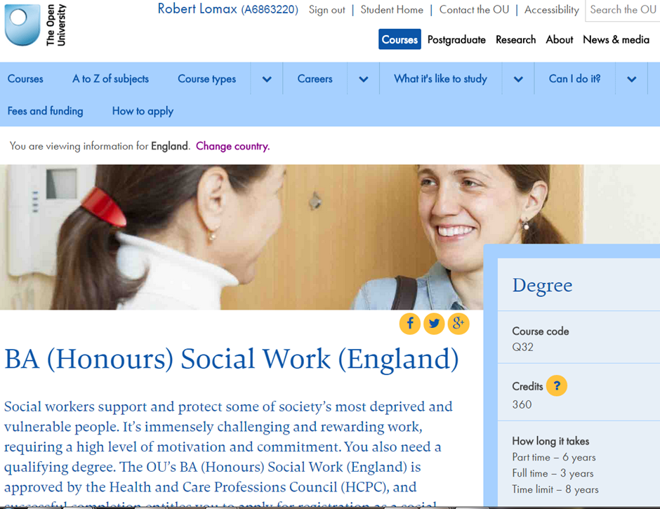
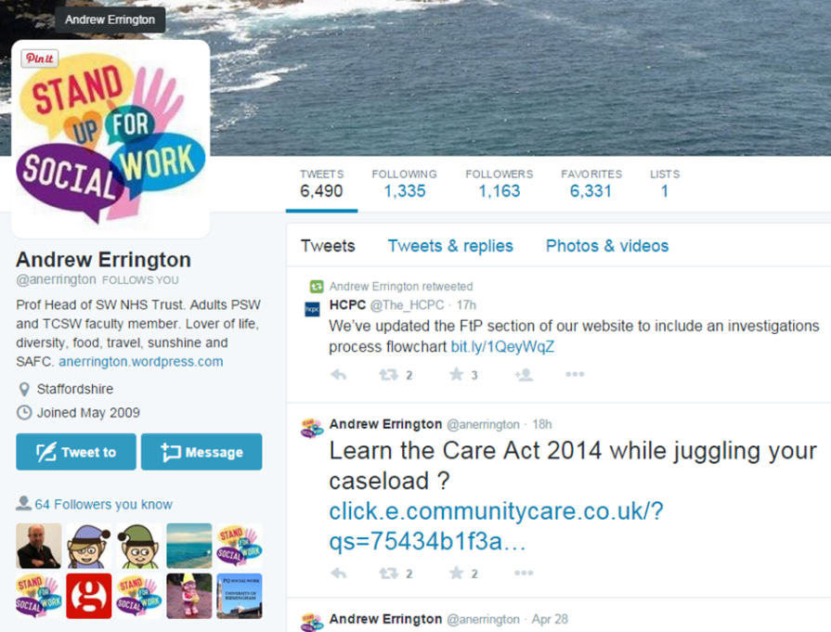
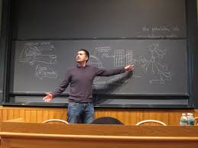
Thinking about…
Three or four images here
~ social media
~ open university & distance learning
~ areas of professional practice: social work , educators

Slide 3
Social media and distance education
“Data …suggests that the wide availability, accessibility and affordances of social media create alternative learning options for some distance learners.
Some distance learners are actively and deliberately using popular, non-institutional social media tools to augment and extend their learning experiences”
Andrews, Tynan & Backstrom (2012) ‘Distance learners’ use of non-institutional social media to augment and enhance their learning experience’

Slide 4
Themes from the literature
Digital natives v. digital immigrants (Prensky, 2001), Net Generation (Oblinger & Oblinger, 2005)
Social media’s technological affordances: social, administrative or learning? (Arteaga Sanchez et al, 2013)
The importance of understanding the student voice, to influence the institutional response (Andrews & Tynan, 2012)
Distance learning: interaction between learners, as well as between learners and teachers, mediated by technology but VLE or PLE? (Keegan, 2008)
Social networking tools: ownership of learning, the role of tutors, barriers to integration with pedagogy (Manca & Ranierit, 2012)

Slide 5
Research questions
Using what methods do students find it helpful to communicate with each other and their tutor?
Which social media do students use?
What do students use social media for?
In what ways do students view their use of social media as augmenting or partially replacing the University’s Tutor Group Forum provision?

Slide 6
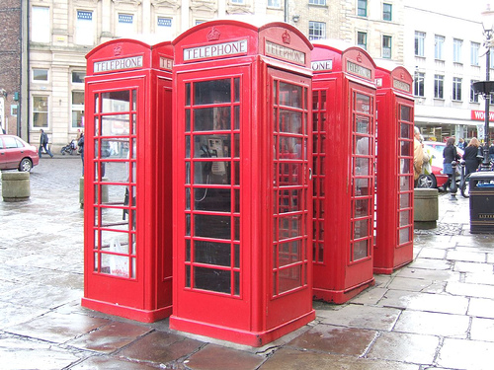
Q1: Using what methods do students find it helpful to communicate with each other and their tutor?
Tasks
finding out information relevant to their studies,
contacting their tutor,
getting help from fellow students to understand module related concepts,
staying in touch socially with fellow students,
working with fellow students on module related tasks,
sharing resources

Slide 7
Q2: Which social media do students use?
Once every few days
How often?
On a daily basis
Never….

Slide 8
Q3: What do students use social media for?
Students
R
a
n
k

Slide 9
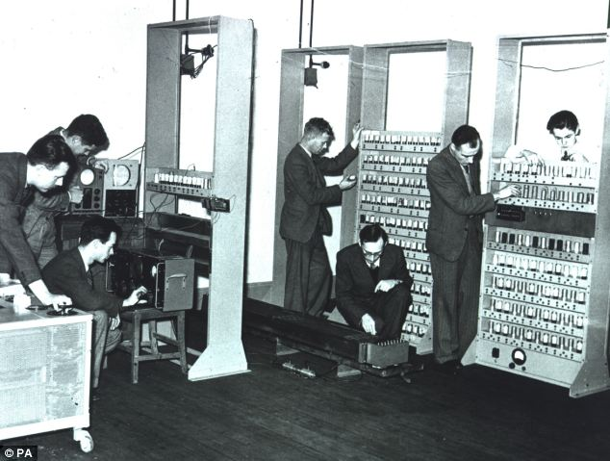
Q4. In what ways do students view their use of social media as augmenting or partially replacing the University’s Tutor Group Forum provision?
Because I use social media in my daily life, I find it easier to carry on using this in my study rather than the TGF
I think the University should replace TGFs with social media entirely
The TGF has contributed more to me successfully studying this module than using social media has

Slide 10
Social media and social work practice: students’ views
Positive views
Useful way to make contact with service users……. Is that okay?
Useful way to find out information about service users…..Is that ethical?
Useful to provide information to service users…….Access issues?
Useful for keeping up to date with developments in practice ….. Yes!
Concerns
Boundary issues/ confidentiality
Not appropriate for communication with service users
Prefer to use an alternative tool
Traditional methods effective, don’t need social media
Hostility online

Slide 11
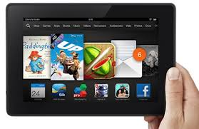
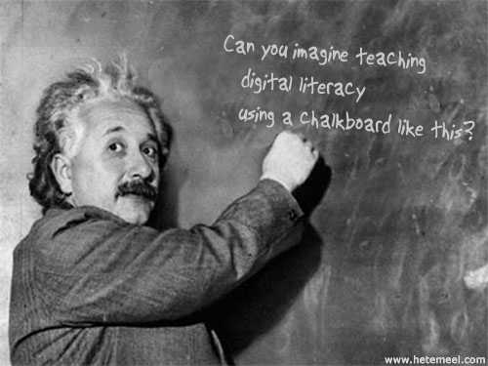
Linking themes from research

Slide 12
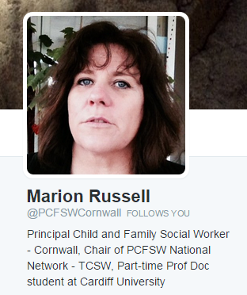
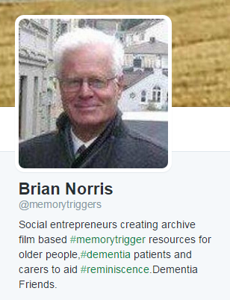
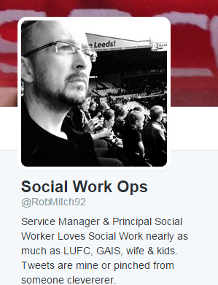
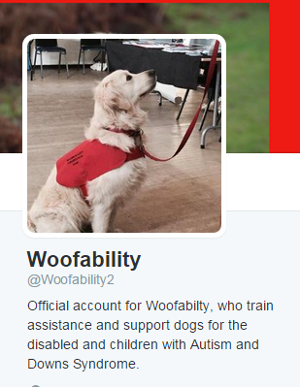
Social media: an opportunity for all?

Slide 13
Suggestions
Social media can be used by educators both to facilitate students’ learning of traditional social work curriculum and to prepare them for using social media in professional practice.
Students need to make the link between their use of social media in their personal life, during their studies and in their professional practice
Service users and social workers need to consider ways social media use can develop and strengthen the relationship between each other and the organisations they work with or for.

Slide 14
Conclusions
Students in the study used a variety of methods to communicate during their studies including face to face, email, phone, text and social media
The most popular social media used was Facebook
Social media was used for a variety of tasks including
finding out information relevant to their studies,
getting help from fellow students to understand module related concepts,
staying in touch socially with fellow students,
University provided communication & learning technologies remain very important to students in supporting them during their studies. Social media is an addition not a replacement.

Slide 15
Thank you for listening
Thanks to:
Ingrid Nix Lecturer, Faculty of Health & Social Care
Janet Bardsley Lecturer, K113 Foundations for Social Work Practice, Module team chair

Slide 16
References
Andrews, T. Tynan B & Backstrom, K.(2012) ‘Distance learners’ use of non-institutional social media to augment and enhance their learning experience’, In: Ascilite 2012: Future Challenges, Sustainable Futures, 25-28 Nov 2012, Wellington, New Zealand. Available at http://oro.open.ac.uk/37930/
Andrews, T and Tynan, B(2012). Distance learners: connected, mobile and resourceful individuals. Australasian Journal of Educational Technology, 28(4) pp. 565–579. Available at http://oro.open.ac.uk/37931/
Arteaga Sanchez, R., Cortijo, G., Javed U. (2013) Students’ perception of Facebook for academic purposes. Computers in Eduction (70) pp. 138-149. Available at http://www.sciencedirect.com/science/article/pii/S0360131513002340
Donlan, L (2012) ‘Exploring the views of students on the use of Facebook in university teaching and learning’ Journal of Further and Higher Education, 38:4, 572-588. Available at http://www.tandfonline.com.libezproxy.open.ac.uk/doi/abs/10.1080/0309877X.2012.726973#.VPR2AHysU1I
Hitchcock, L.I., Battista, A. (2013) ‘Social Media for Professional Practice: Integrating Twitter with social work pedagogy’, The Journal of Baccalaureate Social Work, Vol. 18 Special Issue, pp 33-45. Available at file://userdata/documents5/rl3545/Downloads/HitchcockBattista2013_SocialMediaSWK.pdf

Slide 17
References
Keegan, D (2008). The impact of new technologies on distance learning students. eleed, 4.. Available at http://eleed.campussource.de/archive/4/1422
Madge C, Meek J, Wellens J, Hooley T.(2009) ‘Facebook, social integration and informal learning at university: 'It is more for socialising and talking to friends about work than for actually doing work', Learning, Media and Technology, 34:2, 141-155. Available at http://www.tandfonline.com.libezproxy.open.ac.uk/doi/abs/10.1080/17439880902923606#.VNyTg-asUuc
Manca, S. and Ranieri, M. (2013), Is it a tool suitable for learning? A critical review of the literature on Facebook as a technology-enhanced learning environment. Journal of Computer Assisted Learning, 29: 487–504. Available at http://onlinelibrary.wiley.com/doi/10.1111/jcal.12007/abstract
Oblinger D. G., Oblinger J. L., (2005) (Eds) Educating the Net Generation, Available at: https://net.educause.edu/ir/library/pdf/pub7101.pdf
Prensky, M. (2001) ‘Digital Natives, Digital Immigrants’, On the Horizon, MCB University Press, vol.9, no.5. Available at http://www.emeraldinsight.com.libezproxy.open.ac.uk/doi/pdfplus/10.1108/10748120110424816
Prescott J, Wilson S E & Becket G (2013) ‘Students’ Attitudes Towards Facebook and Online Professionalism: Subject Discipline, Age and Gender Differences’, Health & Social Care Education, Vol 2, Issue 2. Available at http://journals.heacademy.ac.uk/journal/hsce

Slide 18
References
Singh Cooner, T. (2013) ‘Using Facebook to Explore Boundary Issues for Social Workers in a Networked Society: Students’ Perceptions of Learning’, British Journal of Social Work (2013) 1–18. Available at http://bjsw.oxfordjournals.org.libezproxy.open.ac.uk/content/by/year?cgi/doi/10.1093/bjsw/bcs208

