Slide 1
VITAE RESEARCHER DEVELOPMENT INTERNATIONAL CONFERENCE 2015 SPECIAL INTEREST SESSION A8: A RIGHTS BASED APPROACH TO DEVELOPMENT AS A PRIORITY FOR ADDRESSING RACE INEQUALITY IN HIGHER EDUCATION RESEARCH INSTITUTIONS
H. B. ADEDIRAN OLAIYA, M.A.
PhD Candidate in Universal Human Rights,
University of the West of England, Bristol
Email: Ade.Olaiya@uwe.ac.uk

Slide 2
WHAT … is a rights based approach to development ?
- equitable
sustainable
development built on the foundation of human rights

Slide 3
UN POST 2015 DEVELOPMENT AGENDA
“ the principle of equality is applicable to rich and poor countries (…) the post-2015 education agenda should therefore be based on the key principle of universality, (…) and underpinned by a strong commitment to education as a public good.”
UNESCO (2013:p.7-8)

Slide 4
SUSTAINABLE DEVELOPMENT GOAL 4 – promoting lifelong opportunities for inclusive and equitable quality education
Target 4.3: ensure equal access for all to affordable quality tertiary education by 2030 .
Target 4.6: integrate into education programs, knowledge and skills necessary for sustainable development, human rights & gender equality by 2030 .

Slide 5
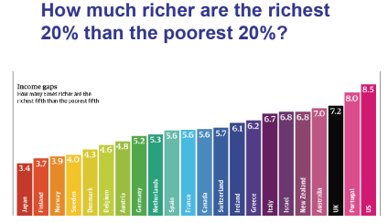
SUSTAINABLE DEVELOPMENT GOAL 10 - reduce inequality within and between countries
Target 10.2: take actions to empower and promote socioeconomic inclusion of all irrespective of ethnicity or economic status by 2030
Target 10.3: reduce inequalities of opportunity and outcome including through eliminating discriminatory laws, policies and practices, & promoting appropriate (…) actions in this regard
Target 10.4: progressively adopt policies especially fiscal to promote greater equality
Target 10.6: facilitate orderly, safe, and responsible migration and (…) of planned and managed migration policies.

Slide 6
“WHEN” ?... NOW !
THE INTERNATIONAL DECADE FOR PEOPLE OF AFRICAN DESCENT
… was proclaimed by the United Nations General Assembly as commencing on 1 January 2015 and ending on 31 December 2024, with the theme “People of African descent: recognition, justice and development”.
A/Res/68/237
The formal adoption of the Post 2015 Development Agenda and SDGS will take place at a UN summit held in New York, between 25-27 Sept. 2015 .

Slide 7
Programme of activities for the implementation of the International Decade for People of African Descent
Development
EMPLOYMENT
“Consistent with the Declaration on the Right to Development, States should adopt measures (…) including people of African descent, in development and decision making (…) and in the fair distribution of benefits resulting therefrom”
A/Res/69/16(22)
“take concrete measures to eliminate racism, racial discrimination, xenophobia and related intolerance in the workplace against all workers, in particular people of African descent, including migrants, and ensure the full equality of all before the law ... ”
A/Res/69/16(22)

Slide 8
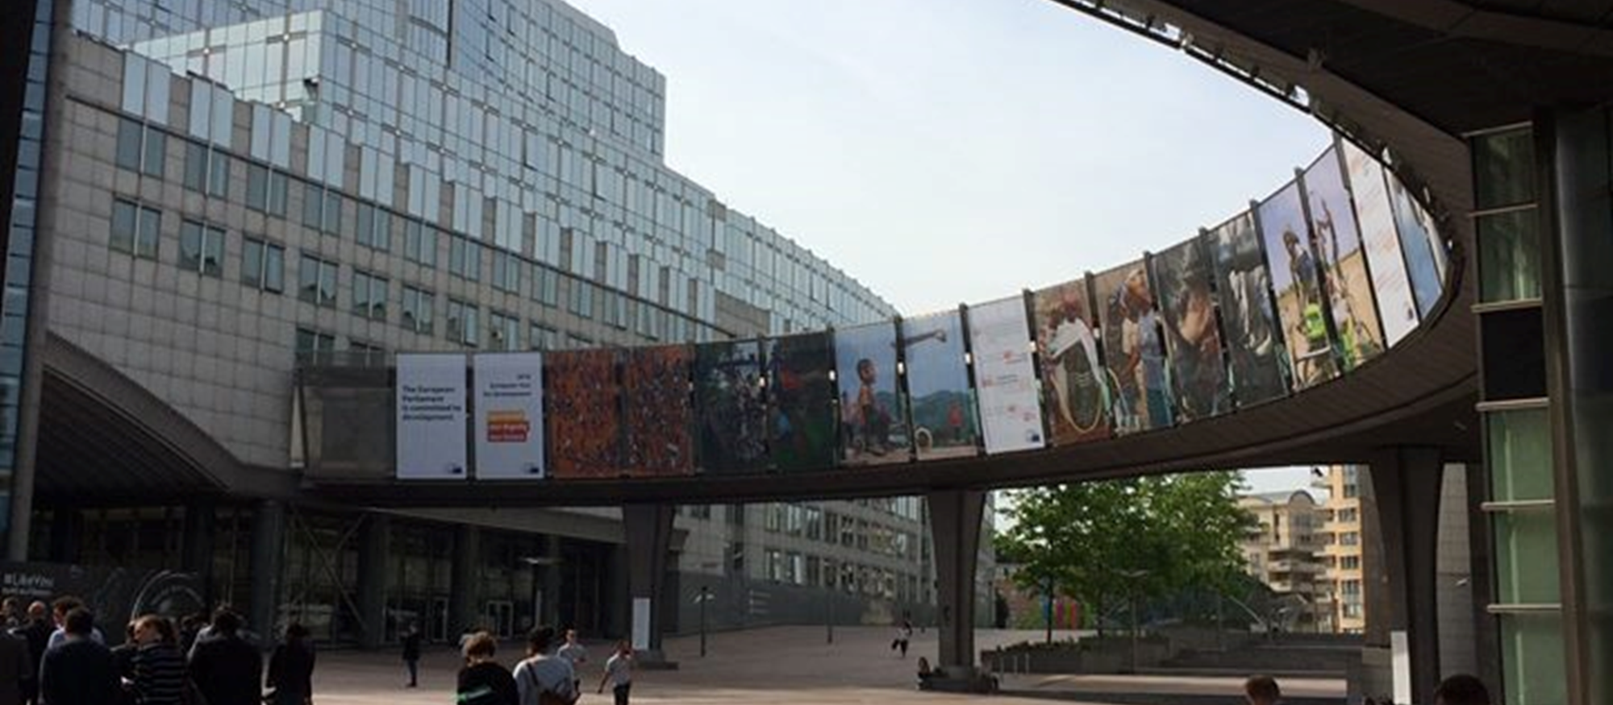
WHO are the intended beneficiaries ?
The post-2015 agenda goes beyond the MDGs 2 & 3 narrow focus on primary education & gender equality by
- identifying migrants and minorities (including people of African descent), as marginalized groups who require better access to quality education
- targeting investment in tertiary and vocational education
- aspiring to be a global, holistic and an integrated approach which fills gaps in the existing education framework.

Slide 9
Examples of Race Inequality in Higher Education Institutions (HEI)
Quotes By UK Black Academics
Quantitative Data
“Black staff are treated with contempt and disgust and career progression is almost non-existent among our demographic,”
“You are not taken as seriously and it is as if you have to do more/owe more in order to receive the same as a white British individual,”
“constantly being challenged by students and staff who have low expectations with regards to receiving a high level of education from a black female”.
54.7 % of white applicants received offers from Russell Group Universities, compared to 21.9 % of their Black peers.
Although 30 % of university students are of BME background; only 1.79% self identified as Black or Black British.
4% of domicile Black academic staff are professors in contrast with an average of 13% for other ethnicities
85 of the UK’s 18,500 professors are black, and only 17 are black women.
73 % of a sample of 100 Black British Academics stated they would rate their institutions’ performance as “poor” or “very poor”, in a Race Equality Survey

Slide 10
KEY POLICY OPTIONS WHICH ADDRESS AFROPHOBIA IN BRITISH HIGHER EDUCATION RESEARCH INSTITUTIONS
Education For All
EFA3 – ‘that the learning needs of all young people and adults are met through equitable access to appropriate learning and life-skills programmes’
EFA6 - improving all aspects of the quality of education and ensuring excellence of all (…) and essential life skills.
UNESCO (2013)
Principle 6 of the Concordat to Support the career development of researchers, promotes equality & diversity to stakeholders for all aspects of the recruitment & career management of researchers
Widening participation of under-represented groups (including people of African descent) in all aspects of HE, through Access agreement targets for early career researchers initiated in 2013.

Slide 11
WHY … do we need to address race inequality in HE policy development ?
NON PERFORMATIVITY OF DISCOURSES OF DIVERSITY e.g. failure to implement change
UNDER-PERFORMANCE. e.g. . 4% of domicile professors and 2.1% of non domicile are Black.
ORGANISATIONAL CULTURE e.g. negative stereotyping Black people as the disadvantaged other
ORGANISATIONAL CULTURE can reproduce social boundaries between different ethnicities, which further contribute to structural inequalities.
NON PERFORMATIVITY OF DISCOURSES OF DIVERSITY e.g. failing to acknowledge where systemic racism contributes to differences in participation and outcome, between peers from different ethnicities.
UNDER-PERFORMANCE in achieving Access Agreement targets, recruitment & progression of Black academic staff. Staff profiles rarely match those of students even in “culturally diverse” institutions.

Slide 12
REF 2014
The Research Excellence Framework (REF)
- assesses the quality of research submitted by HEIs in the UK through a process of expert review.
- scope of quantitative analysis assesses whether HEI’s process of selection of eligible academic staff , results in unbiased outcomes from an equality and diversity perspective.
- assesses staff selection in terms of disability, age, sex, ethnicity, nationality and early career researcher status.
Black researchers showed statistically significant lower selection rates,
< 1% of 52 185 eligible staff submissions were Black.
UK nationals - 35% of Black , compared to 56% of White & 68% of Chinese researchers work was submitted.
Non domicile EU national staff – 15 out of 30 submissions by Black researchers, compared to 20 of 20 Chinese, 35 of 45 Asian and 8,615 of 11,470 White researchers.
Non-EU staff - Black research active staff have the lowest selection rate at 46% compared to 76 % of their White counterparts.

Slide 13
WHERE ?
The European Research Area (ERA) can lead global consensus in race equality policy development for equality of outcome in HEI,
E.g. by implementing equality and diversity policies that have an equal impact on different (ethnic) groups, or intend the same outcomes for different (ethnic) groups, in the recruitment and progression of early career researchers …

Slide 14
EURAXESS Rights
The Human Resources Strategy for Researchers (HRS4R) enables the European Commission to ensure that research institutions implement measures which enhance working conditions for researchers across ERA in accordance with the European Charter and Code of Conduct for researchers..
The European Charter for Researchers sets out the rights and duties of researchers, as well as research and funding.
The Code of Conduct for the Recruitment of Researchers aims at ensuring equal treatment of all researchers in Europe and increases transparency in their recruitment.
EURAXESS is a pan-European initiative, which supports research institutions in their search for research talent. It is a joint initiative of the European Commission and the countries participating in the European Union's Framework Programme for Research.
… provides information regarding the Charter and the Code of Conduct , as well as a range of information and support services, to researchers wishing to pursue their careers in the (ERA).
E.g. Euraxess Rights assists European researchers to advance their careers in other European countries.
NB. 56 % of UK nationals were selected for REF 2014, compared with 75% of EU staff, & 70% of non-EU staff

Slide 15
European Network Against Racism
Advocates for recognition of IDPAD by EU institutions
Collaborates the Intergroup Against and For Diversity (ARDI) of the European Parliament to secure Parliamentary work e.g. on Afrophobia & other forms of racism affecting ethnic minorities and migrants.
Advocates for and participates in race equality data collection throughout the EU, in order to plan and monitor implementation of inclusive national policies.
Holds meetings with the European Parliament and Council of Europe to promote human rights in the workplace
Long term goals include increasing the recruitment, retention rate and career progression of ethnic minorities and migrants, by employers in ERA countries.
ENAR’s Objectives for 2016:
adopting and implementing strategic goals to combat Afrophobia & other forms of xenophobia.
Council of Europe’s recommendation on equality data collection.
development of Equal@Work & operational best practices,
Mainstreaming of progressive policies in national political debates.

Slide 16
HOW … can progress towards education quality and equity be measured ?
Monitoring to ensure
- Equitable recruitment & selection of staff from marginalised ethnicities
Accountability in the institutional career management & progression of Black researchers & academic staff .
Inclusive, transparent and fair policy development with action planning to promote race equality and diversity in HE research institutions.

Slide 17
Race Equality Charter Mark
The Equality Challenge Unit’s RECM Goals address race inequality in UK HEIs & include
Equity of outcomes for all ethnicities to the opportunities HE affords.
Policy development to achieve race equality in HE research institutions.
Long-term institutional culture change NOT long term solutions aimed at changing individuals.
Analysis of data to consider appropriate actions with sensitivity to the diverse backgrounds and experiences of minority ethnic staff and students ( e.g. through intersectionality).
Impact through successful outcomes for institutions representative of inclusive diversity.
“Improving the representation, progression and success of black and minority ethnic staff and students within higher education”.
Equality Challenge Unit (2014)

Slide 18
The Role of Trade Unions in the UK
- negotiate policies to move fixed-term staff onto open-ended contracts
- have won significant legal cases that increase researchers’ rights
- lobby the government & research councils.
- Offer membership of Researchers Networks.
- Black Members self organised groups.
Contact campaigns@ucu.org.uk for more details

Slide 19
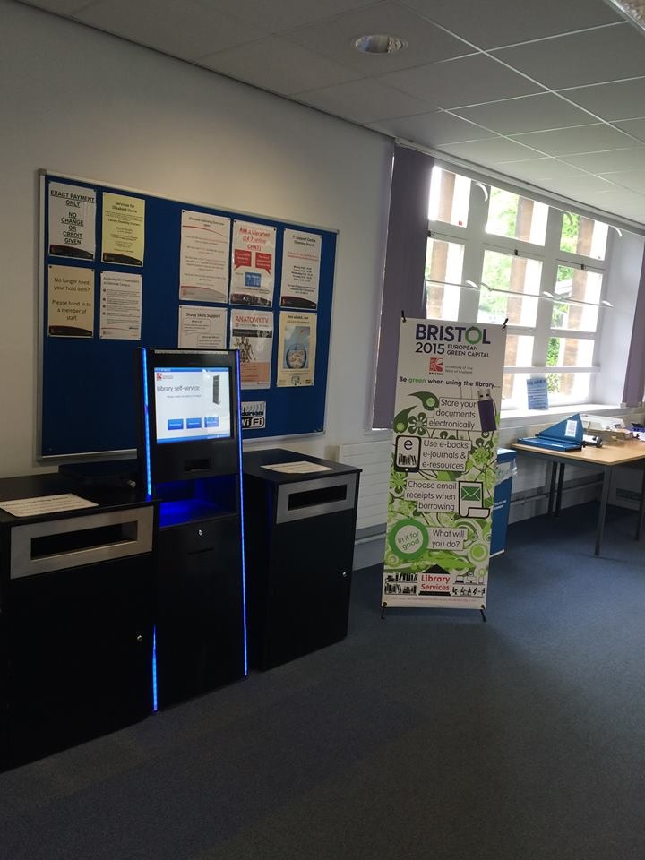
Assessing Impact and Measuring Success (AIMS) in widening participation research, UWE Bristol
Project Summary
“ aims to make progress towards a new consensus on research approaches to assessing the impact (and therefore success) of initiatives designed to widen participation in higher education to groups that are currently under-represented or who have limited patterns of participation”

Slide 20
RECOMMENDATIONS
Inclusive recruitment and career development of Black researchers in ERA - should be promoted as a priority in recognition of IDPAD.
Peer to peer and external mentoring -to support Black researchers and other academic staff in HE where required.
Stakeholders should enable enhanced & visible prospects - to encourage more people of African descent in pursuing research careers.
Data collection, analysis and action planning is imperative - to ensure accountability and impact in policy development, e.g. in recruitment and career management of minority ethnic researchers.

Slide 21
BIBLIOGRAPHY
Centre for the Study of Ethnicity & Citizenship (2015) A one day symposium on : Ethnicity and educational inequality: the Role of Aspirations, University of Bristol , 19/08/2015
European Commission (2015) EURAXESS Researchers in Motion, http://ec.europa.eu/euraxess/# : European Commission [19/08/15]
Equality Challenge Unit (2014) Equality in Education Statistical Report, ECU
Grove, J (2014) Black scholars still experience racism on campus, https://www.timeshighereducation.co.uk/news/black-scholars-still-experience-racism-on-campus/2012154.article : Times Higher Education [20 /09/15]
Havergal, C (2015) Russell Group universities ‘unfairly rejecting ethnic minority students’ https://www.timeshighereducation.co.uk/news/russell-group-universities-%E2%80%98unfairly-rejecting-ethnic-minority-students%E2%80%99 : Times Higher Education [21/08/15]
HEFCE (2015) Selection of staff for inclusion in the REF 2014 http://www.hefce.ac.uk/media/HEFCE,2014/Content/Pubs/2015/201517/HEFCE2015_17.pdf : HEFCE 2015 [22/08/15]
Kimura, M. (2014) Non –performativity of university and subjectification of students: the question of equality and diversity in UK universities, British Journal of Sociology of Education, 35.4,523-540, DOI:10.1080/01425692.2013.777207
Parr, C. (2015) Race discrimination in universities still a problem, reports survey, https://www.timeshighereducation.co.uk/news/race-discrimination-in-universities-still-a-problem-reports-survey/2012474.article#comment-form : Times Higher Education [ 19/09/15]
OCHR (2015) A Tribute To Those Who Lost Their Lives In The Service of Human Rights http://www.ohchr.org/EN/Pages/WelcomePage.aspx# :OCHR 1996-2015 [21/08/15]
United Nations (2015) 2015 – 2024 International Decade for People of African Descent http://www.un.org/en/events/africandescentdecade/ : UN Web Services [20/08/15]
United Nations (2015) 2015 Time for Global Action for People and Action, http://www.un.org/sustainabledevelopment/ : UN Web Services [5/09/15]
UNDESA (2014) Introduction and Proposed Goals and Targets on Sustainable Development for the Post 2015 Development Agenda, https://sustainabledevelopment.un.org/index.php?page=view&type=111&nr=4523&menu=35 : United Nations Department of Economic and Social Affairs [25/08/15]
UNESCO& UNICEF (2013) Making Education a Priority in the Post-2015 Development Agenda: Report of the Global Thematic Consultation on Education in the Post-2015 Development Agenda, UNESCO
UWE (2014) Assessing Impact and Measuring Success (AIMS) in widening participation research, http://www1.uwe.ac.uk/cahe/research/brille/researchprojects/aims.aspx : UWE [18/09/15]
Vitae (2015) Equality & Diversity in the research environment, https://www.vitae.ac.uk/researchers-professional-development/engagement-influence-and-impact/working-with-others/equality-and-diversity-in-the-research-environment/equality-and-diversity-in-the-research-environment : Careers Research and Advisory Centre Ltd [19/09/15]

Slide 22
.
FIN

