Slide 1
Separated by a Common Language of Assessment?
Undertaking a Linguistic Analysis of
Assessment Documentation
QAA Collaborative Enhancement Project
Harry West & Luke A. Rudge
University of the West of England, Bristol, UK
Document Analysis Working Group (in no particular order): Harry West, Luke Rudge, Laura Bennett, Nicole Skidmore, Nhi Ho, Anne Harbin, Cathy Minett-Smith, Juliet Eve, Marvelle Brown, Marjolein Groefsema, Jo Cahill, Rachel George, Jennifer Marie, Nikki Makinwa
SRHE Annual Research Conference 2021
Online
Dec 2021

Slide 2
Context
Assessment and feedback are arguably more influential to the student/learner experience than teaching (Hattie & Timperley, 2007).
Universities consistently receive low student satisfaction scores in student surveys globally (Yang & Carless, 2013).

Slide 3
Context
Students need to become self-regulated learners…. To be able to judge their own work, identify merits, locate weakness, and determine how to improve it (Nicol, 2009; Sadler, 2009).
All in relation to relevant academic standards (assessment criteria) (Sadler, 2009).
“Any assessment that does not build students’ capacity to effectively judge their work is unsustainable”
(Boud & Malloy, 2013)

Slide 4
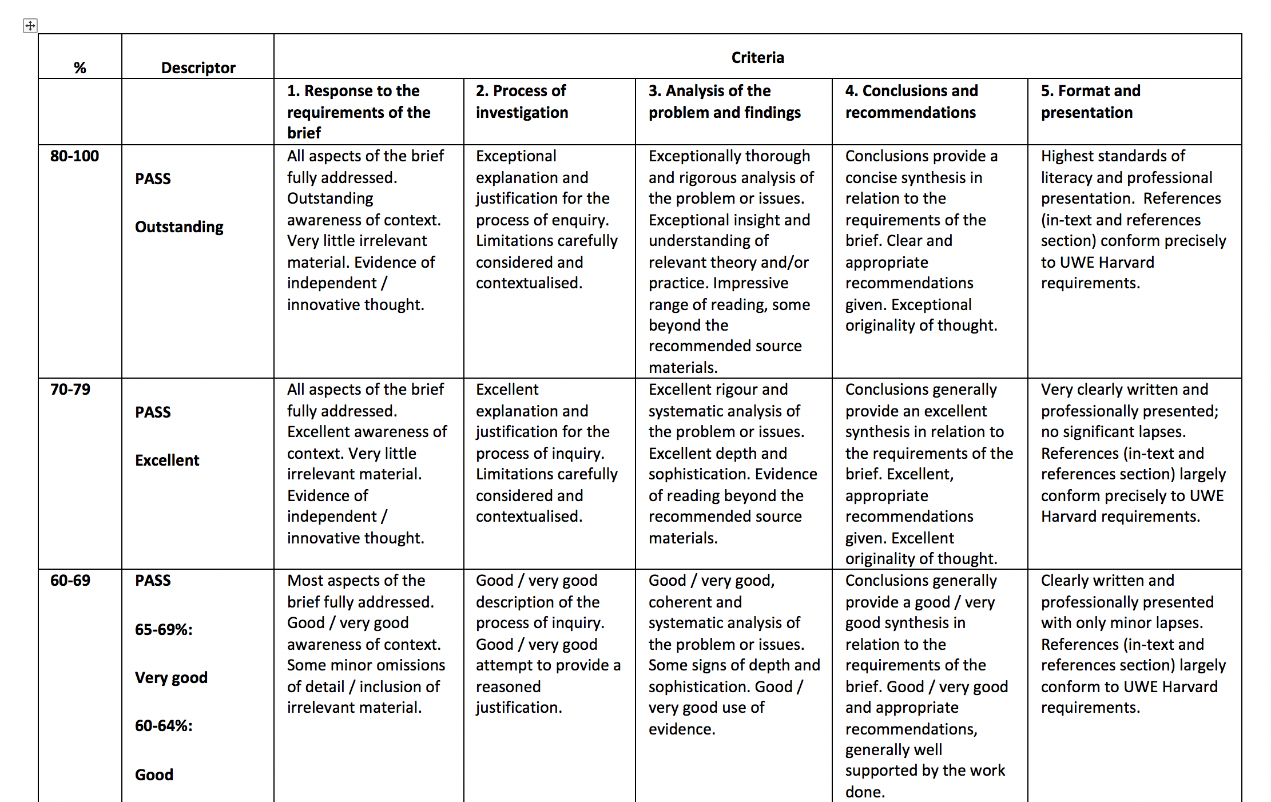
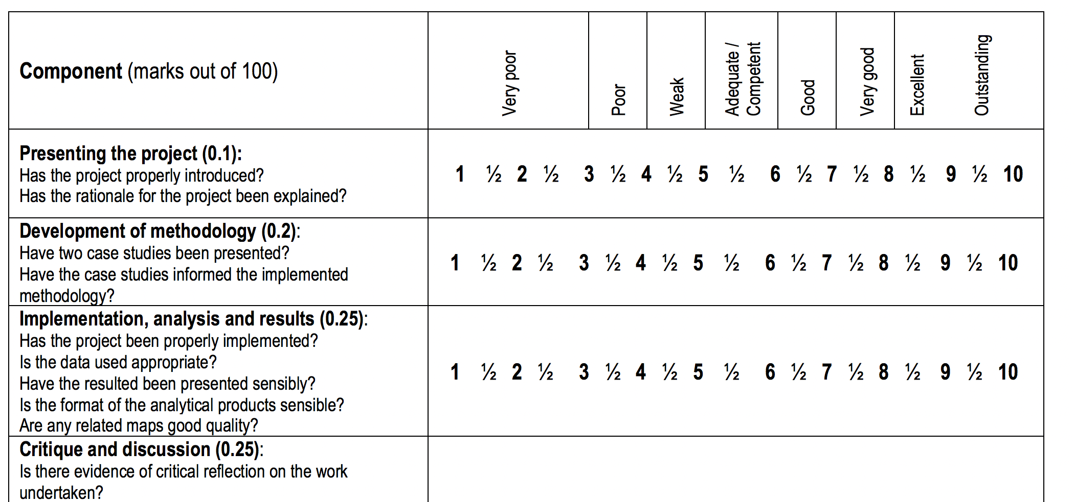
Assessment Criteria

Slide 5
Assessment Criteria
The benefits of clear assessment documentation are well-established (Freeman and Lewis, 1998).
Students can compare their work with past performance (Rowntree, 1987) and gain an understanding of what is required at different levels (Neil et al., 1999).
Different practices exist which make use of such assessment documents/criteria, including
Self-assessment (Lew et al., 2010),
Using annotated exemplars during feedback (Bell et al., 2013; Worth, 2014)
Adopting a dialogic feedforward approach (Hill & West, 2020)
Co-creation of marking criteria (Orsmond et al., 2000).

Slide 6
Assessment Criteria
The literature suggests that when students meaningfully engage with and reflect upon assessment documentation, performance is improved, and the benefits of assessment literacy are realised.
However, these practices do, to various extents, assume a common understanding of the language used in assessment documentation amongst both students and staff.
For example do staff and students interpret ‘critically’, ‘competent’, ‘professional’ in the same way?

Slide 7
Aim
As part of the QAA Collaborative Enhancement Project exploring the language of assessment, this paper reflects on the process of undertaking a linguistic analysis of a range of assessment documentation.
The aim being to create a bank of frequently used assessment language that would feed into the survey and focus groups.
Documents analysed, included:
Assessment briefs
Module learning outcomes and specifications
Marking criteria
Grading descriptors
Any other student-facing assessment documentation at module/unit level

Slide 8
Method
Each of the four UK partner institutions performed equivalent corpus analyses of their documentation, with the goal being to apply corpus linguistic methodologies to query the language used (McEnery and Hardie, 2012).
This provided insight into identifying common and key terms and phrases relating to assessment, marking and the regulation of assessment (e.g. critically analyse, describe), and the level of performance (e.g. excellent, good, poor).
Each institution complied documentation from across 17 subject clusters, mapped according to the UK HECoS CAH1 codes – the clusters were chosen where at least 3/4 of the partner institutions were delivering large programmes.

Slide 9
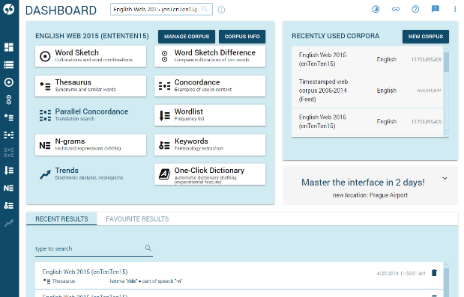
Sketch Engine Analysis
The documentation was compiled and analysed using the software package Sketch Engine (Kilgarriff et al., 2014).
One main corpus was compiled in each institution.
We initially had intensions to analyses the documentation using two different approaches:
Word frequency analysis
Keyword analysis
False-positives were removed and further investigation was undertaken into how lexis/terms are used in context via collocational analysis.

Slide 10
Keyword Analysis
A keyword analysis identifies statistically salient single and multi-word terms relative to a corpus of everyday British English usage (the English Web 2020 corpus).
Reflections:
At an institutional level this analysis provided some interesting results (e.g. innovative thought and rigorous argument).
However for a meaningful comparison across institutions each institutions corpus needed to be of a similar size (word length).
Given the huge variety in assessment document structure/format (both within and across institutions) this was a significant issue.
Flags up interesting questions around does document structure influence understanding, is having lots of different models accessible and inclusive?

Slide 11
Word Frequency Analysis
Useful for analysing the raw frequencies of words (or word classes, like nouns and verbs) within the corpus.
Using raw frequencies of words was problematic due to different corpora lengths across the four institutions.
Resolved by looking at relative frequencies (usage per x number of words).
Word types:
Nouns, Verbs, Adjectives, Adverbs
Finally, the top 100 results of each query across the four institutions were then compared to identify lexical patterns, discrepancies and, ultimately, the terminology that would feedforward into the next stage of the larger project.

Slide 12
Do We Use Similar Language?
 | Total Words | Potential Total | Overlap
Nouns | 187 | 400 | 46.75%
Verbs | 163 | 400 | 40.75%
Adjectives | 180 | 400 | 45%
Adverbs | 160 | 400 | 40%

Slide 13
‘Doing’ Words
Word | Concordance | Word | Concordance
Develop | develop a coherent argument | Demonstrate | demonstrate you have achieved the learning outcomes
Discuss | discuss the ways in which | Consider | carefully consider
Explain | explain the rationale | Define | define a research topic
Evaluate | identify and evaluate, critically evaluate | Inform | use literature to inform your approach
Review | review literature relevant to the project | Examine | examine key concepts
Explore | explore the relationship | Carefully | carefully consider
Analyse | analyse these sources, analyse data | Critical | ……..

Slide 14
‘Feedback Words’
Word | Concordance | Word | Concordance
Indicate | please indicate clearly | Properly | properly reference, question properly addressed
Appropriate | using clear and appropriate language | Suitably | suitably organised
Academic | academic literature, academic content | Effective | demonstrate effective research skills
Professional | Professional presentation, literature, practice | Logical | logical structure, argument is logical
Wide | evidence of wide reading

Slide 15
‘Descriptor’ Words
Good | Satisfactory
Excellent | Inadequate
Poor | Competent
Adequate | Original
Outstanding | Weak

Slide 16
Summary
This analysis allows us to meaningfully look across a broad range of assessment documentation across four institutions.
The quantitative linguistic approach gives us assurance that the terminology which feeds into the survey is commonly used in documentation.
The broader project permits us to determine the extent to which there is a common understanding of frequently used language in assessment documentation,
But as alluded to above, this could only be completed in a robust manner by accurately following supportable linguistic methodology and theory.

Slide 17
References
Bell, A., Mladenovic, R. & Price, M. (2013), Students’ perceptions on the usefulness of marking guides, grade descriptors and annotated exemplars, Assessment and Evaluation in Higher Education, Vol.38(7), 769-788.
Boud, D. & Molloy, E. (2013) Rethinking models of feedback for learning: the challenge of design, Assessment & Evaluation in Higher Education, 38, 698-712.
Freeman, R. & Lewis, R. (1998), Planning and implementing assessment, London: Kogan Page.
Hattie, J. & Timperley, H. (2007) The power of feedback. Review of Educational Research, 77, 81-112.
Hill, J. & West, H. (2020), Improving the student learning experience through dialogic feed-forward assessment, Assessment & Evaluation in Higher Education, Vol.45(1), 82-97
Kilgarriff, A., Baisa, V., Bušta, J., Jakubíček, M., Kovář, V., Michelfeit, J., Rychlý, P. & Suchomel, V. (2014), The Sketch Engine: ten years on, Lexicography, Vol.1, 7-36.
McEnery, T. & Hardie, A. (2012), Corpus Linguistic, Cambridge: Cambridge University Press.
Neil, D.T., Wadlet, D.A. & Phinn, S.R. (1999), A generic framework for criterion-referenced assessment of undergraduate essays, Journal of Geography in Higher Education, Vol.23(3), 303-325.
Nicol, D. (2009) Assessment for learner self-regulation: Enhancing achievement in the first year using learning technologies. Assessment & Evaluation in Higher Education, 34(3), 335-352.
Orsmond, P., Merry, S. & Reiling, K. (2000), The use of student derived marking criteria in peer and self-assessment, Assessment and Evaluation in Higher Education, Vol.25(1), 23-38.
Sadler, D.R. (2009) Indeterminacy in the use of present criteria for assessment and grading. Assessment & Evaluation in Higher Education, 34(2), 159-179.
Worth, N. (2014), Student-focused assessment criteria: Thinking through best practice, Journal of Geography in Higher Education, Vol.38(3), 361-372.
Yang, M. & Carless, D. (2013) The feedback triangle and the enhancement of dialogic feedback processes. Teaching in Higher Education, 18, 285-297.

Slide 18
QAA Collaborative Enhancement Project
Thank you for
Listening
Contact: harry.west@uwe.ac.uk

