Slide 1
“We’re over here, on Facebook": social work students' use of social media during a Level 1 module.
Robert Lomax May 8th Camden

Slide 2
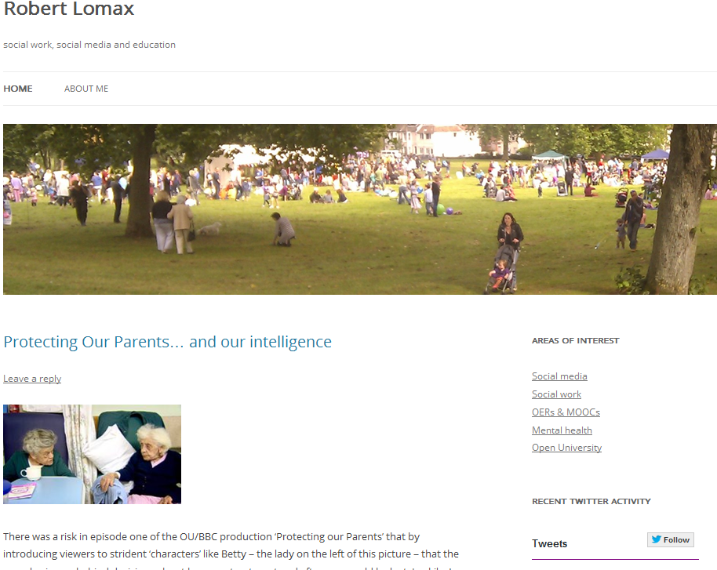
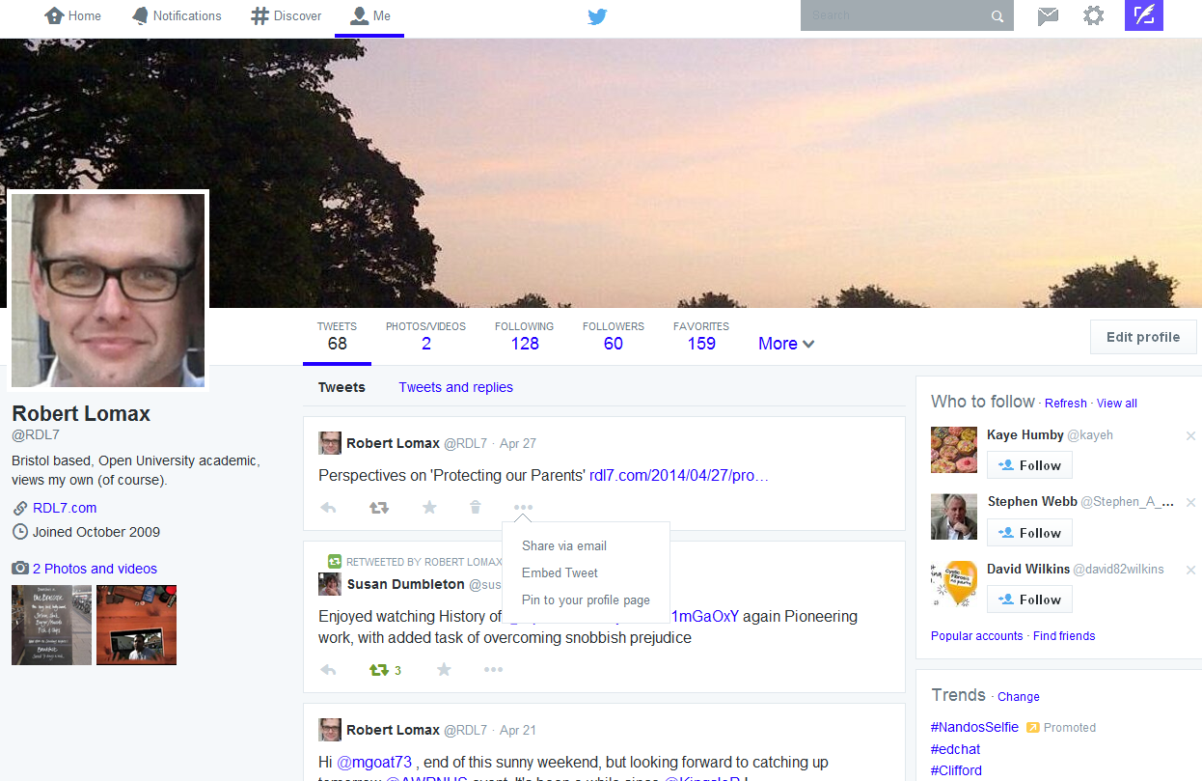
Research & scholarship

Slide 3
The 1980s

Slide 4
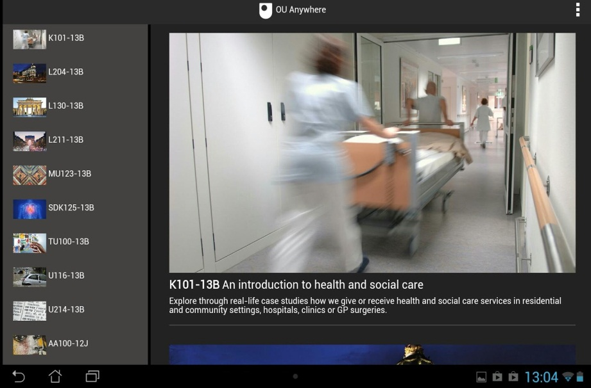
2014

Slide 5
Andrews, Tynan & Backstrom (2012)
“Data …suggests that the wide availability, accessibility and affordances of social media create alternative learning options for some distance learners. Some distance learners are actively & deliberately using popular, non-institutional social media tools to augment and extend their learning experiences”
Implications for institutions include
the need to support all students to see the potential affordances of social media within the learning context
the need to support students utilise the affordances of social media
supporting students could include
Re-structuring learning and teaching activities
Support and development of tutors to use social media
Support of technology

Slide 6
How do you leverage the latest technologies in teaching & learning?
Need to understand how students use technology and how they think, before applying technology in learning and teaching
Berk (2010) Identified 10 major learner characteristics:
Reliance on Search Engines
Interested in Multimedia
Tech Savvy
Emotionally Open
Multitask Orientated
Internet Content Creators
Visually Literate
Prefer Teamwork
Typing Vs. Writing
Experiential Learners

Slide 7
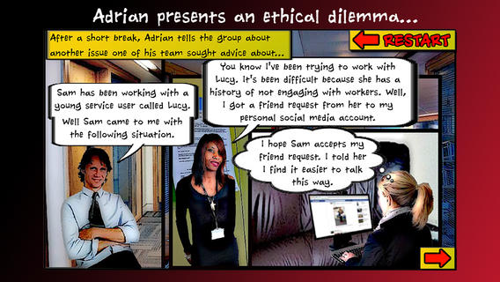
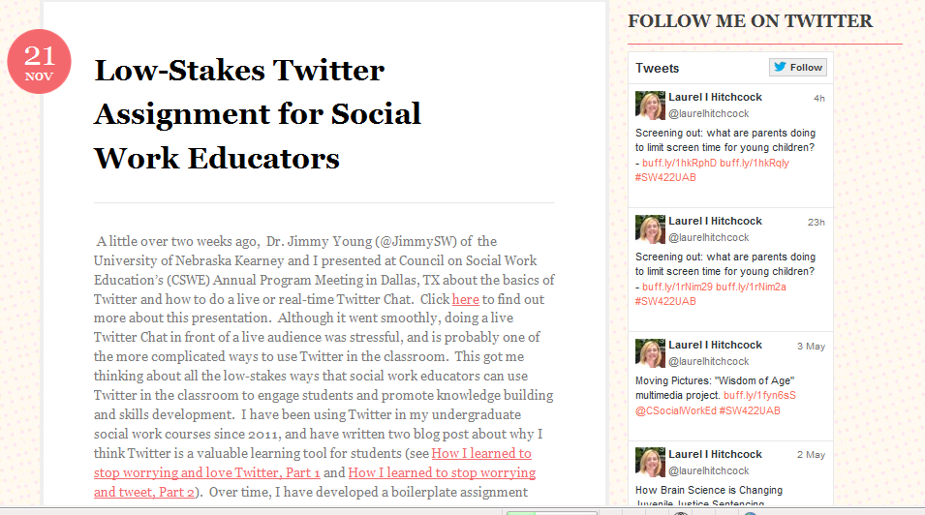
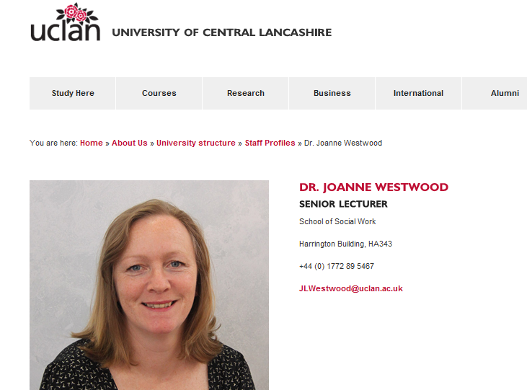
Social media in social work education (1)

Slide 8
Social media in social work education (2)
as a means of communication between students, students & tutors
as a teaching and learning tool
as a dimension of social work practice
To research how students use social media as a means of communication during their study of K(YJ)113

Slide 9
Research questions
Using what methods do K113/KYJ113 students find it helpful to communicate with each other and their tutor?
Which social media do K113/KYJ113 students use?
What do K113/KYJ113 students use social media for?
In what ways do students view their use of social media as augmenting or partially replacing the University’s Tutor Group Forum provision?

Slide 10
The plan…..
June 14: quiz question preparation
August 14: students complete K113 quiz
September 14: data collection & analysis
Autumn 14: write up for publication?
Spring 2015: extend to K216 & K315?

Slide 11
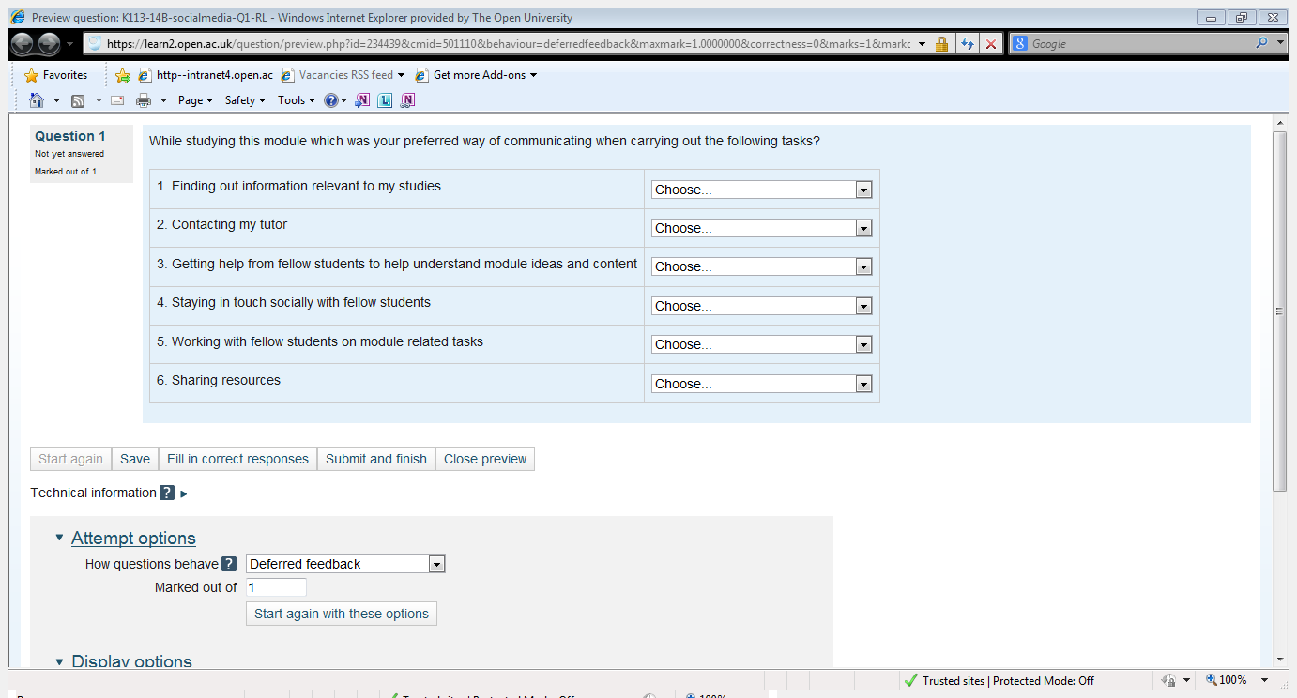
Question options:
TGF
Face to face
Email
Phone/mobile
Social media e.g. Facebook
Wiki

Slide 12
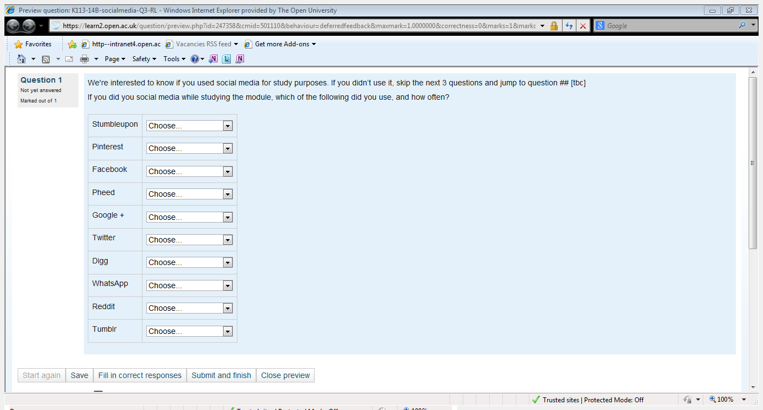
Question options:
Every three months
Once a week
Never used
Once a fortnight
Several times a day
Daily
Never heard of
Once a month
Once every few days
Every six months

Slide 13
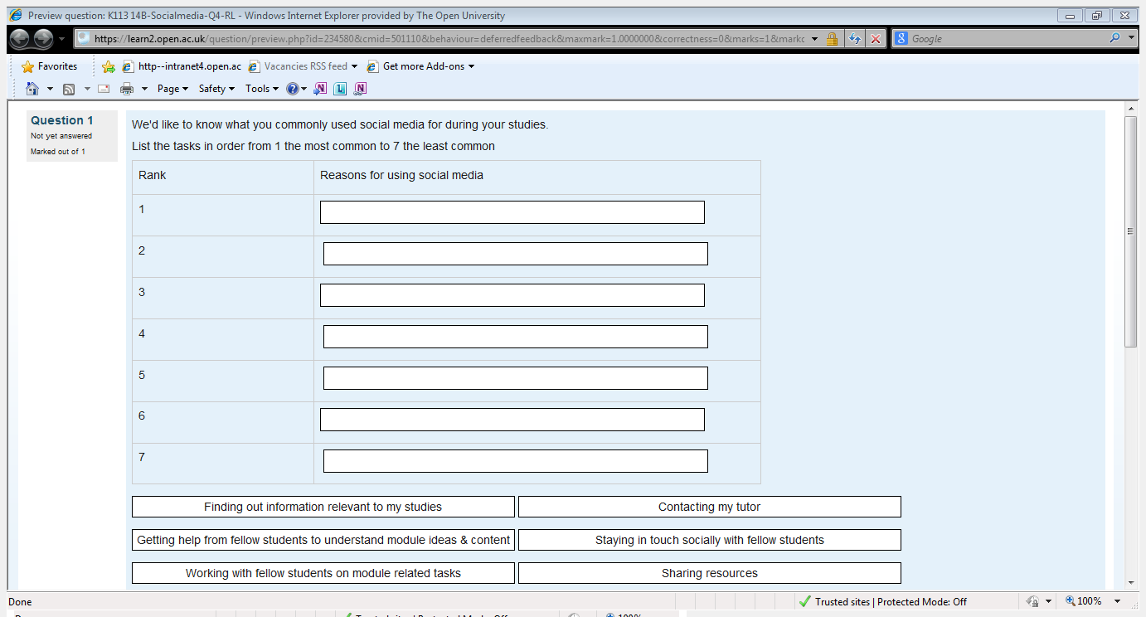

Slide 14
Conclusion
Step by step process
Expanding my knowledge base, merging with the existing areas
Creating a neat fit
Developing professional identity… online and offline

Slide 15
Thank you!

