Slide 1
Neuroimaging in CRPS
Jenny Lewis
Royal National Hospital for Rheumatic Diseases
Bath, UK
Motor
Sensory
Resting state
Cognitive

Slide 2
Neuroimaging in CRPS
Controlled studies
N=12>
All in upper limb CRPS apart from resting state
Mainly MRI
Motor
Sensory
Resting state
Cognitive

Slide 3
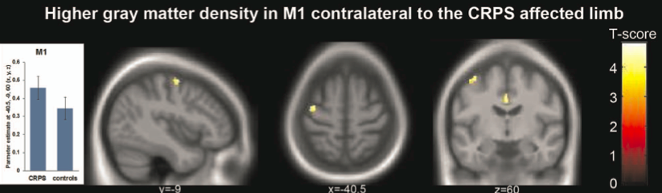
STRUCTURAL CHANGES
Motor
Pleger et al. 2014 DOI 10.1371/journal.pone.0085372

Slide 4
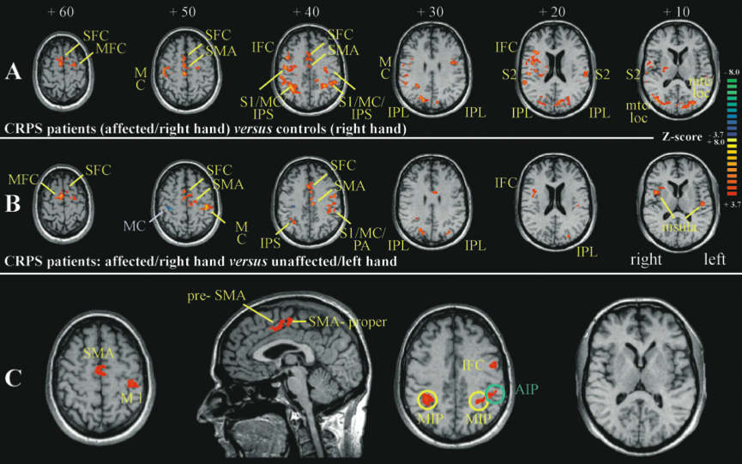
FUNCTIONAL DIFFERENCES
Motor
Maihofner et al. 2007 DOI 10.1093/brain/awm131
Notes:
Fmri of finger tapping task A/U controlled reorganisation of motor circuits and increased activation in M1 and SMA, including ipsilateral M1
When compared to degree of motor impairment, activations in Postreoir parietal corticies, SMA and M1 correlated with the degree of motor disfunction
Increased in GM volume and activation in M1

Slide 5
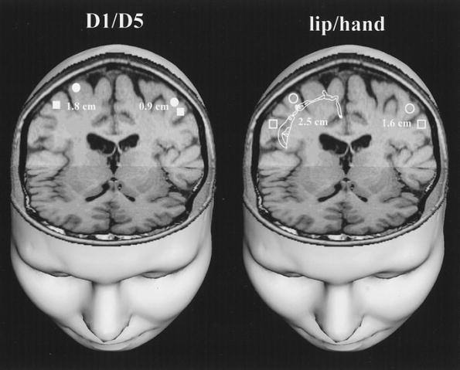
Primary Somatosensory Cortex Function in Complex Regional Pain Syndrome: A Systematic Review and Meta-Analysis
Di Pietro et al. 2013 DOI 10.101n.2013.04.001
No difference in activation, disinhibition or latency of peripherally evoked s1 responses
Smaller spatial representation of the affected hand in S1
Sensory
Maihofner et al. 2003
DOI10.1212/01.WNL.0000098939.02752.8E
Notes:
Recent systematic review of nero imaging focussed on S1 was undertaken by di petro in journal of pian function in S1 in CRPS functional neuorimaging studies.
15 studies met reivew criteria and their finding were
Spatial representation of the affected hand is smaller than that of the unaffected hand or healthy controls
No difference in activation, disinhibition or latency

Slide 6
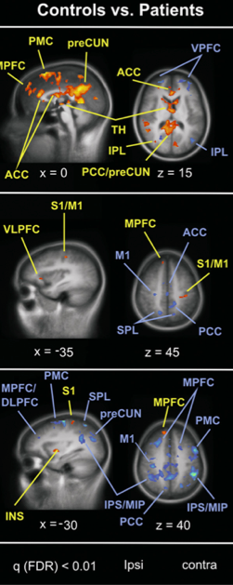
FUNCTIONAL DIFFERENCES
At rest: Functional connectivity contrasts between CRPS and HC
Default mode network
(posterior CC and precuneus)
S1/M1
Resting
state
Intraparietal sulcus
Bolwerk, Seifert and Maihofner 2013 DOI 10.1016/j.jpain.2013.04.007
Notes:
Contrast . Correlation with pain intensity

Slide 7
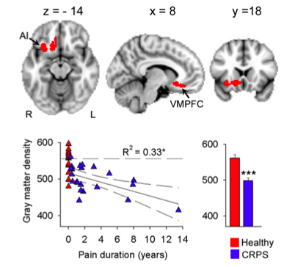
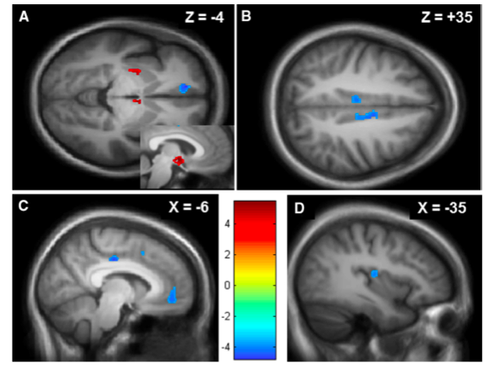
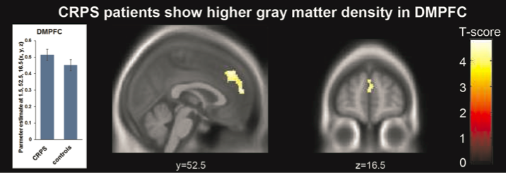
STRUCTURAL CHANGES
Barad et al. 2014 DOI 10.1016/j.jpain.2013.10.011
Geha et al. 2008 DOI 10.1016/j.neuron.2008.08.022
Cognitive
Pleger et al. 2014 DOI 10.1371/journal.pone.0085372
Notes:
Increased GM in left dorsal putamen- pain processing and right hypdlothamams- altered function drives the autonomic system
disease duration and pain intensity corelated with decreased GM in PFC, pain intensity correlated with reduced GM in L posterior hippocampus and amygdala

Slide 8
Summary
MOTOR
Structural ⬆ and functional ⬆. Motor activation correlates with the degree of motor dysfunction
SENSORY
Reduced affected hand representation, no difference in activation, disinhibition or latency of S1 responses
RESTING STATE
Spatial alterations in connectivity in DMN, sensorimotor and with intraparietal sulcus at rest
COGNITIVE
⬇ grey matter in VM/DLPFC and L posterior hippocampus and amygdala. ⬆ DMPFC. Disease duration correlated with ⬇ grey matter in Left hippocampus and amygdala
Motor
Sensory
Resting state
Cognitive

Slide 9
Considerations and future questions
Are central changes the cause or consequence of CRPS pain?
What is the relationship between MRI and clinical features other than pain intensity i.e cognitive function ?
- and can distinct fMRI patterns differentiate between subtypes in CRPS? (e.g. sensory gain versus sensory loss)
Which motor areas are involved?
Is there reorganisation in higher cortical areas (eg posterior parietal cortex)
What are the difference in cortical patterns between CRPS and neuropathic pain?
To what extent does medication contribute to these changes?
How do treatment responses correlate to fMRI findings?
Which changes can be found at the level of the spinal cord?
Notes:
Brain system changes have been shown for anitdepressants and opioids

