Slide 1
Freshers’ Group-Working Activities for Fun, Learning and Prizes
Stewart Green, Rong Yang and Nick PLANT
THE University of the West of England,
Bristol
{stewart.green, Rong.yang, nick.plant}@uwe.ac.uk

Slide 2
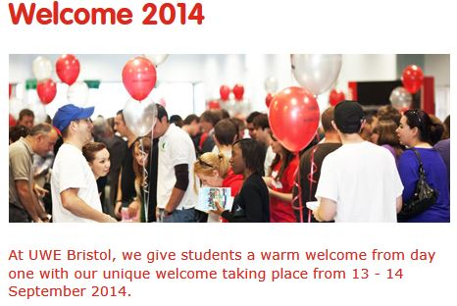
The Wider Induction Context
“Welcome week”
Preceded by “Welcome weekend” activities
Comprehensive range of activities from 3 tiers
Institution-level: registration, Freshers' Fair,
other SU activities…
Department-level: talks on library, IT, resources…
Programme-level: e.g. this activity!...
Some are timetabled
In the CS&CT Department in recent years:
More emphasis on preparing students for academic life
Freshers joining a scholarly community
Research talks from staff
Green IT talks and activities
Programming practical with C and Arduino microcontroller kit
This activity!

Slide 3
Our Group-Working Social Event: Aims
Help students to make friends quickly
Help them to settle into their courses quickly
Be fun!

Slide 4
History
We used bridge building with straws for a number of years to meet these goals

Slide 5
New Aim
Induction to reflect:
cognitive skills &
practical skills
that students will use in their first-year studies

Slide 6
Relevant Cognitive and Practical Skills
Communication skills
Abstract modelling skills
Problem analysis and problem solving skills
Practical modelling skills

Slide 7
Team and Individual Working
The skills are introduced using activities
Activities involve both:
Tasks for individuals and
Tasks for teams

Slide 8
Speed Networking
A fifth activity, speed networking, facilitates:
Meeting and chatting to many more new students

Slide 9
Infrastructure
3 hour event
Large open space
200 students from seven awards
Teams of five
38 numbered tables
5 workstation tables
PA system
Marking templates
Marking spreadsheet

Slide 10
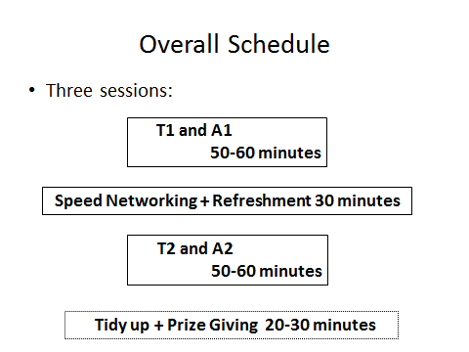
Overall Schedule

Slide 11
Overall Schedule
Three activity types:
T-type,
A-type, and
Speed Networking
T-type:
Each group has a table as its base.
T-type means table based activities; students work on their own table.
A-type:
Arena based activities.
During table based activities, groups are called out to separated areas for activities which require invigilators.

Slide 12
1st-hour Activities
Some typical team names:
Havana Autos
Team Solo Mid
Wildcats
The Doorknobs
Twenty Fourz
22CBD

Slide 13
Activity-1: Individual and team abstract modelling
Modelling two restaurant processes:

Slide 14
1st Model
In your team,
consider the process involved in dining at a first-class restaurant.
Your party will be greeted on arrival and then seated;
next your order will be taken.
This will be followed by your meal being served
and finally payment will be collected.
Model this process using the provided notation

Slide 15
2nd Model
Now consider the seating process in more detail.
If you have booked in advance, you will be assigned a table straight away.
If you haven’t, the waiter will check to see if there is a free table;
if there is one, you will be assigned to it.
If there isn’t, the waiter will see if tables can be rearranged to seat you;
if he can, you will be assigned the rearranged tables;
if he can’t, he will invite you to wait for a table;
and after a certain amount of time he will check again for an available table.
Model this process using the provided notation

Slide 16
Abstract Modelling: Tuition
Think about the process of how a company handles an order.
The company will receive an order,
check that the buyer’s credit is ok,
fulfil the order and send out an invoice.
In the BPMN notation this process is modelled graphically as follows:

Slide 17
Abstract Modelling: Tuition
But what happens if the buyer’s credit is not ok,
or the goods aren’t in stock?
A more complete model of the order process is:
The thin circle at the start is called a start event.
The thick circles at the end is called an end event.
The rounded rectangles are called activities. They represent actions. They have names of the form VERB-NOUN, e.g. Send Invoice.

Slide 18
Activity-2: Team Communication
During the first hour,
While teams are doing abstract modelling,
each team in turn is called to a workstation where
four team members describe a drawn figure to a fifth,
who can’t see it,
but has to draw it!

Slide 19
Acitivity-2: Team Communication

Slide 20
Low Scoring Drawing

Slide 21
High Scoring Drawing

Slide 22
Interval: Tea and Speed Networking
200 people, 40 tables, 5 per table
Using half hour refreshment break:
maximize the total number of new people meeting each other
Three rounds:
In each round students move to a new table to meet new people.
We wrote a computer program to generate a schedule for each individual student

Slide 23
Speed Networking Scheduling Algorithm
Data structures used:
Relation-matrix to track who has met who
People-lists to track who has been assigned or not assigned
From round one to round N do {
From table one to table M do {
Randomly assign people to a table until it’s full
If a person has met any one on the table, pick another person
After assigning a person, update the relation matrix
}
}// if no suitable person, backtrack

Slide 24
2nd-Hour Activities
During the next hour, each team was called to one of the workstations set aside where:
each member flew their aeroplane.
points were scored for the distance flown
scores aggregated for team’s overall score
In parallel, team solved the “travelling salesman” problem

Slide 25
Activity-3: Individual Design and Build
Individual activity: create a paper aeroplane from a sheet of A4 paper…
… and fly it!

Slide 26
Activity-4: Analysis and Problem Solving
Solving the “travelling salesman problem”
A classical computationally “expensive” problem
Encourages teamwork

Slide 27
Activity-4: Analysis and Problem Solving
Explanation
Campus map
On the right is our campus map
Each node is a building
The task is to plan the shortest route from A-block back to A-block, visiting each other block exactly once

Slide 28
Activity-4: Analysis and Problem Solving
The distance between
blocks in metres.
So, e.g. D to C is 24 metres

Slide 29
Results
Results were totalled for each team
Marks for tasks were normally distributed across teams
So task difficulty had been judged (approximately) correctly

Slide 30
Prize Giving
£20, £10 and £5 gift tokens awarded to the 1st, 2nd and 3rd placed teams.

Slide 31
Student Feedback
“I found the speed networking exercise useful.
For some strange reason many computer people are not the most extrovert and this was a really good icebreaker.
The time limits meant you got to meet lots of different people”
“The travelling salesperson was ok
I liked the fact it was intellectual rather than practical –
I hate those things where you have to build something out of straws & milk bottle tops. The paper planes thing was fun and again, a good way of meeting other students.”
“I enjoyed the social a lot.
That is actually where I made some of my closest friends, including one person I am living with next year.
The activities were good for teams to do. A valuable experience!”

Slide 32
Students’ Criticisms & Constructive Suggestions
“One final very small thing, it didn't say there would be food there, so I had lunch beforehand. This meant I missed out on the sandwiches.”
“I did find that the salesman problem was quite long to get through.
I would suggest to use more of a technological approach, for example games that use mobile phones or computers for solving problems that are fun and interactive for a whole team.”
“The travelling salesperson was ok but it's not really something that involves teamwork”
Re the travelling salesman:
“I think something that could be broken into several components would have been more suited to teamwork.”

Slide 33
Staff Costs
Very cost-effective event:
200+ students managed by just 6 members of staff who
Supervised activities
Marked activities

Slide 34
Other Universities may Adopt and Adapt
Either:
Customise the activities we used for these categories
Problem analysis and solving
Communication
Abstract and
Concrete modelling
Or:
Replace one or more of these categories with your own and
Choose appropriate activities for your categories

Slide 35
Materials
A4 paper
200 pencils
20 rubbers
Coloured scellotape (for distance markers on floor)
Table numbers
Blue tac
Marking sheet pro formas
Marking spreadsheet
PA system

Slide 36
Hour-1 Table Materials
Modelling instructions x 5 (one for each team member)
Modelling answer template with header x 1 (team answer)
A4 paper for draft modelling x 5
Drawing task marking sheet x 1
5 pencils
1 rubber

Slide 37
Hour-2 Table Materials
Travelling salesman instructions x 5
Travelling salesman answer sheet x 1 (team answer)
Aeroplane paper x 5 (one for each team member)
Aeroplane instructions x 1 (for the table)
Aeroplane marking sheet x 1 (for the team)

