Slide 1
Time and Tide
Appleby, T. and Croce, B. (2014)
University of the West of England, Bristol

Slide 2
Background
This film looks at the enforceability of MSY by the public using the Clyde as an example
It also posits that area based management should be a feature of MSY
It is based on research monograph by Appleby, T., Everard, M., Palmer, R. and Simpson, S. (2014) Plenty More Fish in the Sea? Available from the UWE repository

Slide 3
Now for the film
Click here

Slide 4
Erratum
This is one niggling error in the film, as it was unscripted.. where it says the public right to fish applies to the rest of Scottish waters – there are some other potential exclusions by other users (such as ports, defence, oil and gas and now renewables). The Isle of Arran no take zone remains the only one for fisheries and conservation purposes in Scotland.

Slide 5
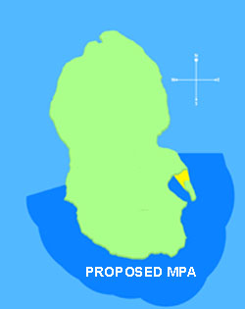
Post script
The South of Arran Marine Protected Area was announced on the 24th July 2014
Active fisheries management measures are still awaited

Slide 6
Corresponding Author
Please contact thomas.appleby@uwe.ac.uk for a full copy of the monograph and for any comments.

