Slide 1
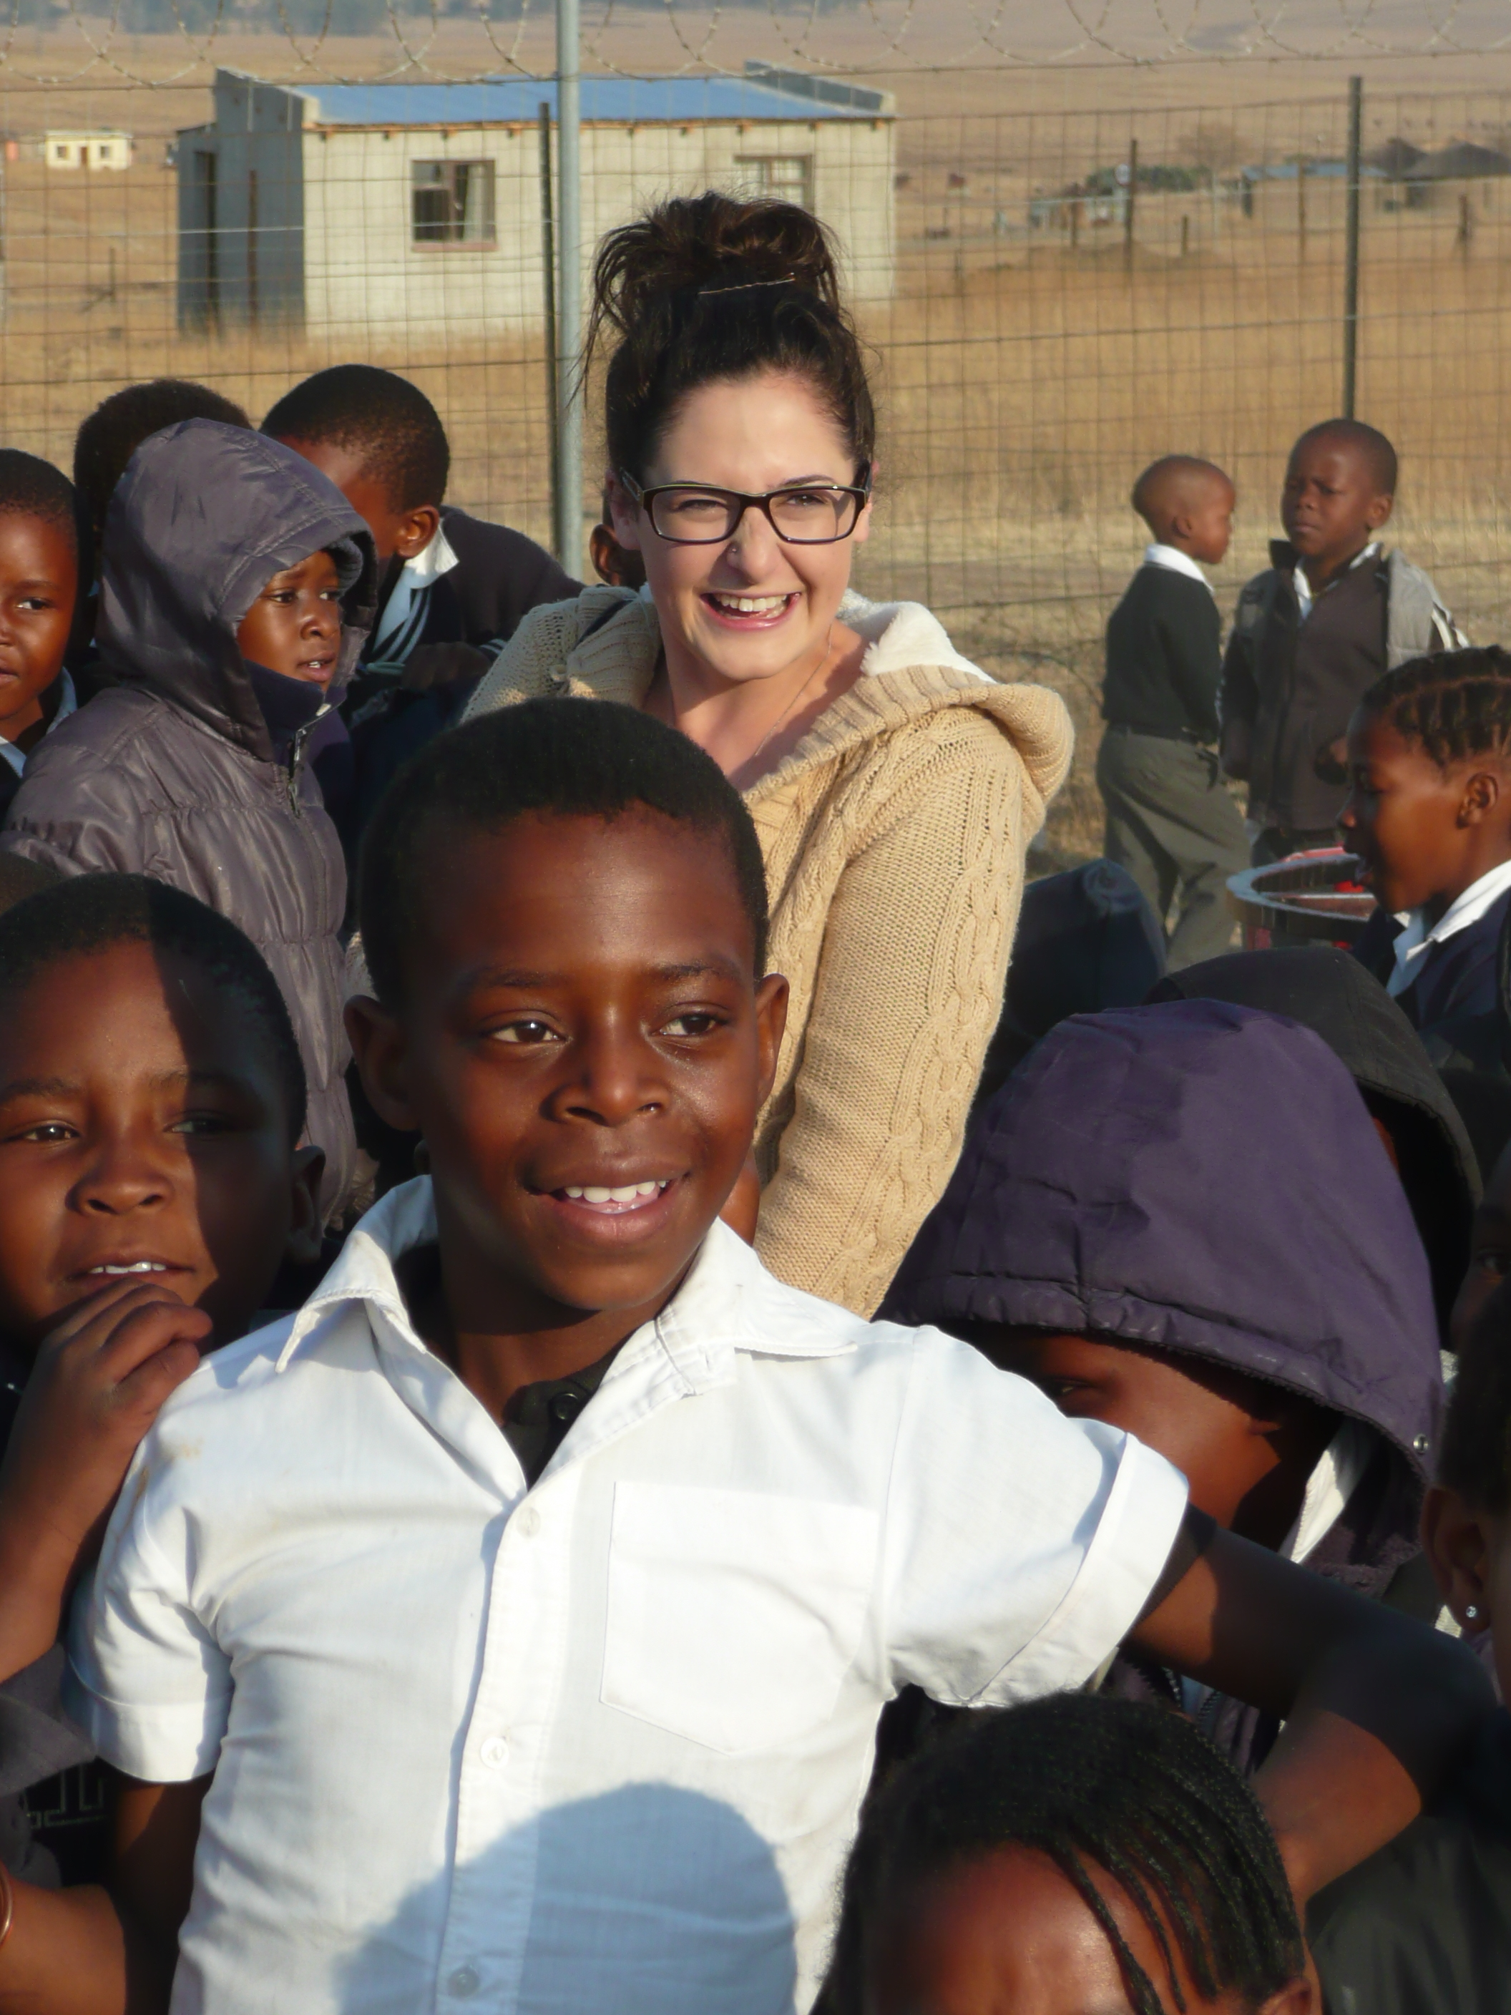
Room to breathe:
Insights from pre-service teachers and NQTs on professional development through informal complementary placements overseas.

Slide 2
Teacher Education Context
Pre-service teachers are heavily monitored through formal observations, target setting and tracking, categorising of lessons ‘Good, Adequate etc.
Professional development viewed exclusively in terms of an inert rubric - Teaching Standards.
Dips in trainee trajectories trigger improvement plans, increased monitoring and support, new targets, higher stakes.
Tangible employability imperative to be judged as ‘Good’ or ‘Outstanding’.
Schools increasingly reluctant to relinquish control to trainees for fear of not meeting their own ‘improvement’ agendas.

Slide 3
What are the issues?
Teaching and learning are dynamic processes (Clark & Yinger, 1987). Classrooms are dynamic places. The instruments of accountability and surveillance (Neoliberal performative agenda - e.g. Ball, 2003) create a controlled environment (see Giddens, 1979 on ‘rules and procedures of Structuration theory) within which a repertoire of dynamic skills are to be judged - contradiction?
this controlled environment positions trainees firmly as:
novices
dependent
…and may limit professional development (PD) and teacher agency.

Slide 4
Knock-on effects
Encourages conservatism, discourages risk-taking, experimentation and innovation.
Decreased opportunities for making mistakes and learning from them.
Trainees take less, not more reflective responsibility for their own professional development.
Focus attention on own performance, not pupil learning.

Slide 5
The Overseas Programme
12 trainees placed in pairs in deprived township or rural primary schools in Kwazulu-Natal, South Africa for 4 weeks teaching.
Class sizes 50-70, subjects, grades and timetables negotiated upon their arrival at the school. All tend to teach Eng/Maths/Sci, most teach ‘foundation’ subjects in addition.
Classrooms are tatty, no displays, mostly chalk boards, pupils sitting on wooden benches.
Prevalent pedagogy - transmission.
therefore, opportunities to innovate and introduce novel approaches is high.
No observations, forms, tracking, targets, progress reviews, judgements or categorising of lessons.
Placement not accredited and forms no part of trainees’ degree or QTS.

Slide 6
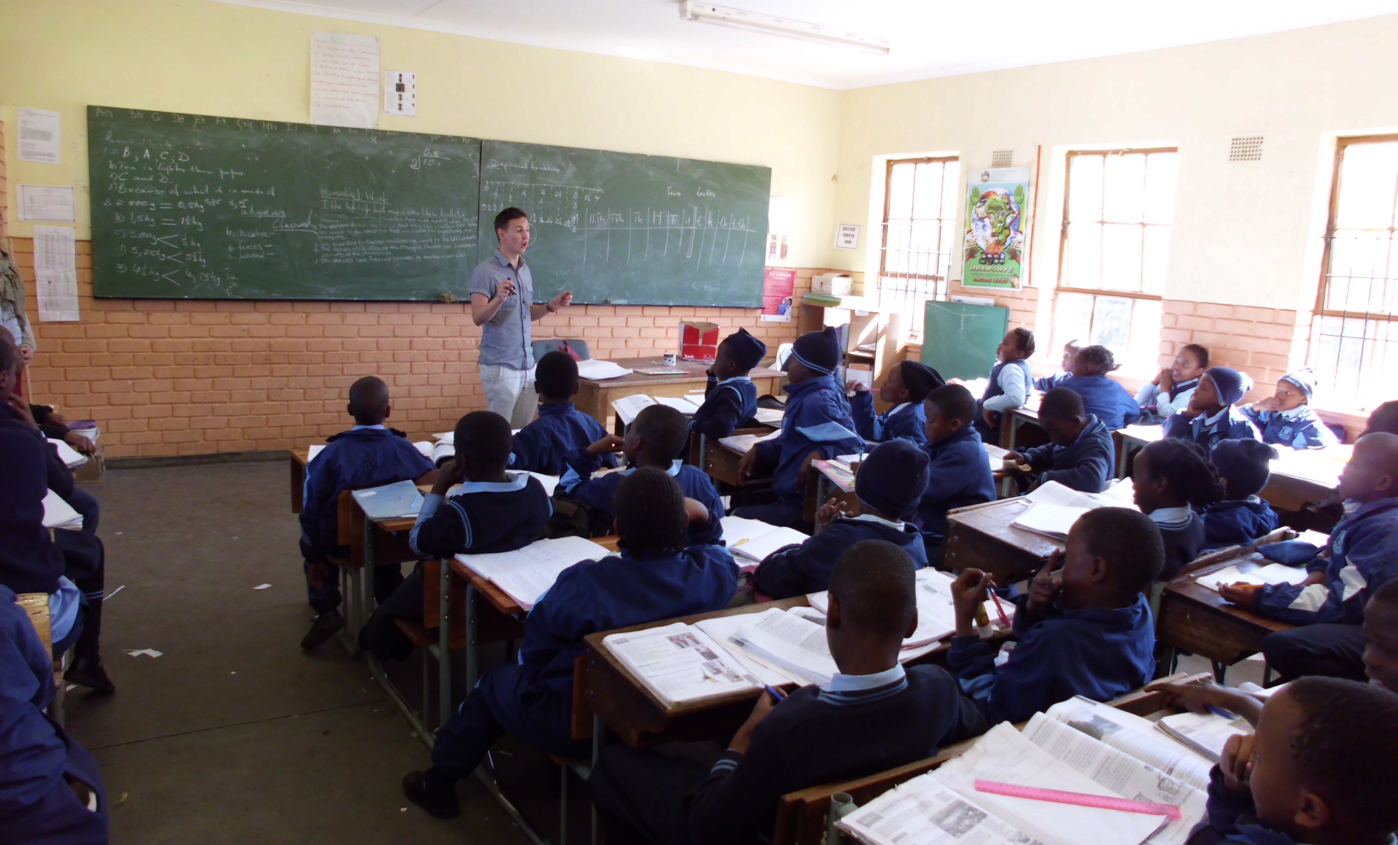
Thomas Kirby, Aug 2013
Grade 4 Sipheni Primary School, Madadeni, KZN, SA.

Slide 7
The Research
Three cohorts of 12 2nd year UG ITE students followed at intervals through the experience, 2012-2016:
before SA (focussing on their expectations and thoughts about likely challenges), during SA (identifying their own strengths and weaknesses in relation to the experience, and comparisons with UK placements), after SA (as 3rd years and as NQTs reflecting on lessons learned and contributions to their professional development).
Epistemology:
Aims to facilitate reflection, not impose judgements. Data gathering exercises designed to be sensitive to the agency of the trainees. Research practices intended to be in-keeping with the placement experience by locating the professional development agency firmly with the trainee.
Methodology:
before SA, semi-structured focus group interview, all 12.
during SA, semi-structured paired interviews after 1 week teaching. Individual journals.
after SA, semi-structured focus group interview, all 12, after 3rd year final placement. Then, email interview/questionnaire during NQT year.

Slide 8
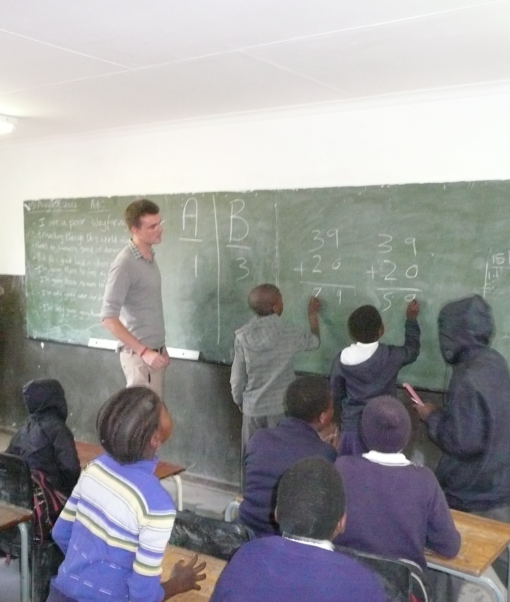
Trainee Reflections
‘The most valuable lesson was thinking on my feet’ (Ryan, 2012 cohort)
‘Here I felt I was more able and they allowed you to do a lot more. The teachers just expect you have a go. Whereas on placement it’s quite {patronising voice} “well you are only a first year so you can’t do this and you won’t be able to do that” There it is more about what you can’t do’ (Agatha, 2013 cohort)
‘I think there [Africa] as well they talk to you like you are their equal so you behave as one. Whereas here [UK] you feel like there is a hierarchy’ (Frankie, 2013 cohort)
‘I’m usually so reliant on the internet for lesson ideas, but here we’re generating really useful ideas by talking to each other {trainee pairs} and trying things out’ (Bethany, 2014 cohort)
‘My confidence to improvise and think quickly about where I’m going to take the journey of a lesson is growing’ (Georgia, 2014cohort)
‘It’s the confidence level, because you go with your gut, take a risk and just get on with it. Next year I’m going to have my own class and I feel more confident in my own ideas and instinct.
‘It has made me comfortable with the unpredictable’ (Josie, 2014 cohort)

Slide 9
Findings
Key themes emerging from all cohorts:
increased confidence
increased situational awareness (see Dreyfus, 1981)
increased ability to go ‘off-script’, improvise and respond to ‘teachable moments’ (Woods, 1996)
increased autonomy and agency (see Hargreaves & Fullan, 2012 - ‘Decisional Capital’ and Pignatelli, 1993)
increased demand on creative thinking in lessons, largely due to lack of Google!
most experience some form of knowledge exchange with teachers, (from informal - being watched, to formal - leading staff training)
all report a change in professional self-perception, from novice to expert; trainee to teacher (see Berliner, 1988)

Slide 10
Complementary Experiences
What can this experience provide that a formal, accredited, assessed UK placement may not?
space to teach with no assessed agenda.
low-stakes pedagogical rehearsal time.
pupils’ learning (not own performance) as the principle benchmark for success.
reliance on own reflection and evaluation (not external judgement) to gauge successes and areas for improvement.
opportunity for risk-taking, experimentation, stepping out of comfort zone (personal and professional), trial and error.
the experience of being seen as ‘expert’ may accelerate a trainee’s PD trajectory. (See Marble, 2012 - ‘becoming’ because of encounters with the ‘Other’ in teacher education.)
offers opportunities for domain general teacher skill development (life skills? - classroom presence, thinking on your feet, situated problem solving) and personal qualities (self-confidence, risk-taking, global perspective, adventurousness).

Slide 12
Berliner (1988). Development in Pedagogical Expertise
A theory of skill learning:
Novice: follow rules without context as requisite for beginning teaching
Advanced Beginner: aware that rules sometimes can be ignored as situations and learners vary
Competent: making conscious choices about classroom activities and knowing what is important to attend to and what is not
Proficient: feel how well lessons are going, develop generalisations about similarities between disparate events, and predict events more precisely based on common understandings of what
Expert: act without calculation or deliberative thought
Limit of PD within ITE
Potential PD extension within ITE

Slide 13
Interim Conclusions
Opportunities to rehearse teaching without the instruments of surveillance and performativity may facilitate different pedagogical motivations, decisions and skills.
Being positioned as ‘experts’ may positively influence professional self-confidence, future risk-taking and employability.
Freedom from ‘paperwork’ allows trainees more time for professional reflection on T&L.
Overall - informal placements have the potential to accelerate trainees’ personal professional trajectories.

Slide 14
References
Ball, S. (2003). The teacher’s soul and the terrors of performativity. Journal of Education Policy Vol.18(2), pp. 215-228.
Berliner, D.C. (1988). The development of expertise in pedagogy. The Charles W. Hunt Memorial Lecture presented at the Annual Meeting of the American Association for College of Teacher Education: Washington D.C. February 17-20, 1988.
Clark, C. & Yinger, R. (1987). Teacher planning. In Calderhead, J. (Ed.) Exploring teacher thinking pp. 84-103. London: Cassel Educational Limited.
Dreyfus, S. E. (1981). Four models v human situational understanding: Inherent limitations on the modelling of business expertise USAF. Office of Scientific Research.
Giddens, A. (1979). Central problems in social theory: Action, structure and contradiction in social analysis. London: Macmillan.
Hargreaves, A. & fullen, M. (2012). Professional Capital: Transforming teaching in every school. New York: Teachers College Press.
Marble, S. (2012). Becoming-teacher: Encounters with the Other in teacher education. Discourse: Studies in the Cultural Politics of Education,Vol. 33(1), pp. 21-31.
Pignatelli, F. (1993). What can I do? Foucault on freedom and the question of teacher agency. Educational Theory Vol. 43(4), pp. 411-432.
Woods, P. (1996). Teachable moments: The art of teaching in primary schools. Buckingham: OUP.

