Slide 1
A panel-based prevalence study of self-reported self-harm in adolescents aged 13-18 in England
Dr Yvette Morey, University of the West of England
Dominic Mellon, Public Health England
Dr Narges Dailami, University of the West of England
Prof Julia Verne, Public Health England
Prof Alan Tapp, University of the West of England

Slide 2
Background to the study
Increased admissions for self-harm 2002/3 – 2008/09
Children aged <15 account for 5% of admissions
Priorities for study:
Clinical iceberg
Over-representation of poisoning
Under 15s
Risks: social contagion, online content
Online ethnography
Prevalence study (community)

Slide 3
Existing prevalence studies
Study |  |  |  |  |  | Prevalence
CASE | Country/pop. | Year | Self-harm Question | Age | Sample | Male | Female | All
 | Multi-country | 2008 | "harm yourself" | 15–16 | School pupils | 4.3% | 13.5% | -
 | England | 2002 |  | 15–16 |  | 3.2% | 11.2% | 13.2%
 | Ireland | 2008 |  | 15–17 |  | 4.3% | 13.9% | 9.1%
 | Scotland | 2009 |  | 15–16 |  | 6.9% | 19.9% | 13.8%
 | N. Ireland | 2014 |  | 15–16 |  | 5.1% | 15.5% | 10%
Other | Avon (County) | 2012 | "hurt yourself on purpose" | 16–17 | ALSPAC cohort | 9.1% | 25.6% | 18.8%

Slide 4
Prevalence in the community
Muehlenkamp et al. (2012): International prevalence of adolescent non-suicidal self-injury & deliberate self-harm
Adolescent NSSI and DSH btw 2005-2011
No significant difference in prevalence figures
NSSI 18.0% DSH 16.1%
Consistent btw 2005 – 2011 → prevalence stabilised?

Slide 5
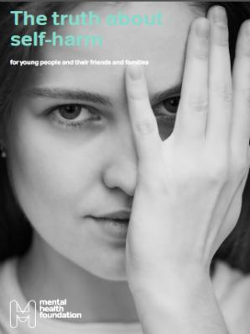
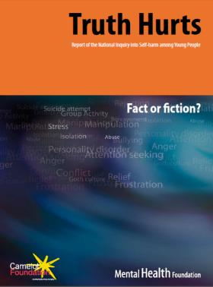
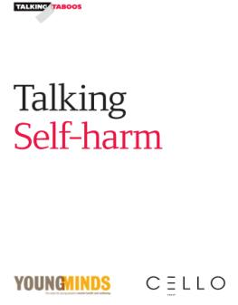
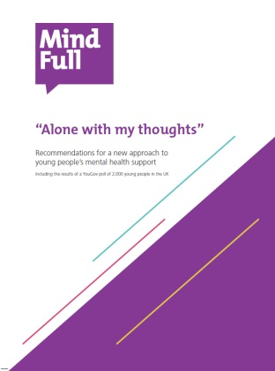
Prevalence in the community

Slide 6
Prevalence study: design & methodology
Cross-sectional survey, 2000 13 -18 yrs
Anonymous online questionnaire
Established market research panel
Descriptive & qualitative analysis
Primary outcome:
self reported self-harm
differentiation of behaviours
under 15s
Secondary outcomes:
mental wellbeing (WEMWBS)
risk behaviours
social contagion
reasons & emotional responses
concerns
help-seeking behaviors
online activities
CASE criteria:
An act with a non-fatal outcome in which an individual deliberately did one or more of the following:
Initiated behaviour (for example, self-cutting, jumping from a height), which they intended to cause self-harm.
Ingested a substance in excess of the prescribed or generally recognised therapeutic dose.
Ingested a recreational or illicit drug that was an act that the person regarded as self-harm.
Ingested a non-ingestible substance or object

Slide 7
Survey design
ChildWise/ResearchBods
Questionnaire (anon, online)
24 items, 15–30 mins
Leisure, lifestyle (risk), health/wellbeing & self-harm
Recommendations from stakeholder groups (multi-disciplinary team & service-user group)
Opportunities for opting out, skip logic
Survey: 2 weeks, April 2013

Slide 8
Recruitment & Sample
OpenEpi tool
2000 sample size for 95% confidence level
YoungBods 37000 11-24 yrs

Slide 9
Sample characteristics
Characteristics |  | 2011 Census | Final Sample
Age
 | 13-15 | 49.1% | 47.8%
 | 16-18 | 50.9% | 52.3%
Socioeconomic status
 | ABC1 | 56.0% | 59.9%
 | C2DE | 44.0% | 40.2%
Ethnicity
 | White | 86.0% | 81.6%
 | BME | 14.0% | 17.0%
 | Not disclosed | N/A | 1.4%

Slide 10
Results: prevalence
 |  | Number | Sample | Proportion of self-harmers | 95% CI
Lifetime prevalence (adj.) |  | 309 | 2000 | 15.5% | (13.9 - 17.1)
Sex
 | Male | 68 | 957 | 7.1% | (5.6 - 8.9)
 | Female | 241 | 1043 | 23.1% | (20.6 - 25.8)
Age prevalence (all)
 | 13 | 18 | 263 | 6.8% | (4.1 - 10.6)
 | 14 | 51 | 320 | 15.9% | (12.1 - 20.4)
 | 15 | 47 | 372 | 12.6% | (9.4 - 16.4)
 | 16 | 69 | 370 | 18.6% | (14.8 - 22.9)
 | 17 | 77 | 382 | 20.2% | (16.2 - 24.5)
 | 18 | 52 | 293 | 17.7% | (13.5 - 22.6)
Age-sex prevalence (male and female)
 | Male 13–15 | 24 | 437 | 5.5% | (3.6 - 8.1)
 | Female 13–15 | 89 | 518 | 17.2% | (14 - 20.7)
 | Male 16–18 | 44 | 520 | 8.5% | (6.2 - 11.2)
 | Female 16–18 | 152 | 525 | 29.0% | (25.1 - 33)
Age-sex incidence (self-harm within the past year)
 | Male 13–15 | 10 | 25 | 40.0% | (21.1 - 61.3)
 | Female 13–15 | 50 | 91 | 54.9% | (44.2 - 65.4)
 | Male 16–18 | 16 | 44 | 36.4% | (22.4 - 52.2)
 | Female 16–18 | 67 | 154 | 43.5% | (35.5 - 51.7)
Type of self-harm behaviour (by those who reported self-harm)
 | Cut on arms | 232 | 309 | 75.1% | (69.9 - 79.8)
 | Cut elsewhere | 167 | 309 | 54.0% | (48.3 - 59.7)
 | Self-battery | 159 | 309 | 51.5% | (45.7 - 57.2)
 | Pills or overdose | 88 | 309 | 28.5% | (23.5 - 33.9)
 | Burnt | 66 | 309 | 21.4% | (16.9 - 26.4)

Slide 11
Types of self-harm by gender

Slide 12
Age of onset

Slide 13
Risk behaviours
 |  | Number | Number (%) self-harm | OR | 95% CI | P
Smoking
 | Ever | 430 | 138 (32.1) | 2.59 | (2.20 - 3.04) | <0.0005
 | Never | 1570 | 171 (10.9)
Alcohol use
 | Ever | 1296 | 263 (20.3) | 1.39 | (1.31 - 1.48) | <0.0005
 | Never | 704 | 46 (7.0)
Medication other than specified
 | Ever | 343 | 129 (37.6) | 3.30 | (2.75 - 3.96) | <0.0005
 | Never | 1657 | 180 (10.9)
Recreational drug use
 | Ever | 240 | 80 (33.3) | 2.74 | (2.15 - 3.48) | <0.0005
 | Never | 1760 | 229 (13.0)

Slide 14
Bullying
59.4% of the whole sample (2000) reported being bullied
79.9% of the self-harm cohort (309) reported being bullied

Slide 15
Social contagion – awareness of others
 |  | Number | Proportion of self-harmers | OR | 95% CI | P
Exposure | Anyone | 1173 | 95.1% | 18.1 | (10.7 - 30.7) | <0.0005
 | Family | 198 | 25.5% | 4.1 | (3.0 - 5.6) | <0.0005
 | Friends | 965 | 89.8% | 8.3 | (6.0 - 11.5) | <0.0005
 | Online | 410 | 47.6% | 4.4 | (3.4 - 5.6) | <0.0005
 | Celebrity | 328 | 40.1% | 4.3 | (3.3 - 5.7) | <0.0005

Slide 16
Social contagion: exposure & outcome
Mantel-Haenszel ORs

Slide 17
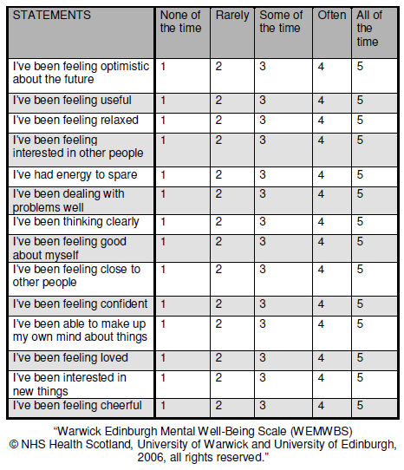
Warwick-Edinburgh Mental Wellbeing Scale (WEMWBS)
Population/group measure
Validated for adults & adolescents
Subjective wellbeing & psychological
functioning
14 items, positively worded
Scoring: 1-5 Likert scale
Min 14, max 70
Mean scores for sample, sub-groups

Slide 18
Wellbeing: overall, age & gender
 |  | Number | Mean WEMWBS Score | 95% CI | Validation Score
Overall self-reported wellbeing |  | 2000 | 45.6 | (45.2 - 46.0) | 48.8
Age specific self-reported wellbeing
 | 13 | 263 | 48.8 | (47.6 - 49.9) | 48.7
 | 14 | 320 | 47.0 | (45.8 - 48.1) | 48.6
 | 15 | 372 | 46.7 | (45.7 - 47.7) | 50.1
 | 16 | 370 | 43.5 | (42.4 - 44.5) | 49.8
 | 17 | 382 | 44.4 | (43.4 - 45.4)
 | 18 | 293 | 43.8 | (42.7 - 44.9)
Age-sex specific self-reported wellbeing
 | Male 13-15 | 437 | 48.8 | (47.9 - 49.7) | N/A
 | Female 13-15 | 518 | 46.1 | (45.3 - 46.9) | N/A
 | Male 16-18 | 520 | 45.3 | (44.4 - 46.2) | N/A
 | Female 16-18 | 525 | 42.5 | (41.7 - 43.3) | N/A

Slide 19
Wellbeing: self-harm prevalence & type
 |  | Number | Mean WEMWBS Score | 95% CI | Validation Score
Self-reported self-harm
 | Any | 309 | 38.7 | (37.6 - 39.9) | N/A
 | None | 1691 | 46.8 | (46.3 - 47.3) | N/A
Self-reported self-harm by type
 | Cut on arms | 235 | 37.9 | (36.6 - 39.2) | N/A
 | Cut elsewhere | 170 | 37.4 | (35.9 - 38.9) | N/A
 | Self-battery | 163 | 38.1 | (36.5 - 39.6) | N/A
 | Burnt | 68 | 37.0 | (34.4 - 39.7) | N/A
 | Pills or overdose | 89 | 36.7 | (34.3 - 39.0) | N/A
 | Something else | 24 | 38.8 | (34.7 - 43.0) | N/A

Slide 20
Wellbeing: awareness of self-harm & bullying
 |  | Number | Mean WEMWBS Score | 95% CI | Validation Score
Awareness of self-harm by others
 | Any | 879 | 45.9 | (45.2 - 46.5) | N/A
 | None | 812 | 47.8 | (47.2 - 48.5) | N/A
Bullied
 | Ever | 1188 | 44.8 | (44.2 - 45.4) | N/A
 | Never | 812 | 46.6 | (46.0 - 47.3) | N/A

Slide 21
Reasons for self-harm

Slide 22
Emotional responses after self-harming

Slide 23
Concerns about self-harm

Slide 24
Reasons for looking at self-harm websites

Slide 25
Help-seeking across genders

Slide 26
Help-seeking across BME/non-BME groups

Slide 27
Conclusions
Self-harm is highly prevalent in adolescents
Cutting most common community behaviour
Heterogeneity in self-harm behaviours
Peak prevalence, incidence and onset for full picture
Awareness and exposure significantly associated with self-harm and reduced wellbeing
Differences in reasons, concerns and help-seeking → strategies for prevention

Slide 28
Strengths and limitations
Update on prevalence in England, contributes to knowledge on community prevalence
Wider age group (self-harm in under 15s)
Representative sample and shared criteria
Market research panel – speedier, more cost-effective, possibility of repeat surveys
Cross-sectional, only a snapshot of prevalence
Correlation rather than causation
Univariate and descriptive analysis (but secondary data)
Possible exclusion of more severe mental health problems

Slide 29
Further research
Does prevalence (15.5%) support suggestions of stabilised rates?
Representative, longitudinal survey studies
Relationship btw evidence on prevalence and increased awareness, visibility and help-seeking
Wellbeing and self-harm, wellbeing for all
Gender differences in self-harm behaviours
There is value in confirming what we know, critically questioning what we know, and examining what we don’t know.

Slide 30
References
Brophy M (2006) Truth hurts: Report of the national inquiry into self-harm among young people. Mental Health Foundation.
Cooke, H., Schneider, K. & Verne, J. (2011) Suicide and Self-harm in the South West. [online]. Hawton, K., Rodham, K., Evans, E. & Weatherall, R. (2002) Deliberate self harm in adolescents : self report survey in schools in England. British Medical Journal. 325 (November), 1207–1211.
Kidger J, Heron J, Lewis G, Evans J, Gunnell D (2012) Adolescent self-harm and suicidal thoughts in the ALSPAC cohort: a self-report survey in England. BMC Psychiatry 12. doi: 10.1186/1471-244X-12-69
Madge, N., Hewitt, A., Hawton, K., de Wilde, E.J., Corcoran, P., Fekete, S., van Heeringen, K., De Leo, D., Ystgaard, M., Wilde, E.J. De, Heeringen, K. Van & Leo, D. De (2008) Deliberate self-harm within an international community sample of young people: comparative findings from the Child & Adolescent Self-harm in Europe (CASE) Study. [online]. Journal of child psychology and psychiatry, and allied disciplines. 49 (6), 667–677.
Muehlenkamp JJ, Claes L, Havertape L, Plener PL (2012) International prevalence of adolescent non-suicidal self-injury and deliberate self-harm. Child Adolesc Psychiatry Ment Health 6:10.
Morey C, Corcoran P, Arensman E, Perry IJ (2008) The prevalence of self-reported deliberate self harm in Irish adolescents. BMC Public Health 8:79
Morey, Y., Eagle, L., Verne, J. & Cook, H. (2011) Deliberate Self-harm in the South West: Setting a Research Agenda. [online]
O’Connor RC, Rasmussen S, Miles J, Hawton K, Connor RCO (2009) Self-harm in adolescents: self-report survey in schools in Scotland. Br J Psychiatry 194:68–72
O’Connor RC, Rasmussen S, Hawton K (2014) Adolescent self-harm: a school-based study in Northern Ireland. J Affect Disord 159:46–52. doi: 10.1016/j.jad.2014.02.015
Stewart-brown, S., Janmohamed, K., & Parkinson, J. (2008). Warwick-Edinburgh Mental Well-being Scale User Guide. Warwick: Warwick Medical School
Walker, P. & John, M. (2012). From Public Health to Wellbeing. The New Driver for Policy and Action. Basingstoke: Palgrave.

