Slide 1


How to be a good listener
Dr Kate Muir

Slide 2
Emotional intensity fades over time
Bias towards unpleasant events
Fading Affect Bias
(FAB)
Pleasant events retain positive emotional intensity…
…but negative emotions fade

Slide 3

A problem shared is a problem halved?
Is the act of talking about events involved?
Skowronski et al (2004)
Events disclosed 0, 2 or 3 times
3 times = Pleasant increased in intensity
Unpleasant decreased in intensity

Slide 4
How does social disclosure have its effects?
Verbalisation of narrative?
Presence of listener?
Behaviour of listener?
Listener responses?

Slide 5
Baseline
3 x Pleasant Events
3 x Unpleasant Events
Rated for Emotional Intensity
In the Lab
Social Disclosure: Either giving each other feedback (Feedback condition)
or
Sat listening quietly (No Feedback condition)
Immediately post manipulation
Re-rate each event for emotional intensity

Slide 6
Experimental Results: Summary
Presence and behaviour of listener important in fading of emotional intensity
  Talking to ‘interactive’ listener = increase in positive emotions, decrease in negative emotions
  Talking to ‘non-responsive’ listener = increase in positive emotions BUT also increase in negative emotions
How does the listener help?
Are there any particularly ‘helpful’ listener responses?

Slide 7
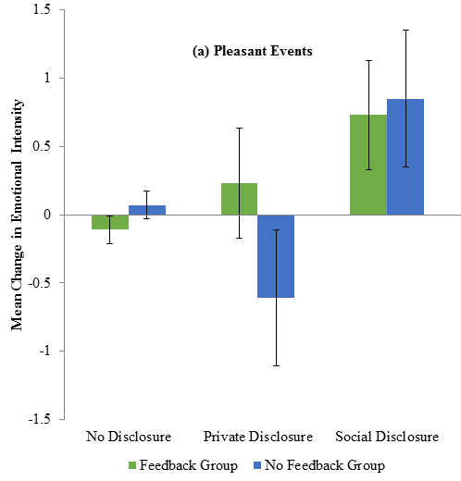

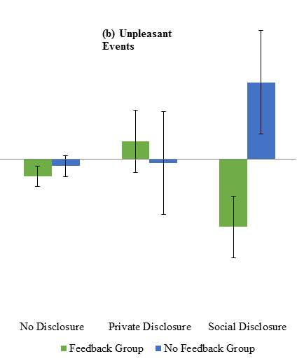
Selection of Social Disclosure Transcripts for Conversation Analysis
…we went there and then we were up until like we watched the sun rise in the [morning]. [laughs ] So when we were walking home- it was like 5 o’clock in the morning and we were going down to {location} and the sun was rising so we just sat outside. I was so [yeah ] tired and then everyone brought presents and stuff out to [me ] it was so good you [wow]

Slide 8

Conversation Analysis
Describes the order within everyday conversation, produced by the participants
Transcripts examined for evidence of actions performed by participants in their talk
Unmotivated looking: discovering existing patterns in the data

Slide 9
Qualitative Results: Summary
Certain conversational patterns characteristic of a decrease in negative emotions and/or increase in positive emotions
  Alignment between speaker and listener
  Emotional support offered by listener
  Listener encourages positive focus
  Lets have a closer look…

Slide 10
Alignment
Yielding the floor (1)
1 P96 2 3 4 5 6 P95 7 P96 8 9 P95 10 P96 11 P95 12 P96 13 14 P95 | …so it was just weird because I was in halls and I was in {location} and I’ve got a really good group of friends here and I just- I remember my birthday was on a Sunday and obviously because I had uni the next day I couldn’t go home and it was just like I felt quite sad about that. But then because my friends were so amazing and like they all came into [mine] and we all went out the night before [yeah] and had like such an amazing night and like they like threw like a little bit of a surprise party [for me ] the night before and like everyone came over they [oh really ] did all the kitchen [up ] put bags all over the floor and stuff and then they all [yeah] brought a cake and like brought loads of presents for me because they knew I felt quite upset about it. Yeah.
Overlapping verbal ‘continuers’
Show listener is paying attention and understands the story
Listener signals they are happy to pass their turn at talk
Speaker successfully tells story

Slide 11
Alignment
Yielding the floor (2)
1 P25 2 3 4 P26 5 P25 6 7 8 P26 9 P25 10 11 P26 12 P25 13 14 15 P26 | …sort of the like media advertised it as like everything was 50% off but it wasn’t it was more like 10%. It wasn’t that good a deal that they got. So a lot of customers were not the nicest of [people] so and it’s just hard when you’ve seen like you’ve had [aww ] to work to put all the store together to see it sort of people just like- people would come up dump things and it’s just- and it shut in January. But I was sort of worried because I had to pay like uni and [stuff] so I needed to get another job pretty quickly [yeah] but the only good thing is we did get redundancy pay. Erm but it was sort of at the time just worrying to think “oh I’m not going to have any money coming in” [or ] [yeah] because I’ve got my car to run and stuff. But it’s- I’ve got another job now so it’s not too bad but at that point I was just really sort of I don’t quite know what I’m going to [do ]. [yeah].
Overlapping verbal ‘continuers’
Show listener is paying attention and understands the story
Listener signals they are happy to pass their turn at talk
Speaker successfully tells story
One continuer also expresses sympathy

Slide 12
Alignment
Demonstrations of understanding (1)
Assessment of event at story end is a listener ‘preferred’ response
Listener’s positive assessment agrees with the speaker’s assessment
Listener demonstrates understanding of story meaning as speaker intended
1 P96 2 3 P95 4 P96 5 6 P95 7 P96 8 9 P95 10 P95 | …we went there and then we were up until like we watched the sun rise in the [morning]. [laughs ] So when we were walking home- it was like 5 o’clock in the morning and we were going down to {location} and the sun was rising so we [yeah ] just sat outside. I was so tired and then everyone brought presents and stuff out to [me ] it was so good you know. [wow] That’s quality.

Slide 13
Alignment
Demonstrations of understanding (2)
Continuer in form of expression of sympathy: emotional support
Anticipatory response uses same evaluative term as speaker
More sympathy expressed as part of end of story assessment
Acknowledgement of speaker’s negative feelings as valid emotional reaction
1 P96 2 P95 3 P96 4 P95 5 P96 6 7 P95 8 P96 9 P95 10 P96 11 P95 12 P96 13 14 P95 15 P96 16 P95 17 | Okay my negative event is Christmas Day- last Christmas just [gone] and I went [yeah] to go- my granddad had just had a [fall ] and he was like eighty eight nearly so [right] he’s like really old now. So we had to go and visit him on Christmas Day and it was just upsetting because I’ve always had every single Christmas with [him ] [yeah] and it was the first one without him [so ] yeah. It was just weird to see him in a [aww] hospital with like all old people and like he just looked really [old ] and frail in [yeah] his chair in there. I felt really guilty because we were “hey, Merry Christmas [okay ] we’re going to go now and have our Christmas dinner without you. [yeah, yeah] Sorry bye”. But [yeah] that’s [sad] [aaw ] [sad]. Mine’s not as sad. Mine’s not even a bit like that. Mine’s not even that sad a memory. Aaw that’s horrible…

Slide 14
Alignment
Demonstrations of understanding (3)
Listener tells related story (self-disclosure)
Story agrees with speaker’s assessment – demonstrating understanding of meaning
Acknowledgement of speaker’s negative feelings as valid emotional reaction
Self disclosure engenders rapport and intimacy
1 P25 2 3 P26 4 P26 5 6 P25 | …but that’s it really. And obviously like to lose sort of all your friends that you’ve met through your [job ] it’s not very nice. [yeah] I’ve got a friend who worked in Woolworths as [well ] so yeah they said it was a bit of a horrible time… [mmm]

Slide 15
Lack of Alignment looks like this…
1 P56 2 3 4 5 6 7 P55 8 P56 9 10 11 12 13 14 P55 15 P56 | …and so I rung up the department and she just said “Oh you got 2:1” so I was absolutely delighted because I’d just spent the higher year in this awful awful panic and just sitting in the library basically in cold sweats. And yeah, so I rung her up and she was like- she told me that and I was absolutely delighted. I think I screamed at her slightly on the phone and I was just in a complete state and quite over-excited. (2.0) And my sister- she was in the room next to where I was on the phone. She kind of came out. She was asleep and she was like “What on earth is the matter with you?” And then yeah I kind of went on to tell my family and my friends and (0.1) and then I had to go to work. I remember doing that and then in the evening I went up to see my dad who lives in the Midlands- I’m from Hampshire- and so we went out and we celebrated. (0.5) And yeah I think that was kind of it- but- yeah what about your first thing.
Listener fails to:
  give continuers
  take up her turn at talk
  give an end of story assessment
Speaker feels less positive about event afterwards

Slide 16

Alignment:
Smooth flow of conversation
  Participants orient to turn-taking norms
  Speaker successfully tells story
  Mutual understanding of story meaning
  Validate speaker’s feelings as appropriate emotional reaction

Slide 17
Emotional Support (1)
1 P128 2 P127 3 P128 4 5 P127 6 P128 7 8 9 P127 10 P128 11 P127 12 P128 13 14 P127 15 P128 16 P127 17 P128 18 P127 | …I’ve had strained ankles and things [before] and it never felt quite like that and [yeah ] I remember eventually they went and did the x-rays and I saw the woman go sort of (sharp intake of breath) and I thought “oh no” And then we eventually went [oh dear ] through to the sort of A&E booth where they were going to do- where they were going to tell me what had gone on and they showed me the x-ray and it was snapped at one side and then a radial fracture at the [back ] and my heart just [oh god] sank. I was just “oh my goodness”. I’ve never broken anything so. It was just the thought of “what am I gonna do” you know. I live two miles away from the uni. I can’t drive up. [I can’t ] walk up. And then they give you the [yeah can’t] worst news. It’s not a load-bearing sort of [break] so you’re gonna have to keep [aaw ] all your weight off it. Yeah oh god.
Sympathetic continuers
Acknowledge negative content of story
Empathise and understand why speaker feels event is negative

Slide 18
Emotional Support (2)
1 P44 2 3 4 P43 5 P44 6 P43 7 8 P44 9 P43 10 P43 11 | …me and dad went round to go and see her um and she was like in bed and she’s not usually in bed and um yeah it was just a bit sad really like I was worried [obviously] and um I could see that my dad was worried which kind of didn’t [yeah ] help. Yeah I know. If you see your parents are worried then you’re just like “oh no”. I know yeah they’re the kind of people you look to [yeah ] so she got better. [mmm] That happened to me actually. Exactly the same thing happened to my granddad but he got- my mum was getting really worried about it and once they do you get really worried as well…
Show understanding of speaker’s feelings
Demonstrate the speaker is not alone in their emotional reactions
Self-disclosure of a similar story to demonstrate empathy

Slide 19
Emotional Support
What not to do (1)
Listener does not acknowledge negativity of the event
Laughter by listener signals misunderstanding
Belittlement of importance of speaker’s event
Failure by listener to show empathy = speaker felt more negative about event after discussion
1 P89 2 3 4 5 P90 6 P89 7 P90 8 9 | …and it was just really unusual and I was just- because they have like a little screen that tells you when the next bus comes and it didn’t say anything about the free city bus so I had to walk home with quite a few groceries and it was just really unpleasant. Oh god. Yeah it was like a thirty minute walk so. (laughs) Mine’s a bit more deep. I- my dad- basically my mum and dad haven’t been getting on for like years and- but we all lived under the same roof because my brother was quite young…

Slide 20
Emotional Support
What not to do (2)
Listener misunderstood emotions felt by speaker
Speaker struggles to convey her feelings
Listener then focusses on the negativity of event without expression of sympathy
Failure by listener to show empathy = speaker felt more negative about event after discussion
1 P127 2 3 4 5 P128 6 P127 7 8 9 P128 10 P127 | …and it was just- yeah it was really awful but I was kind of like felt sorry for my dad ‘cos he was obviously upset and felt really guilty and then was like shocked and then I was upset for my mum and I was just like “oh my god” yeah really random. If you can get to the angry stage. No no no it wasn’t (0.3) no I definitely wasn’t angry. I was just (0.2) yeah it was really weird. It was just like totally unexpected. So that stood out yeah as my negative event. Yeah that would have been terrible. Yeah.

Slide 21

Emotional Support
Expressions of sympathy
Acknowledge negative content of story
Speakers are encouraged to tell story whilst feeling supported
Demonstrate empathy through self-disclosures
Speaker feels understood and their emotional reactions are valid

Slide 22
Positive Focus (1)
1 P90 2 3 4 5 6 7 P89 7 P90 8 9 10 11 P89 12 P90 13 14 15 16 P89 14 P90 | Mine’s a bit more deep. I- my dad- basically my mum and dad haven’t been getting on for like years and but we all lived under the same roof because my brother was quite young- well he’s 13 but at the time he was like 10- 11- and neither of them wanted to not see him for a day so they didn’t really want to move- either of them. And so after like two three years of them not really getting on my dad finally- they both filed for divorce and he moved out. But he’s only round the corner. It’s in literally the next street. Well that’s good. He’s still close. It’s really good because they get to see him every day and obviously I can just do my own thing and go home when I want and stuff. And yeah it was horrible. It was really like horrible because my dad found it really hard to deal with it obviously he was moving out of the home we’ve lived in all like all my [life ] and he really struggled not seeing my brother every day and- and it was horrible [mm-hmm] like to see him like upset. But it is definitely for the better so I can kind of (0.1) I can kind of come out with it with a positive- but yeah it was horrible at the time when they were both like- and I always like- it was really like they’re lonely as well but I think it will work out for the better. It obviously like will do because it’s happier in both houses now so. Oh that’s good. Yeah.
Listener picks up on subtle positive angle of speaker’s negative story
Listener offers positive assessment
Speaker builds on positive interpretation and closing evaluation is positive

Slide 23
Positive Focus (2)
1 P25 2 3 P26 4 P25 5 6 P26 7 P25 8 P26 9 P25 10 11 | …it- apparently like seven hundred people applied and only fifty got a job. I don’t know how I managed it but. Oh well done. That’s good. Yeah. It was alright because at least it sort of- you can go home at Christmas and [stuff] they want you like in term like well they don’t want you at like [yeah] on holidays so you can just go home. That’s really good. So it’s much better than- like at Woolworths I had to get- I was going home every weekend anyway. It wasn’t that far for me to go but it was a bit of a pain…
Listener picks up positive aspect of story alluded to by speaker
Speaker elaborates on positive ending to a negative event
Speaker changes evaluation of event from negative to focussing on positive outcome

Slide 24
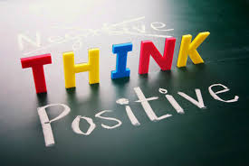
Positive Focus
Speakers often include subtle positive interpretations of negative events in their accounts
Listeners highlight and encourage speakers to focus on positive consequences
Mutual development of more positive interpretation of the event

Slide 25
Implications: Positive Disclosures
Listener responses to positive events:
  Consistent with active-constructive responding style (enthusiastic support; i.e., Gable, Gonzaga & Strachman, 2006)
  Encourage speaker to savour positive emotions (Bryant & Veroff, 2007)
  Boost speaker self-esteem and self-efficacy (Fredrickson, 2001)

Slide 26
Implications: Negative Disclosures (1)
Listener demonstrate empathy to negative events:
  Consistent with research into helpful listener responses for emotional recovery (love, concern & understanding; Lehman & Hemphill, 1990)
  Enables mobilisation of internal resources to deal with negative events (Taylor, 1991)

Slide 27
Implications: Negative Disclosures (2)
Listeners encourage speakers to cognitively reappraise the meaning of events from negative to positive
  Reinterpret meaning of event and its consequences, and/or ability to deal with event
Consistent with effectiveness of challenging vs. empathetic listening styles (Lepore et al., 2004)
To help speakers feel better – or due to social norms?

Slide 28
Limitations
Small sample of transcripts selected as exemplars
Not generalisable beyond sample
Exploratory qualitative analysis
Strangers – social norms?
Non-verbal behaviour not manipulated or recorded

Slide 29
Some (very tentative) conclusions
Speakers are not passive recipients of emotional support
Consistent with the social function of autobiographical memory (Alea & Bluck, 2003)
  People disclose memories for social purposes
  Enhancement of FAB (i.e., increase positive and decrease negative emotions) is a by-product of disclosure
  Did social disclosure evolve as a process by which emotional regulation is achieved?

Slide 30

How to be a good listener…
Alignment
  Participants take turns at talk allowing speaker to tell story
  Smooth conversational flow
  Mutual understanding of story meaning
Emotional Support
  Listener takes role as troubles recipient
  Display understanding of speaker’s emotional state
  Express sympathetic concern
Encouraging Positive Focus
  Encourage speaker to build on positive aspects of negative events
  Develop positive interpretations of events

