Slide 1
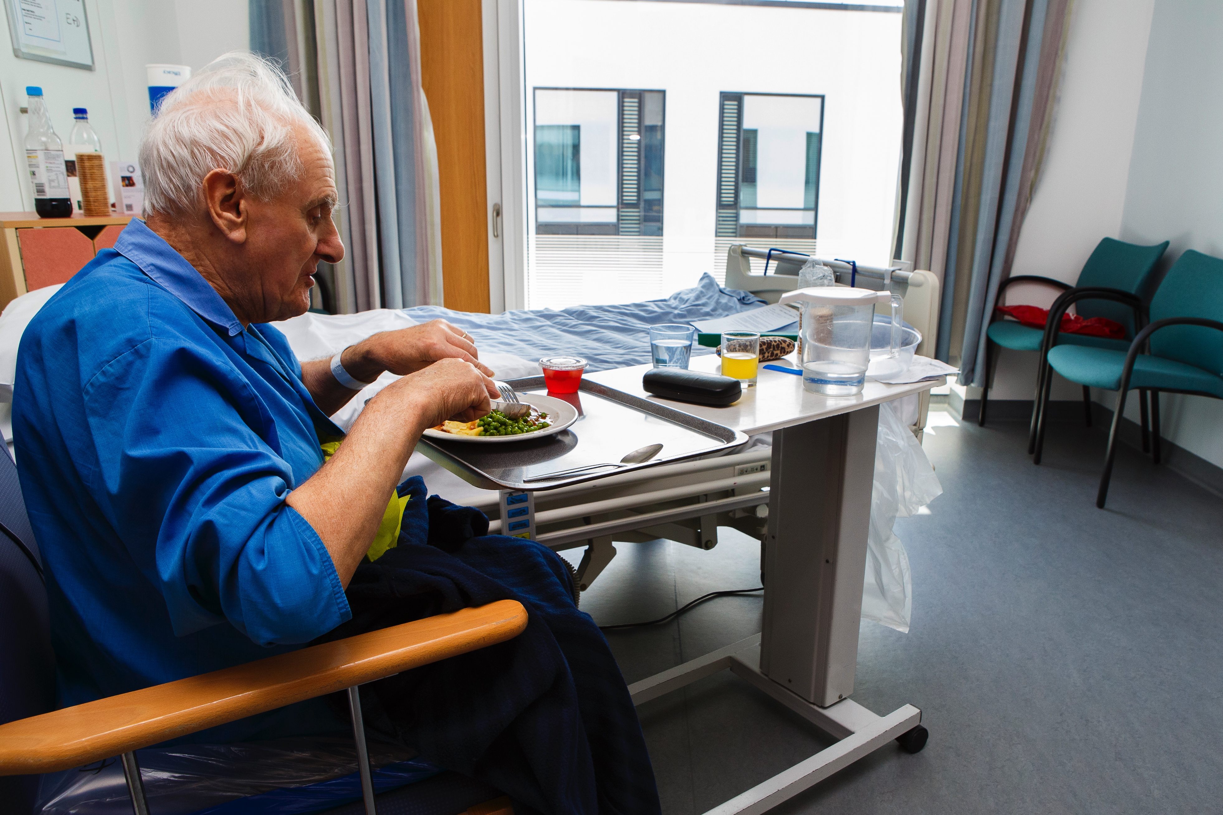
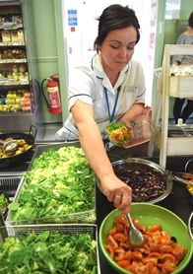
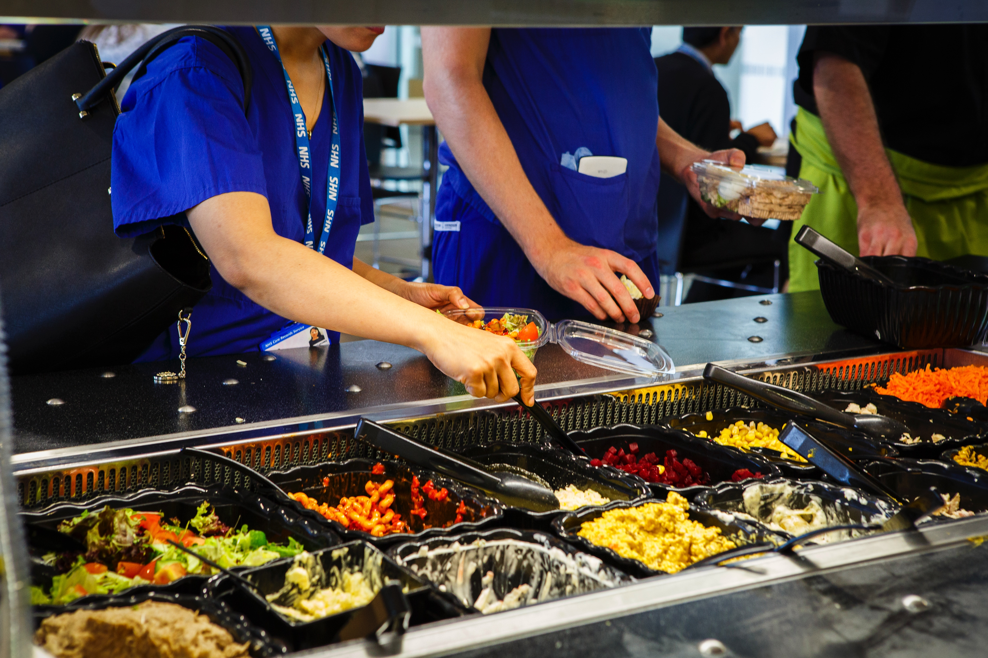
Improving Hospital Food: evaluating the impact of the UK Soil Association Food for Life Partnership
Selena Gray, Robin Means, Judy Orme, Hannah Pitt, Matthew Jones, Debra, University of the West of England, Bristol, UK
Background
The Food for Life Partnership (FFLP) is an initiative led by the Soil Association (SA), a non governmental organisation in the UK which aims to encourage a healthy, sustainable food culture in communities. The SA also runs a Catering Mark scheme that provides an independent endorsement that food providers are taking steps to improve the food they serve, using fresh ingredients which are free from undesirable additives and trans fats, are better for animal welfare, and comply with national nutrition standards. FFLP work in schools has already been shown a significant impact and FFLP has now been extended to hospitals, care homes, universities and early years settings
Aims To evaluate the progress of FFLP within the hospital setting
Methods
A case study approach with three pathfinder organisations working with the SA (Barts Health, South Warwickshire NHS Foundation Trust and Calderdale and Huddersfield NHS Foundation Trust. Semi-structured interviews were undertaken with staff and stakeholders, and relevant document analysis was undertaken.
Findings
There is huge scope to improve the quality of food in hospital settings for patients, visitors and staff. Each of the three Trusts will shortly achieve a SA Catering Mark for staff and visitor catering, but current models of delivering patient food using centralized cook-chill facilities make it challenging to do this for patient food. Out of hours food provision for staff is generally poor, with a strong reliance on vending machines.
FFLP has helped to catalyse a systems approach to food within organisations, and provided an external lever to help drive up the quality and nature of the food provided by external contractors.
Cross-institution and community involvement including leadership commitment and engagement, along with a recognition that food quality is closely linked to core objectives such as care provision are needed to make progress.
Conclusions and key messages
1. The importance of food in hospitals for patients, staff and visitors is not always recognized and is of variable quality, with much provision now delivered under contract from external providers
2. Engagement with the Soil Association Food for Life Partnership has the potential to catalyse significant changes in the focus on food within hospitals, and improve the quality of food provided

