Slide 1
The National Urban Design Conference 2015 - Bristol
Development, Design and Profit in C21
How developers and society can profit from well designed towns and cities
Addressing health challenges: the role of urban planning and design
Dr Laurence Carmichael
Coordinator
WHO Collaborating Centre for Healthy Urban Environments
University of the West of England, Bristol
Laurence.carmichael@uwe.ac.uk
@laurencecarmich

Slide 2
Content
Do we really need to invest into urban design to tackle diseases?
Built environment and our health: prevention
Built environment and health equity: social justice
Case study - Tackling obesity: the role of planning and design…and the costs
The obesity epidemic and its costs
Urban planning and design for healthy weight environments…and viability?
A few examples of local authorities promoting healthy living environments
Conclusion: healthy planning and design: a few issues to consider
Evidence base
Delivery mechanisms
Politics

Slide 3
Do we really need to invest into urban design to tackle diseases?

Slide 4
What is health?
WHO definition of Health:
Health is a state of complete physical, mental and social well-being and not merely the absence of disease or infirmity
Preamble to the Constitution of the World Health Organization as adopted by the International Health Conference, New York, 19-22 June, 1946.

Slide 5
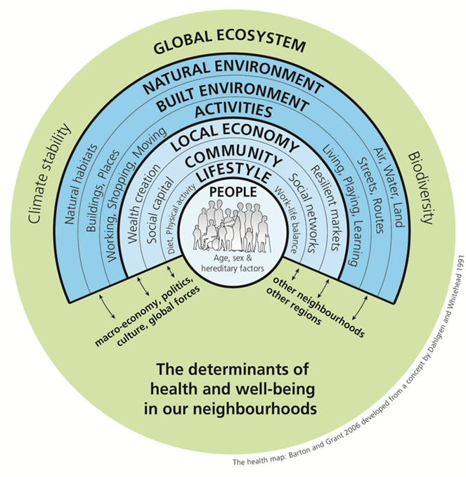
What role does the built environment play in influencing health and wellbeing?
Physical and social characteristics of neighbourhoods are factors of health
Physical and mental health: perception of local area
social connections
physical activity
Environmental health:
air quality, water, noise
Safety, security:
Traffic safety
Health equity:
Access to green space, fresh food

Slide 6
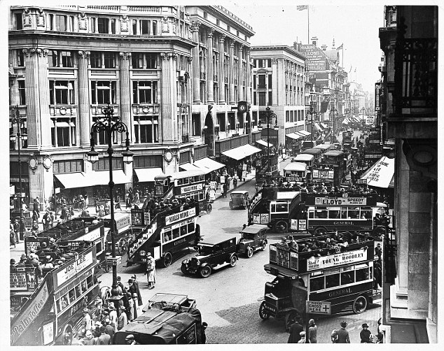
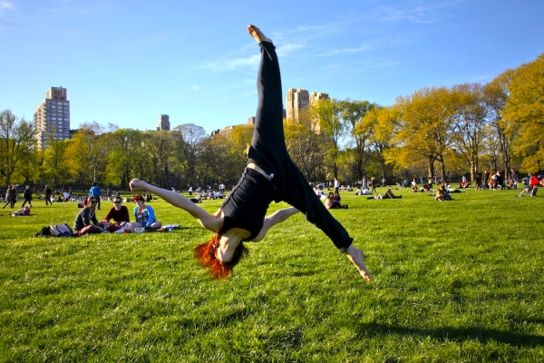
Road traffic noise is associated with increased cardiovascular morbidity and mortality and all-cause mortality in London Halonen et al.. (2015)…Walking quieter routes to work can avoid peaks in air pollution (European Respiratory Society’s International Congress, 2015).
Mytton et al. (2012) found a positive association between green space and physical activity levels
Ward-Thompson et al. (2012) showed that more green space is linked to less stress in deprived communities.
Evidence is particularly strong for positive associations between experience of natural environments and mental health.
Researchers reported that changing and improving park signs can increase physical activity by seven to 12 percent. (Photo : Eduardo Munoz/Reuters)
http://www.counselheal.com/articles/7242/20131018/study-finds-better-park-signs-can-increase-exercise.htm#ixzz3lEroJ32c

Slide 7
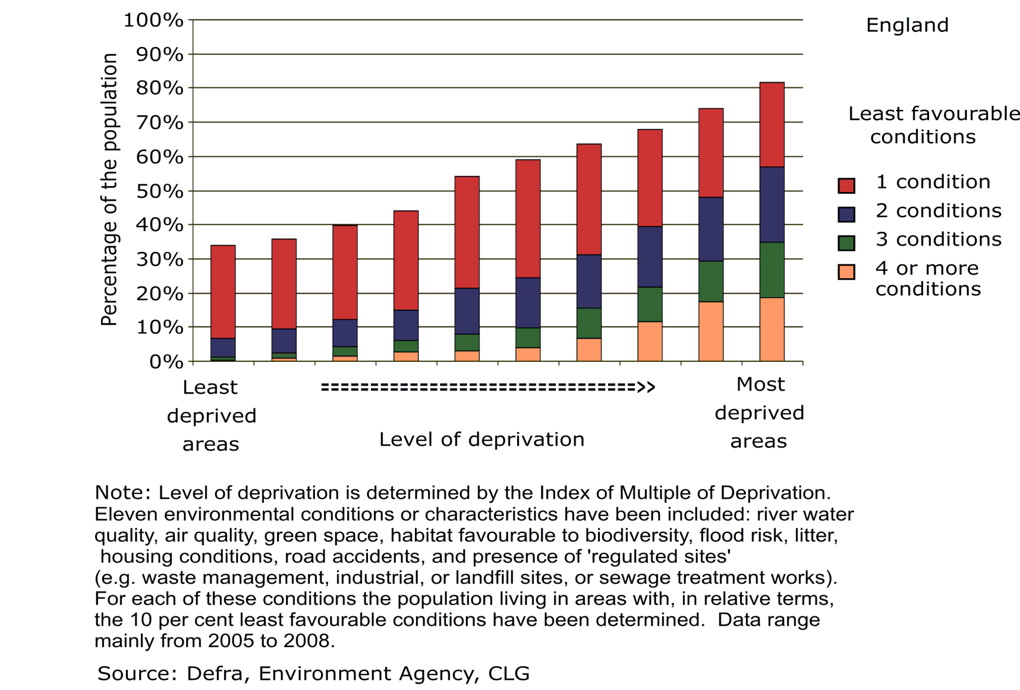
Health inequalities and the built environment
20% of most affluent neighbourhoods in England have 5 times the amount of greenspace than the most deprived 10% neighbourhoods.

Slide 8
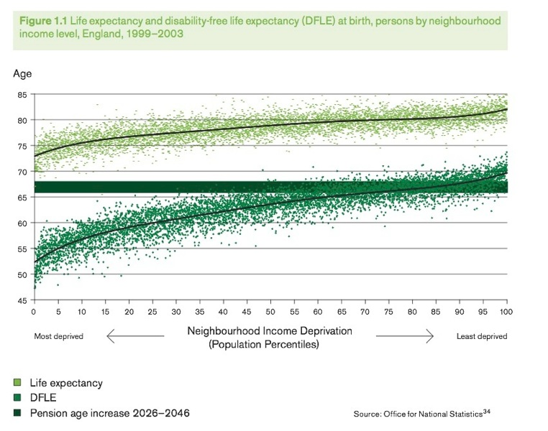
Health inequalities and the built environment

Slide 9
Health challenges in UK today and the link to healthy environments
Not anymore scurvy, cholera and polio
The rise of non communicable diseases:
Tobacco, cancers and heart disease: smoke-free workplaces
Type II diabetes: changes in diet, physical activity
Obesity and heart disease: changes in diet, physical activity
Cardio-vascular and respiratory diseases: particulate air pollution/traffic emissions
And the trends towards:
Ageing: adaptation of our built environment
Dementia: Adaptation of homes and designing Dementia-Friendly Neighbourhoods: Helping People with Dementia to Get Out and About (Mitchell and Burton, 2010)

Slide 11
Tackling obesity:
the role of planning and design…and the costs?

Slide 12

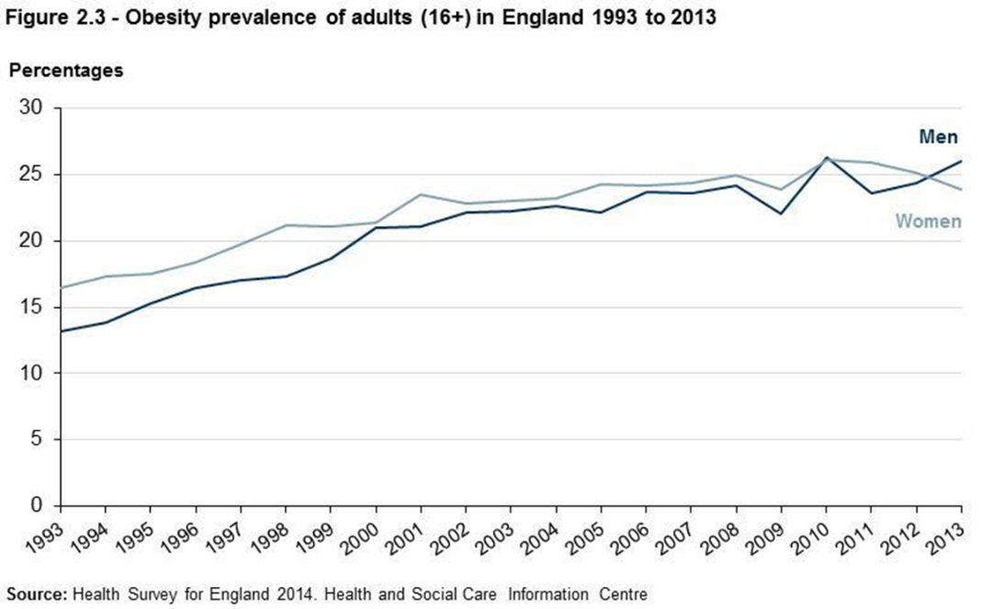
Obesity epidemic: the shape of things to come

Slide 13
Costs of obesity
Calculating the future costs of elevated BMI (£ billion /year) | 2007 | 2015 | 2025 | 2050
Total cost to the NHS of stroke, heart disease, diabetes and related diseases | 17.4 | 19.5 | 21.5 | 22.9
NHS costs attributable to elevated BMI | 4.2 | 6.3 | 8.3 | 9.7
Wider costs of elevated BMI (through lower productivity, etc) | 16 | 27 | 37 | 50
Source: Foresight report on Tackling Obesity, 2007

Slide 14
Local Authority costs
Care of house-bound residents suffering from obesity related illnesses (eg arthritis, heart disease, diabetes) and those requiring help towards walking aids and home adaptations may be considerable - and likely to increase in line with national predictions for obesity prevalence.
PHE (work in progress, 2014) suggests that local authorities spend an estimated extra £352 million per year on providing formal care for severely obese people compared to healthy weight people.
Public Health England (online www.noo.org.uk/LA/impact/economic)

Slide 15
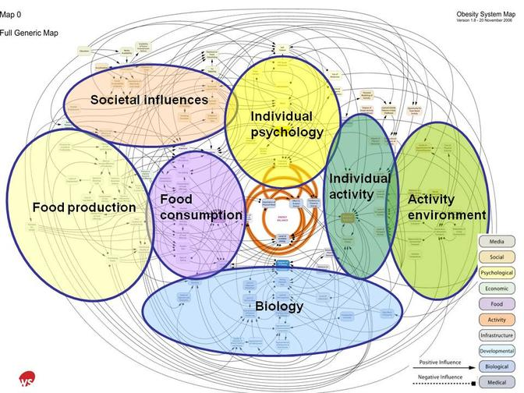
Obesity and the activity environment
http://hdvchpediatricobesity.wikispaces.com/About+child+obesity

Slide 16
Built environment and physical activity
Built environment and physical activity:
Physical activity = lifestyle factor for long-term health and to tackle obesity.
people who regularly use active transport gain health benefits
Characteristics of neighbourhood design can influence individual behaviour and take up of physical activity, for instance:
  High connectivity
  mixed neighbourhoods
  Land use mixture
  public transport, pedestrian facilities or proximity
  Green spaces, signage
  Neighbourhood aesthetics used to design-in walking and cycling in our daily lives
(Saelens, Sallis and Frank, 2003; Booth, Pinkston and Carlos Poston, 2005; Warburton Nicol and Bredin 2006; Lake and Townshend, 2006; Andersen, Wedderkopp, Pucher, Buehler, Bassett and Dannenberg, 2010; Kristensen, Moller, Froberg, and Cooper, 2011; Rhodes and Nasuti, 2011; de Nazelle et al., 2011; DoH, 2011; Mytton, Townsend, Rutter and Foster, 2012; Audrey, Procter and Cooper, 2014; White et al., 2013)

Slide 17
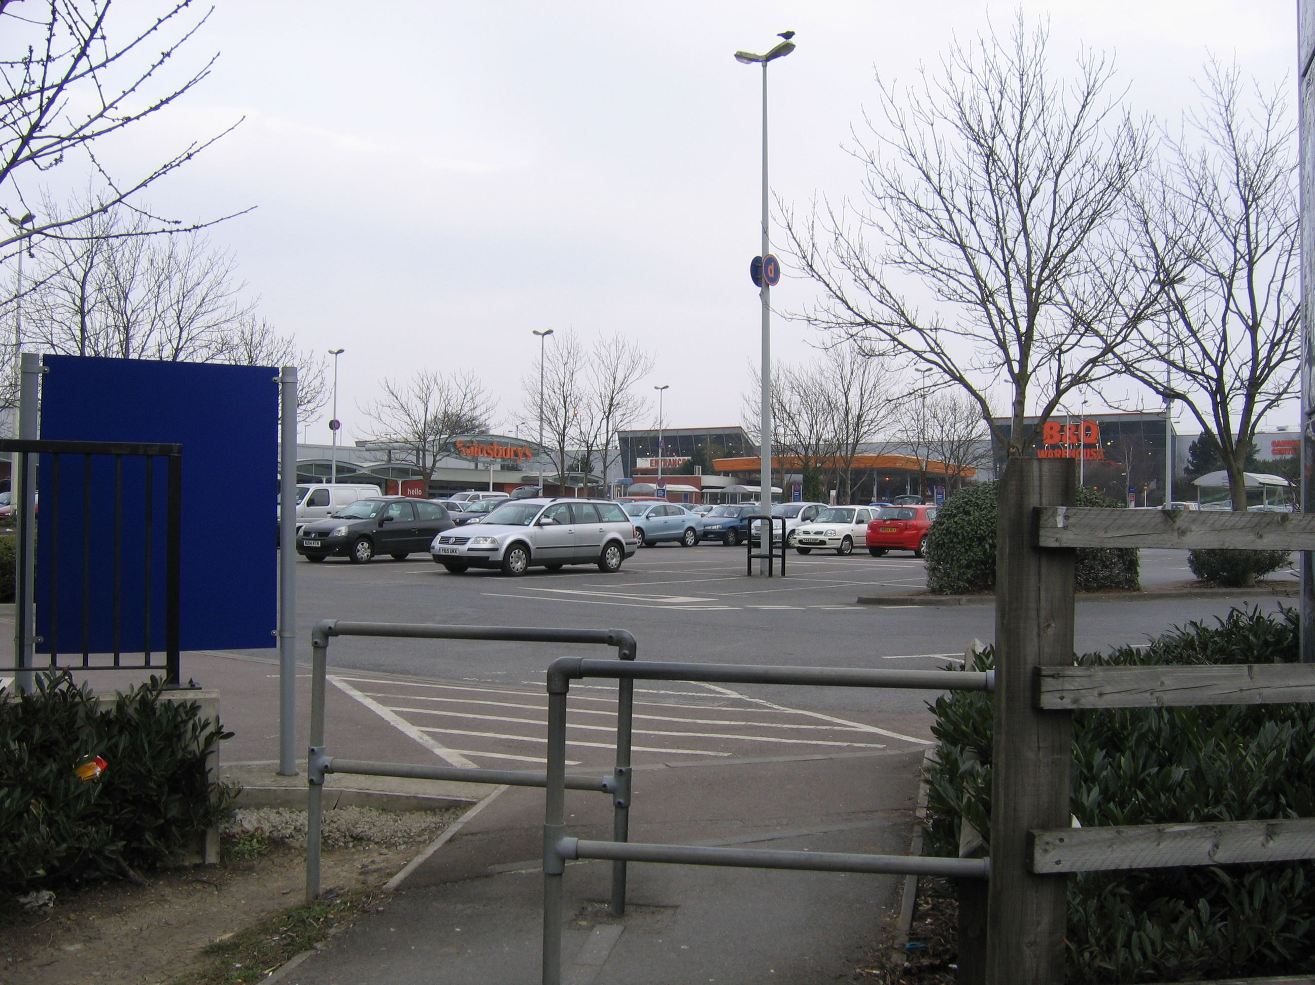

Slide 18
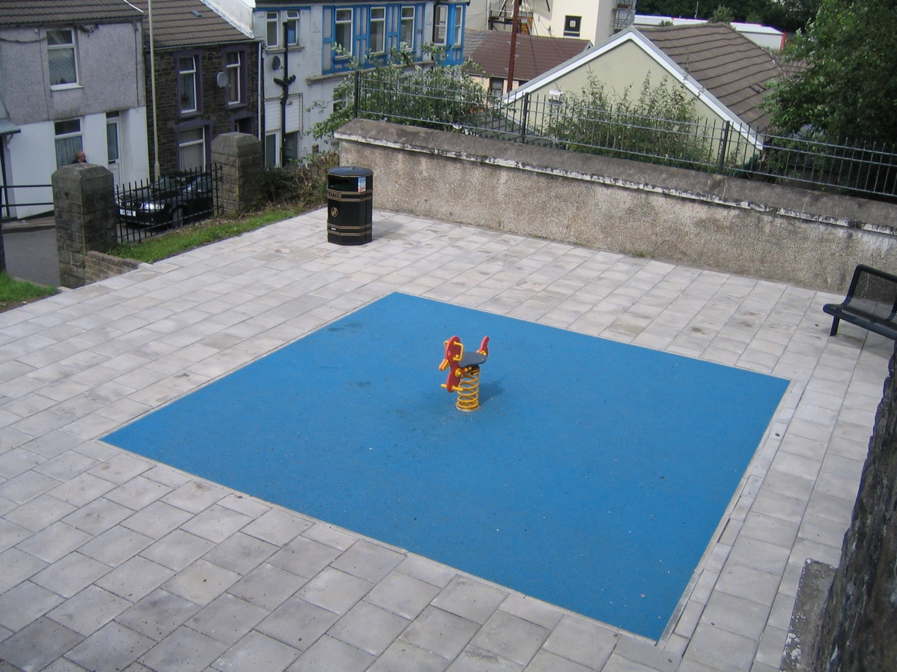

Slide 19
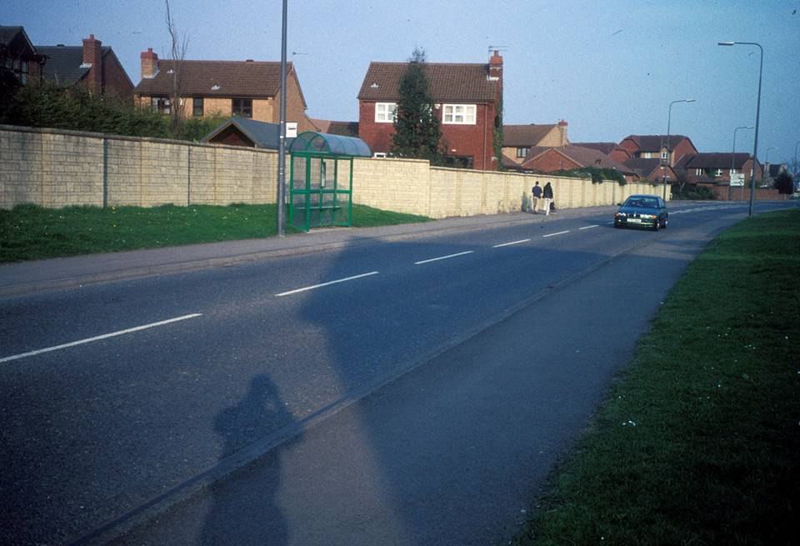

Slide 20
Have we got the right national and local planning policies and processes, design guidance and partnerships in place to tackle obesity?

Slide 21
Urban planning policy to promote healthy weight environments
Section 8 of the National Planning Policy Framework (NPPF) includes creating healthy communities.
Joint Health and Wellbeing Strategies and obesity strategies provide evidence on obesity to planners.
Obesity evidence can be used to strengthen the argument for achieving a range of existing planning policy objectives (sustainable transport, climate change adaptation/mitigation, sustainable design, local economic growth and better-designed places).
But: no national planning policy guidance focusing specifically on reducing obesity and creating healthy weight environments.

Slide 22
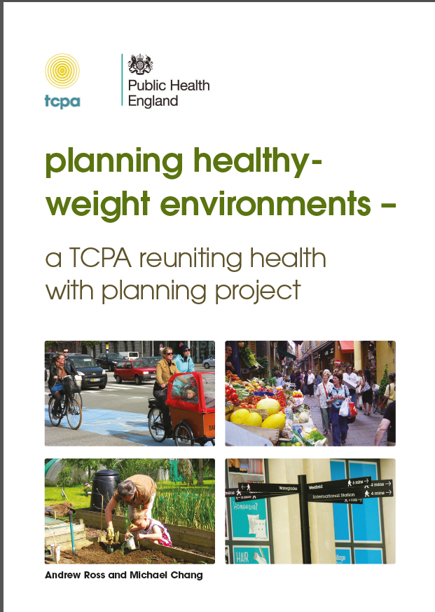
Guidance in the field: e.g. Planning Healthy Weight Environments, TCPA
Notes:
How do we do it? There is lots of guidance available, but we will use the TCPA as a starting point, as it gives a good overall picture and refelcts the strategic aims well. Also then talk through some case studies which highlight elements of both.

Slide 23
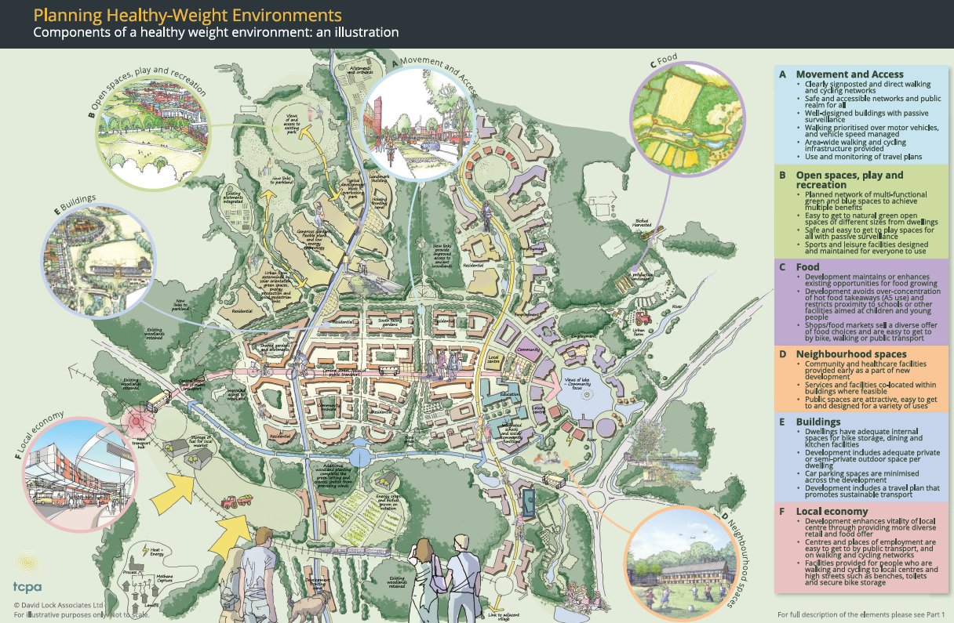

Slide 24
Themes of a healthy weight environment: a role for all stakeholders in development process
Design, access, maintenance to promote healthy behaviours and living
Movement and access: Walking and cycling environments; local transport services.
Open spaces, recreation and play: Open spaces; natural environment; leisure and recreational spaces; play spaces.
Food: Food retail, food growing; access.
Neighbourhood spaces: Community and social infrastructure; public spaces.
Building design: Homes; other buildings.
Local economy: Town centres and high streets; job opportunities and access.

Slide 25
Other useful guidance
Steps to healthy planning: proposals for action Spatial planning & health group. 2011 www.spahg.org.uk/?page_id=194
Active design: promoting opportunities for sport and physical activity through good design Sport England. 2007 www.sportengland.org/facilitiesplanning/planning-for-sport/planningtools-and-guidance/active-design/
Spatial Planning for Health: A guide to embedding the Joint Strategic Needs Assessment in spatial planning Town & Country Planning Association. 2012. www.tcpa.org.uk/data/files/spatial_planning_for_health.pdf
Faculty of Public Health Briefing Statement on ‘Built Environment and Physical Activity’ www.fph.org.uk/uploads/briefing%20statement%20-%20built%20environment%20and%20physical%20activity.pdf
NICE Guidance (all available at www.nice.org.uk)
  NG7 - Maintaining a healthy weight and preventing excess weight gain among adults and children
  PH8 - Physical activity and the environment
  PH41 - Walking and cycling: local measures to promote walking and cycling as forms of travel or recreation
  PH17 - Promoting physical activity for children and young people
  PH42 - Obesity: working with local communities

Slide 26
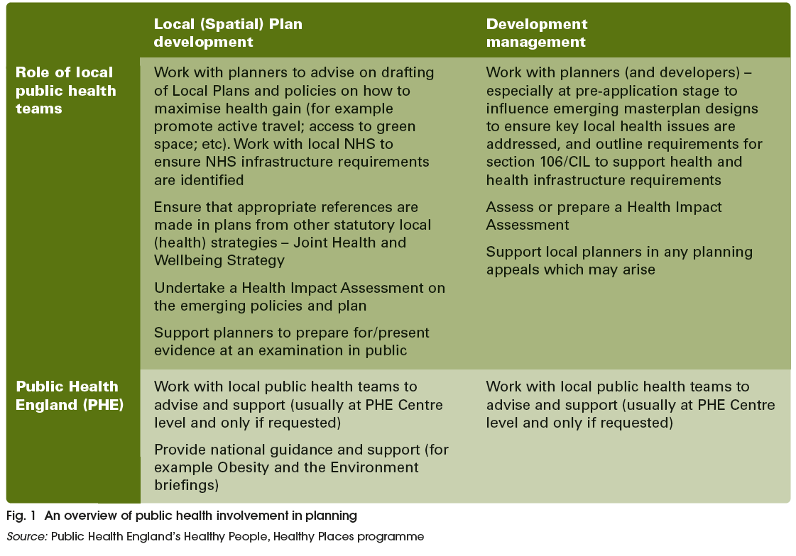
Partnership: public health support of planning

Slide 27
Partnership with the private sector?
The dilemma for developers and land owners…and local authorities: ensuring viability and deliverability
Key issue: ability for developers and land owners to receive ‘competitive returns’ from their development as they “suffer” the cumulative burden of national and local design standards and policies (NPPF, para. 173-174).
Could a healthy-weight environment create more economically thriving spaces that add value to schemes, as well as fulfilling national and local health policies? TCPA refers to evidence but more empirical work needed
  Retailers report an increase in trade of up to 40% when places are made more attractive for walking.
  Places that are easier and more attractive to walk around (designed for so-called ‘walkability’) do better commercially (with an 80% increase in retail sales) and have higher housing values.
  (BUT be careful – could contribute to inequalities! )
Notes:
This economic evidence can help to build the case for development management planners to require an assessment of the health impact of a proposal, for example by requiring a Health Impact Assessment for larger schemes.

Slide 28
A few examples of local authorities promoting healthy living environments
    Sandwell and West Midlands Healthy Urban Group – Partnership working
    Bristol protocol - HIA process
    Plymotion - Integrated transport/active travel
    Waltham Forest – Healthy eating
    Torbay – Greenspace Strategy
    Let’s Walk Bedminster - Community project

Slide 29
Conclusion healthy planning and design: a few issues to consider
Evidence base
Methodological challenges to ensure robustness of the evidence
Change research priorities to challenge medical paradigms
Engage stakeholders in research (Wellcome Trust project)
Address the economics of healthy planning and design
Generalisability vs local evidence to inform local plans, planning decisions
Translate the evidence so it can be material consideration in planning decisions
Delivery mechanisms for spatial planning
NPPF needs to give planning for health a higher priority
Develop integrated policy-making across professions/across strategies at local level
Local plan: address the issue of viability (long term impact of new development on health)
Consider Health impact assessment in other forms of assessments
Politics
Public health seen as left of centre/health diplomacy needed
Leadership at local level
Understand the co-benefit of health agenda (transport, housing, education, sustainable development)

Slide 30
References
Useful resource: Barton, Thompson, Burgess and Grant (eds) (2015). The Routledge Handbook of Planning for Health and Well-being, London: Routledge.
Aboelata, 2004. The built environment and health - 11 Profiles of Neighborhood Transformation, Prevention Institute: Oakland, CA.
Andersen, L. B., Wedderkopp, N., Kristensen, P. L., Moller, N. C., Froberg, K. and Cooper, A. (2011). Cycling to School and Cardiovascular Risk Factors: A Longitudinal Study. Journal of Physical Activity and Health, 8, 1025-33.
Audrey, S., Procter, S. & Cooper, A. (2014). The contribution of walking to work to adult physical activity levels: a cross sectional study. International Journal of Behavioural Nutrition and Physical Activity, 11, 37.
Barton, H. (2009). Land use planning and health and well-being. Land Use Policy 26S S115–S123.
Barton, H. (2009). Land use planning and health and well-being. Land Use Policy 26S S115–S123.
Bristol City Council (2011a). Bristol Development Framework Core Strategy, adopted June 2011. Bristol: Bristol City Council.
CABE (2010a). Community green: using local spaces to tackle inequality and improve health, London: CABE.
CABE (2010b). Urban green nation: building the evidence base. London: CABE.
Carmichael, L., Barton H., Gray S., Lease H . & Pilkington P. (2012). Integration of health into urban spatial planning through impact assessment: identifying governance and policy barriers and facilitators. EIA Review, 32 (1), 187-194.
Chaix, B. (2009). Geographic life environments and coronary heart disease: a literature review, theoretical contribution, methodological updates and a research agenda. Annual review of Public Health, 30, 81-105.

Slide 31
Clark, P. et al. (2013). Greening dementia: a literature review of the benefits a d barriers facing individuals living with dementia in accessing the natural environment and local greenspace. Worcester: Natural England.
Commission for the Architecture and the Built Environment (2010). Improving the design of new housing: What role for standards? London: CABE.
Commission for the Architecture and the Built Environment (2010). Improving the design of new housing: What role for standards? London: CABE.
Committee on Physical Activity, Health, Transportation, and Land Use, Transportation Research Board, Institute of Medicine of the National Academies, Washington DC.
Crew, D. (2007). The tennants’ dilemma – warning: your home is at risk if you dare complain. Liverpool: Citizen Advice Bureau.
Crisis (2011). Homelessness: a silent killer a research briefing on mortality amongst homeless people, Crisis.
Croucher, L. et al. (2007). The links between greenspace and health: a critical literature review, Stirling: Greenspace Scotland.
Cummins, S. & Macintyre, S. (2005). Food environments and obesity - neighbourhood or nation? International Journal of Epidemiology, 35, 100-4.
Cummins, S., Petticrew, M., Higgins, C., Findlay, A. & Sparks L. (2005). Large-scale food retailing as health intervention: quasi-experimental evaluation of a natural experiment. J. Epidemiol Community Health, 59, 1035-40.
Dahlgren G, Whitehead M. 1991. Policies and strategies to promote social equity in health. Stockholm: Institute for Future Studies.
De Nazelle, A., Nieuwenhuijsen, M. J., Anto, J.M., Brauer, M., Briggs, D., Braun-Fahrlander, C., … Lebret, E. (2011). Improving health through policies that promote active travel : a review of evidence to support integrated health impact assessment. Environment International, 37, 766-77.

Slide 32
Department of Health (2011a). Start active, stay active: a report on physical activity for health from the four Home countries’ Chief Medical Officers, London: DoH.
Department of Health (2011c). Healthy Lives, Healthy People: A call to action on obesity in England. London: DoH.
Evans, G. W. (2003). The built environment and mental health. Journal of Urban Health: Bulletin of the New York Academy of Medicine 80(4), 536-55.
Foster, S., Wood, L., Christian, H., Knuimna, M. & Giles-Corti, B. (2013). Planning safer suburbs: do changes in the built environment influence residents’ perceptions of crime risk? Social Science and Medicine, 97, 87-94.
Galea, S., Ahern, J., Rudenstine, S., Wallace, Z.Vlahov D. (2005). Urban built environment and depression: a multilevel analysis. J Epidemiol Community Health, 59, 822-7.
Giles-Corti, B., Wood, G., Pikora, T., Learnihan, V., Bulsara, M., Van Niel, K., …Villanueva, K. (2011). School site and the potential to walk to school: the impact of street connectivity and traffic exposure in school neighborhoods. Health and Place, 17, 545-550.
Guite, H. F, Clark, C., & Ackrill, G. (2006). The impact of the physical and urban environment on mental well-being. Public Health, 120, 1117-26.
Halonen, J., Hansell, A.., Gulliver, J. et al. (2015). Road traffic noise is associated with increased cardiovascular morbidity and mortality and all-cause mortality in London. European Heart Journal. DOI: 10.1093/eurheartj/ehv216 - See more at: http://www.lshtm.ac.uk/newsevents/news/2015/road_traffic_noise_associated_with_deaths_and_strokes.html#sthash.nFL1cmpy.dpuf
Harker, L. and Shelter (2006). Chance of a lifetime: the impact of bad housing on children’s lives. London: Shelter.
Healy, J. D. (2003). Excess winter mortality in Europe: a cross country analysis identifying key risk factors. Journal of epidemiology and community health 57(10), 784-789.

Slide 33
Jackson, L. E. (2003). The Relationship of urban design to human health and condition. Landscape and Urban Planning 64(4), 191-200.
Jackson, R., Dannenberg, A. and Frumkin, H, (2013). Health and the Built Environment: 10 Years After, American Journal of Public Health Vol. 103, No. 9 : pp. 1542-1544.
Kihal-Talantikite, W., Padilla, C., Lalloué, B., Gelormini, M., Zmirou-Navier, D. & Deguen, S. (2013). Green space, social inequalities and neonatal mortality in France. BMC Pregnancy and Childbirth, 13, 191.
Lake, A., & Townshend, T. (2006). Obesogenic environments: exploring the built and food environments. Journal of the Royal Society for the Promotion of Health, 126(6), 262-267.
Leslie, E., & Cerin, E. (2008). Are perceptions of the local environment related to neighborhood satisfaction and mental health in adults? Preventive Medicine, 47(3), 273-278.
Liddell, C. and Morris, C. (2010). Fuel poverty and human health: a review of recent evidence . Energy Policy 38 (6), 2987-2997.
Maas, J. et al. (2009). Morbidity is related to a green living environment. Journal of epidem. and comm. Health 63 (12), 967-973.
Marmot, Sir M. (2010). Fair Society, Healthy Lives – The Marmot Review. London: Department of Health.
Miles, R., Panton, L. B., Jang, M. & Haynes, E. M. (2008). Residential context, walking and obesity : two African-American neighborhoods compared. Health and Place, 14, 275-86.
Mitchell, Lynne and Burton, Elizabeth J.. (2010) Designing Dementia-Friendly Neighbourhoods: Helping People with Dementia to Get Out and About. Journal of Integrated Care, Vol. 18 (No. 6). pp. 11-18. ISSN 1476-9018
Murray, L. et al. (2013). ‘UK health performance: findings of the Global

Slide 34
Burden of Disease Study 2010’. The Lancet,2013, Vol. 381 (9,871), 997-1020.
Mytton, O., Townsend, N., Rutter, H. and Foster, C. (2012). Green space and physical activity: an observational study using health survey for England data. Health and Place, 18, 1034-41.
National Institute for Health and Care Excellence (2008). Physical Activity and the Environment – NICE guidelines PH8. London: NICE.
Nielsen, T. & Hansen, K. (2007). Do green areas affect health? Results from a Danish survey on the use of green areas and health indicators. Health and Place, 13, 839-50.
O’Campo, P., Salmon, C., and Burke, J. (2009). Neighbourhoods and mental well-being: What are the pathways? Health and Place, 15(1), pp. 56-68.
O’Mullane, M. (ed.) (2013). Integrating Health Impact Assessment with the policy process. Oxford: Oxford University Press.
Phillips, D. R., Siu, O., Yeh, A.G.O. & Cheng, K. H. C. (2005). The impact of dwelling conditions on older persons’ psychological well-being in Hong Kong; the mediating role of residential satisfaction. Soc. Sci. Med., 60, 2785-97.
Pretty, J. et al. (2007). Green exercise in the UK countryside: effects on health and psychological wellbeing, and implications for policy and planning. Journal of environmental planning and management 50(2), 211-231.
Pucher, J., Buehler, R., Bassett, D. R. & Dannenberg, A.L. (2010). Walking and cycling to health : a comparative analysis of city, state, and international data. American Journal of Public Health, 100, 1986-92.
Rhodes, R. E. & Nasuti, G. (2011). Trends and changes in research on the psychology of physical activity across 20 years: a quantitative analysis of 10 journals. Preventive Medicine, 53 (1-2), 17-23.

Slide 35
Saelens, B. E., Sallis, J. F. & Frank, L. D. (2003). Environmental correlates of walking and cycling: findings from the transportation, urban design, and planning literatures. Ann Behav Med, 25, 80-91.
Spielman, S., Yoo, E.-H. & Linkletter, C. (2013). Neighbourhood contexts, health, and behaviour: understanding the role of scale and residential sorting. Environment and Planning B: Planning and Design, 40, 489-506.
Taylor, L., Gowman, N. & Quigley, R. (2003). Evaluating health impact assessment. Wetherby: Health Development Agency.
Teedon, P., Gillespie, M., Lindsay, K. & Baker, K. (2014). Parental perceptions of the impacts the built environment has on young children's health: a qualitative examination and lay assessment amongst residents in four Scottish communities. Health and Place, 28, 50-57.
The Institute of Health Equity (2013). Review of the social determinants and the health divide in the WHO European region. Copenhagen: WHO Europe.
Town and Country Planning (2014). Special Issue Reuniting Health with Planning. Town and Country Planning, 83, 11.
TRB (2005) Does the built environment influence physical activity? : examining the evidence /
Turrell, G., Haynes, M., Wilson, L.-A. & Giles-Corti, B. (2013). Can the built environment reduce health inequalities? A study of neighbourhood socioeconomic disadvantage and walking for transport. Health and Place, 19, 89-98.
Warburton, D., Nicol, C. & Bredin, S. (2006). Health benefits of physical activity: the evidence, CMAJ, 174, 801-9.
Ward-Thompson, C., Roe, J., Aspinall, P., Mitchell, R., Clow, A., Miller, D. (2012). More green space is linked to less stress in deprived communities: Evidence from salivary cortisol patterns, in Landscape and Urban Planning 105 (3) 15, 221–229.
White, M., Alcock, I., Wheeler, B. & Depledge, M. (2013). Would you be happier living in a greener urban area? A fixed-effects analysis of panel data. Psychological Science, 24, 920-928.

Slide 36
Wismar, M., Blau, J., Ernst, K. & Figueras, J. (eds) (2007). The Effectiveness of Health Impact Assessment: scope and limitations of supporting decision-making in Europe. Copenhagen, Denmark: World Health Organization Regional Office for Europe.
World Health Organization (2008). Air quality and health, fact sheet 313. http://www.who.int/mediacentre/factsheets/fs313/en/

