Slide 1

Market manipulation: regulatory and enforcement responses in the United Kingdom and United States of America
Dr. Nicholas Ryder
Professor in Financial Crime
Tuesday, 10th November, 2015
11th Economic Crime Symposium

Slide 2
Introduction
The financial crisis and financial crime
What is market manipulation?
Examples of market manipulation
LIBOR
  Civil Proceedings
  Criminal Proceedings#
Conclusions

Slide 3
The financial crisis and financial crime
A significant factor is financial crime:
  Subprime Mortgages and Mortgage Fraud,
  Credit Rating Agencies,
  Predatory Lending,
  Ponzi Fraud Schemes
  The War on Terror,
  Market Misconduct, and
  Market Manipulation.

Slide 4
What is market manipulation?
“Market manipulation is artificially raising or lowering the price of stock on any national securities or commodities exchange or in the over-the-counter (OTC) marketplace” (FBI)
“Manipulation is intentional conduct designed to deceive investors by controlling or artificially affecting the market for a security” (SEC)

Slide 5
Examples market manipulation
  Spreading false or misleading information about a company;
  improperly limiting the number of publicly-available shares;
  or rigging quotes, prices or trades to create a false or deceptive picture of the demand for a security and
orchestrated stock purchases or sales designed to inflate or deflate the true sales volume, demand, and ultimately, price of a stock.

Slide 6
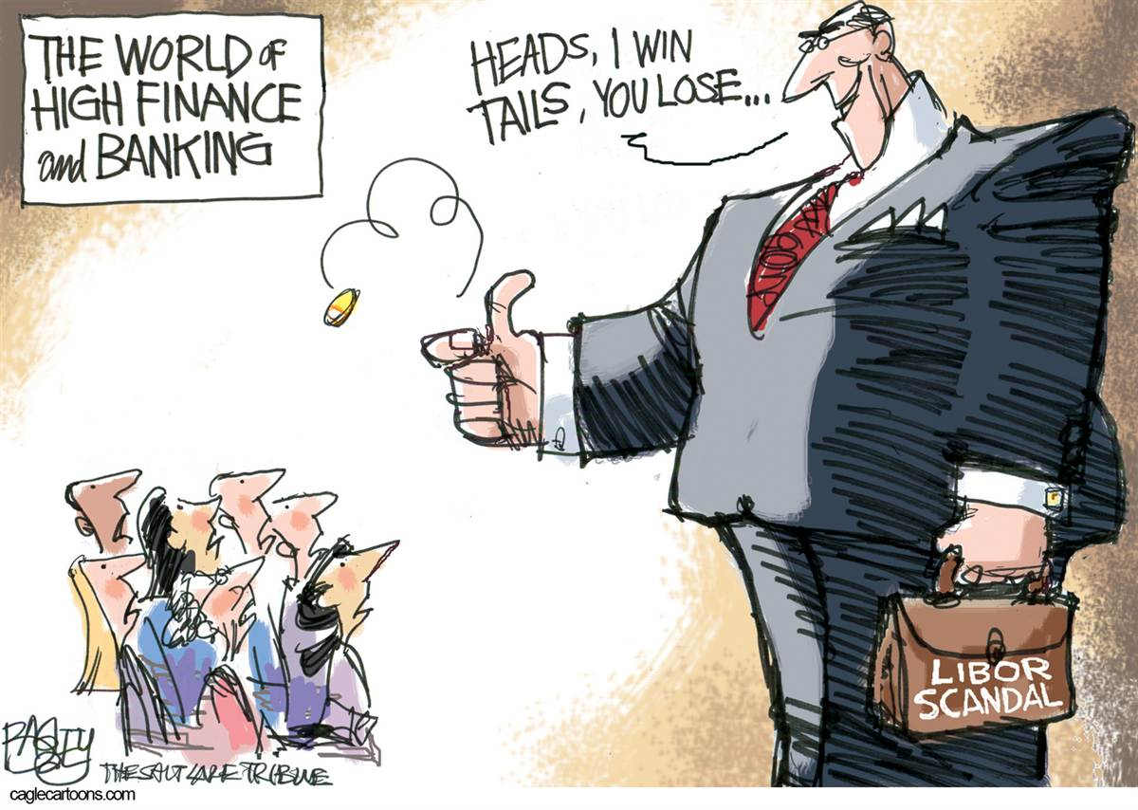
LIBOR

Slide 7
LIBOR: Definitions
“the rate at which an individual contributor panel bank could borrow funds, were it to do so by asking for and then accepting interbank offers in reasonable market size, just prior to 11.00am London time” (British Bankers Association)
“a benchmark reference rates fundamental to the operation of both UK and international financial markets, including markets in interest rate derivatives contracts” (Financial Services Authority)

Slide 8
LIBOR: Value
It has been reported that the value of the contracts attached to LIBOR are between $300tn and $800tn.
“LIBOR is … used to calculate interest rates on a range of global financial instruments in excess of $350tn” (Lim, 2013)

Slide 9
LIBOR: Regulation
LIBOR was managed and regulated by the British Bankers Association (BBA), which is the UK trade body of the banking and financial services sector
The administration of LIBOR is the duty of BBA LIBOR Ltd, which is a subsidiary of the BBA, and managed by the LIBOR Manager
An example of self regulation

Slide 10
LIBOR: early warning signs
The first evidence of wrong doing regarding the LIBOR was witnessed in 2005.
Barclays Bank attempted to manipulate the dollar LIBOR and the EURIBOR rates of interest after being asked by derivative traders and other banking institutions.
The misconduct took place in both London and New York.
Further breaches of took place between February 2006 and October 2007

Slide 11
LIBOR: concerns raised
Concerns about the submissions were voiced by:
  the New York Federal Reserve,
  the Wall Street Journal,
  the Commodity Futures Trading Commission
  and the Bank of International Settlements

Slide 12
Civil Proceedings: The United Kingdom
Financial Regulator:
  Extensive enforcement powers under Financial Services and Markets Act 2000,
  Can be used for breaches of the Hand Book,
  Financial penalties,
  Prohibition orders and
  Prosecutions?

Slide 13
Civil Proceedings: The United Kingdom
2015:
  Deutsche Bank £227m (with DoJ)
2014:
  Lloyds Bank and Bank of Scotland, £105m
  Martin Brokers (UK) Ltd £630,000
2013:
  Rabobank, £105m
  ICAP Europe Ltd, £14m
  Royal Bank of Scotland, £85m.
2012:
  UBS AB, £160m
  Barclays Bank, £59.5m

Slide 14
Criminal Proceedings
Several legislative options available:
  Theft Act 1968,
  Enterprise Act 2002,
  Fraud Act 2006,
  the common law offence of conspiracy to defraud and
  the Financial Services (Banking Reform) Act 2013.

Slide 15
Criminal Proceedings
Tom Hayes
  “Not even Mother Teresa wouldn’t manipulate Libor if she was setting it and trading it.”
  “Just give the cash desk a mars bar and they’ll sell what ever you want”
  Described by his defense as “More Austin Powers, isn’t it, than James Bond?" .

Slide 16
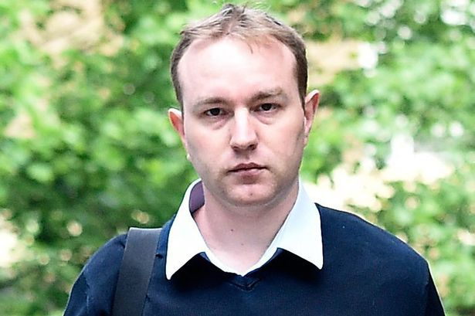
Criminal Proceedings
R v Tom Hayes, Southwark Crown Court, 3rd August 2015
Convicted of conspiracy to defraud
Sentenced to 14 years imprisonment
The SFO stated:
  “The jury were sure that in his admitted manipulation of Libor, Hayes was indeed dishonest. The verdicts underline the point that bankers are subject to the same standards of honesty as the rest of us”.
Appealed sentence (September, 2015)

Slide 17
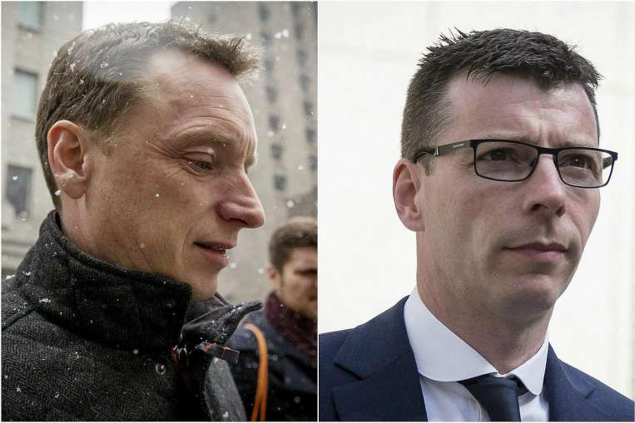
Criminal Proceedings
Anthony Allen and Anthony Conti have been accused of manipulating LIBOR
The men were indicted a year after Rabobank reached a $1bn (£655m) settlement with US and European regulators
Jury selection took place in October 2015
Trial started October 2015

Slide 18

Criminal Proceedings
12 individuals have been accused of manipulating LIBOR:
  Noel Cryan,
  Terry Farr,
  James Gilmour,
  Peter Johnson,
  Jonathan Mathew,
  Stylianos Contogoulas,
  Darrell Read,
  Colin Goodman,
  Danny Wilkinson,
  Jay Vijay Merchant,
  Alex Julian Pabon and
  Ryan Michael Reich.

Slide 19
United States of America
Civil Proceedings
Criminal Proceedings
Deutsche Bank, $2.5bn (DoJ)
Barclays Bank, $200m (CFTC)
UBS, $1.5bn (DoJ and CFTC)
RBS, $325m (CFTC)
ICAP, $65m (CFTC)
Anthony Allen and Anthony Conti have been accused of manipulating LIBOR
The men were indicted a year after Rabobank reached a $1bn (£655m) settlement with US and European regulators
Jury selection took place in October 2015
Trial started October 2015

Slide 20
Conclusions and Questions
Financial penalties
Lack of accountability?
Credible deterrence?
Reform of criminal law insufficient?
More fines to follow?

