Slide 1
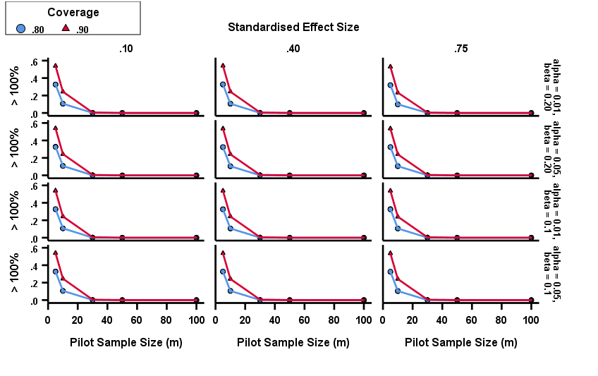
INVESTIGATING BROWNE'S METHOD IN SAMPLE SIZE DETERMINATION
Scholastica Obodo, Deirdre Toher, Paul White
University of West of England, Bristol UK
Email: {Scholastica.obodo, Deirdre.toher, Paul.white} @uwe.ac.uk
Background
The design corresponds to a 2 by 2 by 2 by 3 by 5 fully crossed design. 100,000 replicates will be conducted at each cell combination (contrast with Browne who undertook 2000 replicates per cell)
M | 80% Coverage Mean (MPE) | 90% Coverage Mean (MPE)
5 | 59 | 109
10 | 35 | 60
15 | 26 | 44
20 | 22 | 36
25 | 19 | 31
30 | 17 | 28
35 | 16 | 25
40 | 14 | 23
45 | 14 | 22
50 | 13 | 20
The pilot randomised trial is frequently conducted to aid in the development of a future substantive or definitive trial (Thabane et.al. 2010). When the minimal importance difference (MID) is specified, Browne (1995) proposed a procedure for estimating the sample size required for a definitive two-arm randomised controlled trial. If the sample size for a planned definitive trial is too small, there is high likelihood of inconclusive results (Machin et al., 2011) and putting too few people through a trial is unethical (Halpern et. al. 2002). Too large a sample size would lead to more patients than necessary receiving a treatment that may later prove ineffective and implies waste of resources too (Julious, 2009). Too large a sample size or too small a sample size may therefore be considered unethical.
Results
Table 2 :Percentage of the time the estimated sample size exceeds $n$ $±$ $pn$ (p = -0.2, +0.2, +0.3, +0.5, +1.0, +1.5) for $α$= 0.05, $β$=0.2, $1− γ$ = 0.8
Pilot Sample size (m) | Effect size | >-20% | >$n$ | >+20% | >+30% | >+50% | >+100% | >+150%
5 | .10 | .884 | .799 | .701 | .650 | .547 | .325 | .175
10 | .10 | .922 | .800 | .634 | .544 | .377 | .107 | .021
30 | .10 | .973 | .799 | .452 | .289 | .086 | .001 | .000
50 | .10 | .989 | .797 | .334 | .159 | .019 | .000 | .000
100 | .10 | .998 | .801 | .164 | .035 | .000 | .000 | .000
5 | .40 | .883 | .799 | .698 | .646 | .544 | .325 | .175
10 | .40 | .920 | .800 | .629 | .539 | .367 | .105 | .021
30 | .40 | .972 | .801 | .450 | .284 | .079 | .001 | .000
50 | .40 | .988 | .801 | .332 | .154 | .018 | .000 | .000
100 | .40 | .998 | .801 | .159 | .032 | .000 | .000 | .000
5 | .75 | .876 | .801 | .694 | .638 | .547 | .325 | .174
10 | .75 | .910 | .801 | .617 | .520 | .370 | .106 | .020
30 | .75 | .963 | .798 | .423 | .255 | .085 | .001 | .000
50 | .75 | .982 | .799 | .327 | .126 | .018 | .000 | .000
100 | .75 | .996 | .799 | .130 | .023 | .000 | .000 | .000
Aim
Table 3: Mean Median percentage error for a given pilot sample size per arm
This study aims to determine
how accurate Browne’s approach is in pilot sample size determination
the pilot sample size to control median percentage errors (MPE) between predicted sample size and the true minimum unknown sample size needed to satisfy power requirements.
Conclusion
Results supports Browne’s procedure of pilot sample size determination. However the data reveals that the procedure underestimates and overestimates sample size. Fig. 1 shows $α and β$ have no practical effect on degree of excess which increases as coverage increases from and diminishes with increasing pilot sample size. Using regression the results shows the median percentage error (MPE) at each pilot sample size and this can assist researchers make better decisions in determining pilot sample size.
Method
The Monte Carlo Simulation design is used for the analysis in the R programming language at the following combinations
Table 1: Parameter combinations
Factor | Number of Levels | Levels
Significance level ($α$) | 2 | 0.01, 0.05
Power (1 – $β$) | 2 | 0.8, 0.9
Coverage level ($1− γ$) | 2 | 0.8, 0.9
Standardised Effect size ($δ$ ) | 3 | 0.10, 0.40, 0.75
Pilot sample size per arm (m) | 5 | 5, 10, 30, 50, 100
References
Browne, R.H., (1995). On the use of a pilot sample for sample size determination. Statistics in medicine, 14(17),.1933-1940.
Halpern, S.D., Karlawish, J.H. and Berlin, J.A., (2002). The continuing unethical conduct of underpowered clinical trials. Jama, 288(3),.358-362.
Machin, D., Campbell, M.J., Tan, S.B. and Tan, S.H. (2011). Sample size tables for clinical studies. John Wiley & Sons.
Thabane, L., Ma, J., Chu, R., Cheng, J., Ismaila, A., Rios, L.P., Robson, R., Thabane, M., Giangregorio, L. and Goldsmith, C.H., (2010). A tutorial on pilot studies: the what, why and how. BMC medical research methodology, 10(1),.1.
Alpha($α$) and Beta ($β$) are Type I and Type II error rates for the planned definitive study, effect size ($δ)$ relates to the true state of nature (both in pilot and main trial) and coverage ($1− γ$) is the desired (probability) of not being underpowered
Figure 1: Graphical representation for $\hat{n}$ >2n for table 1 parameter combinations

