Slide 1

The butterfly effect: facilitating and enabling citizen self-organising for systemic change
Sophie Laggan
Action Researcher, UWE Bristol

Slide 2
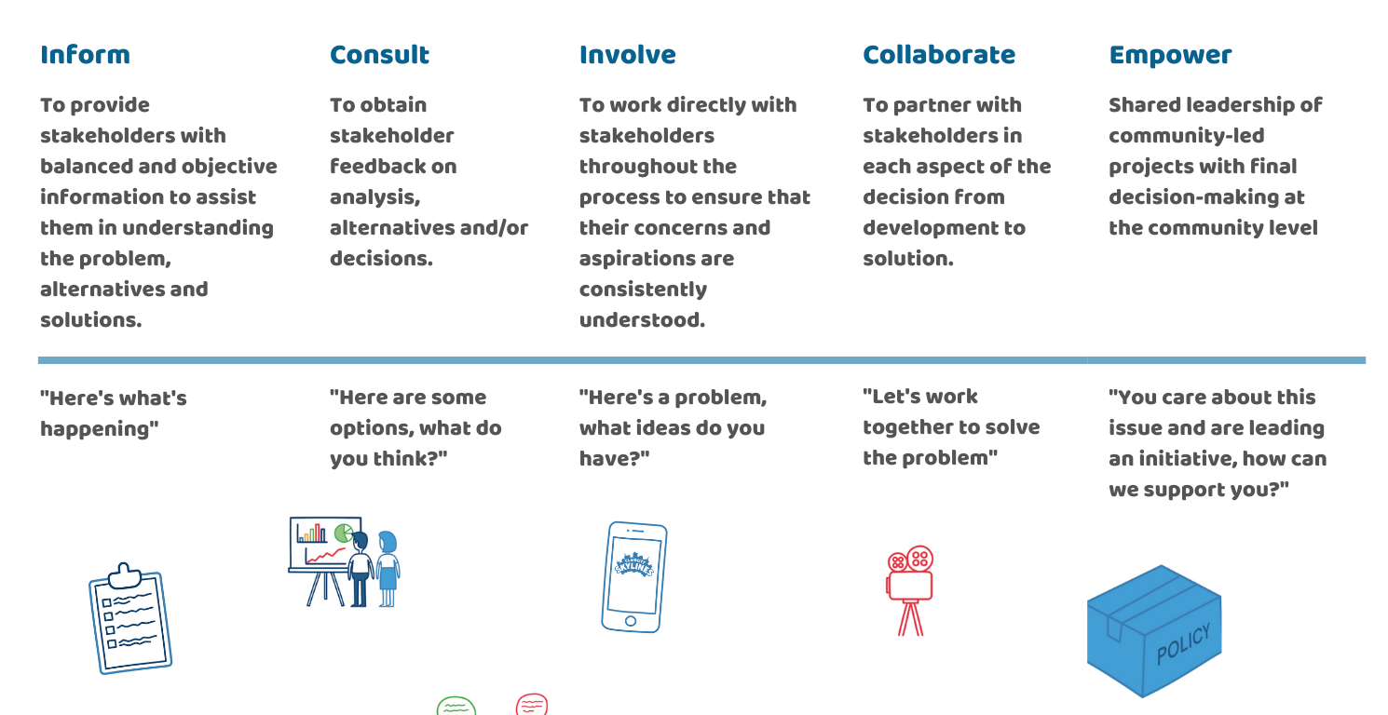
Spectrum of participation
Notes:
Collaborate and empower citizens and ourselves

Slide 3
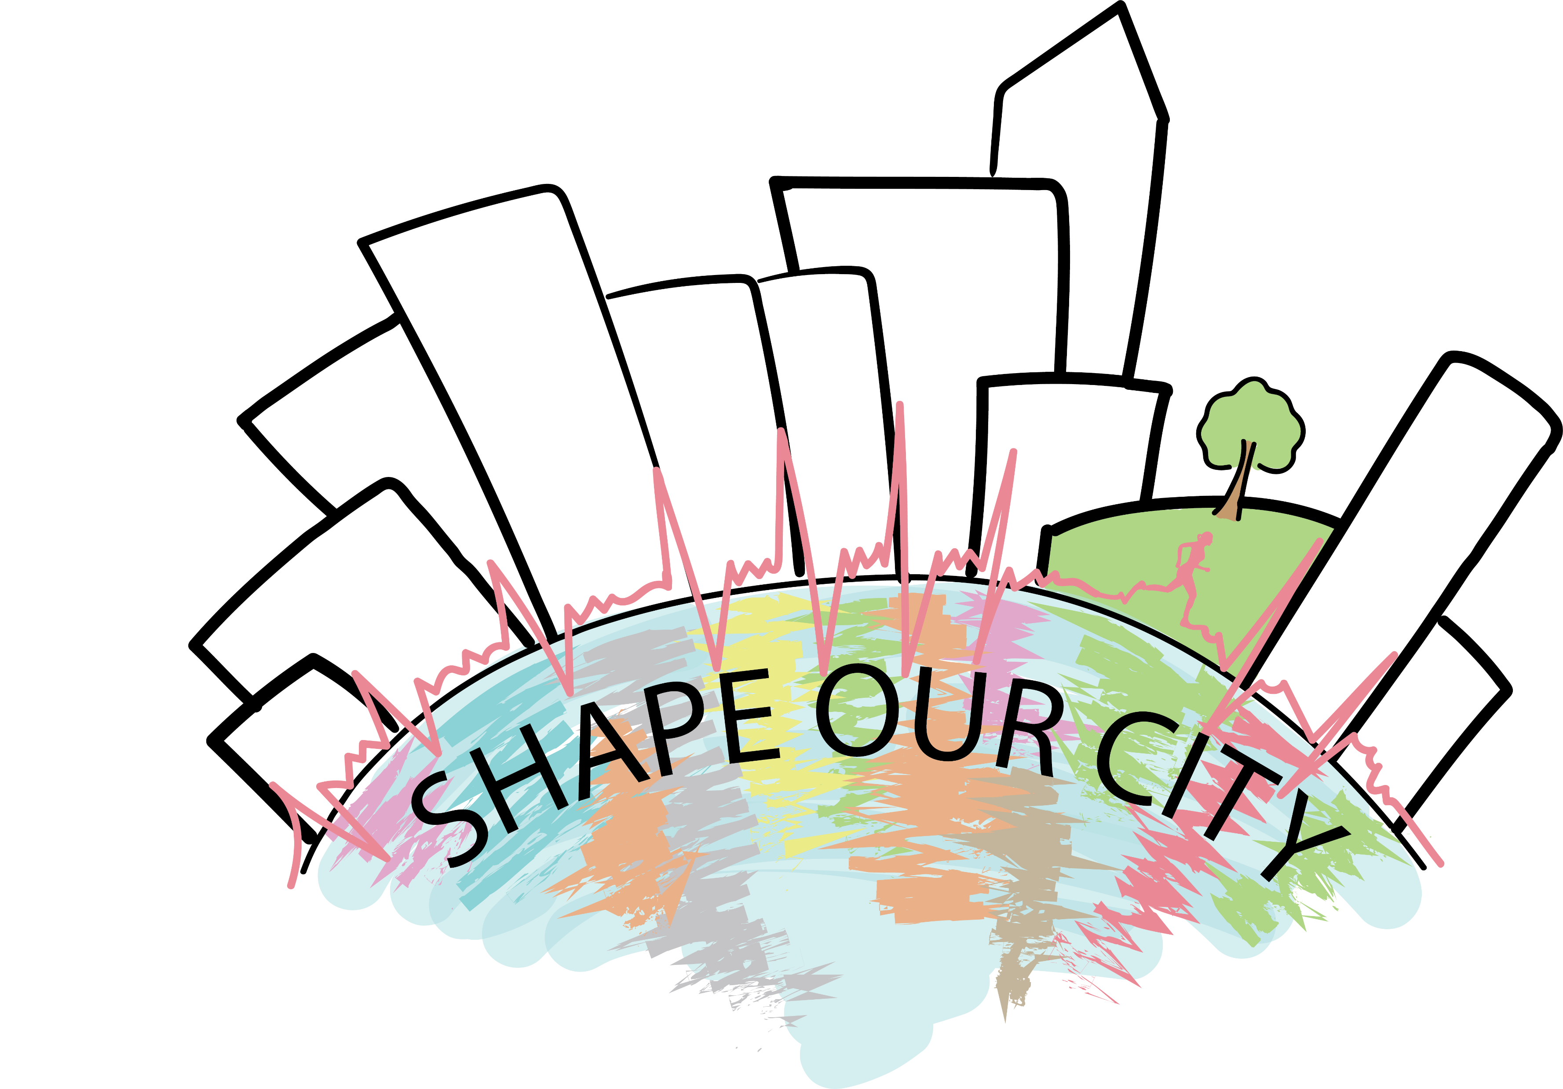
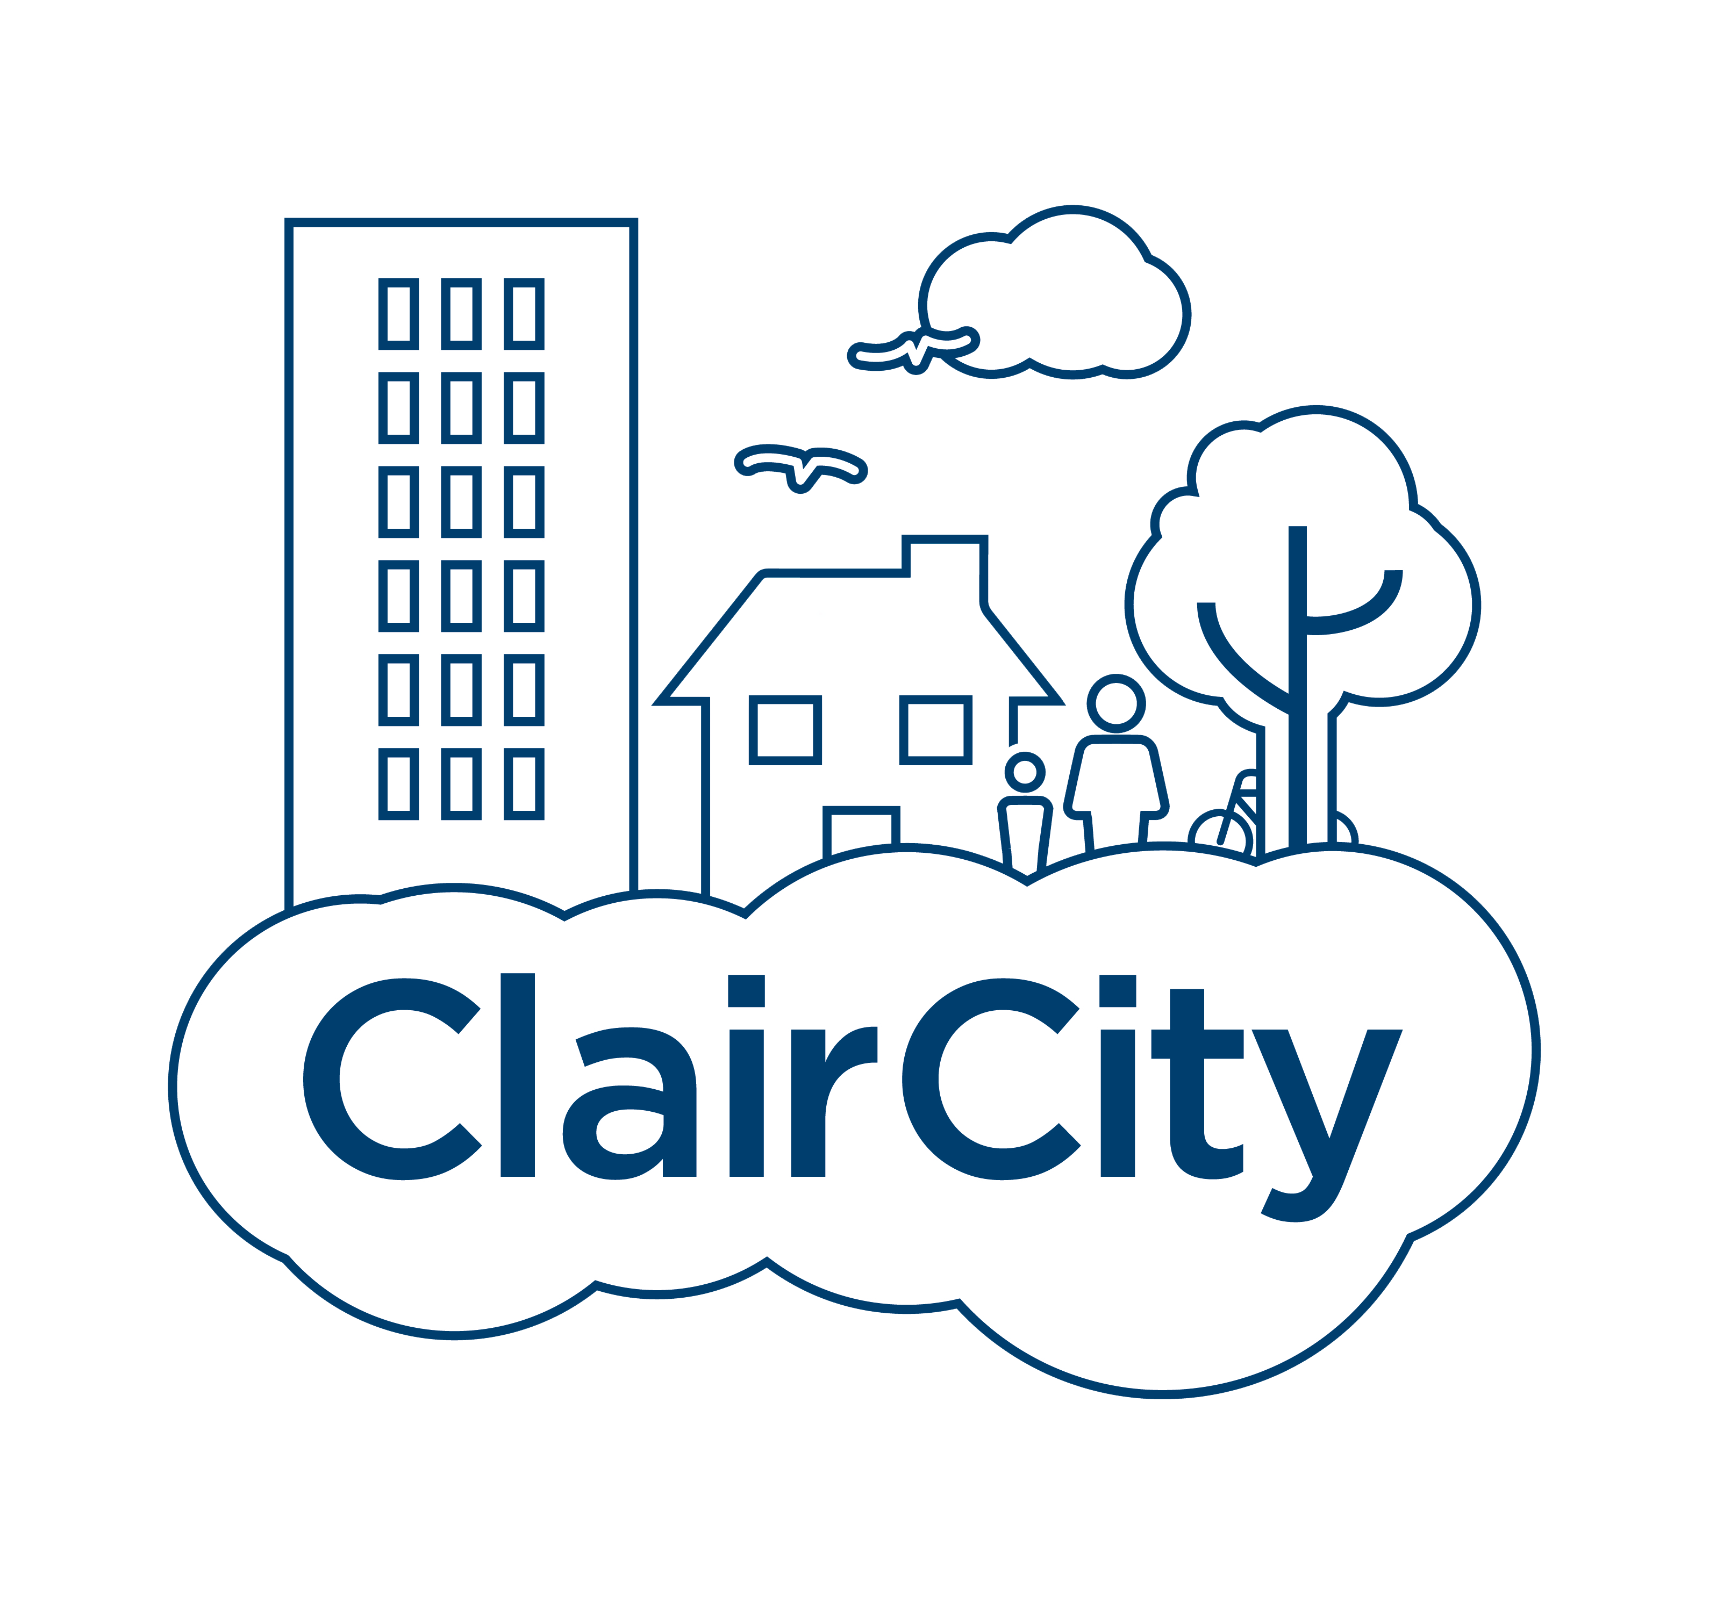

Cities impact people…
…and people’s behaviour and decisions impact cities
Notes:
Showing how we are all connected (making the invisible visible)
Bristol
Wellcome
Sister project Upstream, which looked to understand whether upstream decision makers (such as financers and land owners like Councils and the NHS) were prioritising health in urban decision making processes. A novel part of the project looked at an economic valuation of costs associated with the health impacts of different planning and design features.

Slide 4




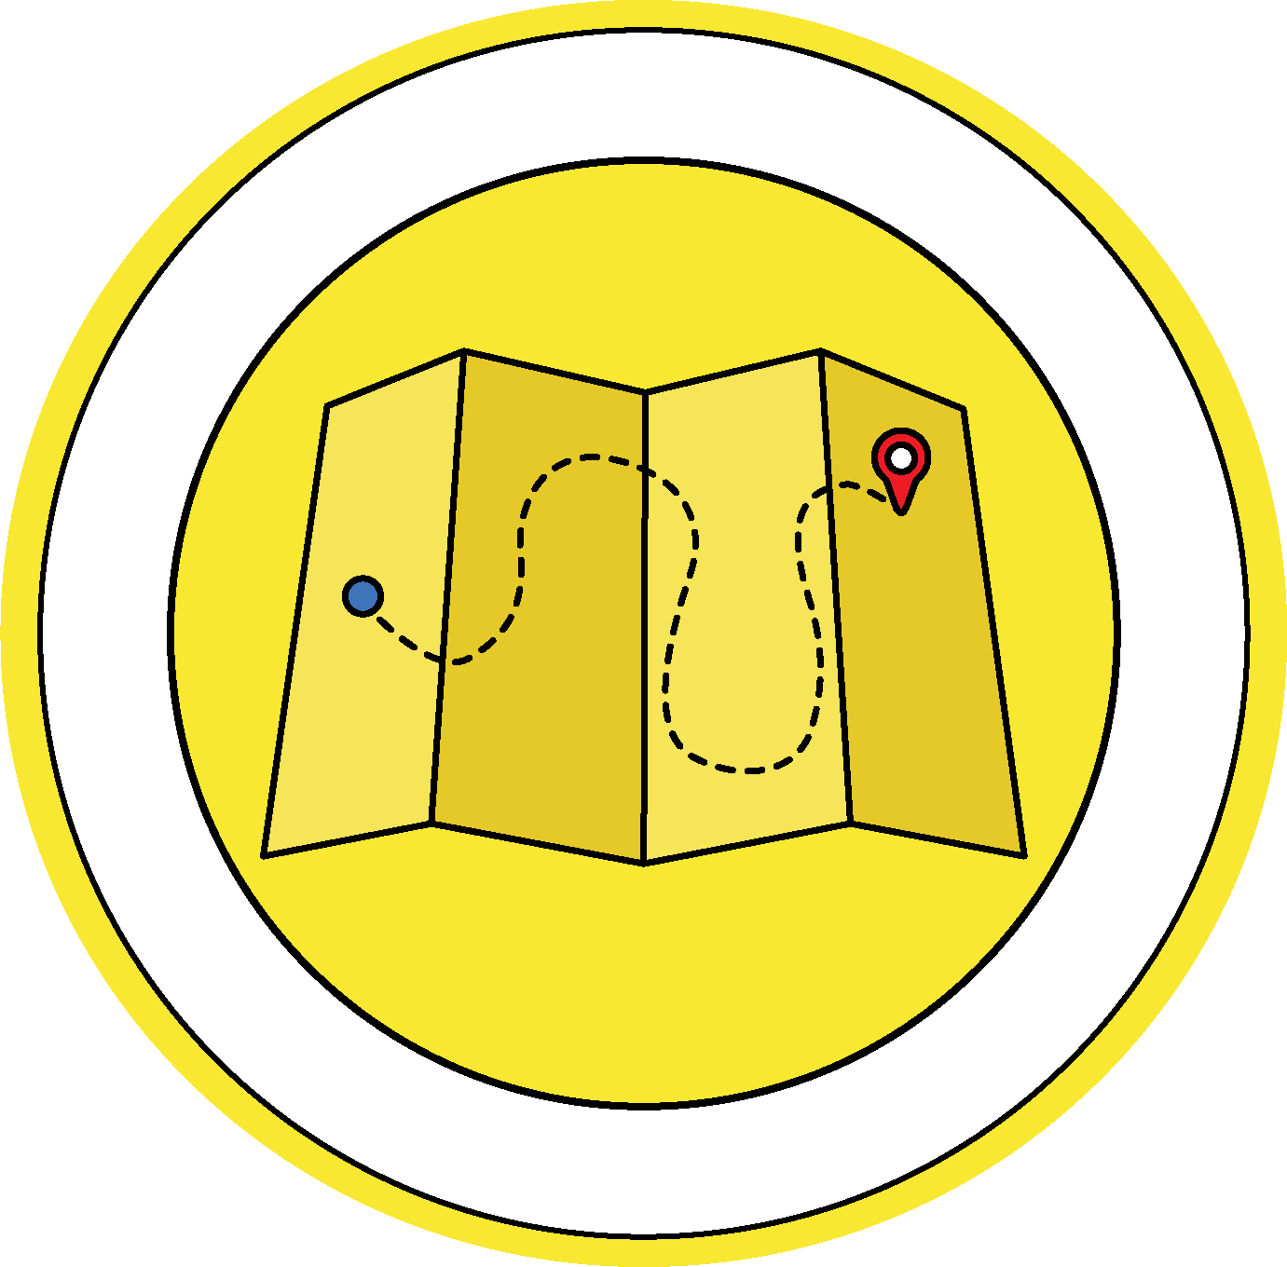

Researchers
Planners and policymakers
Communicating systemic issues using only
>short engagements<
Urban developers
Communities?
Green space
Buildings
Transport
Neighbourhood design
Food environment
https://urban-health-upstream.info/impact/our-city-our-health/
Notes:
The five main areas explored in the research project were green space, buildings, transport, neighbourhood design and the food environment.
These themes then became the topics of conversation for our engagements

Slide 5
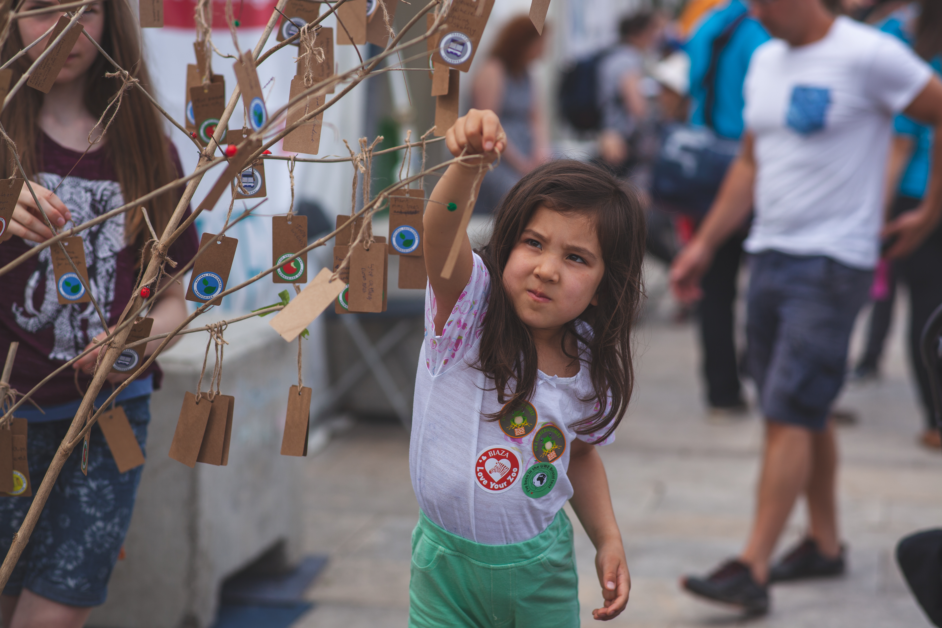
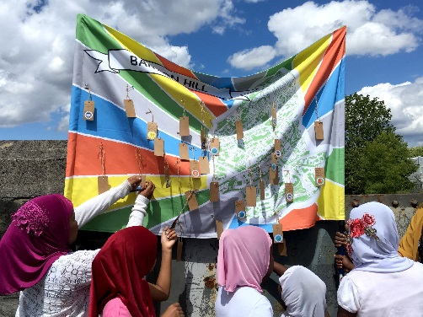
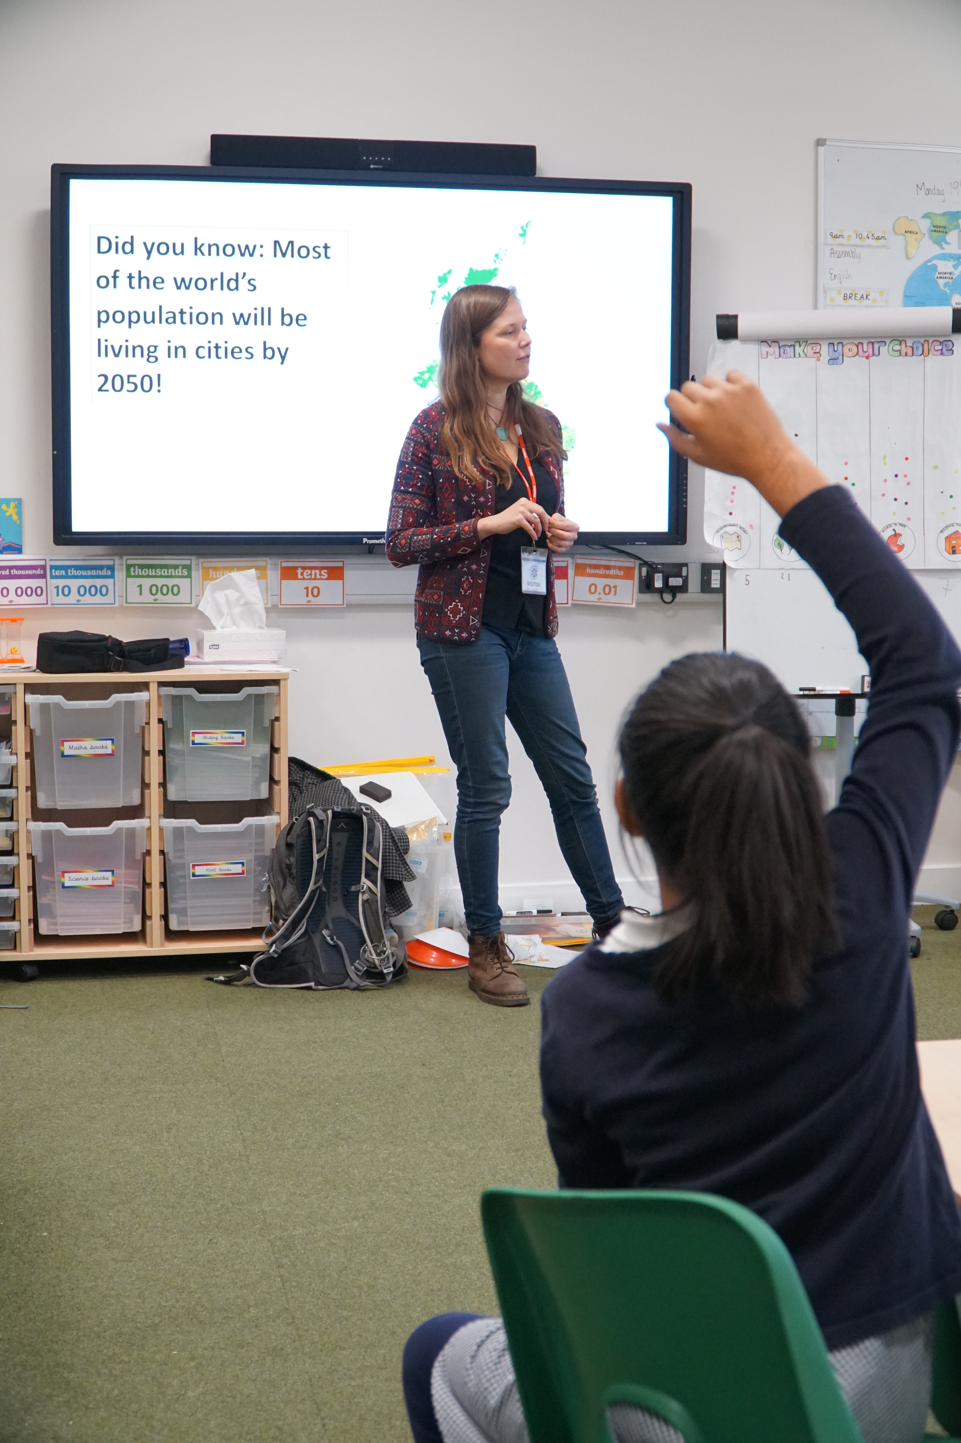
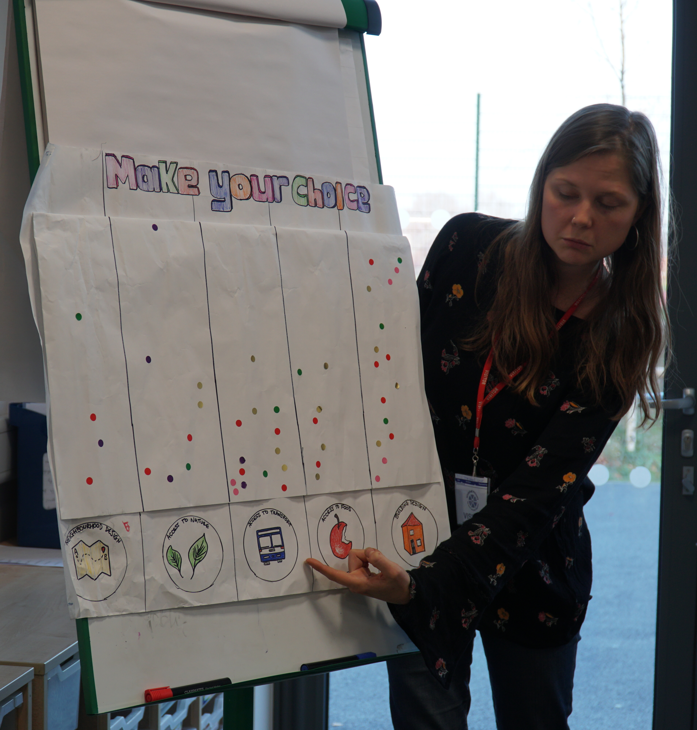
How does the place you live make you feel?
What would you improve?
Public
Neighbourhood
Community
Notes:
We engaged the public at three levels:
public engagement at city-wide scale (e.g. Inhale sculpture)
community consultations over lunch to discuss neighbourhood issues
asset-based community development, looking at what local needs are
In the case of young people, this meant engaging them at big public events, engaging them where they lived and engaging them were they learn
You can see here that we had these tags with our five themes on which sparked conversations. We also had board games, drawing activities to reimagine streets and in schools we delivered deep mapping exercises, which posed these questions.
Again, we were engaging young people by stealth

Slide 6
How does the place you live make you feel?
What would you improve?
Over 1,500 direct f-2-f engagements
Public
Neighbourhood
Community
Notes:
We engaged the public at three levels:
public engagement at city-wide scale (e.g. Inhale sculpture)
community consultations over lunch to discuss neighbourhood issues
asset-based community development, looking at what local needs are
In the case of young people, this meant engaging them at big public events, engaging them where they lived and engaging them were they learn
You can see here that we had these tags with our five themes on which sparked conversations. We also had board games, drawing activities to reimagine streets and in schools we delivered deep mapping exercises, which posed these questions.
Again, we were engaging young people by stealth

Slide 7
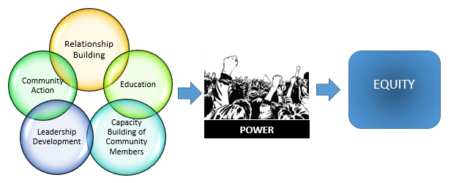
Community organising
Source: Communityscience.com
Notes:
The theory behind this work stems from Community Organising
Reaching out, building relationships…

Slide 8
Science communicators and researchers as facilitators and enablers
Source: Communityscience.com

Slide 9
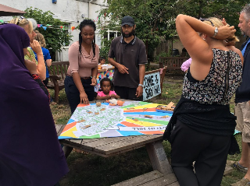
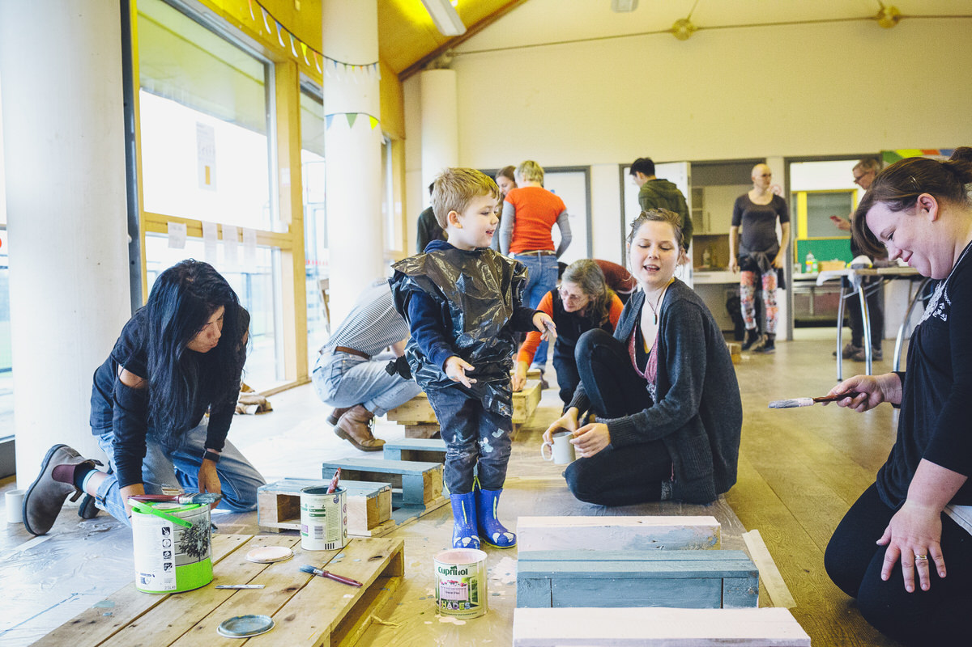
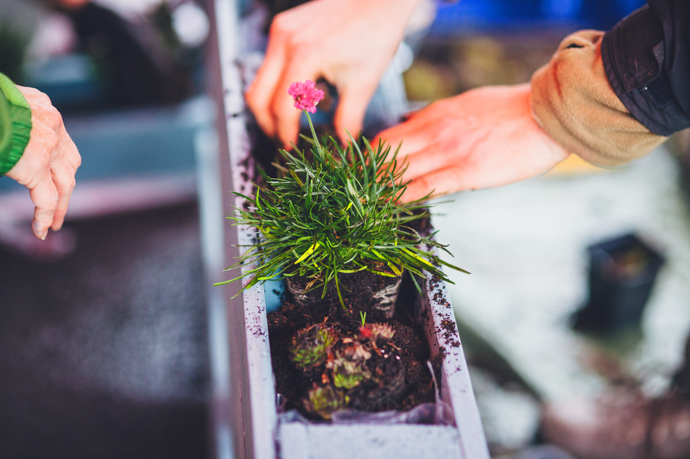
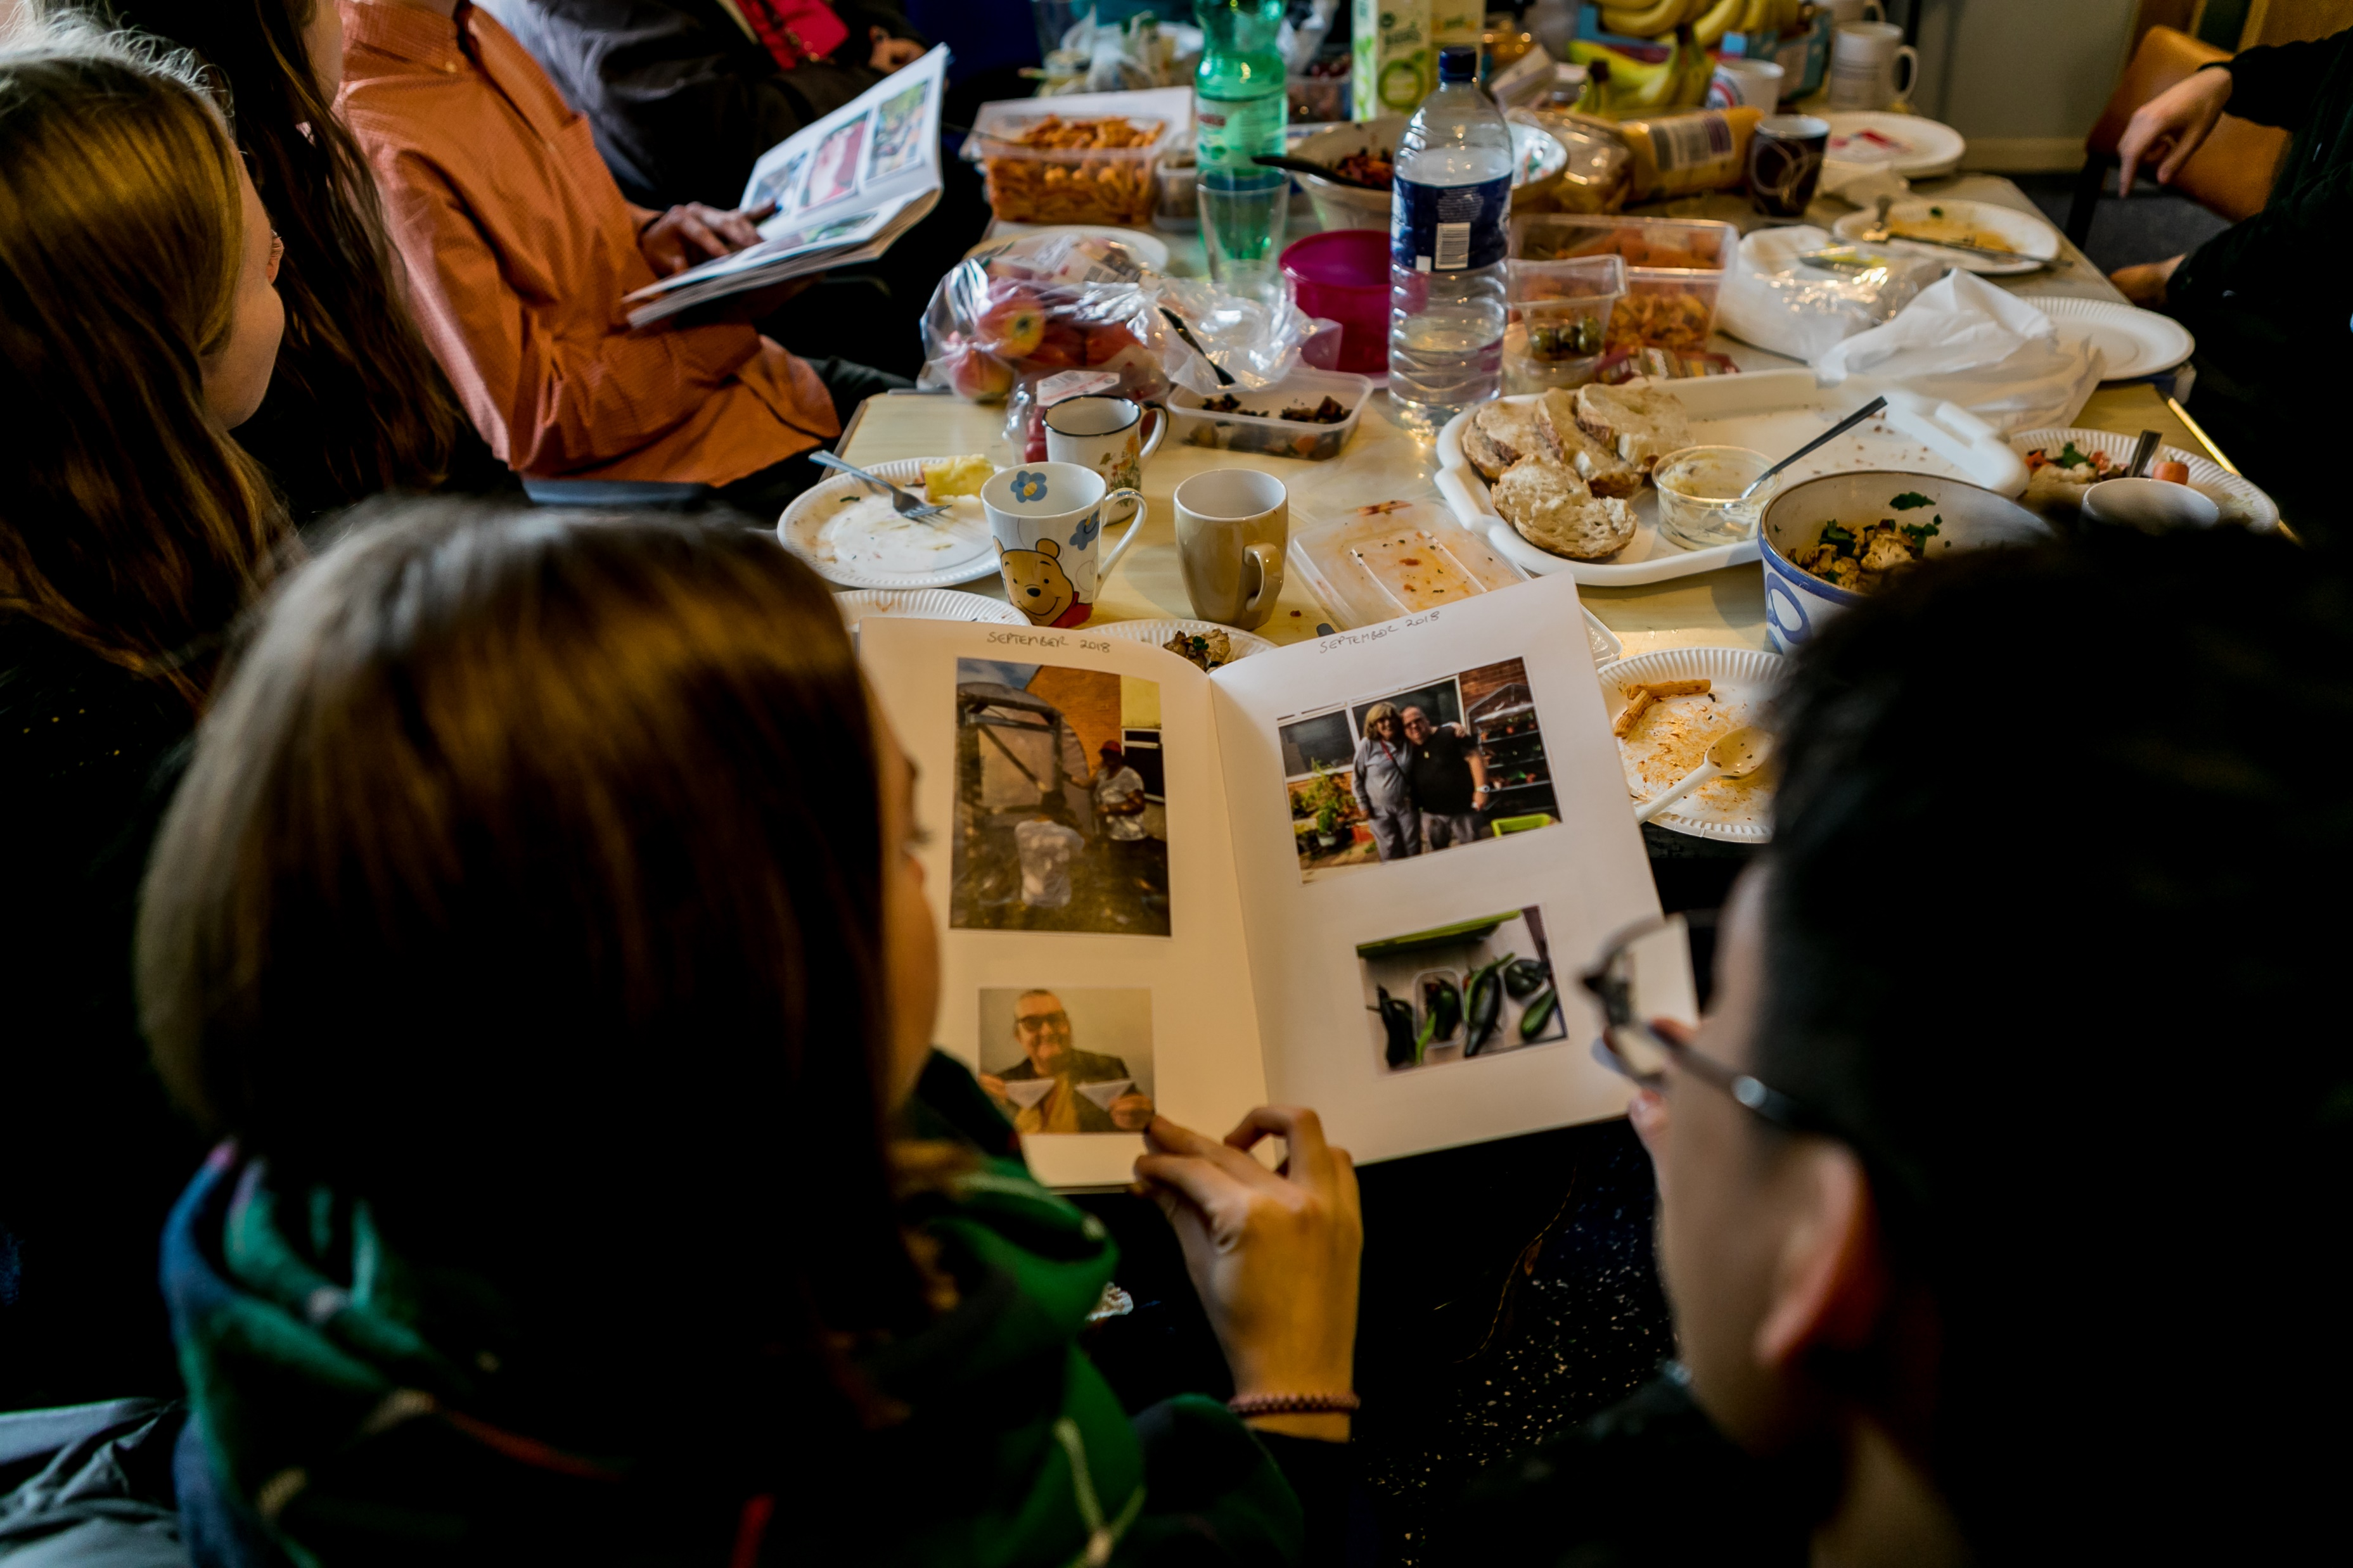
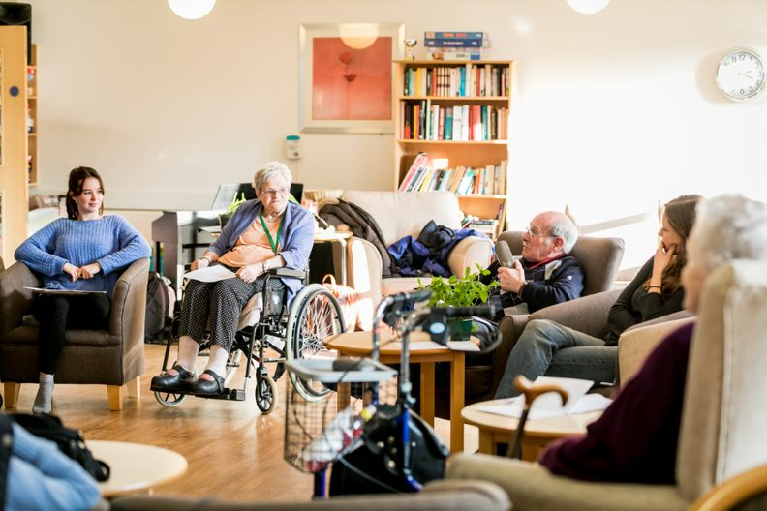
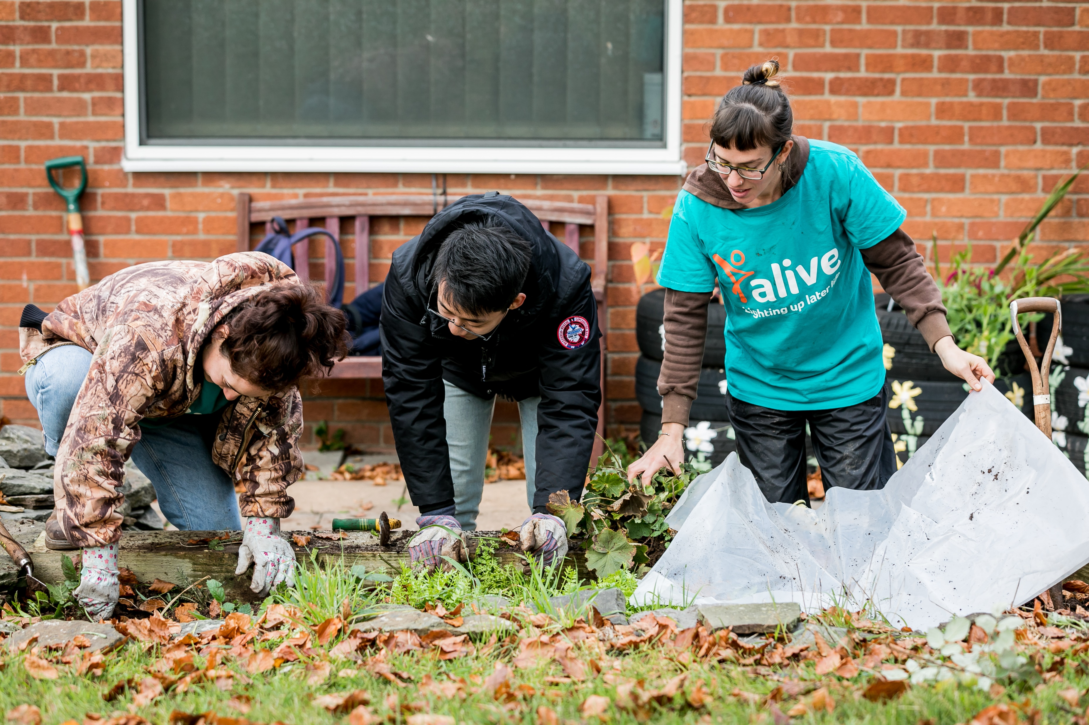
Relationship building Education Capacity building Leadership development Community action
Notes:
Areas of multiple deprivation
Community centre; care home
Citizen-led vs. student and partner organisation facilitated
Sensing their environment; documenting their observations
Going where the spark is

Slide 10
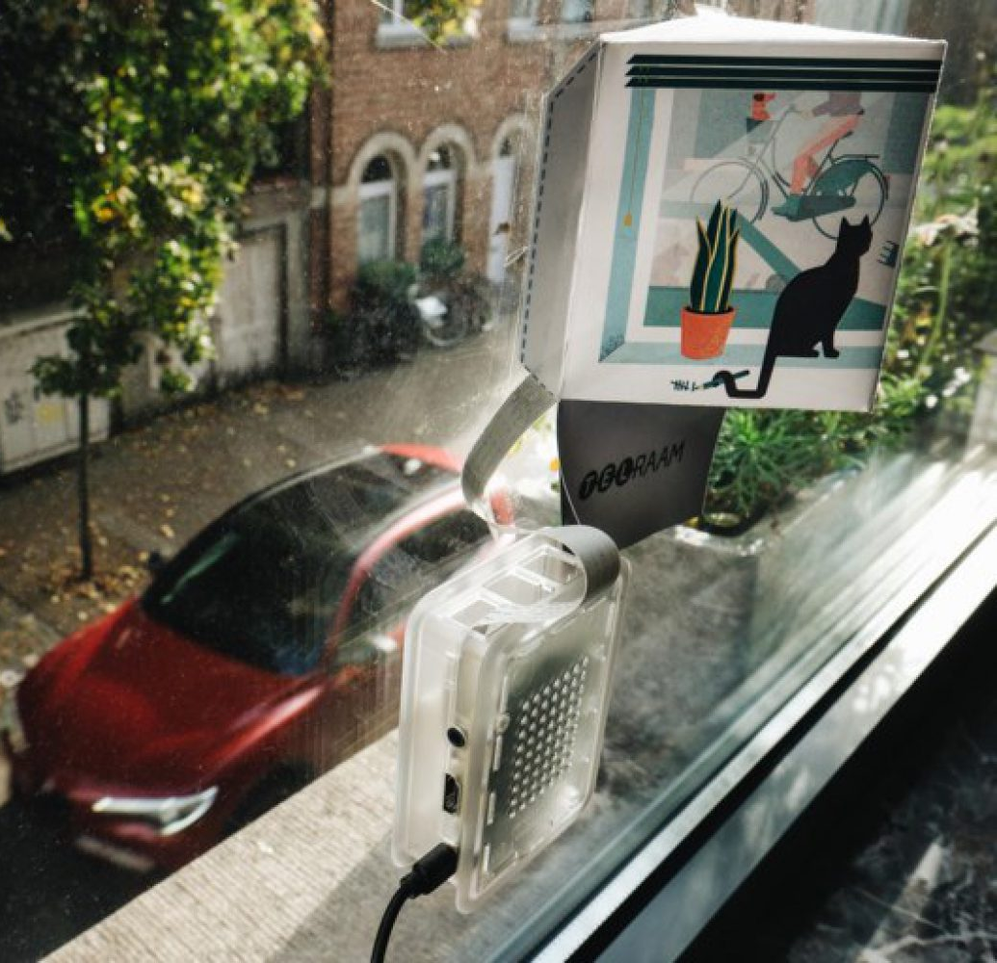
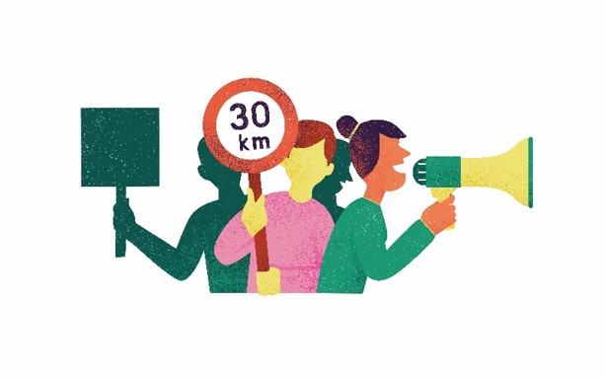
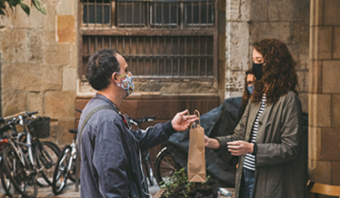
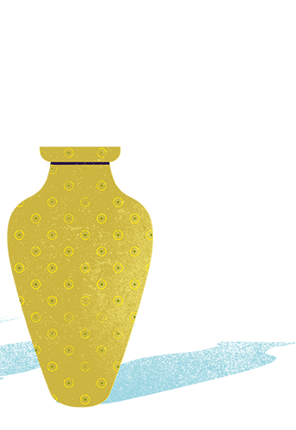
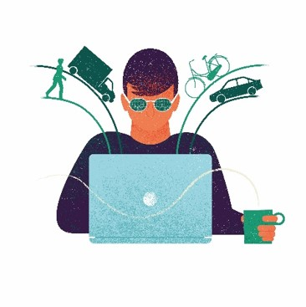
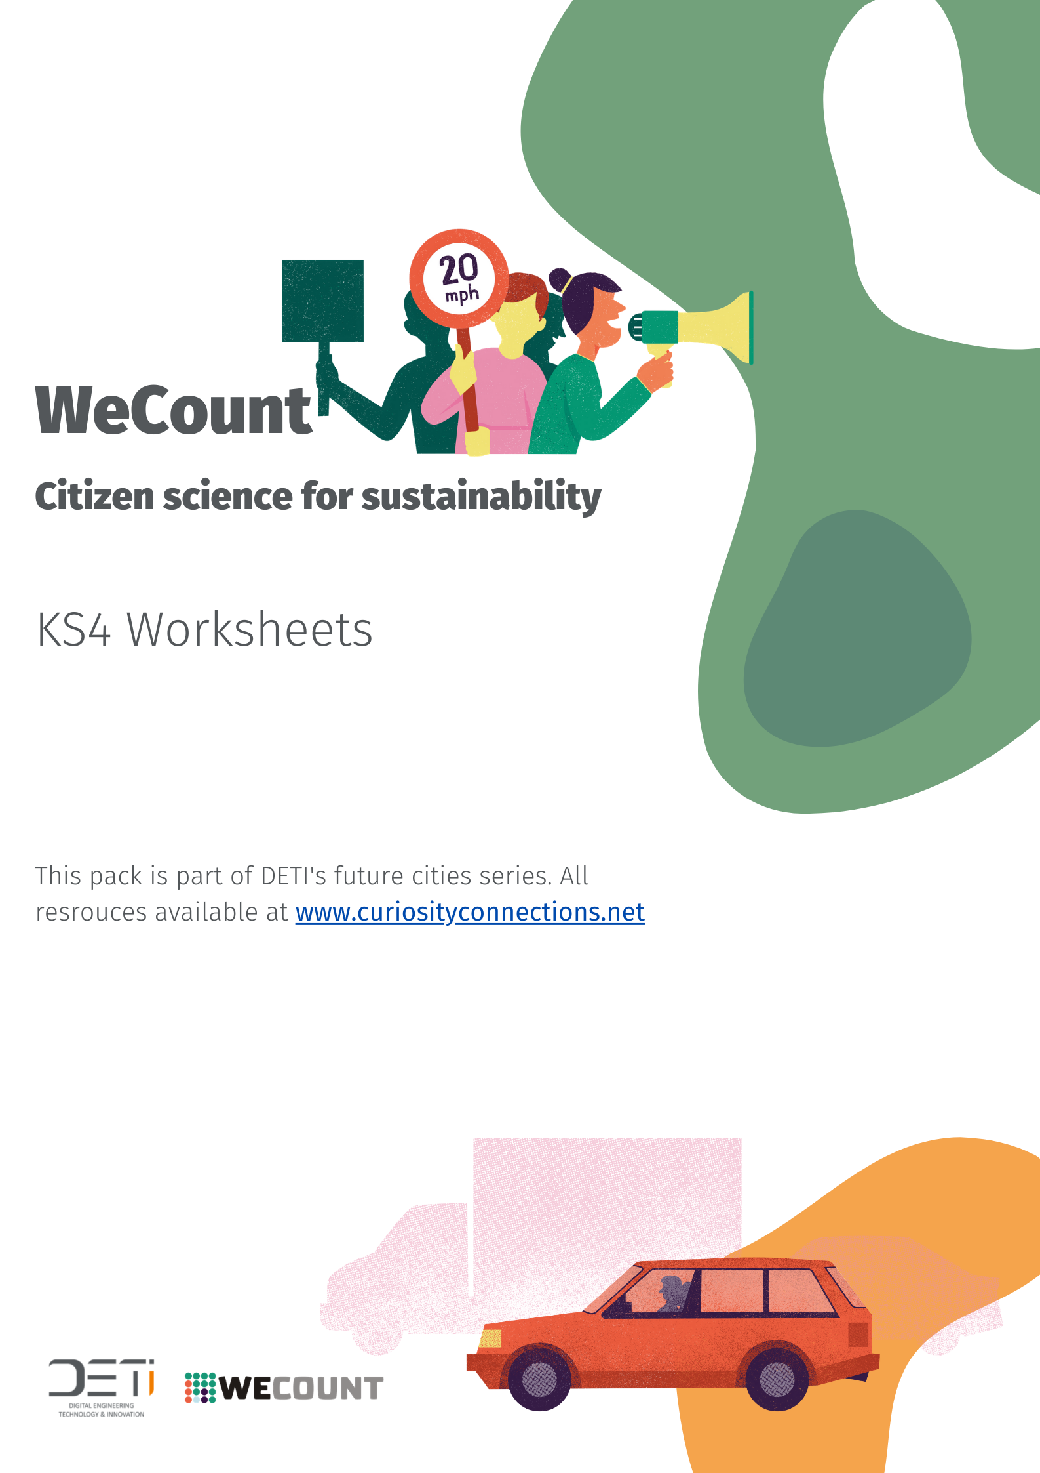
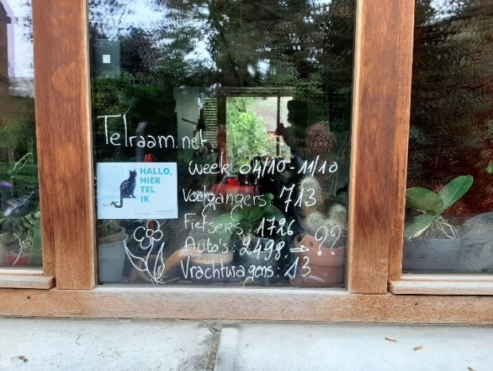
Relationship building Education Capacity building Leadership development Community action
Notes:
F-2-F drop off moments
Identifying community champions
Educational materials…. Being used with DETI

Slide 11
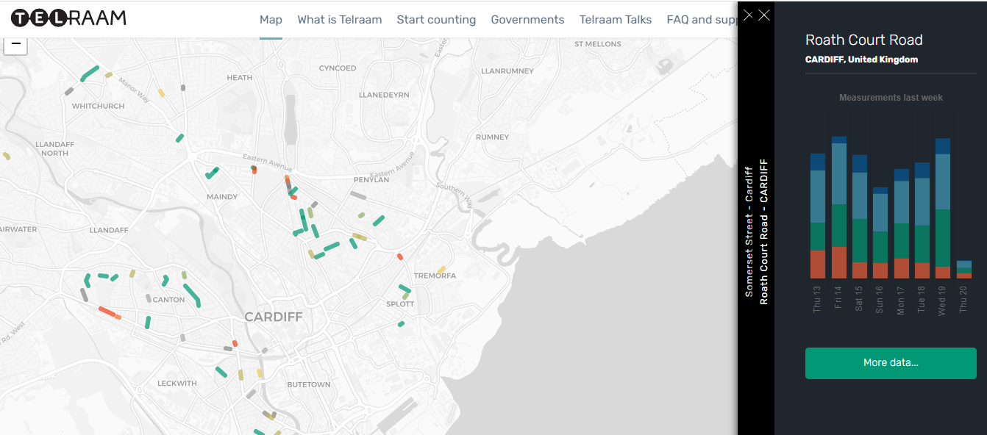

Slide 12
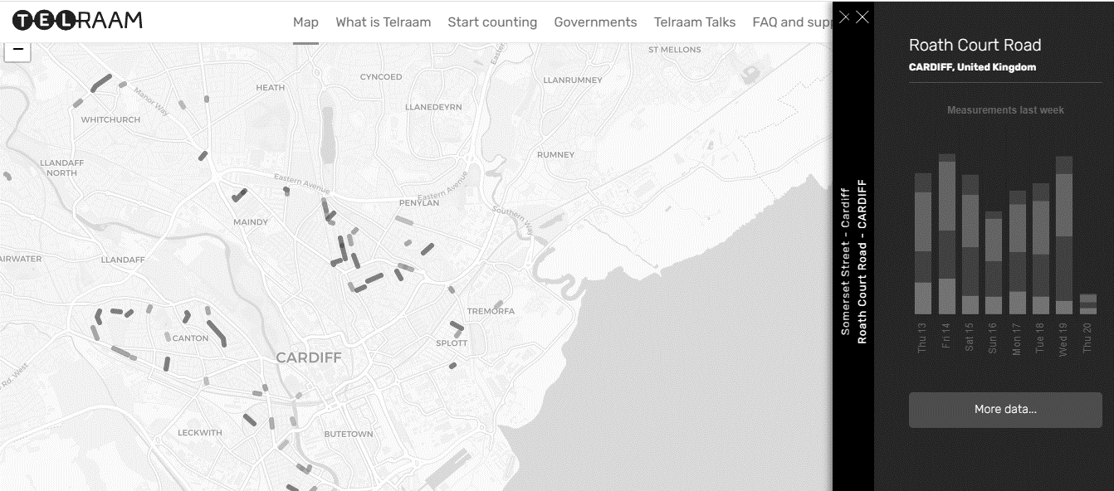
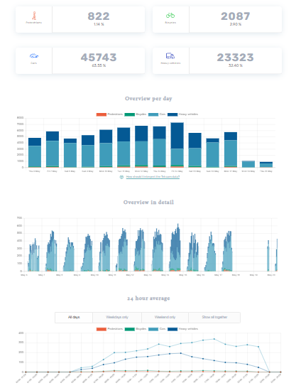

Slide 13
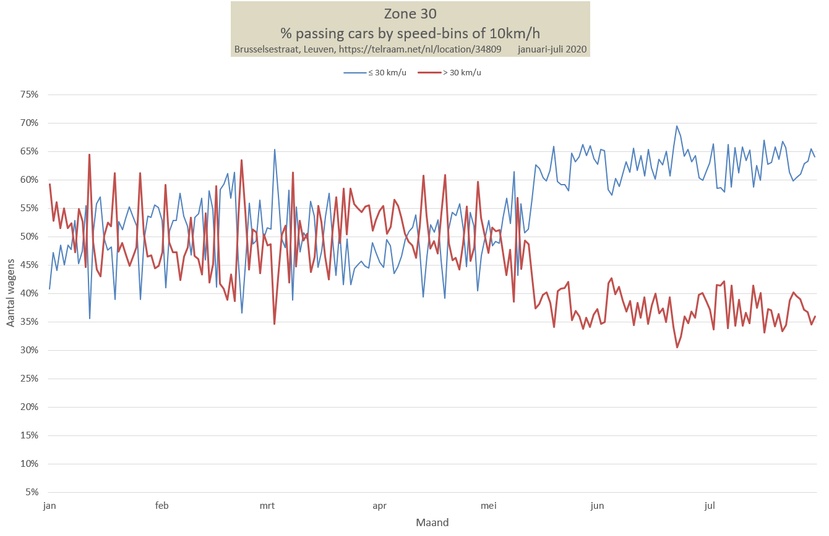
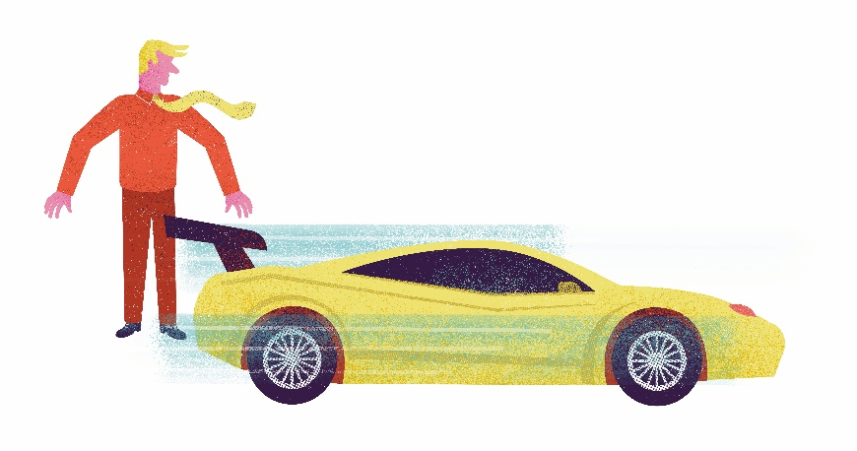
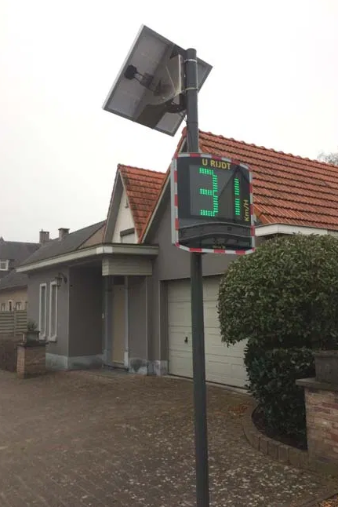
Notes:
A community in Barcelona also did the same – now monitoring compliance
Also shown impact of covid on traffic
Working with Cardiff council to monitor changes before and after the implementation of low traffic neighbourhoods

Slide 14
Takeaways
Community organising for climate action
Science communicators as agents for change
Take time
Allow space for things to emerge
Create cross-scale linkages
Food, art, digital tech/biosensors and craft as a hooks; as tools to break down power
Notes:
Hooks - resonate

