Slide 1
Formalising the Relationship between Geography Education & Geographies of Education as GeogEd
Harry West¹, Jennifer Hill², Matt Finn³, Ruth Healey⁴, Alan Marvell² and Natalie Tebbett⁵
¹ University of the West of England, ² University of Gloucestershire, ³ University of Exeter, ⁴ University of Chester, ⁵ Loughborough University
Evolving the ‘Higher Education Research Group’ to the ‘Geography & Education Research Group’
Royal Geographical Society (with IBG) Annual International Conference
August/Sept 2021
Notes:
15 min presentation and 5 mins questions
HW

Slide 2
Background
In 2019 the Higher Education RG formally became the Geography and Education RG (GeogEd)
The discussions that kickstarted this evolution began at the 2018 AIC in Cardiff, including a lunchtime meeting chaired by Matt Finn and Itta Bauer
This was followed by 12 months of formal reflection and dialogue within HERG - including a consultation and membership vote in Spring 2019
Notes:
HW
What may appear as a simple change in RG name masks a renewed understanding of the synergies between geography education (at all levels) and the geographies of education.
In this presentation, we will contextualise that change through the relationships between the two inter‐related fields, and outline the process of forming the new Geography and Education Research Group.

Slide 3
Background
At the centre of the evolution was the idea of expanding the ‘official’ remit of HERG, and bringing together different areas/disciplines
This included individuals working on the ‘geographies of education’ and those with interests in geography education beyond HE (including teacher training)
The aim was to create an inclusive and facilitative group for anyone interested in ‘geography and education’, promoting communities of research and scholarship and consequent research-informed practice
Notes:
HW
We hope that expanding the remit of the group will lead to new members, more fruitful conversations, and hence a broadening and deepening of research across the boundaries of geographies of education and geography education.

Slide 4
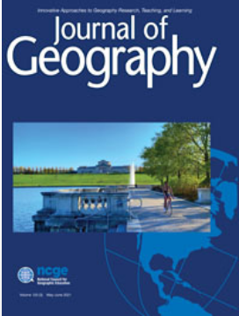
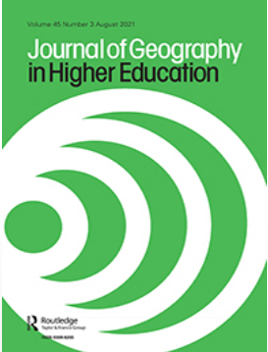
Defining GE and GofE
Geography Education: seeks to enhance our theoretical and conceptual understanding of pedagogy, the findings of which can be applied to practice, thus enhancing the student experience
Geographies of Education: takes education as the object of its study; education is studied as a geographical phenomenon
Notes:
JH
Geography Education - pedagogic research or SoTL – dedicated journals such as JGHE , Journal of Geography, International Research in Geographical and Environmental Education, Geographical Education
Geographies of Education - explores the relationships between the geographical study of education spaces and processes and wider influences (Holloway et al. 2010). Numerous outlets. Transactions and Area are RGS journals.

Slide 5
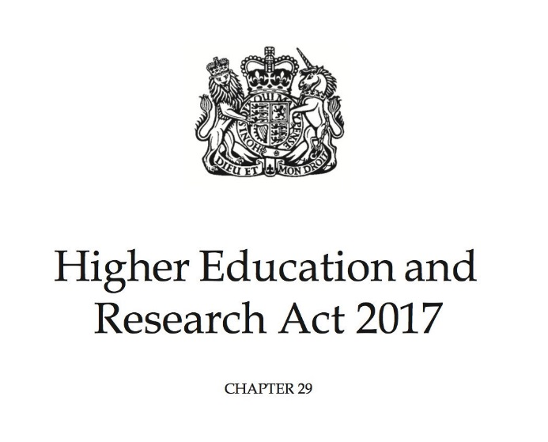
A Reciprocal Relationship
Geographies of education and geography education are complementary intellectual territories:
University system cited as a ‘driver of economic growth’ … ‘engine of social mobility’ … ‘cornerstone of our cultural landscape’
(BIS, 2016: 7)
OfS to ‘promote quality … in the provision of HE’ … ‘encourage competition between … providers’ … ‘promote equality of opportunity in … access’ (HERA 2017: 1-2)
Notes:
JH
It is hard to escape the politico-economic forces enshrined in the BIS White Paper (2016) and Higher Education Research Act (2017):
- frame HE as key to economic growth and productivity
- establish socio-cultural targets for higher education to reduce inequality and disadvantage

Slide 6
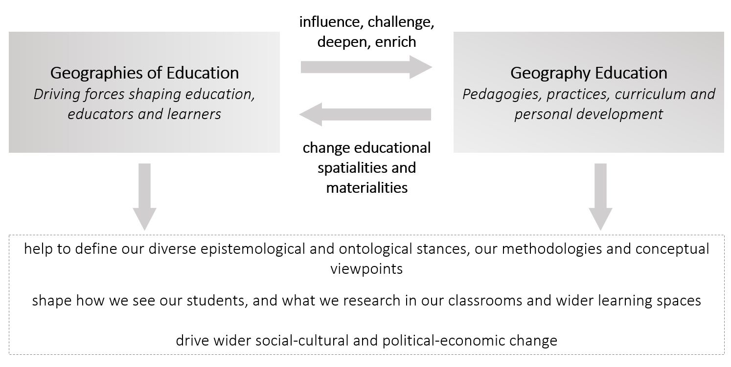
A Reciprocal Relationship
Notes:
JH
Put simply, geographies of education research seeks to identify, understand and critique the drivers of change affecting education, educators and learners
Geographies of education influence, challenge, deepen and enrich our pedagogies, practices, curricula, and personal development.
Our responsive and evolving pedagogies, in turn, manifest in changed educational spatialities and materialities, which need further interrogation under a geographical lens.
Thus, geographies of education and geography education are integrally linked, in an iterative manner, and this relationship is vital for a truly holistic understanding of each.
Working together, GofE and GE help shape who we are as educators, how we behave, how we see our students, and what we research in our classrooms and wider learning spaces (Hill et al. 2016). Equally, our students are the product of this relationship; their outlook and desire to “become a geographer”.

Slide 7
A Reciprocal Relationship
‘Geographies of education’ interrogates education from a geographical perspective
Adopts registers of space, scale, location and time
Recognises that the full educational journey, from entry to outcomes, occurs differentially and relationally
As such…
Informs us as geography educators to continually research, and then critically adopt, a range of relevant pedagogies …
Notes:
JH

Slide 8
Geographies of Ed in Geography Ed
We are mindful of addressing awarding gaps (Desai, 2017) and delivering inclusive curricula (Hughes, 2016) – challenging normative pedagogic practices in geographical education that might disadvantage some student groups
We are working to decolonise our curricula: Domosh (2015) Why is our curriculum so white? AAG Newsletter
2017 RGS AIC: Decolonising geographical knowledges, supported by sections in Transactions 42 (3) (2017), edited by Sarah Radcliffe, and Area 49 (3) (2017), edited by Patricia Noxolo
Notes:
JH
Attainment and inclusivity
Vandana Desai, Dept of Geography, Royal Holloway – examines the profile of BME students and staff in contemporary UK Geography – ‘troubling equality and diversity issues’
Annie Hughes – geographer, now Head of the Learning and Teaching Enhancement Centre at Kingston University – sees inclusive curricula as engaging students in leaning that is accessible, relevant and meaningful to them irrespective of their backgrounds e.g. active learning and co-creation. Working with Nona McDuff.
RGS-IBG AC2014 BME geographers in the Academy convened by Caroline Bressey (UCL) et al.
Decolonisation
2017 RGS chair’s theme - decolonising geographical knowledges, or reproducing coloniality?
Mona Domosh: cultural-historical geographer Dartmouth College, USA
Sarah Radcliffe: Dept of Geography, Uni of Cambridge
Patricia Noxolo: School of Geog, Earth and Envl Sciences, Uni of Birmingham
James Esson and Angela Last – anti-racist L&T in British Geography - Area Special Section 2020 - curriculum against domination
Peter Jackson (1989) Challenging racism through geography teaching. JGHE, 13(1), 5-14.
Alderman, D. (2019) Reflections on operationalizing an anti-racism pedagogy: teaching as regional storytelling. JGHE.
RGS Development Geographies Research Group – Decolonising development resource library – collection of teaching resources

Slide 9
Geographies of Ed in Geography Ed
More widely diversifying student learning experiences (Hall et al., 2004; Maddrell et al., 2015; Browne, 2020)
Examining educational provision across the life-course:
school-university transition (Hill & Jones, 2010; Tate & Swords 2013; Richardson & Tate 2013; Ferreira, 2018)
graduate capabilities (Hill & Walkington, 2016; Spronken-Smith et al., 2016; Walkington et al., 2018)
Notes:
JH
Internationalisation
RGS-IBG AC2015 session: internationalisation of curricula in HE (Simm & Marvell)
Diversification
Need to challenge the reproduction of inequality and injustice within the Academy and to afford any student a sense of legitimacy and belonging in their course/institution. It is important to create courses that counteract the perpetuation of hegemonic discourses and identities, delivering new ways of learning, teaching and being that are based upon coexistence and respect, and allowing all students to see themselves reflected in the curriculum.
Hall et al 2004 – disability and fieldwork
Maddrell et al. 2015 - gender disparities
Skelton, 2019 - sexuality
Browne, 2019 - geographies of sexualities and genders
RGS-IBG AC2007: session on diversity in the curriculum convened by Derry Corey and Claire Jarvis (as part of 4 broader sessions)
Life-course
RGS-IBG AC2008: Geography learning across the life course: two sessions entitled ‘Lifelong Geography’, which sought to examine the status and relevance of geography as a discipline. Speakers from schools, universities, public organisations and private consultancies offered theoretical and practical insights into the journey from geography at school to university and beyond. Included Rita Gardner and David Lambert.
Graduate capabilities
Following work of Simon Barrie in Australia
GAs and employability – RGS-IBG AC2013, 2015
At AC 2013 HERG convened a panel session examining the contribution of geographical pedagogies to developing graduate competencies. Through short contributions from a range of Research Group representatives, the session explored sub-disciplinary signature pedagogies (Shulman, 2005) and epistemic ways of thinking, knowing and doing to build theoretical and empirical guidelines for effective teaching and learning of graduate attributes in the discipline. This led to publication of a symposium in Journal of Geography in Higher Education in 2016.
We have tended to diversify our teaching methods to prepare students to recognise and work within the heterogeneity and change they will encounter in local, regional, and global contexts.

Slide 10
Proposing GeogEd
Historically the HERG committee took a broad view of its constitutional aims, for example (co-)sponsoring sessions ‘beyond HE geography’ at the AIC:
‘Lifelong Geography Education’ (2008)
‘Education Geographies’ (2010)
‘Geographical Education Beyond the Traditional Classroom’ (2011)
‘Geograohiedidaktik and Young Peoples Geographies’ (2018)
Reveals HERG’s engagement with the broader geography and education field, and a willingness to be inclusive
Notes:
HW

Slide 11
Proposing GeogEd
Nonetheless, it was clear through conversations between HERG chairs and session convenors that the perceived HE focus of HERG could be off-putting
Even when those involved in HERG understood it to have a broader remit, the title could be seen as exclusive
It was important to seek a name that removed any sense of exclusion for anyone identifying as either/ both a geography education or geographies of education researcher/ academic/ scholar/ practitioner
Notes:
HW

Slide 12
Proposing GeogEd
Geography and Education Research Group (GeogEd) was suggested as the most parsimonious means of capturing the areas to be united
Agreement that this title was broad enough to welcome those working across the different sectors of education research and the geographies of education
The name would be sensitive to the historic HERG remit and membership
As well as a change in title, the constitutional aims were updated to officially recognise the broader remit and interests of the group
Notes:
HW

Slide 13
Formalising GeogEd
In May 2019 the membership was given a month to vote on the proposal
With a response rate of 35% (resulting in quoracy), 98.1% were in favour of the change
The new name and constitution was ratified at the HERG AGM on 28th August 2019 (just under one year from the initial proposal)
Signed-off by the RGS (with IBG) on 7th October 2019
Notes:
HW

Slide 14
The Future of GeogEd
As GeogEd evolves, we are keen to ensure the group works alongside others with interests in geography and education: RGS-IBG Research Groups and the Geographical Association
The hope is for the change to be additive and constructive
We are conscious of potential thematic and membership overlaps between groups, and acknowledge that working in parallel may require re-evaluating practices and boundaries
Notes:
HW

Slide 15
The Future of GeogEd
Historically, a pre-requisite for HERG membership was RGS-IBG Membership/Fellowship
Might have excluded some groups such as teachers/teacher educators, who might naturally gravitate towards the Geographical Association
This pre-requisite has been removed, allowing for a more diverse membership across the geography and education nexus
Notes:
HW

Slide 16
The Future of GeogEd
We conclude by reaffirming the hope that GeogEd will be an inclusive space for anyone identifying with either/ both/ the synergies of our composite areas
Removing any sense of ‘othering’ that establishes a need to ‘seek permission’ to identify with, and be part of, the group
Finn et al. discuss and reflect on the future of the Geography and Education Research Group
To be continued …
Notes:
HW
By exploiting the synergies of GE and GofE we hope to expand our appreciation about who we are and what the discipline can become, (re)producing our chosen future(s) from a more encompassing perspective. As a result, we can enable critical, radical, and liberatory pedagogies and geographies, encouraging creative (and sometimes necessarily disruptive) evolution and development.
Achieving this would allow us to establish more meaningful connections and deeper ways of knowing in the classroom, over our campuses, and in communities across the world.

Slide 17
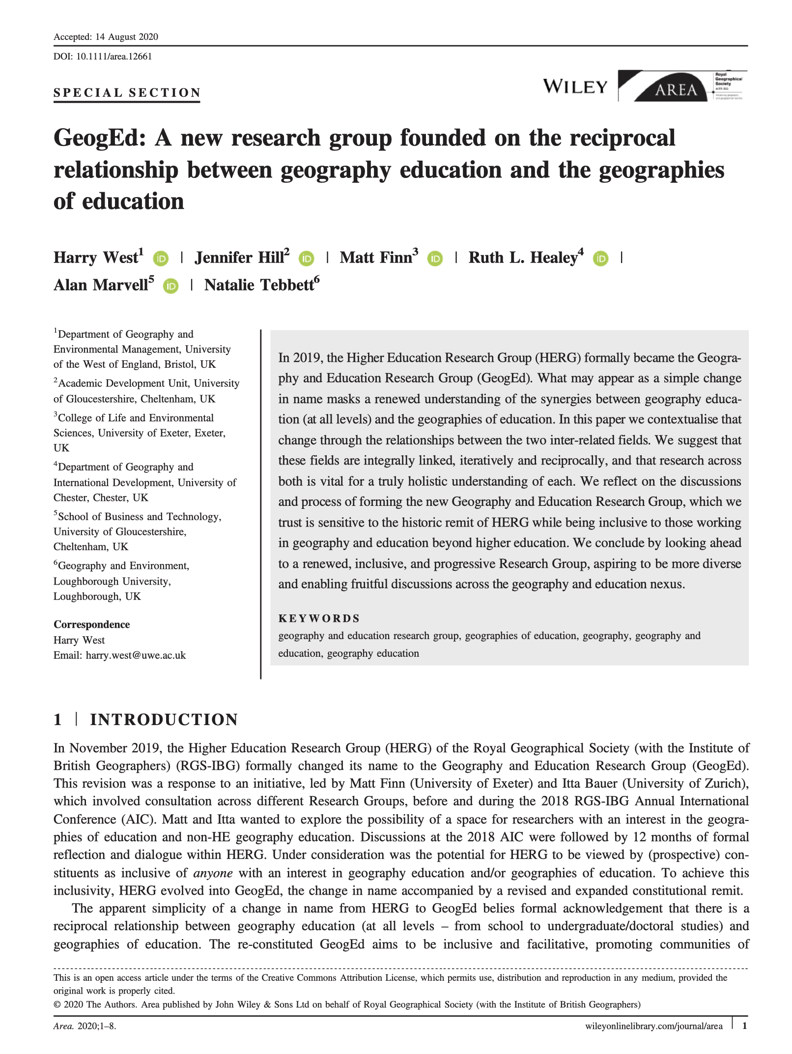
Area Paper
The work from this presentation was written up for the forthcoming Area Special Section marking the evolution of the GeogEd group.
For this work see West et al (2020) ‘GeogEd: A new research group founded on the reciprocal relationship between geography education and the geographies of education’.
Available Open Access in Area since last summer.
https://rgs-ibg.onlinelibrary.wiley.com/doi/10.1111/area.12661

Slide 18
References
Browne, K. (2020) Isn’t this just about lesbians? Teaching hegemonic geographies of sexualities and genders here and now. JGHE, 44, 203-216.
Desai, V. (2017) Black and minority ethnic (BME) student and staff in contemporary British geography. Area, 49, 320-323.
Domosh, M. (2015, June 1) Why is our curriculum so white? - Association of American Geographers Newsletter. Available at http://news.aag.org/2015/06/why-is-our-geography-curriculum-so-white/ (Accessed 26 August 2021).
Ferreira, J. (2018) Facilitating the transition: doing more than bridging the gap between school and university geography. JGHE, 42, 372-383.
Hall, T., Healey, M. & Harrison, M. (2004) Fieldwork and disabled students: discourses of exclusion and inclusion. JGHE, 28, 255-280.
Hill, J. & Jones, M. (2010) ‘Joined-up geography’: connecting school-level and university-level geographies. Geography, 95, 22-32.
Hill, J. & Walkington, H. (2016) Developing graduate attributes through participation in undergraduate research conferences, JGHE, 40, 222-237.
Hughes, A. (2016) Exploring normative whiteness: ensuring inclusive pedagogic practice in undergraduate fieldwork teaching and learning. JGHE, 40, 460-477.
Maddrell, A., Strauss, K., Thomas, N. & Wyse, S. (2015) Mind the gap: gender disparities still to be addressed in UK Higher Education’ Area, 48, 48­-56.

Slide 19
References
Richardson M.J. & Tate, S. (2013) Improving the transition to university: introducing student voices into the formal induction process for new geography undergraduates. JGHE, 37, 611-618.
Spronken-Smith, R., McLean, A., Smith, N., Bond, C., Jenkins, M., Marshall, S. & Frielick, S. (2016) A toolkit to implement graduate attributes in geography curricula. JGHE, 40, 254-266.
Tate, S. & Swords, J. (2013) Please mind the gap: students' perspectives of the transition in academic skills between A-level and degree-level geography. JGHE, 37, 230-240.
Walkington, H., Dyer, S., Solem, M., Haigh, M. & Waddington, S. (2018) A capabilities approach to higher education: geocapabilities and implications for geography curricula. JGHE, 42, 7-24.

