Slide 1
Creating Pivotal Moments in Undergraduate Learning through Assessment Dialogue
Jennifer hill & harry west
Assessment, Feedback and Academic Standards in Geography
RGS-IBG Annual International Conference 2021

Slide 2
Dialogue in assessment and feedback
A key debate in HE is how A&F can be constructed to maximize opportunities for meaningful student learning, moving beyond certification of performance to assessment for and as learning (Carless 2019; Winstone and Boud 2019).
Dialogue is particularly important in learning-focused feedback (Nicol 2010).
Dialogue has the potential to reduce students’ difficulties in appreciating feedback as it encourages co-creation of meaning.
Dialogic feedback forms part of a social constructivist, participatory approach to assessment.

Slide 3
Dialogic feed-forward
In this small-scale intensive study, we explore how a learning-focused model of feedback is enacted in practice.
We focus on a particular form of undergraduate feedback pedagogy: ‘dialogic feed-forward’ (Hill & West 2020).
Emphasis is placed on student involvement with learning through teacher commentary on developing work (i.e. discussion based on a draft submission prior to formal grading).

Slide 4
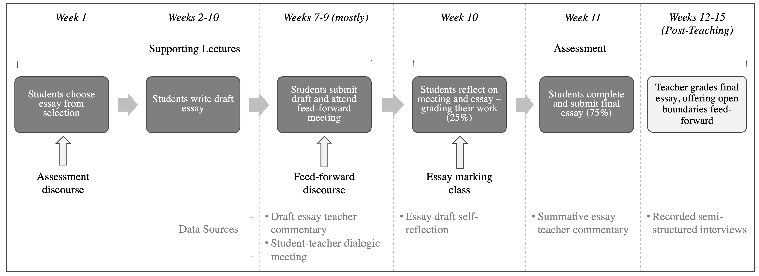
Dialogic feed-forward approach

Slide 5
Research Aim
Our aim was to uncover the affordances and challenges presented by feed-forward dialogue, considering, in particular, students’ responses to teacher commentary.
We focused on students’ intellectual engagement, emotions and learning behaviours, both in-task and with respect to other units, and we considered what this meant for their self-efficacy and performance outcomes.
We also wished to address the acknowledged shortfall that ‘there are comparatively few studies of how students use feedback’ (Winstone and Carless 2020: 5).

Slide 6
Methods
We examined the personal learning journeys of four students who engaged with dialogic feed-forward in a second-year undergraduate geography unit at a large, teaching-focused British university.
We accessed various sources of data for each student:
Semi-structured interviews on completion of the unit (see Hill & West 2020)
Recordings of teacher-student feed-forward meetings taking place during the unit
Draft and final essay submissions (with teacher commentary)
Draft essay self-reflections
Focus group interviews at the end of students’ final year of study
Student performance within and beyond the unit.

Slide 7
Sample student biographies
Name | Academic disposition | Unit trajectory | Final degree classification
Jane | Motivated and confident. Attended and engaged well. | Draft essay mark mid- to high- 50s. Final essay mark 78% | First-class
Sally-Anne | Lacked confidence as she had come through a foundation degree. Attended well. | Draft essay mark low 40s. Final essay mark 66% | First-class
Melanie | An engaged student who attended well. | Draft essay incomplete so no grade offered. Final essay mark 66% | Upper second-class
Carolyn | Motivated but reticent to share ideas openly in class. Attended well. | Draft essay mark mid-40s. Final essay mark 60% | Lower second-class
Notes: 1. Student names are pseudonyms, 2. Academic disposition is a description offered by the teacher rather than the students.
Notes:
Notes: 1. Student names are pseudonyms, 2. Academic disposition is a description offered by the teacher rather than the students.

Slide 8
FINDINGs: Student 1 - Jane
Teacher feedback on Jane’s draft essay highlighted several weaknesses – with a grade around 57%.
During the feed-forward meeting Jane acknowledged her struggle to write clearly. However, when verbally explaining the confusing statements she did so effectively. There was disjunction at this stage between intent and execution.
Jane was able to decode teacher commentary through active questioning:
‘That was the best aspect, being able to work with the lecturer. The whole discussing what’s written, what it means … I can question until I understand’

Slide 9
Findings: Student 1 - Jane
Key weaknesses highlighted during the meeting were taken up by Jane in her work in progress. Given the opportunity to act, she revised her work successfully.
The reflective exercise encouraged her to judge her work against the marking criteria:
“After considering the feedback conversation and then relating it to the marking criteria, I looked at my draft another two or three times, whereas usually I just skim over it once and hand it in”
She developed higher level cognitive processing, understanding and enacting critical thinking.
Jane secured a high first-class mark for her final submission.

Slide 10
Findings: Student 4 - Carolyn
Carolyn’s draft essay was poor, falling within the third-class band (40-49%).
In the face-to-face meeting Carolyn acknowledged that her draft was not fully formed and that she wanted feedback to gain direction.
She commented that she had planned a structure but believed she had ‘lost her way’ during the writing. The dialogue focused on generating Carolyn’s insight into developing a good structure for her essay and enhancing its critical depth.
Teacher feedback on Carolyn’s final submitted essay (awarded 60%) noted that she had built on her first draft by including a wider range of case studies, applied more effectively to the question.

Slide 11
Findings: Student 4 - Carolyn
Emotionally, Carolyn observed that receiving the teacher commentary was ‘hard but helpful’:
‘I don't always get my feedback because I’m too nervous to go and see the lecturer. But with this you’re encouraged to and that’s good … rather than hiding from your grade, and what went well and what went wrong, you actually discuss it’
Carolyn also believed that going through the process helped her with other second year essays:
‘I know how to structure better and where to go with the research … I will make sure I do a detailed draft and then go through it with the marking scheme’

Slide 12
Key highlights: improving work within and beyond task
The process of dialogic feed-forward promoted all elements of feedback literacy to some extent: appreciating the purpose and value of feedback; making judgments; managing affect, and demonstrating volition and agency to act.
Engaging in dialogic feed-forward helped the students to clarify the task requirements in terms of aims and content (e.g. ideas and analysis) and form (e.g. the structure and coherence of the text).
The students self-avowed to increased self-efficacy, which sustained their motivation and led to improved performance outcomes (see Hill and West 2020).
The assessment dialogue prompted changes to longer term learning strategies as students transferred their positive behaviours and understanding to other units.

Slide 13
Key highlights: Intellectual and emotional responses
Teacher commentary was sometimes challenging for the students to receive, especially those with more vulnerable academic dispositions.
Dialogue with the teacher helped the students to manage their emotions – key here was the establishment of a personalised and caring ‘safe space’ for learning and receiving, sometimes critical, feedback.
Feeding forward in a low stakes environment eases stress for students, helping some to overcome their fear of critique - they can make good their work and learn from their weaknesses before formal grading.

Slide 14
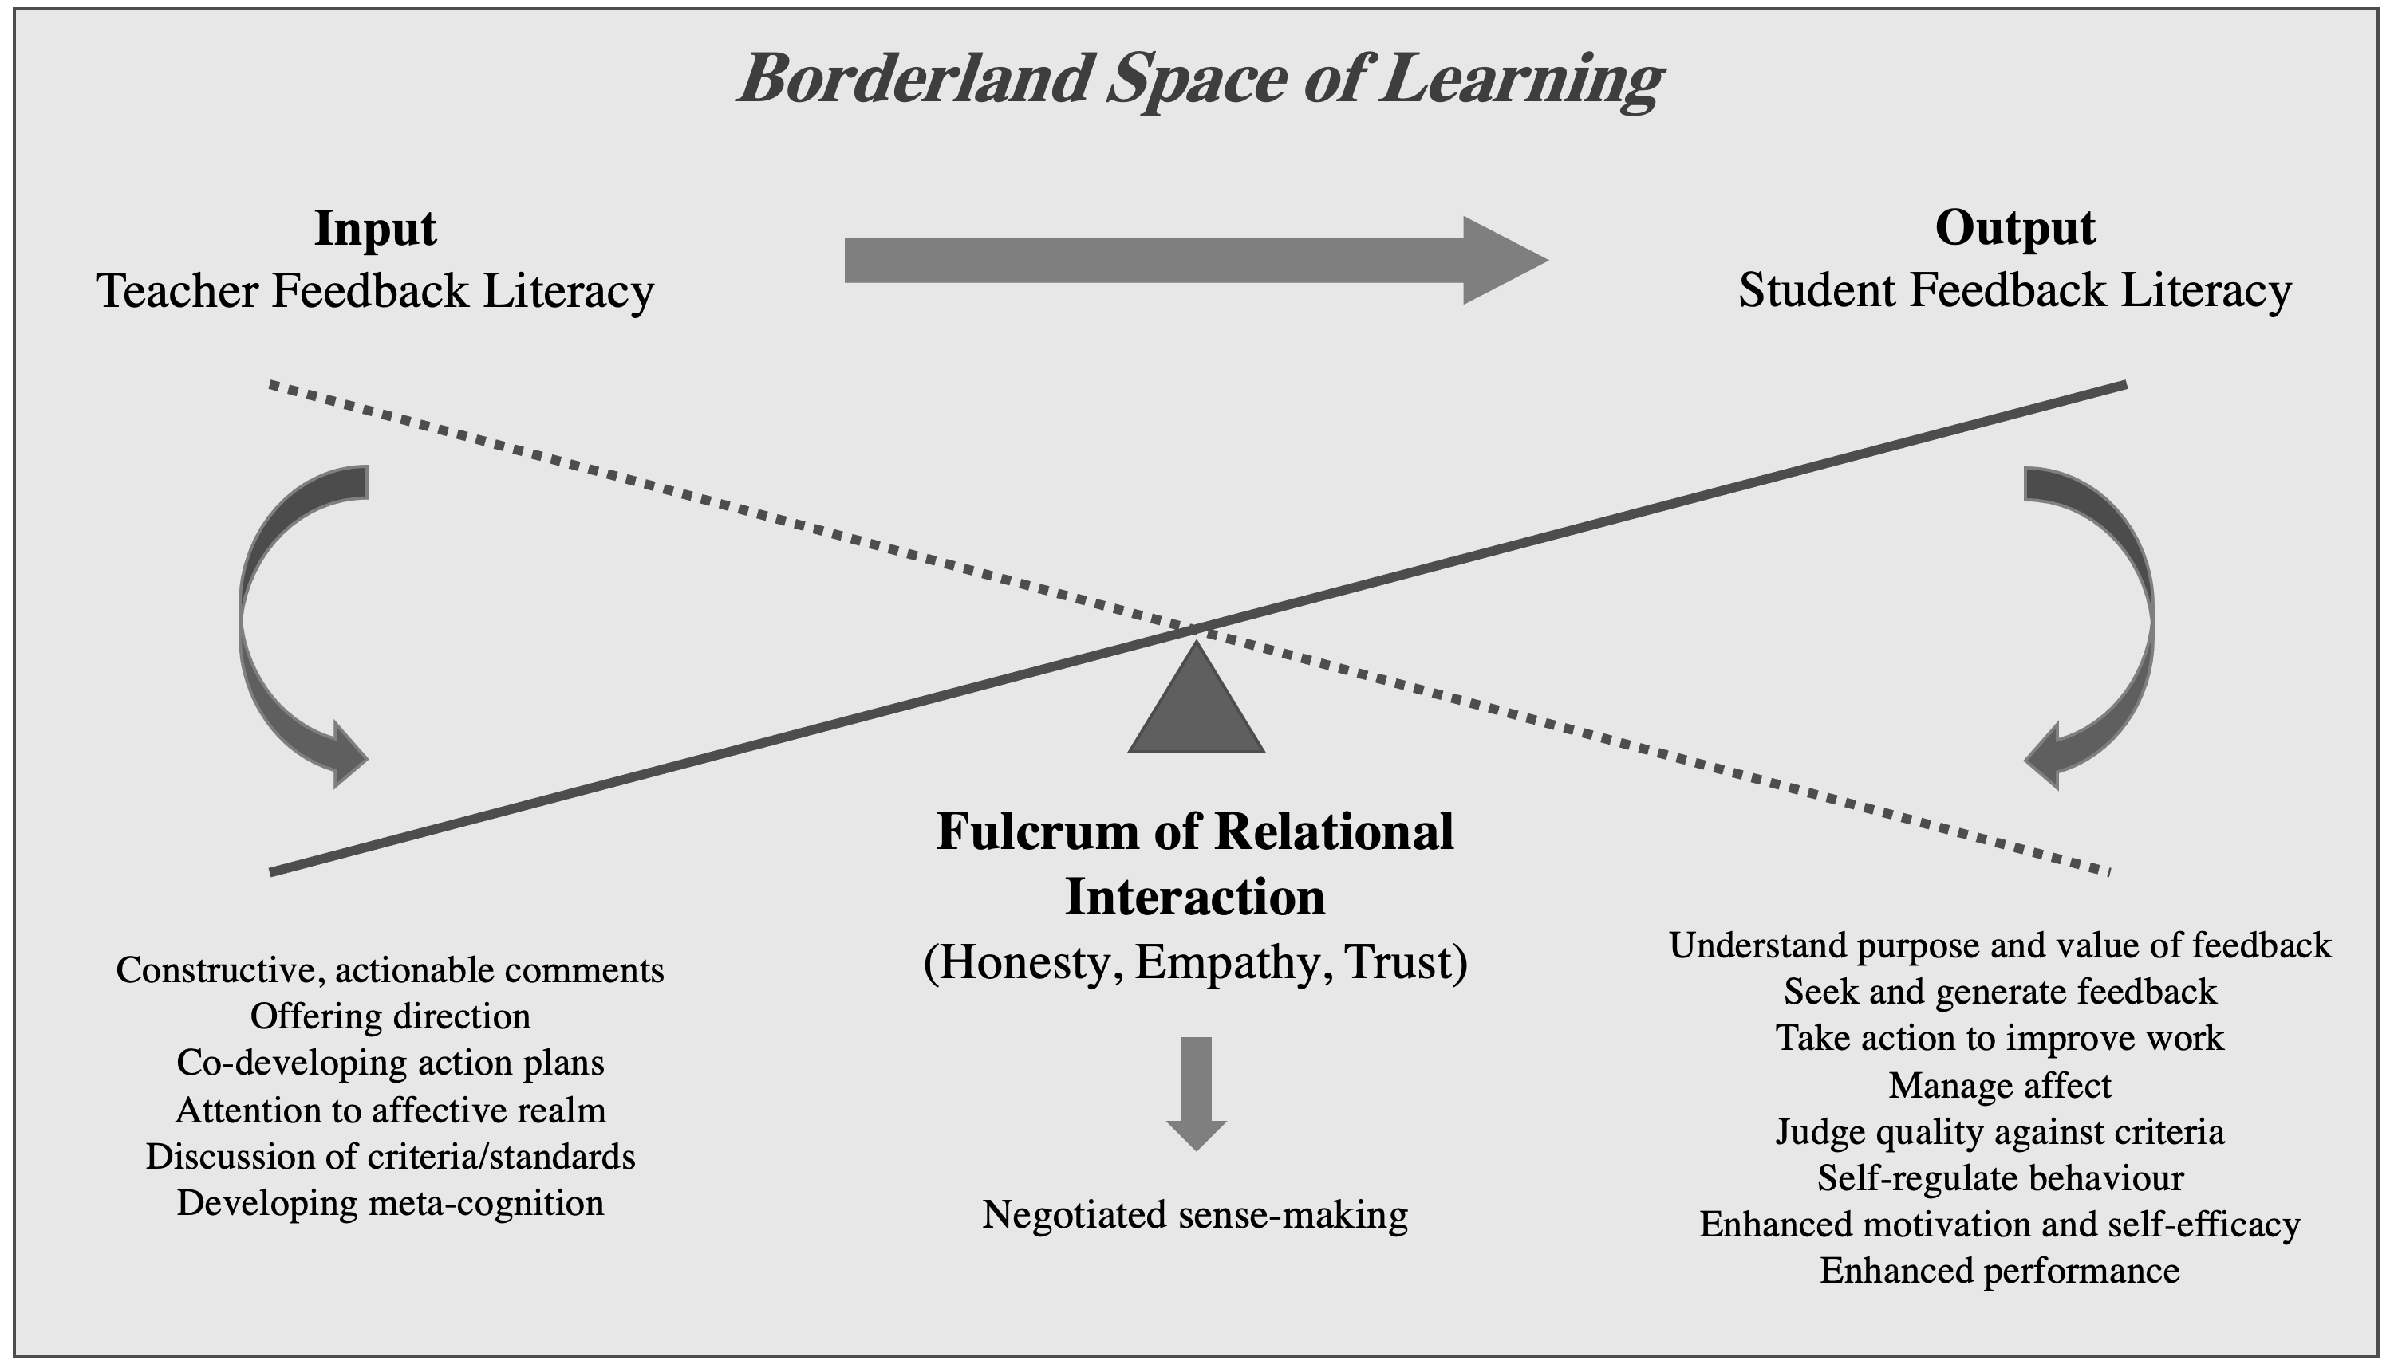
Dialogic feed-forward as a pivotal moment
Our results evidence that personalised DFF can act as a fulcrum, changing passive teacher comments, via a process of negotiated sense-making, into outputs of positive student motivation, behaviours, and performance.
Such meaningful connections can act as pivotal moments in learning.

Slide 15
Problematising dialogic feed-forward
Despite the clear benefits of DFF, if we adopt a broader frame of reference, we can recognise some important challenges …
We recognize that DFF is a resource-intensive intervention.
To offer practical and impactful feedback strategies, the approach needs to be designed strategically into the curriculum (Boud and Molloy 2013).
Possibly in the first year of study when students need to build confidence in their ability to work at degree level and understand their responsibility in seeking out and implementing feedback.

Slide 16
Problematising dialogic feed-forward
Each year, two or three of the 36 students on the unit did not attend a meeting with the teacher.
The dialogic process failed to help reluctant (predominantly white male) students who were not prepared to engage fully with taught classes or feedback opportunities.
Equally, students who presented an excellent, first-class draft (over 70%) often improved their draft only minimally. These students tended to undertake cosmetic or token changes.
This was due largely to the predicted grade meeting their expectations and not wanting to make changes that might lower the final grade.

Slide 17
Problematising dialogic feed-forward
A dialogic feed-forward approach can take students and teachers into ‘borderland’ spaces of learning (Hill et al. 2016).
Moving into these spaces, where they take a more active role in their learning, can be emotionally demanding, often taking students beyond their comfort zone and initiating feelings of uncertainty, vulnerability, and discomfort (Hill et al. 2021).
Teachers should support students to take part confidently in conversations, enabling them to question and challenge, and not feel their self-esteem is threatened (Blair and McGinty 2013).

Slide 18
Summary
Dialogue can play an important role in helping students interpret and work with teacher feedback/feed-forward.
Students report the many benefits that a DFF approach to assessment can have, including sense-making, confidence building, and developing A&F literacy applicable to other work.
As such, DFF can act as a pivotal moment in a student’s learning journey.
However, it is important to reflect on the potential problematics of a DFF approach, including challenges in workload resourcing, the responses of different student groups, and the importance of reflecting on the emotional aspects of receiving feedback in this way.
Notes:
There is also an over-arching question of whether we are truly enabling our students to become autonomous and independent thinkers through such a feed-forward process or whether we are, in fact, socializing our students into a particular way of thinking and being (Ball 2012). To remain true to developing students’ independent critical consciousness, teachers might establish assessment dialogue in a manner that allows students to appropriate their own understanding.
For more information see Hill, J. and West, W: Dialogic Feed-Forward in Assessment: Pivotal to Learning but not Unproblematic. Forthcoming in Teaching and Learning Inquiry.

