Slide 1
Use of Blended Learning to Teach Mathematics to First Year Economics Students
Mohamed Azeem Haroon
Programme Leader for BA/Bsc (Hons) Economics

Slide 2
Plan for the day
Setup of the class
Information technology used
Looking at students engagement with pre-recorded content
Module evaluation report
Research Design
Findings
Conclusions

Slide 3
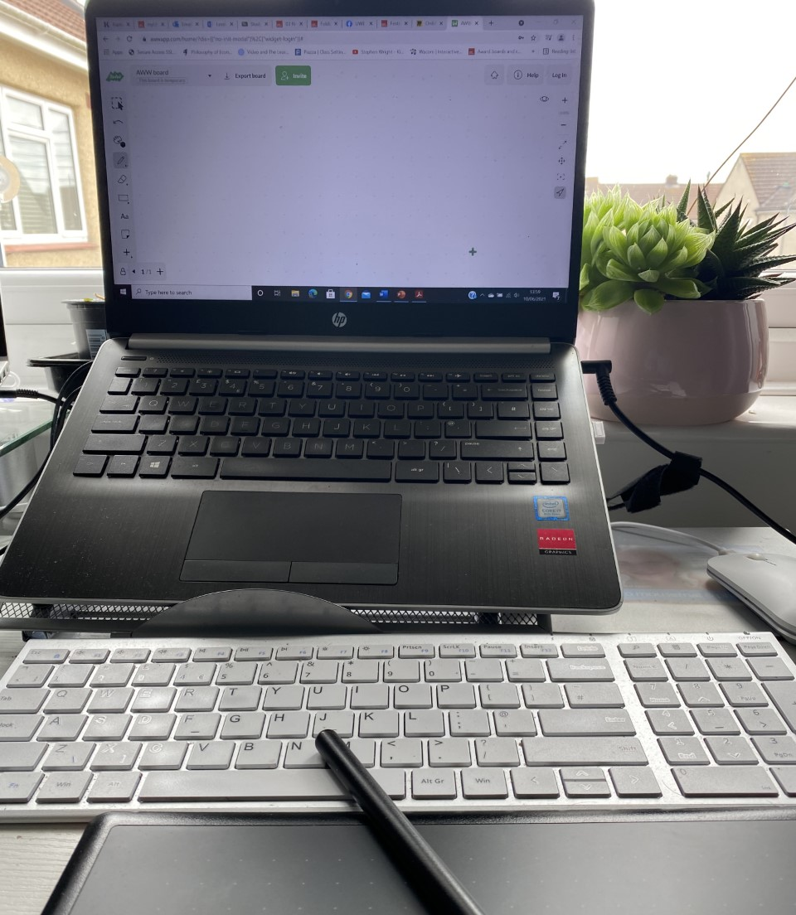
The setup
First year mathematics for economics modules titled ‘Model Building in Economics 1’.
Number of students enrolled in 2020-21: 32 students
Format of the class:
1 hour online live lecture
2 hours f2f workshop (until 2nd December), then moved fully online
Pre-recorded videos involving worked examples for each main theme covered
All lecture materials are made available for students in advance
Detailed solutions to tutorials provided.

Slide 4
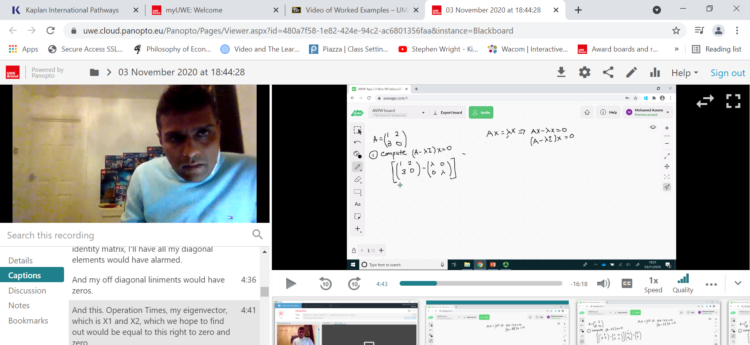
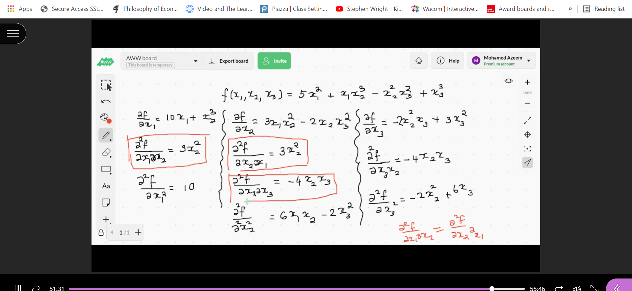
Information technology use in T&L
Live sessions are run through blackboard collaborate
A digital whiteboard is used from Awwapp
Wacom tablet is used to write on the slides and on Whiteboard
Pre-recorded sessions are done through Panapto.
At the end of each theme DEWIS quizzes for students to measure their own learning

Slide 5
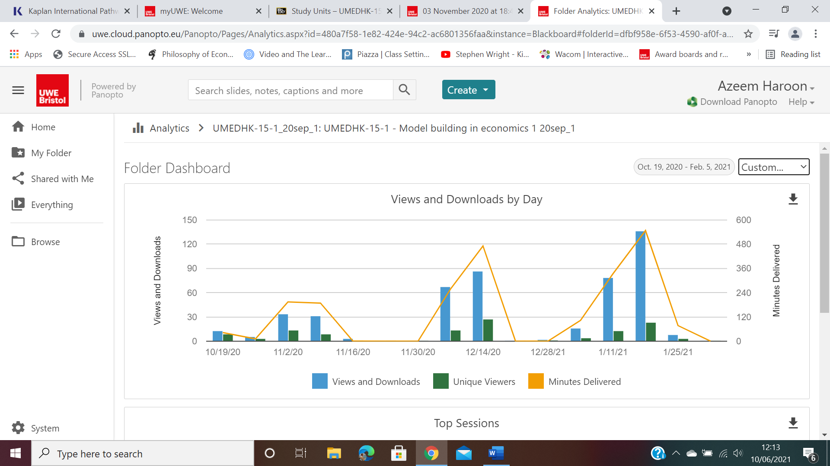
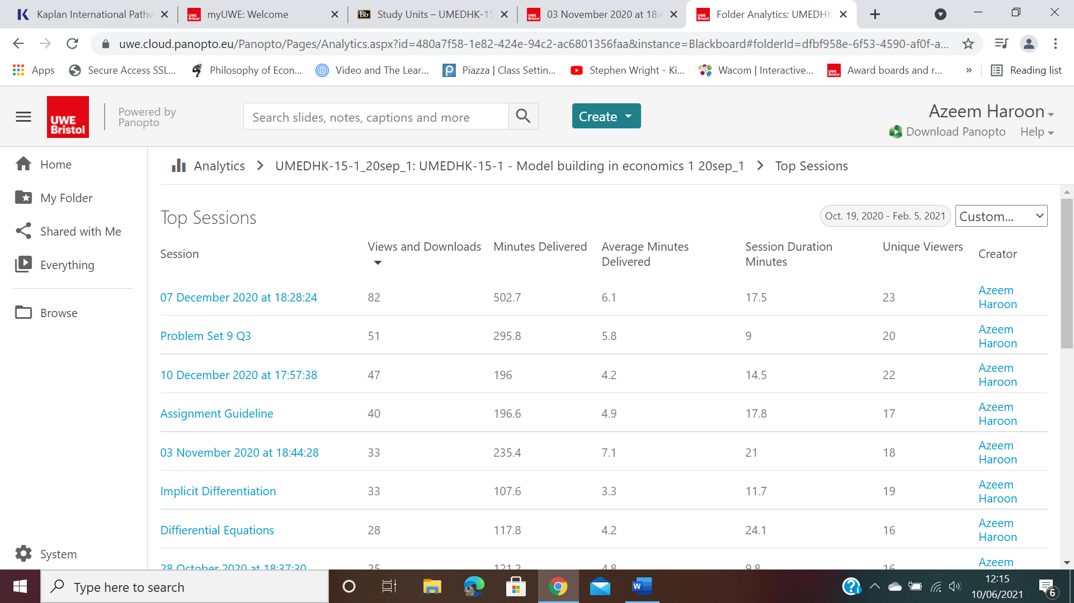
Student engagement with asynchronous content
Engagements cannot be measured on a daily basis
Peaks closer to each assessment point
Following assessment a period of silence
More difficult concepts has over 70% engagement

Slide 6
Looking at module evaluation reports
I found the mix between online and in-person useful. There was always independent work that could be done, worksheets and DEWIS tests, useful to practice the content worked on in class.
The in person lectures are structured very well, and a lot more informative.
a little less rushed if possible, I find myself going back over lectures every time because I cant take everything in.
I enjoy the on campus tutorials as I understand the topics better
Can be difficult to follow the online lectures occasionally

Slide 7
Research Design
During week 6 a questionnaire was administered to all students attending face-to-face workshops
Response rate: 25% of the class.
The questionnaire aims to establish the following connections:
relationship between online learning and student experience of the module
role of online setting in developing a learning community
student perception of their digital identity and barriers to effective online engagement.

Slide 8
Main findings
100% of the students rated their experience of the course delivered using blended learning platform is good.
In the module evaluation survey 83% agreed that they are satisfied with the module delivery/
40% of the students said online classes contributed positively to their learning while 60% of the students stated that the online classes had no significant effect on their learning.
80% stated that they find it difficult to engage with the sessions online and requires more effort.

Slide 9
Challenges associated with online delivery
Reason for difficulty in studying online | % of responses
I find it difficult to concentrate | 80%
I find it difficult to engage online | 80%
My digital skills deter me from participation – I am not good at technology. | 0%
The design an place of delivery by lecturer | 20%
I feel lost and do not know how to project my self during online sessions. | 40%

Slide 10
Aspects of online learning that worked
On-screen step-by-step working
Easy to pace as following slides are easier.
Availability of online live sessions recording to go back to

Slide 11
Aspects of online delivery that requires improvement
Slower peace.
Managing concentrating to the screen and taking notes. Doing both simultaneously is difficult.
Unable to determine where to focus on the screen.
Difficulty to see lecturers cursor – do not know where the cursor is pointed at

Slide 12
Conclusions
There are benefits to students learning by having asynchronous content and recorded materials as evidence from engagement tool.
Much work is needed in equipping students on how to learn online such as
Developing online focus
Developing effective note taking skills
Developing students digital personalities
Inability to engage online during live sessions are due to them being new to online T&L

Slide 13
Thank you

