Slide 1
Presentation by
Elena Marco
Katie Williams
Sonja Oliveira
Danielle Sinnett
Stuff & Space in the Home
An understanding of material possessions to inform spatial storage design
14/04/2021
Housing Studies Association Conference 2021

Slide 2
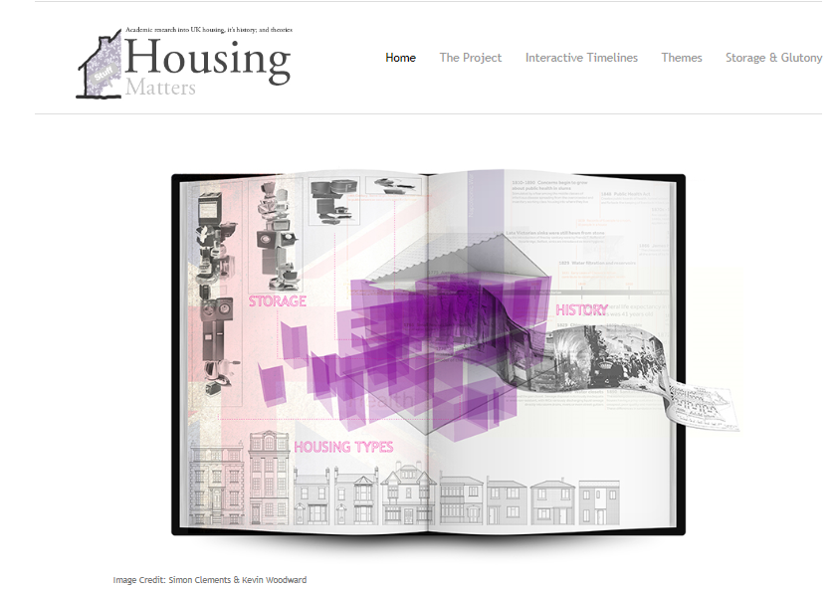
Presentation Overview
The Basics - Introduction
Scope of Study – Stuff & Space
Methodological Rationale
Findings
Conclusion

Slide 3
The Basics
The UK is inhabited at 257 people/km², and is one of the most densely populated countries.
On average each person in the UK has 44m² of usable floor area
The UK has the 5th smallest homes in Europe, averaging 87m²
It has the joint highest number of rooms per m² - 4.7
And the third smallest average room sizes- 18.5m²
In the same footprint we fit more ‘must-have’ rooms than ever.
And at the same time we have more stuff than ever…
Notes:
UK has a low number of people per dwelling - 2.3
7% of households in the UK >4 people - half of the figure 30 years ago
1 person households rose from 18% to 29% over 30 years
Nowadays we are almost 70% more single person households, nearly half of which will contain pensioners
By 2070 the UK is expected to be a ‘super-aged’ population.

Slide 4
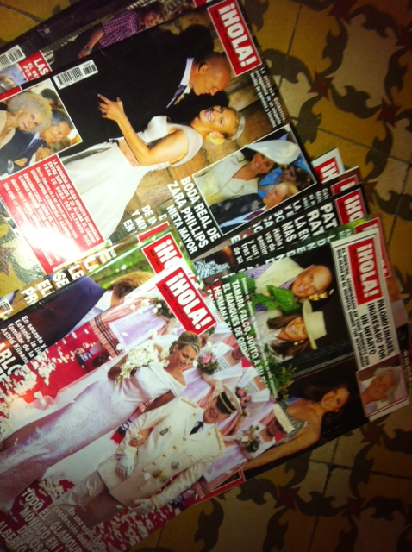
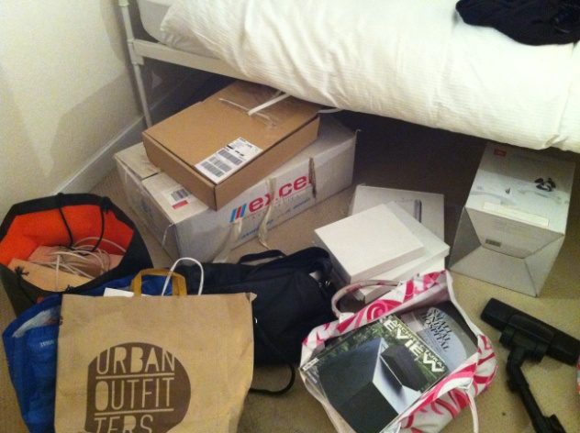
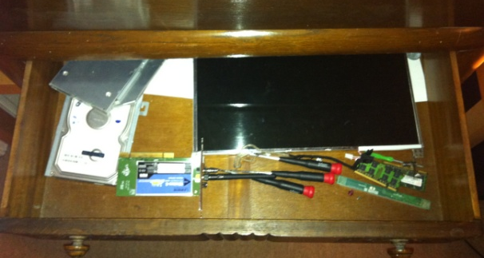
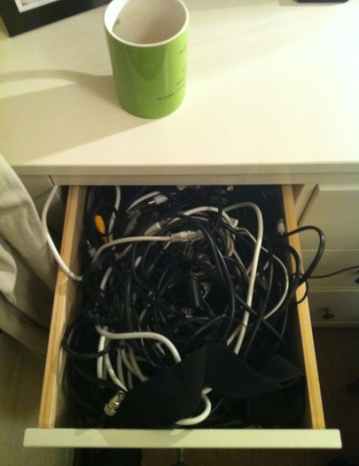
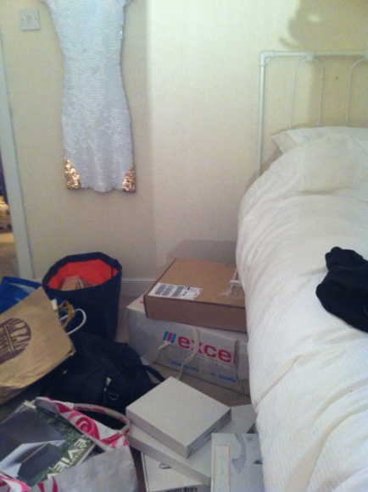
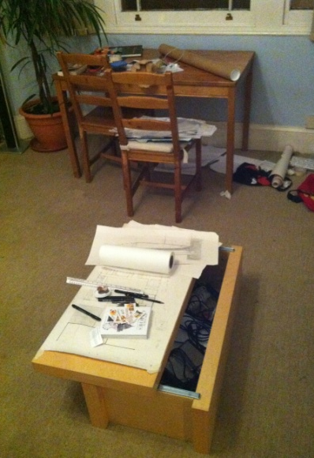
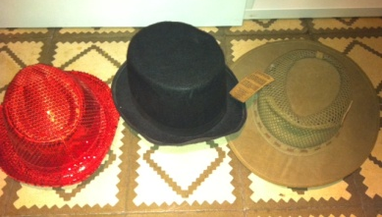
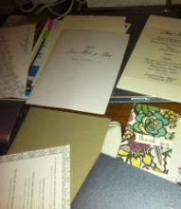

Slide 5
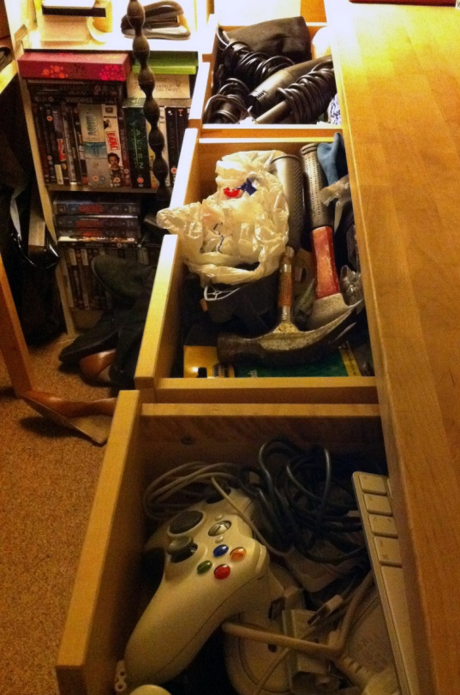
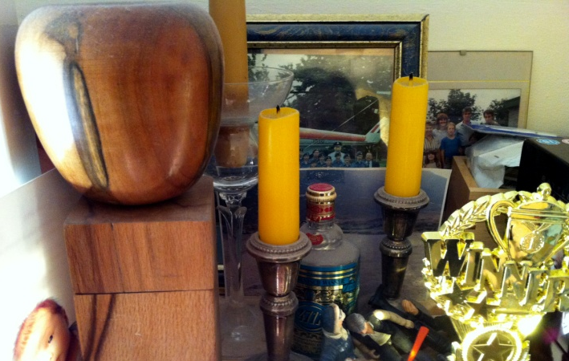
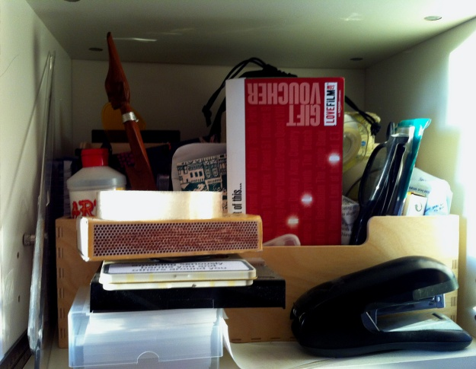
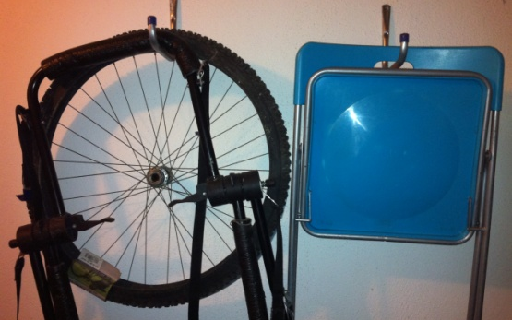
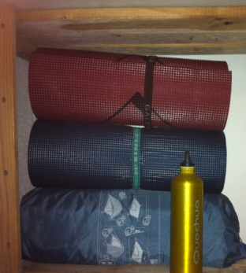
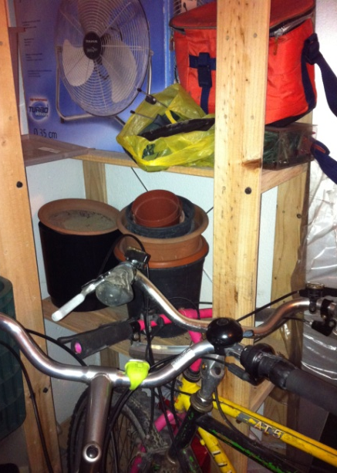
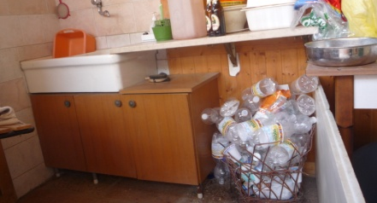
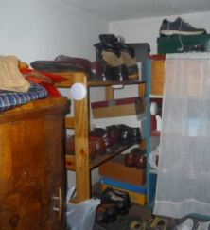
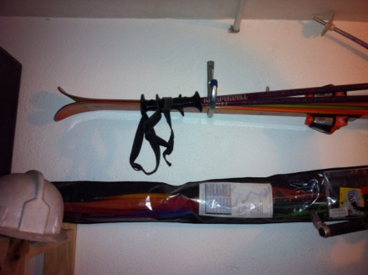

Slide 6
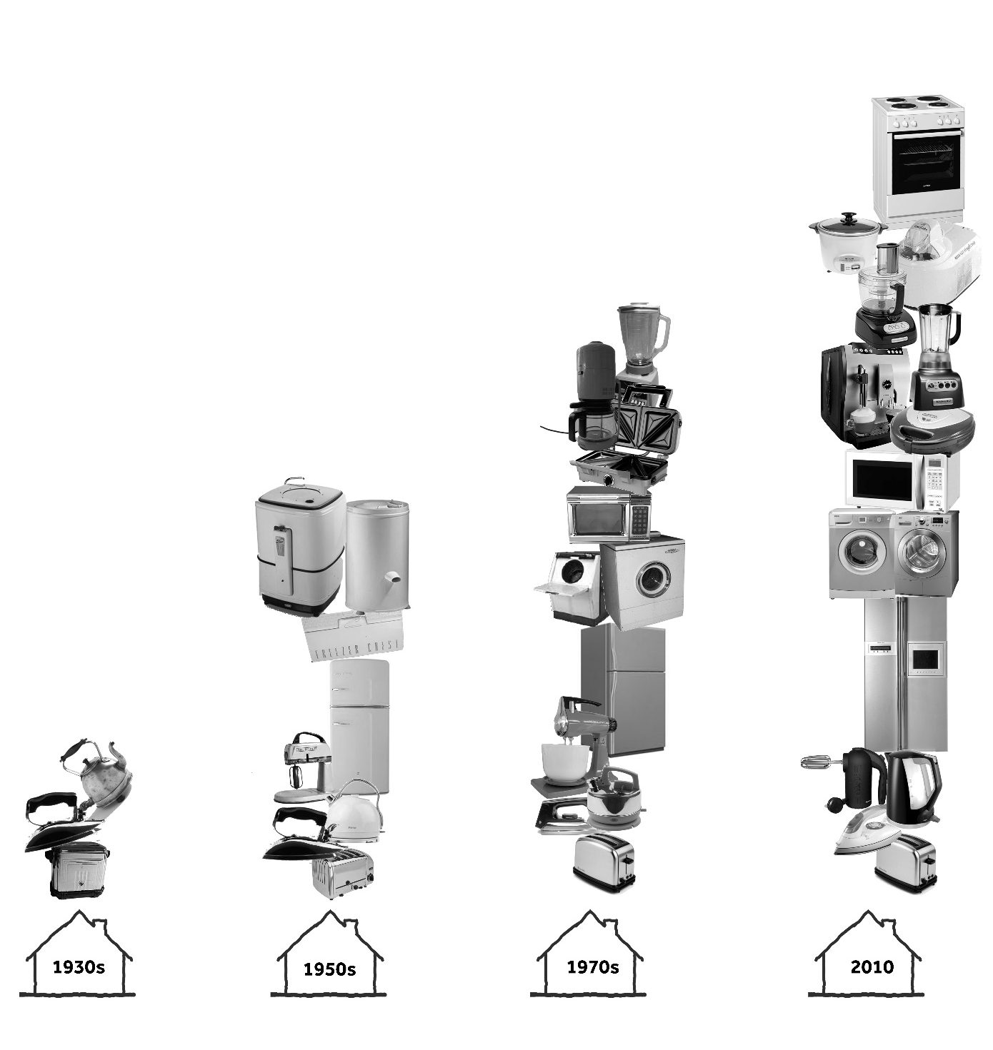
Stuff & space in our lives

Slide 7
Space is overwhelmed by..
not-at-present-in-use-maybe-never-again objects
DEAD- STORAGE
Notes:
CONTEXT/OUR INITIAL THOUGHTS
Parker Morris standards, RIBA research

Slide 8
Material Possessions Analysis people have more stuff than ever material possessions facilitate everyday life
The problem
Research Problem
Houses are not well designed for today’s material possessions
Housing Problem
Analysis
houses are too small
more rooms are crammed in same house footprint
spaces change use to accommodate possessions
How to design houses better for today’s material possessions
Notes:
Storage is fundamental but invisible dimension of inter-personal relationships and inhabitant’s lifestyles that has gone unnoticed in the design of standardised house types
Storage has been overlooked in consumption theories, and I argue, in design
Storage facilitates order, both physically and mentally, in the inhabitant and affects happiness and well-being.
Storage orders material possessions in space and time, and as a consequence also orders the activities, inter-personal relationships and lifestyles of inhabitants
Storage is not valued by inhabitants when buying a house, but inhabitants complain later that there isn’t enough storage
By including storage in the designers agenda, we can begin to provide modern housing that truly reflects the needs of the inhabitants

Slide 9
Why does this research matter?
Storage is fundamental but invisible dimension of inter-personal relationships and inhabitant’s lifestyles that has gone unnoticed in the design of standardised house types
Storage has been overlooked in consumption theories, and I argue, in design
Storage facilitates order, both physically and mentally, in the inhabitant and affects happiness and well-being.
Storage orders material possessions in space and time, and as a consequence also orders the activities, inter-personal relationships and lifestyles of inhabitants
Storage is not valued by inhabitants when buying a house, but inhabitants complain later that there isn’t enough storage
By including storage in the designers agenda, we can begin to provide modern housing that truly reflects the needs of the inhabitants

Slide 10
Multi-methodological approach
Design Research
Expresses the qualitative aspects of the world
Adding something new through design
Design takes a significant role during the research process
Reflective
Exploratory
Experimental
Experience
Visual Ethnography of a
Design Process
Visual / Sensory Ethnography
Participant observation
Routes to understand people’s experiences
Notes:
Combining two explorative methodologies, design research and visual / sensory ethnography, to capture ‘the visual ethnography of a design process’ with practising architects, so an issue raised in practice, but relatively unexplored academically, can be approached from a novel perspective.

Slide 11
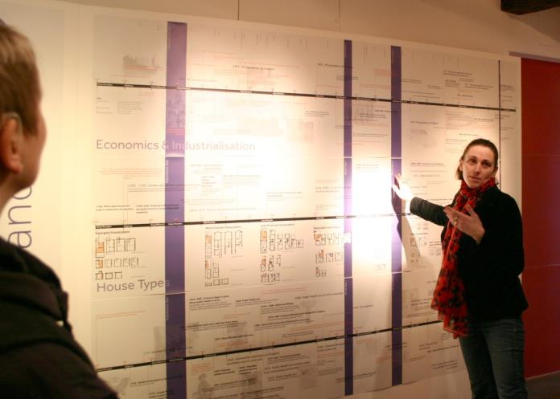
Findings
Notes:
To understand how the design of today’s domestic space has changed over time, and to identify the role that material possessions have played in this change.
Capturing the intellectual agenda of the house as a ‘container’ and the household contents, the stuff, as the ‘contained’. This intellectual agenda, disseminated in the form of an interactive website, advances the theoretical knowledge of the subject of housing design and its associated material possessions.
Identifying six key themes that have impacted the evolution of the concept of domestic space over the last 200 years. The themes were: Economics and Industrialisation; Health; Legislation and Policy; Society; Lifestyles and Technology; and changes in the domestic space of a terraced house typology. These themes were then developed into six graphical timelines, publicly available on a website, providing a unique representation of the development of the UK’s housing stock over time.
Identifying the disconnect between the available storage space in the home and the amount of material possessions that a household contains.
Showing that the size of small terraced houses (two-bedroom) has not changed over time, whist medium- and large-sized terraced houses have shrunk. Georgian, Victorian and Edwardian typologies have been modified the most, via additions of kitchens and bathrooms, whilst the typologies built between 1930s and 1970s were the most spacious. The bathroom has most impacted the overall footprint of the house, especially since 1990s. Kitchens were found to have halved in size in medium- and large- houses over the last 200 years, while it has remined similar in the small typologies. This reduction in size has been linked in the literature with the servantless house and the technological advances in appliances (Muthesious, 1982; Ravezt, 199%), however this study also found significant reduction in storage and work surfaces. Furthermore, the development of ‘open’ kitchens (open-plan or kitchen-dinner) has also reduced the amount of space available to carry out the different activities associated with the kitchen, lounge or dining room.

Slide 12
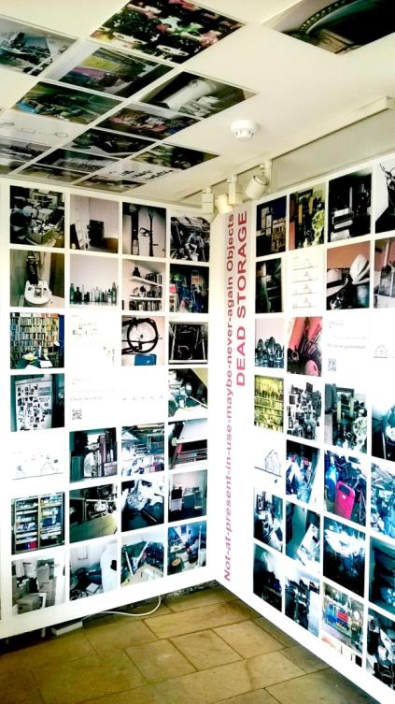
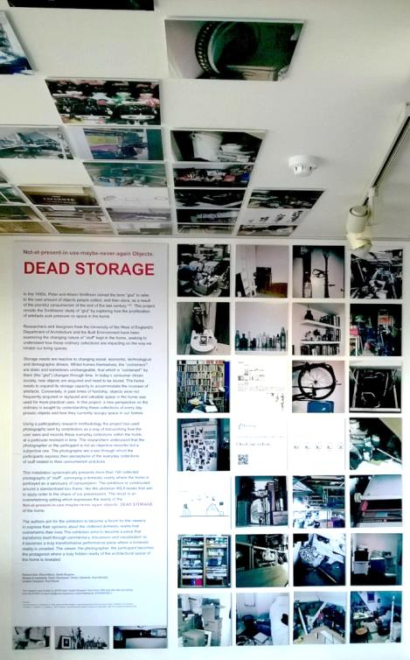
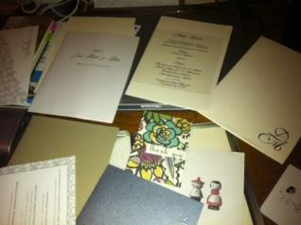
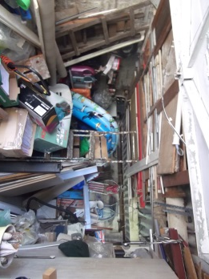
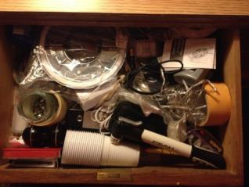
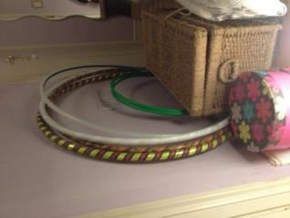
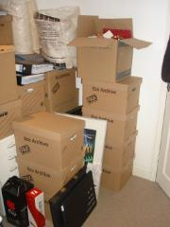
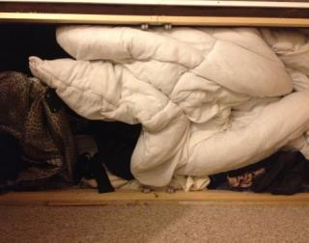
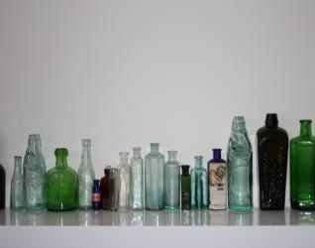
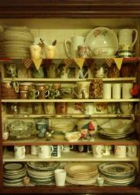
Findings
Notes:
Developing three core architectural visual probes (design research) for three different participatory events as part of the study. The first visual probe was a participatory exhibition, used as a data-gathering tool to get privileged insights into inhabitant’s personal spaces and possessions in the home (Output #2). The second was the architectural model in itself, that was used as a probe to record and store the progress of the study and to communicate the research findings in abstract form (Output #3). The model was also used as a probe to test the effectiveness of the sensory / visual ethnography methodology. The third visual probe was in the form of four diagrams that captured the conceptual framework of material possessions as a way of seeking new design insights for housing design (Output #4).
Identifying from inhabitants, through a participatory exhibition, six-core categories of material possessions: those associated with specific rooms and spaces, those hidden away or displayed, those associated with cycles of use, those related to specific points in the life of inhabitants, those related to maintenance and repair, and those which are archival possessions. These categories give an insight into where inhabitants keep their ‘stuff’ and the extent to which material possessions impact on the physical space of the home.
Revealing the material possessions that inhabitants own, and where they are located in the home. This exposed spaces in the home that are hidden, messy and never seen by invited guests. In contrast, it also showcased spaces that are displayed, carefully composed and exhibited for the household members or invited guests to see. Unlike previous studies that have been more focused on material possessions related to specific areas of the house, such as the garage (Hishman, Ruvio and Belk, 2012), open plan areas (Dowling, 2008) or the kitchen (Shove and Southerton, 2000; Shove, 2003), this study included the totality of the home.
Using a participatory exhibition with auto-photographs taken by the general public to unveil the domestic reality of how material possessions impact on the physical space of the home. The event was particularly novel in that it allowed visitors to the exhibition to contribute their own photographs to the exhibition, so the sample size and range of the exhibition grew as a consequence. It showcased a domestic reality that is generally hidden away from the public and only seen by the household or invited guests. It reinforced the disconnect, already identified through the graphical timelines (Output #1), between storage space and the amount of material possessions that a household contains.

Slide 13
Findings
Notes:
Making a novel and original theoretical contribution to the field of architecture by bringing together for the first time, the sociological, anthropological and consumer research literature, to develop a conceptualisation of material possessions in the form of a new conceptual framework for housing design thinking. By using this conceptualisation, architects, policy makers and house builders can evaluate their practice and adopt a new approach that considers the implications for storage in homes, especially when space is at premium. In this study the impact of material possessions on the physical space of the home, as well as the location of storage of these possessions, is presented as a new perspective for consideration in the current housing debate. The framework identified value, temporality and visibility as the universal characteristics of material possessions. Valued possessions can be categorised as utilitarian, pleasurable, and either shape the inner and / or external self. While the utilitarian and pleasurable possessions are part of short-, medium- or long-term cycles, material possessions related to identity are more sensitive to unidirectional flows of time, be they ‘life flows’, ‘emotional flows’ or ‘lifestyles flows’ (temporal categories). Then, depending on the sentimental, financial or aspirational value placed on the material possessions by the inhabitants, some items will be visible to themselves and others, and some will be hidden away from view (visibility categories). The conceptual framework then integrates these characteristics and categories with spatial information about the home, in the form of strategies for storage at room- and house- level. Hence, this study has identified how material possessions need relevant and carefully designed spaces for storage. Currently, space for storage is not a priority addressed in the most recently published design guides (DCLG, 2015), regardless of the importance placed on such spaces in more historical guides (MHLG, 1961; BRE, 1993).
Making a novel and original theoretical contribution to the research fields of sociology, anthropology and consumer research by building on the work of Richins (1994), Kamptner (1989), Dittmar (1991), Csikszentmihalyi and Rochberg-Halton (1981) and Marcoux (2001) through the identification of universal characteristics of material possessions that could be of use in housing design.
Demonstrating that practising architects found the conceptual framework effective as a prompt to remind them that real people with real material possessions will be living in standardised houses. It produced new empirical knowledge of how storage can be included in housing design, avoiding cluttering spaces and therefore impacting positively on the quality of life and well-being of the inhabitants. The majority of participants who tested the effectiveness of the framework recognised that it unpicked an area of housing design that they had not considered at such a level of detail.

Slide 14
Findings
Notes:
Developing a visual ethnographic six-stage design-probe method with practising architects, which combined qualitative research interviews, in the form of in-depth semi-structured interviews supported by architectural visual probes, with a design event engaging the practising architects.
Stimulating new housing design approaches focused on storage for material possessions related to activities, inner- or external- self, either at room- or house- level.
Demonstrating that the space for storage has been eroded to accommodate the ever-increasing number of ‘must-have’ rooms that reduce the flexibility of developers’ schemes and amount of overall storage space. This study has also argued that a consideration of storage and its associated practices is vital for housing design. It proposes new storage strategies at house- or room- level as part of the new conceptual framework of material possessions for housing design. By considering the characteristics of space and possessions, the inhabitant’s lives and lifestyles can be better supported, which will have a positive impact on their health and well-being.
Approaching design for storage by trying to create a valued ‘room’ in the form of a ‘wall of storage’ or a ‘central house storage’. Storage became a valued dedicated space in itself, one that could be costed-in and marketed by the developers. Creating a valued ‘must have’ room that embeds storage is a way to challenge the static developers’ portfolios. This study proposes ‘common sense’ design responses that bring back flexibility within a standard typology. These design approaches reinforced previous studies, where flexibility had been considered as an essential part of any housing provision (Schneider and Till, 2005). They also built on the work of Bentley (1999), by placing the inhabitants, and their well-being, at the centre of any design decision. However, this study advocates achieving flexibility whilst maintaining current standardised house types sizes and exploring the reduction in number of these ‘must have’ rooms. This is a key message for both practitioners and policy makers, as the viability and affordability of housing is an important factor that cannot be ignored.
Concluding that a ‘layered approach to storage’ is crucial. This reinforces previous studies’ findings (Schneider and Till, 2005; Wigglesworth, 2019) that housing models need to be driven by flexibility and adaptability as well as inhabitant’s profiles. For example, the framework led two participants to explore the novel idea of an ‘expandable and contractible attic space’ to accommodate long term possessions. Another developed the idea of a ‘blanket house’, that not only considers internal storage but also external storage (e.g. bikes, bins, garden tools, maintenance tools, etc.). Flexibility has been identified as an essential part of any future housing provision.

Slide 15
Conclusions
Storage needs to be valued and flexibility has to be the default, so that new models of housing can emerge that address the well-being and health implications associated with the cluttering of space.
Viability and affordability of housing cannot be ignored !
Notes:
Having completed this study, the researcher now advocates for housing policy makers, practitioners and architectural researchers to acknowledge the relationship between material possessions and housing design. By better understanding the nature of ‘stuff’ and space in UK houses, houses can be better designed. Storage needs to be valued and flexibility has to be the default, so that new models of housing can emerge that address the well-being and health implications associated with the cluttering of space. These new models cannot ignore the viability and affordability of housing, especially when considering the smallest units, the standardised house types, but neither can they ignore the needs of the inhabitant’s themselves.

Slide 16
THANK YOU!
Notes:
Theoretical Contributions
Capturing the intellectual agenda of the house as a ‘container’ and the household contents, the stuff, as the ‘contained’. This intellectual agenda, disseminated in the form of an interactive website, advances the theoretical knowledge of the subject of housing design and its associated material possessions.
Making a novel and original theoretical contribution to the field of architecture by bringing together for the first time, the sociological, anthropological and consumer research literature, to develop a conceptualisation of material possessions in the form of a new conceptual framework for housing design thinking. By using this conceptualisation architects, policy makers and even house builders can evaluate their practice and adopt a new approach that considers the implications for storage in homes, especially when space is at premium. In this study the impact of material possessions on the physical space of the home, as well as the location of storage of these possessions, is presented as a new perspective for consideration in the current housing debate. The conceptual framework then integrates these characteristics and categories with spatial information about the home, in the form of strategies for storage at room- and house- level. This study has identified how material possessions need relevant and carefully designed spaces for storage. Currently, space for storage is not a priority addressed in the most recently published design guides (DCLG, 2015), regardless of the importance placed on such spaces in more historical guides (MHLG, 1961; BRE, 1993).
Making a novel and original theoretical contribution to the research fields sociology, anthropology and consumer research by building on the work Richins (1994), Kapmter (1991), Dittmar (1991), Csikszentmihalyi and Rochberg-Halton (1981) and Marcoux (2001) through the identification of universal characteristics of material possessions that could be of used in housing design.
Demonstrating that practising architects found the conceptual framework effective as a prompt to remind them that real people with real material possessions will be living in standardised houses. It produced new empirical knowledge of how storage can be included in housing design, avoiding cluttering spaces and therefore impacting positively on the quality of life and well-being of the inhabitants. The majority of participants who tested the effectiveness of the framework recognised that it unpicked an area of housing design that they had not considered at such a level of detail.
Using an architectural model as means to synthesise information from disparate sources and provide a visual representation of that information, so that the findings can be visually and conceptually archived.
Methodological Contributions
Combining two explorative methodologies, design research and visual / sensory ethnography, to capture ‘the visual ethnography of a design process’ with practising architects, so an issue raised in practice, but relatively unexplored academically, can be approached from a novel perspective.
Using carefully considered and constructed architectural probes (design research) in the form of a series of diagrams capturing a novel conceptual framework of material possessions and using them during the architectural design process.
Engaging users in a participatory exhibition as part of a visual / sensory ethnographic methodology to identify, expose and augment the way possessions are impacting on the physical space of the home and where people keep their stuff.
Using a participatory exhibition with auto-photographs taken by the general public to unveil the domestic reality of how material possessions impact on the physical space of the home. The event was particularly novel in that it allowed visitors to the exhibition to contribute their own auto-photographs to the exhibition, so the sample size and range of the exhibition grew as a consequence. It showcased a domestic reality that is generally hidden away from the public and only seen by the household or invited guests. It reinforced the disconnect, already identified through the graphical timelines (Output #1), between storage space and the amount of material possessions that a household contains.
Reflecting on, and testing, two exploratory methods through a design intervention event as way to re-focus the enquiry of the study in itself, and to ensure the architectural probes became an effective design tool. This also highlighted the importance of creating a ‘taxonomy of stuff’.
Developing a visual ethnographic six-stage design-probe method with practising architects, which combined qualitative research interviews, in the form of in-depth semi-structured interviews supported by visual probes, with a design event engaging the practising architects.
Using this ethnographic method, not with participants that have gone through a lived experience (in this context, the residents), but with the professionals that need to understand the residents (the architects themselves), to enact a rich dialog and design response.
Demonstrating how new knowledge can be produced by engaging a small number of practising architects in an exploration of design using a dynamic and reflective research method that challenged architects to approach a design problem from a new perspective.
Subject-specific Contributions
Undertaking a detailed graphical historical study with a focus on UK housing typologies, to assess the evolution of housing that, when combined with the review of possessions and photographs, demonstrates how the relationship between space and stuff has changed over time.
Stimulating new housing design approaches focused on storage for material possessions related to activities, inner- or external- self, either at room- or house- level.
Demonstrating that the space for storage has been eroded to accommodate the ever-increasing number of ‘must-have’ rooms that reduce the flexibility of developers’ schemes and amount of overall storage space. This study has also argued that a consideration of storage and its associated practices is vital for housing design. It proposes new storage strategies for at house- or room- level as part of the new conceptual framework of material possessions for housing design. By considering the characteristics of space and possessions, the inhabitant’s lives and lifestyles can be better supported, which will have a positive impact on their health and well-being.
Approaching design for storage by trying to create a valued ‘room’ in the form of a ‘wall of storage’ or a ‘central house storage’. Storage became a valued dedicated space in itself, one that could be costed-in and marketed by the developers. Creating a valued ‘must have’ room that embeds storage is a way to challenge the static developers’ portfolios. This study proposes ‘common sense’ design responses that bring back flexibility within a standard typology. Flexibility has been considered as an essential part of the future housing provision (Schneider and Till, 2007), and this study has reinforced this message for both practice and policy makers. However, this study advocates achieving flexibility whilst maintaining current standardised house types sizes and exploring the reduction in number of these ‘must have’ rooms. This is a key message for both practitioners and policy makers, as the viability and affordability of housing is an important factor that cannot be ignored.
Concluding that a ‘layered approach to storage’ is crucial. This reinforces previous studies’ findings (Till and Schneider, 2005; Wigglesworth, 2019) that housing models need to be driven by flexibility and adaptability as well as inhabitant’s profiles. For example, the framework led two participants to explore the novel idea of an ‘expandable and contractible attic space’ to accommodate long term possessions. Another developed the idea of a ‘blanket house’, that not only considers internal storage but also external storage (e.g. bikes, bins, garden tools, maintenance tools, etc.).Flexibility has been identified as an essential part of any future housing provision.
Concluding that the current developers’ housing portfolios are static and there is a need for new and appropriate housing models. These new models can address the health implications, such as stress, low mood and insomnia that have been associated with the accumulation of material possessions and insufficient space to store them (Raines et al., 2015; Saxbe and Repetti, 2010).
Challenging the way houses are currently sold, based on the number of rooms instead of floor space, so that space for living and storing possessions becomes valued. This has notable implications for housing policy and the current property market approach, as it would require a more-informed residents with a better understanding of what they need at different points in their lives depending on their lifestyles.

