Slide 1
Can practitioners adopt a mental health equality imagination for recovery?
Robert Lomax
Senior Lecturer
3rd December 2020

Slide 2
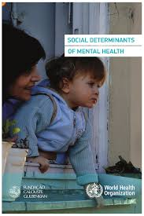
Social Determinants of Mental Health
‘the conditions in which people are born, grow, live, work and age, and inequities in power, money and resources’ (Marmot 2020, p1).
‘A person’s mental health (is) …shaped by various social, economic, and physical environments operating at different stages of life. Risk factors ..are heavily associated with social inequalities, where by the greater the inequality the higher the inequality in risk’ (WHO 2014, p9).

Slide 3
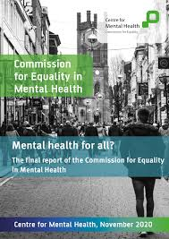
Mental Health Inequalities
Poorest 20% of households, four more likely to be diagnosed with a serious mental illness.
People from BAME communities have higher rates of PTSD, suicide, and Schizophrenia.
Women ten times more likely than men to have experienced physical or sexual abuse
People from the LGBT+ community have higher rates of common mental health issues
Impact of Covid 19 higher for some people from BAME communities

Slide 4
Recovery Approach
The recovery approach acknowledges the lived experience of service users, and stresses the need for greater choice and control in their lives
(Tew, 2013).
The recovery approach has become embedded in UK mental health policy but it is a contentious term. Some mental health survivors and service users challenge the co-option of the term by mainstream services (Howell & Voronka, 2012).
Can social workers really support recovery unless their practice is strongly informed by in a health inequalities/social determinants perspective?
Tew’s (2013) need for an overarching ‘recovery capital’ must include a focus on addressing economic and social capital, not just personal and identity capital.

Slide 5
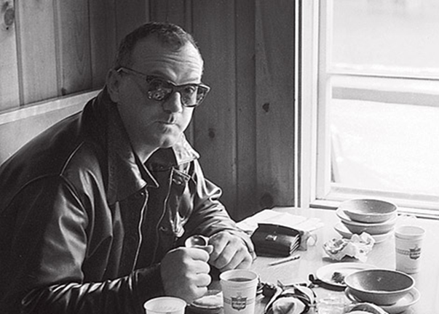
Sociological Imagination
“You can never really understand an individual unless you also understand the society, the historical time period in which they live, personal troubles, and social issues”
“The sociological imagination enables us to grasp history and biography and the relations between the two within society. That is its task and its promise”
C. Wright Mills (1959) ‘The Sociological Imagination’

Slide 6
Health Equality Imagination
‘Regardless of the context of practice, social work can develop a health equality imagination in order that, in both direct practice and in education, social workers are continuing to promote the growth of equality in health and well-being and not further contributing to inequality’ (Giles 2009, p530)
Can practitioners develop a mental health equality imagination?
Could a MHEI link with social work’s traditional focus on social justice, human rights, strengths, dignity and wellbeing?

Slide 7
What would adoption of a MHEI mean for practice?
Social workers could
Ensure broader understandings of mental health inequalities are represented in core assessment processes.
Use knowledge of mental health inequalities and social determinants to ensure a critical perspective is adopted in hypothesising and problematising the experiences of service users.
Support action to address common ‘presenting problems’ through engaging with research, policy development and advocacy.
Widen the lens: use multiple perspectives to inform practice interventions -social models of disability, health inequalities, ethics, social justice, human rights.
(Pockett & Beddoe, 2017)

Slide 8
References
Commission for Equality. 2020. Mental health for all? The final report of the commission for equality in mental health. London: Centre for Mental Health.
Giles, R. 2009. Developing a health equality imagination: Hospital practice challenges for social work priorities. International social work 52(4), pp. 525-537. doi: 10.1177/0020872809104255
Howell, A. and Voronka, J. 2012. Introduction: The Politics of Resilience and Recovery in Mental Health Care. Studies in social justice 6(1), pp. 1-7. doi: 10.26522/ssj.v6i1.1065
Marmot, M. 2020. Health equity in England: the Marmot review 10 years on. BMJ 368, p. m693. doi: 10.1136/bmj.m693
Mills, C. W. 1959. The sociological imagination. New York: New York : Oxford University Press.
World Health Organisation. 2014. Social Determinants of Mental Health. Geneva: WHO.
Pockett, R. and Beddoe, L. 2017. Social work in health care: An international perspective. International Social Work 60(1), pp. 126-139. doi: 10.1177/0020872814562479
Tew, J. 2013. Recovery capital: what enables a sustainable recovery from mental health difficulties? European Journal of Social Work 16(3), pp. 360-374. doi: 10.1080/13691457.2012.687713

Slide 9
Thank you.
Robert2.lomax@uwe.ac.uk
@RDL7
Profile

