Slide 1
Presentation by
Socio-economic impacts of air quality
IAPSC
The Priory Rooms, Birmingham
Dr Jo Barnes
Air Quality Management Resource Centre
University of the West of England, Bristol
4th December 2019

Slide 2
OR
Environmental Injustice and Social Inequalities of
Air Pollution Exposure and Generation

Slide 3
Highlights
A 16-year update on the first UK environmental justice air quality study (Mitchell & Dorling, 2003)
Emissions for private vehicles are attributed to census area of registered keeper
Social inequalities in traffic-related pollution exposure are clearer and stronger
Young children, adults, and households in poverty have highest levels of exposure
A strong inverse relationship was found between poverty and emissions generation

Slide 4
Introduction

Slide 5
Mitchell & Dorling (2003)
Mitchell G, Dorling D, 2003, An environmental justice analysis of British air quality, Environment and Planning A, 35(5) 909 – 929
First EJ and AQ study in the UK
Ward level analysis of NO₂ concentrations (1999) and NOx emissions against:
Age deciles
Poverty (Breadline Britain Index – BBI (Gordon & Pantazis, 1997))
Car ownership
1991 Census

Slide 6
EPSRC award EP/K000438/1, 2012-15, http://gow.epsrc.ac.uk/NGBOViewGrant.aspx?GrantRef=EP/K000438/1
Notes:
3 year research – funded by EPSRC/Research Council’s Energy project
Led by Jillian Anable at Aberdeen, with Eddie Wilson at Bristol Uni and Sally Cairns at TRL/UCL
DECC and DfT as signed up project partners

Slide 7
MOT (Ministry of Transport) test
UK’s annual safety inspection for all road vehicles >3 years old
Since 2005 results have been captured and stored digitally
In November 2010, Department for Transport published the first 5 years of this data online
35,000,000 vehicle tests each year
>160 million data points!

Slide 8
Methodology

Slide 9
Demographic - Age
(2011 Census)
Socioeconomic
(Poverty -
BB Index)
Car availability
(2011 Census)
NOx emissions
(MOT)
NO₂ concentrations (PCM)
Exposure
=
Inequalities
Generation
=
Injustice

Slide 10
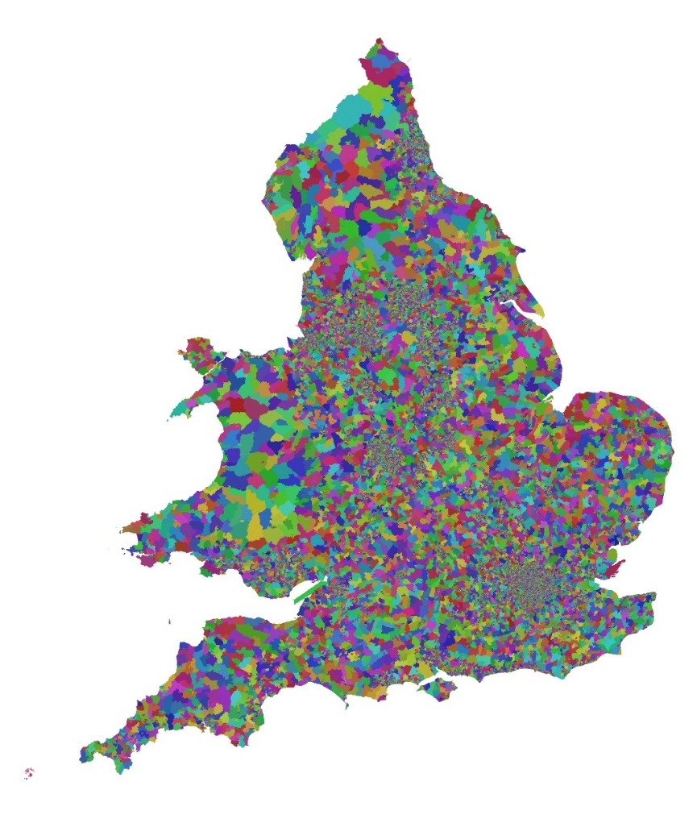
Study area & scale of analysis
England and Wales
Lower Super Output Areas (LSOAs)
34,753 LSOAs
~700 households (range 400-1200)
~1600 residents (range 1000-3000)
~ consistent population size
uniformity of socioeconomic characteristics

Slide 11
Calculation of Emissions/Fuel Use
MOT Dataset
Odometer Reading and Date of Test
Calculate annual mileage using straddle dates (Wilson et al. 2013)
Engine size/Fuel type/Date of first registration
Fuel Usage
Figures by year and engine size from www.cso.ie
Emission Factors
Alt. fuel from www.carfueldata.gov
UWE ECOstars project (Barnes and Bailey, 2013)
Copert 4 (v8.1), TRL (2009) for petrol and diesel
NAEI (2013), EMEP/EEA (2013) for alt. fuel
Vehicles <3 years old (7.8% private vehicles) interpolated from distance driven between date of first registration and recorded mileage at first test
Chatterton et al. (2015)
Notes:
So – what have we done with the data so far:
Taken Mileage and test date from MOT records to calculate annual mileage
We then take engine size, fuel type and vehicle age (as date of first registration) to construct an emissions and energy profile for each of the 27 million vehicles in a 12 month slice of the data.
Data on fuel consumption, and emissions has been compiled on the basis of best available data (best being a compromise between accuracy and extensiveness/usability) but as long-term practitioners in this field we are pretty happy that the factors we use are very good – though further work will be done to improves these as well as to compare with the manufacturers values to be provided by DfT.
THESE ARE THEN AVERAGED BY LSOA TO CREATE AN AVERAGE CAR

Slide 12
Emissions methodology
Date of first registration was used to estimate specific emission factors for each and every vehicle
Multiplied by the annual distance driven by that vehicle (recorded mileage)
Vehicles located by the LSOA of the registered keeper so a profile for an average car within each LSOA was generated
Data on household car ownership (2011 Census) used
NO_{x} and PM₁₀ emissions (total and average) calculated for all privately-owned vehicles (up to 3.5 tonnes) in each LSOA in the UK (n ≈ 27 million)

Slide 13
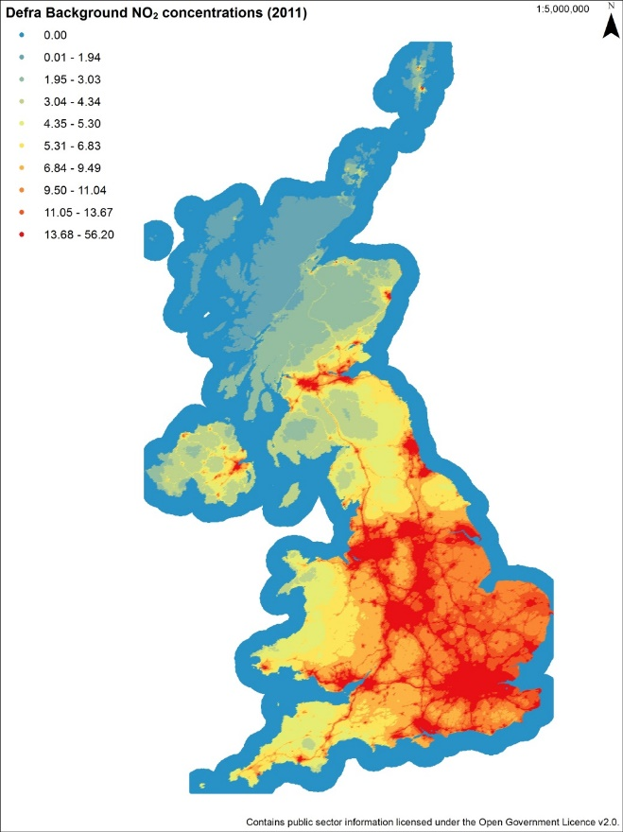
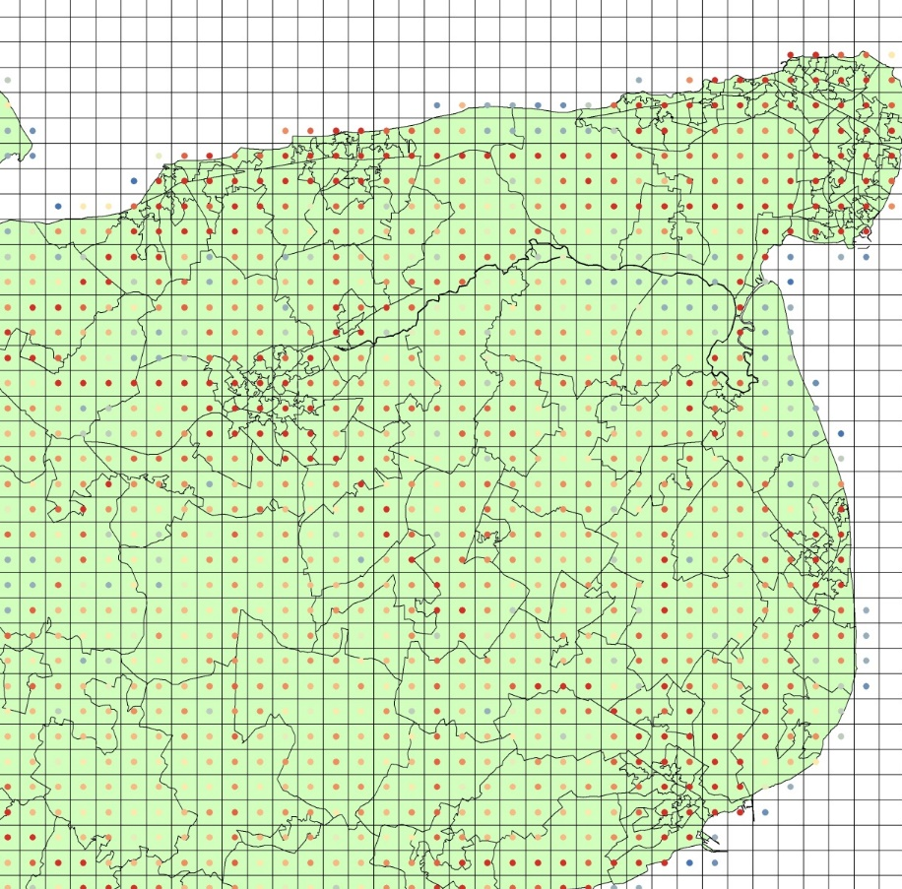
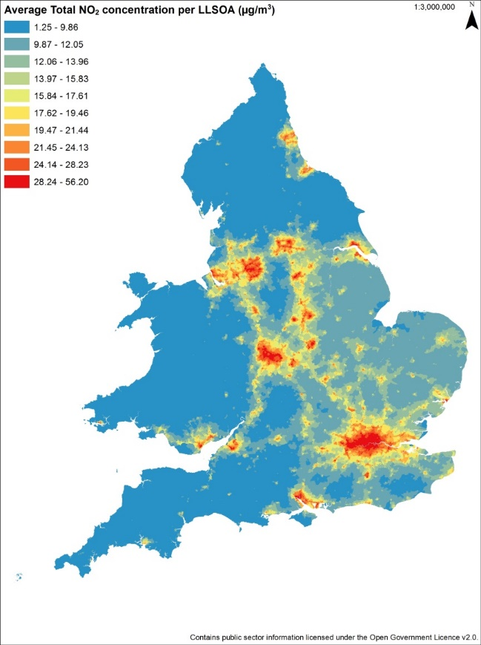
NO₂ concentrations by LSOA
Weighted average NO₂ per LSOA

Slide 14
Exposure vs. Emissions
Average NO₂ concentrations per LSOA are used to estimate exposure of households within those areas, i.e. who is being exposed.
MOT-derived emissions from private vehicles are used to attribute vehicle emissions to the location of the driver (or more precisely the registered vehicle keeper) i.e. who is generating the emissions, not where these emissions happen.

Slide 15
Poverty by LSOA (Breadline Britain Index)
21.7% of Households with access to no car/van*
20.3% of total HHs not in owner-occupied housing
16.0% of Lone-parent HHs
15.9% of the total HHs whose head was in social classes IV & V.
Household Reference Person in NS-SeC categories equivalent to Social Classes IV (semi-skilled) (L11.2, L12.2, L12.4, L12.5, L12.7,L 13.1, L13.2, L13.5) and V (unskilled) (L13.4)
9.4% of HHs headed by unemployed workers (NS-SeC category 8)
10.8% of total HHs with person with long-term limiting illness
* “the weakest direct relationship with car ownership of any of the common deprivation measures” (Mitchell & Dorling, 2003)
[adapted from Gordon & Pantazis (1997)]

Slide 16
Results

Slide 17
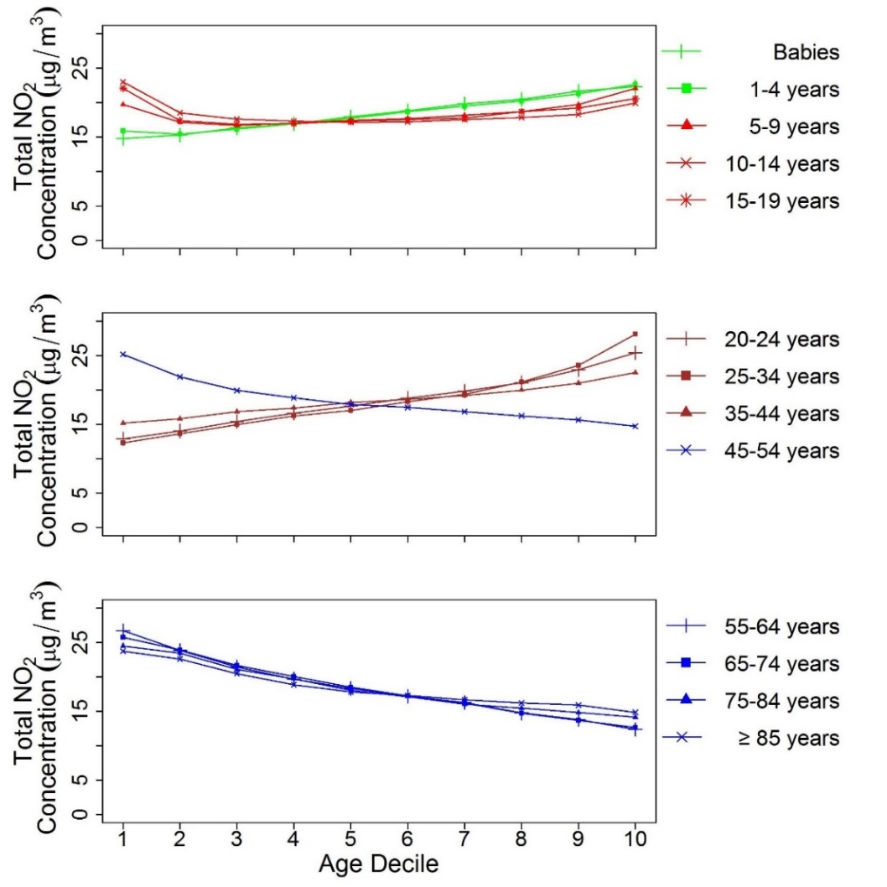
Exposure vs. Age
Average annual mean NO₂ concentrations by age profile.
Age decile 1 = 10% LSOAs with the lowest proportion of an age group.
Age decile 10 = 10% LSOAs with the highest proportion of an age group.
Under-fives and adults aged 20 to 44 have higher NO₂ concentrations.
Areas with more over-45s tend to have better air quality.

Slide 18
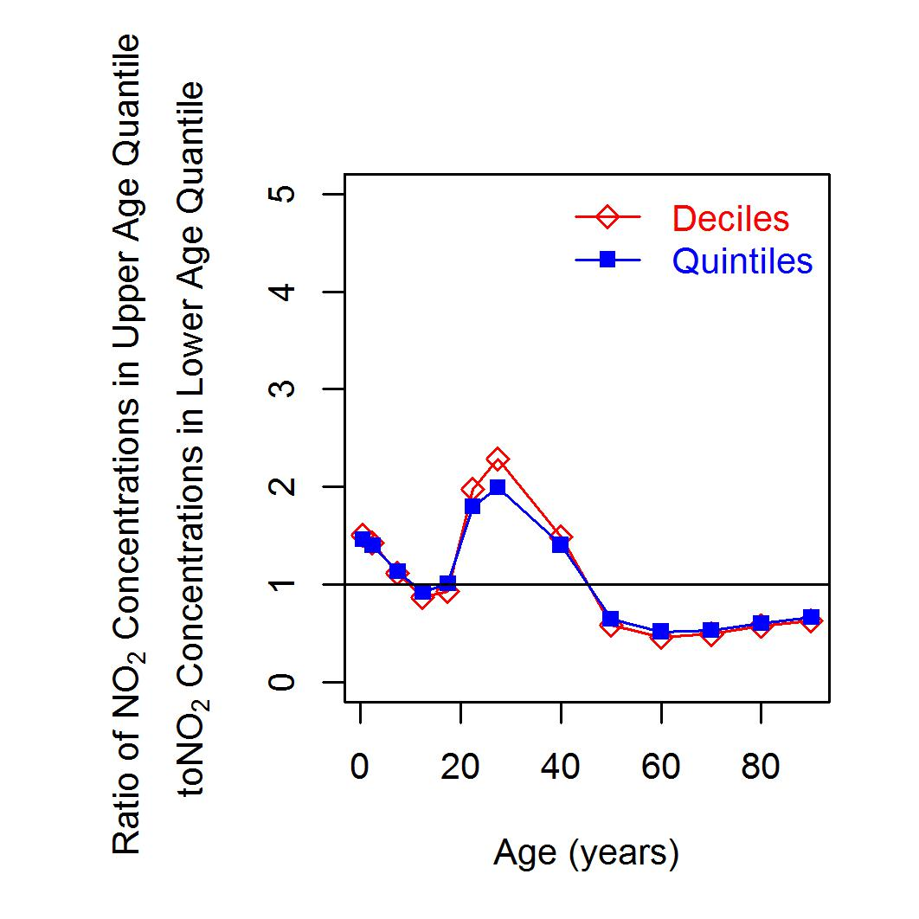
Exposure vs. Age
Ratio of NO₂ concentrations between highest and lowest quantiles in each age band
If ratio >1, exposure is higher than average for the population
Younger children (<5 years) and adults (in their 20s and 30s) have higher NO₂
Older children (10-20) and adults (>50) are associated with lower NO₂
NO₂ concentrations in areas with more young adults are two times the average

Slide 19
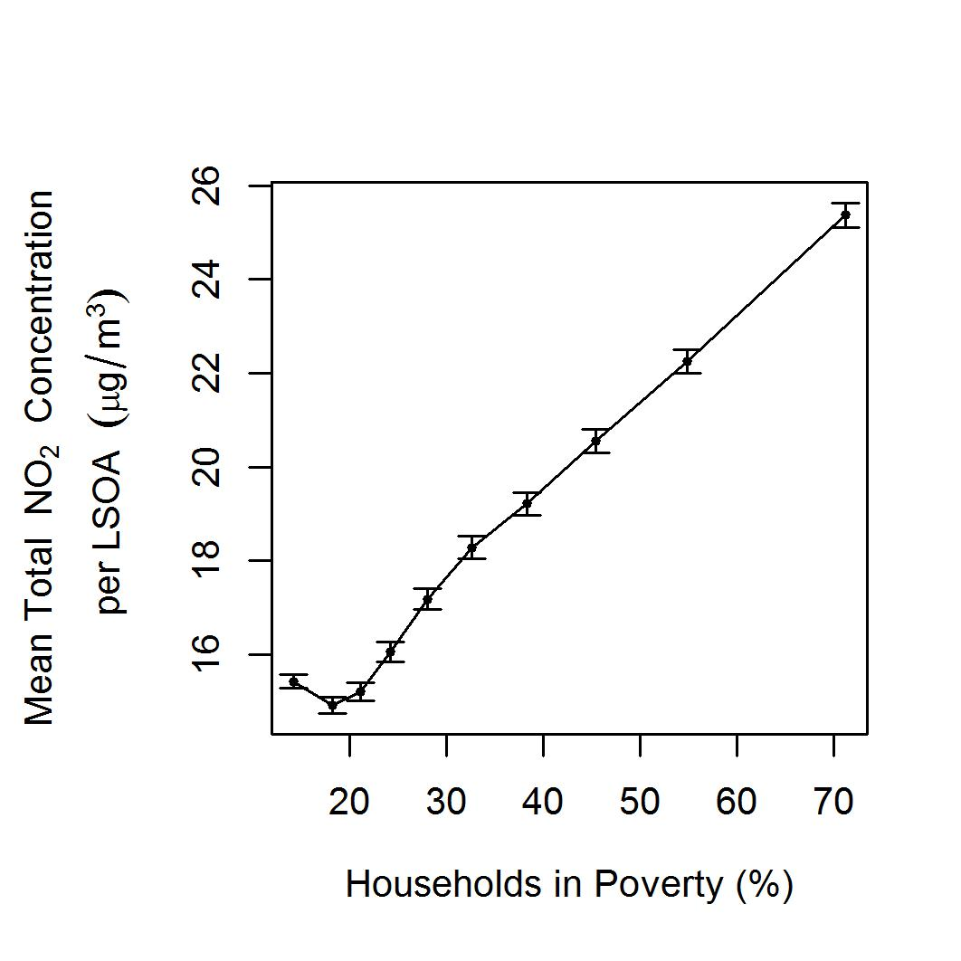
Exposure vs. Poverty
Exposure to NO₂ concentrations against % households in poverty within an LSOA
In lowest decile (i.e. 10% LSOAs with the lowest proportion of households in poverty) average concentrations are <16 µg/m³
In highest decile (i.e. 10% LSOAs with the highest proportion of households in poverty) average concentrations are >25 µg/m³
Clear social inequality in exposure to NO₂ (>50% difference) - same relationship for PM₁₀
Error bars = 95% confidence intervals (CIs).

Slide 20
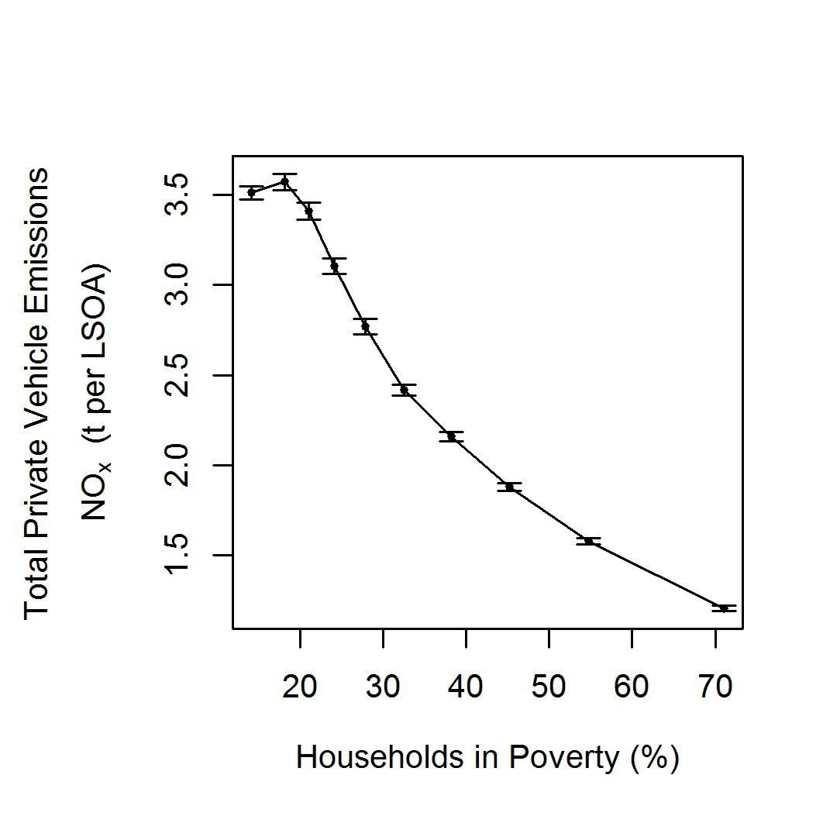
Generation vs. Poverty
NO_{x} emissions from private vehicles against % households in poverty within an LSOA
In lowest decile (i.e. 10% LSOAs with the lowest proportion of households in poverty) average total private vehicle emission per household are ~3.5 t per LSOA
In highest decile (i.e. 10% LSOAs with the highest proportion of households in poverty) average total private vehicle emission per household are ~1 t per LSOA
Households in the poorest areas emit the least NO_{x} (and PM), whilst HHs in the least poor areas emitted the most
Error bars = 95% confidence intervals (CIs).

Slide 21
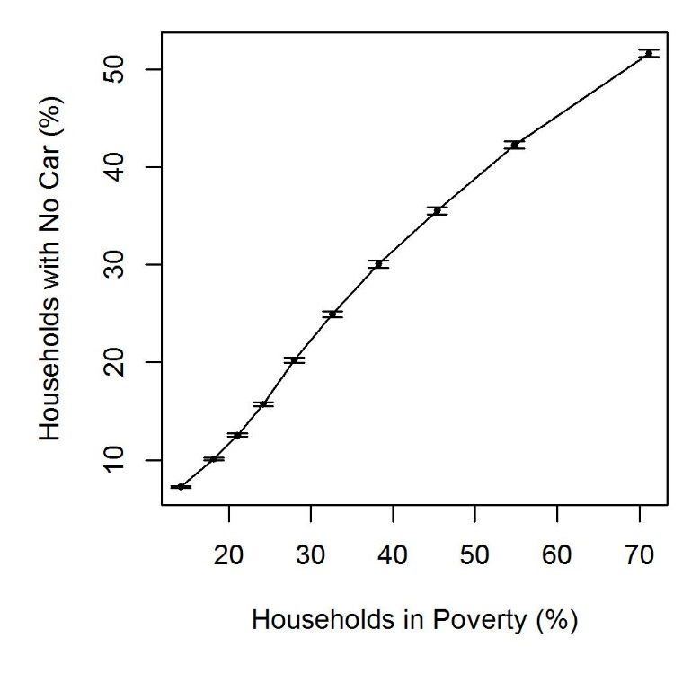
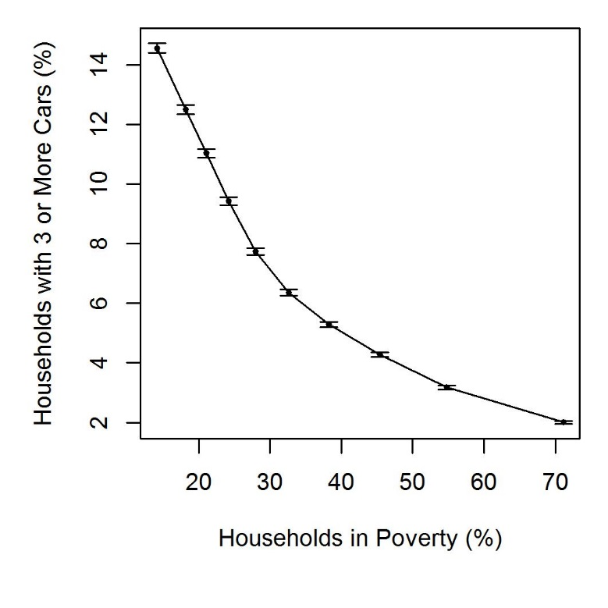
Access to a car vs. Poverty
Error bars = 95% confidence intervals (CIs).

Slide 22
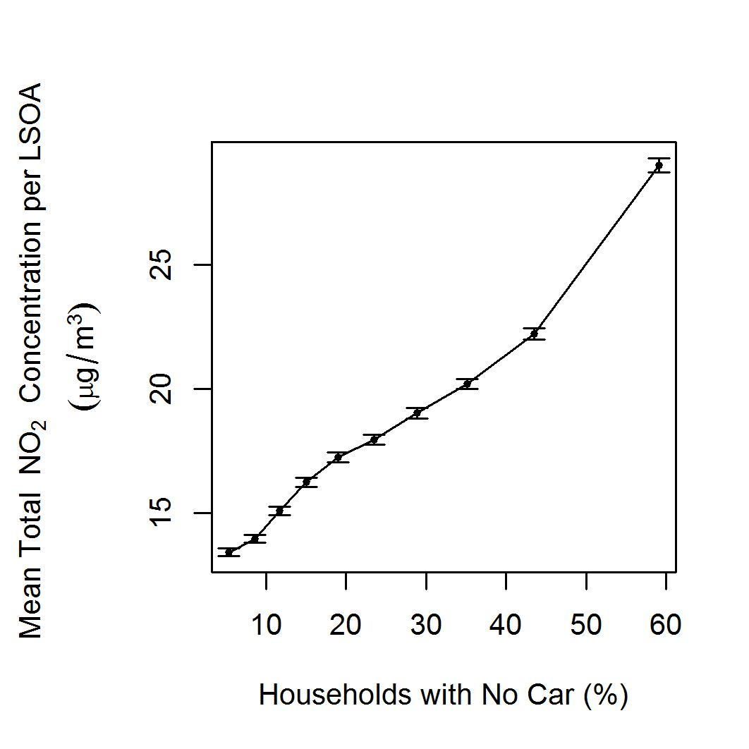
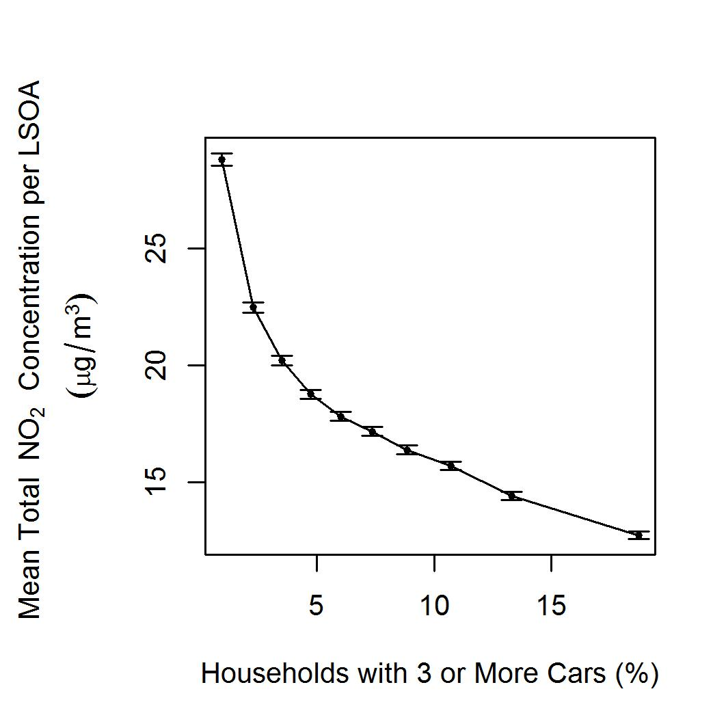
Exposure vs. Access to a car
Error bars = 95% confidence intervals (CIs).

Slide 23
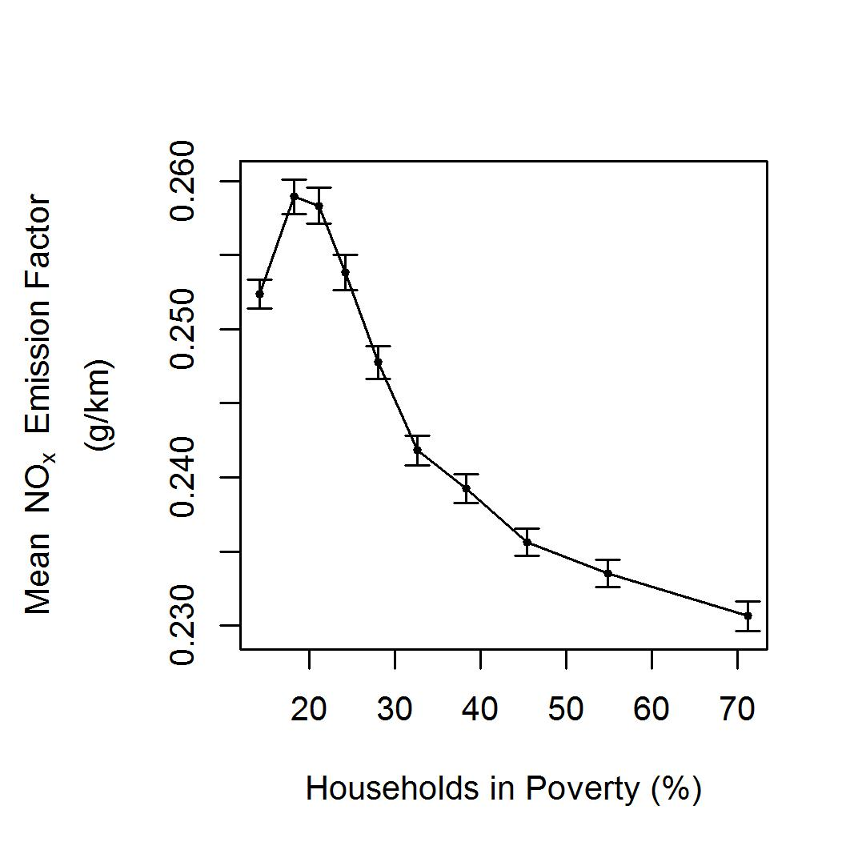
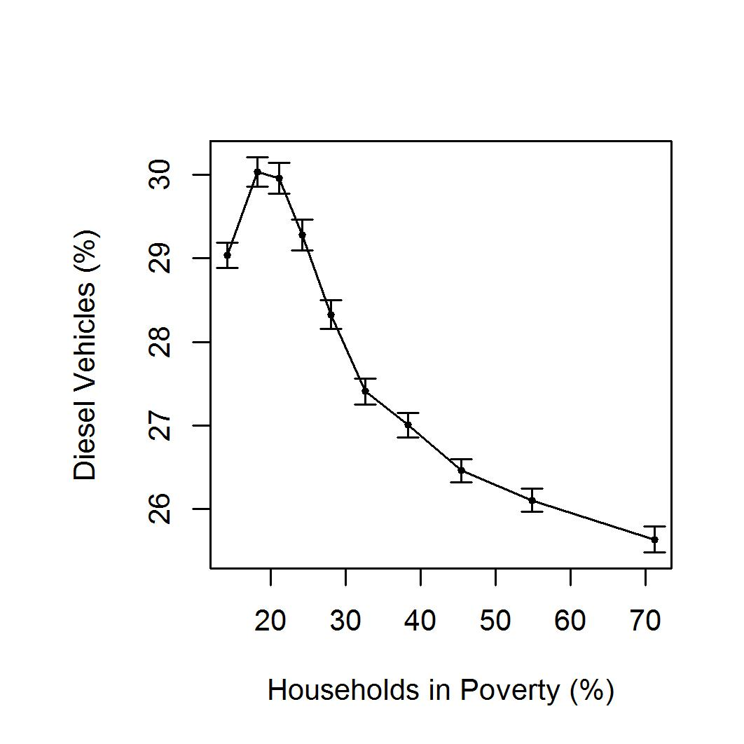
EFs/Diesel ownership vs. Poverty
Error bars = 95% confidence intervals (CIs).

Slide 24
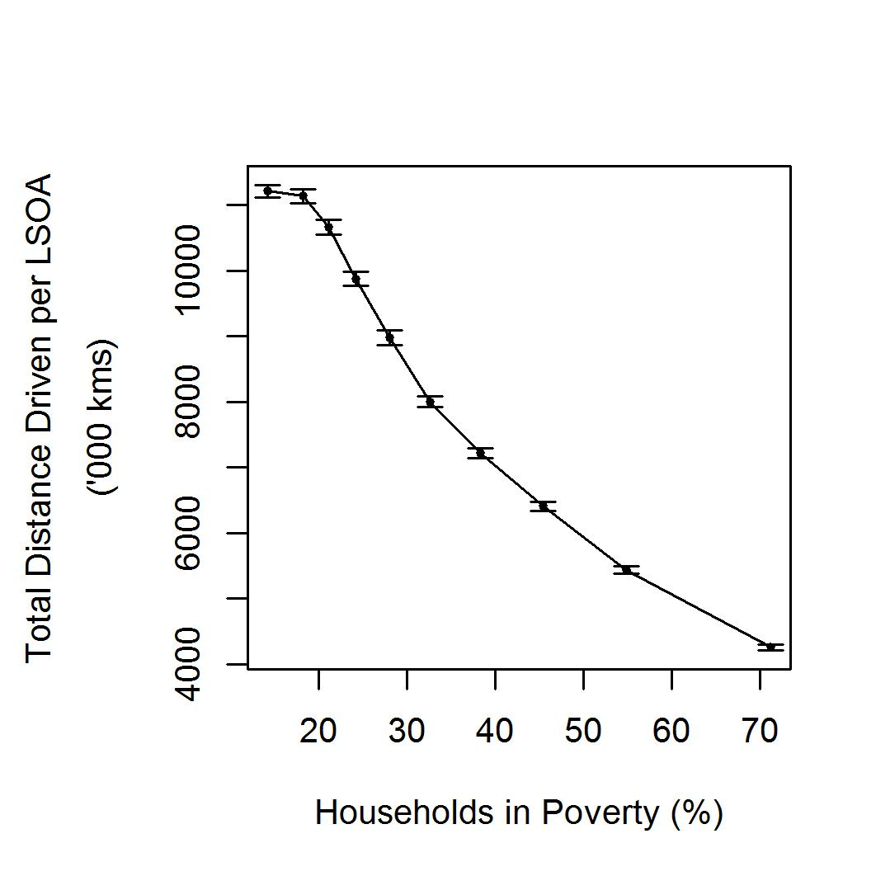
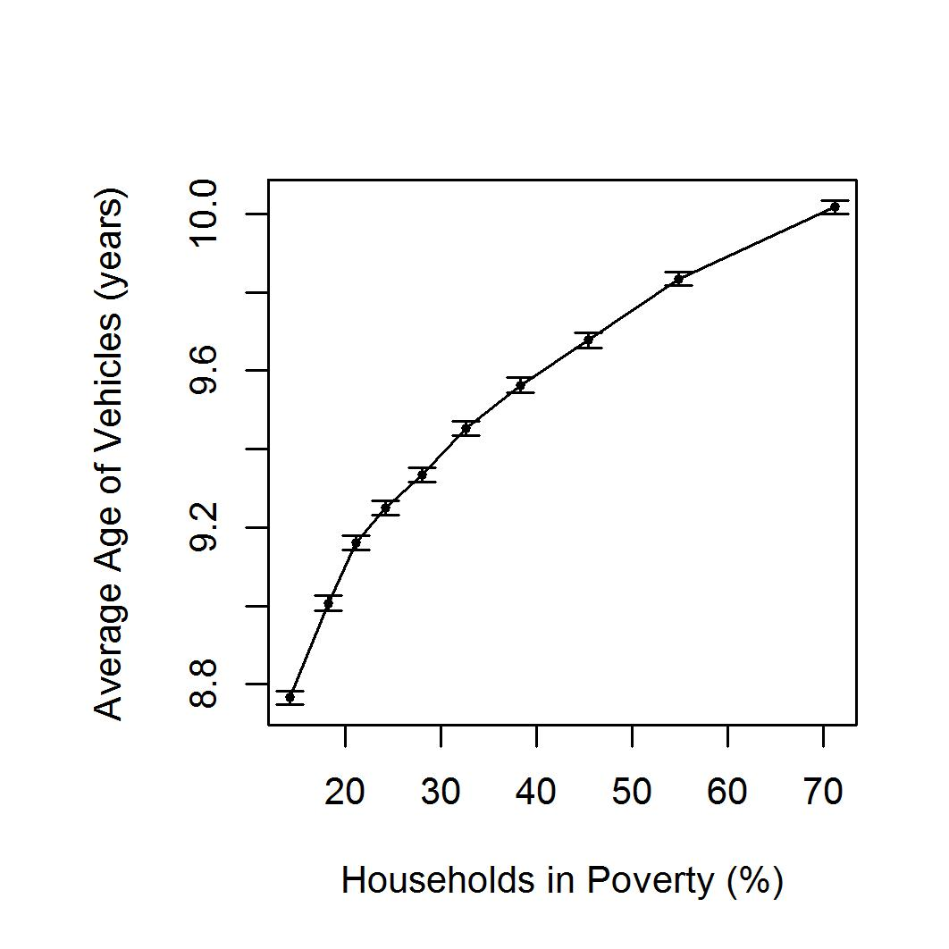
Vehicle age/Distance driven vs. Poverty
Error bars = 95% confidence intervals (CIs).

Slide 25
Summary & Conclusions

Slide 26
Summary
LSOAs with higher proportions of young families and households in poverty (as opposed to the converse) have higher concentrations of NO₂
LSOAs with more households in poverty also have:
lower total private vehicle emissions per household
higher levels of non-car ownership /fewer multiple-car households
lower average NOx emission factor per household
fewer diesel vehicles per household
drive less
have vehicles on average only just over a year older than households in the least poor areas

Slide 27
Conclusions
The most elevated levels of NO₂ and other pollutants occur in LSOAs containing the poorest households.
These households contribute significantly less to air pollution than the least poor households.
Furthermore, the economic circumstances of those living in the poorest households means that they are less capable of altering their situation, i.e. by moving to a less polluted area or purchasing newer, less polluting vehicles.
Despite more than a decade of air quality policy, environmental injustice of air pollution exposure has worsened.
New evidence regarding the responsibility for generation of road traffic emissions provides a clear focus for policy development and targeted implementation.

Slide 28
Acknowledgements
This work has been undertaken under EPSRC Grant EP/K000438/1
Contains National Statistics and Ordnance Survey data © Crown copyright and database right 2012. MOT Project website www.MOTproject.net. An earlier version of this research was published by WIT Press (Barnes, J. and Chatterton, T. (2017). An environmental justice analysis of exposure to traffic-related pollutants in England and Wales. WIT Transactions on Ecology and the Environment, 210 (12). pp. 431-442. ISSN 1743-3541)
Acknowledgements to the Department for Transport, the Driver and Vehicle Standards Agency, the Driver and Vehicle Licensing Agency and the Department for Business, Energy and Industrial Strategy, Dr Paul White (UWE Bristol), Professor David Gordon (University of Bristol), Professor Danny Dorling (University of Oxford), and the MOT project team (Professor Jillian Anable, Dr Sally Cairns, Professor Eddie Wilson, Dr Oliver Turnbull, Simon Ball and Paul Emmerson), and to Professor Jimi Irwin and Kris Vanherle (TML) for their helpful comments on an earlier draft of this paper.

Slide 29
References
Barnes, J., Chatterton, T., & Longhurst, J. (2019). Emissions vs exposure: Increasing injustice from road traffic-related air pollution in the United Kingdom. Transportation Research Part D: Transport and Environment, 73, 56-66. https://doi.org/10.1016/j.trd.2019.05.012
Chatterton, T., Barnes, J., Wilson, R.E., Anable, J., Cairns, S. (2015) Use of a novel dataset to explore spatial and social variations in car type, size, usage and emissions. Transportation Research Part D: Transport and Environment, 39:151-164.
Gordon, D. & Pantazis, C., 1997. Breadline Britain in the 1990s, Ashgate, Aldershot.
Mitchell, G. & Dorling, D., (2003), An environmental justice analysis of British air quality. Environment and Planning A, 35(5) 909 – 929.
Wilson, R. E., Cairns, S., Notley, S., Anable, J., Chatterton, T., & McLeod, F. (2013) Techniques for the inference of mileage rates from MOT data. Transportation Planning and Technology. 36 (1):130-143.
Wilson, R. E., Anable, J., Cairns, S., Chatterton, T., Notley, S., & Lees-Miller, J. D. (2013) On the estimation of temporal mileage rates. Transportation Research Part E: Logistics and Transportation Review, 60:126-139.

