Slide 1
Mitigation of risk; Approved Mental Health Professionals Under the Mental Health Act (England & Wales, UK)
Dr Kevin Stone
University of the West of England, Bristol
@AMHPResearch @KevinStoneUWE

Slide 2
Introduction
This presentation will offer some emerging data arising from study focusing on risk mitigation by AMHPs.
This will focus on:
Context
Research design
Emerging research findings
Implications for law reform

Slide 3
Method & Methodology
Qualitative study
Approved Mental Health Professionals (10 Social Work & 10 Nurses)
Currently practicing
Ethics given by University Research Ethics & Locally
Semi-structured interviews of 1.5 hours containing questions relating to risk
Social Constructivist Method

Slide 4
Research Question
AMHPs participants were asked:
to recall and discuss a referral where they considered significant risk to be present?
if during their practice as an ASW and/or AMHP, they had ever felt afraid or unsafe.

Slide 5
Initial Emerging Themes
Challenges with:
Upholding the principles of the Mental Health Act;
Containment;
Appropriate resourcing.
Impact of fear on decision making

Slide 6
Guiding Principles of the Mental Health Act 1983 (2007) England
Least restrictive option and maximising independence Where it is possible to treat a patient safely and lawfully without detaining them under the Act, the patient should not be detained. Wherever possible a patient’s independence should be encouraged and supported with a focus on promoting recovery wherever possible.
Empowerment and involvement Patients should be fully involved in decisions about care, support and treatment. The views of families, carers and others, if appropriate, should be fully considered when taking decisions. Where decisions are taken which are contradictory to views expressed, professionals should explain the reasons for this.
Respect and dignity Patients, their families and carers should be treated with respect and dignity and listened to by professionals.
Purpose and effectiveness Decisions about care and treatment should be appropriate to the patient, with clear therapeutic aims, promote recovery and should be performed to current national guidelines and/or current, available best practice guidelines.
Efficiency and equity Providers, commissioners and other relevant organisations should work together to ensure that the quality of commissioning and provision of mental healthcare services are of high quality and are given equal priority to physical health and social care services. All relevant services should work together to facilitate timely, safe and supportive discharge from detention.

Slide 7
AMHP - Dirty Work
“…far from being simply designated by the social workers as ‘dirty’ or ‘shit’ work, AMHP work was portrayed as high-status work, requiring advanced skills, and the ability to manage very complex situations”
Lisa Morriss, AMHP Work: Dirty or Prestigious? Dirty Work Designations and the Approved Mental Health Professional, The British Journal of Social Work, Volume 46, Issue 3, April 2016, Pages 703–718,

Slide 8
MHA assessment as an AMHP can involve stress and fear
Studies have highlighted that there is evidence to suggest that the experience of undertaking a MHA assessment as an AMHP can involve stress and fear. (Bowers, Clark and Callaghan 2003, Gregor 2010, Hudson and Webber 2012).
It would appear that there needs to be a greater acknowledgement of the impact of fear on the AMHP role, and new strategies developed to support AMHPs undertaking MHA assessments.

Slide 9
Findings - Feeling fear
Mitigation of Risk

Slide 10
Seventeen participants (8 N-AMHP 9 SW-AMHP) reported that they had felt afraid or unsafe
Ironically, no. I think, because I’d worked in [the department] for so long, you’ve been threatened a lot by people who are absolutely … So I think I’ve been there. It’s just if someone’s got a weapon it’s slightly different, but yes, I wouldn’t have said that I felt overly frightened. Obviously it sets you off balance, but…

Slide 11
Yes. I feel frightened throughout the day when I'm on the rota, even if I don’t get an assessment. That’s a constant background state of being, because you’re not quite sure what might come through the door. With resources being the way they are you can’t be certain the police will turn up. You can’t be certain how long you’ll have to wait for an ambulance these days, and the prospect of being left alone with a patient who is psychotic, that in itself is a fear.

Slide 12
Probably a couple of times because of the decisions but that was more to do with afterwards, afterwards reflection, ‘I shouldn’t have done that’. Like, ‘I don’t think I should have detained that person.’ That’s probably happened twice and once probably with violence.

Slide 13
I think the main bit I’ve always done if I’ve felt unsafe or frightened is you’ve got to change it, you can’t just sit there. There’s no way the assessment is going to carry on like that because also, once you’re unsafe and frightened, you’re not assessing properly because your head is in a different place, isn’t it? You’ve got to think for the person you’re assessing, that’s not right for them either.

Slide 14
Yes, I’ve had assessments where, often with bipolar actually. It’s got a bit hairy where people have ran off. I had one where, there were two of us because we knew the risks were high, and the guy actually cornered my colleague and picked him up and threw him over a fence.

Slide 15
I think it varies. As I say, it was ironic that it was in a police station really because the place was full of coppers. Maybe I’d have probably been more cautious if we’d been in another setting. Maybe it was something, maybe I was a bit too over-confident or cocky or something because it was a police station. I don’t know. On both accounts, the old man was in a police cell too.

Slide 16
Findings – managing risk.
Mitigation of Risk

Slide 17
Risks to patients own health and safety
There was a young man here who was quite paranoid, and was threatening to self-harm. He had actually - from the information I had gathered - he’d actually … purchased things like ligatures and whatever, ropes. There was a sense of some significant risk here, quite a high level of risk.

Slide 18
Risks to others
In terms of the risks, we considered that there was a risk to his health, obviously because of the physical health problems. Whatever was going on down there, it was having an impact on his health, on his mental health. We also considered the issue around him attacking other members of staff and other service users, other patients in there. We were concerned about the safety of the other people in there, because he was just randomly going for people.
He had been grabbing, stamping on heads, and sometimes in some cases inappropriate touching them, staff as well. But grabbing, sometimes hitting and punching, assaulting staff really, and other service users. I guess that was a significant risk.

Slide 19
Risk to self & others
Basically the person had a diagnosis of bipolar disorder so he was under the care of the team. He’d gradually been becoming unwell and so attempts had been made by the team to engage him, because he’d disengaged. There came a point when the Mental Health Act assessment was convened. It ended up being relatively late in the evening because of having to get a warrant.
By the time we did that the police were there and everyone was assembled and the doctors. The man himself was quite distressed. I mean he knew what was happening but he wouldn’t let anyone in. While we were trying to speak to him, rather than break the door down, it was a solid thing, he set light to – he had a Bunsen burner or something like that in his house so he set light to that. There was a fire, basically.

Slide 20
Risk History
He was really unwell, I’ve never seen anyone so psychotic.
Doctors had never seen anyone so psychotic. Drug-induced psychosis. He was assessed in the back of a police van and he needed [psychiatric intensive care unit], so we got it organised.
He couldn’t have been managed in any of the local units. He was previously known to the Community Mental Health team. I can’t remember what happened with input from the CMH team and he was, he had a forensic history, I think it was attempted manslaughter, or attempted murder, I can’t remember the actual details, but roughly about ten years ago, which, looking back at the history, was when the symptoms became quite florid and that’s when he came into Social Services

Slide 21
Managing exaggerated risk
The risks were quite high. It was alleged this young man, this young Moroccan male, … He’d been threatening in his own accommodation to neighbours outside, indiscriminately waving an iron bar.
There were indications he had a weapon, he was very aggressive. Police had been to the address on two occasions … The risks were quite high. It looked as if he was quite psychotic, really.
It later transpired it was a curtain rod, which is that very light alloy at best, not… It was an exaggerated piece of information, I think, to justify an intervention.
I’ll jump to the end quickly. We decided to hold onto the recommendations to give the family a chance to support a treatment plan in the community. It was opened to the Crisis team. I decided, as an AMHP, “We can hold this because we could lose this family. If this man is developing a schizophrenic illness we’re going to need their support, consent… They have to feel safe, and trust and work with Mental Health Services.”

Slide 22
Managing unanticipated risk
We actually went to the property and the police executed the warrant. They went into the flat and he was there… when he saw the police, he attacked the police, which was a completely unexpected outcome of us going into the property. We hadn’t anticipated that at all.
There were about three officers, and there was myself and the other AMP. They had to make a very quick exit from the building because he was in the kitchen and he had a knife. In the whole process, I actually got pushed into the toilet and separated from everybody else.
It was something that we just hadn’t anticipated, and I suppose it made me think afterwards that although you think you have covered everything in your head, you just have to be so mindful when you are going into situations really. He behaved in a completely different way.

Slide 23
Managing risk from others
It was a difficult assessment because it was – he had real difficulty in terms of being interviewed because he was so angry. That’s what made it very risky in terms of how to manage it. I desperately wanted him to have the chance to talk to us because I’d got a whiff with him that we had to be careful this actually was a mental disorder and not just behaviour, perhaps related to alcohol. Was this really going to justify a Mental Health Act? I wanted to give him plenty of space.

Slide 24
Managing assessments increasing risk
I knocked on the door and explained to him who I was and what the purpose of our visit was. I explained that, “I’ve got a couple of doctors with me, we’re here because there have been some concerns and we’d like to talk to you and make sure that you’re okay”.
The next thing, he walked away. It was one of those glass doors, where you can’t see but it’s like you can see if someone’s behind it. I can’t think what it’s called. The ones that used to have wire running through them. He moved away from the door and the next thing he comes back to the door and he’s got this wrench, this massive great spanner-come-wrench type thing. He said, “The first person through the door is going to get this”.
Again, I tried speaking to him to try and calm the situation down, but he was having none of it. “The first fucking social worker who comes through this door is going to get this across their head”.
I did explain to him again about the police, about the warrant, and how we want to avoid all that. He said, “What is a Section 135 warrant”? I said, “I’ve got a copy of it, I’ll put it through the letterbox”. Put it through the letterbox and it was, “No, you haven’t got any legal power, this is not law”, and all this type of thing. I tried to explain to him. He said, “No, no-one’s coming in”.

Slide 25
Risk Environments
The referral had come from the care coordinator of a man with a longstanding history of schizophrenia and risks of harm to others through assaulting people, when he’s not that ill. So very high risk of fire setting when he’s unwell because he gets a fascination with flames rather than a deliberate arson as in he just wants to cause damage, or not because he’s careless with cooking or anything like that. He specifically gets a fascination with flames and begins to gather rubbish in his room.
He lives in supported accommodation he’d only recently moved into, and all the early warning signs were there of risk too: getting very aggressive with the hostel staff and stockpiling papers and stuff in his room.
So when we arrived, he was being restrained in the hall of the accommodation by the police who had arrived earlier. [participant 12]

Slide 26
Conclusions
Mitigation of Risk

Slide 27
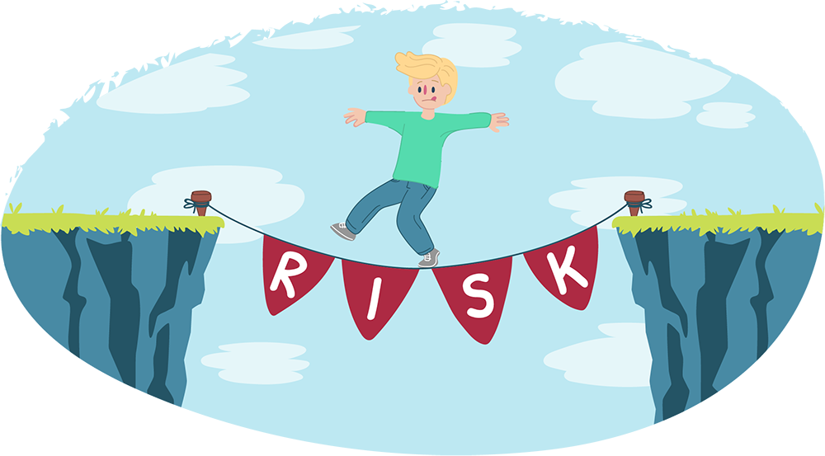
Articulation of Risk
Majority of AMHPs felt afraid
Risk basis of the referral
Risk to patients health & Safety
Risk to the public by the patient.
AND/OR
Risk to the assessing team.

Slide 28
Conclusions
Challenges with:
Upholding the principles of the Mental Health Act;
Containment;
Appropriate resourcing.
Impact of fear on decision making
Implication of MHA Amendments – recognising that impact that fear can have on MHA work, the complexity of MHA assessments.

Slide 29
END

Slide 30
Questions

