Slide 1
Editor for an Hour
Myra Evans and Dr Sally Reardon

Slide 2
UWE’s 2020 Vision
Professionally recognised and practice-oriented programmes, which contribute to an outstanding learning experience and generate excellent graduate employment opportunities and outcomes for all students.

Slide 3
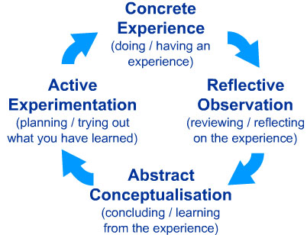
Practice-based learning in Journalism
Kolb’s Experiential Learning Cycle (1984)

Slide 4
News Days
Q: What is a news day?
A: A hybrid of simulation and experiential learning where students become practising journalists.
PLAY VIDEO

Slide 5
Now it’s your turn…
What you need to do is:
Create a running order ( a list of stories) you want to run that day and place them in the order you feel is appropriate for your news outlet.
You may wish to use all of them or you may wish to select how many you wish to use.

Slide 6
You need to consider:
Which story would you put as the lead – the headline story - and how would it be constructed? |For instance: what images/interviews would you need? What is the first sentence of the story?
Time – you need to cover this for the bulletin that evening…the clock is ticking, do you have time to do what you want to do?
What news values are you employing to rank the stories?
Who is your audience and how important is that?
Who is your competition and how important is that?
What elements will you need to construct the story (sound/images/interviews/graphics etc)
Resources – will you be able to get those elements?

Slide 7
Report back
BBC | CNN | Al Jazeera | Fox | RussiaT

Slide 8
But does this kind of teaching work?
An investigation into practice-based learning methods in the training and employment of tomorrow’s journalists. (Evans, 2015)

Slide 9
What did I do?
Semi-structured interviews and focus groups with students of journalism at the University of the West of England and Coventry University
Semi-structured group interview with former journalism students at UWE now working in the journalism industry

Slide 10
Findings
Benefits of “doing it for real” are widespread (work experience and industry skills)
Incremental autonomy that comes with the scaffolded learning employed on news days creates a deeper level of learning.
News days are a “safe place” to make mistakes.
Surprising amount of self-reflection.

Slide 11
Back to that 2020 Vision
Does it contribute to an outstanding learning experience and generate excellent graduate employment opportunities and outcomes?

Slide 12
Quote from former student now working in TV journalism
“…everything that we’ve been taught on our news days is pretty much everything that we do every single day. So, like, news days alone are probably one of the most beneficial things for us because it’s more practical. And obviously we’re out and about doing practical things every day that, to be honest with you, news days have probably been the one thing that’s really done it for me, anyway.”

