Slide 1
Presentation by
Learning through practice in Higher Education .
Myra
Evans
Associate Head of Department for Broadcast and Journalism, BA Journalism Programme Leader and Senior Lecturer of Journalism
UWE Learning and Teaching Conference, June 2018 .

Slide 2
UWE Strategy 2020
“ a University recognised for the success and impact of our professionally recognised and practice-orientated programmes”. (UWE Strategy 2020)
Picture from UWE Strategy 2020

Slide 3

Learning through practice
Experiential Learning Cycle
Kolb (1984)
Situated Learning and Communities of Practice
Lave and Wenger (1991)

Slide 4
Experiential Learning
Builds from socio-constructivist theory
Experience is core to learning process
Learning can be formed and reformed through experience and reflection.

Slide 5
Kolb’s Experiential Learning Cycle (1984)
Based on:
Dewey
Lewin
Piaget
Others:
Beard & Wilson (2006)
Moon (2008)
Rogers (1969)
Schon (1987)
Concrete Experience (doing/having
an experience)
Reflective Observation (reflecting on the experience)
Abstract Conceptualisation (concluding/ learning from experience)
Active Experimentation (planning/trying out what you have learned)

Slide 6
Situated Learning: Communities of Practice
(Lave and Wenger 1991)
Socio-cultural approach
Knowledge is relational and negotiated
Learning takes place in communities

Slide 7
Lave & Wenger: Communities of Practice
Others:
Brown, Collins et al (1989)
Eckertt (1989)
Fuller & Unwin (2005)
Latour (1987)
Rogoff (1990)
Sergiovanni (2004)
Wilkerson & Gijselaers (1996)
Domain of knowledge/interest
Practice
Community

Slide 8
Lave and Wenger:
Situated Learning: Legitimate Peripheral Participation (1991)
Newcomers/apprentices
Situated Learning
Old Timers/
Masters
Through:
Engagement, interaction collaboration, learning of knowledgeable skills
Social practice
Full participation

Slide 9
Situated Learning: Communities of Practice
(Participating)
Experiential Learning
(Reflecting)

Slide 10
How does this relate to journalism education in HE?
Experiential Learning:
Brandon (2002): “Experiential learning could open new areas of knowledge for journalism education as well as helping to improve the courses for students.” (p65)
Steel et al (2007): “Doing it for real.”(p 330)
Kartveit (2009): “..experiential learning offers a comprehensive setting of how practical journalism training can be implemented.” (p46)
Evans (2016 & 2017): News Days - the embodiment of experiential learning

Slide 11
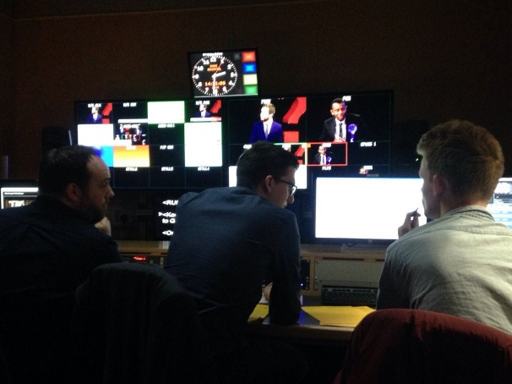
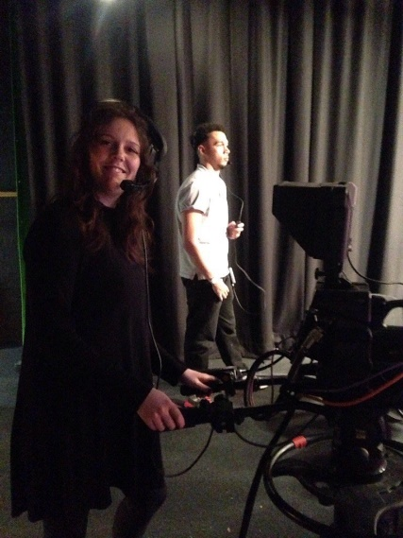
News Days
Practice
Reflect
Theorise
Pictures by Myra Evans

Slide 12
But is it the best way to teach journalism?
Mensing (2010 & 2011) - Journalism education needs to realign with democracy and community. (A community of practice?)
BUT
Schmitz-Weis etc al (2017) – Technology enabled collaboration but NO community of practice

Slide 13
Work placement – with the safety net of the classroom
Fuller et al (2005) - The UK’s Modern Apprenticeship (MA) programme, introduced in 1994
Degree Apprenticeships introduced in 2015

Slide 14
Experiential Learning
Advantages | Disadvantages
Safe place to make mistakes | Can be seen as “unreal” and disconnected from reality
Space for reflection and critique of practice | Time consuming and costly
 | Replicates the industrial model (Mensing, 2011)

Slide 15
Situated Learning (communities of practice)
Advantages | Disadvantages
Real world experience | No safe place to make mistakes
Learning from current practitioners | “Unchanging” - apprentice learns same mistakes as masters
Sense of community | Carries connotations of parochialism
Cheaper (earn while you learn) | Western Society is individualistic, & hierarchical preventing real communities to develop (Kerno, 2009)

Slide 16
My conclusion:
Experiential Learning
Communities of Practice

Slide 17
Is it time to consider a new model for journalism education?
Concrete Experience (doing/having
an experience)
Reflective Observation (reviewing/reflecting on the experience)
Abstract Conceptualisation (concluding/ learning from experience)
Active Experimentation (planning/trying out what you have learned)
Community

Slide 18
References:
Beard, C. & Wilson, J.P. (2006) Experiential learning: a best practice handbook for educators and trainers, 2nd edn, Kogan Page, London.
Brandon, W. (2002) Experiential learning: A new research path to the study of journalism education, Journalism and Mass Communication Educator, 57,(1). pp. 59-66.
Brown, J.S. Collins, A., et al (1989) Situated cognition and the culture of learning. Educational Researcher, 18. pp 32-42.
Eckertt, P. (1989) Jocks and burnouts: Social categories and identity in the high school. New York: Teachers College Press.
Evans, M. (2017) Providing students with real experience while maintaining a safe place to make mistakes. Journalism Education, 6 (1). pp. 76-83.
Evans, M. (2016) Storytelling in the newsroom: An investigation into practice-based learning methods in the training and employment of tomorrow’s journalists. Journalism Education, 5 (2). pp. 37-45)

Slide 19
References cont’d
Fuller, A. Hodkinson, H. Hodkinson, P. and Unwin, L. (2005) Learning as peripheral participation in communities of practice: a reassessment of key concepts in workplace learning, British Educational Research Journal, 31 (1). pp 49-68.
Kartveit, K. (2009) Journalism teaching and experiential learning, Journalism Research Science Journal (Communication and information) 2. pp. 34-46.
Kerno, S. (2009) Limitations of communities of practice: a consideration of unresolved issues and difficulties in approach, Journal of Leadership and Organizational Studies, 15(1).pp 69-78.
Kolb, D. (1984) Experiential Learning: Experience as the Source of Learning and Development. New Jersey: Prentice Hall.
Latour, B. (1987) Science in action: How to follow scientists and engineers through society. Cambridge: Harvard University Press.
Lave, J. & Wenger, E (1991) Situated learning: legitimate peripheral participation. Cambridge: Cambridge University Press.

Slide 20
References cont’d
Mensing, D. (2010) Rethinking (again) the future of journalism education, Journalism Studies, 11(4). pp 511-523 Volume 5 number 2 Journalism Education p 45 .
Mensing, D. (2011) Realigning journalism education in Franklin & Mensing (2011) Journalism Education Training and Employment, New York: Routledge.
Moon, J.A. (2008) Reflection in learning & professional development: theory & practice, New York, London: Routledge.
Rogers, C.R. (1969) Freedom to learn, Merrill: Charles E. Publishing.
Rogoff, B. (1990). Apprenticeship in thinking: Cognitive development in social context. New York: Oxford University Press.
Scmitz-Weiss, A. Higgins Joyce, V. Saldana, M. and Calmon Alves, R. (2017) Latin American investigative journalism education: Learning practices, learning gaps, Journalism and Mass Communication Educator, 72(3).pp 334-348.

Slide 21
References cont’d
Schon, D. (1987) Educating the reflective practitioner. San Francisco: Jossey-Bass
Sergiovanni, T.J. (2004) Collaborative Cultures & Communities of Practice. Principal Leadership, 5(1). pp. 48-52.
Steel, J., Carmichael, B., Holmes, D., Kinse, M. and Sanders, K. (2007). Experiential learning and journalism education: Lessons learned in the practice of teaching journalism, Education and Training, 49(4). pp 325-34.
Stevenson, A. & Waite, M. 2011, Concise Oxford English dictionary, 12th edn, Oxford University Press, Oxford;New York;.
UWE Strategy 2020. Available from: http://www1.uwe.ac.uk/about/corporateinformation/strategy.aspx. [Accessed 7 January, 2018]
Wilkerson, L. and Gijselaers, W.H. (1996). Bringing problem-based learning to higher education: Theory and Practice. San Francisco: Jossey-Bass.

