Slide 1
DOING IT FOR REAL
A study of experiential and situated learning approaches in teaching journalism practice through engagement with the public domain.

Slide 2
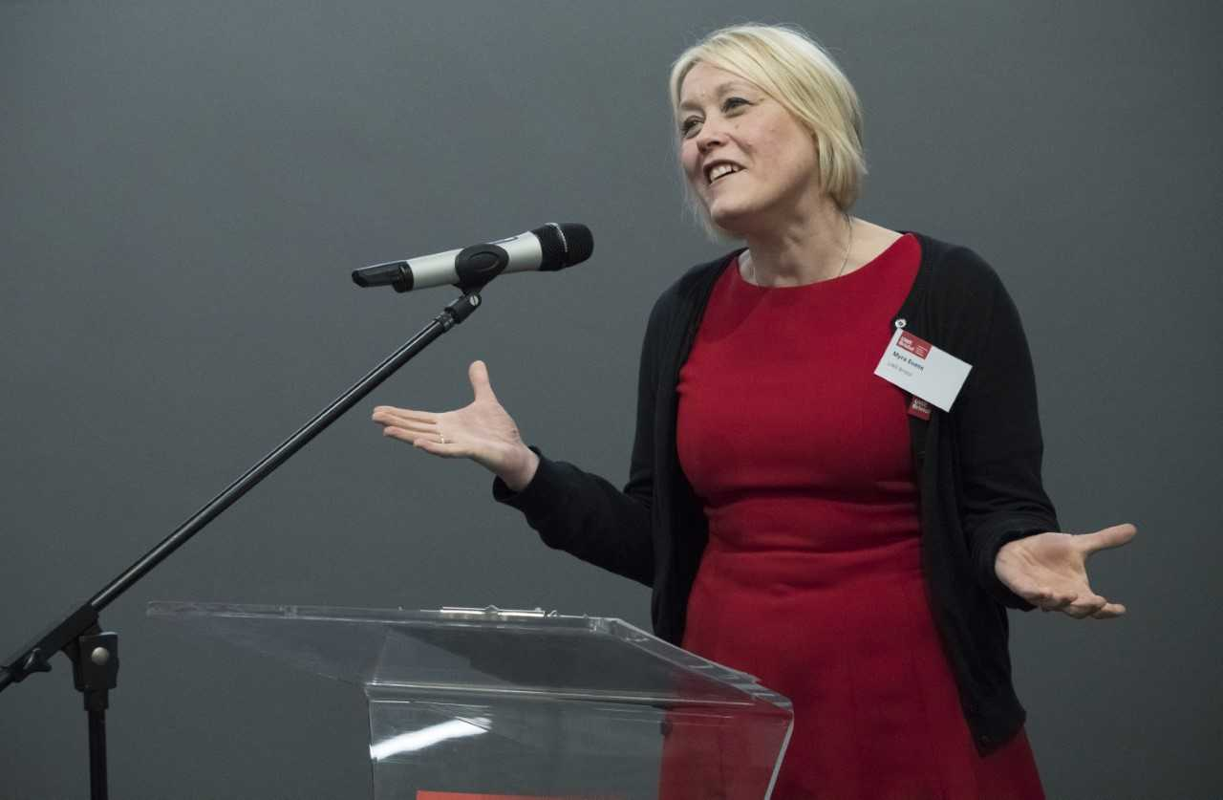
Myra Evans
Faculty Academic Director for Inclusive and Practice-Oriented Curriculum (ACE)

Slide 3
Learning through practice
Experiential Learning Cycle
Kolb (1984)
Situated Learning and Communities of Practice
Lave and Wenger (1991)

Slide 4
Experiential Learning
Builds from socio-constructivist theory
Experience is core to learning process
Learning can be formed and reformed through experience and reflection.

Slide 5
Kolb’s Experiential Learning Cycle (1984)
Concrete Experience (doing/having
an experience)
Reflective Observation (reflecting on the experience)
Abstract Conceptualisation (concluding/ learning from experience)
Active Experimentation (planning/trying out what you have learned)
Based on: Dewey, Lewin, Piaget
Others:
Beard & Wilson (2006) Moon (2008) Rogers (1969) Schon (1987)

Slide 6
Situated Learning Lave and Wenger, (1991)
Socio-cultural approach
Knowledge is relational and negotiated
Learning takes place in communities

Slide 7
Lave and Wenger: Communities of Practice
Domain of Knowledge/Interest
Practice
Community
Others:
Brown, Collins et al (1989)
Fuller & Unwin (2005)
Latour (1987)
Rogoff (1990)
Sergiovanni (2004)
Wilkerson & Gijselaers (1996)

Slide 8
Lave and Wenger’s Situated Learning: Legitimate Peripheral Participation (1991)
Newcomers/apprentices
Situated Learning
Through:
Engagement, interaction collaboration, learning of skills
Old-timers
/masters
Social practice
Full participation

Slide 9
Learning through practice
Situated Learning
(Participating)
Experiential Learning Cycle
(Reflecting)

Slide 10
Relating the models to journalism education
Experiential Learning:
Brandon (2002): “Experiential learning could open new areas of knowledge for journalism education as well as helping to improve the courses for students.” (p65)
Steel et al (2007): “Doing it for real.”(p 330)
Kartveit (2009): “..experiential learning offers a comprehensive setting of how practical journalism training can be implemented.” (p46)
Evans (2016 & 2017): News Days - the embodiment of experiential learning

Slide 11
Relating the models to journalism education
Situated Learning
Schaffer (2004) Reflection can be done on the job. ”…journalists share common ways of thinking and working and individuals who work in the field of journalism incorporate these ways of thinking and working into their sense of self. Coming to think of themselves, at least in part, as journalists.” (Schafffer, 2004. p1404)
Tulloch and Mas Manchon (2018) The Catalan News Agency Experiment
Degree Apprenticeships introduced in 2015

Slide 12
Safe place to make mistakes
Evans (2017) – for experiential learning to be successful there needs to be a safe place to make mistakes.
Kisfalvi and Oliver ( 2016)
Winnicott (1989)

Slide 13
Two UK case studies
University A (close to Kolb’s ELC (Kolb, 1984)
University B (closer to Lave and Wenger’s situated learning or LPP model (Lave and Wenger, 1991)
Both accredited by the Broadcast Journalism Training Council

Slide 14
University A
Hybrid of experiential and simulation based learning
Real stories, real world reporting
Material mostly kept in house – safe place to make mistakes
Big focus on the reflection

Slide 15
University B
Optional module working as intern in local TV station (week on/week off)
Runs alongside other modules
Instead of news day module
Material is broadcast in the public domain
Real world experience
Fully immersed - students are treated like and feel like journalists

Slide 16
Ethical challenges
University A:
Professional identity – can be seen as ‘unreal’ or disconnected from reality
Pride in their work
Exposure
Securing interviews easier/more difficult

Slide 17
Ethical challenges
University B:
Students positioned as journalists from day one:
“…that is the ethos of (name of institution) we tell them don’t think of yourselves as students think of yourselves as journalists who happen to be students. It is the kind of ethos we try to instil in all students whether they are on (name of the internship module) of whether they are working as a newsgathering team on news days.” (Lecturer 2, University B)

Slide 18
Ethical challenges
No safe place to make mistakes
No editorial control – extra measures introduced to mitigate problems that arise.
Reconciling the differences between classroom and newsroom – expectations, parity and workflow.
Should it be available to all?
Unpaid

Slide 19
Can the benefits of full immersion mitigate the ethical challenges?
Exposure and full immersion can bring many benefits
Support needs to be built in to mitigate what might go wrong
Space for reflection is crucial

Slide 20
Hybrid
Concrete Experience (doing/having
an experience)
Reflective Observation (reviewing/reflecting on the experience)
Abstract Conceptualisation (concluding/ learning from experience)
Active Experimentation (planning/trying out what you have learned)
Community

Slide 21
References
Beard, C. & Wilson, J.P. (2006) Experiential learning: a best practice handbook for educators and trainers, 2nd edn, Kogan Page, London.
Brandon, W. (2002) Experiential learning: A new research path to the study of journalism education, Journalism and Mass Communication Educator, 57,(1). pp. 59-66.
Brown, J.S. Collins, A., et al (1989) Situated cognition and the culture of learning. Educational Researcher, 18. pp 32-42.
Evans, M. (2017) Providing students with real experience while maintaining a safe place to make mistakes. Journalism Education, 6 (1). pp. 76-83.
Evans, M. (2016) Storytelling in the newsroom: An investigation into practice-based learning methods in the training and employment of tomorrow’s journalists. Journalism Education, 5 (2). pp. 37-45)
Fuller, A. Hodkinson, H. Hodkinson, P. and Unwin, L. (2005) Learning as peripheral participation in communities of practice: a reassessment of key concepts in workplace learning, British Educational Research Journal, 31 (1). pp 49-68.
Kartveit, K. (2009) Journalism teaching and experiential learning, Journalism Research Science Journal (Communication and information) 2. pp. 34-46.
Kisfalvi, V. & Oliver, D. (2015). Creating and maintaining a safe space in experiential learning, Journal of Management Education, Sage. 39(6).pp 713-740.

Slide 22
References
Kolb, D. (1984) Experiential Learning: Experience as the Source of Learning and Development. New Jersey: Prentice Hall.
Latour, B. (1987) Science in action: How to follow scientists and engineers through society. Cambridge: Harvard University Press.
Lave, J. & Wenger, E (1991) Situated learning: legitimate peripheral participation. Cambridge: Cambridge University Press.Moon, J.A. (2008) Reflection in learning & professional development: theory & practice, New York, London: Routledge.
Rogers, C.R. (1969) Freedom to learn, Merrill: Charles E. Publishing.
Rogoff, B. (1990). Apprenticeship in thinking: Cognitive development in social context. New York: Oxford University Press.
Schaffer, D. (2004) Pedagogical praxis: the professions as models of post industrial education. Teachers College Record 106(7). pp. 1401-1421.
Schon, D. (1987) Educating the reflective practitioner. San Francisco: Jossey-Bass
Sergiovanni, T.J. (2004) Collaborative Cultures & Communities of Practice. Principal Leadership, 5(1). pp. 48-52.

Slide 23
References
Steel, J., Carmichael, B., Holmes, D., Kinse, M. and Sanders, K. (2007). Experiential learning and journalism education: Lessons learned in the practice of teaching journalism, Education and Training, 49(4). pp 325-34.
Tulloch, C. and Manchon, R. M (2018) When the newsroom becomes the classroom: CNA: A wire service journalism training model to bridge the theory versus practice dichotomy, Journalism & Mass Communication Educator, 73(1), pp. 37 –49.
Wilkerson, L. and Gijselaers, W.H. (1996). Bringing problem-based learning to higher education: Theory and Practice. San Francisco: Jossey-Bass.
Winnicott, D. W. (1965) The maturational processes and the facilitating environment. New York, NY: International University Press Sergiovanni, T.J. (2004) Collaborative Cultures & Communities of Practice. Principal Leadership, 5(1). pp. 48-52.

